Slide 1
Acceleration: the change in speed over time.
Accelerometer: An accelerometer is an electromechanical sensor used to measure acceleration forces.
Kinetic Energy: The energy in an object in motion.
Potential Energy: Energy stored in an object due to its height above the ground.
Python: (programming) Python is an interpreted, high-level, general-purpose programming language.
Raspberry Pi: The Raspberry Pi is a low-cost credit-card sized computer. It also has communication pins for sensors to be attached.

Slide 2
An estimated 6,300,000 packages will be shipped per day by Amazon in 2020, many of them fragile. Using a Raspberry Pi and accelerometer I will determine what the best safety packaging material is to protect fragile items. I will perform drop tests using an Amazon box and an electronic measurement of the acceleration forces felt when the box is dropped.
An item above the ground has potential energy. Gravity pulls the box down, converting potential energy to kinetic energy of motion and when it hits the ground it decelerates quickly and the longer the deceleration is spread out over time the gentler the impact is.
An accelerometer is an electronic circuit that uses a sample mass and electricity to measure acceleration forces felt when the mass moves. The packing materials in the box will slow down the deceleration of the item in the box by absorbing kinetic energy and protecting the sensitive item from decelerating too quickly and breaking.

Slide 3
Write a program using Python programming language on a Raspberry Pi to read acceleration from MPU6050 sensor to measure acceleration.
Place Raspberry Pi and accelerometer in a box with packaging material.
Drop box with electronics and sensors inside from same height.
Repeat test multiple times with different packing materials.
Analyze the results to compare the acceleration looking for the softest drop.

Slide 4
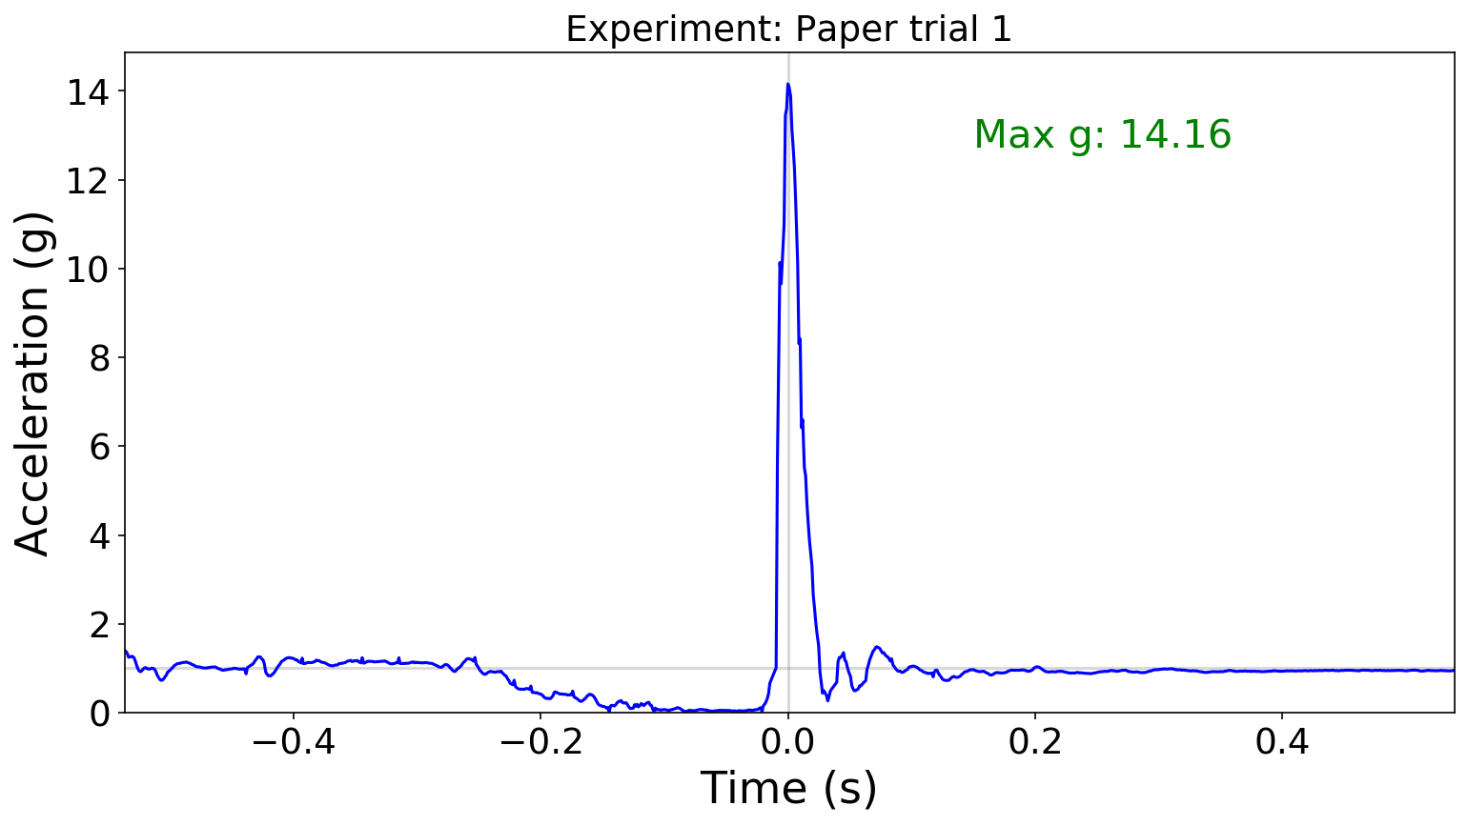
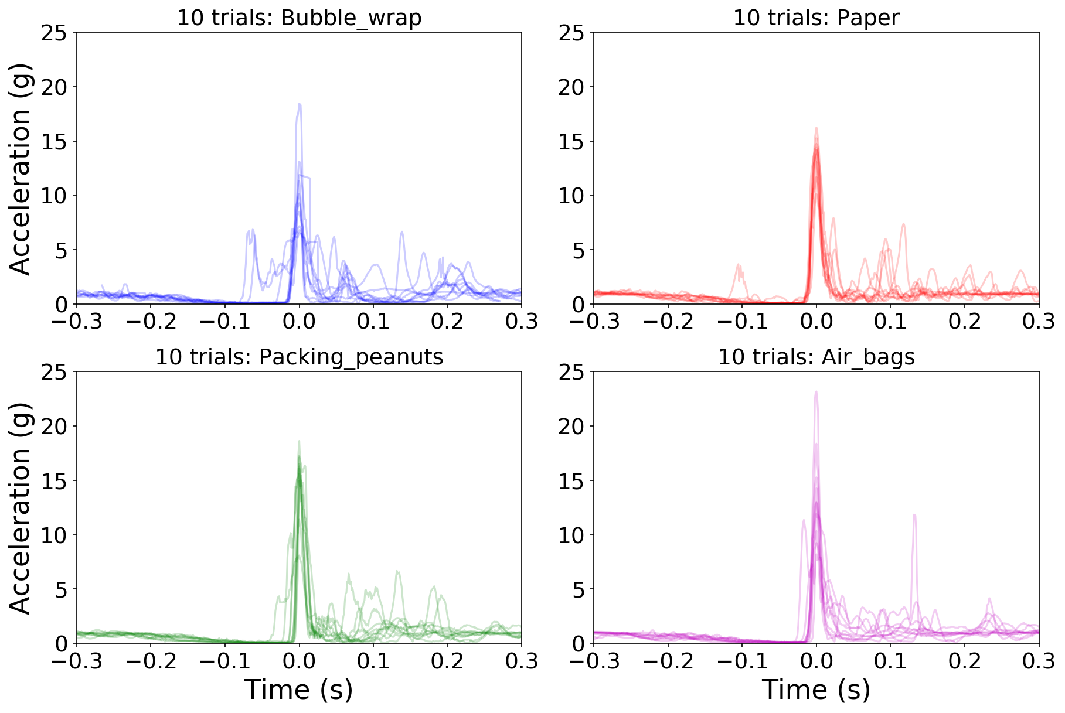

Slide 5
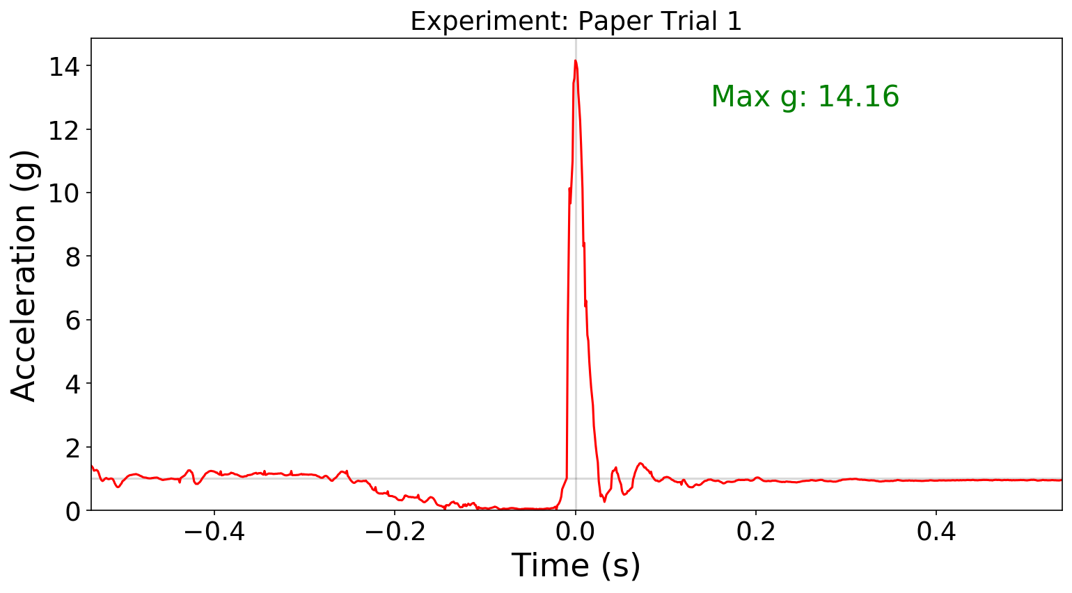
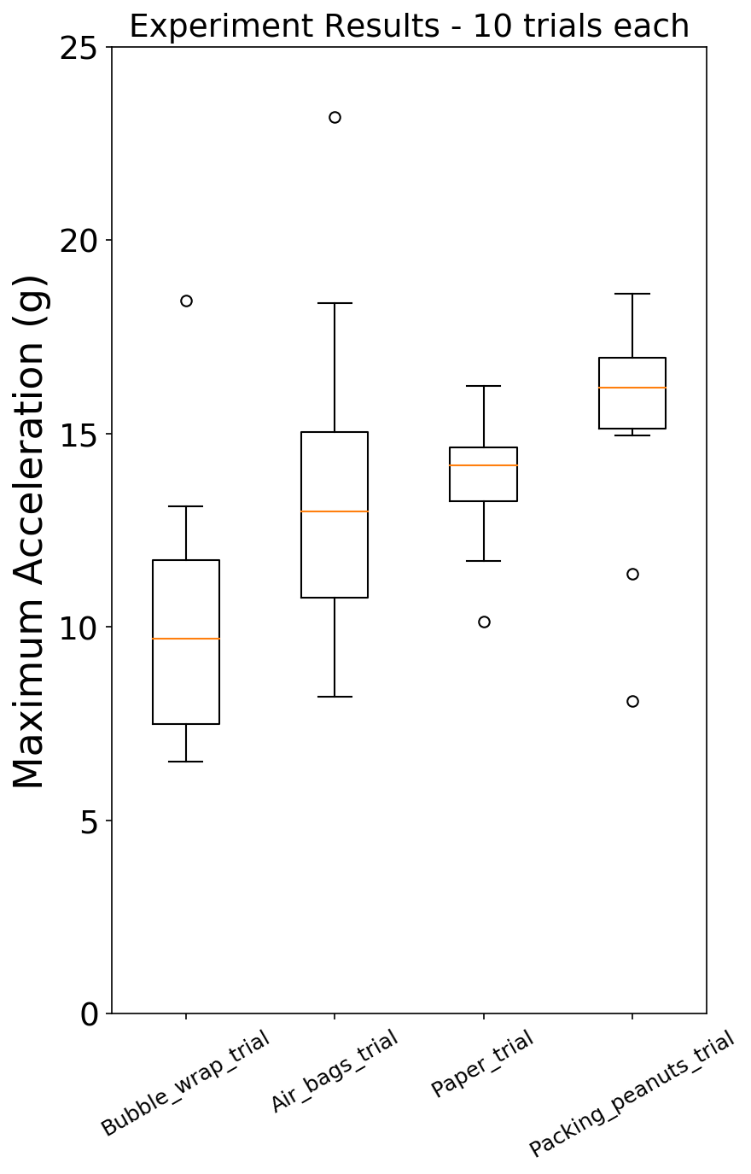

Slide 6
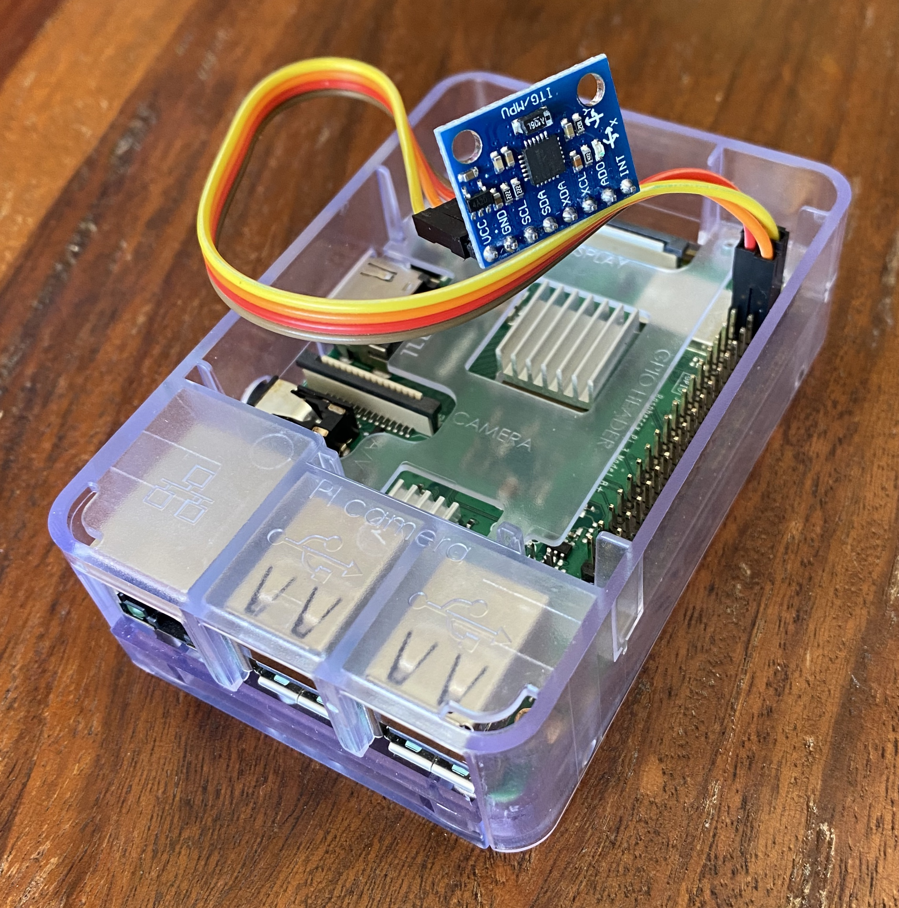
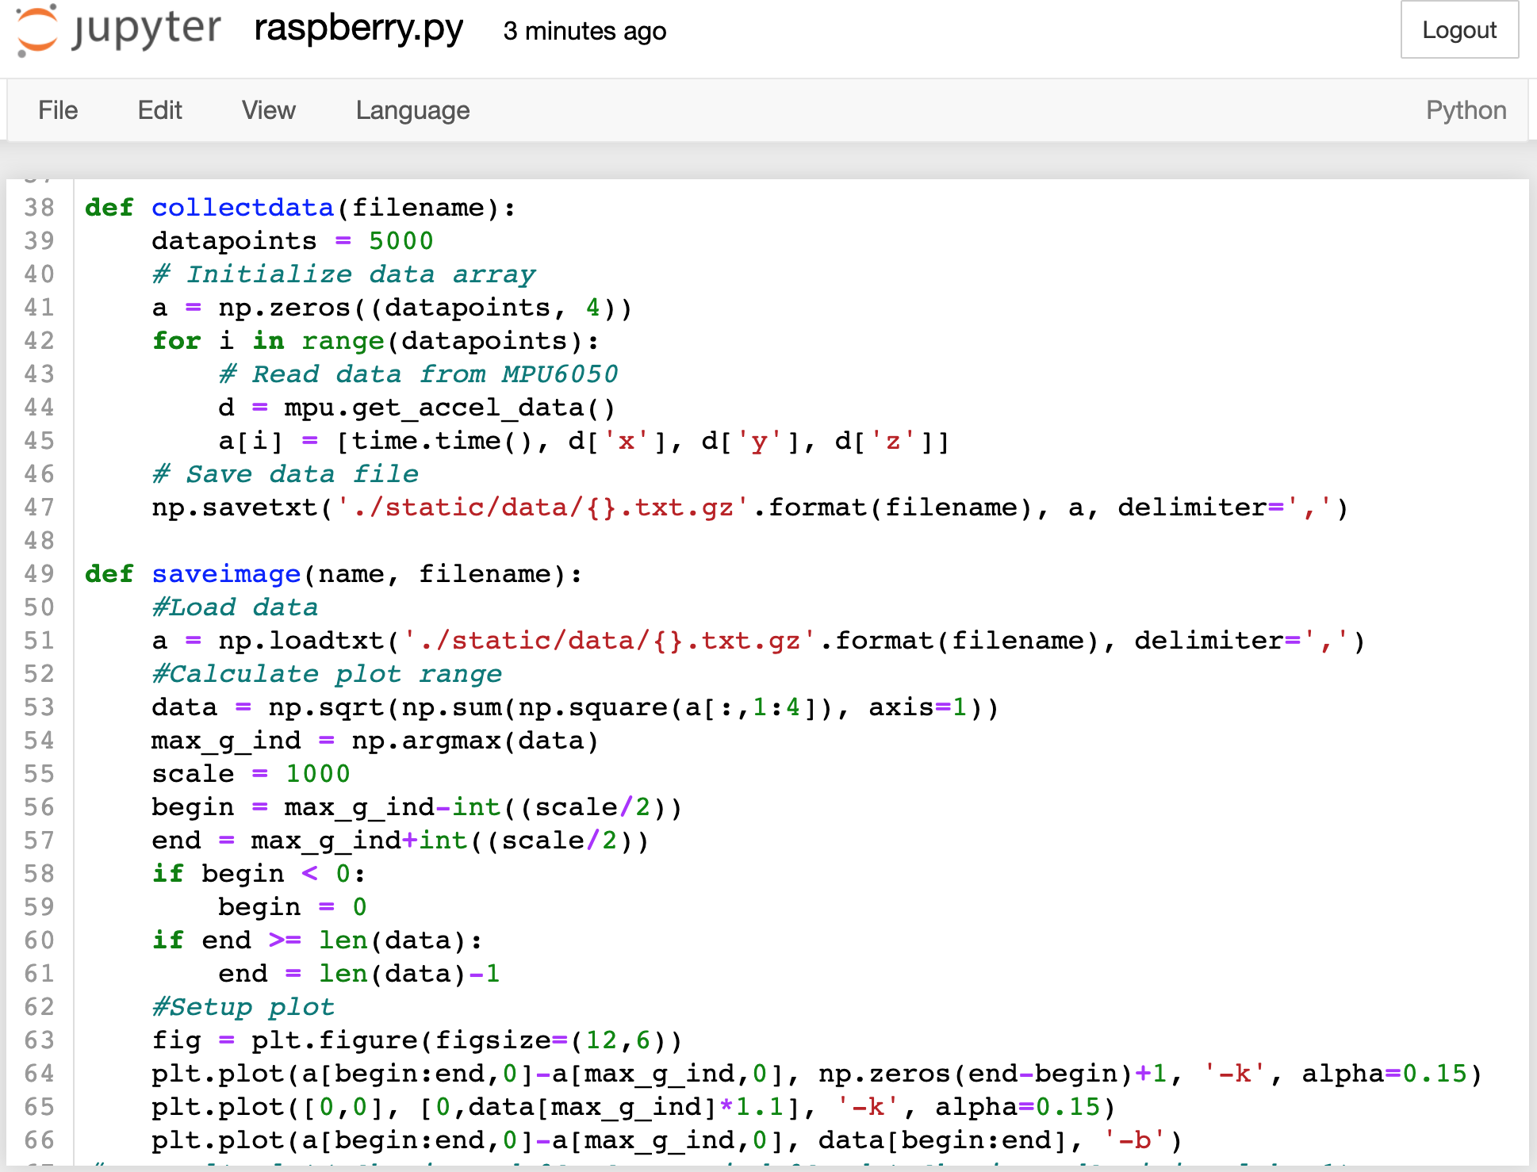

Slide 7
YouTube “1st place Egg Drop project ideas- using SCIENCE” - Mark Rober https://youtu.be/nsnyl8llfH4
Quora: “how many boxes does Amazon ship every day?” https://www.quora.com/How-many-boxes-does-Amazon-ship-every-day
https://www.savethepostoffice.com/an-amazon-puzzle-how-many-parcels-does-it-ship-how-much-does-it-cost-and-who-delivers-what-share/
MPU6050 accelerometer code: https://github.com/m-rtijn/mpu6050
Wikipedia: https://www.wikipedia.org/
What is the best way for Amazon to protect sensitive electronics in a shipping box?
I predict the best method for packaging sensitive electronics is packing peanuts because they take up the unused space in the box and hold the electronics tightly.

Slide 8
My hypothesis was incorrect. The results and data say that bubble wrap is the best way to protect sensitive electronics or fragile items, the packing peanuts was actually the worst one.
I think that packing peanuts was the highest deceleration because the packing peanuts got tightly packed together therefore they couldn’t shift around and so the deceleration was felt directly by the sensors. In the bubble wrap, paper, and air bags, they could shift around or deform and absorb the force over a longer period of time than the packing peanuts could.
Packing Material | Median Max g force
Bubble Wrap | 9.7
Air Bags | 13.0
Paper | 14.2
Packing Peanuts | 16.2

