Slide 1

Momentum and Value in Japan: An Integrated View
2025-06-23
Presenter: SeongJe Hong
Email: hsj6897@kaist.ac.kr
Github: https://github.com/WQGGSEY/FF2
KFAC

Slide 2
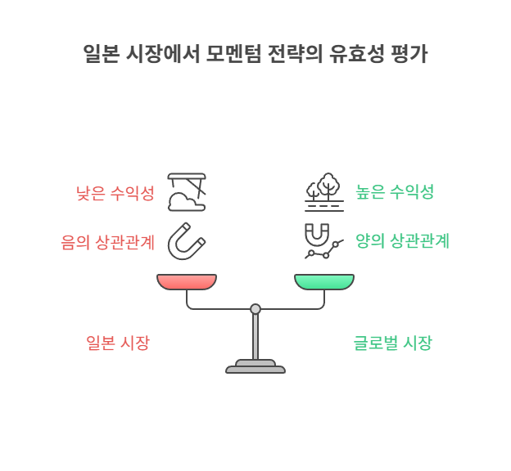
Motivation: Re-evaluating
Momentum in Japan
Traditional Strategies
Momentum and Value are known for achieving excess returns in markets.
Japanese Anomaly
Claims persist that Momentum strategies don't yield significant excess returns in the Japanese market. (Asness, Moskowitz, and Pedersen [2010], Fama and French [2010], Griffin, Ji, and Martin [2003], and Rouwenhorst [1998])
Conclusion
This Japanese case supports Momentum, due to its negative correlation with the Value Factor.
KFAC

Slide 3
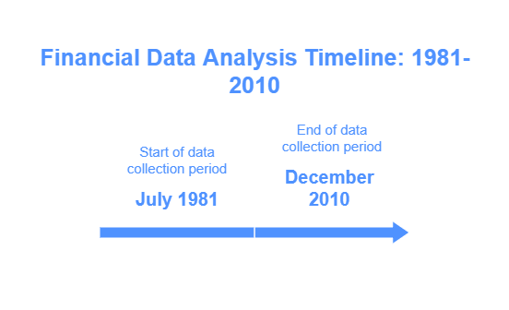
Data and Portfolio Construction
Data Description
We used 29.5 years of data (July 1981 - December 2010) from the US, UK, EUR, and JPN markets, focusing on the top 90% of market capitalization.
Portfolio Construction
Portfolios were constructed based on Momentum and Value, following Asness, Moskowitz, and Pedersen [2010] methodology*. This involved creating three equal groups based on rankings and using Value Weighted Portfolios for each group.
* Momentum was calculated as (p11-p0)/p0, and Value as ts_delay(book, 6 month)/cap.
KFAC

Slide 4
Basic Evidence: Performance Across Regions
Value Strategy (Exhibit 2)
Momentum Strategy (Exhibit 3)
US showed no statistical significance.
JPN region showed very low performance with a Sharpe ratio of 0.03.
EUR was borderline.
JPN exhibited the strongest statistical significance for Value.
The 50/50 strategy (Exhibit 4) in JPN yielded a Sharpe Ratio of 0.68, a significant improvement from individual Momentum (0.03) and Value (0.71). This increase is expected due to the negative correlation between Momentum and Value strategies, enhancing diversification (Exhibit 5).
KFAC

Slide 5
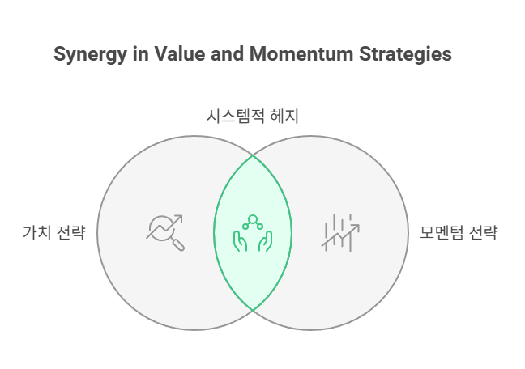
Simulations: Understanding JPN's Momentum Failure
Was JPN's Single Momentum Failure Just Bad Luck? Yes.
Monte-Carlo simulations (10,000 samples) showed that a Momentum Sharpe ratio of 0.03 in Japan is not uncommon, with a 26% probability of occurring in at least one of the four regions.
Should Value and Momentum Be Viewed as One System? Yes.
Momentum and Value strategies have a negative correlation, acting as hedges. Simulations indicate a 30% chance of simultaneously observing the best and worst Sharpe ratios.
KFAC

Slide 6
Ex Post Optimal Portfolios & Correlation Analysis
Optimal Portfolio in Japan
Annual Return Analysis
An in-sample exercise over 29.5 years revealed that a 70% Value and 30% Momentum allocation maximized Sharpe in Japan, yielding 0.88, surpassing the pure Value portfolio's 0.71. This refutes the notion that Momentum is a failed strategy.
The 50/50 portfolio's worst annual return was -13%, significantly better than Value (-61%) or Momentum (-49%) alone. This highlights the diversification effect from their -0.55 negative correlation.
KFAC

Slide 7
EMH vs. AMH: Explaining Factor Premiums
Efficient Market Hypothesis (EMH)
Adaptive Market Hypothesis (AMH)
EMH assumes asset prices fully reflect all available information. Value and Momentum's significant alpha challenges Semi-Strong Efficiency. Fama-French attributes these premiums to systematic, undiversifiable risk, though debate continues on whether they are risk-based or inefficiency-based.
AMH integrates EMH and behavioral finance, viewing market efficiency as dynamic. It posits bounded rationality and survival as goals for market participants. This explains Japan's strong Value factor and weak Momentum factor post-bubble, as Value adapted to the market's mean reversion.
KFAC

Slide 8
Considerations for Alpha Research Beyond USA
Factor Models are Not Universal
The 5-factor model may not apply uniformly across all markets.
Dynamic Factor Timing
Given factor performance cyclicity, static allocations are suboptimal. Dynamic factor timing, adjusting exposure based on expected performance, is crucial.
Factor Timing Criteria
Factor timing can be based on Macroeconomic Regimes, Factor Momentum, and Factor Valuation.
KFAC

Slide 9
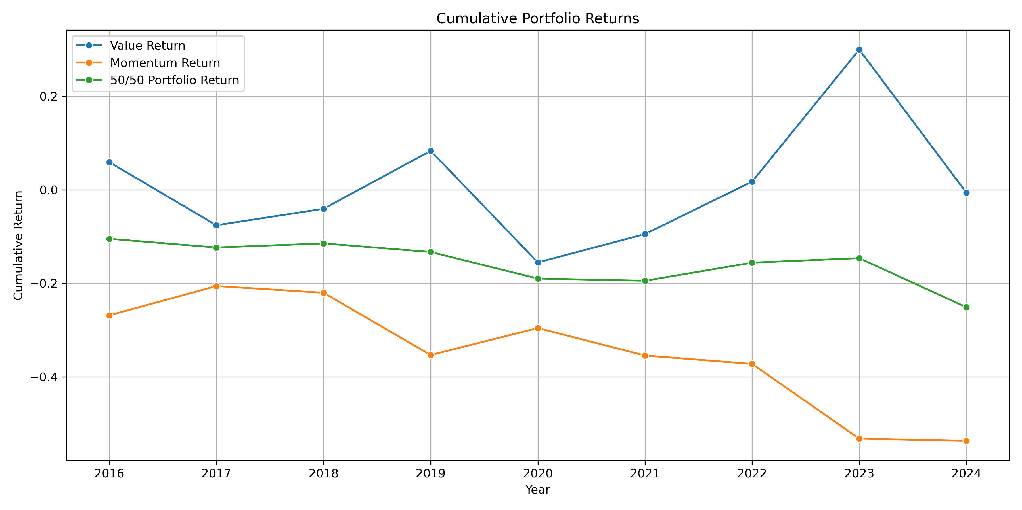
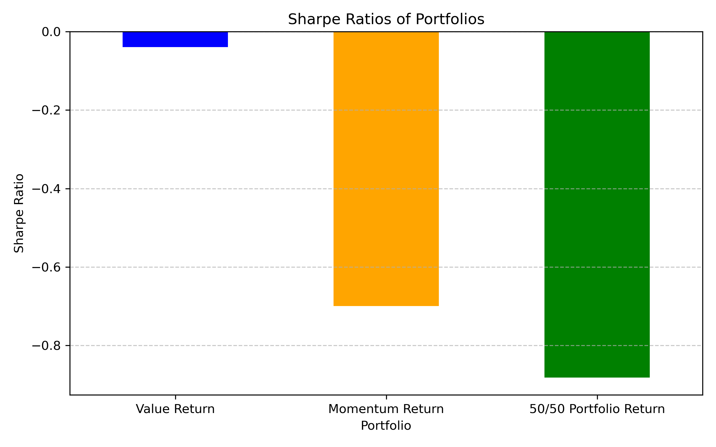
Exercise: Momentum and Value Strategy for KOR Region 1. Data Observation
Correlation Coefficient: -0.7546 For the single strategy, Value portfolio is failed.
On the other hand, the momentum strategy worked very well.
High negative correlation between two strategies explains this result.
KFAC

Slide 10

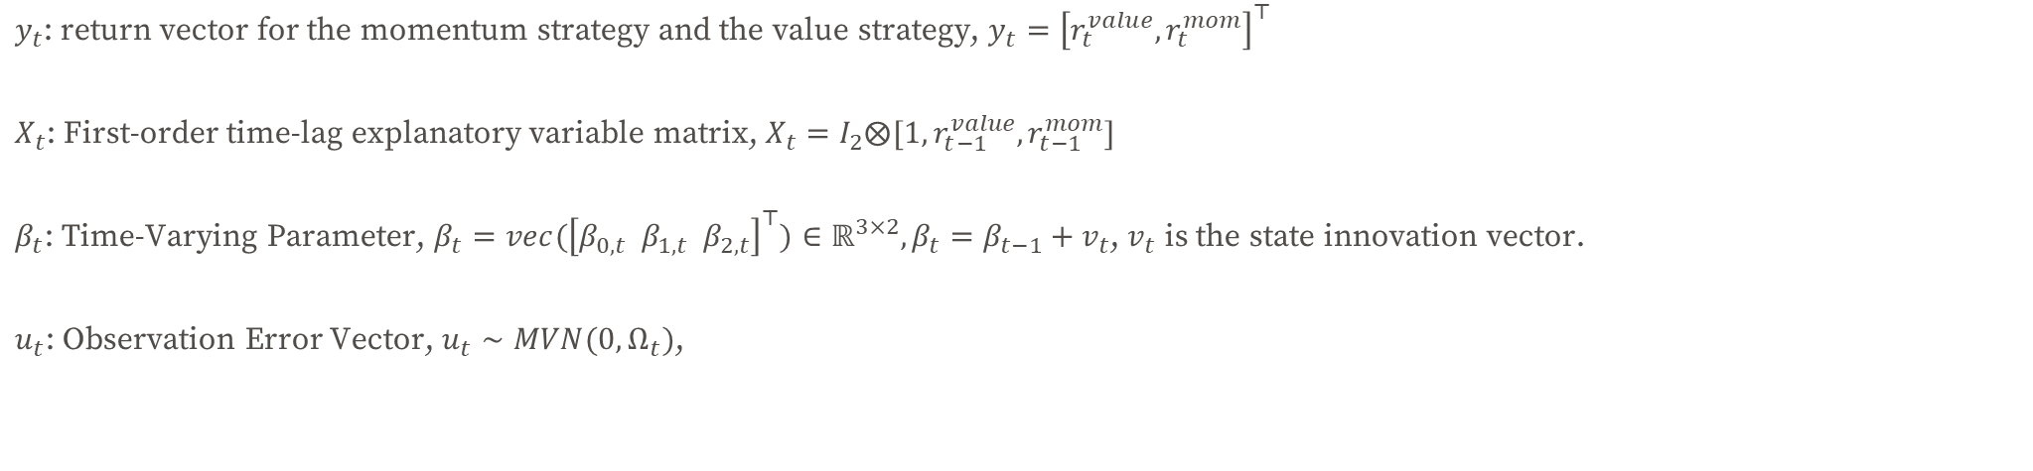
Exercise:
2. Modeling Based of AMH (TVP-VAR Model)
We have a small dataset (only 9 years return for two portfolios). With the Hierarchical Bayesian Modeling, we can borrow the information from another portfolio and make stable the result.
$$y_{t}=X_{t}β_{t}+u_{t}$$
$y_{t}$: return vector for the momentum strategy and the value strategy, $y_{t}={\left[r_{t}^{value},r_{t}^{mom}\right]}^{⊤}$
$X_{t}$: First-order time-lag explanatory variable matrix, $X_{t}=I_{2}⨂[1, r_{t−1}^{value},r_{t−1}^{mom}]$
$β_{t}$: Time-Varying Parameter, $β_{t}={vec(\left[β_{0,t} β_{1,t} β_{2,t}\right]}^{⊤})∈ℝ^{3×2}, β_{t}=β_{t−1}+v_{t}$, $v_{t}$ is the state innovation vector.
$u_{t}$: Observation Error Vector, $u_{t}∼MVN(0, Ω_{t})$,
KFAC

Slide 11

Exercise:
3. Prior Settings for the TVP-VAR Model
Initial TVP: $β_{0}∼N\left(0,10×I_{6}\right)$, weak belief of the initial state. Since there are no training samples, we center them around 0 to reflect the lack of prior knowledge about a particular direction.
The variance is set to be weakly informative to allow for initial uncertainty, but flat to avoid estimation instability that would otherwise occur.
State Innovation Vector: $v_{t}∼N\left(0,Q\right), Q∈ℝ^{6×6}$
To prevent overfitting, set $Q$ as the diagonal matrix, $diag(θ_{1},…,θ_{6})$
State Innovation Vector Covariance: $θ_{j}|φ_{j},κ^{2}∼inverse−gamma\left(\frac{1}{2},\frac{1}{2φ_{j}κ^{2}}\right)$ (Local Shrinkage),
$φ_{j}∼gamma\left(d,d=0.1\right),κ^{2}∼gamma(c_{0}=0.01, c_{1}=0.01)$ (Global Shrinkage)
This double-gamma prior distribution has a very sharp peak at 0, but also heavy tails, giving it the flexibility to allow $θ_{j}$ ​to shrink strongly to 0, or to take on large values ​​when necessary.
Observation Error Covariance: $Ω_{t}=\left(\begin{matrix}σ_{value,t}^{2} & ρ_{t}σ_{value,t}σ_{mom,t} \\ ρ_{t}σ_{value,t}σ_{mom,t} & σ_{mom,t}^{2}\end{matrix}\right)$
Considering the method of Primiceri (2005), decompose $Ω_{t}$ to $A_{t}$ and $H_{t}$ s.t. $Ω_{t}=A_{t}^{−1}H_{t}{\left(A_{t}^{−1}\right)}^{⊤}$, $A_{t}=\left(\begin{matrix}1 & 0 \\ a_{vm,t} & 1\end{matrix}\right), H_{t}=\left(\begin{matrix}h_{1,t} & 0 \\ 0 & h_{2,t}\end{matrix}\right)$ Each parameter $a_{vm,t},h_{1,t},h_{2,t}$ follow the log random walk
→ $a_{vm,t}=a_{vm,t−1}+ξ_{t}$, $ξ_{t}∼N(0,σ_{a}^{2})$
→ $\log\left(h_{jt}\right)=\log\left(h_{j,t−1}\right)+ζ_{t}$, $ζ_{t}∼N(0,σ_{h}^{2})$
Also, for each variance parameter, we set $σ_{a}^{2}∼inverse−gamma\left(d_{a0}=0.01,d_{a1}=0.01\right)$, $σ_{h}^{2}∼inverse−gamma\left(d_{h0}=0.01,d_{h1}=0.01\right)$ Set the Initial value as $a_{vm,0}∼N(0,10)$, $\log\left(h_{j0}\right)∼N(0,10)$
KFAC

Slide 12
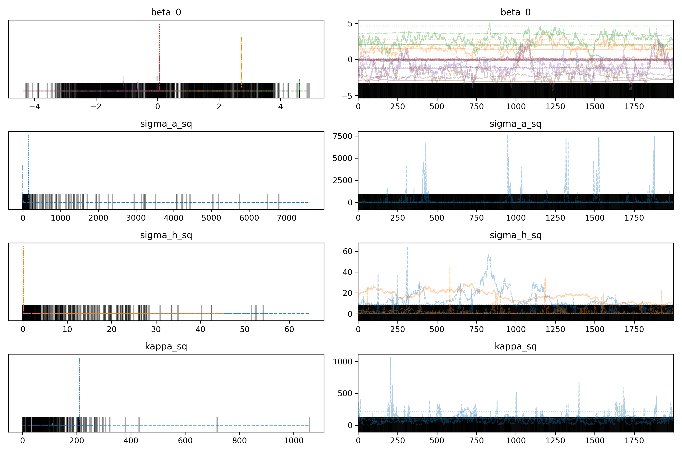
Exercise:
4. Prior Settings for the TVP-VAR Model
This visual pattern clearly shows the difficulty that the sampler has when exploring the 'funnel' shaped posterior distribution.
The sampler easily gets stuck in the 'neck of the funnel' region (where the variance is close to zero) which has a high probability density but is very narrow.
Attempts to escape this narrow space and move to the wide 'mouth of the funnel' region (where the variance is high) often result in uncontrollable jumps, causing divergence.
This provides a direct visual indication of the low ESS and divergence.
KFAC

Slide 13
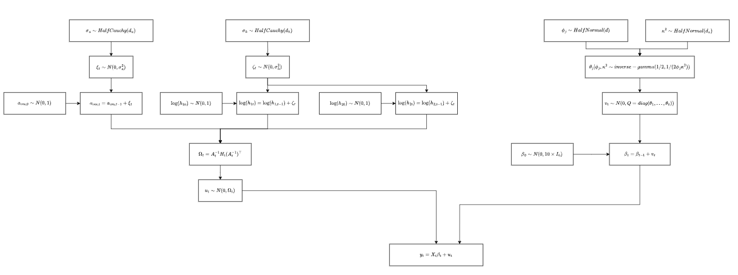
Exercise:
4. Prior Settings for the TVP-VAR Model
KFAC
Notes:
This visual pattern clearly shows the difficulty that the sampler has when exploring the 'funnel' shaped posterior distribution. The sampler easily gets stuck in the 'neck of the funnel' region (where the variance is close to zero) which has a high probability density but is very narrow. Attempts to escape this narrow space and move to the wide 'mouth of the funnel' region (where the variance is high) often result in uncontrollable jumps, causing divergence. This provides a direct visual indication of the low ESS and divergence.

Slide 14
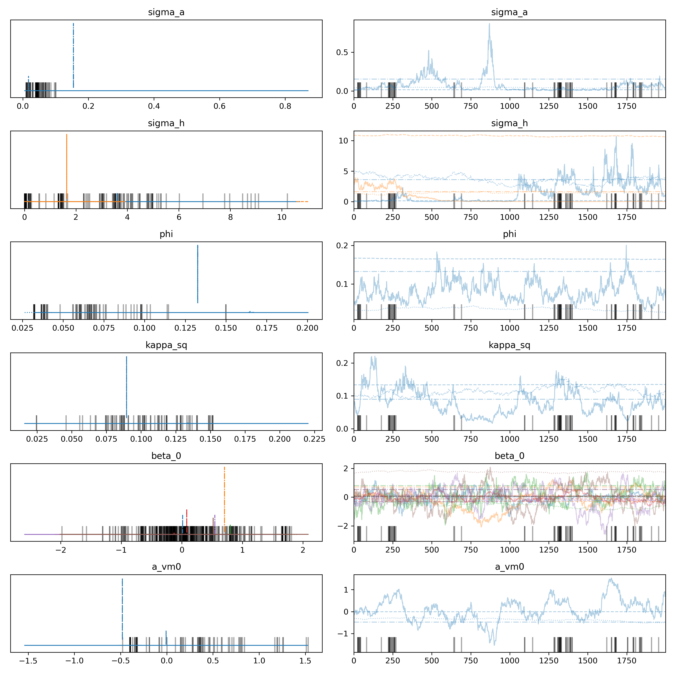
Exercise:
5. MCMC Sampling Results
MCMC Convergence Diagnostics: Excellent
Successful Convergence Achieved
The MCMC simulation converged successfully, indicating that the numerical estimation process was stable and reliable.
Well-Mixed Chains (R^≈1.0)
The trace plots (right column) show excellent mixing for all parameters (e.g., sigma_a, beta_0).
The different colored chains are indistinguishable, resembling "fuzzy caterpillars," which confirms they all explored the same target distribution.
Stable Posterior Distributions
The posterior density plots (left column) for all parameters are smooth, well-defined, and generally unimodal.
This demonstrates that the model was able to identify a single, stable estimate for each parameter from the data.
Conclusion: The parameter estimates generated by the MCMC process are numerically sound and statistically trustworthy.
KFAC

Slide 15
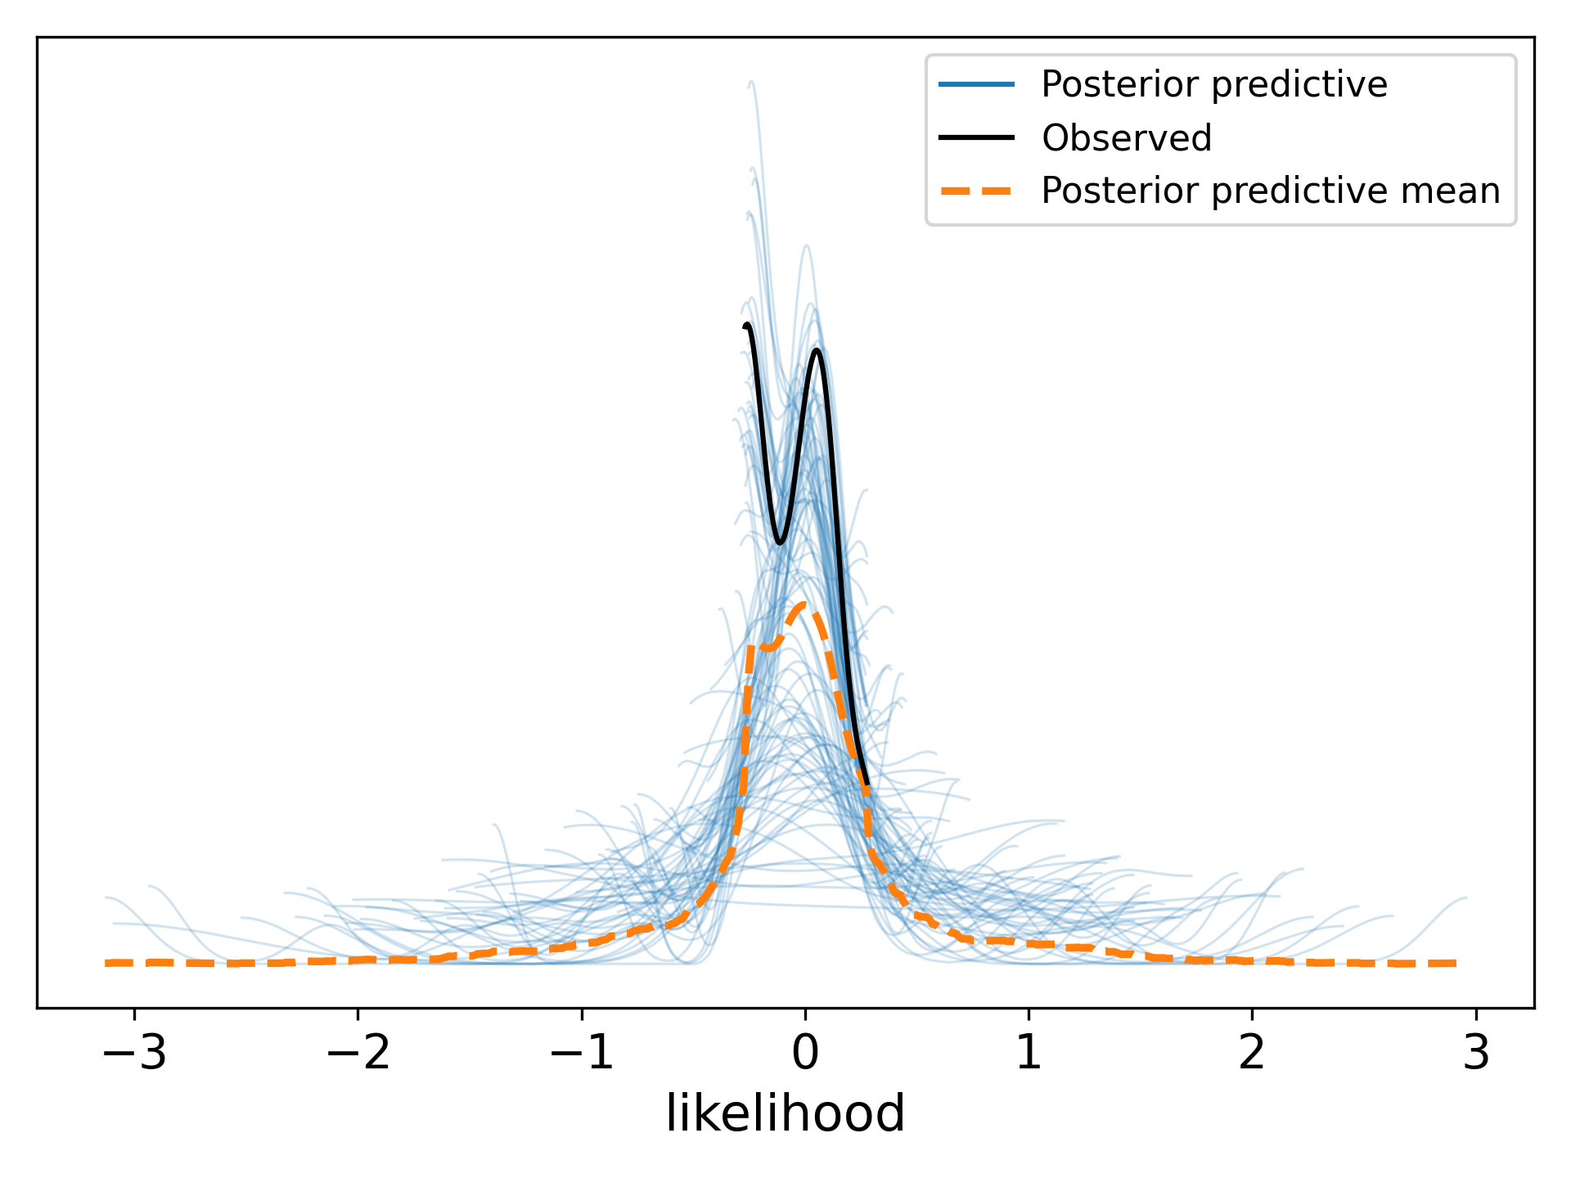
Exercise:
5. MCMC Sampling Results
Model Fit Assessment via PPC: Significant Misfit Identified
Systematic Discrepancy Between Model and Reality
The Posterior Predictive Check (PPC) reveals that the model fails to replicate key features of the observed data.
Analysis of Observed Data (Black Line)
The distribution of the real data is strongly bimodal, with two distinct, sharp peaks clustered near zero.
It exhibits high kurtosis (leptokurtic), meaning the data is highly concentrated around these two modes.
Analysis of Model Predictions (Blue/Orange Lines)
The model consistently predicts a unimodal (single-peak), symmetric distribution centered at zero.
It completely fails to capture the bimodal structure of reality.
The model's predictions have much lower peaks and fatter tails, indicating it overestimates the variance and underestimates the kurtosis.
Conclusion: The model is not a good fit for the data. It is fundamentally mis-specified.
KFAC

Slide 16
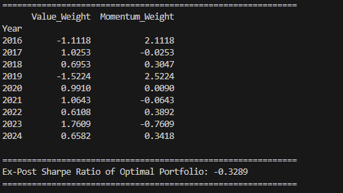
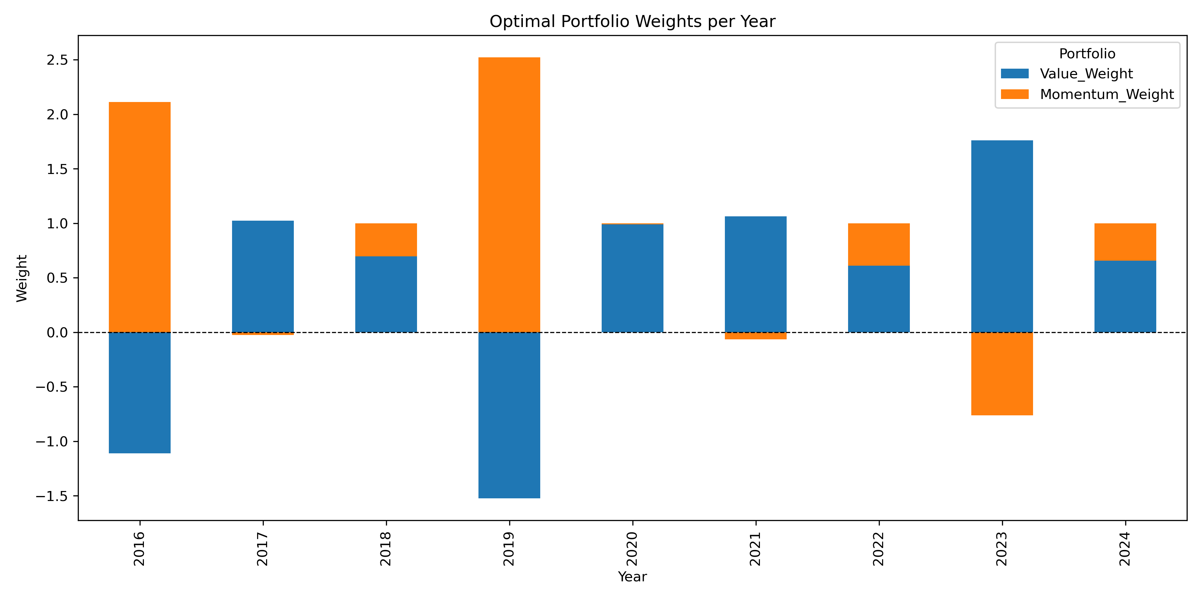
Exercise:
6. Conclusion: Optimal Weights for Value and Momentum
KFAC

