Slide 1
Q3 2026 board update
Sample Co. (fictional company). All figures are sample data.

Slide 2
Executive summary
Q3 new ARR $1,150k vs plan $950k
Ending ARR $11,050k vs plan $10,900k
SMB logo churn 3.1% monthly in Q3 (Q1: 1.8%)
Onboarding team still 2 specialists
Proposal to change the Q4 hiring plan
Cash $14.2M

Slide 3
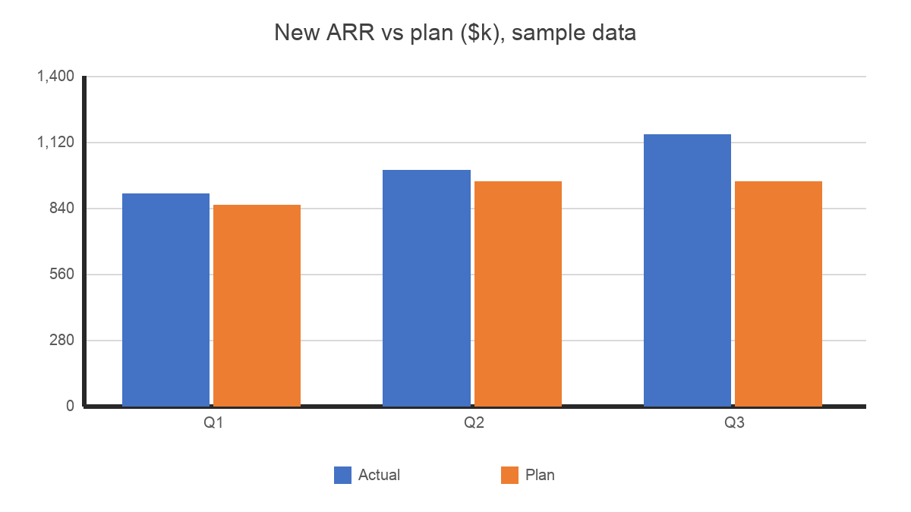
Bookings performance
Source: [SOURCE NEEDED]

Slide 4
Q3 ARR bridge
$k | Q3
Beginning ARR | 10,160
New | 1,150
Expansion | 300
Contraction | -80
Churned | -480
Ending ARR | 11,050
Plan ending ARR | 10,900
Source: [SOURCE NEEDED]

Slide 5
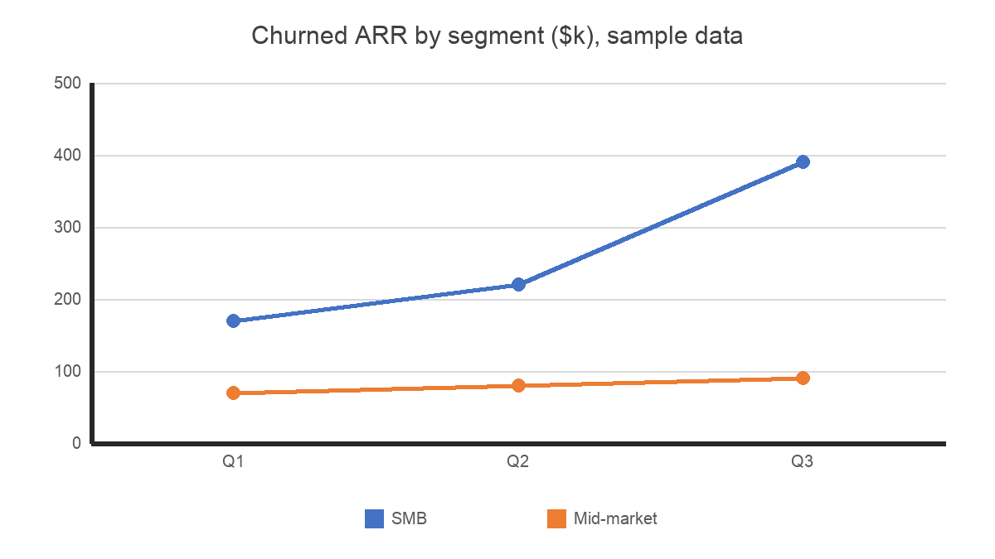
Churn by segment
Source: [SOURCE NEEDED]

Slide 6
Q4 outlook
Q4 plan new ARR $1,050k
Year-end ARR plan $12,000k
Year-end ARR forecast: TBD
Churn trend is a risk to the plan

Slide 7
Setup status of churned accounts
61 SMB accounts churned in Q3
44 had not finished setup within 30 days of signing
17 had finished setup

Slide 8
Churn by setup status
Jan-Jun 2026 SMB cohort, 90-day churn
Setup finished within 30 days: 4%
Setup not finished: 19%

Slide 9
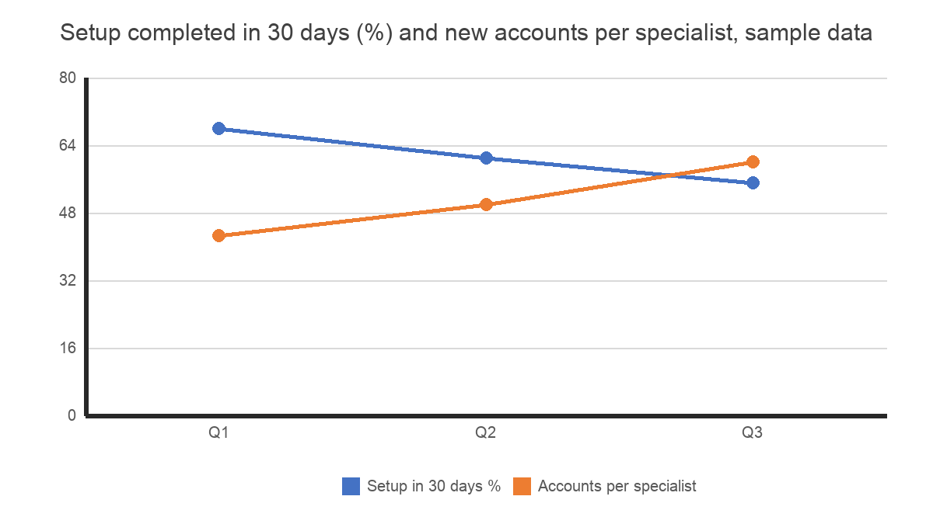
Onboarding capacity
Source: [SOURCE NEEDED]

Slide 10
Proposal: hiring plan changes
Convert 2 of the 4 Q4 AE requisitions into onboarding specialists
AE fully loaded about $150k; onboarding specialist about $95k
170 SMB accounts signed Apr-Sep have not finished setup
Two support team members can transfer now

Slide 11
Risks
2027 sales capacity
Churn could keep rising
Hiring timelines

Slide 12
Next steps
Discuss the hiring plan
Update the forecast
Review churn again in January

Slide 13
Cash runway
Cash $14.2M at end of Q3
Net burn about $650k a month

Slide 14
Q1-Q3 2026 metrics by quarter
$k | Q1 | Q2 | Q3
New ARR | 900 | 1,000 | 1,150
Plan new ARR | 850 | 950 | 950
Ending ARR | 9,250 | 10,160 | 11,050
Plan ending ARR | 9,200 | 10,050 | 10,900
Churned ARR, SMB | 170 | 220 | 390
Churned ARR, mid-market | 70 | 80 | 90
SMB logo churn, % a month | 1.8 | 2.2 | 3.1
Mid-market logo churn, % a month | 0.6 | 0.7 | 0.6
Source: [SOURCE NEEDED]

