Slide 1
Generalized Additive Model GAM
Wilmer Ropero Castaño
wilmer.ropero@udea.edu.co
Jairo Arturo Morán Burgos
jairo.moran@udea.edu.co
Maestría en ingeniería
Universidad de Antioquia – Medellín, 2020-1

Slide 2
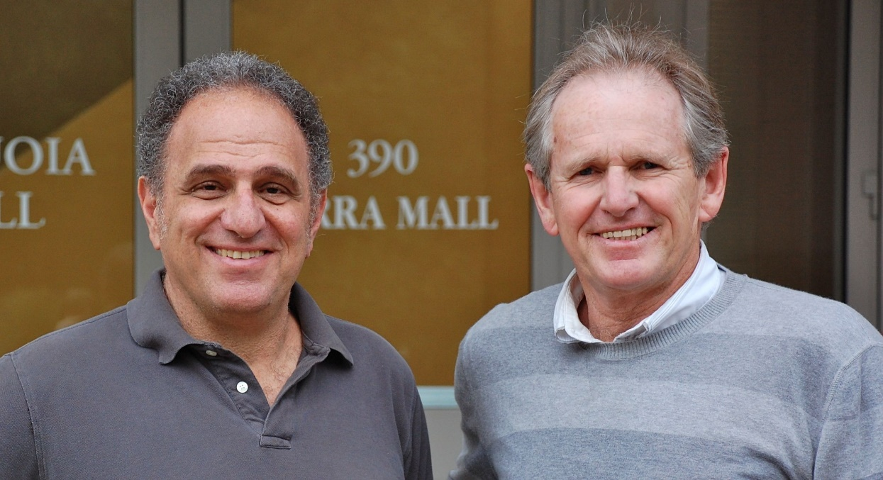
Introduction
Founders
Robert Tibshirani and Trevor Hastie 1986
Notes:
Relationships between the individual predictors and the dependent variable follow smooth patterns that can be linear or nonlinear.
we can estimate these smooth relationships simultaneously and then predict g(E(Y))) by simply adding them up

Slide 3

Introduction
Despite its lack of popularity in the data science community, GAM is a powerful and yet simple technique.
Easy to interpret.
Flexible predictor functions can uncover hidden patterns in the data.
Regularization of predictor functions helps avoid overfitting.
Notes:
Diferencia esta en el numero de soluciones provisionales de cada iteración

Slide 4
Motivation
Logarítmica
Polinomial
Linear
GAM

Slide 5
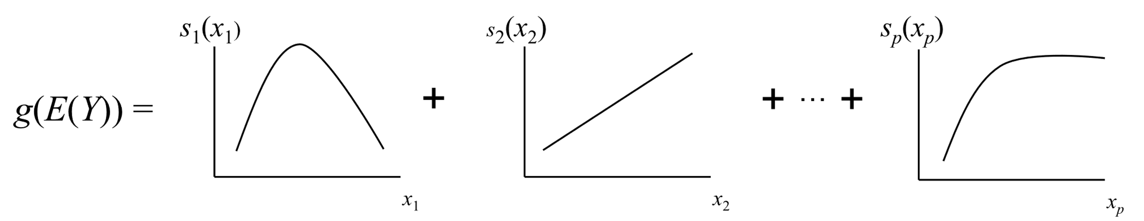
What is GAM?
Mathematically speaking, GAM is an additive modeling technique where the impact of the predictive variables is captured through smooth functions which, depending on the underlying patterns in the data, can be nonlinear
non-linear
Linear
non-linear

Slide 6
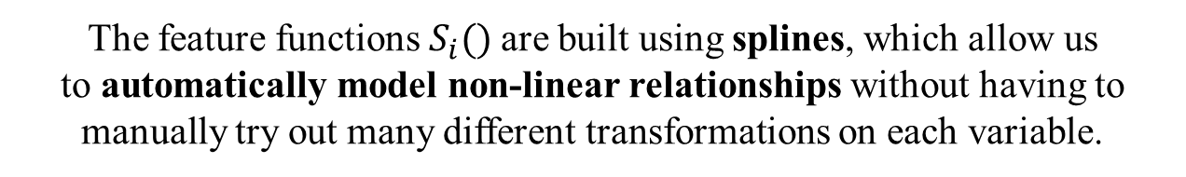
What is GAM?
link function
dependent variable
independent variables
$$g\left(E\left|y\right|\right)=α+s_{1}\left(x_{1}\right)+s_{2}\left(x_{2},x_{3}\right)+…+s_{p}(x_{p})$$
The feature functions $S_{i}()$are built using splines, which allow us to automatically model non-linear relationships without having to manually try out many different transformations on each variable.
Notes:
where X.T = [X_1, X_2, ..., X_N] are independent variables, y is the dependent variable, and g() is the link function that relates our predictor variables to the expected value of the dependent variable
The feature functions f_i() are built using penalized B splines, which allow us to automatically model non-linear relationships without having to manually try out many different transformations on each variable.

Slide 7

A brief tour or splines
Local regression(Loess)
Smoothing splines
Regression splines
there are three classes of smoothers used for GAM

Slide 8
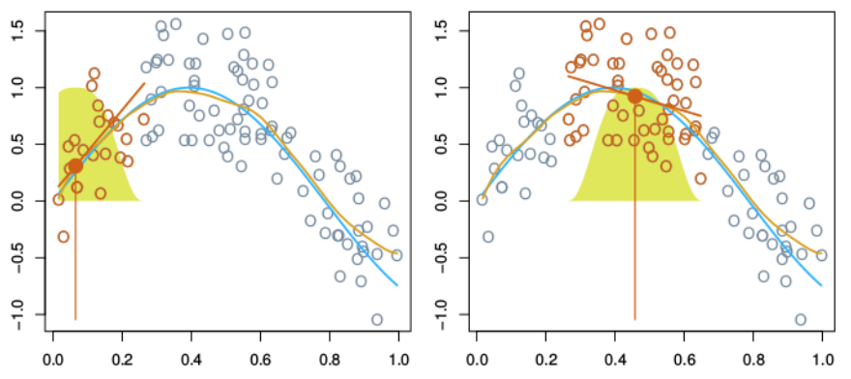
A brief tour or splines
Local regression(Loess)
Loess produces a smoother curve than the running mean by fitting a weighted regression within each nearest-neighbor window
there are three classes of smoothers used for GAM

Slide 9
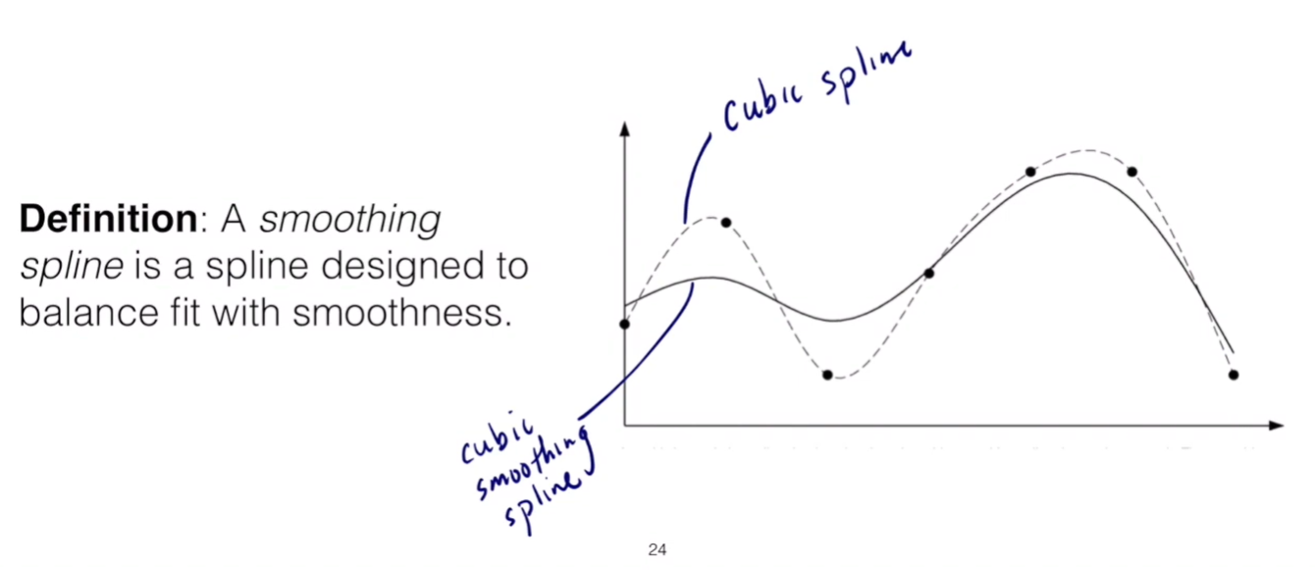
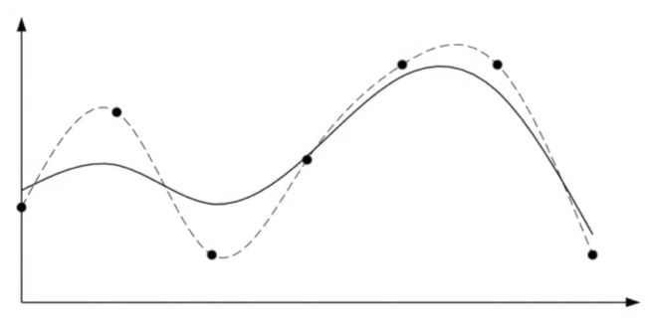
A brief tour or splines
Smoothing splines
Is a spline designed to balance fit with smoothness
there are three classes of smoothers used for GAM

Slide 10
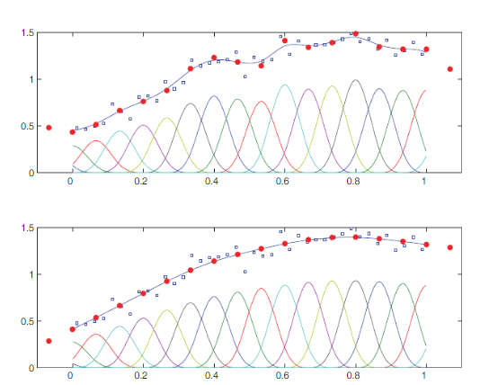
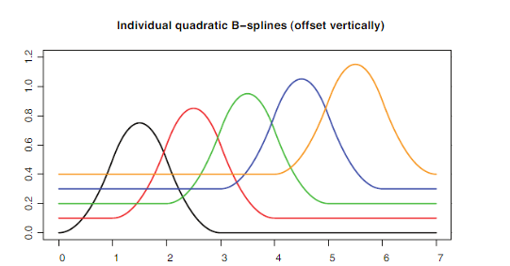
A brief tour or splines
Regression splines
they can be expressed as a linear combination, that do not depend on the dependent variable Y
there are three classes of smoothers used for GAM

Slide 11
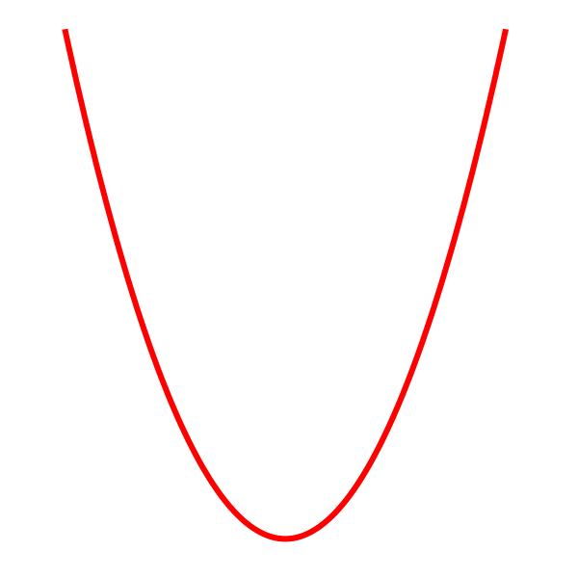
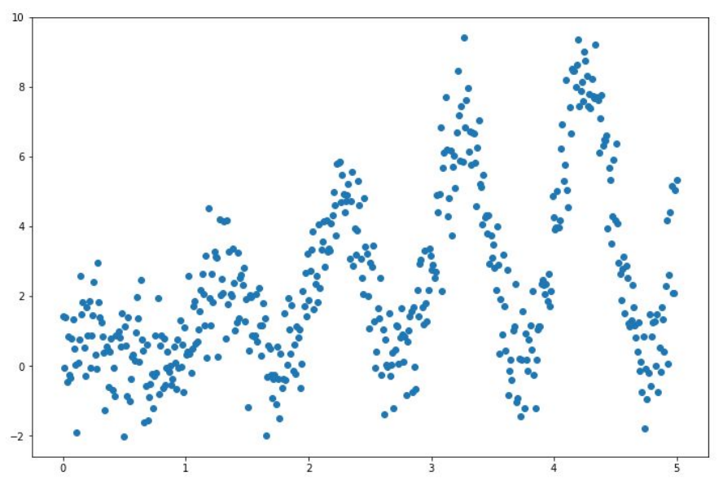
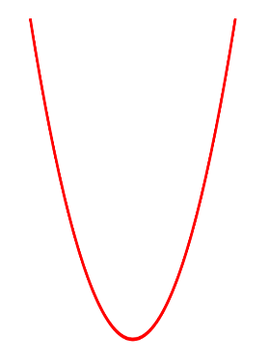
Building interpretable models

Slide 12
Building interpretable models
λ

Slide 13
Building interpretable models
λ

Slide 14
Building interpretable models
λ

Slide 15
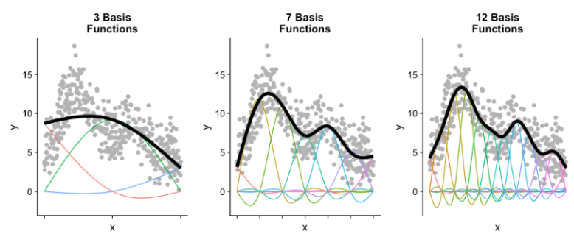
Building interpretable models

Slide 16
Estimating GAMs
GAMs consist of multiple smoothing functions. Thus, when estimating GAMs, the goal is to simultaneously estimate all smoothers, while factoring in the covariance between the smoothers
GAM as a large GLM
Local scoring algorithm
Any type of smoother
Computationally more expensive
Penalized Re-weighted Iterative Least Squares (PIRLS)
Automated selection of smoothing parameters

Slide 17
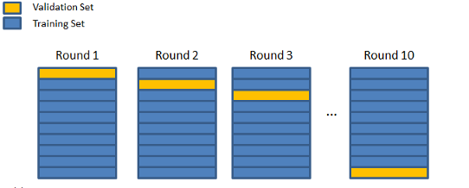
Choosing the Smoothing Parameters
The choice of smoothing parameters, i.e., the parameters that control the smoothness of the predictive functions, is key for the aesthetics and fit of the model
Generalized cross validation criteria (GCV)
Mixed model approach via restricted maximum likelihood (REML).
The strategy is to remove one data point at a time, fit a smoother to the remaining data, and then fit of the smoother against the entire dataset.
The goal is to pick the λj that minimizes the average error across all n validations.
Given a trial vector λ, estimate β using PIRLS.
Update λ by maximizing the restricted log likelihood.
Repeat steps 1 and 2 until convergence.

Slide 18
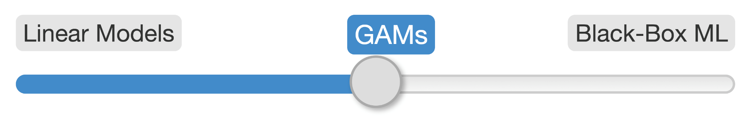
Why Use GAM?
interpretability, flexibility/automation, and regularization.

Slide 19
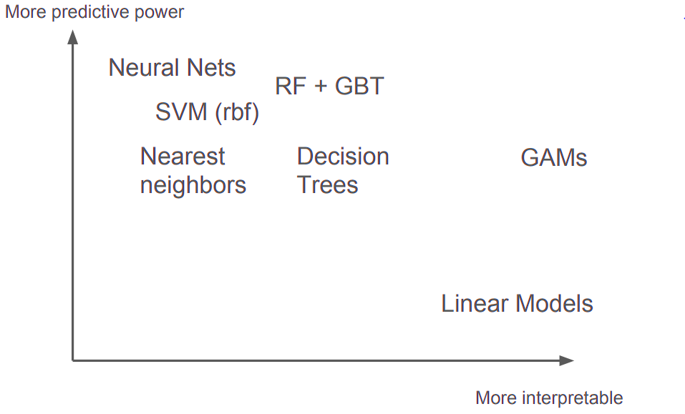
Why Use GAM?
GAMs

Slide 20
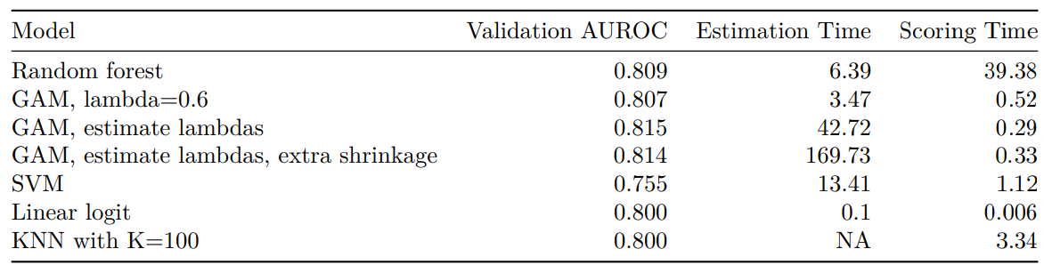
Some comparations

Slide 21
Conclusions
Intuitive regularization via smoothing
Automatically model non-linearities
Constraints (convexity, monotonicity, periodicity, ... )
Controlled extrapolation

Slide 22
Referencias
Green, P. J., & Silverman, B. W. (1993). Nonparametric regression and generalized linear models: a roughness penalty approach. Chapman and Hall/CRC.
Hastie, T. and Tibshirani, R. (1990). Generalized Additive Models, volume 43. CRC Press, 1990.
Wood, S. N. (2017). Generalized additive models: an introduction with R. Chapman and Hall/CRC.
Hastie, T., and Tibshirani, R. (1987). Generalized additive models: some applications. Journal of the American Statistical Association, 82(398), 371-386.
https://cran.r-project.org/package=gam
https://cran.r-project.org/package=mgcv
https://www.statsmodels.org/stable/gam.html
https://pygam.readthedocs.io/
https://github.com/dswah/PyData-Berlin-2018-pyGAM/

Slide 23


