Slide 1
Information Integration
Task 1. Extraction
Project
by Nikolay Ivanov and Stephan Roth

Slide 2


Project idea
+

Slide 3
OSM Source Data
<!ELEMENT node (tag*)>
<!ATTLIST node id CDATA #IMPLIED><!-- 64-bit decimal integer, negative when creating a new node with a placeholder -->
<!ATTLIST node lat CDATA #REQUIRED><!-- decimal floating point, in [-90 .. 90] degrees on the WGS84 spheroid -->
<!ATTLIST node lon CDATA #REQUIRED><!-- decimal floating point, in [-180 .. 180] degrees on the WGS84 spheroid -->
<!ATTLIST node timestamp CDATA #IMPLIED><!-- ISO 8601 format -->
<!ELEMENT tag EMPTY>
<!ATTLIST tag k CDATA #REQUIRED><!-- UTF-8 encoded, shorter than 256 characters, should be documented on the OSM wiki -->
<!ATTLIST tag v CDATA #REQUIRED><!-- UTF-8 encoded, shorter than 256 characters -->

Slide 4
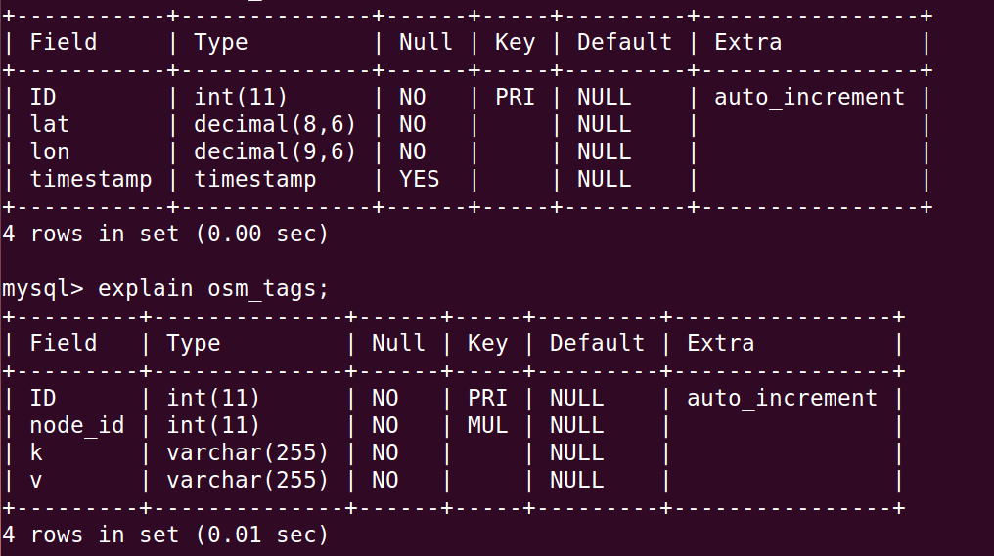
OSM Target Data

Slide 5
Wiki Source Data
<!ELEMENT mediawiki (siteinfo?,page*)>
<!-- ... -->
<!ELEMENT page (title,id?,restrictions?,(revision|upload)*)>
<!ELEMENT title (#PCDATA)> <!-- Title with namespace prefix -->
<!ELEMENT id (#PCDATA)>
<!ELEMENT restrictions (#PCDATA)> <!-- optional page restrictions -->
<!ELEMENT revision (id?,timestamp,contributor,minor?,comment,text)>
<!ELEMENT timestamp (#PCDATA)> <!-- according to ISO8601 -->
<!ELEMENT minor EMPTY> <!-- minor flag -->
<!ELEMENT comment (#PCDATA)>
<!ELEMENT text (#PCDATA)> <!-- Wikisyntax -->
<!ATTLIST text xml:space CDATA #FIXED "preserve">
<!-- ... -->

Slide 6
Wiki Target Data
+---------+--------------+------+-----+---------+----------------+
| Field | Type | Null | Key | Default | Extra |
+---------+--------------+------+-----+---------+----------------+
| ID | int(11) | NO | PRI | NULL | auto_increment |
| title | varchar(255) | NO | | NULL | |
| content | longtext | NO | | NULL | |
+---------+--------------+------+-----+---------+----------------+
Content needs to be splitted before merging.

Slide 7
Questions
1.Why is data integration relevant for your application?
2. What challenges in integration do you foresee?

