Slide 1
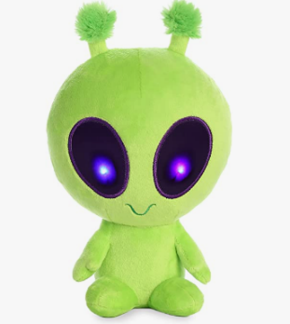

Notes:
Oh look. [ET appears (in the distance), small and out of center]
That's my friend ET!
ET is from another planet, and he wants to learn all about Earth.
So let's help him!

Slide 2
Notes:
[ET appears, now larger and centered.]
Hello ET! [...] ET: Hi...

Slide 3
Notes:
Here's what we'll do. We’ll LOOK at some PICTURES with ET, ...
And we’ll listen to a recording that matches one of the pictures.
And guess what: You get to be the teacher!
You'll show ET which picture matches by clicking on it.
ET: Hello Teacher!

Slide 4
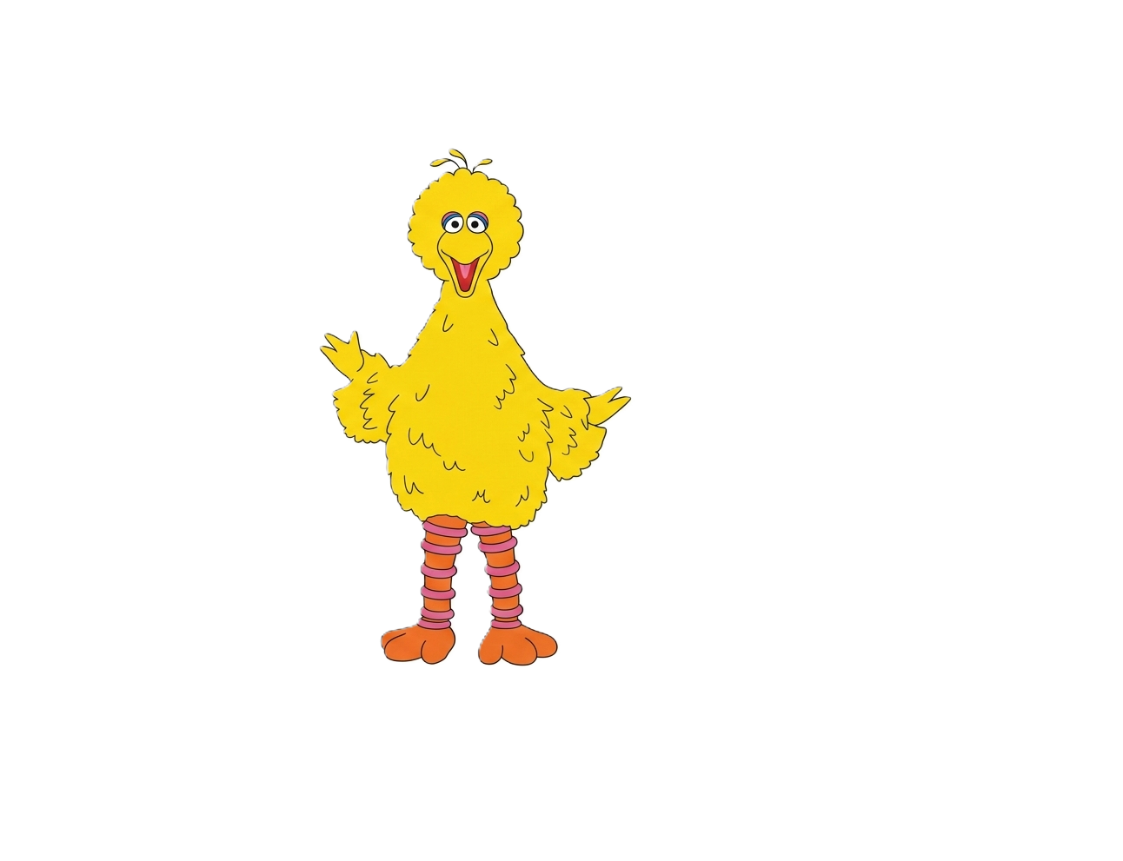
Notes:
Before we start, let's go over the characters in the pictures.
You might have seen some of them before.
There's Big Bird,

Slide 5
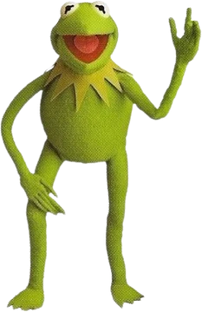
Notes:
Kermit the Frog,

Slide 6
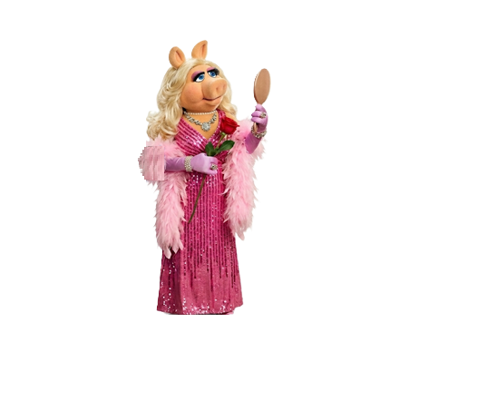
Notes:
and Miss Piggy.

Slide 7
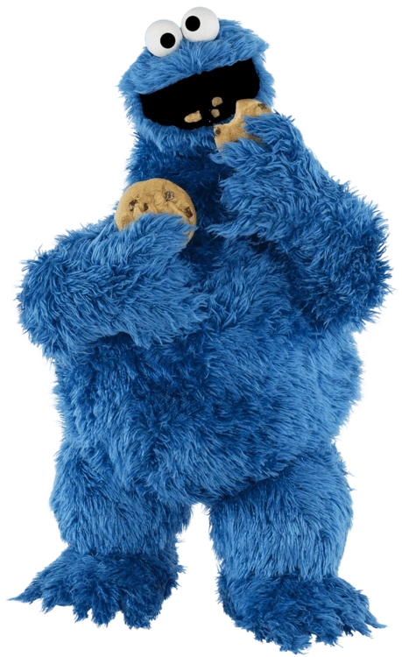
Notes:
We'll also see Cookie Monster,

Slide 8
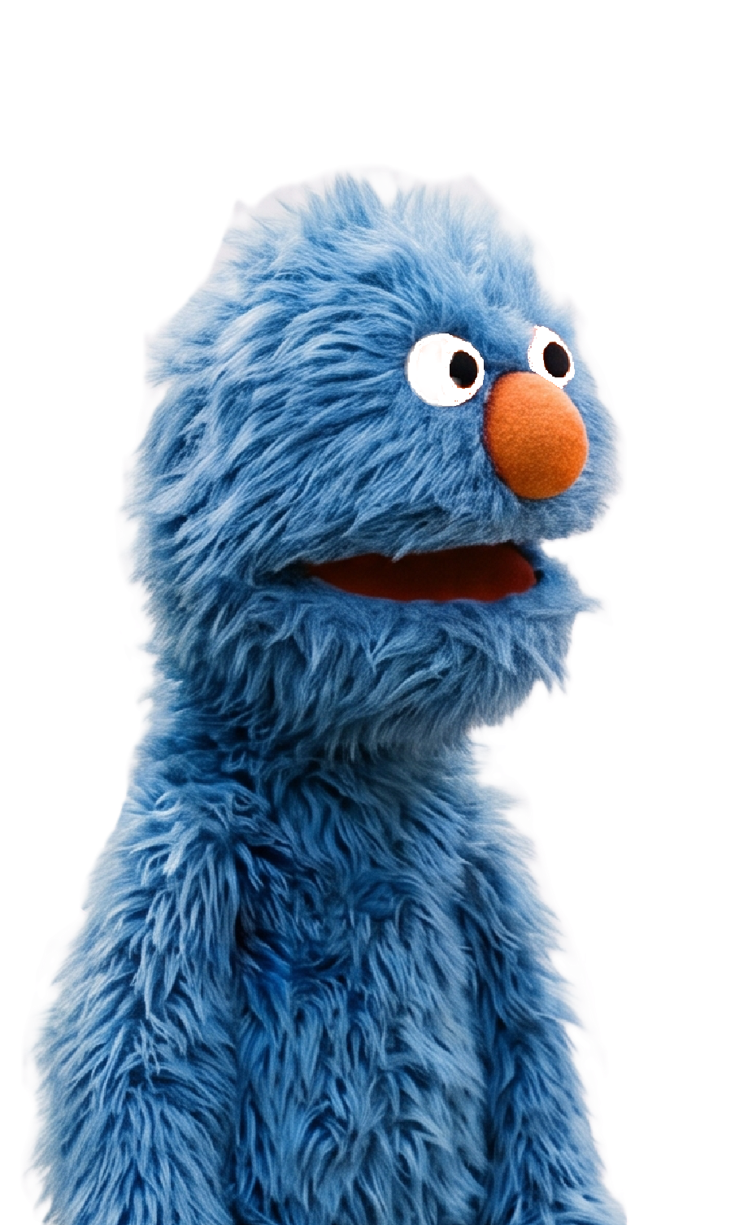
Notes:
and we might even see Grover!

Slide 9
Notes:
Here’s an example.

Slide 10
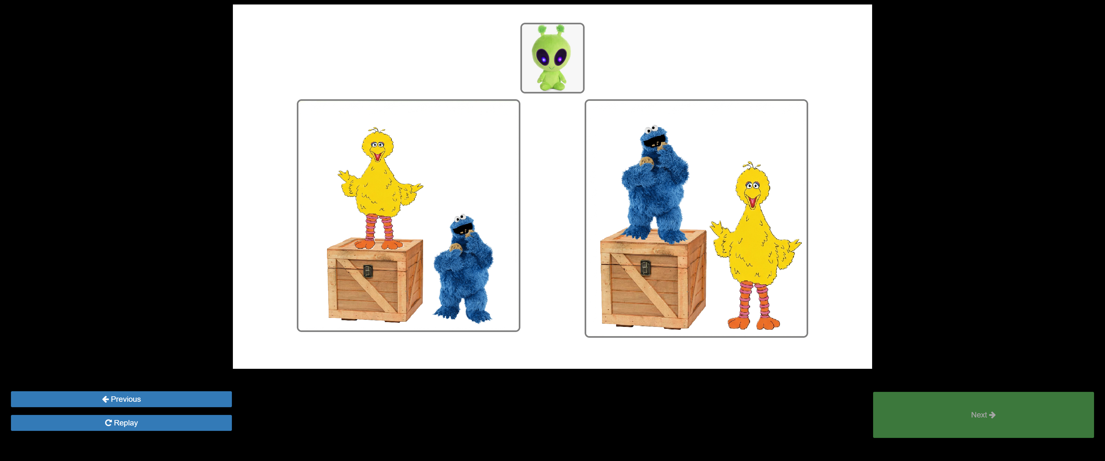
Notes:
Here we see two pictures, side by side...
And suppose we hear a recording that says, “Big Bird is on the Box”

Slide 11

Notes:
Well... Big Bird is in this picture, so we could click on this picture...

Slide 12
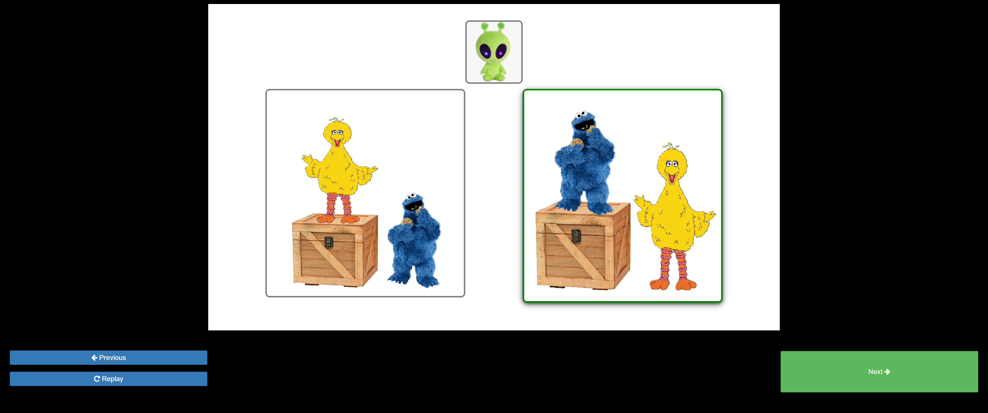
Notes:
But Big Bird isn’t on the box... Cookie Monster is!!

Slide 13
Notes:
So, let's check the other picture. Here we see BB again, and this time he's on the box. So, we actually click on this picture. This is the one that matches.

Slide 14
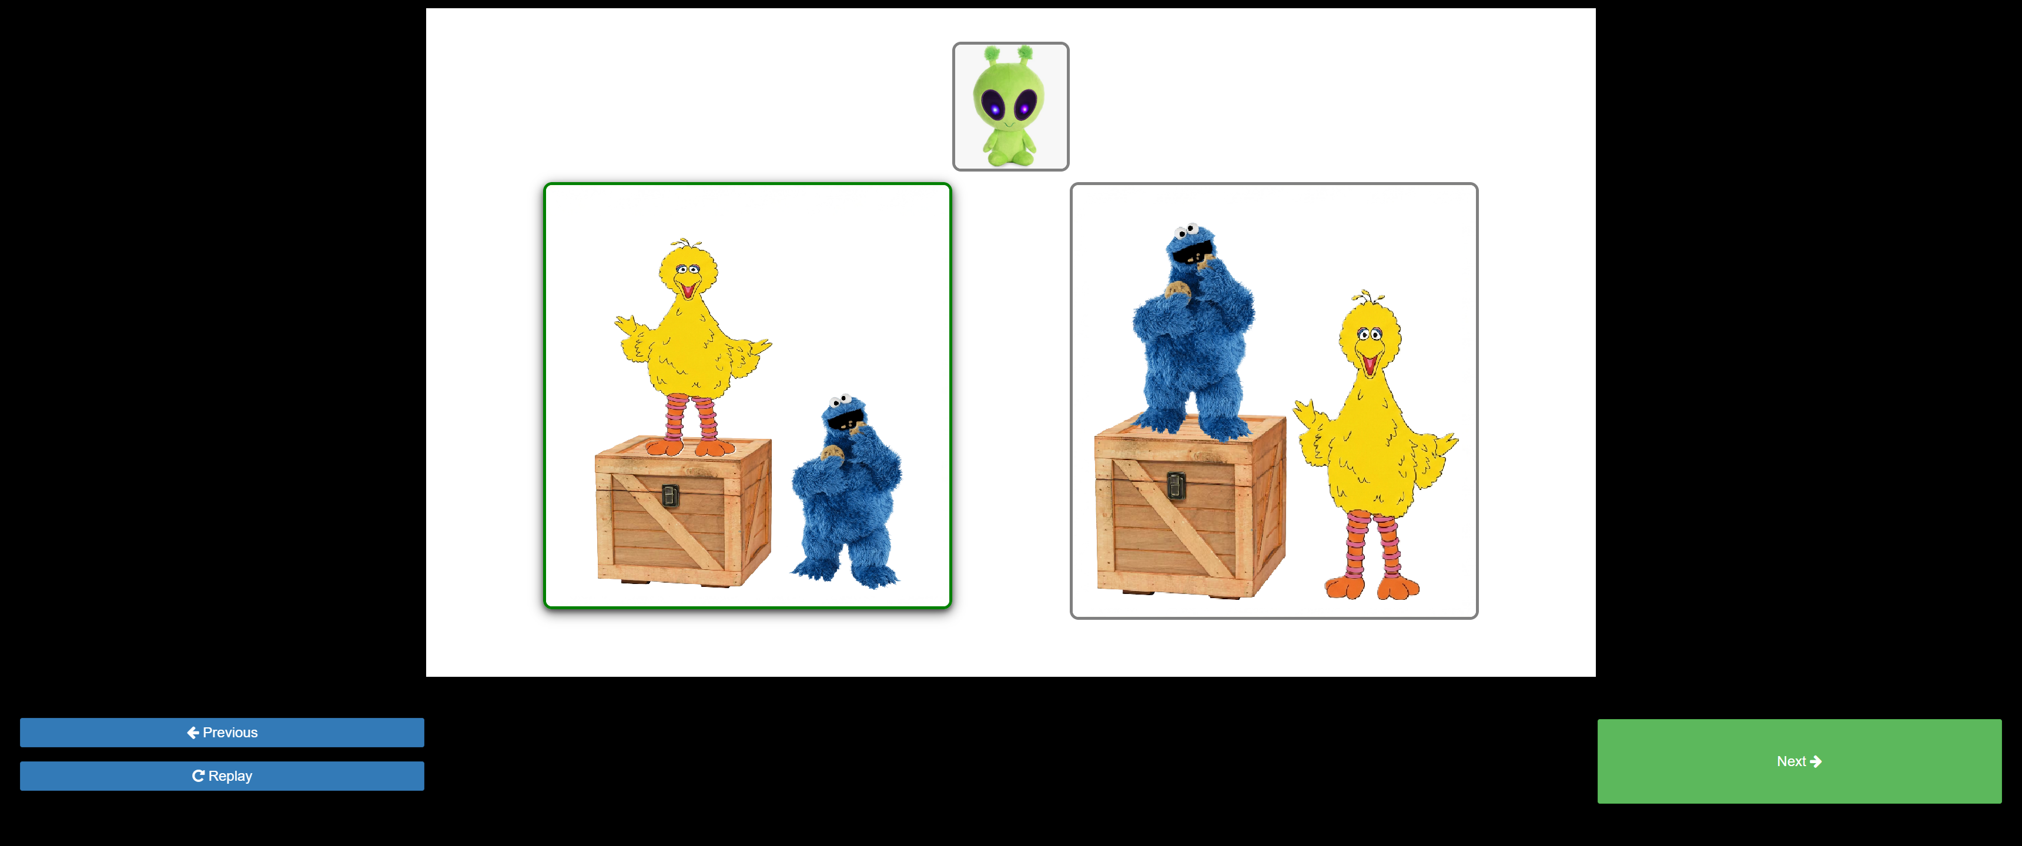
Notes:
At this point we've made our choice,
but if we still want to double-check,
we can listen to the recording more one more time.
To do that, we click on this button.
["Big Bird is on the box“]

Slide 15
Notes:
Great! We definitely want the picture with BB on the box! So, now we tell ET that we're done, by clicking on the green rectangle:

Slide 16
Notes:
Now it's your turn, Teacher. Let's do one more for practice.

