Slide 1
COMP7940 Project
Cloud-Deployed Telegram Chatbot with HKBU GenAI, AWS RDS, Docker Compose, and CI/CD
Project: Telegram chatbot for student Q&A and activity support
Core stack: Telegram Bot API, HKBU GenAI REST API, AWS EC2, AWS RDS PostgreSQL,
Docker Compose, Nginx, GitHub Actions
Meaningful features: interest matching and activity recommendations
Name:Wang Shangbo
student ID:25434705
Telegram bot username:@Utbm_bot
Github link:https://github.com/WSBBEst/comp7940-lab.git

Slide 2
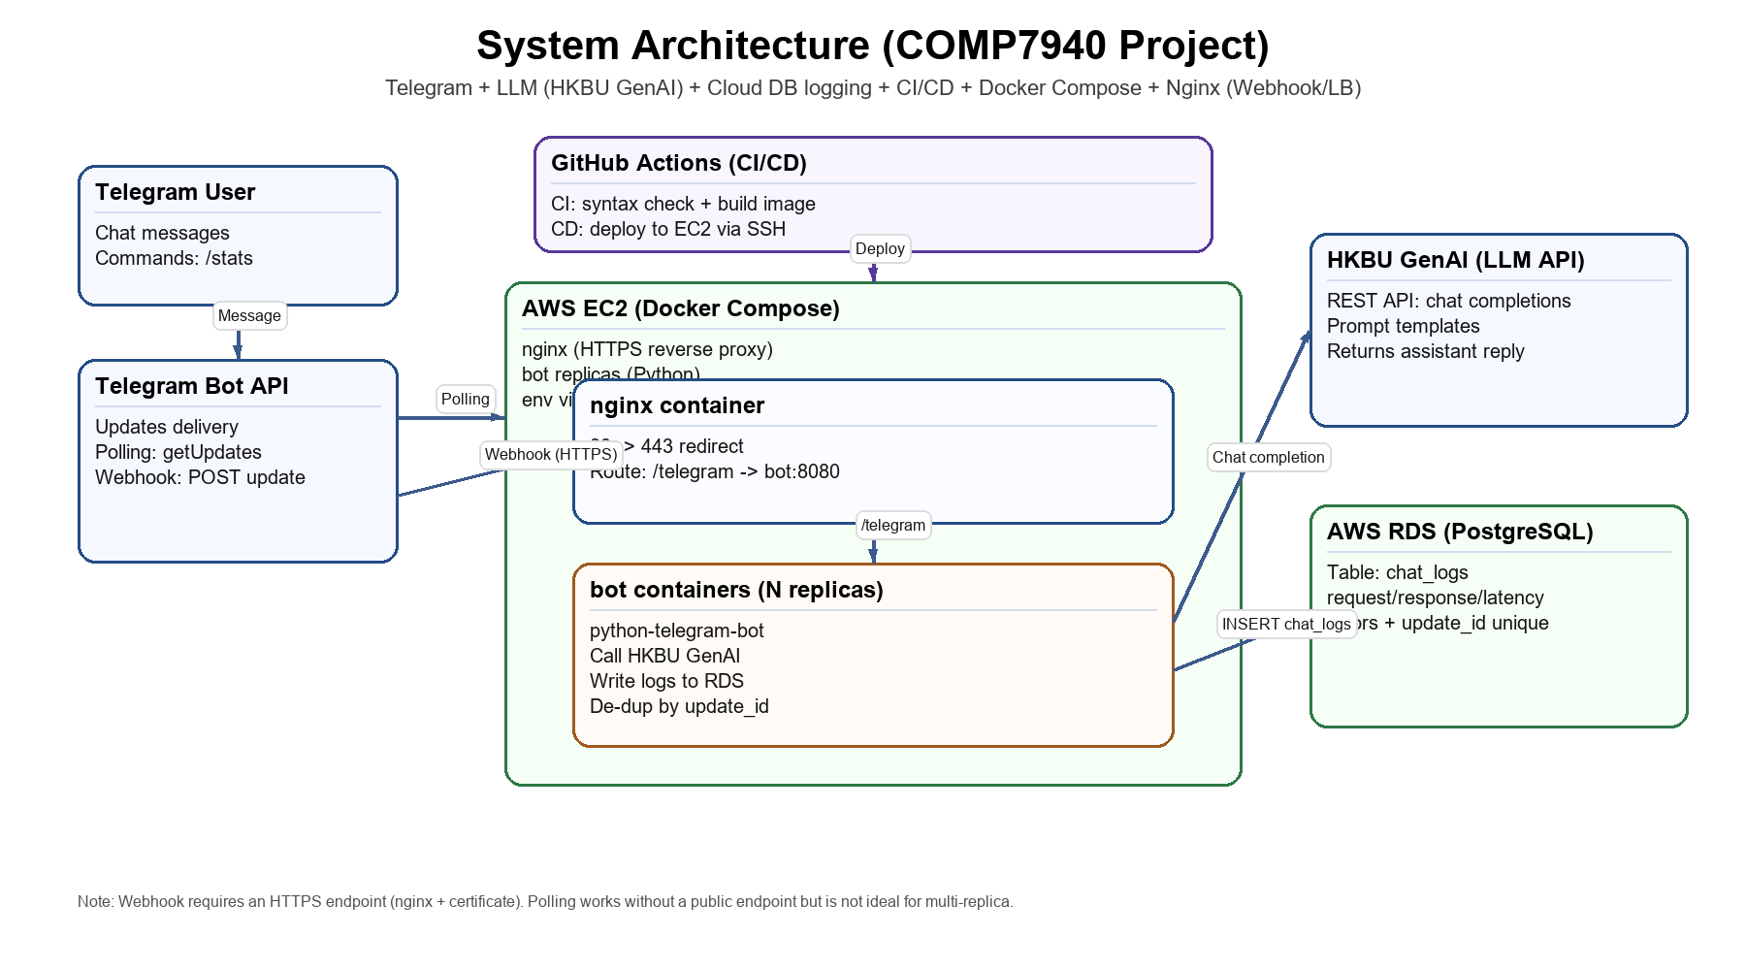
System Architecture
End-to-end flow from Telegram to LLM, database, and deployment pipeline
Key Points
Telegram is the user interface.
Bot runs on EC2 via Docker Compose.
HKBU GenAI generates responses.
RDS stores chat logs and user profiles.
GitHub Actions deploys updates to EC2.

Slide 3
Cloud Deployment and DevOps
How the project is packaged, deployed, and operated
Infrastructure
Containers
CI/CD and Monitoring
AWS EC2 hosts nginx and bot containers.
AWS RDS PostgreSQL stores persistent data.
Webhook mode can run behind HTTPS with nginx.
Dockerfile packages the Python bot.
docker-compose orchestrates nginx + bot replicas.
Shared database keeps state consistent across replicas.
GitHub Actions runs checks and deploys to EC2.
The bot exposes /stats for total requests, errors, and latency.
Docker logs are used for lightweight runtime troubleshooting.

Slide 4
Meaningful Features
Two student-oriented prototype features added beyond basic Q&A
1. Interest Matching
2. Activity Recommendations
Users save interests with /setprofile and review them with /myprofile.
Profiles are stored in PostgreSQL in the user_profiles table.
The /match command compares overlapping interests and returns top matches.
This addresses the requirement of matching users with similar interests.
The /recommend command generates ideas for workshops, competitions, and study communities.
It uses the HKBU GenAI API with a task-specific system prompt.
If a profile already exists, the bot can reuse saved interests automatically.
This addresses the requirement of recommending relevant activities.

Slide 5
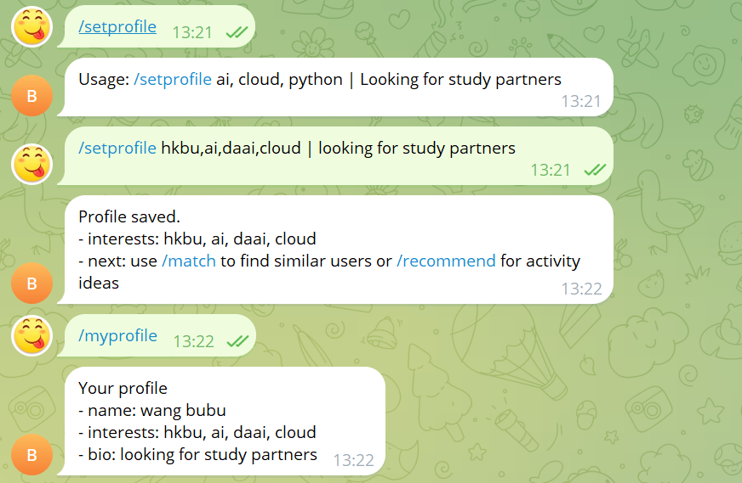
Live Demo Flow

Slide 6
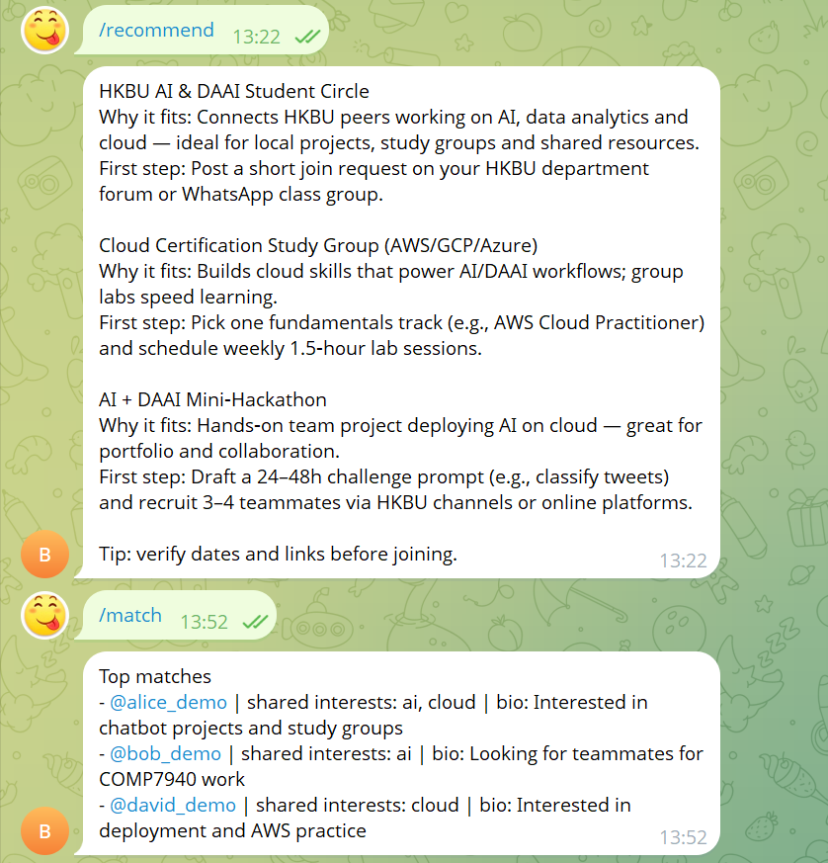
Live Demo Flow

Slide 7
Challenges, Limitations, and Future Work
Be ready for common defense questions
Challenges Solved
Current Limits
Future Work
Integrated Telegram, HKBU GenAI, RDS, Docker Compose, and CI/CD in one deployment.
Fixed database logging behavior and safe update de-duplication.
Kept the system simple enough for a prototype but complete enough for cloud deployment.
Interest matching uses keyword overlap, not semantic similarity.
Recommendations are prompt-based and not connected to live event feeds.
Monitoring is lightweight and not a full production dashboard.
Add semantic matching and richer group discussion features.
Connect to real event APIs or verified activity sources.
Extend observability with dashboards and alerts.

