Slide 1
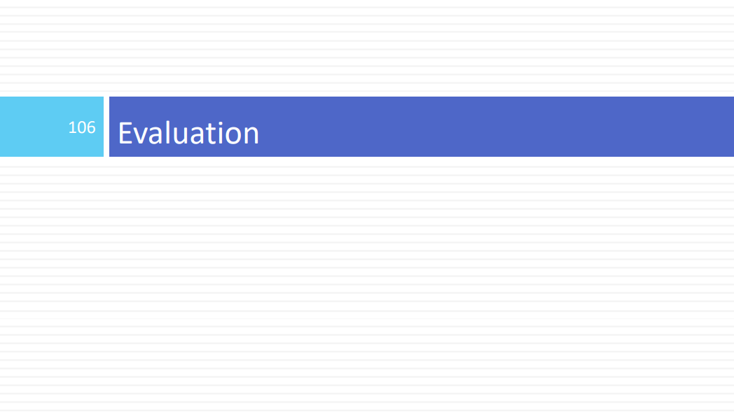

Slide 2
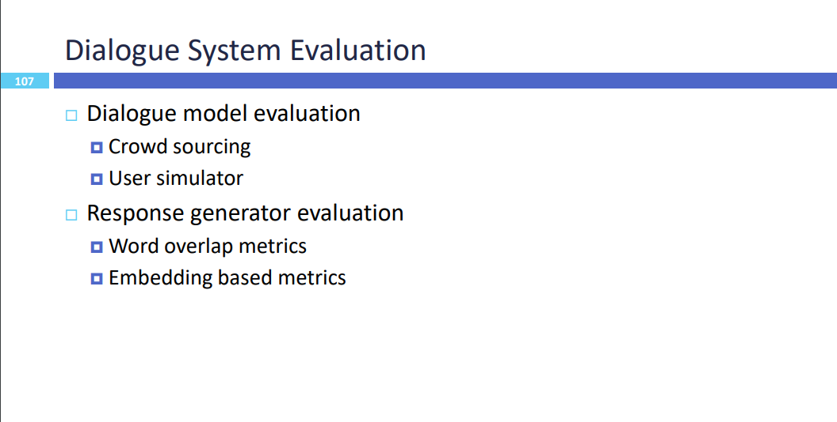

Slide 3
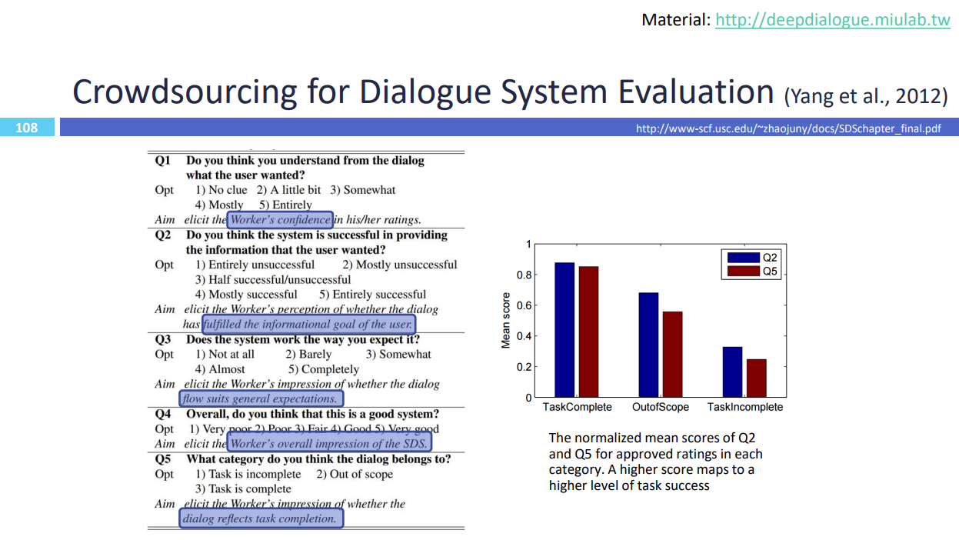

Slide 4
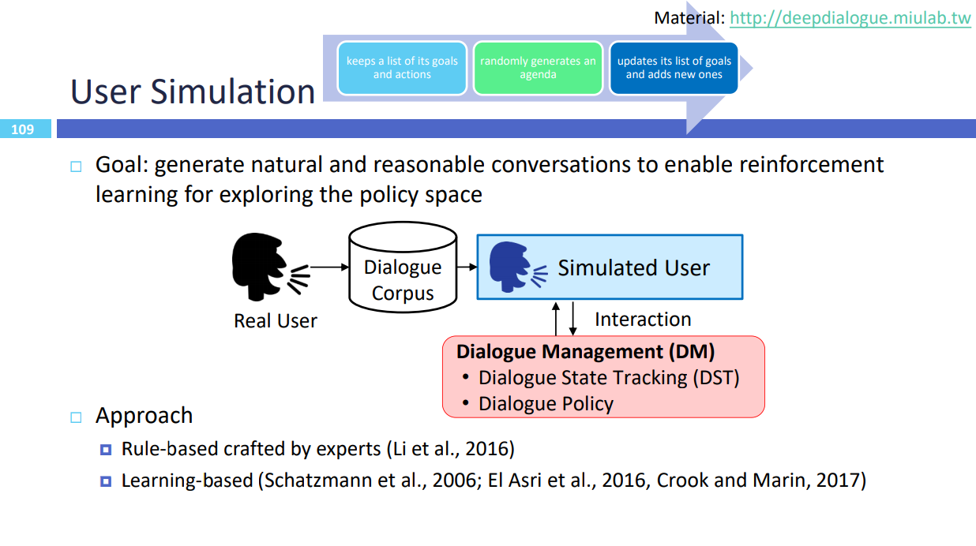

Slide 5
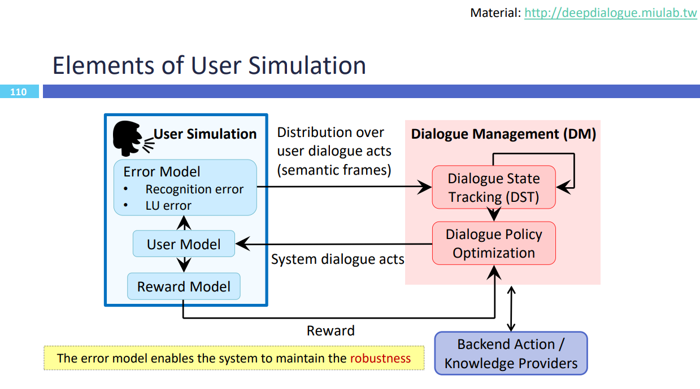

Slide 6
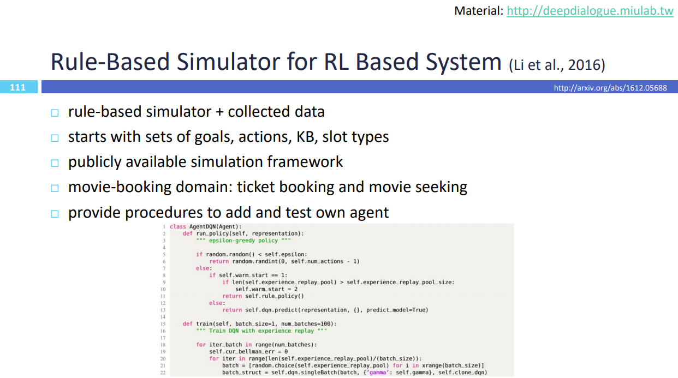

Slide 7
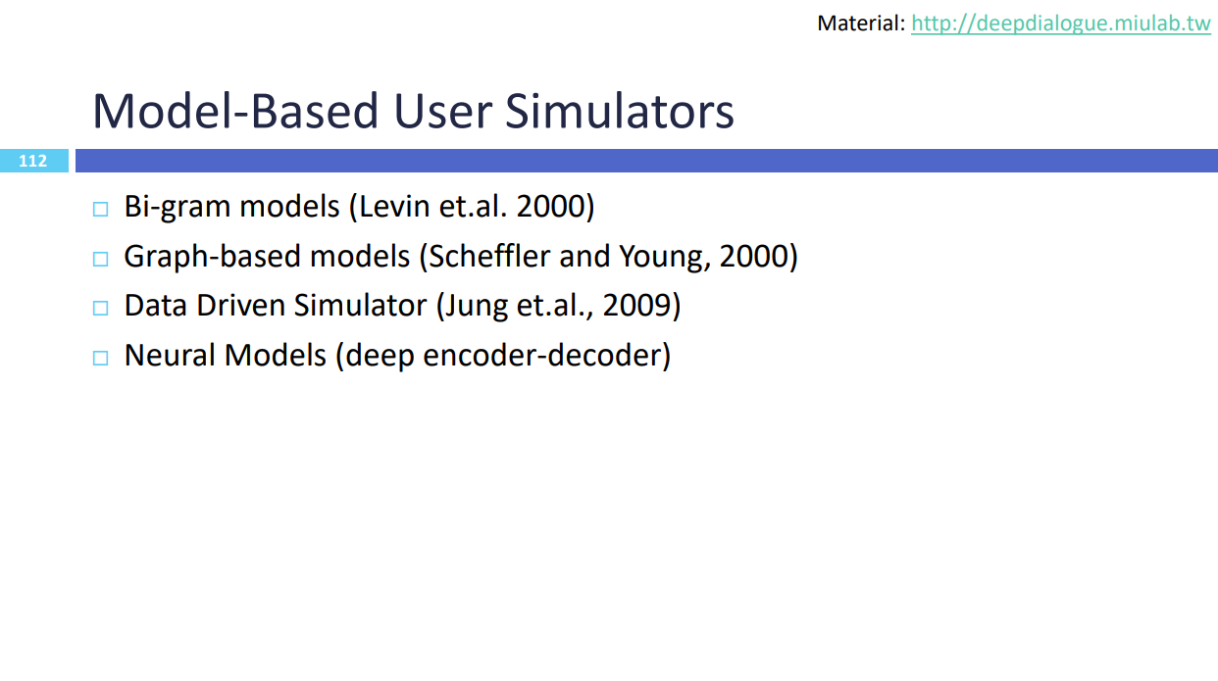

Slide 8
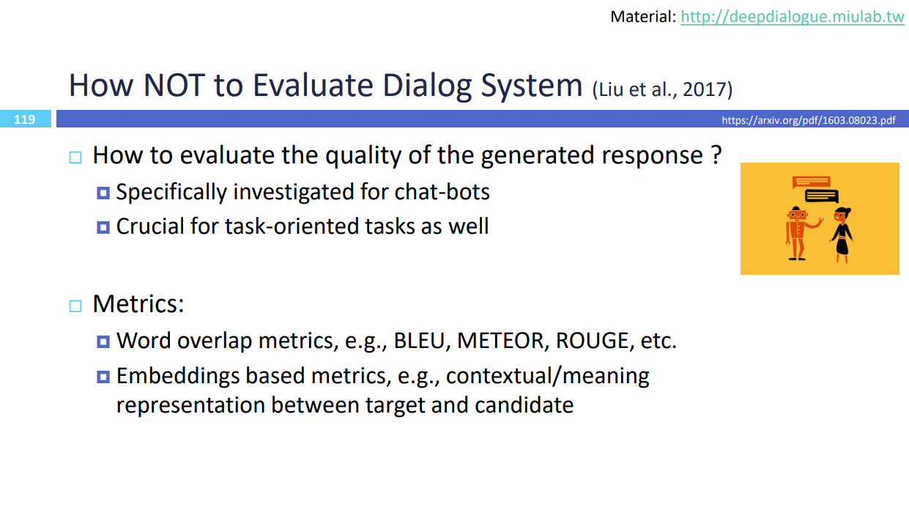

Slide 9

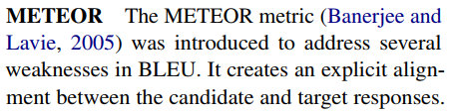
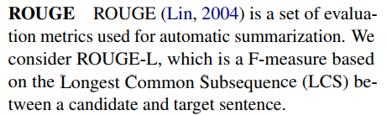

Slide 10
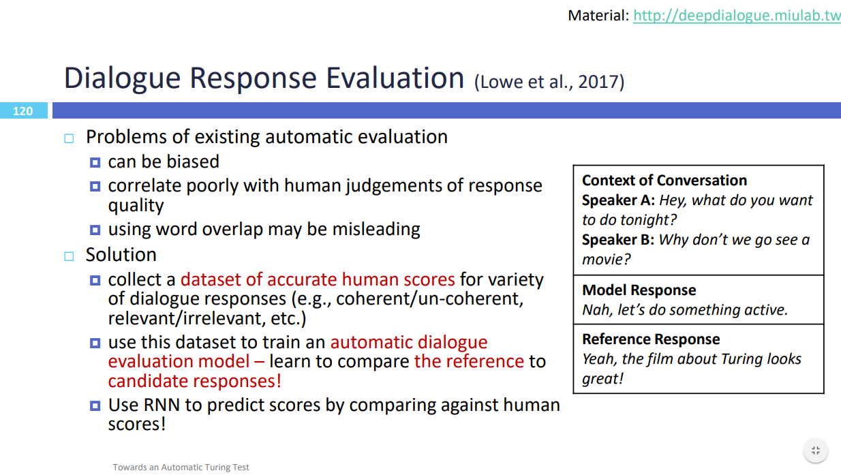

Slide 11
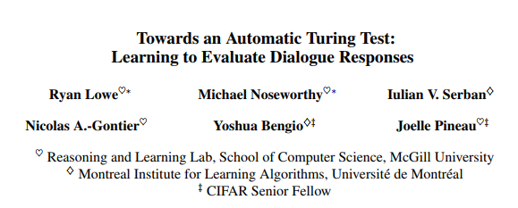
Backgroud: automatic evaluation metrics are biased and correlate very poorly with human judgements of response quality
contribution: present an evaluation model (ADEM) that learns to predict human-like scores to input responses
captures semantic similarity beyond word overlap statistics
exploits both the context and the reference response to calculate its score for the model response

Slide 12
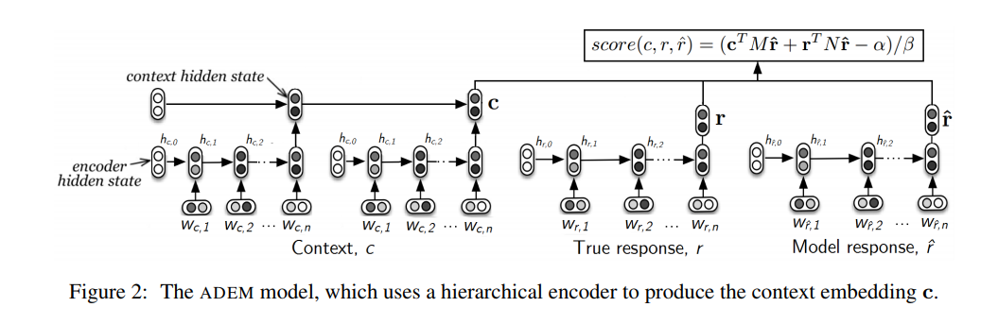


模型结构

Slide 13
训练数据收集
we use the following 4 sources of candidate responses:
a response selected by a TF-IDF retrieval-based model
(2) a response selected by the Dual Encoder (DE)
(3) a response generated using the hierarchical recurrent encoder-decoder (HRED) model
(4) human-generated responses.

Slide 14
Pre-training with VHRED
Motivation: evaluation model that can make accurate predictions from few labeled examples, since these examples are expensive to obtain
Method: use a pre-training procedure to learn the parameters of the encoder. In particular, we train the encoder as part of a neural dialogue model
we attach a third decoder RNN that takes the output of the encoder as input, and train it to predict the next utterance of a dialogue conditioned on the context.

Slide 15
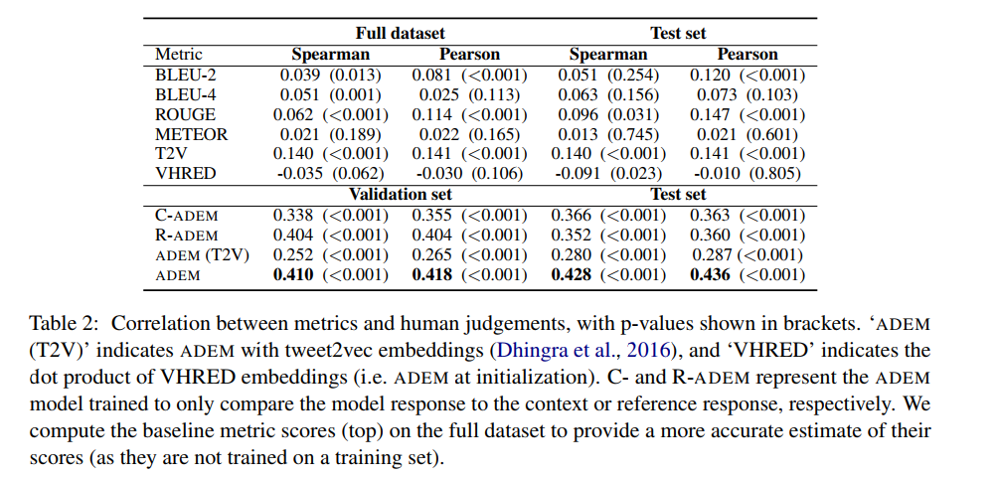
results

Slide 16
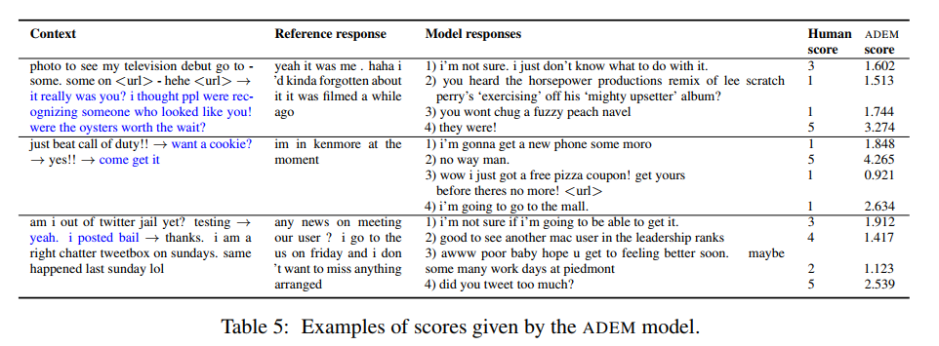
results
One drawback we observed is that ADEM tends to be too conservative when predicting response scores. This is the case in the third context, where the model assigns low scores to most of the responses that a human rated highly. This behaviour is likely due to the squared error loss used to train ADEM; since the model receives a large penalty for incorrectly predicting an extreme value, it learns to predict scores closer to the average human score.

Slide 17
results
Drawback: The evaluation model proposed in this paper favours dialogue models that generate responses that are rated as highly appropriate by humans. It is likely that this property does not fully capture the desired end-goal of chatbot systems. Since humans often provide high scores to generic responses due to their appropriateness for many given contexts (Shang et al., 2016), a model trained to predict these scores will exhibit the same behaviour.

