Slide 1












nYOUtrition.org
Email
Password
Sign in
AUDIENCE
HEALTHY EATING STYLE
ONLINE TOOLS
MY.NYOUTRITION
Search
Welcome to nYOUtrition.org!
Eating healthy is a progressive journey. Ask US; we are all willing to help YOU!
We invite YOU to TAKE ACTION NOW:
CALCULATE YOUR BMI (*) NOW »
(*) Body Mass Index (BMI)
CALCULATE YOUR DCII (**) NOW »
(**) Daily Calories Intake Index (DCII)
FIND resources for you
EXPLORE online tools
MY.nyoutrition.org
Children
Students
Adults
Professionals
People with disability
Non english natives
Special needs
Online BMI calculator
Interactive checklists
Basic monitoring tool
Advanced monitoring tool
Portion distortion
BMI benchmarking tool
DCI benchmarking tool
Fruits
Vegetables
Grains
Protein Foods
Dairy
Oils
My.nYOUtrition
FIND ONLINE RESOURCES »
EXPLORE ONLINE TOOLS »
REGISTER NOW FOR VALUDE-ADDED SERVISES »
© nYOUtrition.org
Site map
Data policies
Privacy policy
Accessibility statement
Code of conduct
Information quality
Contacts

Slide 2


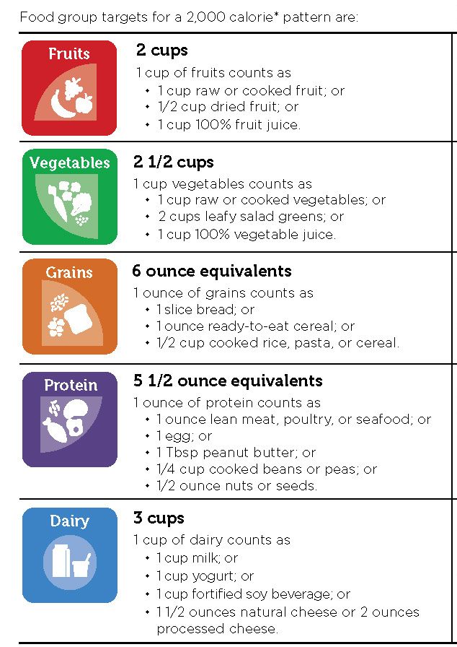
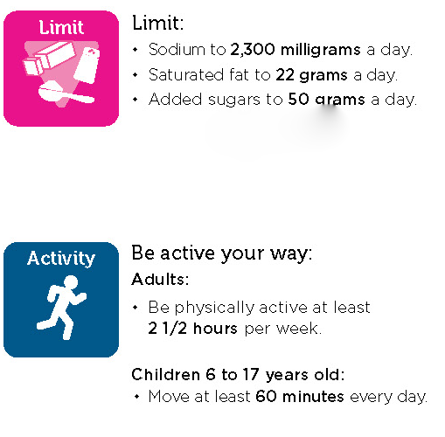

my.nYOUtrition.org
Jone Doe
Sign out
DASHBOARS
MY FOOD PLANS
ONLINE TOOLS
MY.NYOUTRITION
Search
TO DO
Insert your notification message here.
My network
Messaging
Notifications
My expert
Jone Doe
BMI: 30 (Target: 25)
DCII: 3000
Calorie target: 2000
Benchmarking
© nYOUtrition.org
Site map
Data policies
Privacy policy
Accessibility statement
Code of conduct
Information quality
Contacts

Slide 3

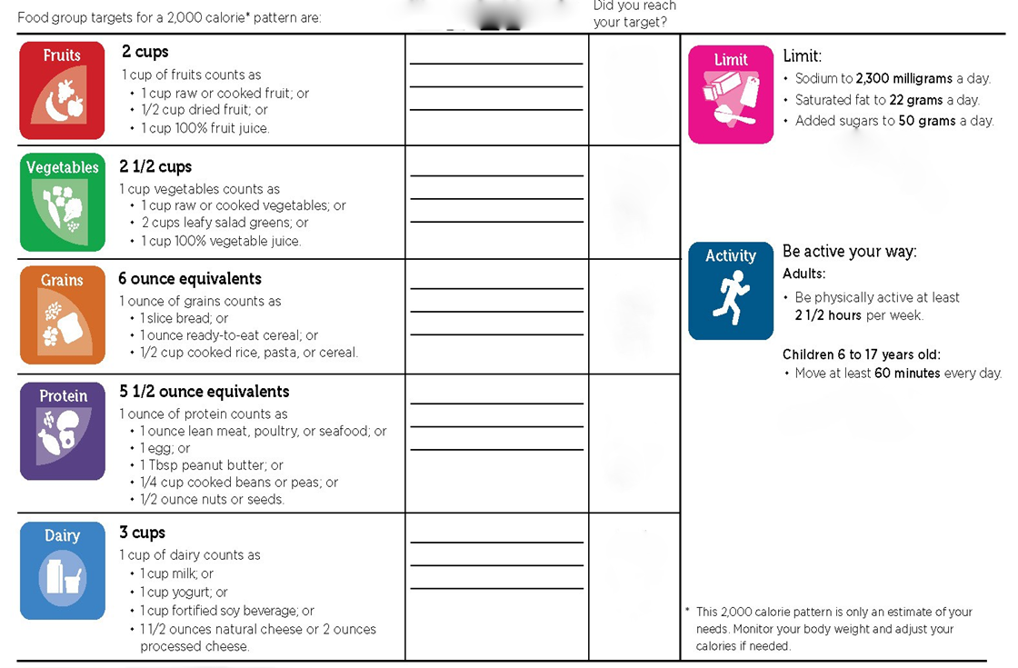
my.nYOUtrition.org
Jone Doe
Sign out
DASHBOARS
MY FOOD PLANS
ONLINE TOOLS
MY.NYOUTRITION
Search
TO DO: UPLOAD YOUR BILLS
Insert your notification message here.
My network
Messaging
My expert
Jone Doe
BMI: 30 (Target: 25)
DCII: 3000
Calorie traget: 2000
Benchmarking
© nYOUtrition.org
Site map
Data policies
Privacy policy
Accessibility statement
Code of conduct
Information quality
Contacts

Slide 4
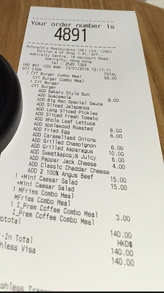
my.nYOUtrition.org
Jone Doe
Sign out
DASHBOARS
MY FOOD PLANS
ONLINE TOOLS
MY.NYOUTRITION
Search
TO DO: UPLOAD YOUR BILLS
Insert your notification message here.
My network
Messaging
My expert
Jone Doe
BMI: 30 (Target: 25)
DCII: 3000
Calorie traget: 2000
Benchmarking
© nYOUtrition.org
Site map
Data policies
Privacy policy
Accessibility statement
Code of conduct
Information quality
Contacts

Slide 5

my.nYOUtrition.org
Jone Doe
Sign out
DASHBOARS
MY FOOD PLANS
ONLINE TOOLS
MY.NYOUTRITION
Search
TO DO: UPLOAD YOUR BILLS
Insert your notification message here.
My network
Messaging
My expert
Jone Doe
BMI: 30 (Target: 25)
DCII: 3000
Calorie traget: 2000
Benchmarking
© nYOUtrition.org
Site map
Data policies
Privacy policy
Accessibility statement
Code of conduct
Information quality
Contacts

Slide 6
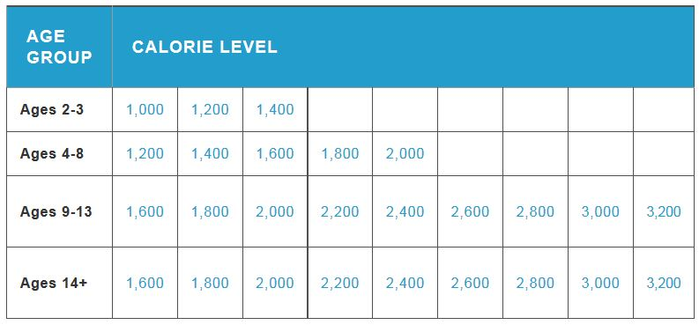
my.nYOUtrition.org
Jone Doe
Sign out
DASHBOARS
MY FOOD PLANS
ONLINE TOOLS
MY.NYOUTRITION
Search
TO DO: UPLOAD YOUR BILLS
Insert your notification message here.
My network
Messaging
My expert
Hello Jone! Which calorie level you are targeting now?
Jone Doe
BMI: 30 (Target: 25)
DCII: 3000
Calorie traget: 2000
Benchmarking
© nYOUtrition.org
Site map
Data policies
Privacy policy
Accessibility statement
Code of conduct
Information quality
Contacts

Slide 7
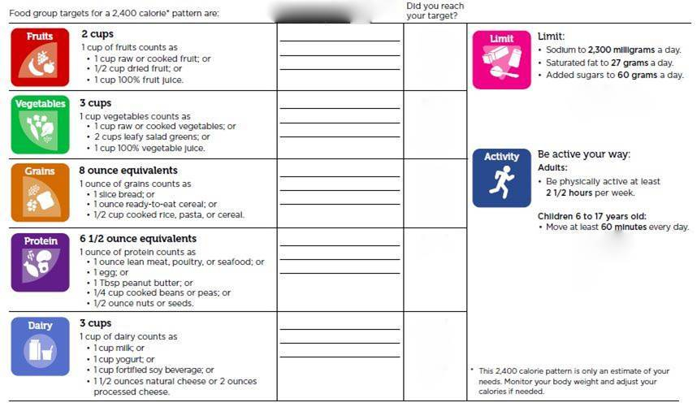
my.nYOUtrition.org
Jone Doe
Sign out
DASHBOARS
MY FOOD PLANS
ONLINE TOOLS
MY.NYOUTRITION
Search
TO DO: UPLOAD YOUR BILLS
Insert your notification message here.
My network
Messaging
My expert
Jone Doe
BMI: 30 (Target: 25)
DCII: 3000
Calorie traget: 2400
Benchmarking
© nYOUtrition.org
Site map
Data policies
Privacy policy
Accessibility statement
Code of conduct
Information quality
Contacts

