Slide 1
gitignore clean cached file
git rm --cached filename
remove all cached file ：git rm --cached -r .

Slide 2
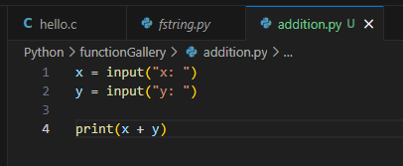
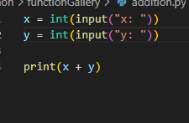



Slide 3
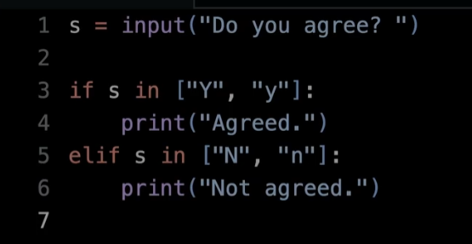
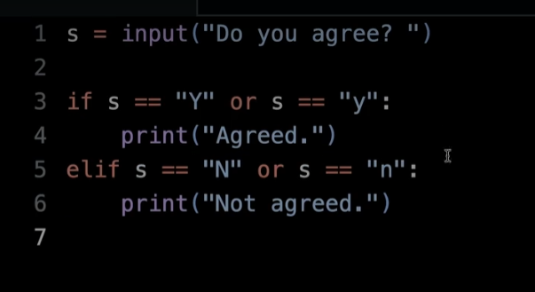
same

Slide 4
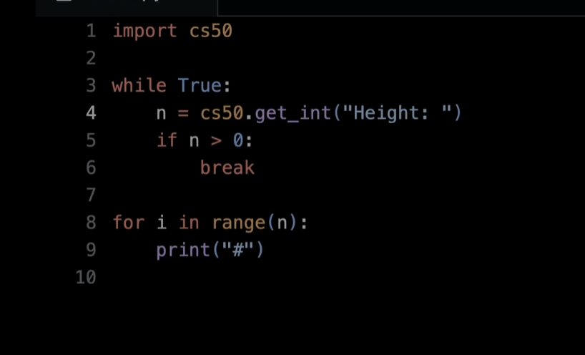

Slide 5
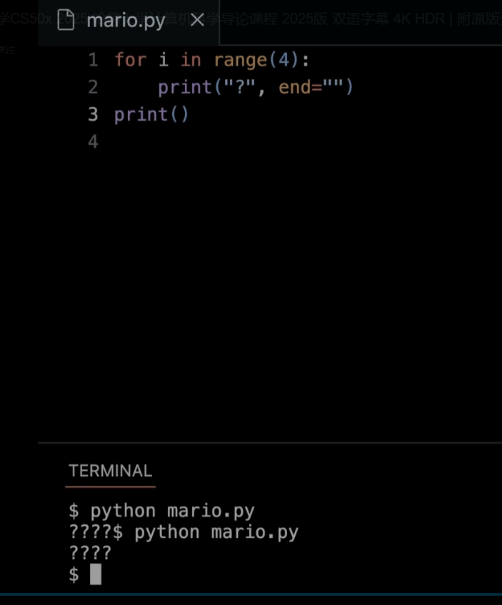
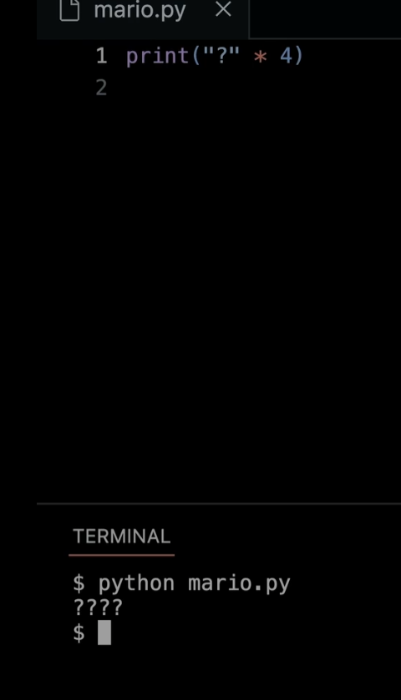
这里同print来结束行，创建新的一行，和右图一个效果

Slide 6
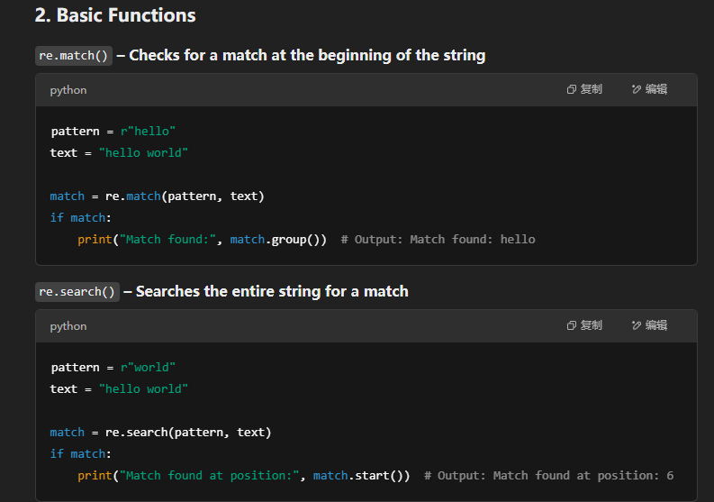
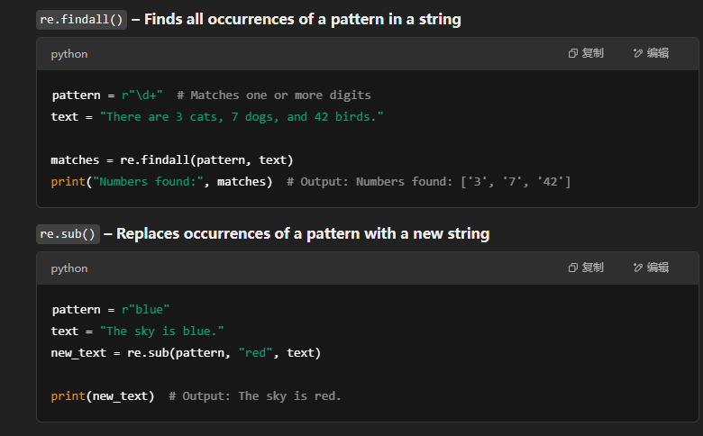
re module:Python’s re module provides support for working with regular expressions, allowing you to search, match, and manipulate strings efficiently.

Slide 7
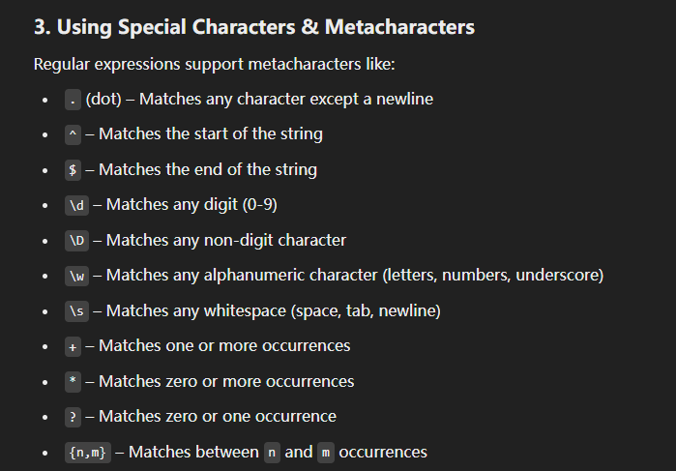
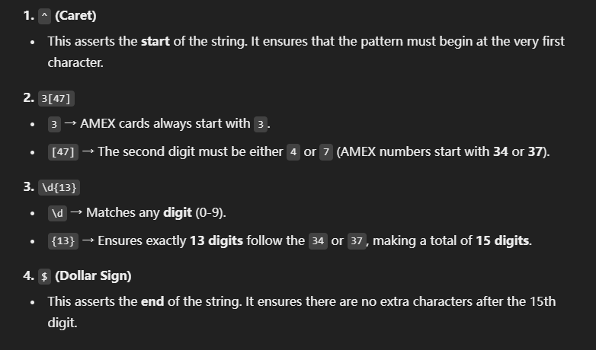
特殊符号
比如amex_pattern = r"^3[47]\d{13}$"
翻译为

