Slide 1
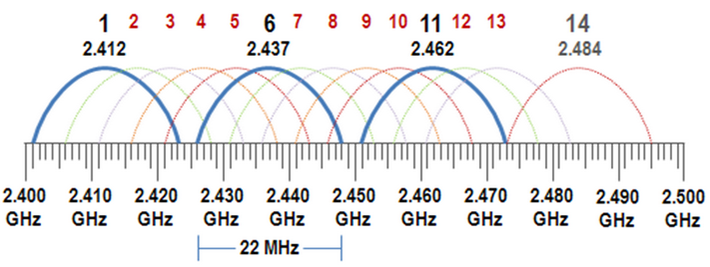

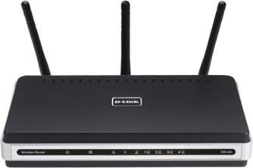
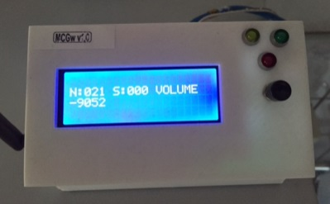
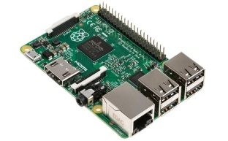


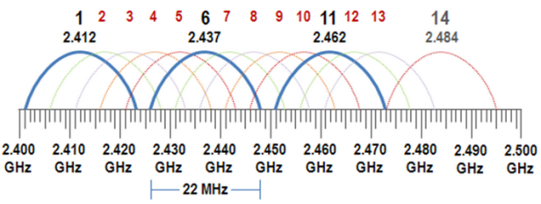
WSN@Work topology
Wifi : auto channel
http(s)://192.168.0.107
Open SSID : WSNatWork
(192.168.0.1)
LAN
192.168.0.x
(192.168.0.225)
(192.168.0.107)
MQTT client Gateway
Controller
Wireless Sensor Network
Sensor / Actuator node
Repeater node
selfhealing
meshing
w/battery powered
ISM (Industrial Scientific Medical) license-free band
Channel 76
(2.476Ghz)

