Slide 1
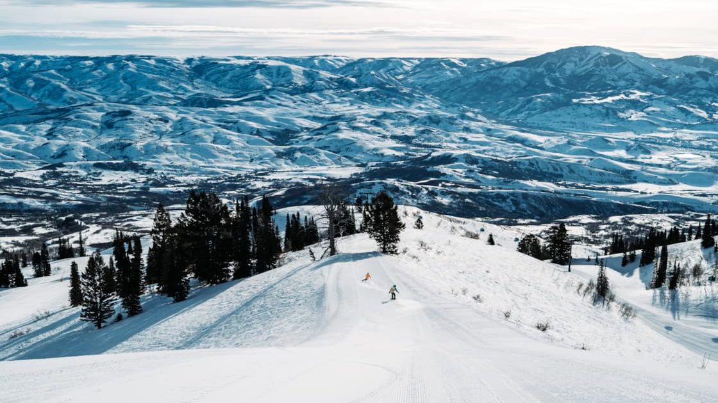

Snowbasin “Congestion Engine”
Predict Trappers Loop (SR-167) peak arrivals 72 hours ahead
The Wildcats - Dani Lopez, Hazem Dawahi, Roberto Camposeco, Kevin Bell
CS-6580
Notes:
[Sources]
- https://www.snowbasin.com/azure/snowbasin/media/siteassets/images/scenic/winter/scenic-winter-strawberry-groomer-valley-view.jpg (background photo)
- https://upload.wikimedia.org/wikipedia/en/thumb/8/8e/Weber_State_University_logo.svg/960px-Weber_State_University_logo.svg.png (WSU logo)
[/Sources]

Slide 2
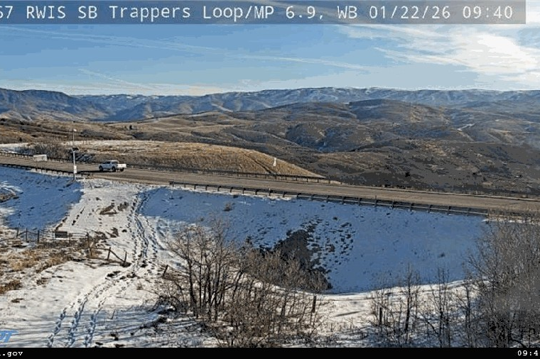
The problem → a decision Snowbasin can act on
If we can forecast morning arrivals (7–9 AM) 72 hours ahead, operations can:
Adjust staffing levels for lifts, rentals, food, and guest services. Activate overflow parking / traffic control before queues form. Send guests arrival recommendations (earlier/later, alternate routes)
Guest Experience
Safety
Operational Cost
Stakeholder
Trappers Loop (SR-167)
Traffic cam example
Snowbasin Resort operations managers
Actionable output
We don’t need perfect precision to be useful - we need early warning + thresholds.
Predicted peak-hour traffic volume + “High Congestion” flag
Forecast window: next 72 hours • Peak window: 7–9 AM
CS-6580 Data Science Capstone • Weber State University • Spring 2026
Notes:
[Sources]
- https://www.skiutah.com/resorts/webcams (webcam image source used for the example)
[/Sources]

Slide 3


Feasibility: the data is public, joinable, and hourly
UDOT Traffic Counts
NOAA Weather
Holidays + WSU calendar
Source: Continuous Count Stations (CCS)
Format: CSV/Sheet export
Granularity: hourly volumes
Scale: ~8,760 rows / year / station
Status: public download
Local Climatological Data (LCD)
Format: CSV + API options
Signals: snowfall, wind, visibility, temp
Scale: multi-year hourly records
Status: public (bulk + CDO API)
Format: small curated CSV
Signals: weekends, MLK, Spring Break, etc.
Scale: < 100 rows
Status: public calendar sources
Integration Strategy (the “Join”)
Join key: Timestamp (Date + Hour) - Granularity: all sources are hourly
Resulting feature table: one row per hour with traffic + weather + calendar indicators → model-ready dataset
CS-6580 Data Science Capstone • Weber State University • Spring 2026
Notes:
[Sources]
- https://connect.udot.utah.gov/business/traffic-data/traffic-statistics/ (CCS hourly volumes availability)
- https://www.ncei.noaa.gov/products/land-based-station/local-climatological-data (NOAA Local Climatological Data overview)
- https://www.ncdc.noaa.gov/cdo-web/webservices/v2 (NOAA Climate Data Online API documentation)
- https://transportationtechnology.utah.gov/wp-content/uploads/2022/09/UDOT_-Transportation-Tech-CMYK_Blue-2-1280x494.png (UDOT logo)
- https://oceanservice.noaa.gov/facts/noaa-emblem-rgb-2022.png (NOAA emblem)
[/Sources]

Slide 4
How we’ll build it (simple first → better over time)
Target
Pipeline
Peak-hour traffic volume (7–9 AM)
Primary output: regression (continuous volume)
Secondary output: classifier (High vs Normal)
Ingest
UDOT + NOAA + Calendar
Clean + Align
(hourly join)
Success metrics (for a “boss-level” view)
Model
(baseline → XGBoost)
Regression: MAE on peak window + calibration of uncertainty. Classification: precision/recall on “High Congestion” days. Business: % of alerts that led to a useful action
Serve
Dashboard / API
CS-6580 Data Science Capstone • Weber State University • Spring 2026
Notes:
[Sources]
- https://connect.udot.utah.gov/business/traffic-data/traffic-statistics/ (traffic counts data source)
- https://www.ncei.noaa.gov/products/land-based-station/local-climatological-data (NOAA LCD data source)
[/Sources]

Slide 5
MVP (localhost): a dashboard that triggers actions
Next 72 hours → predicted peak arrival (7–9 AM)
Recommended actions
1,240 vehicles
ALERT
Schedule extra parking attendants (7–10 AM) Enable overflow lot + signage by 6:30 AM Push guest advisory (arrive before 7:30 AM)
High Congestion Likely
±120 (model uncertainty)
Forecast trend (illustrative)
CS-6580 Data Science Capstone • Weber State University • Spring 2026
Notes:
[Sources]
- Chart values are illustrative mock data (for UI concept only).
[/Sources]

Slide 6
Risk management: we have a kill switch and a backup
Biggest technical blocker
Backup project (Plan C)
Aligning traffic history with weather forecasts at hourly resolution (missing data, station outages)
Great Salt Lake “Dust Warnings” for Ogden
Predict hazardous dust days using lake level + wind + PM sensors. Stakeholder: local public health / city ops. Same end-to-end skills: joinable public data + decision thresholds
Mitigations
Build a robust hourly “time index” and fill gaps with safe defaults. Track data freshness; flag days with unreliable sensors. Start with a baseline (last-year / moving average) for sanity checks
Plan B within the same idea
Why this matters for feasibility
If exact volume is noisy → pivot to a binary classifier:
We won’t get stuck: if one data source blocks us, we still deliver a working predictive product.
“High congestion” vs “Normal” using weather + calendar only
Still supports the same actions: staffing + parking + guest messaging.
CS-6580 Data Science Capstone • Weber State University • Spring 2026

Slide 7
Roadmap (12 weeks) + what we need next
Course sprint plan (high level)
Feasibility & Design
Data Pipeline
EDA + Baseline
Model Refinement
Jan 22–Feb 4
Feb 5–Feb 18
Feb 19–Mar 4
Mar 5–Mar 25
Then: UI/UX + Deployment (localhost) → QA + Final boardroom presentation
Next 2 weeks (deliverables)
Ask (from a stakeholder)
Download sample CCS hourly volumes for the target station and build a clean hourly index. Pull NOAA LCD data for the nearest station; align timestamps and fill gaps. Stand up a localhost dashboard shell + baseline forecast (moving avg / last-year)
1) Confirm what “high congestion” means operationally
2) Confirm which traffic station best represents arrivals
3) Provide 2–3 example days when operations struggled
CS-6580 Data Science Capstone • Weber State University • Spring 2026

