Slide 1
STXM Data Analysis
8/13/2018

Slide 2
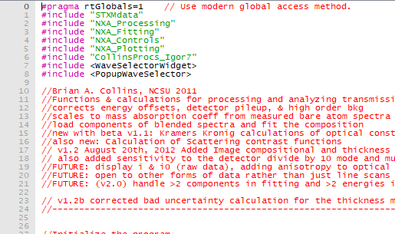
IGOR 7 STXM Analysis:
Required Software
NXA Package:
IGOR Procedures:
NXAMenu
User Procedures:
NXA_Controls
NXA_Fitting
NXA_Init
UPDATE: Make sure #include “CollinsProcs_Igor7” is included!!
NXA_Plotting
NXA_Processing
Additional User Procedures
STXMdata
CollinsProcs_Igor7 (several functions updated for Igor7, otherwise identical)
Required Data (Stored in User Procedures)
Element Library (element absorption edge from CXRO as .nff files

Slide 3
Scans to Load
LineScans
CO2 Calibration - 532_151004082
SM27 Pure Molecule - 532_151004086
SM28 Pure Molecule - 532_151004140
Blend film Lineout – (Could not locate one with the logbook I had, I use SM28 as my example for fitting)
Example Composition Map – 532_151005031 (Stack of images)

Slide 4
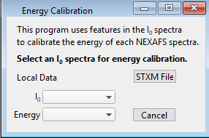
Loading CO2 energy Scan
Run program under /Macros/NEXAFS Analysis
Run ‘STXM File’ and select the CO2 Calibration
With example data this is scan ending in 082
Calibration will be set up for the remaining scans

Slide 5
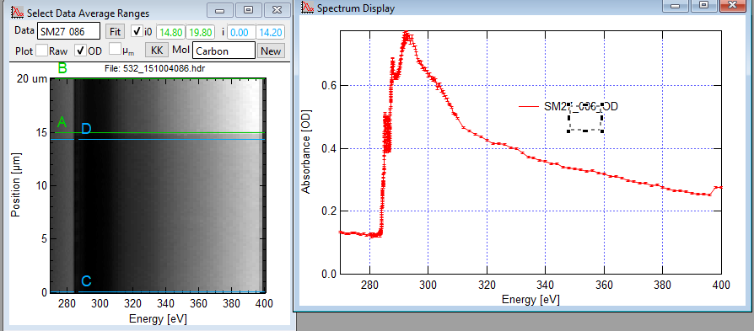
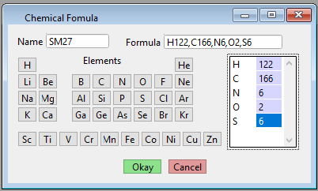
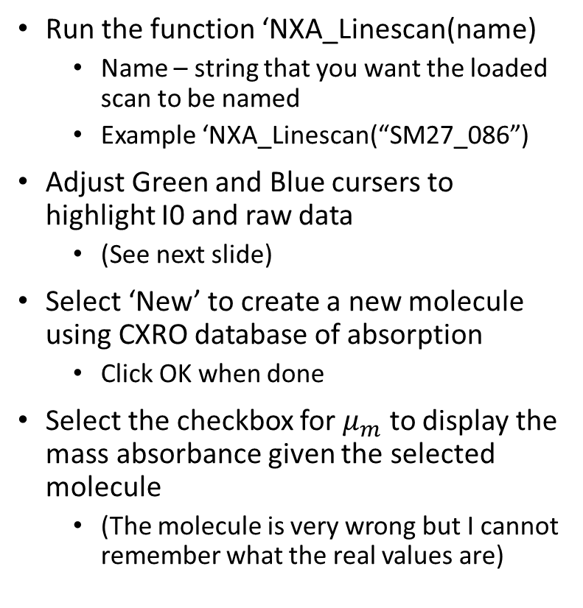
Loading NEXAFS LineScan
Run the function ‘NXA_Linescan(name)
Name – string that you want the loaded scan to be named
Example ‘NXA_Linescan(“SM27_086”)
Adjust Green and Blue cursers to highlight I0 and raw data
(See next slide)
Select ‘New’ to create a new molecule using CXRO database of absorption
Click OK when done
Select the checkbox for $μ_{m}$ to display the mass absorbance given the selected molecule
(The molecule is very wrong but I cannot remember what the real values are)

Slide 6
Fit Spectra to components
Select Dataset
Plot Options
Select Molecule
Display of processed Data
Make Molecule
Do Kramers Kronig
Green Cursers outline I0
Blue Cursers outline Film
Raw Data

Slide 7
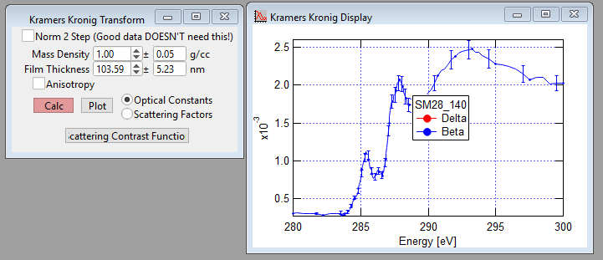
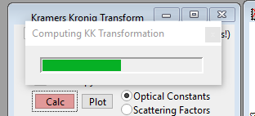
Kramers Kronig
Select Datasee, molecule, and click kk
(On previous Panel)
Input Mass density
Film thickness should be calculated
Click ‘Calc’
Calculating Window
Final Result will display on same graph

Slide 8
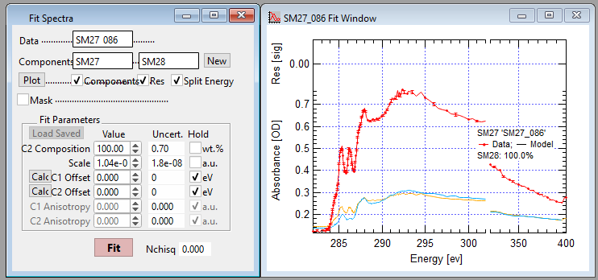
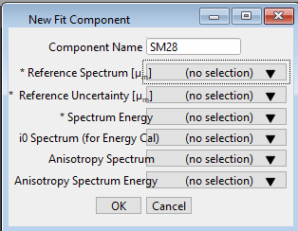
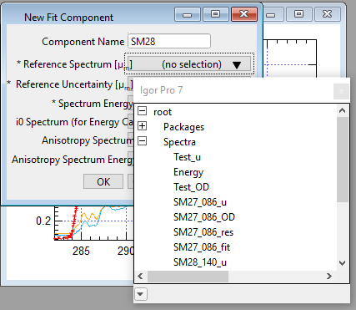
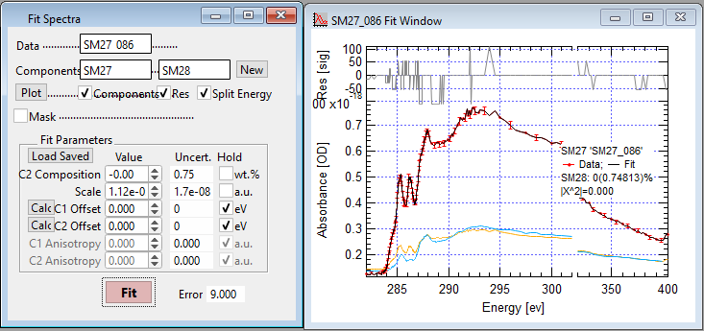
Compositional Fits to NEXAFS Spectra
Fit Blend film NEXAFAS to components to measure composition
Note: I don’t have access to a good blend film spectra right now so this will be done on a NEXAFS spectra of a pure film and just fit for learning….
Select the appropriate Data set and click Fit
(Previous Panel)
Create component for fitting
Click ‘New’ Following the components line item
Give the component a name
Select any drop down menu and pick any of the waves relating to the component. Then click OK
For example, to make a component using SM27 I can select either ‘SM27_086_u’ or ‘SM27_086_OD’ etc. Everything will be filled in appropriately.
Create Both components and select them in the appropriate boxes (Red box above).
Lastly, Select what you want to plot (everything) and click Fit.
When done the black line should be a fit to the red spectra (components in yellow and blue).
Since this example is fitting a component with its own spectra it becomes a perfect fit with 0% the second component (good)

Slide 9
Just a bigger copy!

Slide 10
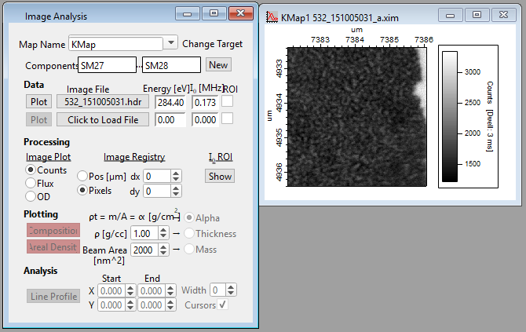
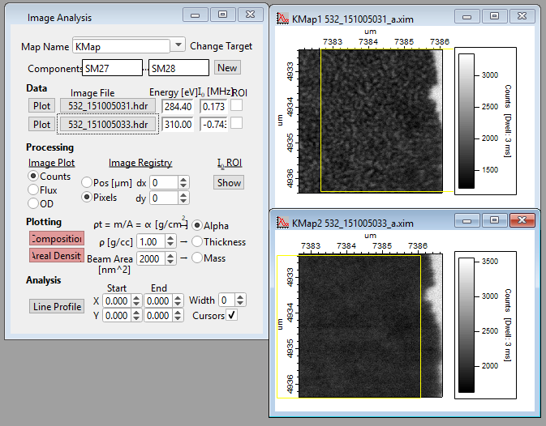
Loading Composition map
Run the function ‘NXA_ImageANalysis(Name)
Again, Name is a string to designate the image.
Example
‘NXA_ImageANalysis(“KMap”)
Select First Image File ‘532_151005031’
Select ‘Click to Load File’ to Load second energy
Note: If you are instead running through an image stack it will ask which energy you would like to load.
Simply follow instructions with the header file selected

Slide 11
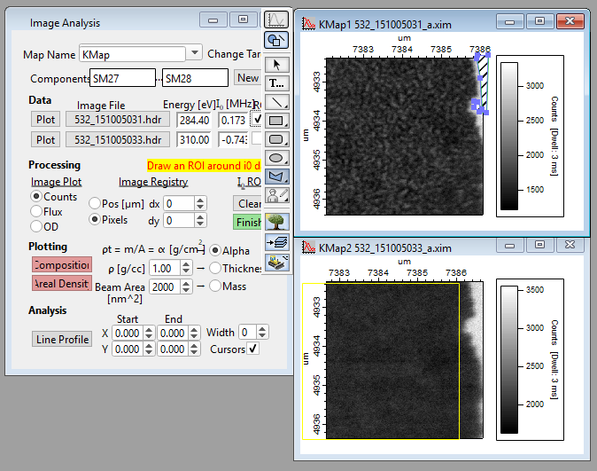
Compositional Map Analysis
Selecting I0
Under the data set click ‘ROI’
It will ask you to draw a mask to select the I0 components, this is done in the same was as masking RSoXS data
Click Finish when done
Repeat with second Image
Now for analysis,
Input a density and click both Composition and Areal Density
Two new windows will pop up

