Slide 1
Interactive dashboards in tableau
Drs. Silas Bergen and Todd Iverson
Winona State University
ICOTS 2018
Kyoto, Japan
July 8, 2018

Slide 2
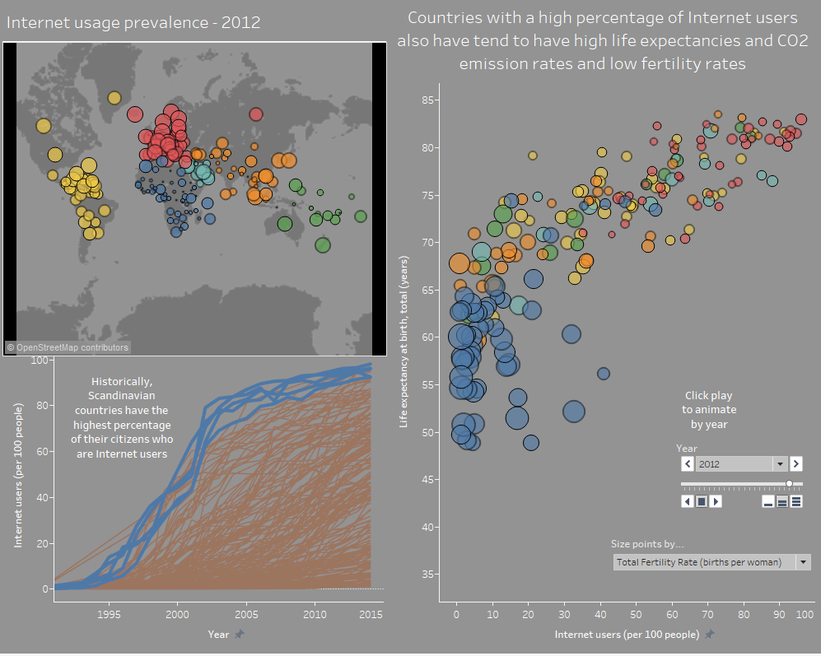
World bank interactive dashboard:
Modified from Chapter 13:
Communicating Data with Tableau
By Ben Jones
Fully interactive version: https://public.tableau.com/profile/silas.bergen#!/vizhome/WorldBankDataVisualizations/Internetusage

Slide 3
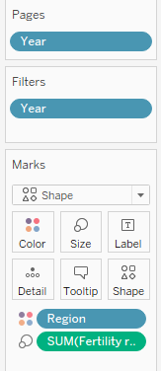

3-way scatterplot
Geom: Shape (circle)
Internet → X
Life expectancy → Y
Fertility rate → Size
Region → Color
Year → Filter
Optional animation:
Year → Pages

Slide 4

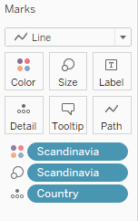
Internet usage by country over time
Geom: Line
Year → X
Internet → Y
Scandinavia → Color
Scandinavia → Size
Country → Detail
Annotate with right click → Annotate → Area

Slide 5
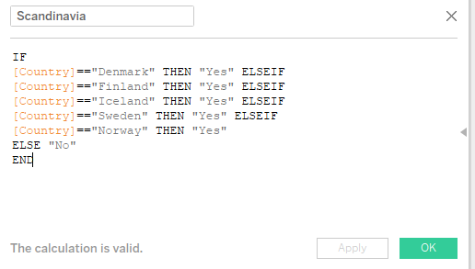
Internet usage by country over time
To create Scandinavia:
Right-click Country → Create Calculated Field
Enter following code:
IF
[Country]=="Denmark" THEN "Yes" ELSEIF
[Country]=="Finland" THEN "Yes" ELSEIF
[Country]=="Iceland" THEN "Yes" ELSEIF
[Country]=="Sweden" THEN "Yes" ELSEIF
[Country]=="Norway" THEN "Yes"
ELSE "No"
END

Slide 6

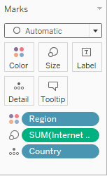

World map of internet usage
Geom: Point
Longitude → X
Latitude → Y
Region → Color
Internet → Size
Year → Filter
Tableau automates with
Country → Detail

Slide 7
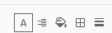
Bells and whistles: The format pane
Right-click → Format
The formatting pane has 5 tools
Right-click sheet name → Copy Formatting to paste formatting across multiple worksheets
Alignment
Borders
Shading
Text
Lines

Slide 8


Dashboard: Bringing it all together
Click New Dashboard:
Arrange worksheets as desired
Use Size dropdown to customize size

Slide 9
Dashboard: interactions
Two important action types
Highlight actions: hovering over a data point on one worksheet highlights corresponding data points on other worksheets;
Filter actions: hovering over or selecting a data point on one worksheet filters corresponding data points on other worksheets.

Slide 10
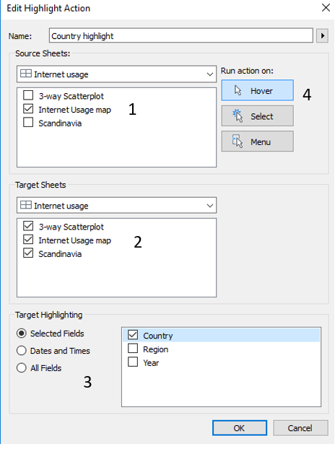
Highlight action
Click Dashboard → Actions…
Add Action → Highlight
Complete the dialogue box as shown. Some things to think about:
From which worksheets do you want the interactivity to be sourced? Select these in the “Source Sheets” box
Which worksheets do you want the interactivity to target? Select these in the “Target Sheets” box
Important: Which fields do you want to control the interactivity? Control this with the “Target Highlighting.” Note that the field(s) you select must be present on all selected target and source sheets for the action to work properly!
Do you want the action to run on hover, or select? Let’s select “Hover” here.

Slide 11
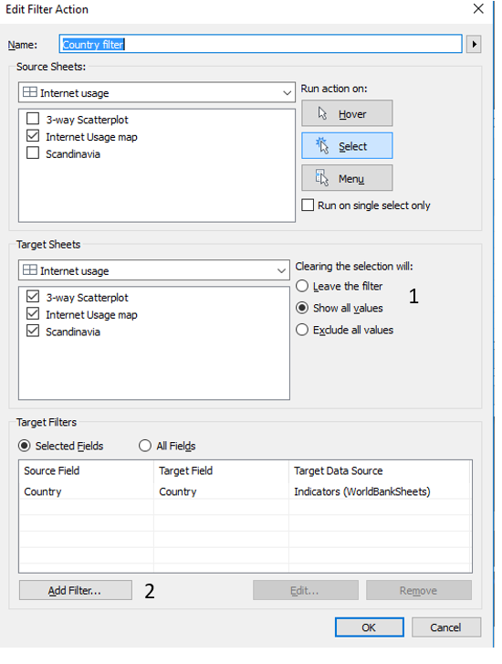
Filter action
Dashboard → Actions…
Add Action → Filter
Set up the Source and Target sheets as before, but note a few new options:
What do you want to happen when the filter is removed? Leave or show all? (I have never encountered a situation where the “Exclude all values” option made sense.)
Filtering by a specified field is accomplished by clicking Add Filter… at the bottom of the dialogue box, and selecting Country.
Set up the dialogue box as shown

Slide 12
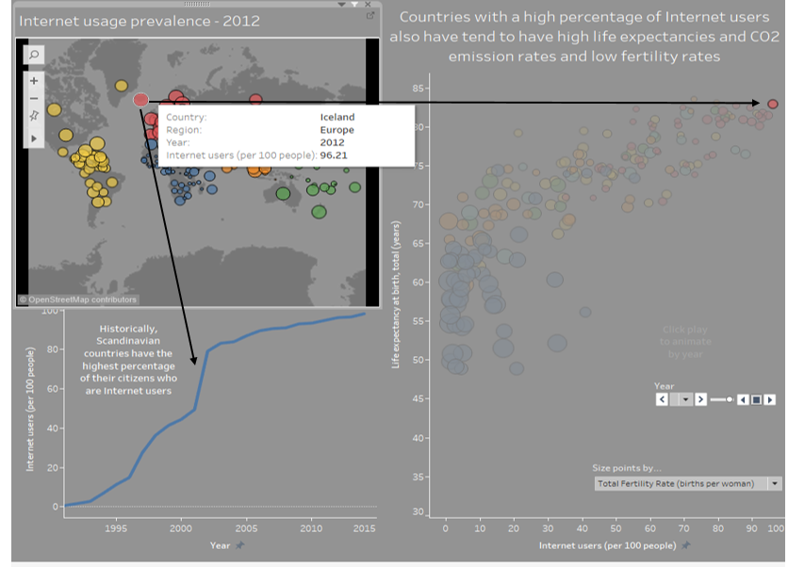
Create!
Reproduce dashboard with interactions indicated by arrows

Slide 13
publish
File → Save to Tableau Public As…
Share your link: you’re good to go!

