Slide 1
Data visualization: principles and practice
Drs. Silas Bergen and Todd Iverson
Winona State University
ICOTS 2018
Kyoto, Japan
July 8, 2018

Slide 2
In the visualizations that follow:
What information can you extract?
How are you extracting this information?

Slide 3
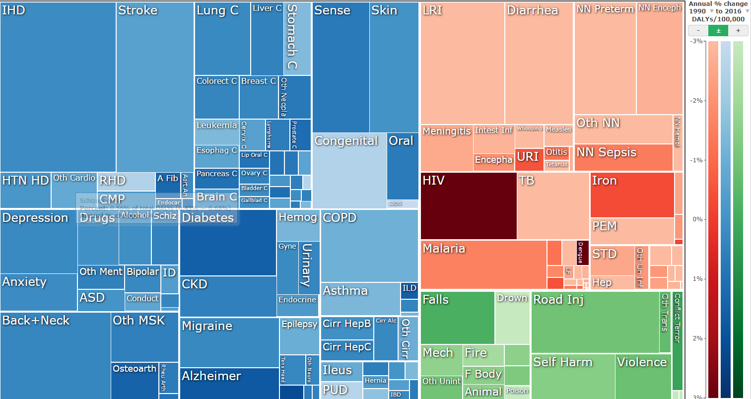
Ihme gbd visualization
https://vizhub.healthdata.org/gbd-compare/

Slide 4
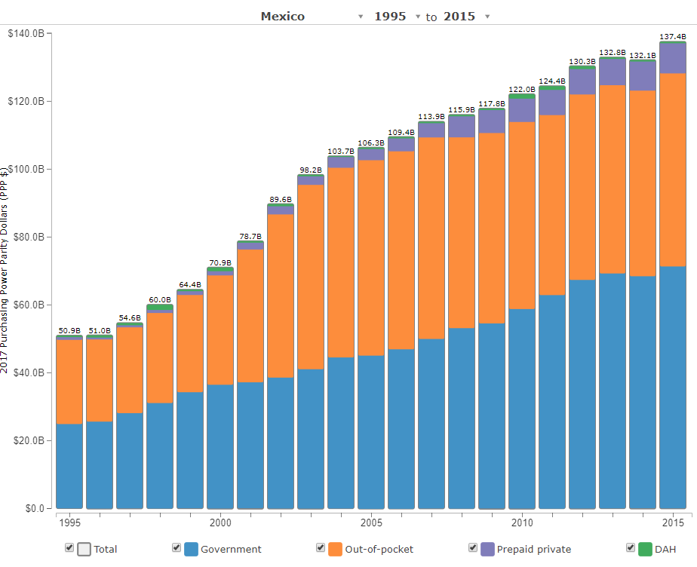
Ihme Health care spending visualization
(DAH = Development Assistance for Health)
http://ihmeuw.org/4iuu

Slide 5
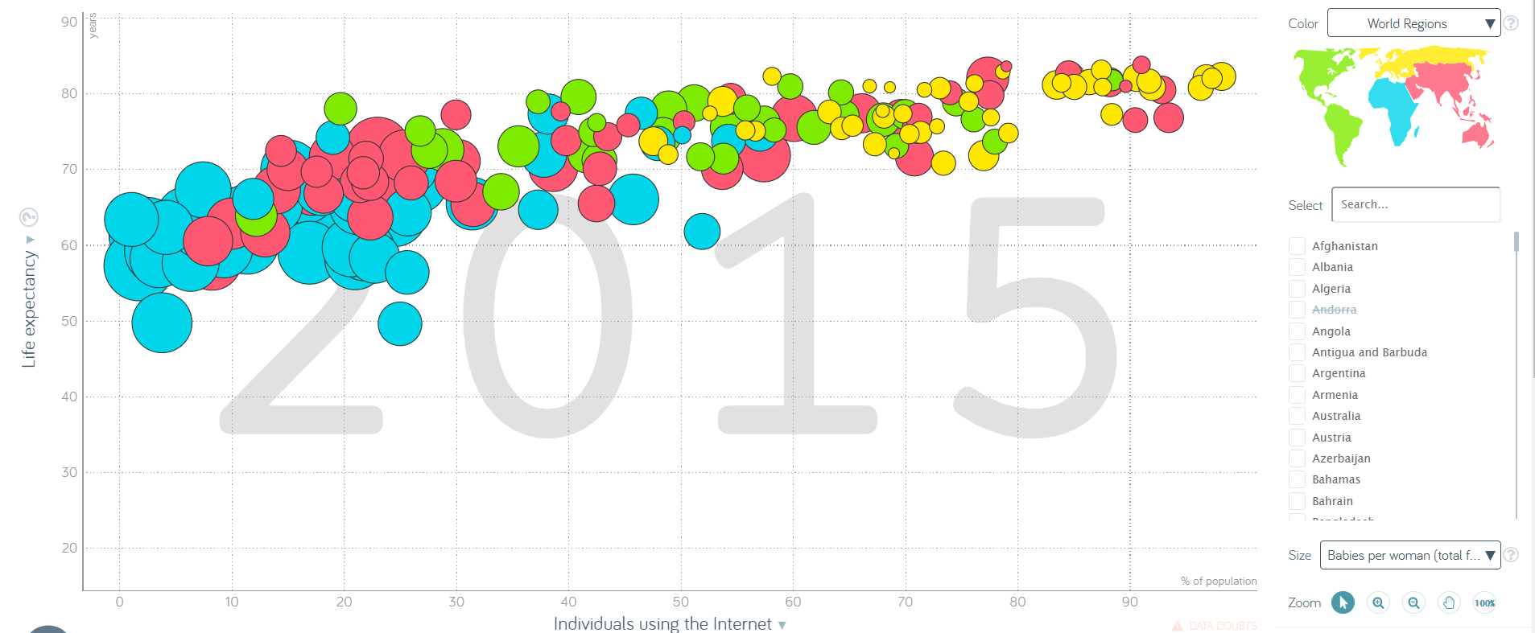
Gapminder visualization
https://www.gapminder.org/tools/#_state_marker_axis/_x_which=internet/_users&domainMin:null&domainMax:null&zoomedMin:null&zoomedMax:null&scaleType=linear;&size_which=children/_per/_woman/_total/_fertility&domainMin:null&domainMax:null;;;&chart-type=bubbles

Slide 6
Primary Sources
Wilkinson, L. The Grammar of Graphics (2nd ed). Springer Science. 2005
Cleveland, WS and McGill, R. Graphical perception: theory, experimentation, and application to the development of graphical methods. Journal of the American Statistical Association. 79(387): 531-554. 1984.

Slide 7
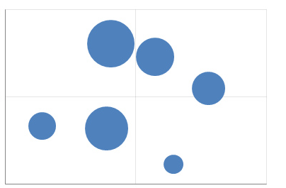
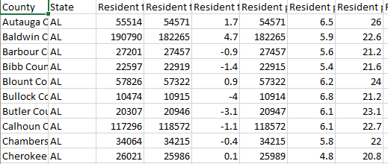
What is a data visualization?
A set of visual geometries whose aesthetics are mapped from data
Many major visualization software (Tableau, ggplot in R, python, graph builder in JMP) are based on this grammar
Aesthetics
Data
Geometries

Slide 8
Geometry
A geometry is a visual entity in space.
Some common geometries encountered in data visualizations:
Point
Line
Bar

Slide 9
Aesthetic
An aesthetic is a visual attribute of a geometry
Common aesthetics:
Position on horizontal (X)
Position on vertical (Y)
Shape
Size
Color
Hue
Saturation (“intensity”)
Value (“brightness”)
Text
Not all aesthetics are available for every geometry

Slide 10

HUE
SATURATION
https://color.adobe.com/build2.0.0-buildNo/resource/img/kuler/color_wheel_730.png

Slide 11
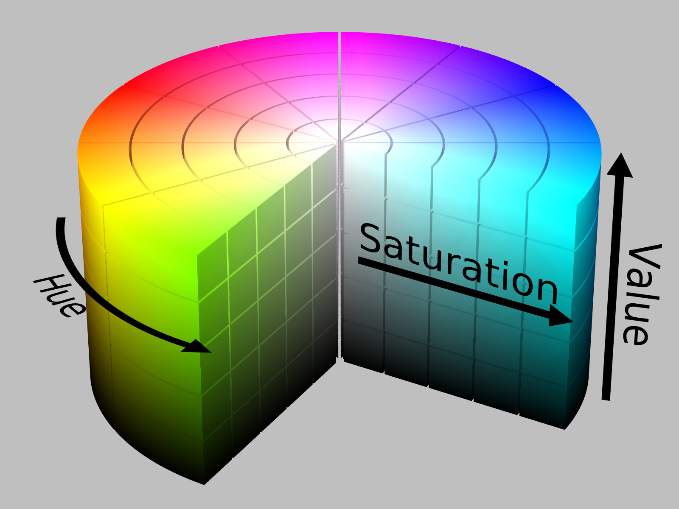
https://upload.wikimedia.org/wikipedia/commons/0/0d/HSV_color_solid_cylinder_alpha_lowgamma.png

Slide 12
Aesthetic attributes of a point geometry
What distinguishes one point from another point?
X, Y
Shape
Size
Hue
Saturation
Value
Text
Point B
Point A

Slide 13
Aesthetic attributes of a line geometry
What distinguishes one line from another line?
X, Y
Shape
Size
Hue
Saturation
Value

Slide 14
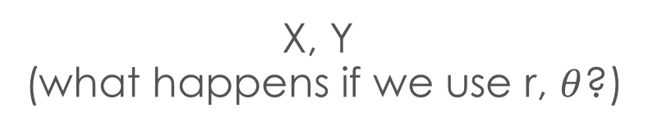
Aesthetic attributes of a Bar geometry
What distinguishes one bar from another bar?
X, Y
(what happens if we use r, $θ$?)
Shape
Size
NA
(a bar is a bar!)
Hue
Saturation
Value

Slide 15
data
To visualize, must have data in row-by-column format where:
Rows represent cases: at most one geometry per case (assuming no aggregation)
Columns represent variables: to be mapped to aesthetic attributes

Slide 16
Constructing a data visualization
Differences in geometry aesthetics map to differences in data variables
Available mappings depend on whether data variable is continuous (height) or discrete (race)

Slide 17


Constructing a data visualization
The following caveats apply:
An aesthetic attribute can be mapped back to at most one variable
A variable can be mapped to more than one aesthetic
Not all mappings make sense
Height
Size
Age
Size
Sex
Hue
Height
Shape

Slide 18
modifiers
Ties: when two cases yield overlapping geometries under a given mapping
Some common modifiers:
Jitter: Stack: Dodge:

Slide 19
Find the mappings!
Revisit the three visualizations we encountered earlier. Identify:
The data cases (assuming one geometry per case);
The geometries;
The aesthetic attributes that are varied;
The variables that control the differences in aesthetic attributes (bonus: are they continuous or discrete?)
Modifiers (if any)

Slide 20
Ihme gbd visualization
https://vizhub.healthdata.org/gbd-compare/

Slide 21
Ihme Health care spending visualization
(DAH = Development Assistance for Health)
http://ihmeuw.org/4iuu

Slide 22
Gapminder visualization
https://www.gapminder.org/tools/#_state_marker_axis/_x_which=internet/_users&domainMin:null&domainMax:null&zoomedMin:null&zoomedMax:null&scaleType=linear;&size_which=children/_per/_woman/_total/_fertility&domainMin:null&domainMax:null;;;&chart-type=bubbles

Slide 23
Ranking the aesthetic attributes
The work of William S. Cleveland

Slide 24
Recall the following aesthetic attributes:
Position on horizontal (X)
Position on vertical (Y)
Shape
Size
Color
Hue
Saturation (“intensity”)
Value (“brightness”)
Cleveland & McGill created a ranking of these when mapping a geometry to a quantitative variable

Slide 25
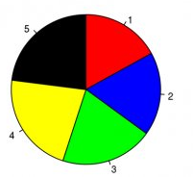
Hypothetical polling data on 5 candidates.
Geometry: “pie wedge” (a bar in polar coordinates)
Aesthetic mappings:
Candidate (discrete) → hue & text
share of vote (continuous) → size, specifically angle
Rank the candidates’ vote shares.
Walter Hickey at Business Insider

Slide 26
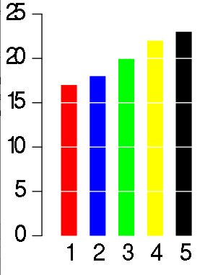
Same data, different visualization
Geometry: bar
Aesthetic mappings:
candidate → hue & X
share of vote → Y
Rank the candidates’ vote shares.
Walter Hickey at Business Insider

Slide 27
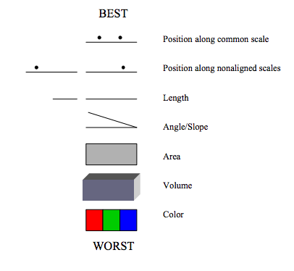
Cleveland’s hierarchy for mapping quantitative data:
Wilkinson, Presentation Graphics

Slide 28
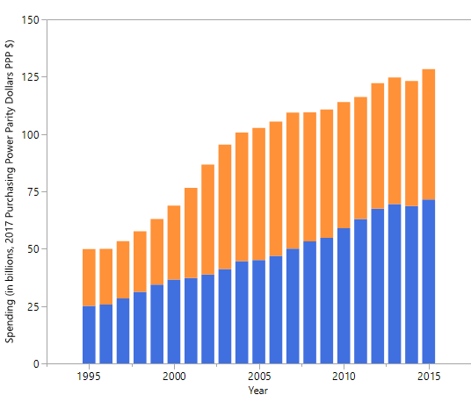
Mexico’s health spending (Government and Out-of-pocket only)
Geometry: Bar
Year → X
Spending → Y
Source → Hue
Modifier: Stack
Geometry: Bar
Year → X
Spending → Y
Source → Hue
Modifier: Dodge
Geometry: Point
Year → X
Spending → Y
Source → Hue, Shape
Modifier: None

