Slide 1
Technology Agnostic
Teach concepts before specific technology

Slide 2
Technology Agnostic Data Verbs
Data Management
Summaries
&
Visualization
Statistical Learning
D | G
5 | a
3 | a
4 | b
2 | b
3 | c
5 | c
4 | c
D
5
3
4
2
3
5
4
D | G
5 | a
3 | a
4 | b
2 | b
3 | c
5 | c
4 | c
Filter (G is not a)
Select (D)
D | G
4 | b
2 | b
3 | c
5 | c
4 | c
D | G
5 | a
3 | a
4 | b
2 | b
3 | c
5 | c
4 | c
D | G | N
5 | a | 10
3 | a | 6
4 | b | 8
2 | b | 4
3 | c | 6
5 | c | 10
4 | c | 8
D | G
5 | a
3 | a
4 | b
2 | b
3 | c
5 | c
4 | c
D | G
2 | b
3 | a
3 | c
4 | b
4 | c
5 | a
5 | c
Mutate (N = 2*D)
Sort (D, G)

Slide 3
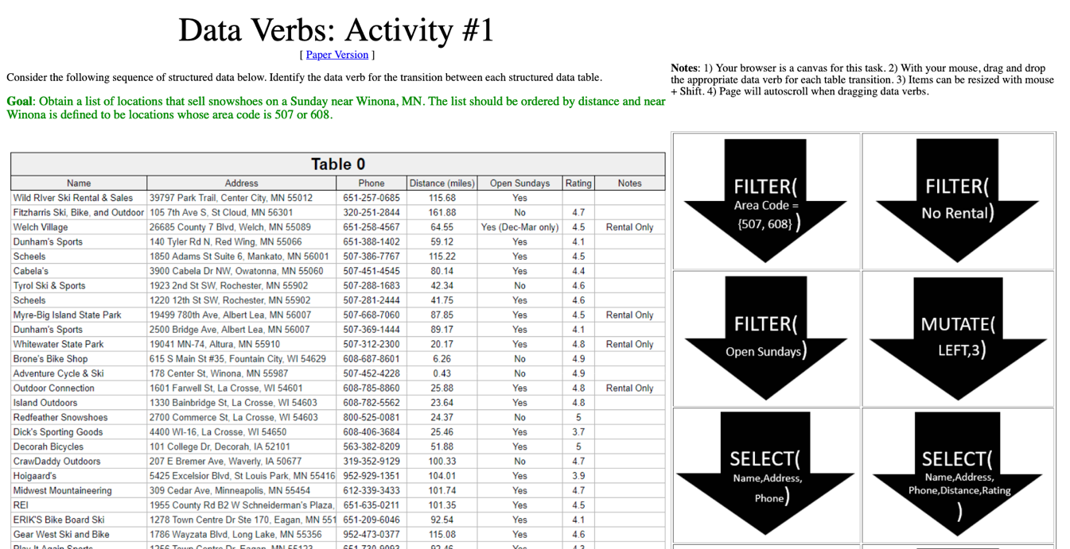
Exercise 1 Purchasing Snowshoes
http://statsclass.org/dsci210/Dataverbs/

Slide 4
Low Code
Start with technology that minimizes the need for code

Slide 5
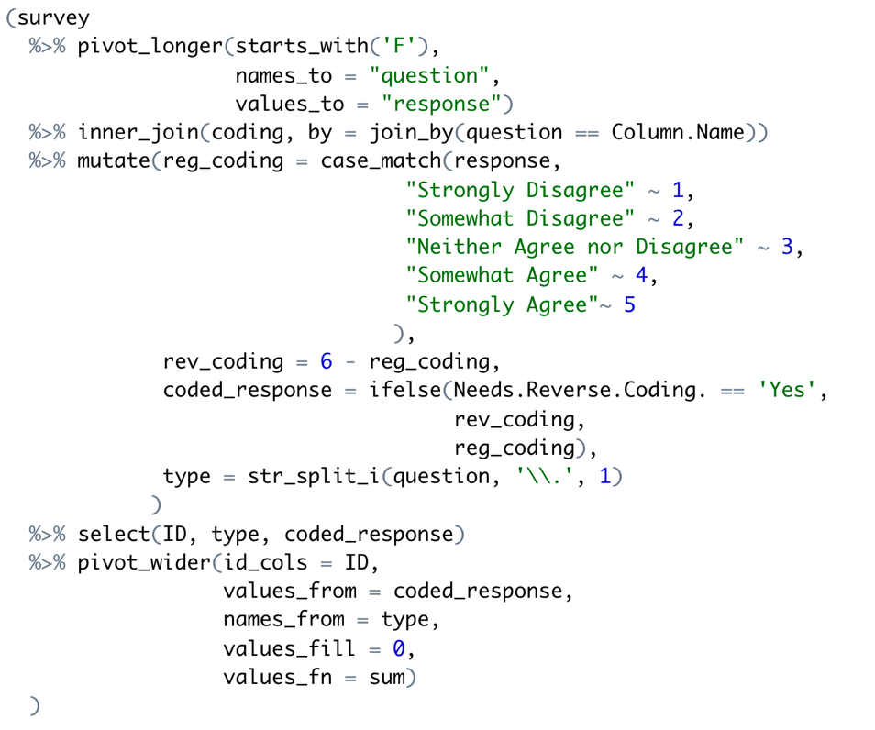
Learning to program is hard!
What should I do first? Second?
What functions should I use?
How do I make my code run/correct?

Slide 6
Doug is struggling!
Algorithm
Step-by-step process
What should I do first? Second?
What functions should I use?
How do I make my code run/correct?

Slide 7
Doug is struggling!
Algorithm
Step-by-step process
What should I do first? Second?
Implementation
Which libraries/functions
What functions should I use?
How do I make my code run/correct?

Slide 8
Doug is struggling!
Algorithm
Step-by-step process
What should I do first? Second?
Implementation
Which libraries/functions
What functions should I use?
Correct Code
Avoid bugs and verify correct results
How do I make my code run/correct?

Slide 9
We decouple the algorithm and the code!
Notes:
Then just in the nick of time …

Slide 10
The algorithm is most important Let’s make sure Doug is proficient here first!
Algorithm
Step-by-step process
Start here!
What should I do first? Second?
Implementation
Which libraries/functions
What functions should I use?
Correct Code
Avoid bugs and verify correct results
How do I make my code run/correct?

Slide 11
Coding should come later in the first course
Outline for DSCI 210
Low Code
Scripting + Low Code
Intro to Tidy Data
Aggregation
Data Verbs
Intro to Visualization
Classification and CART
String Verbs and Window Functions
Managing data with R/tidyverse
Reshaping tables
Table joins
Intro to Arules

Slide 12
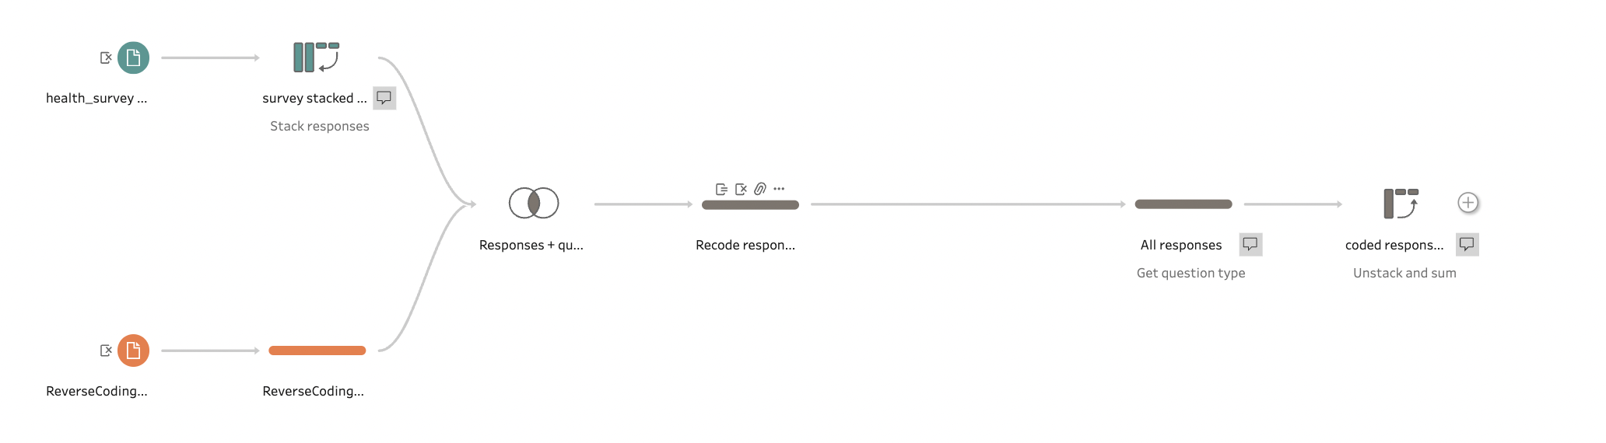
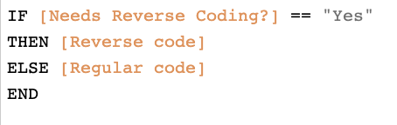
Low Code Data management with Tableau Prep
Data Management
Summaries
&
Visualization
Statistical Learning
Only Code

Slide 13
Translate to Code
Implementing code from low code solutions

Slide 14
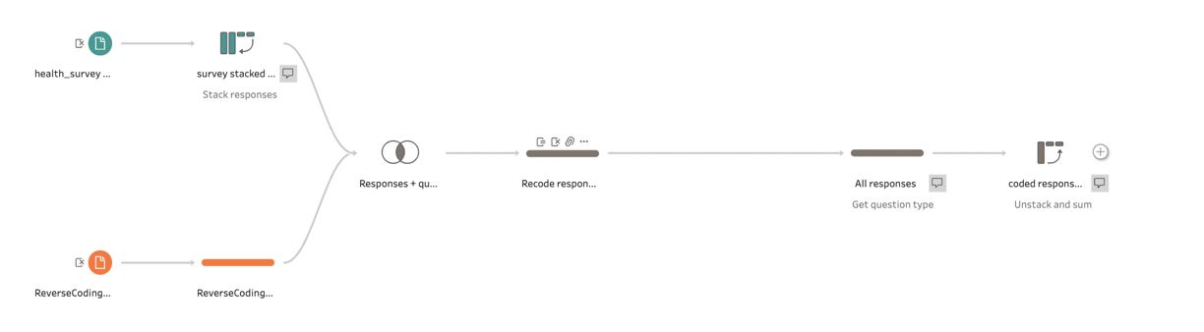

Translate to Code From Tableau Prep to dplyr
Data Management
Summaries
&
Visualization
Statistical Learning

