Slide 1




ICOTS Workshop #8 – July 2026
From Design to Code – A Gentle Introduction to Data Science Programming
Todd Iverson
tiverson@winona.edu
Chris Malone
cmalone@winona.edu
April Kerby-Helm
akerby@winona.edu
GitHub repo
Department of Mathematics & Statistics
Winona State University
Winona, MN. USA
GitHub repo: https://shorturl.at/FrjId

Slide 2
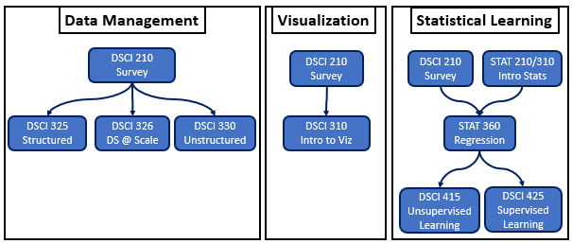
Winona State Data Science
Core Components

Slide 3
Winona State Data Science
Core Components
Strong emphasis management of data

Slide 4
Workshop Goals
Introduce Tableau Prep
A low code software package used to introduce programming to data science majors
Introduce / practice the Code Design concept
Code design precludes the writing of code, used to develops a plan for your code
Emphasize the importance of developing high-quality data

Slide 5
Workshop Timeline
9:00-10:30 – Session #1
10:30-11:00 Morning tea
11:00-12:30 – Session #2
12:30-1:15 Lunch
1:15 – 3:00 – Session #3

Slide 6
ICOTS Workshop #8 – July 2026
From Design to Code – A Gentle Introduction to Data Science Programming
Todd Iverson
tiverson@winona.edu
Chris Malone
cmalone@winona.edu
April Kerby-Helm
akerby@winona.edu
GitHub repo
Department of Mathematics & Statistics
Winona State University
Winona, MN. USA
GitHub repo: https://shorturl.at/FrjId

Slide 7
ICOTS Workshop #8 – July 2026
From Design to Code – A Gentle Introduction to Data Science Programming
Todd Iverson
tiverson@winona.edu
Chris Malone
cmalone@winona.edu
April Kerby-Helm
akerby@winona.edu
Thank you for attending our workshop

