Slide 1
Session 3
Putting it all together

Slide 2
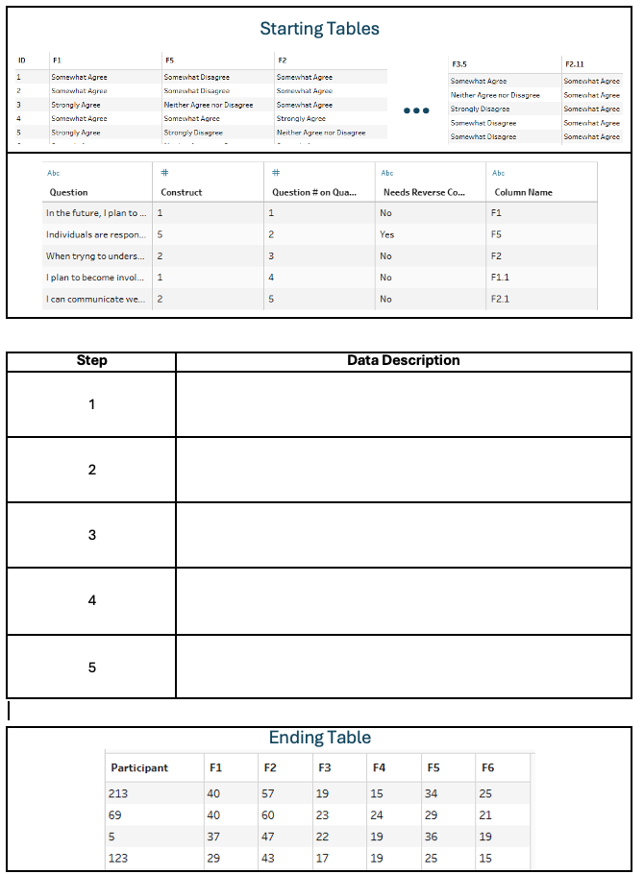
Exercise 1 Write out the steps (handout 1)
Instructions
Identify a sequence of data verbs to transform the Starting Table into the Ending Table
Use data verbs + some pseudo code
Example: MUTATE(ROUND(Distance))
Data Verbs
JOIN
UNSTACK/PIVOT
STACK/UNPIVOT
MUTATE
RECODE
SPLIT STRING
IF/THEN
GROUPBY + AGGREGATE

Slide 3
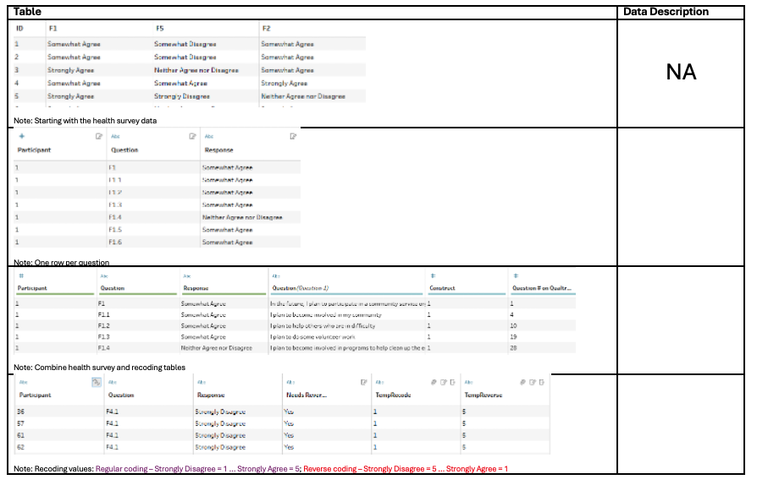
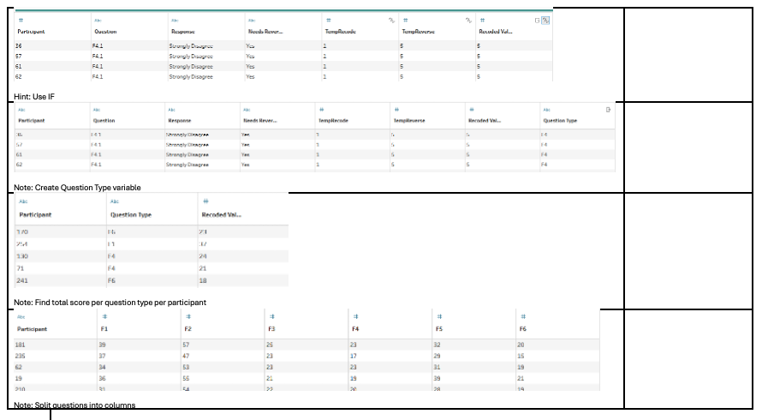
Exercise 2 Write out the steps (handout 2)
Instructions
Identify a sequence of data verbs to transform the Starting Table into the Ending Table
Use data verbs + some pseudo code
Example: MUTATE(ROUND(Distance))
Data Verbs
SELECT
FILTER
MUTATE
GROUPBY + AGGREGATE
PARTITIONBY + ORDERBY

Slide 4
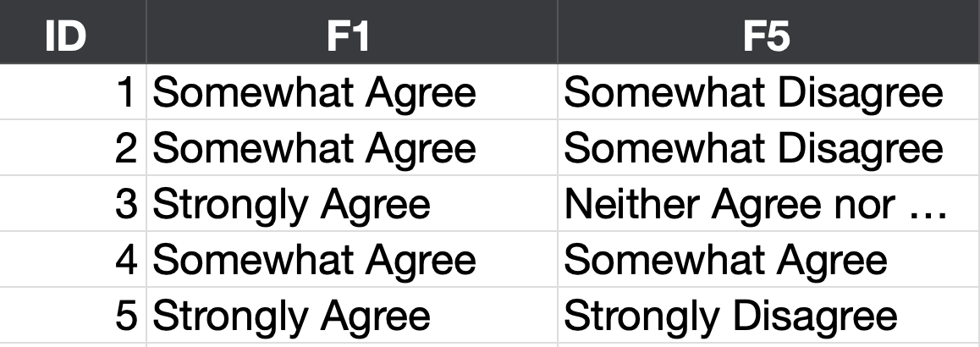
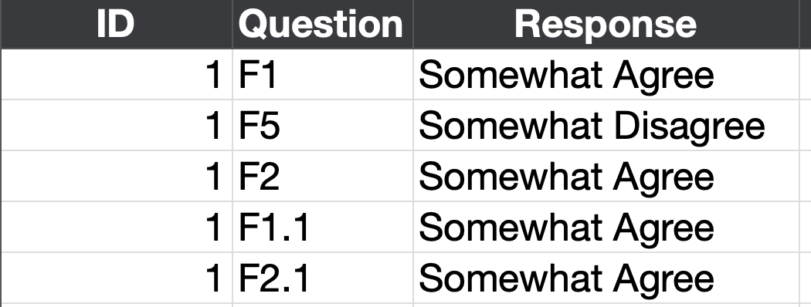
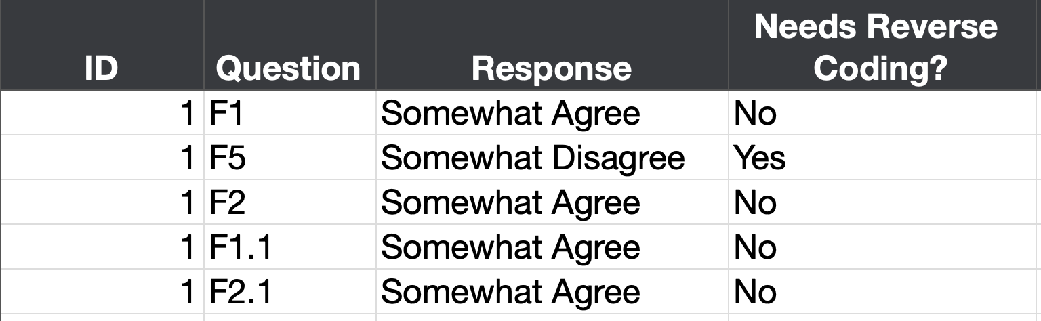
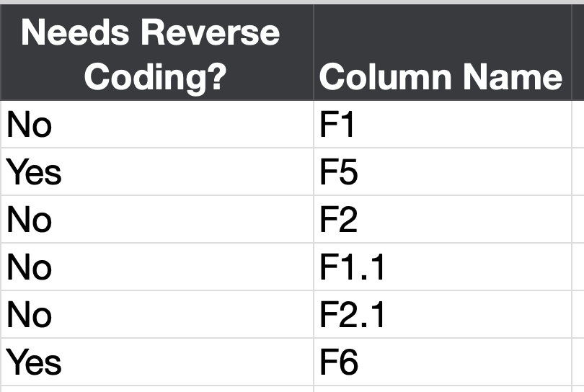
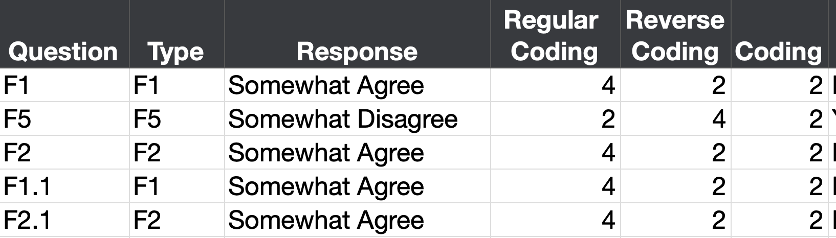
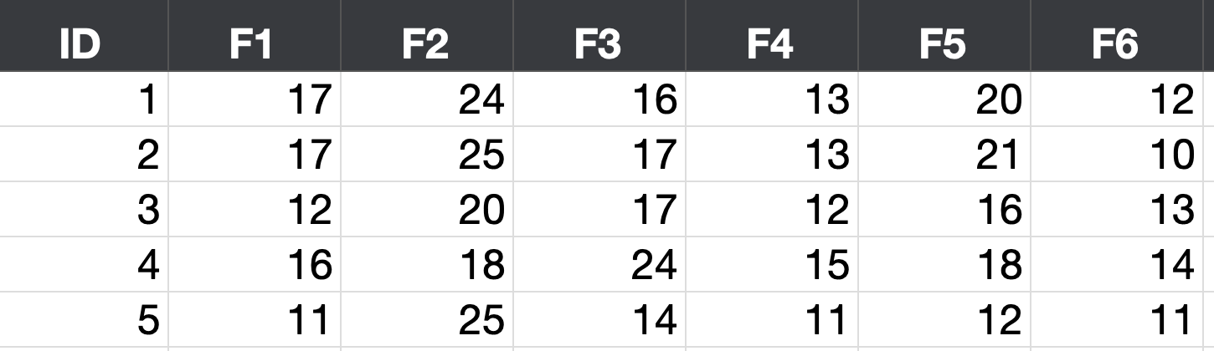
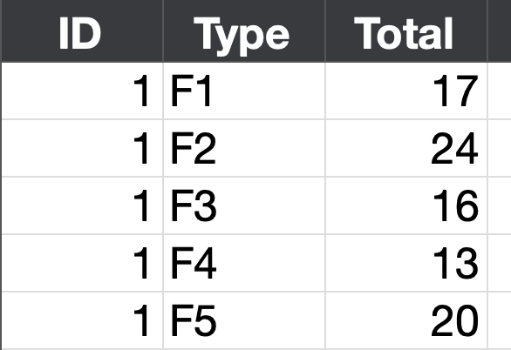
Response Table
Stacked Response Table
Joined Table
Reshape
Join
Agree?
Disagree?
Transform
Question Table
Unstack
Aggregate

