Slide 1
All About Aggregation
Grouping, summarizing, pivoting, and windowing

Slide 2
What is aggregation?
Latin aggregare – “to flock together”
In data terms, to aggregate is to create one number from many numbers
The one number is a summary
Count
Mean
Median
Min
Max
Standard deviation

Slide 3
Simple aggregation
Simple aggregation requires at a minimum 2 ingredients:
A data column
A summary method

Slide 4
Simple aggregation
Data column
Summary method
Aggregation
Outcome
A number

Slide 5
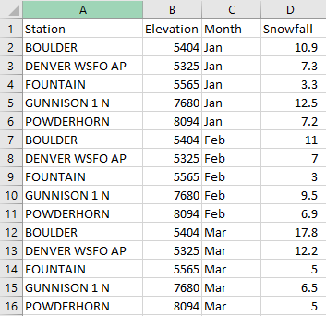
Counting is simple aggregation!
NUMBER OF OBS
15

Slide 6
Averaging is simple aggregation!
AVG
8.34

Slide 7
Maximum as a simple aggregation!
MAX
8094

Slide 8
Simple Window Function
Data column
Window Outcome
Number 1
Number 1
Number 1
.
.
.
.
.
.
.
Number 1
Number 1
Summary method

Slide 9
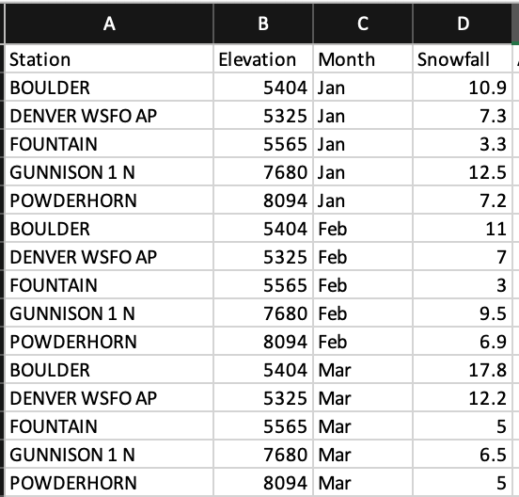
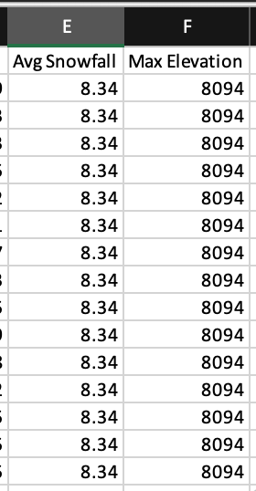
Averaging with a window function!
AVG

Slide 10
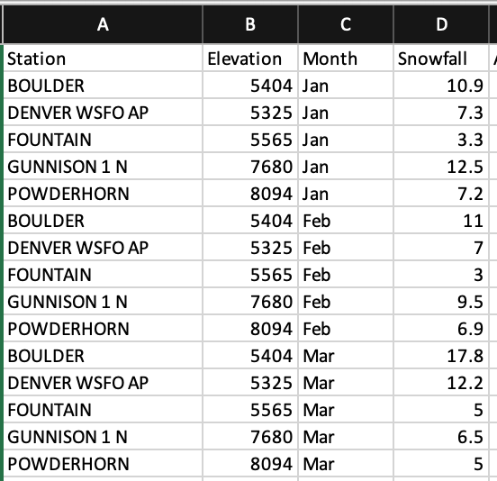
Maximum with a window function!
MAX

Slide 11
Grouped aggregation

Slide 12
Grouped aggregation
Often, we want to aggregate one column according to groupings defined by a second column
Requires min of 3 ingredients
A grouping column
A data column
A summary method

Slide 13
Grouped aggregation One grouping columns
Grouping column
Data column
A
A
A
A
B
B
B
B
C
C
C
C
Summary method
Group ID
Aggregation
Outcome
A
B
C
Number 1
Number 2
Number 3

Slide 14
Grouped aggregation Two grouping columns
Grouping column 1
Grouping column 2
Data column
A
A
A
A
B
B
B
B
C
C
C
C
Fast
Fast
Slow
Slow
Fast
Fast
Slow
Slow
Fast
Fast
Slow
Slow
Group 1 ID
Group 2 ID
Aggregation
Outcome
A
A
B
B
C
C
Fast
Slow
Fast
Slow
Fast
Slow
Number 1
Number 2
Number 3
Number 4
Number 5
Number 6
Summary method

Slide 15
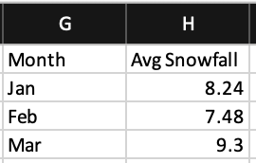
Grouped Aggregation Avg Snowfall by Month
AVG

Slide 16
Partitioned window functions

Slide 17
Partitioned window functions
Partitioned window function ←→ Grouped Aggregation. Again, we want to aggregate one column according to groupings (partitions) defined by a second column
Requires min of 3 ingredients
A partition column
A data column
A summary method

Slide 18
Partitioned window function One partition column
Grouping column
Data column
Grouping column
Window outcome
A
A
A
A
B
B
B
B
C
C
C
C
A
A
A
A
B
B
B
B
C
C
C
C
Number 1
Number 1
Number 1
Number 1
Number 2
Number 2
Number 2
Number 2
Number 3
Number 3
Number 3 Number 3
Summary method

Slide 19
Partitioned window function Two partition column
Grouping column 1
Grouping column 2
Data column
Grouping column 1
Grouping column 2
Data column
A
A
A
A
B
B
B
B
C
C
C
C
Fast
Fast
Slow
Slow
Fast
Fast
Slow
Slow
Fast
Fast
Slow
Slow
A
A
A
A
B
B
B
B
C
C
C
C
Fast
Fast
Slow
Slow
Fast
Fast
Slow
Slow
Fast
Fast
Slow
Slow
Number 1
Number 1
Number 2
Number 2
Number 3
Number 3
Number 4
Number 4
Number 5
Number 5
Number 6
Number 6
Summary method

Slide 20
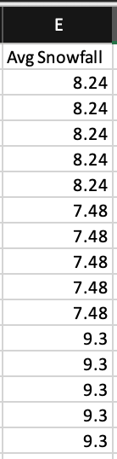
Averaging with a window function! Partition by Month
AVG

Slide 21
Pivot table
Pivot table ←→ Grouped Aggregation. Again, we want to
aggregate one column
according to groupings defined by a second pivot column
And optionally additional grouping columns
Requires min of 3-4 ingredients
A pivot column
A data column
A summary method
1 or more additional grouping columns

Slide 22
Pivot table No grouping columns
Pivot column
Data column
Fast
Fast
Slow
Slow
Fast
Fast
Slow
Slow
Fast
Fast
Slow
Slow
Pivot ID
Summary method
Fast Slow
Number 1 Number 2

Slide 23
Pivot table One grouping columns
Grouping column 1
Pivot column
Data column
A
A
A
A
B
B
B
B
C
C
C
C
Fast
Fast
Slow
Slow
Fast
Fast
Slow
Slow
Fast
Fast
Slow
Slow
Pivot ID
Group 1 ID
Fast Slow
Summary method
A
B
C
Number 1 Number 2
Number 3 Number 4
Number 5 Number 6

Slide 24
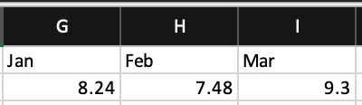
Averaging with a pivot table! Pivot on Month
AVG

