Slide 1

Using Data Verbs to Teach the Management of Tabular Data
https://bit.ly/2HHLry1
Motivation
No Code vs
Code
In the beginning -- No Code
Transitioning To Code
Data Verbs
Across the
Curriculum
Data Verbs
v2.0
Todd Iverson tiverson@winona.edu
Chris Malone cmalone@winona.edu

Slide 2
Motivation
“In my experience, there are four fundamental verbs of data manipulation” (Wickham, 2014)
Filter: subsetting observations
Transform: adding or modifying variables
Aggregate: collapsing multiple values into a single value
Sort: changing the order of observations
R: dplyr
(2019)
filter()
mutate()
summarise()
arrange()
select()
:
Data Verbs are Intrinsic

Slide 3
No Code
vs
Code
Is Accessible
Is Reproducible
Reduces Cognitive Load
Automates Complex Tasks
Emphasizes Process
Is Open Source / Extensible
Separate Process from Code

Slide 4
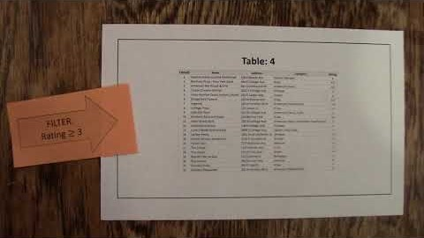

In the beginning … No Code
https://youtu.be/i2JmOiAF31U

Slide 5
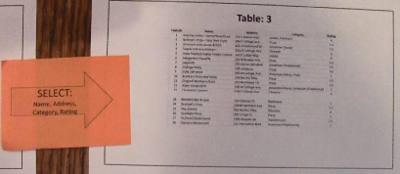
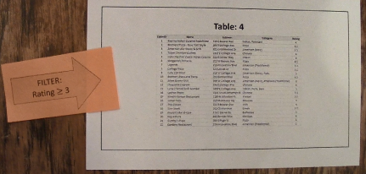
…Transition … to Code
Paper
Restaurants
%>% SELECT( Name, Address, Category, Rating ) %>% FILTER( Rating >= 3 )
R: dplyr
SQL
SELECT Name, Address, Category, Rating
FROM Restaurants
WHERE Rating >= 3

Slide 6
Data Verbs Across the Curriculum
Intro Course
DSCI 210
Core Course DSCI 325
Elective
DSCI 430
SELECT
FILTER
SORT MUTATE
GROUP BY
AGGREGATE
UNION
INNER JOIN
SELECT
FILTER
SORT
MUTATE
GROUP BY
AGGREGATE
PIVOT
SET OPERATIONS JOINS
SELECT
FILTER
SORT
MUTATE
GROUP BY
AGGREGATE
PIVOT
SET OPERATIONS JOINS
STACK / UNSTACK

Slide 7
Data Verbs - v2.0
Simple
Select/Drop
Filter
Mutate
Sort
Summaries
Aggregate
Group By
Pivot
Reshape
Stack
Unstack
Single
Table
Set Operations on Rows
Union (All)
Intersect (All)
Difference (All)
Joins
Inner Join
Outer Join
Left Join
Right Join
Combining
Tables
Low
Cognitive Burden
High

Slide 8


References
https://github.com/WSU-DataScience/SDSS19_data_verb_poster
Wickham, Hadley. (2014). Tidy Data. Journal of Statistical Software. Vol 59, Issue 10.

