Slide 1


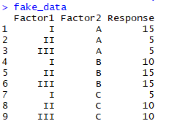
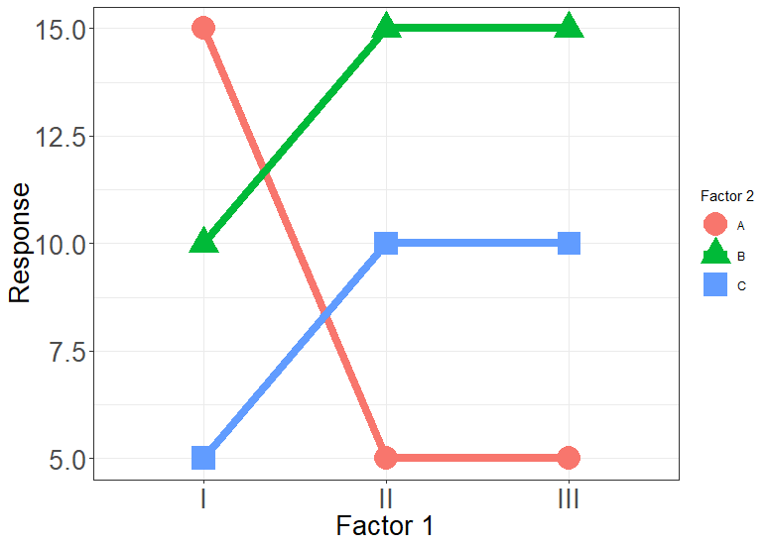
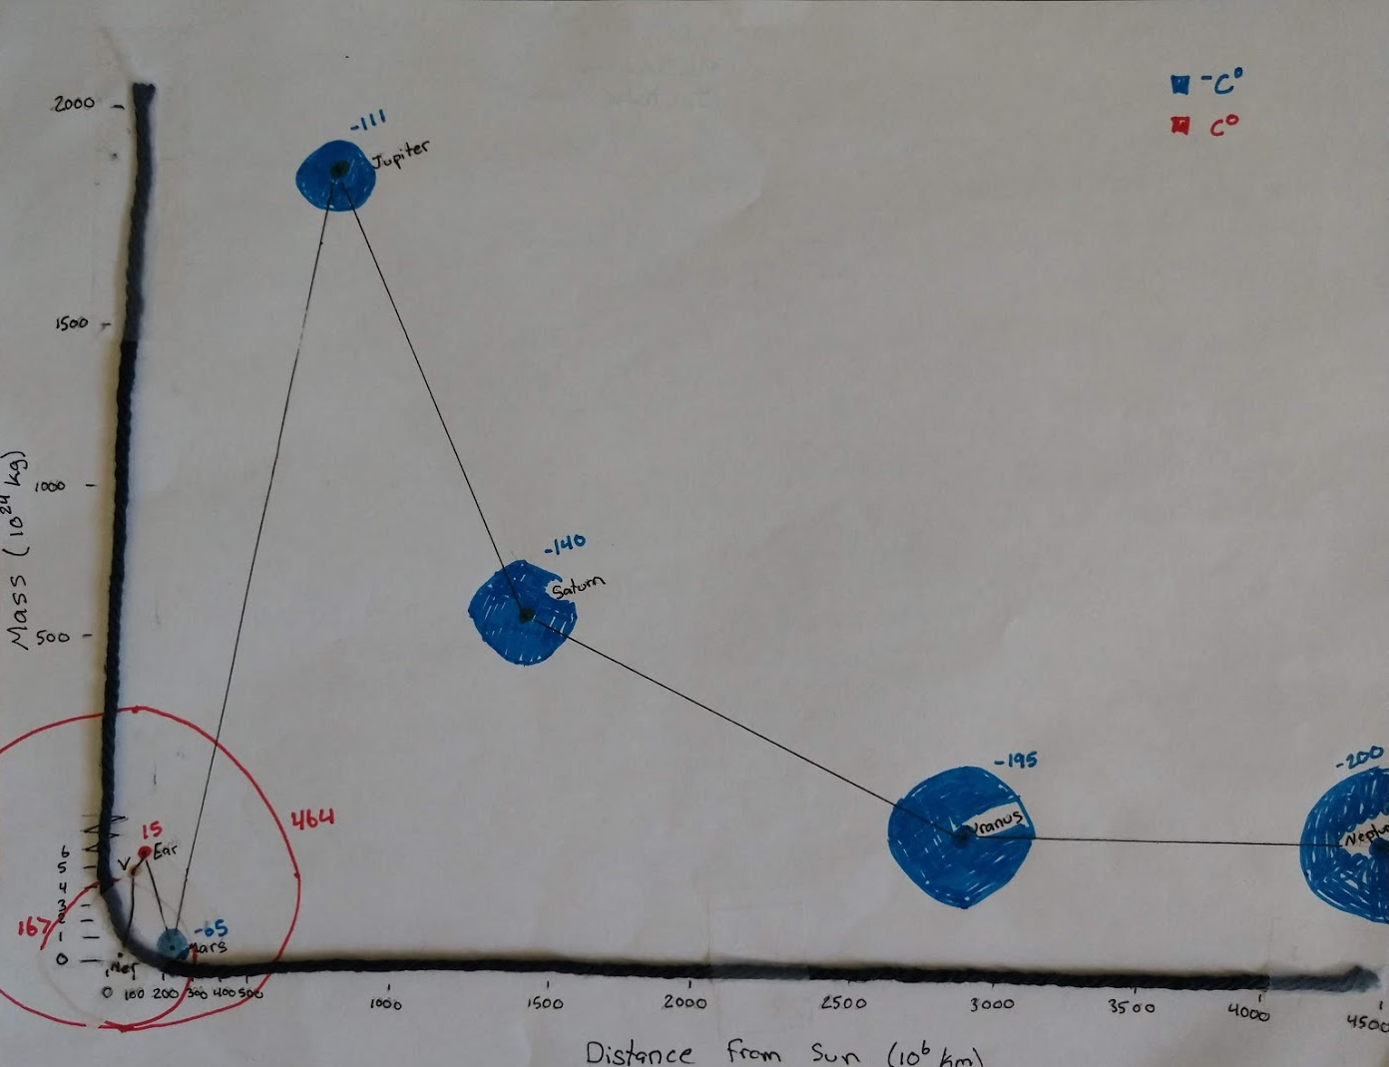
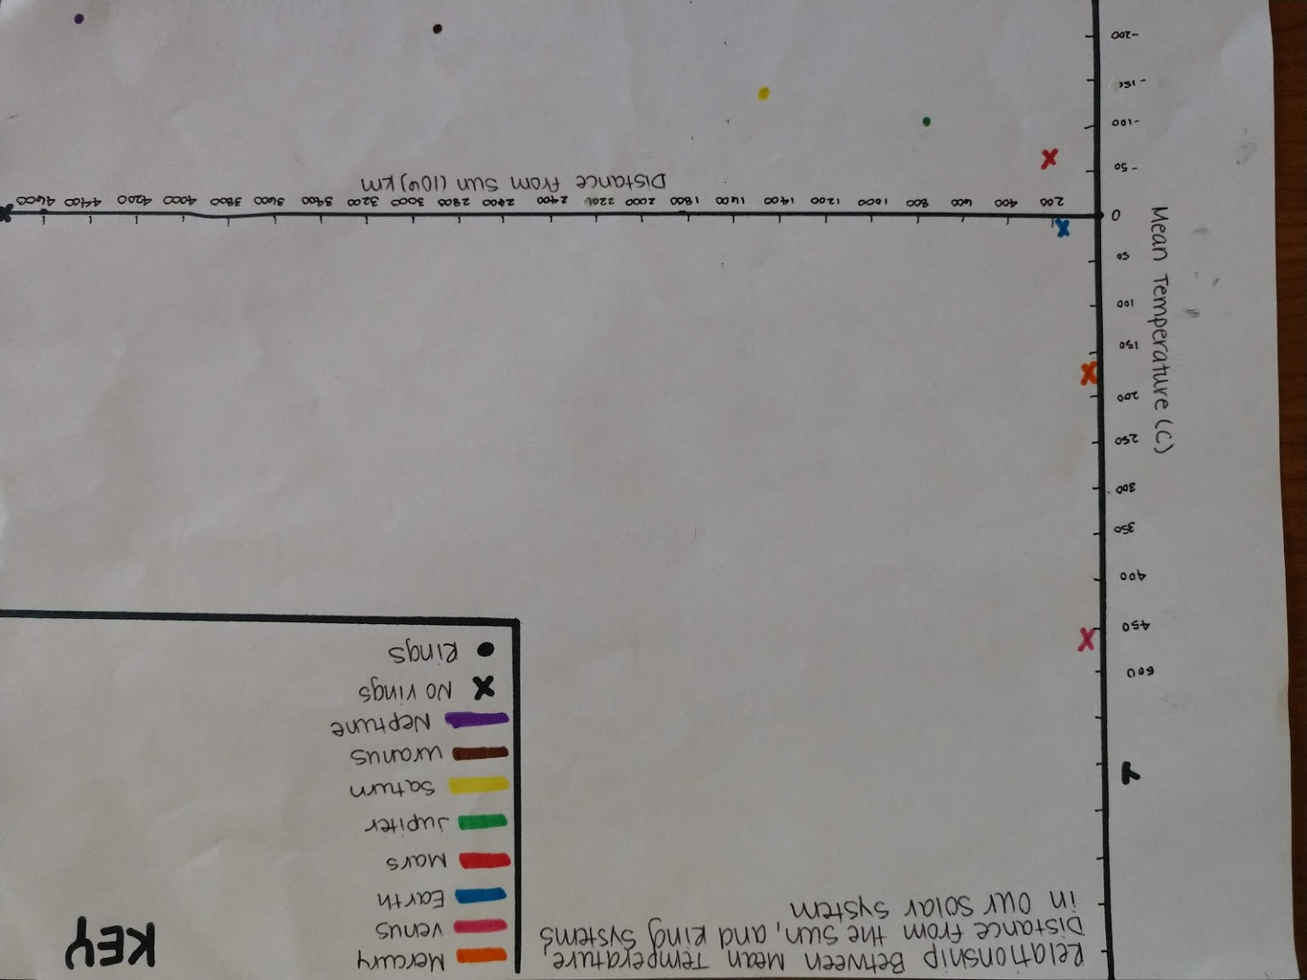
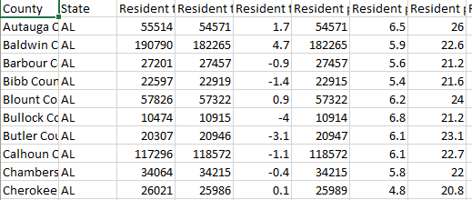
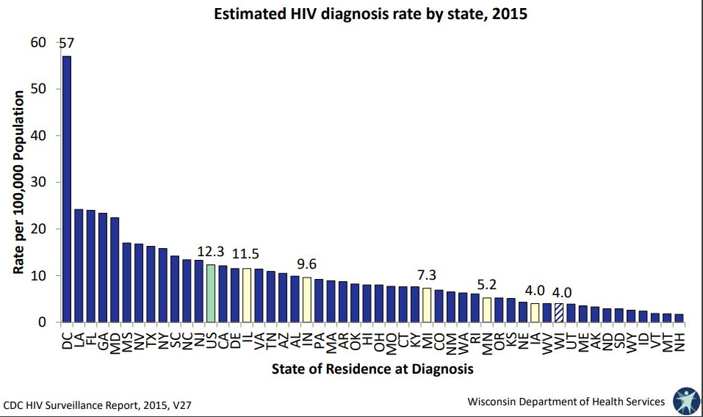
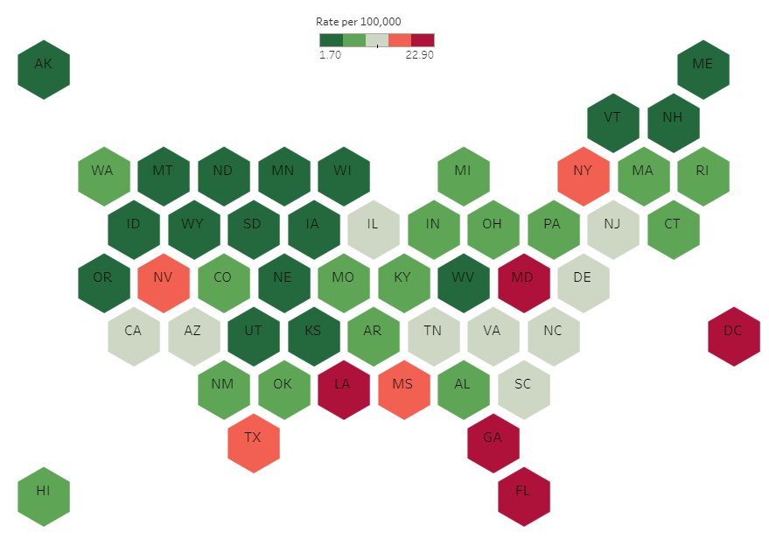
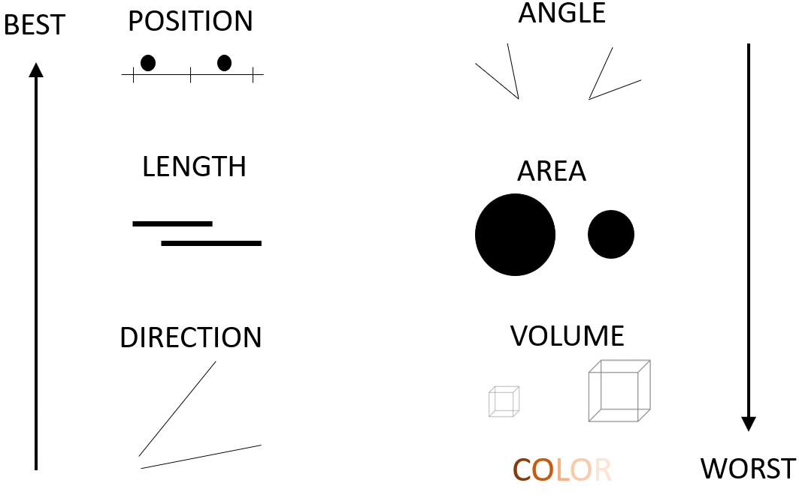
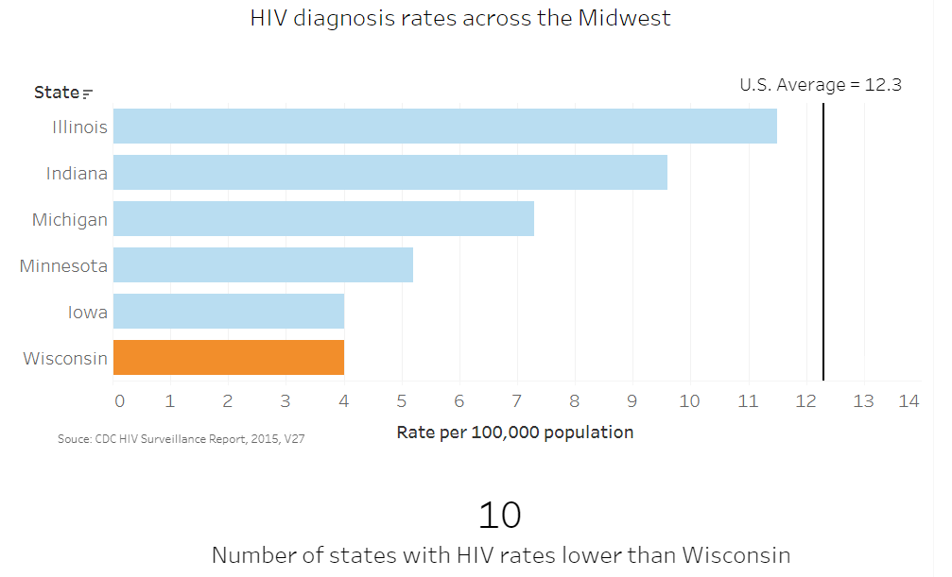

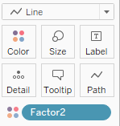
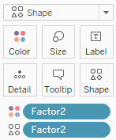
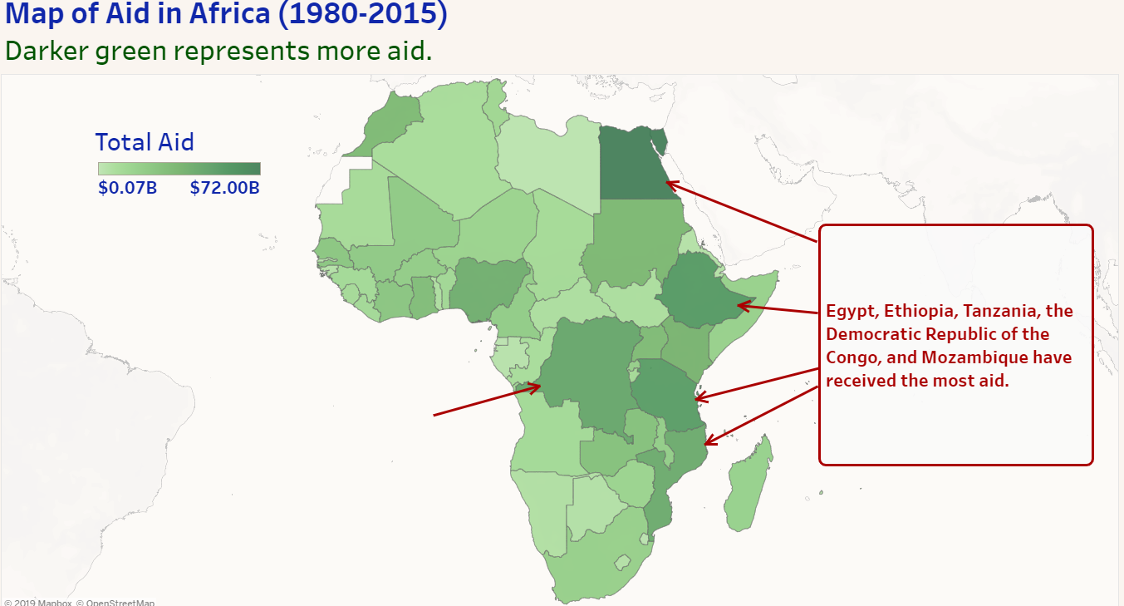
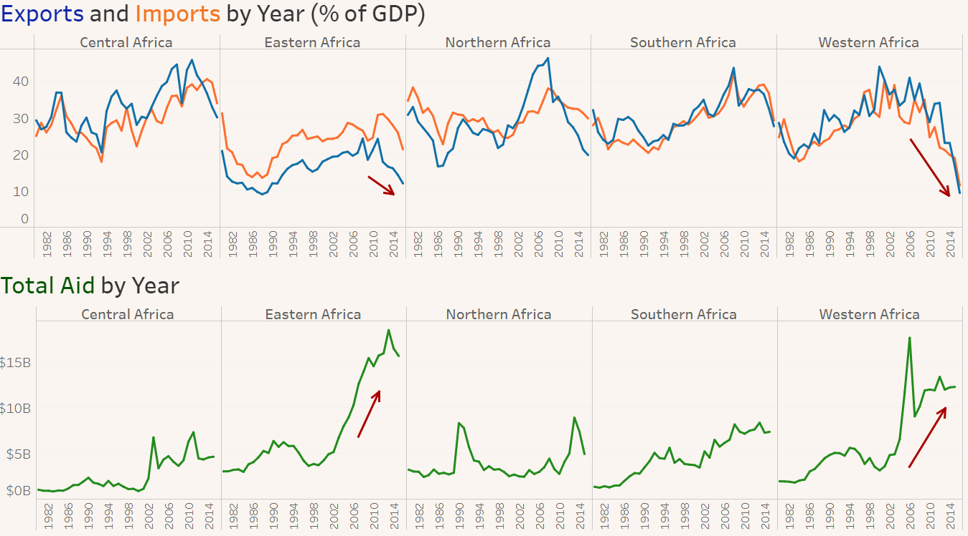
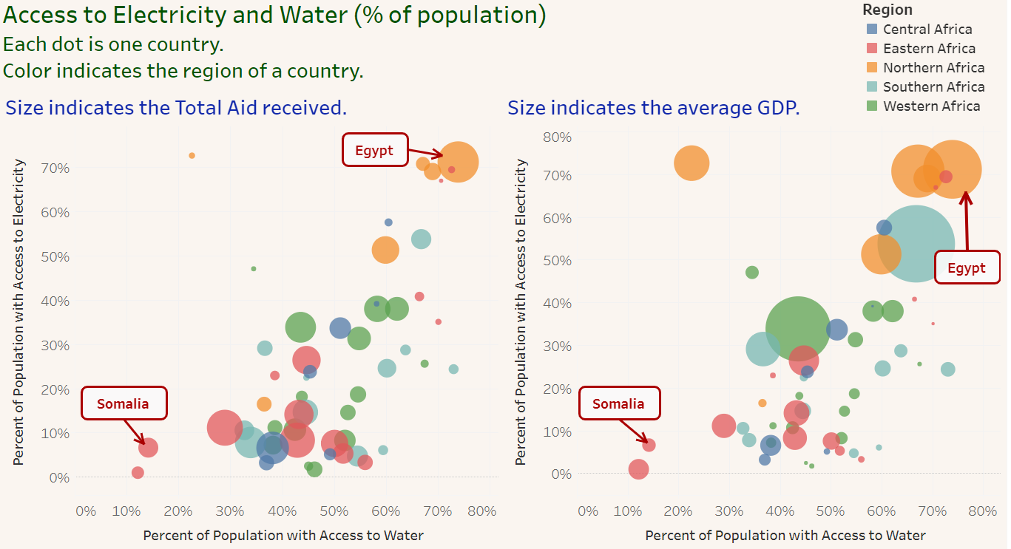
Extending the Grammar of Graphics beyond ggplot2
Silas Bergen Todd Iverson Chris Malone
sbergen@winona.edu tiverson@winona.edu cmalone@winona.edu
THEORY
APPLICATION
STUDENT WORK
Grammar of Graphics set of rules for creating perceivable graphs (Wilkinson, 2005)
Software
Data
Aesthetics
X, Y
Shape
Color
Size
Geometries
Python: Altair
base = alt.Chart(fake_data).encode(x = 'Factor1',
y = 'Response',
color = 'Factor2')
lines = base.mark_line()
points = base.mark_point().encode(shape = 'Factor2')
lines + points
Critiques + Makeovers
Elementary Perceptual Tasks a set of tasks that are carried out when extracting quantitative information from graphs (Cleveland & McGill, 1984)
R: ggplot2
ggplot(data = fake_data, aes(x = Factor1,
y = Response,
color = Factor2)) +
geom_line(aes(group = Factor2)) +
geom_point(aes(shape = Factor2))
Tableau
Projects
Work by Stacey Miertschin | https://public.tableau.com/profile/stacey.miertschin
Gestalt Principles of Grouping the whole is greater than the sum of the parts
ASSESSMENT
REFERENCES
GoG Specification
Geometry ___
X ___
Y ___
Color ___
Shape ___
Size ___
EPTs
Position
Length
Direction
Angle
Area
Color
Gestalt Grouping
Similarity
Proximity
Connection
Enclosure
- Cairo, Alberto. (2016). The Truthful Art: Data, Charts, and Maps for Communication.
- Cleveland, William. (1994). The Elements of Graphing Data.
- Cleveland, W & McGill, R. (1984). Graphic Perception: Theory, Experimentation, and Application to the Development of Graphical Methods. Journal of the American Statistical Association. Vol. 79, No. 387. pp. 531-554.
- Few, Stephen (2012). Show Me the Numbers: Designing Tables and Graphs to Enlighten.
- Robbins, Naomi (2013). Creating More Effective Graphs.
- Wilkinson, Leland. (2005). The Grammar of Graphics, 2nd Edition. - Yau, Nathan. (2011). Visualize This: The FlowingData Guide to Design, Visualization, and Statistics. Electronic Copy of Poster: https://github.com/WSU-DataScience/SDSS19_data_viz_poster
SIMILARITY
PROXIMITY
CONNECTION
ENCLOSURE

