Slide 1
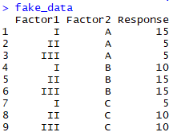
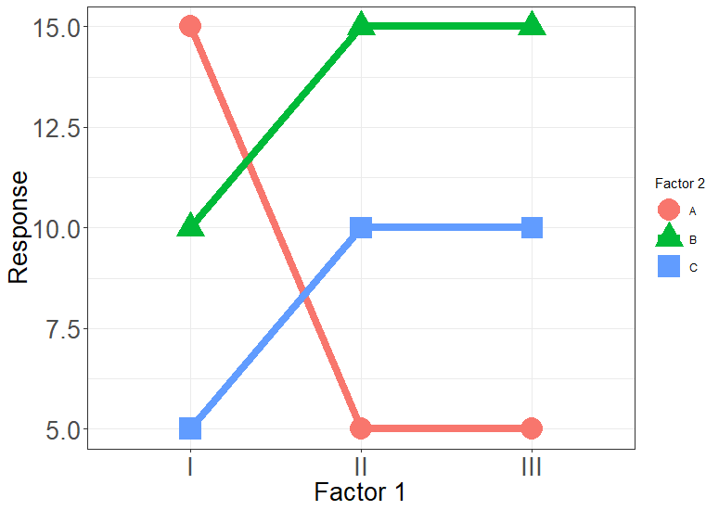
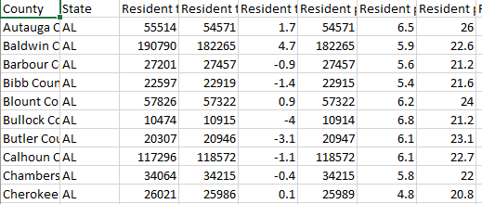
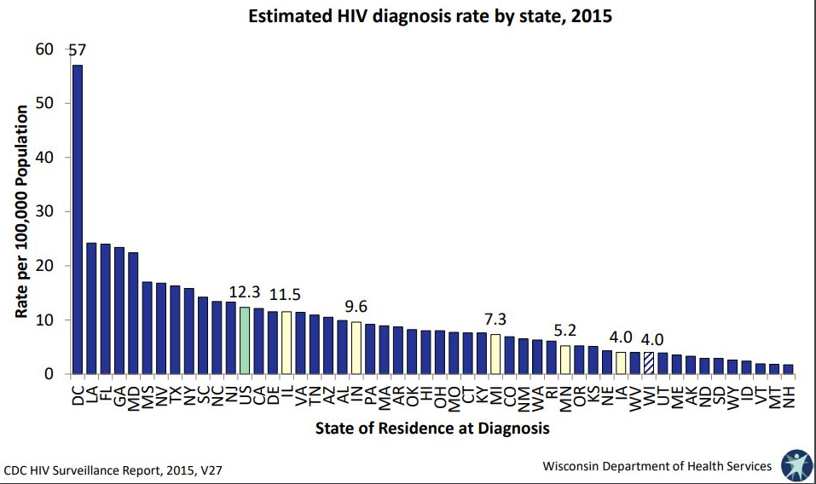
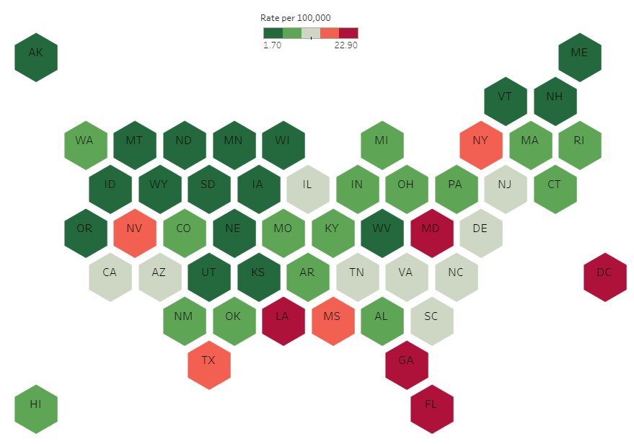
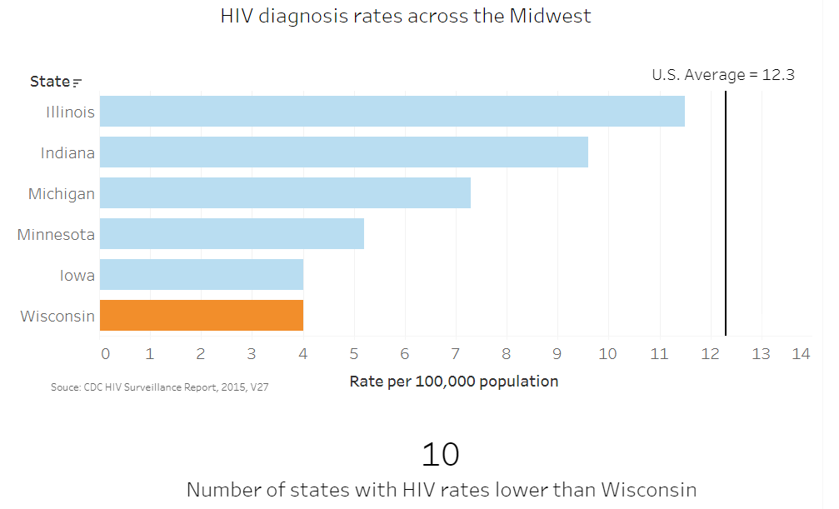
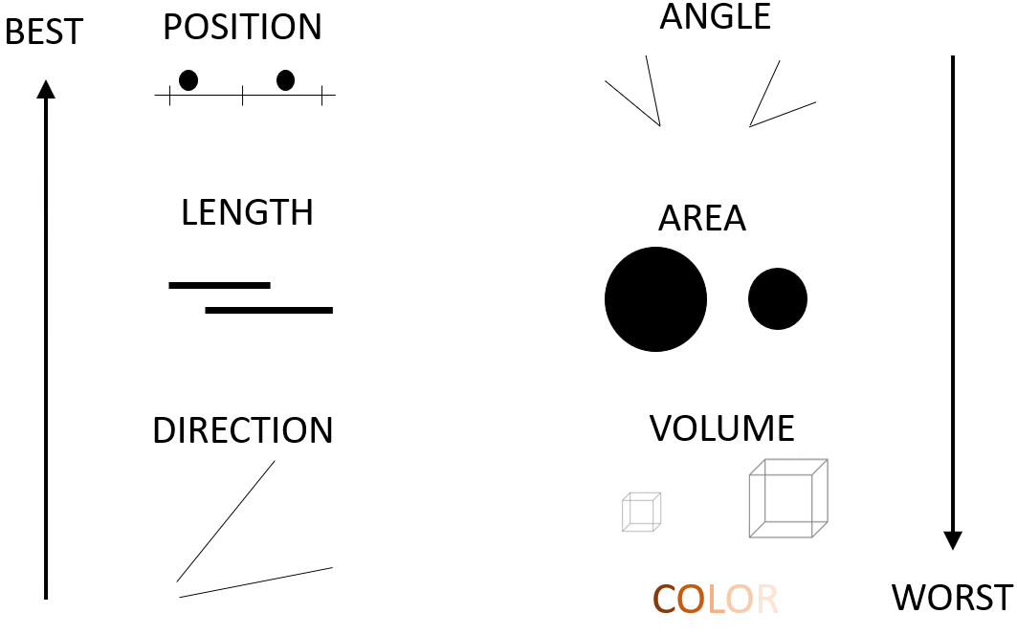

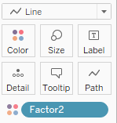
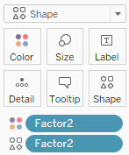
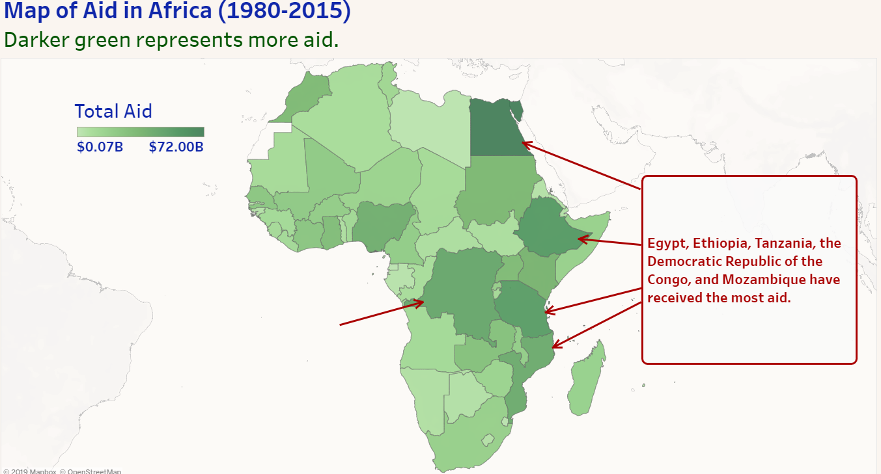
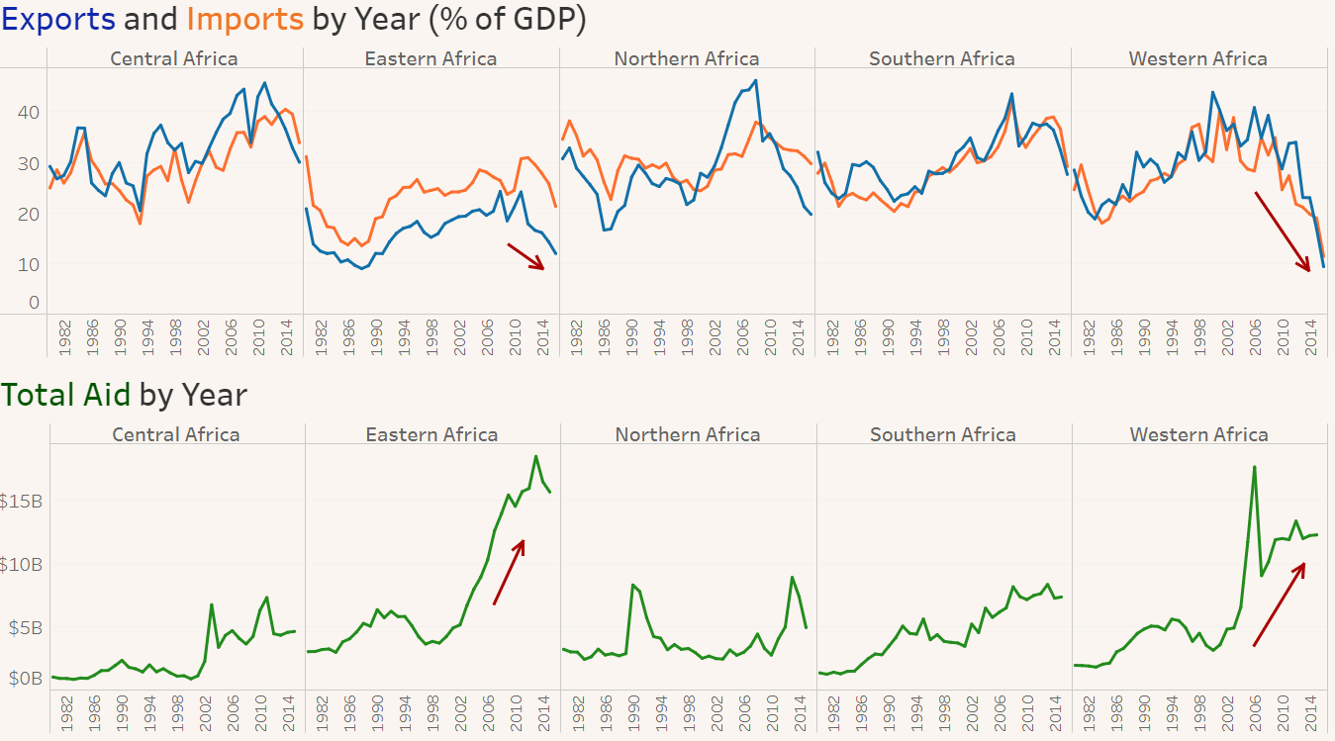
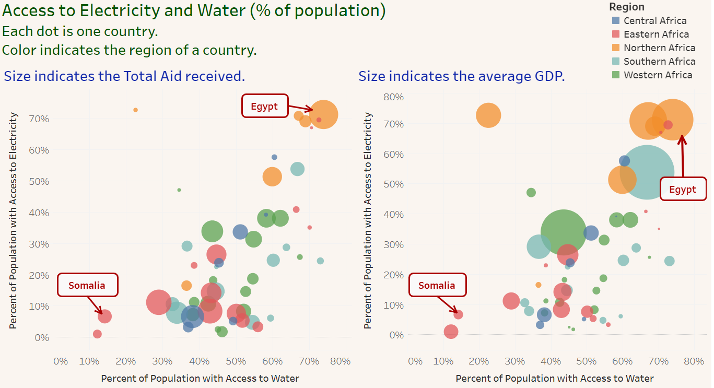

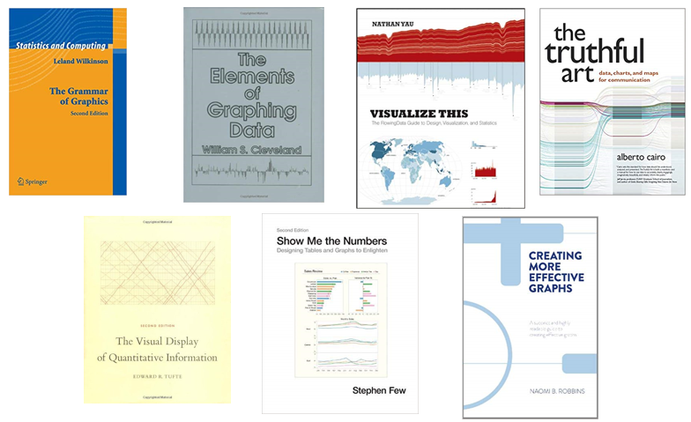
THEORY
APPLICATION
STUDENT PROJECTS
Grammar of graphics
set of rules for creating perceivable graphs (Wilkinson, p1)
Software
Chris Planet Photo 1
Chris Planet Photo 2
Data
Aesthetics
X, Y
Shape
Color
Size
Geometries
ggplot2
ggplot(data = fake_data, aes(x = Factor1,
y = Response,
color = Factor2)) +
geom_line(aes(group = Factor2)) +
geom_point(aes(shape = Factor2))
Critiques & Makeovers
Elementary perceptual tasks
a set of tasks that are carried out when people extract quantitative information from graphs (Cleveland & McGill, 1984)
Altair
base = alt.Chart(fake_data).encode(x = 'Factor1',
y = 'Response',
color = 'Factor2')
lines = base.mark_line()
points = base.mark_point().encode(shape = 'Factor2')
lines + points
Tableau
Large Projects
Work by Stacey Miertschin
Stacey’s Tableau Public Profile:
Gestalt principles of grouping
The whole is greater than the sum of the parts
STUDENT ASSESSMENT
REFERENCES
Specification
Geometry ___
X __
Y __
Color __
Shape __
Size ___
EPTs
Position
Length
Direction
Angle
Area
Color
Grouping principles
Similarity
Proximity
Connection
Enclosure
SIMILARITY
PROXIMITY
CONNECTION
ENCLOSURE

