Slide 1
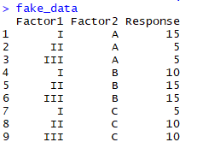
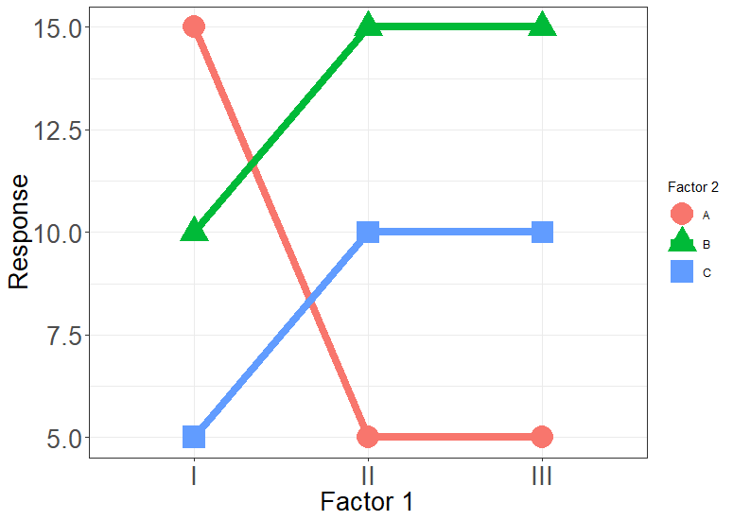
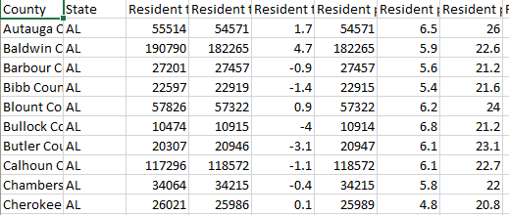
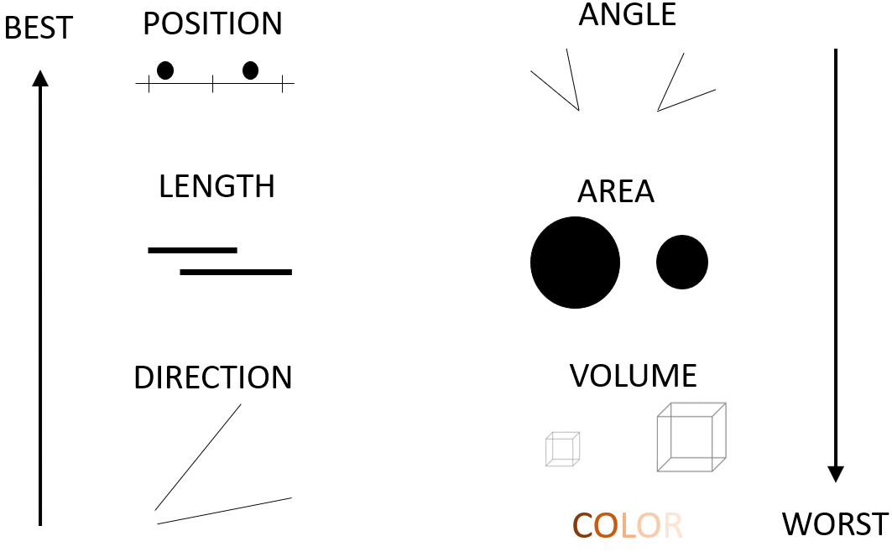

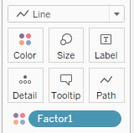
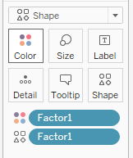
THEORY
APPLICATION
Grammar of graphics
set of rules for creating perceivable graphs (Wilkinson, p1)
Data
Aesthetics
X, Y
Shape
Color
Size
Geometries
ggplot2
ggplot(data = fake_data) +
geom_line(aes(x = Factor1,
y = Response,
col = Factor2, group = Factor2)) +
geom_point(aes(x = Factor1,
y = Response,
col = Factor2, shape = Factor2))
Elementary perceptual tasks
a set of tasks that are carried out when people extract quantitative information from graphs (Cleveland & McGill, 1984)
Tableau
EDUCATION
Gestalt principles of grouping
The whole is greater than the sum of the parts
Specification
Geometry ___
X __
Y __
Color __
Shape __
Size ___
EPTs
Position
Length
Direction
Angle
Area
Color
Grouping principles
Similarity
Proximity
Connection
Enclosure
SIMILARITY
PROXIMITY
CONNECTION
ENCLOSURE

