Slide 1

Using Data Verbs to Teach the Management of Tabular Data
Motivation
No Code vs
Code
In the beginning ... No Code
… Transition …
To Code
Data Verbs
throughout
Curriculum
Data Verbs
Version 2.0
Todd Iverson tiverson@winona.edu
Chris Malone cmalone@winona.edu

Slide 2

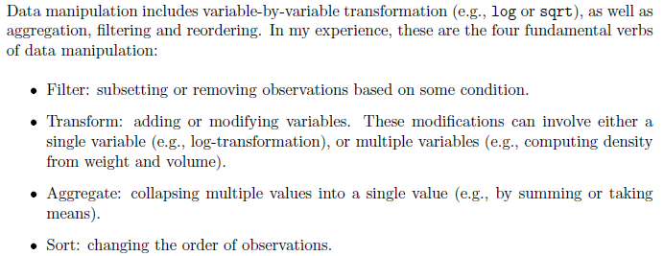
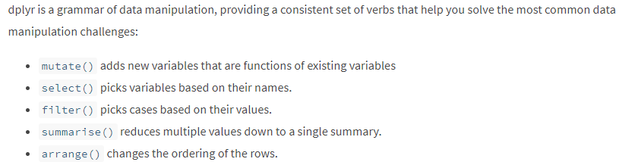
Develop an undergraduate data scientist program
Ensure program outcomes are adequate for employment
Necessity for such a program has a long history
Motivation

Slide 3
No Code
vs
Code

Slide 4
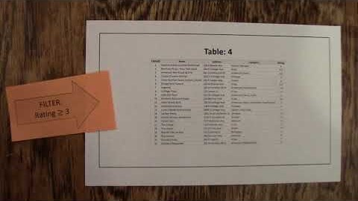

In the beginning … No Code
https://youtu.be/i2JmOiAF31U

Slide 5
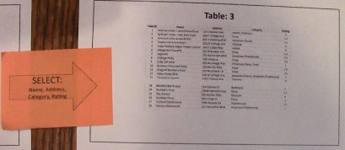
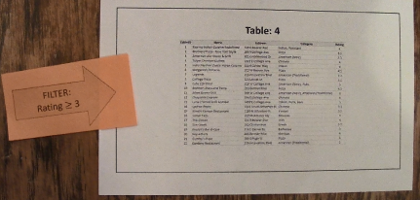
…Transition … to Code
Paper
Restaurants
%>% SELECT( Name, Address, Category, Rating ) %>% FILTER( Rating >= 3 )
R: dplyr
SQL
SELECT Name, Address, Category, Rating
FROM Restaurants
WHERE Rating >= 3

Slide 6
Data Verbs Throughout Curriculum
DSCI 210 Intro Course
DSCI 325
Core Course
DSCI 430
Elective
SELECT
FILTER
MUTATE
SORT
GROUP BY
AGGREGATE
UNION
INNER JOIN
SELECT
FILTER
MUTATE
SORT
GROUP BY
AGGREGATE
PIVOT
SET OPERATIONS JOINS
SELECT
FILTER
MUTATE
SORT
GROUP BY
AGGREGATE
PIVOT
SET OPERATIONS JOINS
STACK / UNSTACK

Slide 7
Data Verbs - Version 2.0
Simple
Select/Drop
Filter
Mutate
Sort
Aggregation
Aggregate
Group By
Pivot
Reshape
Stack
Unstack
Single
Table
Set Operations on Rows
Union (All)
Intersect (All)
Difference (All)
Joins
Inner Join
Outer Join
Left Join
Right Join
Combining
Tables
Low
Cognitive Level
High

Slide 8


References
https://github.com/WSU-DataScience/SDSS19_data_verb_poster
Wickham, Hadley. (2014). Tidy Data. Journal of Statistical Software. Vol 59, Issue 10.

