Slide 1
Teaching Data Science Students to Write Clean Code
https://bit.ly/2WgFIbI
Todd Iverson, Winona State University

Slide 2
Three important concepts from software engineering
Clean code reads like prose
I will focus on names and small functions
Use unit tests to ensure correct code
Refactor code to
Extract functions
Split loops
Notes:
Over the last few years, I have been doing some research on software engineering techniques that will help our students. In this talk I will highlight a few; namely picking good names, using small functions that do one thing, using unit tests to ensure our code is correct, and refactoring our code to make it more modular and readable.
But more importantly, this talk tells the story of Doug.

Slide 3
The Hero
The Villain
I NEED an A!
Hi! I’m Doug
Grrr
Doug?
An A?
HA!
His code stinks!
Doug “Crazy Legs” Ervison
“Mean” Dr. Iverson
Notes:
(click) The hero of our drama, Doug Ervison, budding data science major with a penchant to messy code .
(click) The villain in this drama is the mean Dr. Iverson, who always complains about Doug’s code. He sometimes even says it stinks.

Slide 4
Doug will demonstrate
Good names
Small functions
Unit tests
Refactor code, specifically
Extract functions
Split loops
Notes:
Over the last few years, I have been doing some research on software engineering techniques that will help our students. In this talk I will highlight a few; namely picking good names, using small functions that do one thing, using unit tests to ensure our code is correct, and refactoring our code to make it more modular and readable.
But more importantly, this talk tells the story of Doug.

Slide 5
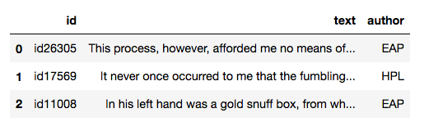
Opening Scene - The Assignment
But Dr. Iverson is SO mean!
Kaggle is Kool!
Kaggle assignment!
https://www.kaggle.com/c/spooky-author-identification/data
Notes:
Doug has a problem.
(click) He was assigned a Kaggle assignment for class and he thinks he has a nice solution, but he knows that Dr. Iverson is going to dock points for messy code.

Slide 6
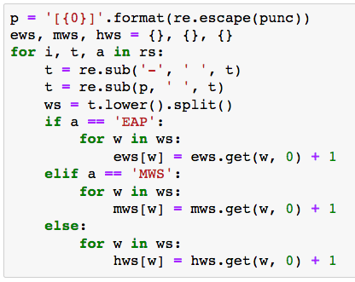
Doug’s Original code
(…this assignment require unit tests!…)
(…F!…)
Iverson loves Bag of Words!
I am going to get an A for sure!
Notes:
Doug solution is based on the word distributions of each author.
(click)Surely this solution will get Doug that elusive A.
(click)Unfortunately, Doug forgot to look over the requirements for the assignment, which included unit tests for all functions.

Slide 7
It looks like our hero is doomed
to an F!
Notes:
It looks like our hero is doomed
to an F!

Slide 8
Then just in the nick of time …
Notes:
Then just in the nick of time …

Slide 9
… Doug remembers unit tests!
You MUST have unit tests.
Notes:
Doug recalls this assignment requires unit tests. What was it that Iverson said in class about unit test?

Slide 10
What are unit tests?
Captures/maintain intended behavior
Helpful when changing code
Should be automated
Notes:
Doug looks back at his notes. So tests should be automated and capture the behavior of the code.

Slide 11
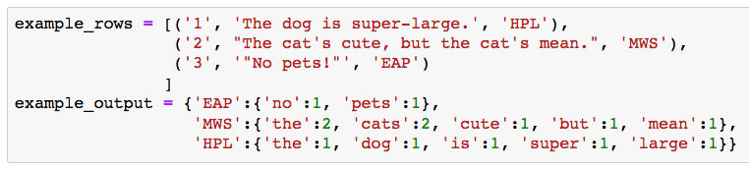
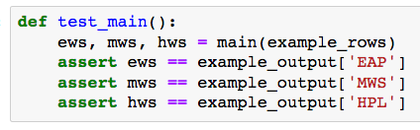
Doug writes some unit tests
Original behavior
That was easy!
And my code passed!
New behavior
Notes:
Ok, unit tests. First, he makes some examples data and the intended output.
(click) Then write an automated test that checks that his main function works.
(click)
(click) Finally, run the test and make sure the original function passes.

Slide 12
Doug’s Original code
(…with names like that …)
(…a C at best…)
Remembered the Unit Tests!
I am going to get an A for sure!
Notes:
Initially, Doug is happy with this code.
(click) Surely this solution will get Doug that elusive A.
(click) but then he remembers losing points for poor names on previous assignments

Slide 13
Luckily, Doug remembers to think about names
Names are important!
They should express intent!
Notes:
He thinks back to a lecture on picking good names, remembering that names should express the intent of your code.

Slide 14
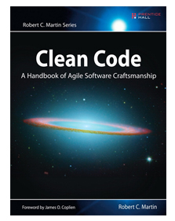
Good names…
Reveal intent
Use the proper parts of speech
Have the proper length for their scope
Avoids disinformation and encodings
Data: What is it?
Function: What does it do?
Notes:
Doug looks over his nores.
(click) So data should say what it is
(click) and functions should say what they do.

Slide 15
Good names…
Reveal intent
Use the proper parts of speech
Have the proper length for their scope
Avoids disinformation and encodings
Variable: Noun
Function: Verb
Boolean: Predicate
Notes:
Doug notices that next slide talks about using the correct parts of speech.
(click) variables are nouns
(click) functions verbs
(click) and something about Booleans.

Slide 16
Doug inspects his names
These names are bad.
What’ ews again??
Notes:
Doug looks over his names. What would Iverson say?

Slide 17
Doug finds some better names
ews hold the words for Edgar Allen Poe
Maybe I should just use poe_words
Notes:
He definitely wouldn’t like ews and hws. He decides to use new names that use the authors last names.

Slide 18
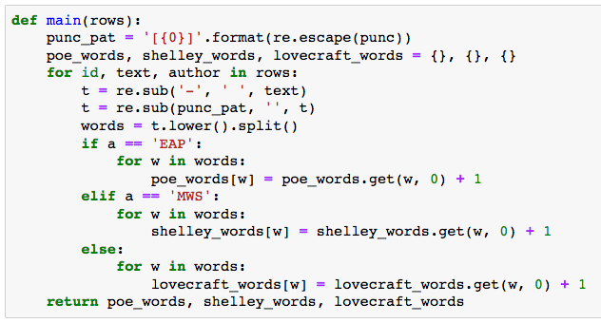
A+ for sure!
(…D at best…)
poe_words is better than ews
(…see the bug?…)
The other names are better too!
Notes:
Doug continues to change names, replaces the name for each variable, trying to better capture the indent of the code.
(click) He is now confident in getting an A!
(click) Unfortunately, there is a bug in his code, and Iverson gives code that crashes a D.

Slide 19
It looks like our hero is doomed
with D!
Notes:
It looks like our hero is doomed with D!

Slide 20
Then just in the nick of time …
Notes:
Then just in the nick of time …

Slide 21
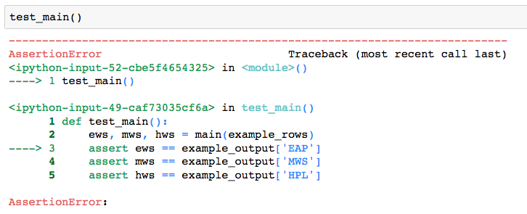

… Doug remembers to test!
Better test!
Oops!
Good thing I ran unit test!
Notes:
Doug remembers to test.
(click) the code fails the test
(click) and he figures out that he forgot to change to “a”s to “author”
(click) he fixes the problem
(click) and verifies the code passes his tests.

Slide 22
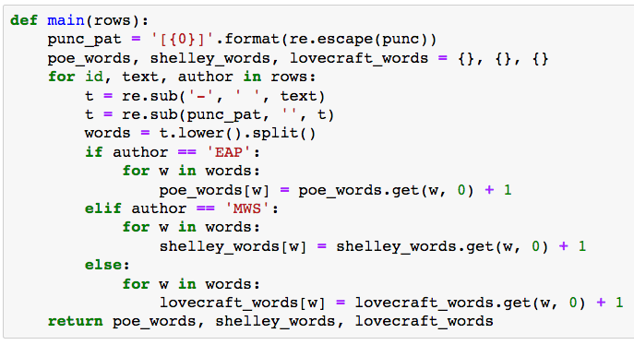
What else would Iverson complain about?
Notes:
That was close. So what other changes should he make?

Slide 23
Doug imagines Iverson’s feedback
Clean functions do one thing
You need more functions
Notes:
He remembers that Iverson likes programs with many small functions.
(click) and he has one large function.

Slide 24
and Doug even remembers refactoring!
Find a block that does something …
… and extract a function!
Notes:
This reminds him of one of his favorite lectures on extracting functions.

Slide 25
Common Refactoring Technique Extract Function
Notes:
He looks over his notes on extracting functions.
(click) so he should find a block that does something
(click) extract the code into a function with a good name
(click) and replace the original block with a function call.

Slide 26
The DRY principle
Don’t repeat yourself!
Find similar code
Make it exactly the same
Extract a function!
Notes:
He also sees that this technique is related to the DRY principle. Whatever!

Slide 27

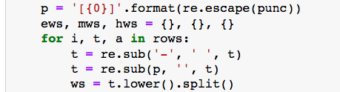
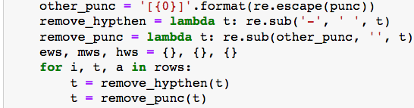
Extract Functions
Test after each change!
Better test
Extract this function!
Replace hyphens
Remove punctuation
What does each part do?
Notes:
Doug looks at his code, looking for blocks that do something.
(click) He finds some code that replaces hyphens with a space,
(click) so he extracts that code to a function called replace_hythen and
(click) replaces the original code with a function call.
(click) Doug has learned his lesson after almost forgetting to test his name changes. He runs his unit test. They pass.
(click) He also find some code that removes punctuation, and extracts a functions for that as well. Again his code passes the unit tests.
(click) Turns out Doug likes to refactor.

Slide 28
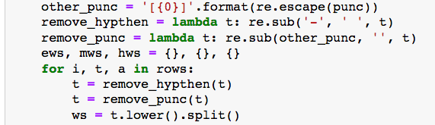
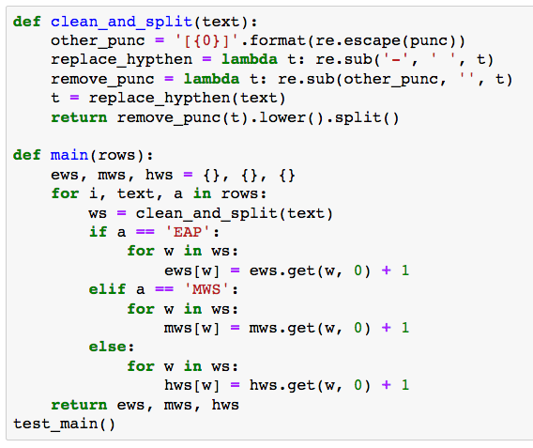
Extract Another Function
Test after each change!
Better test
Extract this too!
Clean and Split
Any other functions!
Notes:
This is fun! Doug decides to extract another function.
(click) This part cleans and splits each block of text.
He extracts this function as well and reruns the tests.
(click)
(click)
(click)

Slide 29
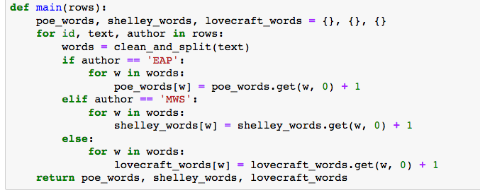
Doug is on a roll now!
There are a LOT of nesting …
… a sign of a function doing too much
And this blocks look similar
Notes:
Doug really does like to refactor
(click)
What other refactoring can he do?
(click) Remembers that nesting is a sign that a function does to much.
(click) and that he should look for repeated blocks of code
He remembers something from class about refactoring a loop that does more than one thing.

Slide 30
Common Refactoring Technique Split Loop
1 Loop that
does 2 things
2 Loop that
do 1 thing
Notes:
Doug looks over his notes on splitting a loop.
(click) you find a loop that does more than one thing
(click) then split it into multiple loops that each do one thing.

Slide 31
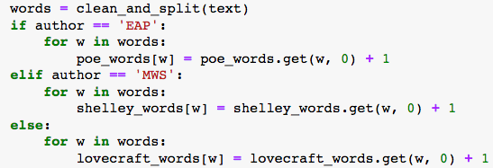
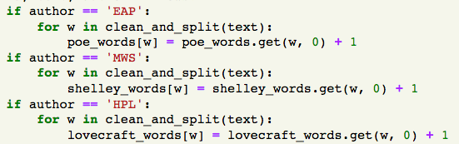
Doug makes the blocks identical …
And replace words with a query
I can separate them!
These are independent!
Notes:
Doug applies this technique
(click) changing the if/else to separate if statements
(click) and replacing a temporary variable with separate queires.

Slide 32
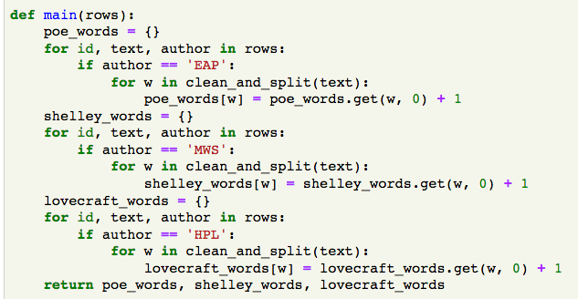
… carefully splits the loop …
First split the loop
Notes:
Then he splits the 1 loop into 3 loops.
(click) one for each author.

Slide 33
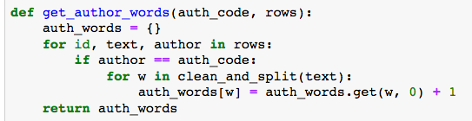
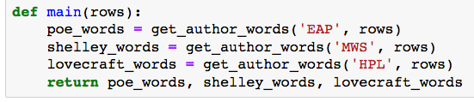
… and extracts a function
Tests pass,
But isn’t this inefficient?
Now extract a function
and replace blocks with a call
Notes:
Now he can extract a loop into a function.
(click)
And replace each loop with function call
(click)
Now that he’s done it, splitting the loop just feels wrong. His old code only passed over the data one time, while the new code scans the data three times. Isn’t this needlessly inefficient?

Slide 34
What did Iverson say about efficiency?
97% of your code doesn’t impact overall speed
Optimize the other 3% … after profiling
Blah blah … Donald Knuth … Blah blah
Notes:
Doug thinks back to what Iverson said in class on efficiency. So not all parts of your code really matter, and you won’t know which parts matter until after you run your code. He also remembers that Iverson went on-and-on about some guy named Knuth.

Slide 35
The real problem is that programmers have spent far too much time worrying about efficiency in the wrong places and at the wrong times; premature optimization is the root of all evil (or at least most of it) in programming.
- Donald Knuth
(…he’s not wrong …)
Iverson is always talking about Knuth
What a fanboy!
Notes:
Doug finds that Knuth guy’s quote in his notes. Hmm, “root of all evil”? That IS strong language. Ok, so maybe he shouldn’t worry so much about efficiency until he sees that his code is slow.

Slide 36
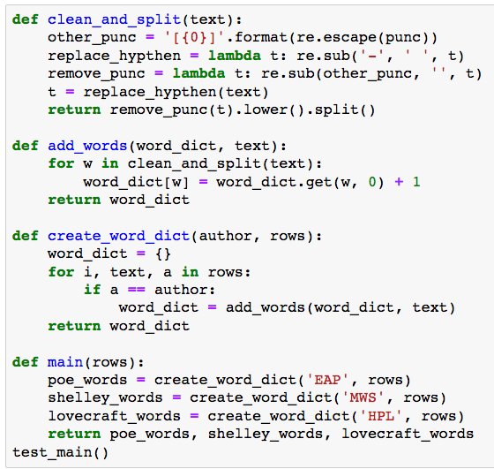
Doug’s Final Product
A+ work for sure!
Short functions!
Fast even with split loops!
Better names!
Notes:
Doug looks over his code one more time. Everything looks good and he has to admit that it is clean and easier to read.

Slide 37
Doug’s code is demonstrably better
Notes:
Doug’s code is demonstrably better

Slide 38
He clearly took Iverson’s
clean code lectures to heart
Notes:
He clearly took Iverson’s clean code lectures to heart

Slide 39
His solution consists of
many small functions
with good names
Notes:
And his code consists of small functions with good names

Slide 40
And he even refactored like a pro
Notes:
He clearly likes to refactor

Slide 41
Tune in next week to find out …
.. on the next exciting episode of
Doug Does Data Science
(MUHAHAHA…)
(Still too much nesting…)
Notes:
Unfortunately you will have to tune in next week to find out

Slide 42
Let’s Review

Slide 43
What are unit tests?
Captures/maintain intended behavior
Helpful when changing code
Should be automated
Notes:
Doug looks back at his notes. So tests should be automated and capture the behavior of the code.

Slide 44
Good names…
Reveal intent
Use the proper parts of speech
Have the proper length for their scope
Avoids disinformation and encodings
Data: What is it?
Function: What does it do?
Notes:
Doug looks over his nores.
(click) So data should say what it is
(click) and functions should say what they do.

Slide 45
Good names…
Reveal intent
Use the proper parts of speech
Have the proper length for their scope
Avoids disinformation and encodings
Variable: Noun
Function: Verb
Boolean: Predicate
Notes:
Doug notices that next slide talks about using the correct parts of speech.
(click) variables are nouns
(click) functions verbs
(click) and something about Booleans.

Slide 46
Refactoring
What is it?
Why use it?
Reorganize your code
Break it into different parts
Change composition
Understand the code
Clean the code
Allow new features

Slide 47
Common Refactoring Technique Extract Function
Notes:
He looks over his notes on extracting functions.
(click) so he should find a block that does something
(click) extract the code into a function with a good name
(click) and replace the original block with a function call.

Slide 48
Common Refactoring Technique Split Loop
1 Loop that
does 2 things
2 Loop that
do 1 thing
Notes:
Doug looks over his notes on splitting a loop.
(click) you find a loop that does more than one thing
(click) then split it into multiple loops that each do one thing.

Slide 49
The DRY principle
Don’t repeat yourself!
Find similar code
Make it exactly the same
Extract a function!
Notes:
He also sees that this technique is related to the DRY principle. Whatever!

Slide 50
Advice for teaching clean code
Require unit tests and good names.
Don’t just teach it, live it!
Allow students to see you clean your messy code.
Teach/reinforce important concepts.
DRY
Refactoring
Efficiency concerns and profiling
Projects that require 100’s of lines of code.

Slide 51
Clean Code Resources
These slides:
Clean Code, a book by Robert Martin
www.cleancoders.com, videos by Robert Martin and friends
Refactoring Code, a book by Martin Fowler

