Slide 1
Using Gestalt principles to help students design effective tables and graphs
Silas Bergen
Winona State University
2020 Symposium on Data Science and Statistics
June 4, 2020

Slide 2


Slide 3
79ºF
52ºF
Minutes since swim

Slide 4
loc | in_out | time | Avg temp
cheek | indoor | pre | 95.2
cheek | indoor | post1 | 84.3
cheek | indoor | post2 | 86.2
elbow | indoor | pre | 95.4
elbow | indoor | post1 | 89.1
elbow | indoor | post2 | 91.4
palm | indoor | pre | 91.7
palm | indoor | post1 | 84.1
palm | indoor | post2 | 89.3
pec | indoor | pre | 93.3
pec | indoor | post1 | 84.2
pec | indoor | post2 | 87.6
cheek | outdoor | pre | 76.0
cheek | outdoor | post1 | 53.0
cheek | outdoor | post2 | 61.6
elbow | outdoor | pre | 92.5
elbow | outdoor | post1 | 61.9
elbow | outdoor | post2 | 80.6
palm | outdoor | pre | 74.6
palm | outdoor | post1 | 48.6
palm | outdoor | post2 | 58.5
pec | outdoor | pre | 87.2
pec | outdoor | post1 | 52.9
pec | outdoor | post2 | 69.6
4 body locations
x 2 water temperatures
x 3 time points
= 24 body temperature averages
3 grouping variables

Slide 5
Client question:
Does the body temperature recovery as recorded at the four body points depend on water temperature?
Consultant questions:
What are the important comparisons?
How do we emphasize them?
Nolan and Perrett, 2016

Slide 6
What are the important comparisons?
Define elemental groupings: an individual or small collection of data values where interest lies in comparing this individual or collection across levels of one or more grouping variable

Slide 7
loc | in_out | time | Avg temp
cheek | indoor | pre | 95.2
cheek | indoor | post1 | 84.3
cheek | indoor | post2 | 86.2
elbow | indoor | pre | 95.4
elbow | indoor | post1 | 89.1
elbow | indoor | post2 | 91.4
palm | indoor | pre | 91.7
palm | indoor | post1 | 84.1
palm | indoor | post2 | 89.3
pec | indoor | pre | 93.3
pec | indoor | post1 | 84.2
pec | indoor | post2 | 87.6
cheek | outdoor | pre | 76.0
cheek | outdoor | post1 | 53.0
cheek | outdoor | post2 | 61.6
elbow | outdoor | pre | 92.5
elbow | outdoor | post1 | 61.9
elbow | outdoor | post2 | 80.6
palm | outdoor | pre | 74.6
palm | outdoor | post1 | 48.6
palm | outdoor | post2 | 58.5
pec | outdoor | pre | 87.2
pec | outdoor | post1 | 52.9
pec | outdoor | post2 | 69.6
What are the important comparisons?
Does the body temperature recovery as recorded at the four body points depend on water temperature?

Slide 8
loc | in_out | time | Avg temp
cheek | indoor | pre | 95.2
cheek | indoor | post1 | 84.3
cheek | indoor | post2 | 86.2
elbow | indoor | pre | 95.4
elbow | indoor | post1 | 89.1
elbow | indoor | post2 | 91.4
palm | indoor | pre | 91.7
palm | indoor | post1 | 84.1
palm | indoor | post2 | 89.3
pec | indoor | pre | 93.3
pec | indoor | post1 | 84.2
pec | indoor | post2 | 87.6
cheek | outdoor | pre | 76.0
cheek | outdoor | post1 | 53.0
cheek | outdoor | post2 | 61.6
elbow | outdoor | pre | 92.5
elbow | outdoor | post1 | 61.9
elbow | outdoor | post2 | 80.6
palm | outdoor | pre | 74.6
palm | outdoor | post1 | 48.6
palm | outdoor | post2 | 58.5
pec | outdoor | pre | 87.2
pec | outdoor | post1 | 52.9
pec | outdoor | post2 | 69.6
What are the important comparisons?
Does the body temperature recovery as recorded at the four body points depend on water temperature?

Slide 9
loc | in_out | time | Avg temp
elbow | indoor | pre | 95.4
elbow | indoor | post1 | 89.1
elbow | indoor | post2 | 91.4
palm | indoor | pre | 91.7
palm | indoor | post1 | 84.1
palm | indoor | post2 | 89.3
pec | indoor | pre | 93.3
pec | indoor | post1 | 84.2
pec | indoor | post2 | 87.6
elbow | outdoor | pre | 92.5
elbow | outdoor | post1 | 61.9
elbow | outdoor | post2 | 80.6
palm | outdoor | pre | 74.6
palm | outdoor | post1 | 48.6
palm | outdoor | post2 | 58.5
pec | outdoor | pre | 87.2
pec | outdoor | post1 | 52.9
pec | outdoor | post2 | 69.6
cheek | indoor | pre | 95.2
cheek | indoor | post1 | 84.3
cheek | indoor | post2 | 86.2
What are the important comparisons?
Does the body temperature recovery as recorded at the four body points depend on water temperature?
cheek | outdoor | pre | 76.0
cheek | outdoor | post1 | 53.0
cheek | outdoor | post2 | 61.6

Slide 10
loc | in_out | time | Avg temp
palm | indoor | pre | 91.7
palm | indoor | post1 | 84.1
palm | indoor | post2 | 89.3
pec | indoor | pre | 93.3
pec | indoor | post1 | 84.2
pec | indoor | post2 | 87.6
palm | outdoor | pre | 74.6
palm | outdoor | post1 | 48.6
palm | outdoor | post2 | 58.5
pec | outdoor | pre | 87.2
pec | outdoor | post1 | 52.9
pec | outdoor | post2 | 69.6
What are the important comparisons?
Does the body temperature recovery as recorded at the four body points depend on water temperature?
elbow | indoor | pre | 95.4
elbow | indoor | post1 | 89.1
elbow | indoor | post2 | 91.4
elbow | outdoor | pre | 92.5
elbow | outdoor | post1 | 61.9
elbow | outdoor | post2 | 80.6

Slide 11
What are the important comparisons?
How do we emphasize them?

Slide 12
Gestalt principles of perception

Slide 13
gestalt = form or pattern
Gestalt principles: predictable ways by which we organize sensory information

Slide 14
Similarity

Slide 15
Similarity

Slide 16
Proximity

Slide 17
Connection

Slide 18
Enclosure

Slide 19
Some principles are stronger than others

Slide 22
Notes:
Left/right
Within left: columns; within right: rows

Slide 23
Notes:
Left/right
Within left: columns; within right: rows

Slide 24
Some principles are stronger than others
Design implication: define and emphasize elemental groupings and facilitate their comparison across relevant levels

Slide 25
Gestalt hierarchy
Tables
Graphs
Enclosure
Connection
Proximity
Similarity
Grids/cell shading
Rules
White space
Font properties
Facets
Lines
White space
Color/shape

Slide 26
loc | in_out | time | Avg temp
cheek | indoor | pre | 95.2
cheek | indoor | post1 | 84.3
cheek | indoor | post2 | 86.2
elbow | indoor | pre | 95.4
elbow | indoor | post1 | 89.1
elbow | indoor | post2 | 91.4
palm | indoor | pre | 91.7
palm | indoor | post1 | 84.1
palm | indoor | post2 | 89.3
pec | indoor | pre | 93.3
pec | indoor | post1 | 84.2
pec | indoor | post2 | 87.6
cheek | outdoor | pre | 76.0
cheek | outdoor | post1 | 53.0
cheek | outdoor | post2 | 61.6
elbow | outdoor | pre | 92.5
elbow | outdoor | post1 | 61.9
elbow | outdoor | post2 | 80.6
palm | outdoor | pre | 74.6
palm | outdoor | post1 | 48.6
palm | outdoor | post2 | 58.5
pec | outdoor | pre | 87.2
pec | outdoor | post1 | 52.9
pec | outdoor | post2 | 69.6
Single average
Time triplets
Swim location
Body location
Most elemental
Least elemental

Slide 27
loc | in_out | time | Avg temp
cheek | indoor | pre | 95.2
cheek | indoor | post1 | 84.3
cheek | indoor | post2 | 86.2
elbow | indoor | pre | 95.4
elbow | indoor | post1 | 89.1
elbow | indoor | post2 | 91.4
palm | indoor | pre | 91.7
palm | indoor | post1 | 84.1
palm | indoor | post2 | 89.3
pec | indoor | pre | 93.3
pec | indoor | post1 | 84.2
pec | indoor | post2 | 87.6
cheek | outdoor | pre | 76.0
cheek | outdoor | post1 | 53.0
cheek | outdoor | post2 | 61.6
elbow | outdoor | pre | 92.5
elbow | outdoor | post1 | 61.9
elbow | outdoor | post2 | 80.6
palm | outdoor | pre | 74.6
palm | outdoor | post1 | 48.6
palm | outdoor | post2 | 58.5
pec | outdoor | pre | 87.2
pec | outdoor | post1 | 52.9
pec | outdoor | post2 | 69.6
 |  | Pre | Post1 | Post2
Cheek | Indoor | 95.2 | 84.3 | 86.2
 | Outdoor | 76.0 | 53.0 | 61.6
Elbow | Indoor | 95.4 | 89.1 | 91.4
 | Outdoor | 92.5 | 61.9 | 80.6
Palm | Indoor | 91.7 | 84.1 | 89.3
 | Outdoor | 74.6 | 48.6 | 58.5
Pec | Indoor | 93.3 | 84.2 | 87.6
 | Outdoor | 87.2 | 52.9 | 69.6
 |  | Indoor | Outdoor
Cheek | pre | 95.2 | 76.0
 | post1 | 84.3 | 53.0
 | post2 | 86.2 | 61.6
Elbow | pre | 95.4 | 92.5
 | post1 | 89.1 | 61.9
 | post2 | 91.4 | 80.6
Palm | pre | 91.7 | 74.6
 | post1 | 84.1 | 48.6
 | post2 | 89.3 | 58.5
Pec | pre | 93.3 | 87.2
 | post1 | 84.2 | 52.9
 | post2 | 87.6 | 69.6
 |  | Pre | Post1 | Post2
Cheek | Indoor | 95.2 | 84.3 | 86.2
 | Outdoor | 76.0 | 53.0 | 61.6
Elbow | Indoor | 95.4 | 89.1 | 91.4
 | Outdoor | 92.5 | 61.9 | 80.6
Palm | Indoor | 91.7 | 84.1 | 89.3
 | Outdoor | 74.6 | 48.6 | 58.5
Pec | Indoor | 93.3 | 84.2 | 87.6
 | Outdoor | 87.2 | 52.9 | 69.6

Slide 28
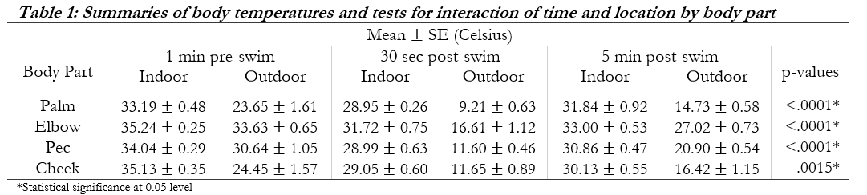
Student tables

Slide 29
Student tables

Slide 30
Student tables

Slide 31
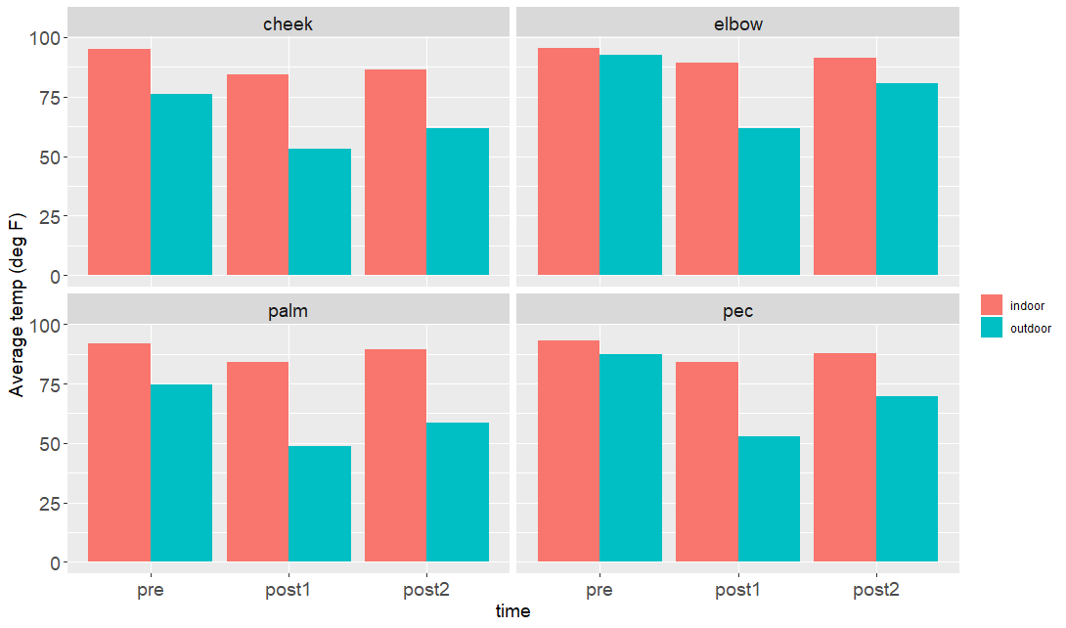
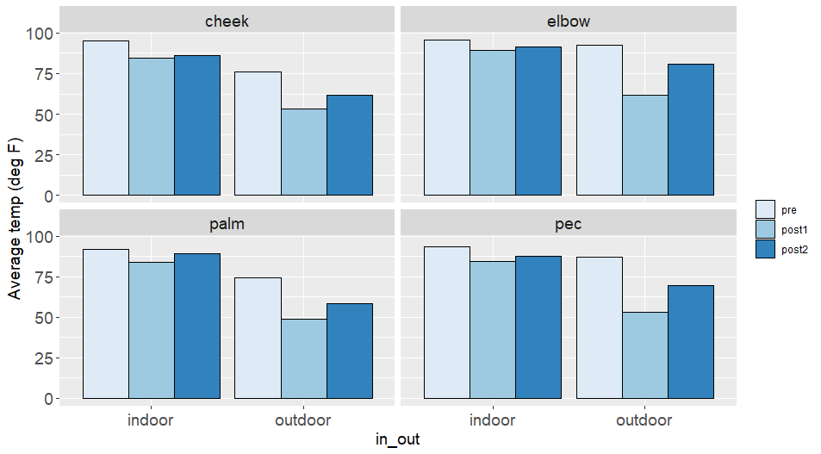

What about graphs?

Slide 32
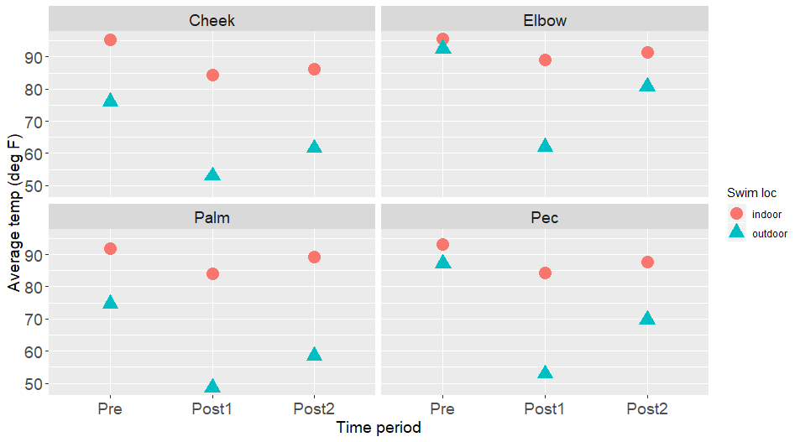
What about graphs?

Slide 33
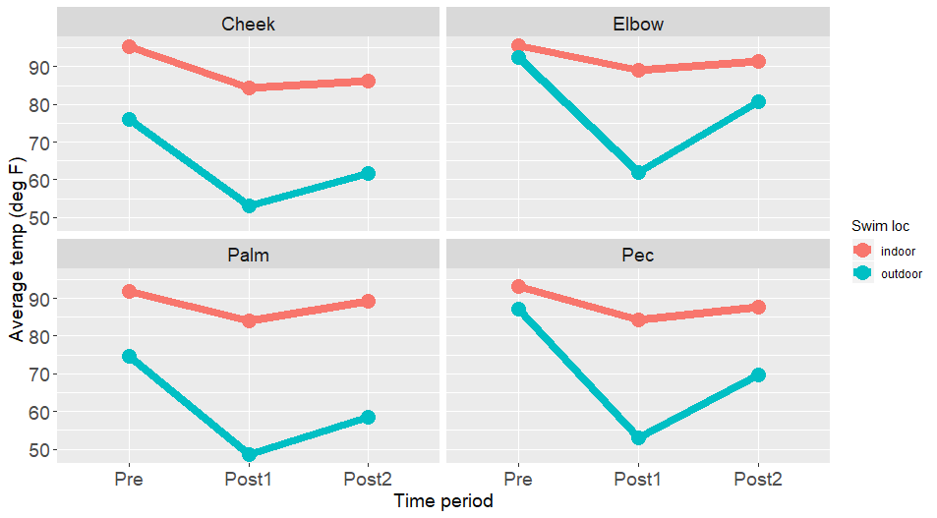
What about graphs?

Slide 34
Summary
Students first need to identify the important comparisons
Define hierarchy of elemental groupings
Teaching the Gestalt principles can help them emphasize the most important comparisons
Relevant for table and graph design

Slide 35
Sources
Stephen Few. 2012. Show Me the Numbers: Designing Tables and Graphs to Enlighten. Analytics Press; Second edition, Burlingame, CA.
Deborah Nolan and James Perrett. 2016. Teaching and learning data visualization: Ideas and assignments. The American Statistician, 70(3):260-269.

Slide 36
Slides
https://github.com/WSU-DataScience/SDSS20_teaching_gestalt/raw/master/Bergen_Gestalt_presentation_SDSS2020.pptx

