Slide 1
Teaching novice programmers to manage data
Todd Iverson
Winona State University

Slide 2
Beliefs

Slide 3
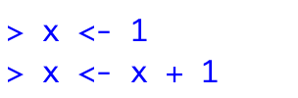

1. Side effects impede learning

Slide 4
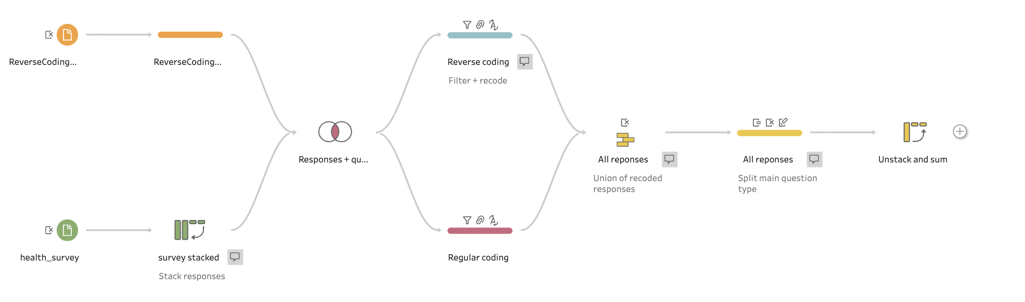
2. There is an over-emphasis on programming
All drag and drop in Tableau Prep

Slide 5
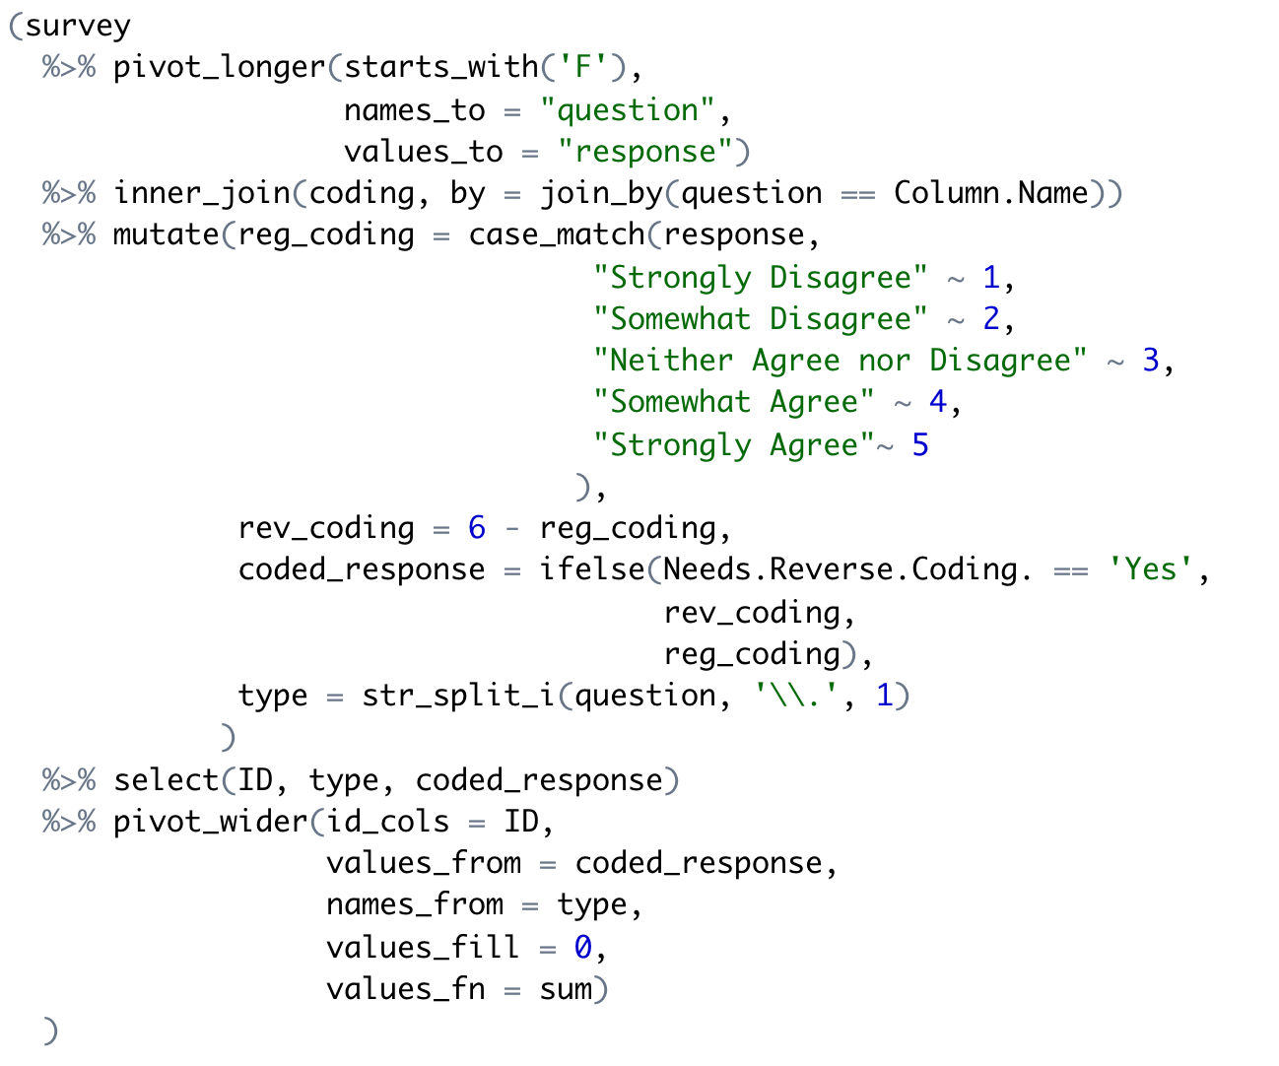
3. Loops should become the next GO TO statement
Look Mom! No Loops!

Slide 6
Views

Slide 7


1. Code should read like prose
Naming rules
Data → noun
Function → verb
Boolean → predicate

Slide 8
2. Learning to program is hard!
What should I do first? Second?
What functions should I use?
How do I make my code run/correct?

Slide 9
3. Coding should come later in the first course
Outline for DSCI 210
Low Code
Scripting + Low Code
Intro to Tidy Data
Aggregation
Data Verbs
Intro to Visualization
Classification and CART
String Verbs and Window Functions
Managing data with R/tidyverse
Reshaping tables
Table joins
Intro to Arules

Slide 10
Algorithms First!
Or why coding should come later in the first course

Slide 11
Doug is struggling!
Algorithm
Step-by-step process
What should I do first? Second?
What functions should I use?
How do I make my code run/correct?

Slide 12
Doug is struggling!
Algorithm
Step-by-step process
What should I do first? Second?
Implementation
Which libraries/functions
What functions should I use?
How do I make my code run/correct?

Slide 13
Doug is struggling!
Algorithm
Step-by-step process
What should I do first? Second?
Implementation
Which libraries/functions
What functions should I use?
Correct Code
Avoid bugs and verify correct results
How do I make my code run/correct?

Slide 14
We decouple the algorithm and the code!
Notes:
Then just in the nick of time …

Slide 15
The algorithm is most important Let’s make sure Doug is proficient here first!
Algorithm
Step-by-step process
Start here!
What should I do first? Second?
Implementation
Which libraries/functions
What functions should I use?
Correct Code
Avoid bugs and verify correct results
How do I make my code run/correct?

Slide 16
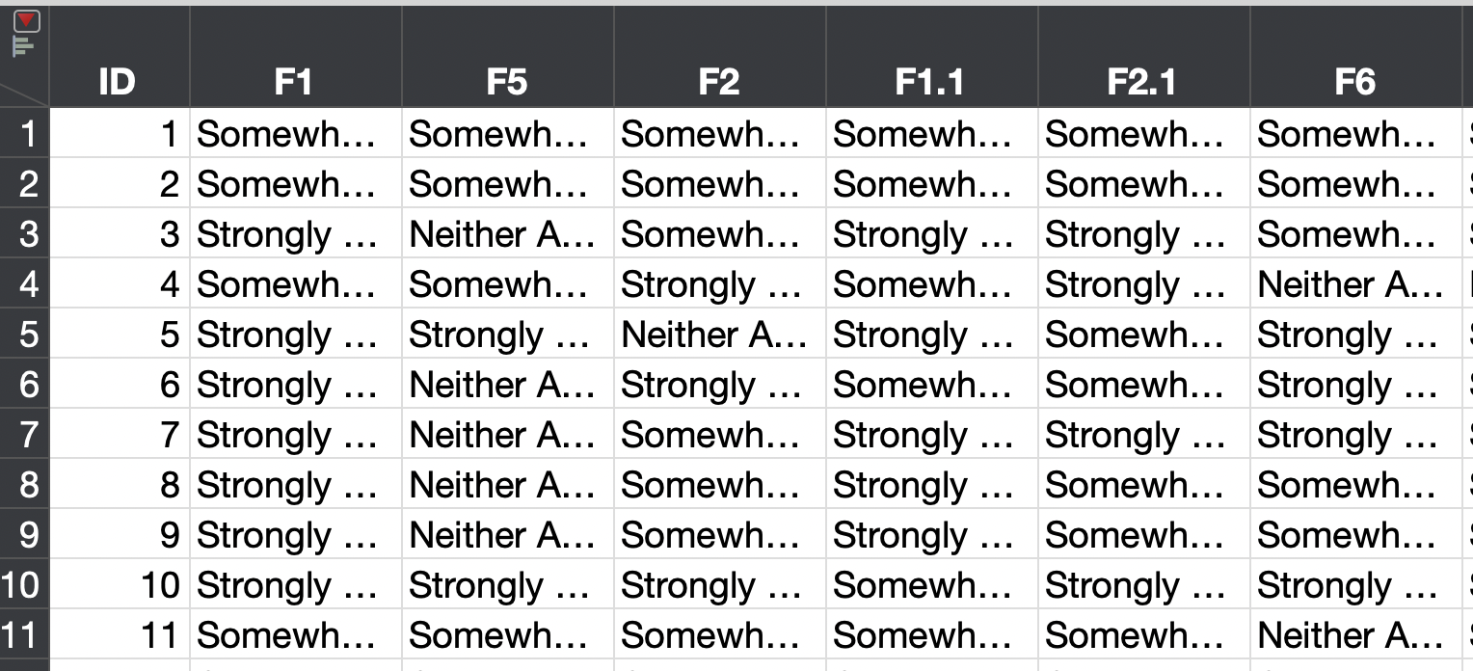
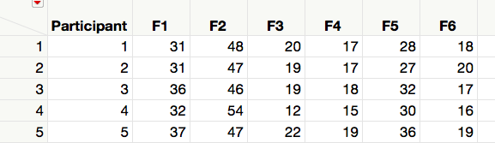
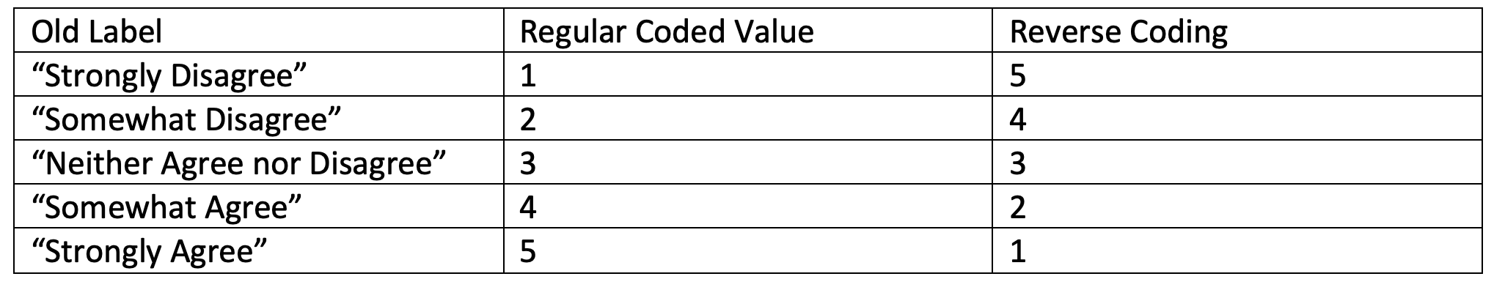
Problem 1 Summarize a health survey

Slide 17
No code solution in Tableau Prep
Bifurcate + filter replaces an IF

Slide 18
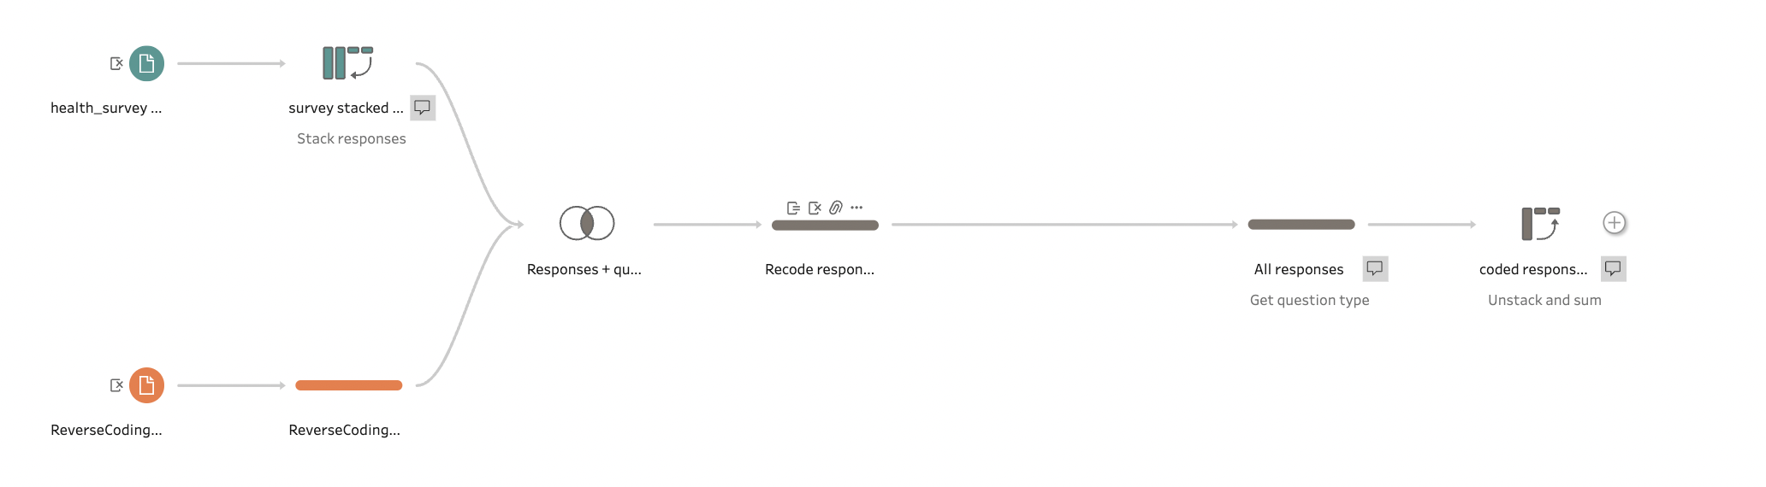
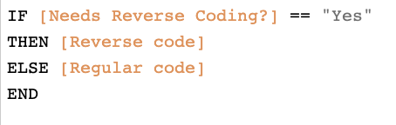
Low code solution
Only Code

Slide 19
Translate to a scripting language

