Slide 1
A Core Curriculum for Undergraduate Data Science
Silas Bergen, Brant Deppa, Tisha Hooks, Todd Iverson, April Kerby, and Chris Malone;
Winona State University

Slide 2
Block 2 – Data Visualization Wednesday, 8:30-12:30
Data Management
Visualization
Statistical Learning
DSCI 210
Survey
DSCI 210
Survey
DSCI 210
Survey
STAT 210/310
Statistics
DSCI 325
Structured
DSCI 330
Unstructured
DSCI 310
Intro to Viz
STAT 360
Regression
DSCI 430
DS @ Scale
DSCI 415
Unsupervised
DSCI 425
Supervised

Slide 3
Students should be…
Savvy with data verbs
Filter
Mutate
Gather
Spread
Savvy with aggregated data vs microdata

Slide 4

Structure
Theory
Practice
Specification
Visual perception
Gestalt principles
Critiques
Design tasks
Projects
Presentations

Slide 5
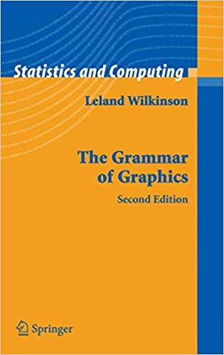
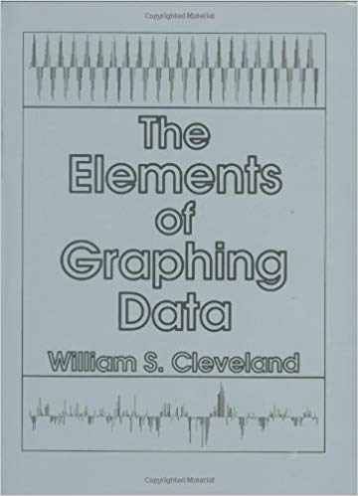

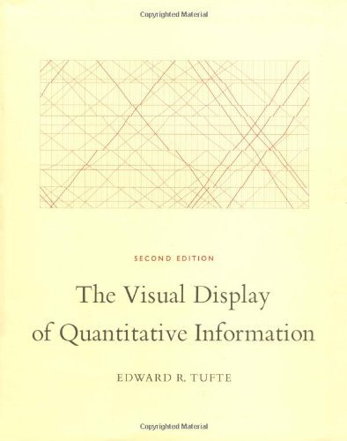
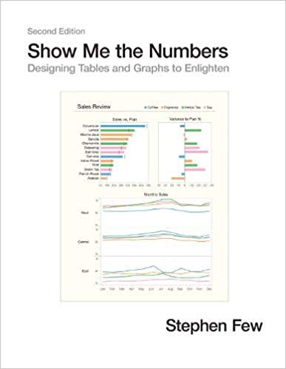
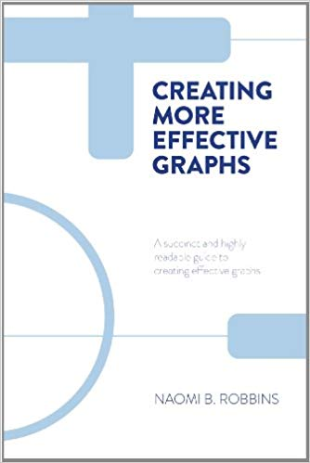


Slide 6



Software

Slide 7
Theory

Slide 8
In the visualizations that follow:
What information can you extract?
How are you extracting this information?

Slide 9
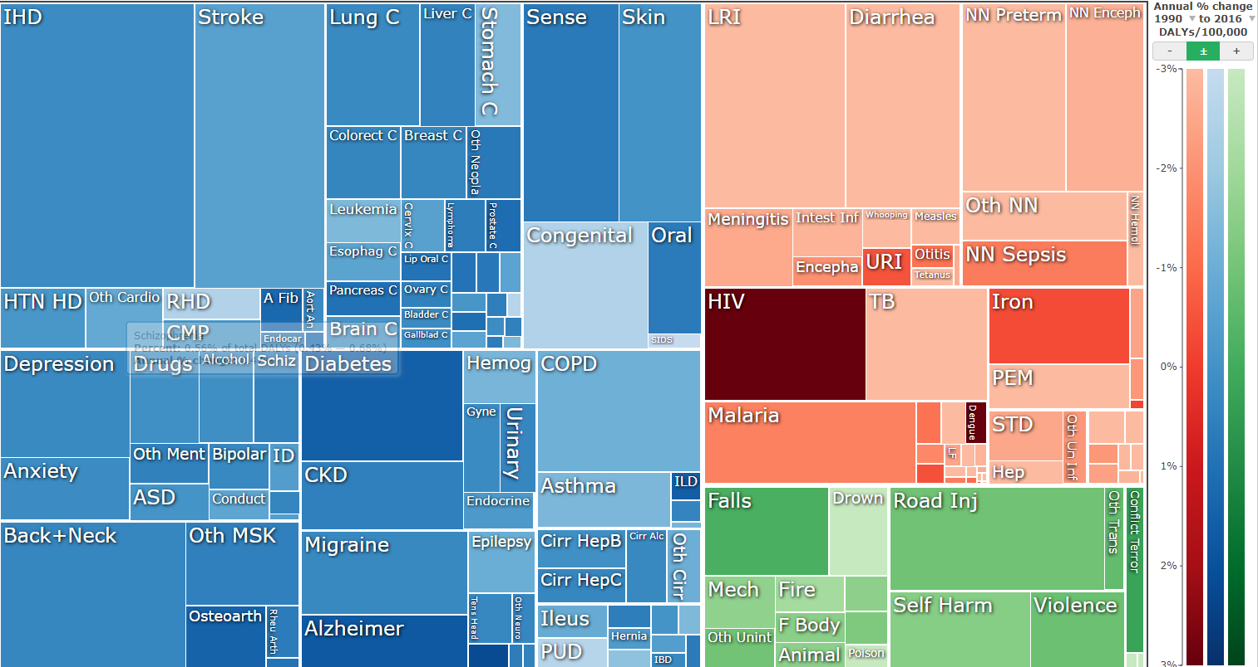
IHME GBD visualization
https://vizhub.healthdata.org/gbd-compare/

Slide 10
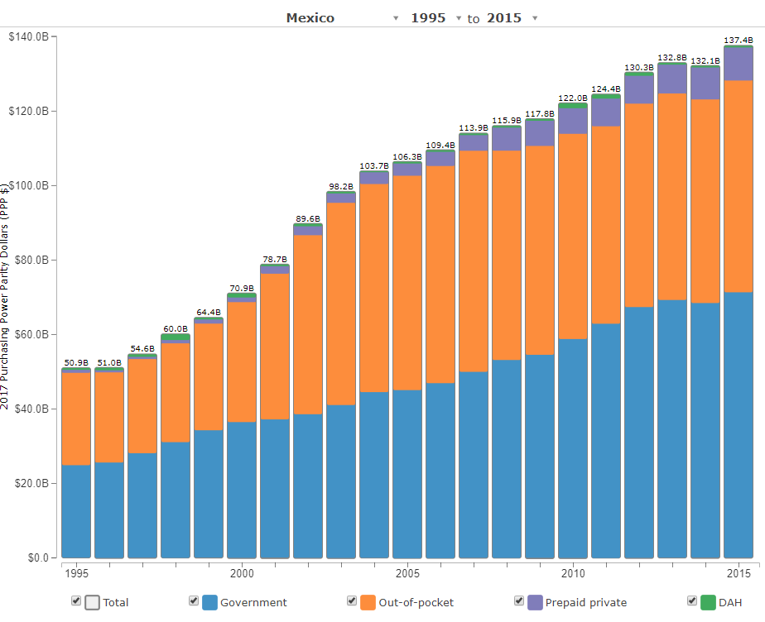
IHME health care spending visualization
(DAH = Development Assistance for Health)
http://ihmeuw.org/4iuu

Slide 11
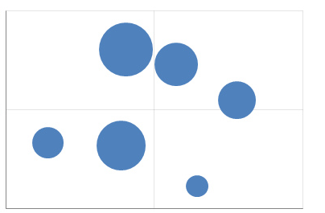
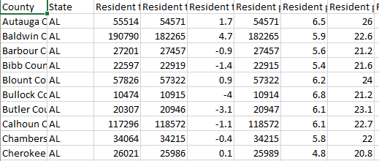
What is a data visualization?
A set of visual geometries whose aesthetics are mapped from data
Many major visualization software (Tableau, ggplot in R, python, graph builder in JMP) are based on this grammar
Aesthetics
Data
Geometries

Slide 12
Geometry
A geometry is a visual entity in space.
Some common geometries encountered in data visualizations:
Point
Line
Bar

Slide 13
Aesthetic
An aesthetic is a visual attribute of a geometry
Common aesthetics:
Position on horizontal (X)
Position on vertical (Y)
Shape
Size
Color
Hue
Saturation (“intensity”)
Value (“brightness”)
Text
Not all aesthetics are available for every geometry

Slide 14

HUE
SATURATION
https://color.adobe.com/build2.0.0-buildNo/resource/img/kuler/color_wheel_730.png

Slide 15
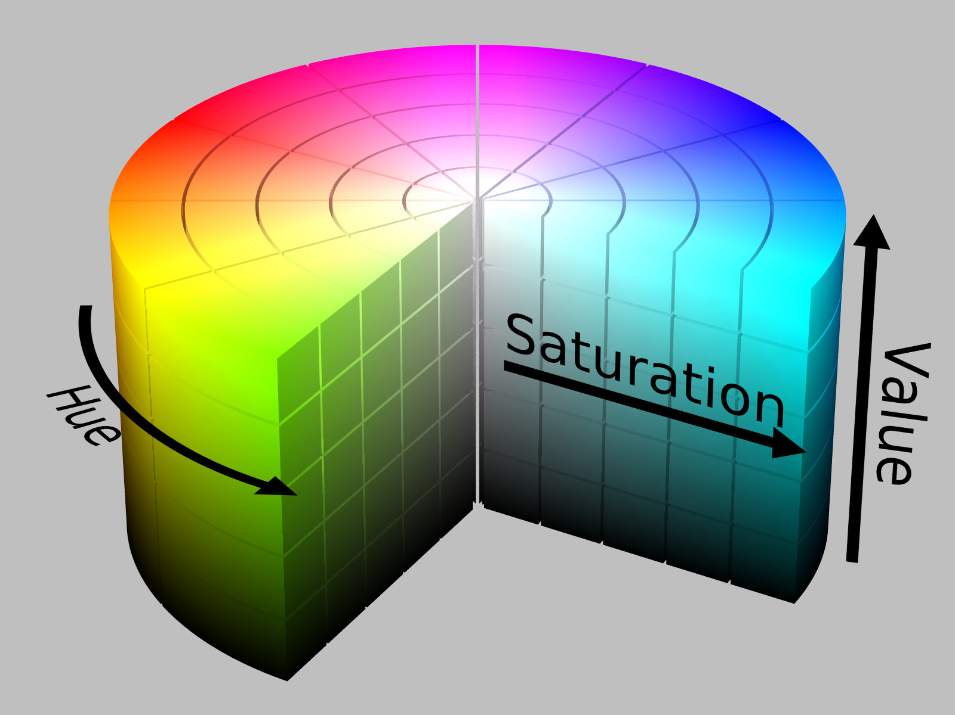
https://upload.wikimedia.org/wikipedia/commons/0/0d/HSV_color_solid_cylinder_alpha_lowgamma.png

Slide 16


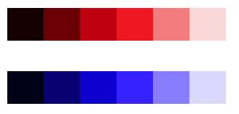
Issues with HSV
6 hues, full saturation, same value:
Converting to grayscale:
Equidistant changes in value not created equal; red step appears much more drastic than blue step:
https://www.vis4.net/blog/posts/avoid-equidistant-hsv-colors/

Slide 17
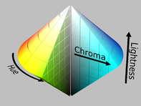
Hue Chroma Luminance
https://en.wikipedia.org/wiki/HSL_and_HSV

Slide 18
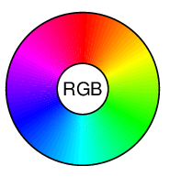
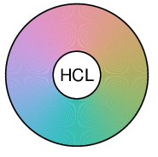
Hue Chroma Luminance
HSV
HCL
http://hclwizard.org/why-hcl/

Slide 19
Aesthetic attributes of a point geometry
What distinguishes one point from another point?
X, Y
Shape
Size
Hue
Saturation
Value
Text
Point B
Point A

Slide 20
Aesthetic attributes of a line geometry
What distinguishes one line from another line?
X, Y
Shape
Size
Hue
Saturation
Value

Slide 21
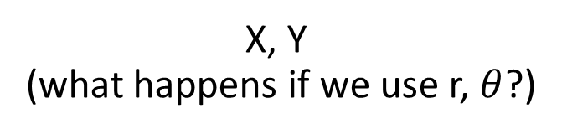
Aesthetic attributes of a bar geometry
What distinguishes one bar from another bar?
X, Y
(what happens if we use r, $θ$?)
Shape
Size
NA
(a bar is a bar!)
Hue
Saturation
Value

Slide 22
Data
To visualize, must have data in row-by-column format where:
Rows represent cases: at most one geometry per case (assuming no aggregation)
Columns represent variables: to be mapped to aesthetic attributes

Slide 23
Specifying a data visualization
Differences in geometry aesthetics map to differences in data variables
Available mappings depend on whether data variable is continuous (height) or discrete (race)

Slide 24


Specifying a data visualization
The following caveats apply:
An aesthetic attribute can be mapped back to at most one variable
A variable can be mapped to more than one aesthetic
Not all mappings make sense
Height
Size
Age
Size
Sex
Hue
Height
Shape

Slide 25
Modifiers
Ties: when two cases yield overlapping geometries under a given mapping
Some common modifiers:
Jitter: Stack: Dodge:

Slide 26
Specify the mappings!
Revisit the three visualizations we encountered earlier. Identify:
The data cases (assuming one geometry per case);
The geometries;
The aesthetic attributes that are varied;
The variables that control the differences in aesthetic attributes (bonus: are they continuous or discrete?)
Modifiers (if any)

Slide 27
IHME GBD visualization
https://vizhub.healthdata.org/gbd-compare/

Slide 28
IHME health care spending visualization
(DAH = Development Assistance for Health)
http://ihmeuw.org/4iuu

Slide 29
Visual perception
How we compare quantities

Slide 30
Recall the following aesthetic attributes:
Position on horizontal (X)
Position on vertical (Y)
Shape
Size
Color
Hue
Saturation (“intensity”)
Value (“brightness”)
Cleveland & McGill created a ranking of these when mapping a geometry to a quantitative variable

Slide 31
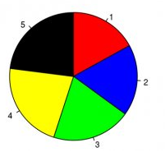
Hypothetical polling data on 5 candidates.
Rank the candidates’ vote shares.
Walter Hickey at Business Insider
Specification
Geometry: “pie wedge” (a bar in polar coordinates)
Aesthetic mappings:
Candidate (discrete) → hue & text
share of vote (continuous) → size, specifically angle

Slide 32
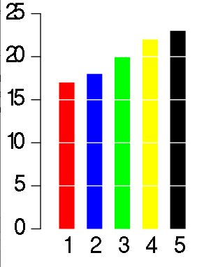
Same data, different visualization
Rank the candidates’ vote shares.
Walter Hickey at Business Insider
Specification
Geometry: bar
Aesthetic mappings:
candidate → hue & X
share of vote → Y

Slide 33
Elementary perceptual tasks
a set of tasks that are carried out when people extract quantitative information from graphs
Cleveland and McGill. Graphical Perception: Theory, Experimentation, and Application to the Development of Graphical Methods. JASA, 1984

Slide 34
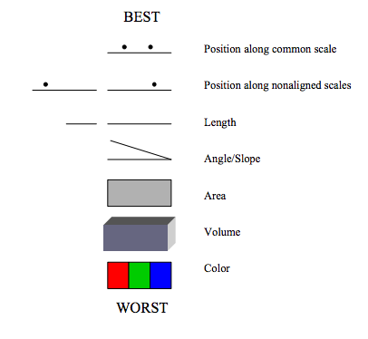
Cleveland’s and McGill’s hierarchy of elementary perceptual tasks
Image source: Wilkinson, Presentation Graphics

Slide 35
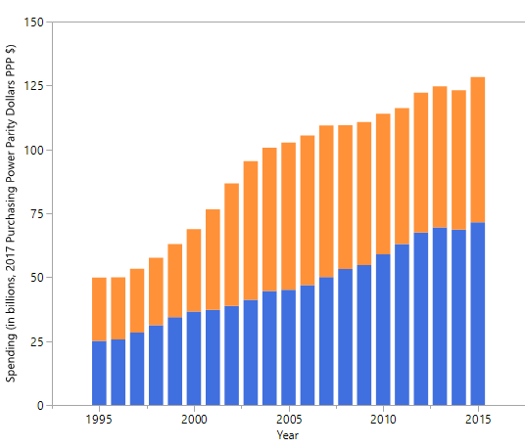
Mexico’s health spending (Government and Out-of-pocket only)
Geometry: Bar
Year → X
Spending → Y
Source → Hue
Modifier: Stack
http://ihmeuw.org/4iuu

Slide 36
Mexico’s health spending (Government and Out-of-pocket only)
Geometry: Bar
Year → X
Spending → Y
Source → Hue
Modifier: Dodge
http://ihmeuw.org/4iuu

Slide 37
Mexico’s health spending (Government and Out-of-pocket only)
Geometry: Point + line
Year → X
Spending → Y
Source → Hue, Shape
Modifier: None

Slide 38
Gestalt principles
How we perceive groups

Slide 39
gestalt = form or pattern
Gestalt philosophy: the whole is greater than the sum of the parts
Gestalt principles: predictable ways by which we organize sensory information
Developed by Max Wertheimer & followers; early 20th century

Slide 40
Find the fives
6
3
1
2
1
9
5
3
2
8
5
5
7
5
5
4
9
5
5
4
3
6
5
3
9
4
3
5
8
2
2
1
5
7
4
3
1
5
5
7
6
5
9
8
4
2
4

Slide 41
Find the fives
6
3
1
2
1
9
5
3
2
8
5
5
7
5
5
4
9
5
5
4
3
6
5
3
9
4
3
5
8
2
2
1
5
7
4
3
1
5
5
7
6
5
9
8
4
2
4
Inspired by Fig 6.2, The Functional Art by Alberto Cairo

Slide 42
Similarity
rows or columns?

Slide 43
Similarity
rows or columns?

Slide 44
Proximity
rows or columns?

Slide 45
Connection
rows or columns?

Slide 46
Enclosure
rows or columns?

Slide 47
Some principles are stronger than others

Slide 48
rows or columns?

Slide 49
rows or columns?

Slide 50
What are the groups?
Within group: rows or columns?
Notes:
Left/right
Within left: columns; within right: rows

Slide 51
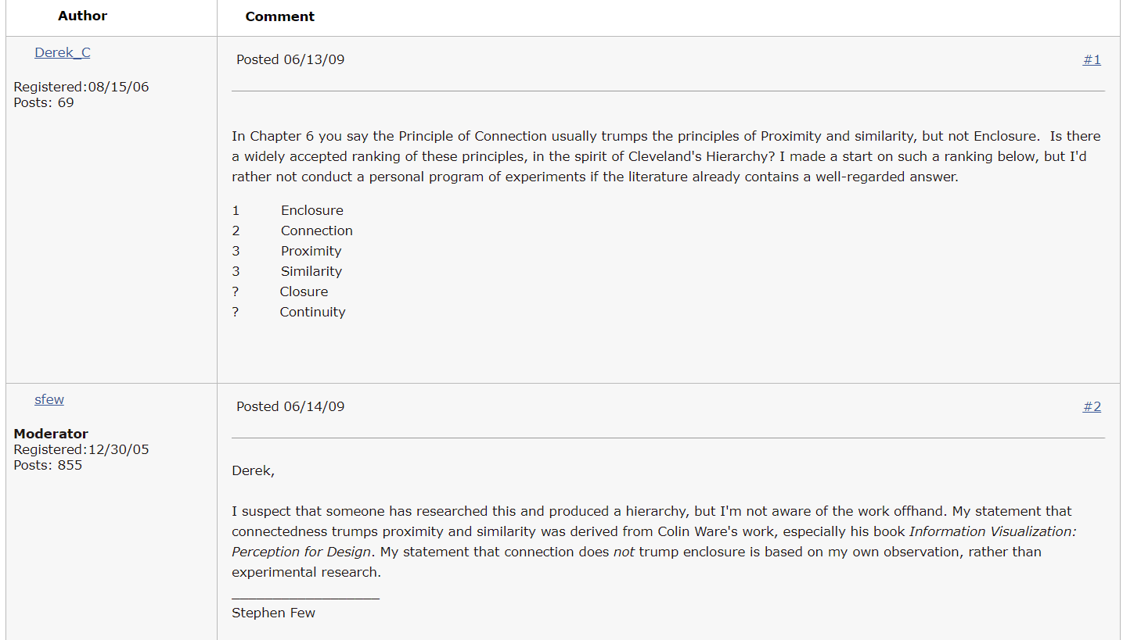
http://sfew.websitetoolbox.com/post/ranking-the-gestalt-principles-3524646 (now unavailable; 5/8/19)

Slide 52
color usually trumps shape when incorporating similarity

Slide 53
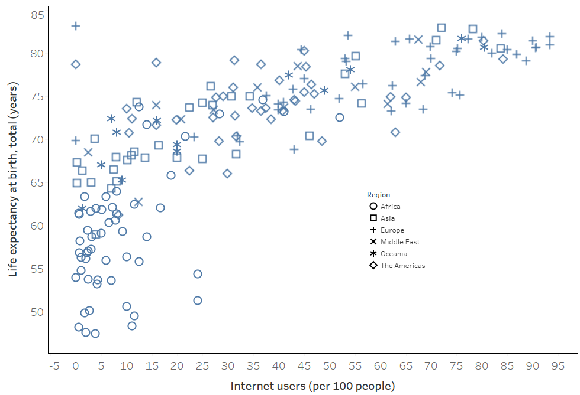
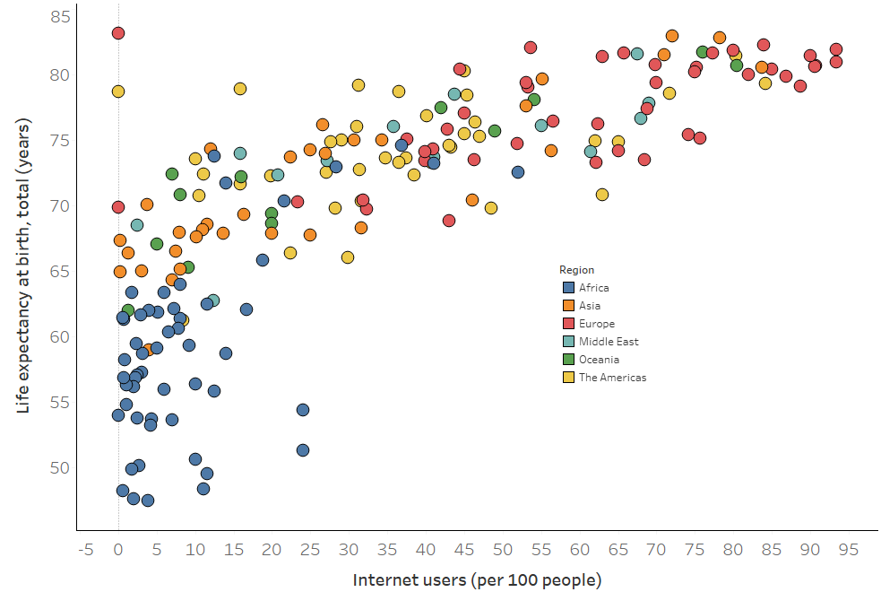
Data source: World Bank, 2010 indicators

Slide 54
but you can double up

Slide 55
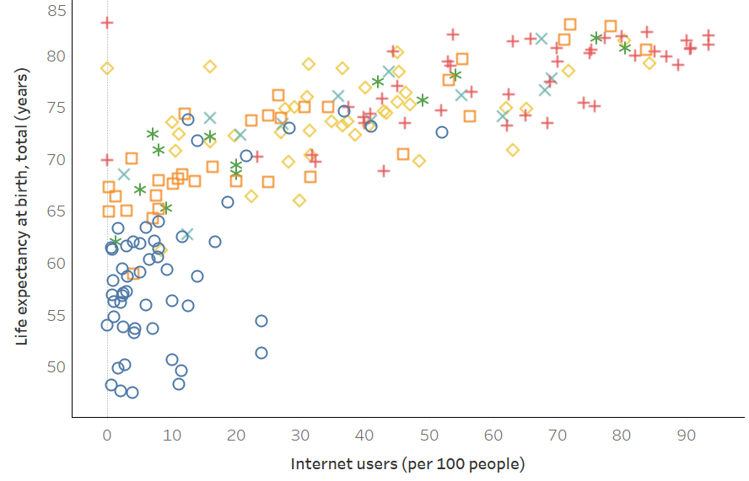

Slide 56
Implications for practice
Know how we compare quantities
Know how we perceive groups
Employ these principles to facilitate the most important comparisons
“The most important comparisons” depend on your message

Slide 57
> fake_data
Factor1 Factor2 Response
1 A I 15
2 A II 5
3 A III 5
4 B I 10
5 B II 15
6 B III 15
7 C I 5
8 C II 10
9 C III 10

Slide 58
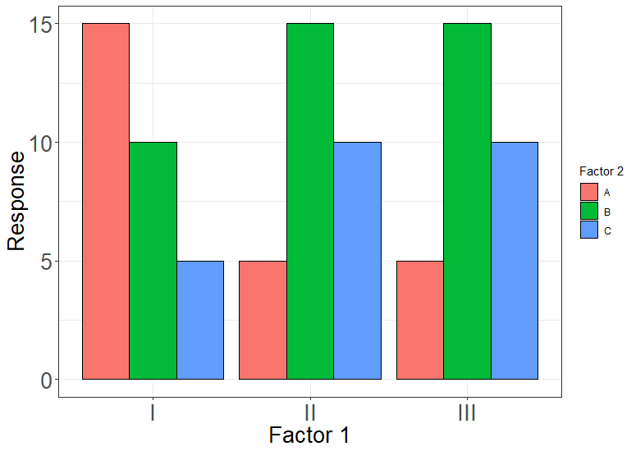
Geom: bar
Position_X: Factor 1
Color: Factor 2
Position_Y: Response
Notes:
775 x 550; proximity

Slide 59
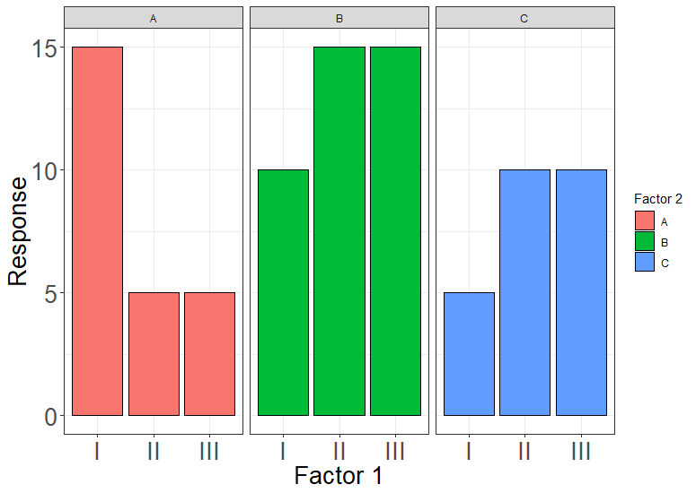
Geom: bar
Position_X: Factor 1
Color: Factor 2
Position_Y: Response
FACET: Factor 2
Notes:
775 x 550; proximity + enclosure

Slide 60
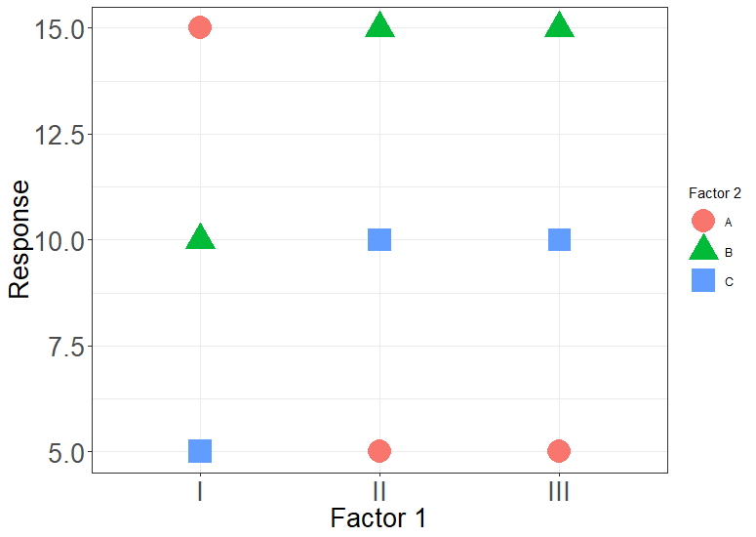
Geom: point
Position_X: Factor 1
Color: Factor 2
Shape: Factor 2
Position_Y: Response
Notes:
What am I supposed to look at? Similarity is too weak

Slide 61
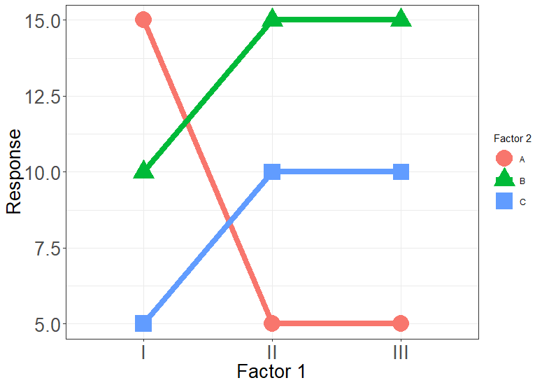
Geom: point
Position_X: Factor 1
Color: Factor 2
Shape: Factor 2
Position_Y: Response
Geom: line
Position_X: Factor 1
Color: Factor 2
Group: Factor 2
Position_Y: Response
Notes:
Adding connection helps

Slide 62
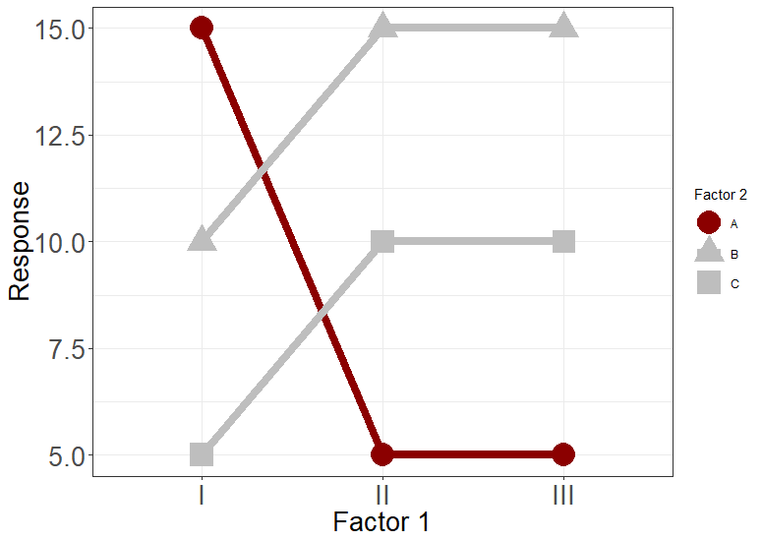
Geom: point
Position_X: Factor 1
Color: Is_neg
Shape: Factor 2
Position_Y: Response
Geom: line
Position_X: Factor 1
Color: Is_neg
Group: Factor 2
Position_Y: Response
Notes:
Similarity + connection

Slide 63
Geom: point
Position_X: Factor 1
Color: Is_neg
Shape: Factor 2
Position_Y: Response
Geom: line
Position_X: Factor 1
Color: Is_neg
Group: Factor 2
Position_Y: Response
Notes:
Enclosure + Similarity + connection

Slide 64
Practice

Slide 65
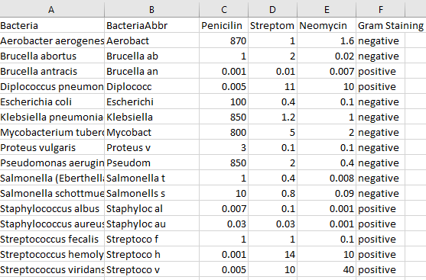
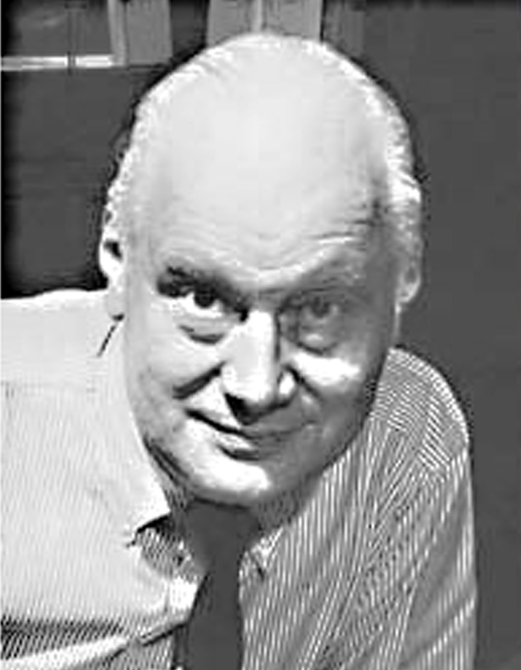
Introductory viz assignment task #1
William Burtin’s bacteria data
Image source: http://adcglobal.org/hall-of-fame/will-burtin/

Slide 66
Introductory viz assignment task #1
After World War II, antibiotics earned the moniker “wonder drugs” for quickly treating previously-incurable diseases. Data was gathered to determine which drug worked best for each bacterial infection. Comparing drug performance was an enormous aid for practitioners and scientists alike.
In the fall of 1951 German graphic designer William Burtin gathered data on the minimum inhibitory concentration (MIC) of three antibiotics for 16 different bacteria (smaller = more effective). Each bacteria was classified according to Gram Staining: Positive/Negative
Questions to be answered:
Which bacteria was hardest to kill? Easiest to kill?
Was one antibiotic the most effective?
Did antibiotic effectiveness vary by gram staining?

Slide 67
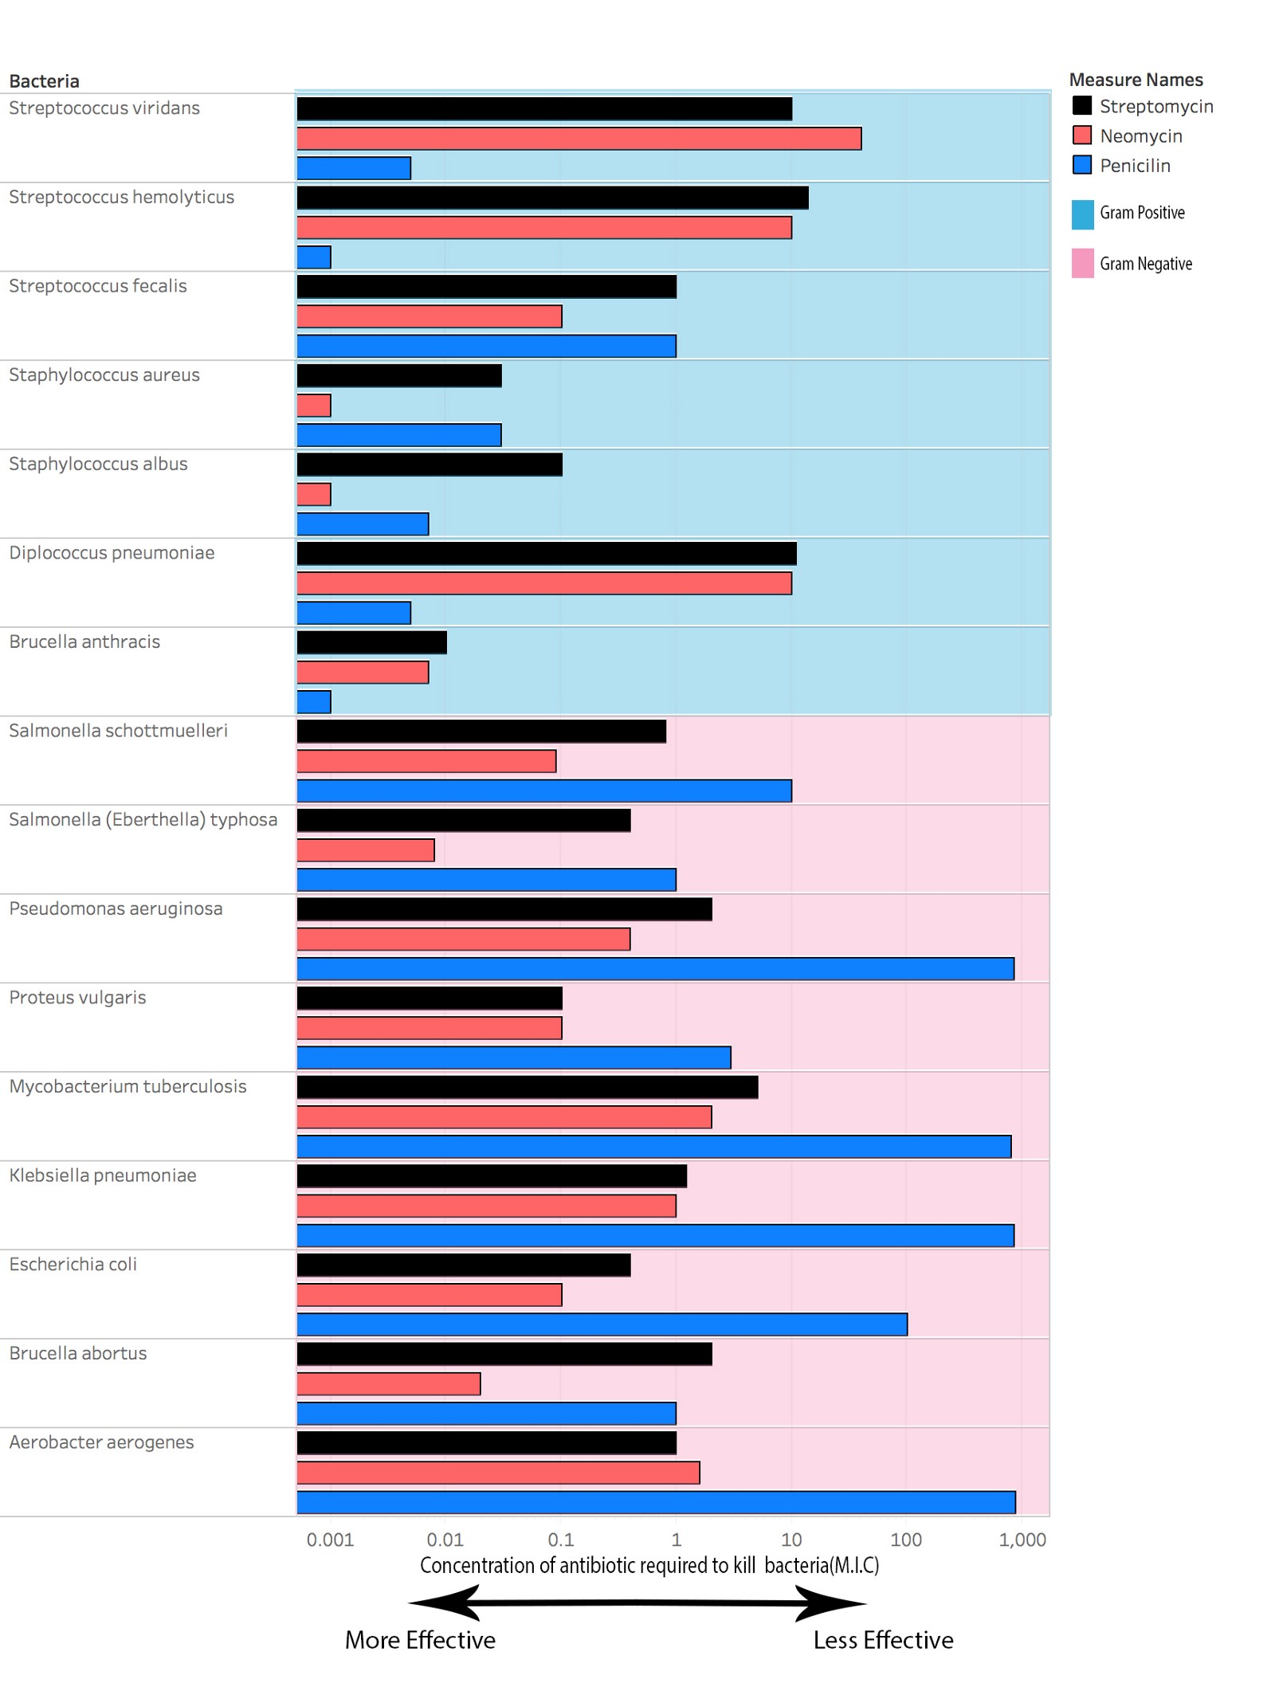
Source: https://medium.com/@harshdev_41068/burtins-legendary-data-on-antibiotics-9b32ecd5943f

Slide 68
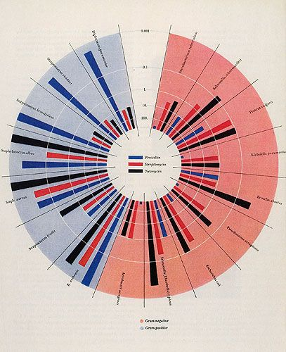

Slide 69
Design

Slide 70

Alberto Cairo
http://www.thefunctionalart.com/

Slide 71
The five qualities of great visualizations
Truthful
Functional
Beautiful
Insightful
Enlightening
Alberto Cairo, The Truthful Art, Ch 2.

Slide 72
1. Truthful
Is the visualization based on thorough and honest research?

Slide 73
2. Functional
Does the visualization facilitate meaningful comparisons?

Slide 74
3. Beautiful
Is it attractive, intriguing, and aesthetically pleasing?

Slide 75
4. Insightful
Does the visualization elicit an “a-ha”, a “wow”, an “I see”?

Slide 76
5. Enlightening
Does the visualization cast light over relevant issues? Will it “change minds”?

Slide 77
Truthful
Functional
Beautiful
Insightful
Enlightening
Winona State data viz course, currently:
Using the right data; aggregating correctly; etc.
Using specifications that exploit principles of visual perception
DESIGN: Storytelling, annotating, cleaning, editing, color choices, stretching creativity

Slide 78
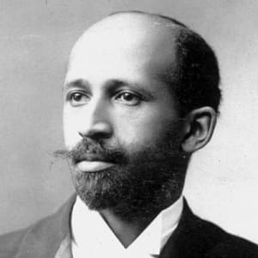
Exposition Universelle Paris World Fair 1900
W.E.B. Du Bois
Sociologist, Atlanta University

Slide 79
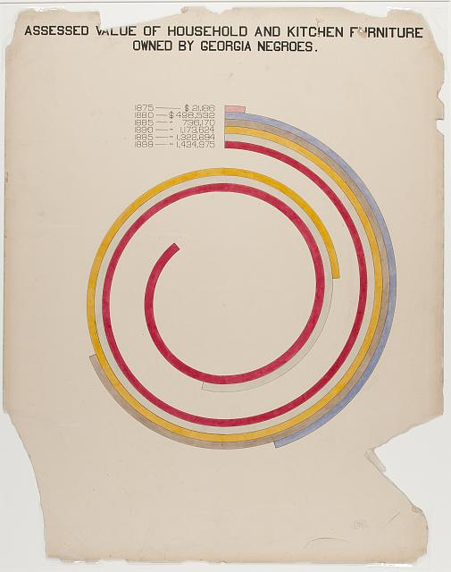
Image Source: https://www.loc.gov/pictures/resource/ppmsca.33887/?co=anedub
Notes:
Beautiful: Pre-empts the Avant Garde European art movement

Slide 80
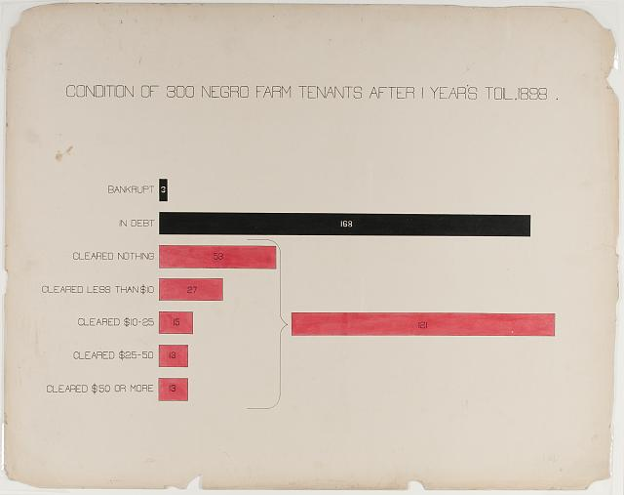
Image Source: https://www.loc.gov/pictures/resource/ppmsca.33892/?co=anedub
Notes:
Insightful: Power of annotation

Slide 81
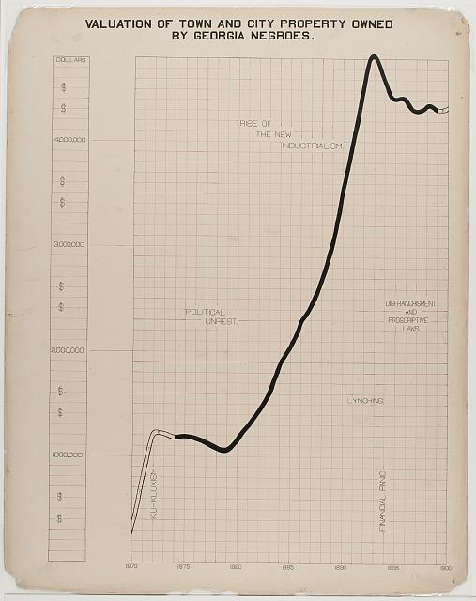
Image Source: https://www.loc.gov/pictures/resource/ppmsca.33883/?co=anedub
Notes:
Insightful: Power of annotation

Slide 82
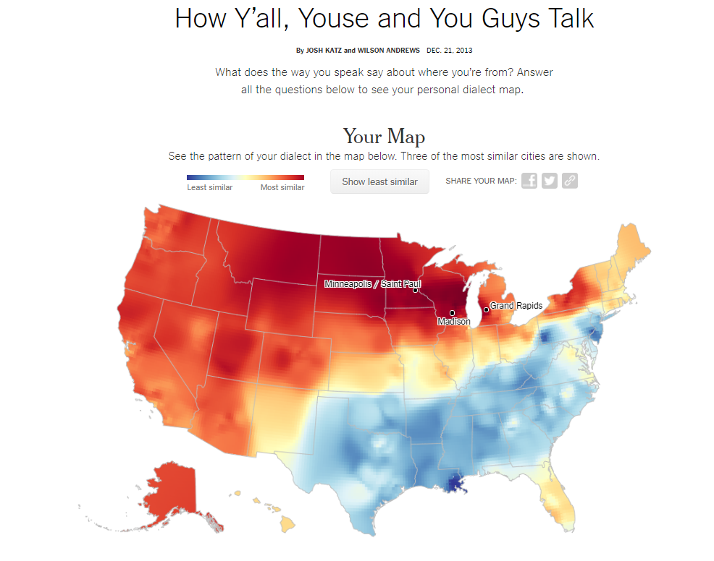
https://www.nytimes.com/interactive/2014/upshot/dialect-quiz-map.html

Slide 83
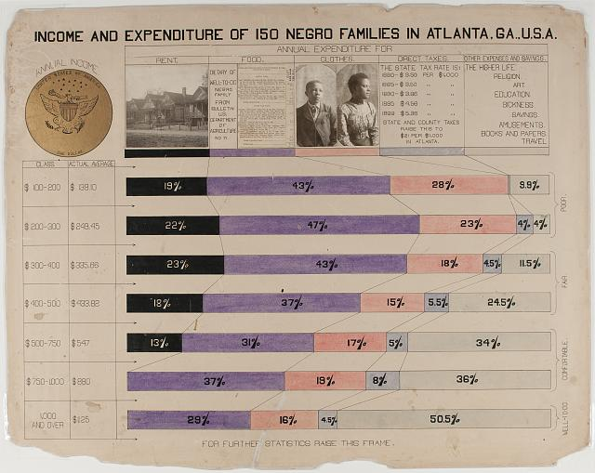
Image Source: https://www.loc.gov/pictures/resource/ppmsca.33893/?co=anedub
Notes:
When a legend is more than just a legend

Slide 84
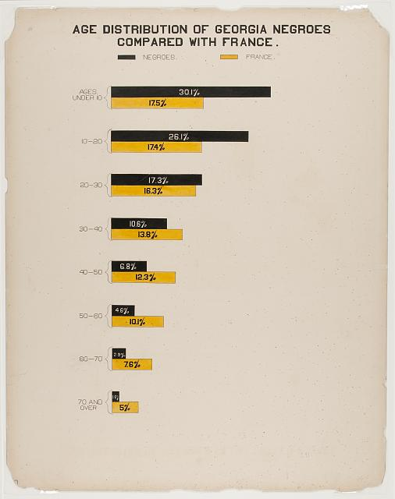
Image Source: https://www.loc.gov/pictures/resource/ppmsca.33871/?co=anedub
Notes:
The “Me” factor

