Slide 1
The Management of Unstructured Data
DSCI 330

Slide 2
What is unstructured data?
Structured Data …
Unstructured Data …
can be stored in a table.
is all other data.
Computer World: Unstructured information might account for more than 70%–80% of all data in organizations.
^{-Wikipedia}

Slide 3
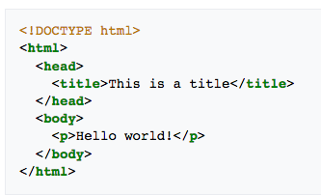

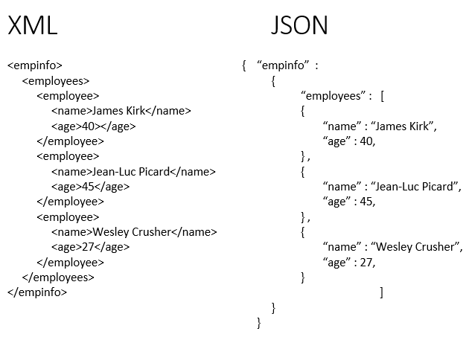
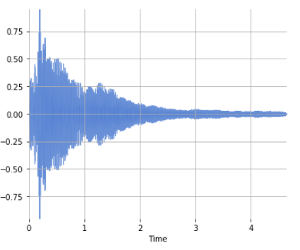
Examples
HTML
Image/Video
image source
XML
JSON
image source
Audio
image source
image source

Slide 4
DSCI 330 The Management of Unstructured Data
Data Types
Additional Topics
Text
Web Pages/Scraping
Audio
Images
JSON/XML (coming soon)
Videos (coming soon)
Python basics
Git and GitHub
Programming concepts
Name Selection
Abstraction with Functions
Refactoring
Unit Tests

Slide 5
Teaching Python with Text Processing
Cleaning up text
Decomposing a problem
Composing Functions
Basic string processing
Simple questions about words,
i.e. average word length
Iteration with comprehensions
Composition
More complicated questions about words
Dictionaries and sets
Accumulator pattern/Group by/Reduce by

Slide 6
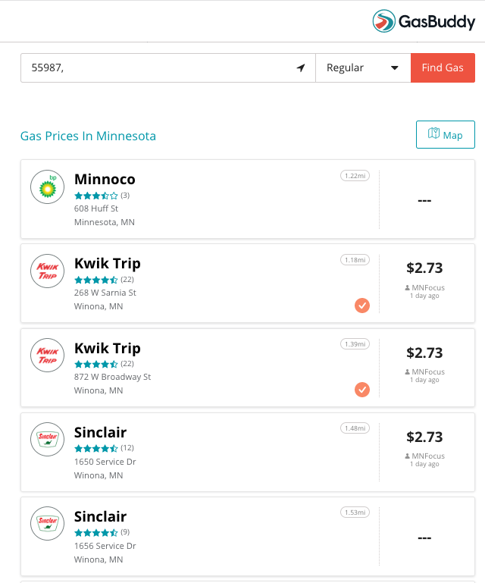
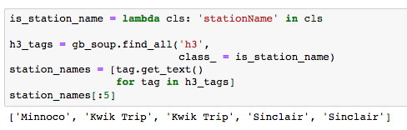
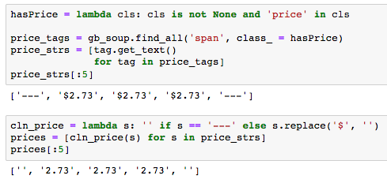
Web Scraping

Slide 7
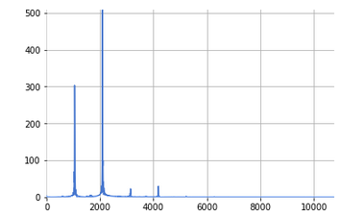
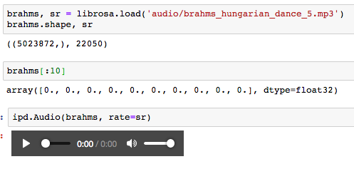
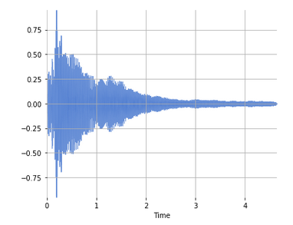
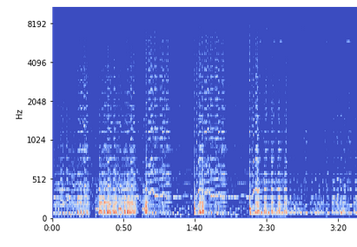
Audio
Frequency Domain
Digital Representation and Python Tools
Time Domain
Mel-Spectogram

Slide 8
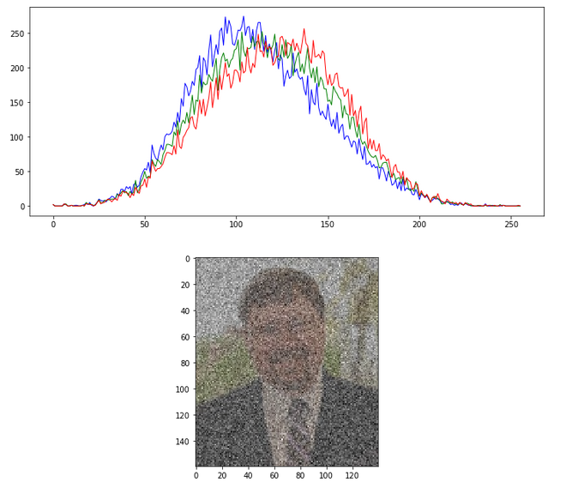
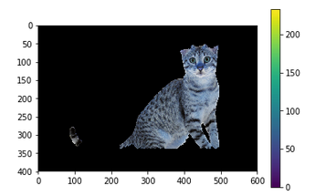
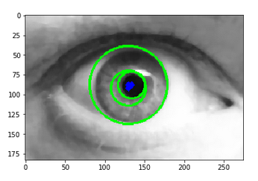
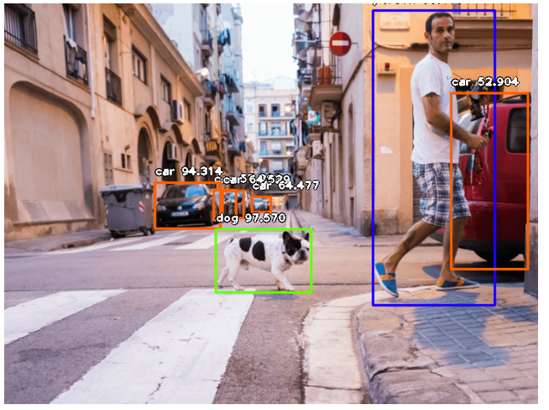
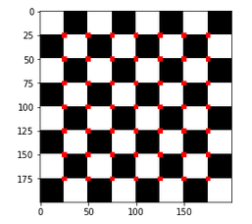
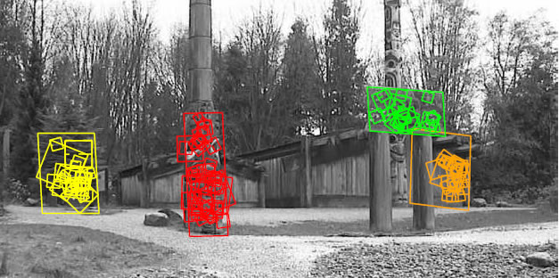
Images Student Presentations
Smoothing & Edge Detection
Circle Detection
GrabCUT algorithm
Object Detection
Scale Invariant
Feature Transformation
Harris
Corner Detections

Slide 9
Data Science at Scale
DSCI 430

Slide 10

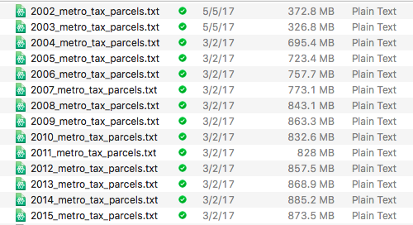
The Problem Processing large data
Competition:
Data analytics competition
1 Month with data
Context:
Determine relationship between water quality and the surrounding properties
Takeaway:
Most groups struggled with the size of the data
Data science students should be able to handle this problem
data source (use Big Query)

Slide 11
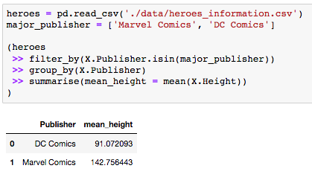
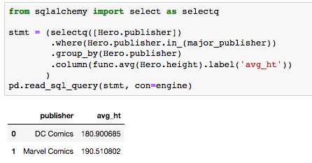
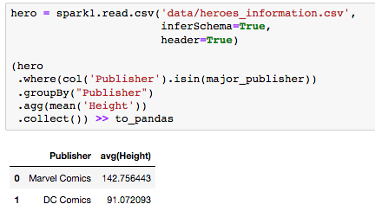
DSCI 430 Data Science at Scale
Pandas + dfply
sqlalchemy
pyspark
The Good
Best for data that fits in RAM
Can read large data in chunks
The Bad
Working with large data is slow and clunky
The Good
Best for large data that still fits on the hard drive
35% improvement over read/writing large files
The Bad
Creating the initial database is a hassle
The Good
Best for data won’t fit on a single machine
No upper bound on data size
The Bad
Need expensive infrastructure

Slide 12
An argument for teaching data verbs

Slide 13

Resources
DSCI 330
https://github.com/yardsale8/DSCI330
https://www.nltk.org/book/
https://musicinformationretrieval.com/
https://docs.opencv.org/2.4/doc/tutorials/tutorials.html
DSCI 430
https://github.com/yardsale8/DSCI430

