Slide 1
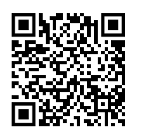


What belongs together? Using elemental groupings and Gestalt principles to help students design more insightful data visualizations
Silas Bergen
sbergen at winona dot edu
2023 US Conference on Teaching Statistics
June 2, 2023
https://bit.ly/3OM7ff6
Breakout materials

Slide 2
Course context
Week 2 of DSCI 310: data visualization course
Just covered: grammar of graphics (how to specify a data → graph mapping)
Not covered: any graphing software

Slide 3
The data: Quarterly hospital lengths of stay following an initiative to shorten lengths of stay
The question:
 | Duration of stay (in hours)
Quarter | <=24 | 24 -36 | 36 - 48 | 48 - 59 | >=60 | Unknown
Q1 | 12.20% | 53.90% | 6.30% | 18.90% | 6.90% | 1.80%
Q2 | 14.30% | 58.30% | 4.10% | 16.70% | 5.90% | 0.70%
Q3 | 19.50% | 52.20% | 2.80% | 17.40% | 7.00% | 1.10%
Q4 | 25.40% | 50.30% | 2.70% | 14.40% | 5.60% | 1.70%
Has the initiative worked?
How can we best graph these data to answer this question?
Source: https://community.storytellingwithdata.com/exercises/how-can-we-improve-this-graph
Knaflic, Cole. storytellingwithdata.com.

Slide 4
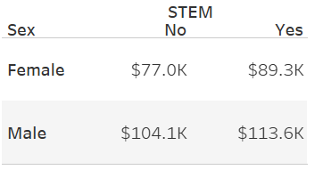
The data: mean income by field of occupation among MNs with master’s (ACS 2016)
The question:
How does the income gender gap differ by field of occupation (STEM vs non-STEM)?
How can we best graph these data to answer this question?

Slide 5

You must always begin with a clear sense of what belongs together, that is, what your readers should perceive as belonging to the same group because those units of information have something in common….
…It’s your job to make this grouping obvious to your readers. It shouldn’t be up to your readers to do the work of arranging the content into meaningful groups when you can do this in advance for them.
-Show me the numbers pg. 145.

Slide 6
What belongs together?
Define elemental groupings: an individual or small collection of data values where interest lies in comparing this individual or collection across levels of one or more grouping variable

Slide 7
How to identify elemental groupings?
Define your message (think: “headline” or “question”)
Find the data values that represent the subject of the headline
This set of data values = one elemental grouping

Slide 8
How does the gender gap differ by field (STEM vs non-STEM)?
Sentence subject: gender gap
($77.0K, 104.1K) constitute one elemental grouping
($89.3K, $113.6K) constitute a second elemental grouping
These groupings should be preserved and emphasized in any visualization of these data intended to address the question above
These data values define a gender gap
These data values define another gender gap

Slide 9
What if the question subject is unclear? Rephrase the question so it’s not (from a data perspective)
Has the initiative worked?
Could become….
Have the short stays increased?
 | Duration of stay (in hours)
Quarter | <=24 | 24 -36 | 36 - 48 | 48 - 59 | >=60 | Unknown
Q1 | 12.20% | 53.90% | 6.30% | 18.90% | 6.90% | 1.80%
Q2 | 14.30% | 58.30% | 4.10% | 16.70% | 5.90% | 0.70%
Q3 | 19.50% | 52.20% | 2.80% | 17.40% | 7.00% | 1.10%
Q4 | 25.40% | 50.30% | 2.70% | 14.40% | 5.60% | 1.70%
One elemental grouping
A second elemental grouping

Slide 10
How do we show “what belongs together”? Gestalt principles of grouping

Slide 11
How many “5”s are there?
6
3
1
2
1
9
5
3
2
8
5
5
7
5
5
4
9
5
5
4
3
6
5
3
9
4
3
5
8
2
2
1
5
7
4
3
1
5
5
7
6
5
9
8
4
2
4

Slide 12
How many “5”s are there?
6
3
1
2
1
9
5
3
2
8
5
5
7
5
5
4
9
5
5
4
3
6
5
3
9
4
3
5
8
2
2
1
5
7
4
3
1
5
5
7
6
5
9
8
4
2
4
Inspired by Fig 6.2, The Functional Art by Alberto Cairo

Slide 13
gestalt = form or pattern
Gestalt philosophy: the whole is greater than the sum of the parts
Gestalt principles: predictable ways by which we organize sensory information
Developed by Max Wertheimer & followers; early 20th century

Slide 14

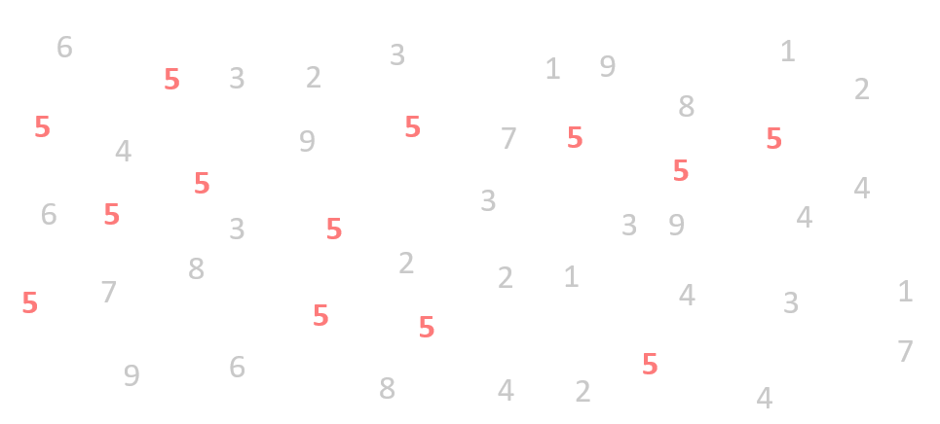
Figure and ground
Pittsburgh Zoo & PPG Aquarium logo

Slide 15
Similarity
Rows or columns?

Slide 16
Similarity
Rows or columns?

Slide 17
Proximity
Rows or columns?

Slide 18
Connection
Rows or columns?

Slide 19
Enclosure
Rows or columns?

Slide 20
Some principles are stronger than others

Slide 21
Rows or columns?

Slide 23
Notes:
Left/right
Within left: columns; within right: rows

Slide 24
Notes:
Left/right
Within left: columns; within right: rows

Slide 25
Gestalt principles in hierarchy | Graphical elements that activate the principle
Enclosure | Facets
2. Connection | Lines
3. Proximity | 3. White space
4. Similarity | 4. Color/shape

Slide 26
Implications for practice
Know the graph’s intent
Identify the elemental groupings in your data
Employ Gestalt principles to protect the integrity of the
elemental groupings

Slide 27
Example: Hospital stays
Data on quarterly duration of hospital stays following initiative to lower length of stay
 | Duration of stay (in hours)
Quarter | <=24 | 24 -36 | 36 - 48 | 48 - 59 | >=60 | Unknown
Q1 | 12.20% | 53.90% | 6.30% | 18.90% | 6.90% | 1.80%
Q2 | 14.30% | 58.30% | 4.10% | 16.70% | 5.90% | 0.70%
Q3 | 19.50% | 52.20% | 2.80% | 17.40% | 7.00% | 1.10%
Q4 | 25.40% | 50.30% | 2.70% | 14.40% | 5.60% | 1.70%
Question: Has the initiative worked?
Aka:
Have the short stays increased?

Slide 28
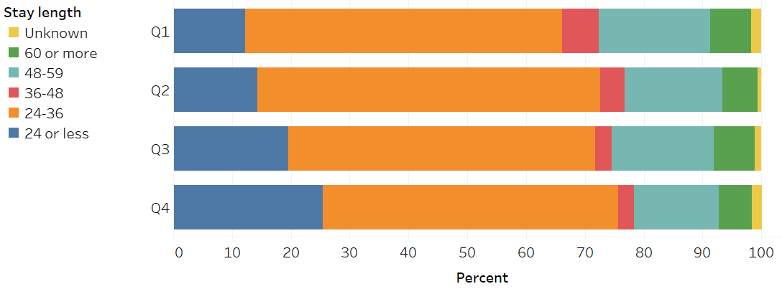
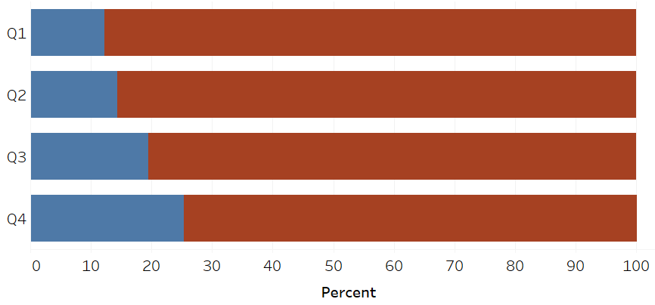
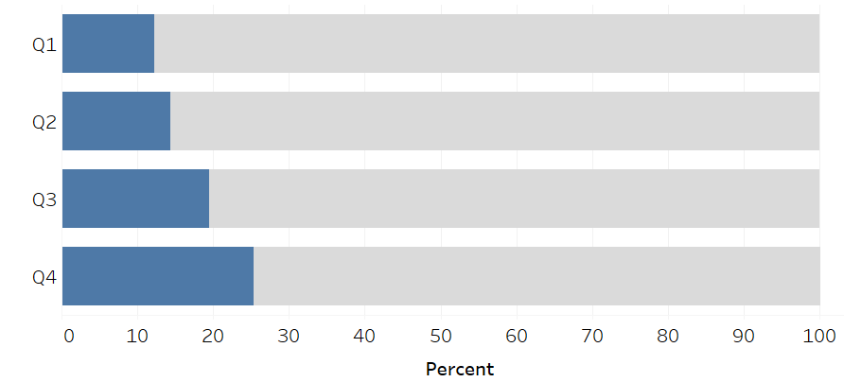


Graph A
Which graph is “best” and why?
What Gestalt principles are at play?
Graph B
$≤$ 24 hrs
More than 24 hrs
Graph C
$≤$ 24 hrs
More than 24 hrs

Slide 29
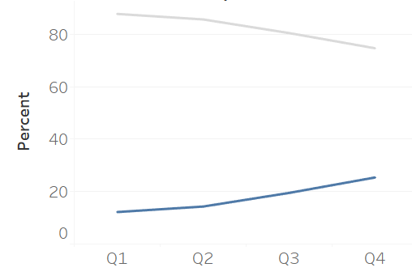
Similarity and connection:
The rate of stays $≤$ 24 hours has increased relative to stays > 24 hours

Slide 30
Example
Data: average income of Minnesotans, in 2016, among people with a master’s degree working full time (source: American Community Survey)
Question: How does the gender gap differ by field (STEM vs non-STEM)?

Slide 31
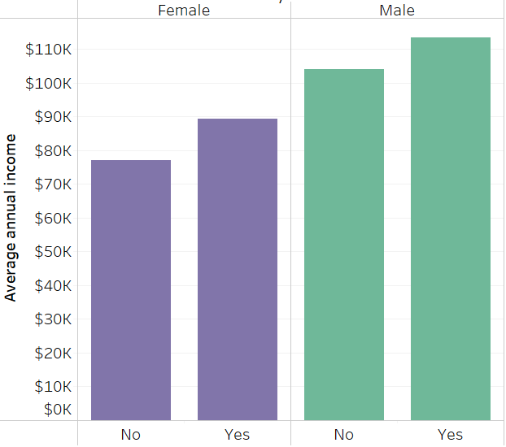
Thoughts on this graph?
Question: How does the gender gap differ by field (STEM vs non-STEM)?
Stem?
Stem?

Slide 32
How does the gender gap differ by field (STEM vs non-STEM)?
We see two groups:
Purple bars on right
Green bars on left
But these are not the elemental groupings! The geometries representing gender gap members are:
Far apart (proximity)
Different colors (similarity)
In different facets (enclosure)
So do these!
These belong together!

Slide 33
($77.0K, 104.1K) constitute one elemental grouping
They should be any/all of: close, similar, connected, and enclosed in the same region
($89.3K, $113.6K) constitute a second elemental grouping
They should be any/all of: close, similar, connected, and enclosed in the same region
These data values define a gender gap
These data values define another gender gap

Slide 34
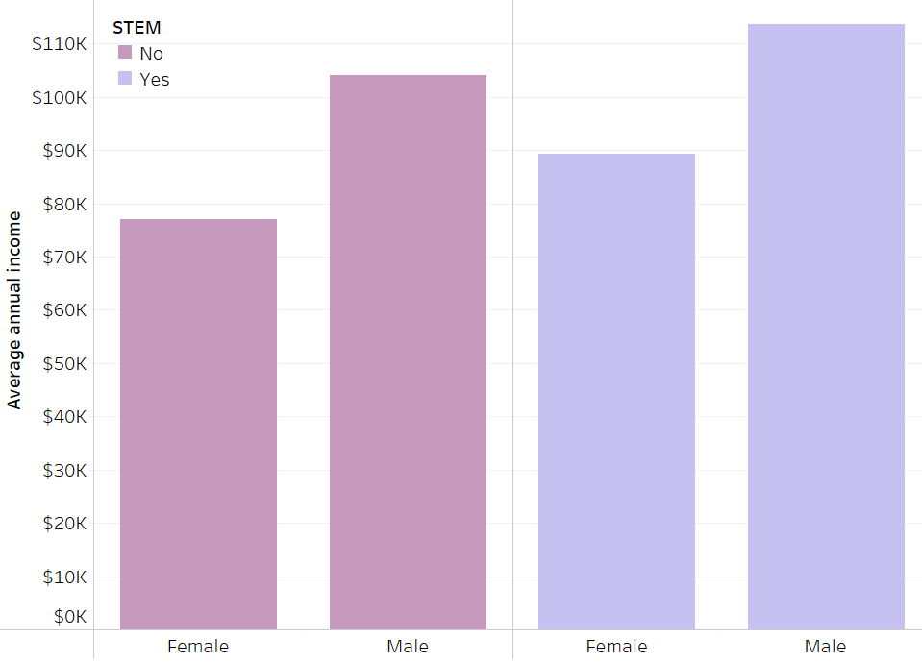
Better
Geometries representing data points within each elemental grouping are similar and proximal (close).

Slide 35
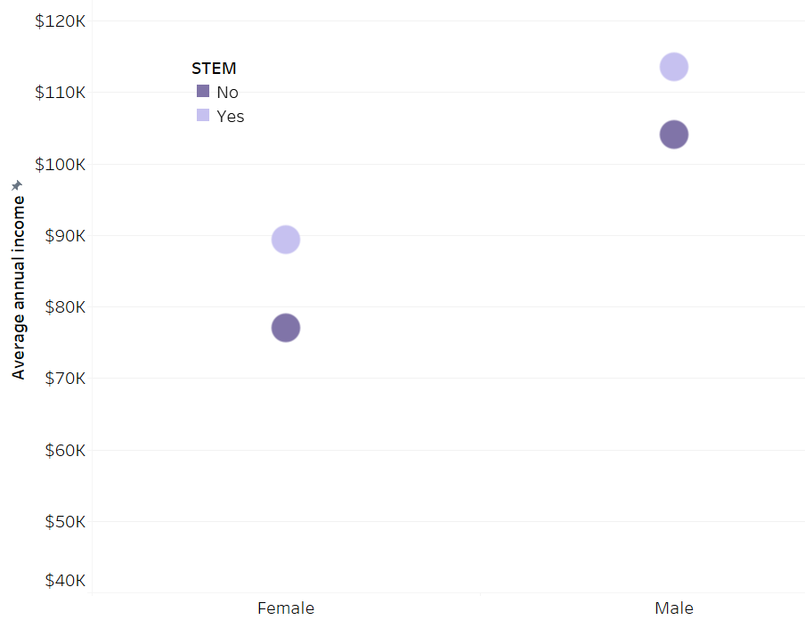
Room for improvement
These belong together…
…not these
Geometries representing items within each elemental grouping are similar, but greater proximity of items across elemental grouping results in unclear communication of what belongs together (proximity > similarity)

Slide 36
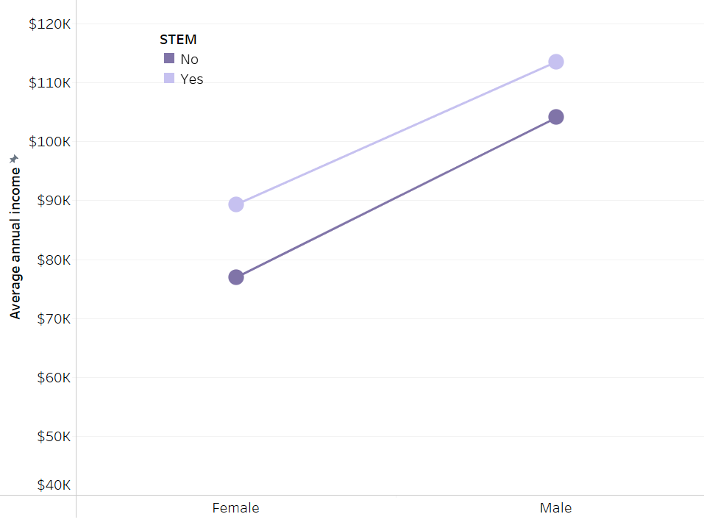
So improved
Adding connection strengthens the sense of what belongs together

Slide 37
ACTIVITY TIME!!

Slide 38
Student work and comments

Slide 39
Despite growth, rural Americans have consistently lower levels of smartphone ownership than urbanites and suburbanites.
Year | Residence | % with smartphone
2011 | Rural | 21
2011 | Suburban | 37
2011 | Urban | 38
2016 | Rural | 58
2016 | Suburban | 78
2016 | Urban | 77
2021 | Rural | 80
2021 | Suburban | 84
2021 | Urban | 89
One elemental grouping
Headline subject: growth
Elemental grouping: data points that would depict growth

Slide 40
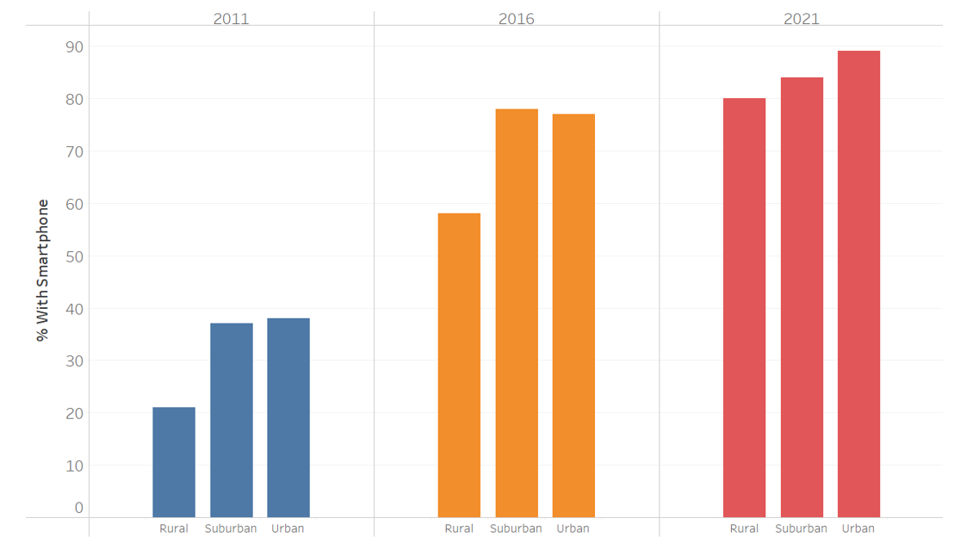
One elemental grouping
Original design: the elemental grouping members are:
Dissimilar
Far apart
In separate enclosures

Slide 41
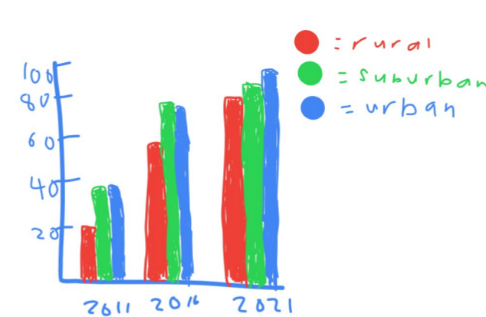
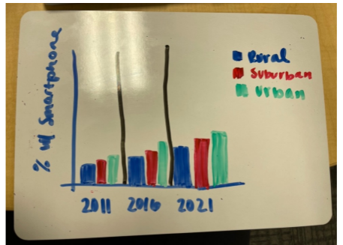
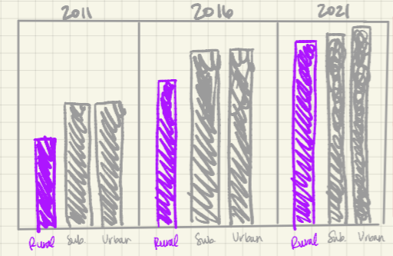
Original grouping preserved
Color used to make the items inside the elemental grouping similar, but they are still difficult to perceive as a group because they are in separate enclosures and/or far apart.

Slide 42
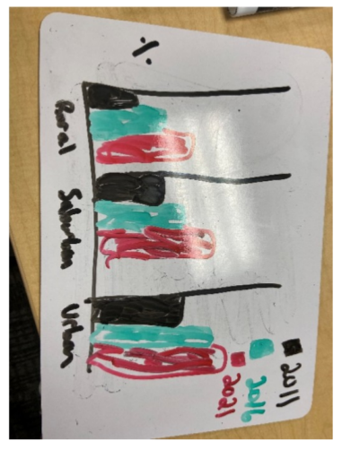
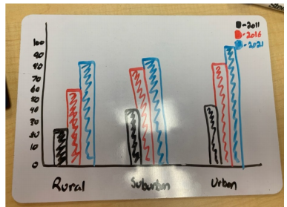
Improved enclosure / proximity
However, the items within each elemental grouping (the rural, suburban, urban triplets) are different colors (dissimilar): better not to map Year to color.

Slide 43
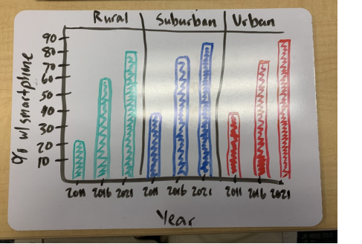
Members of elemental groupings are now similar and in same enclosure

Slide 44
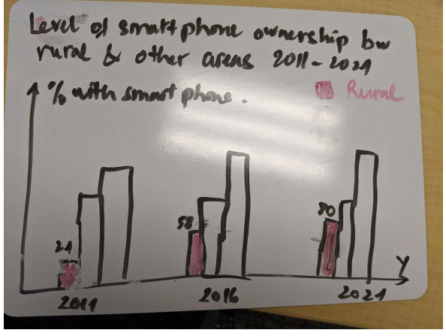
Boxes removed, “rural” set apart from the other two regions
Suburban/urban now clearly “other” from rural (but need labeling somehow)

Slide 45
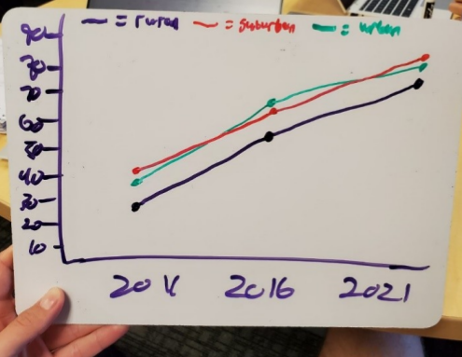
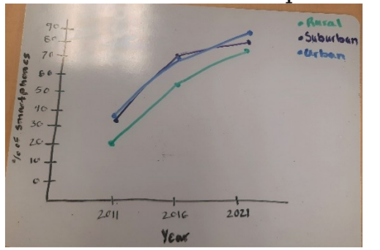
Added connection to enhance the sense of “what belongs together” – growth by region now much more apparent, lack of enclosure makes it easy to compare the trends

Slide 46
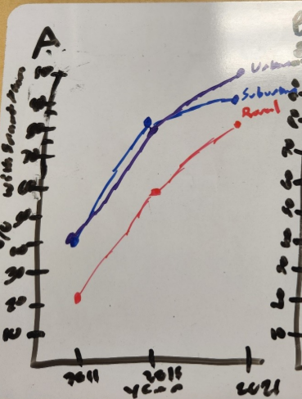
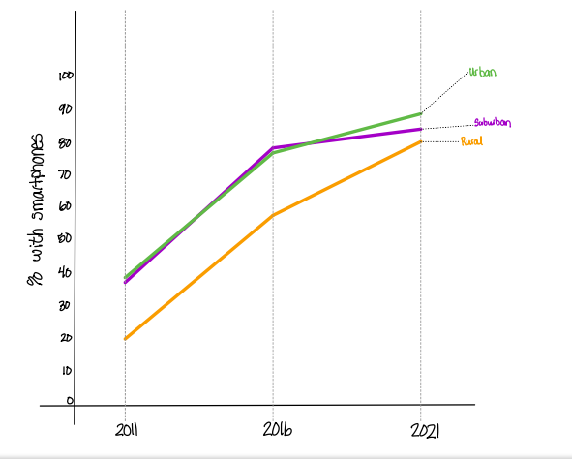
Enhanced, color-coded line-end labeling allows doing away with legend

Slide 47
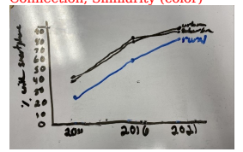
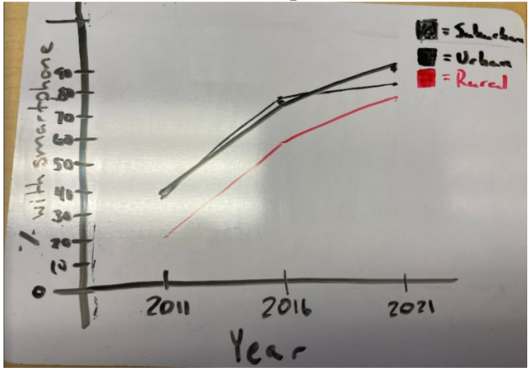
Emphasizing “rural” enhances the clarity of what viewers should focus on (though the legend doesn’t work when 2 colors are identical)

Slide 48
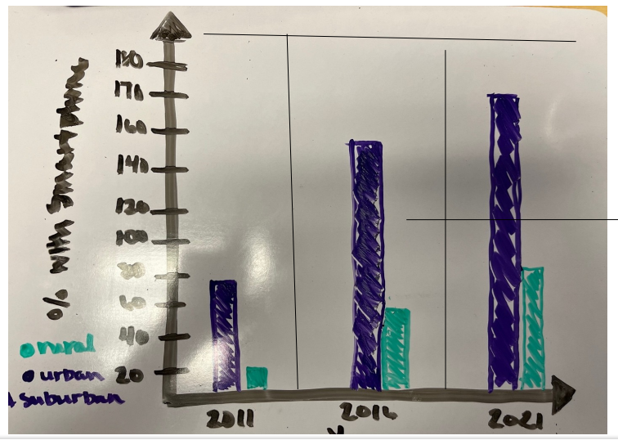
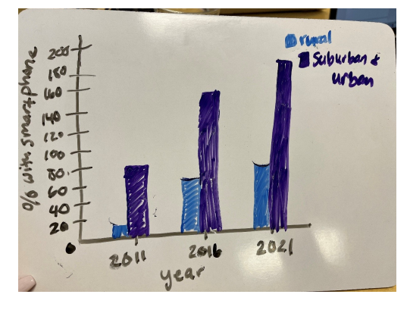
CAREFUL WITH COMBINING!!
Careful with combining into “other”! 2016 and 21 exceed 100%.
Year | Residence | % with smartphone
2011 | Rural | 21
2011 | Suburban | 37
2011 | Urban | 38
2016 | Rural | 58
2016 | Suburban | 78
2016 | Urban | 77
2021 | Rural | 80
2021 | Suburban | 84
2021 | Urban | 89
No combination of these %’s is required to sum to 100%.

Slide 49
Awesome sources for your data viz class
Stephen Few. 2012. Show Me the Numbers: Designing Tables and Graphs to Enlighten. Analytics Press; Second edition, Burlingame, CA.
Cole Knaflic. Storytelling with data (2015) and Storytelling with data: let’s practice! (2020) Also the storytellingwithdata.com blog.
https://www.makeovermonday.co.uk/

