Slide 1
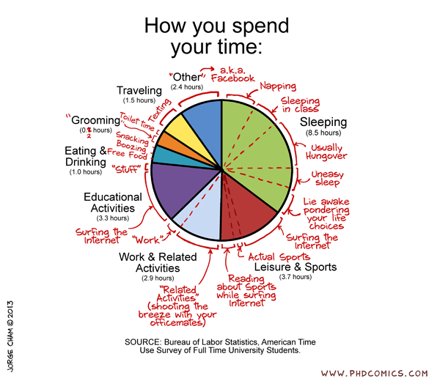
Session #2 Time Use Example
Article: https://www.nbcnews.com/data-graphics/men-do-housework-women-still-do-more-rcna216748
Data: https://www.bls.gov/tus/

Slide 2
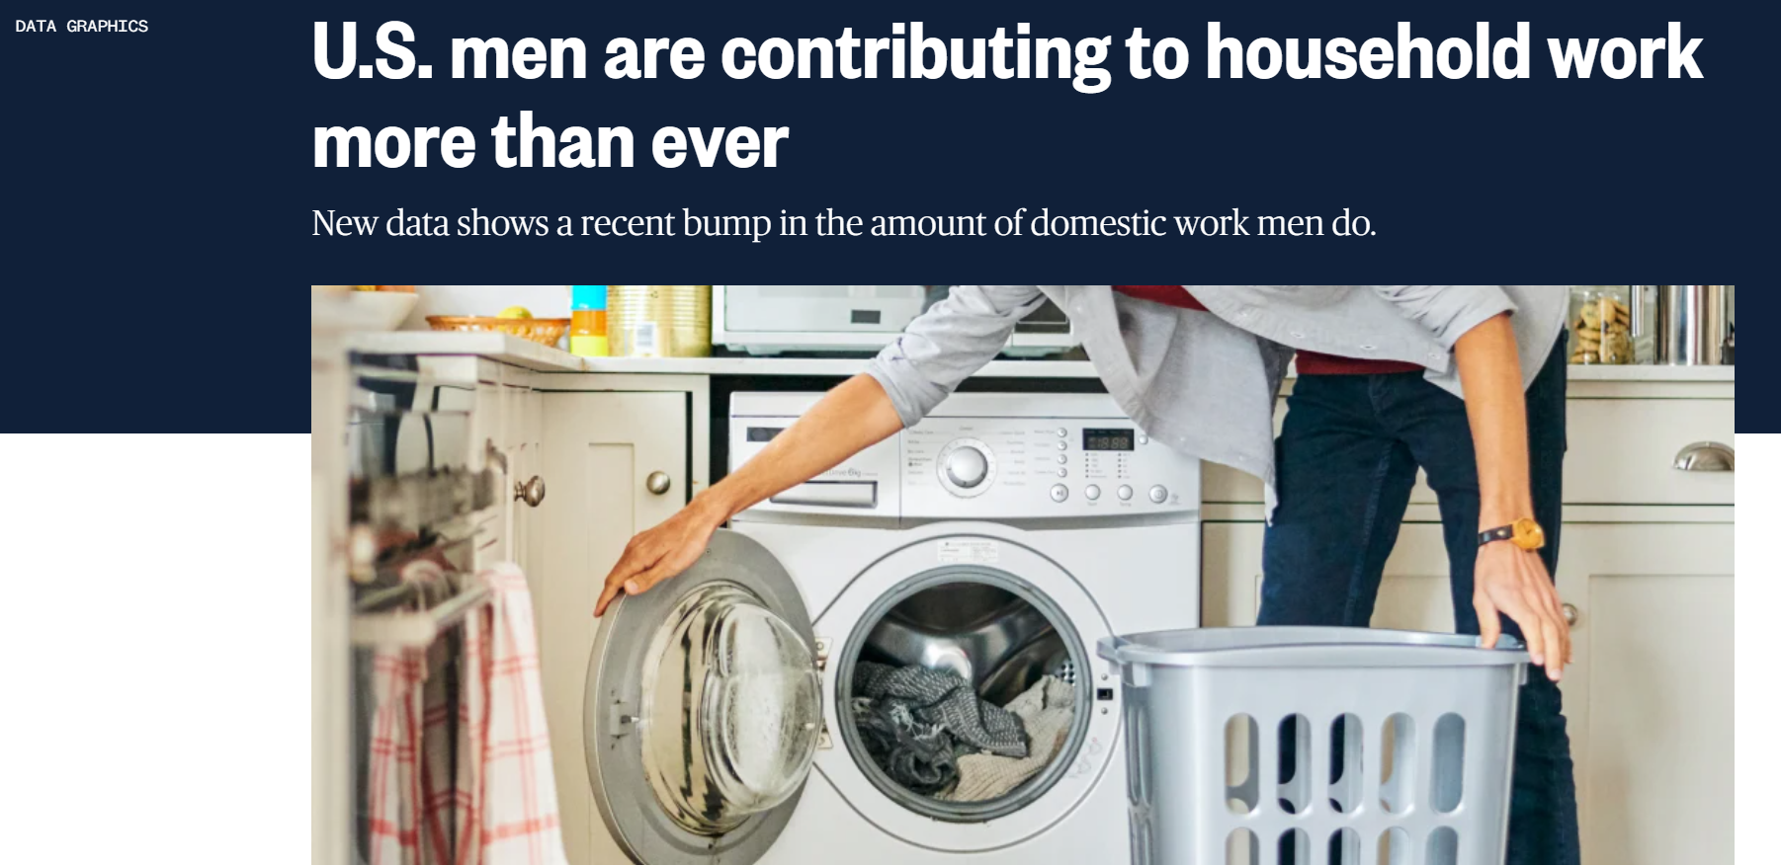


Slide 3
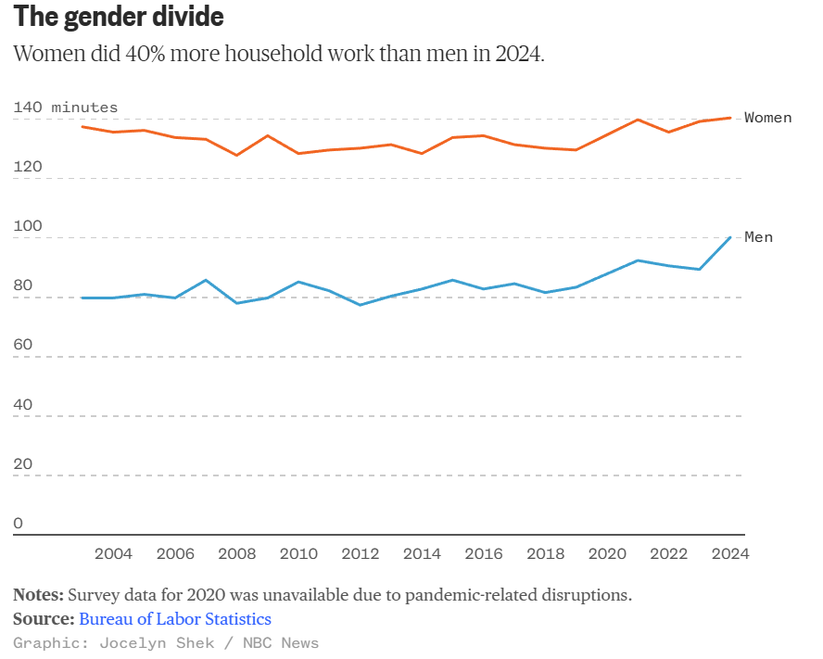
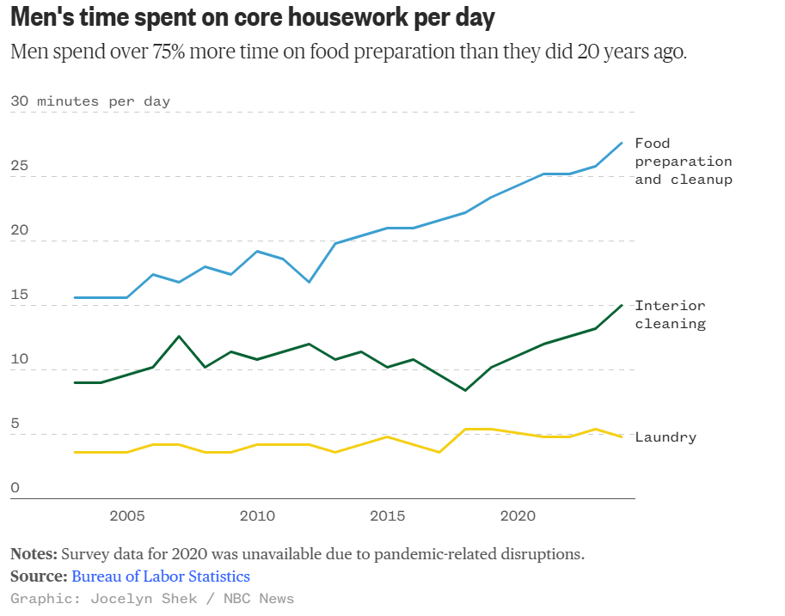
Gender Divide
Men Time Spent

Slide 4
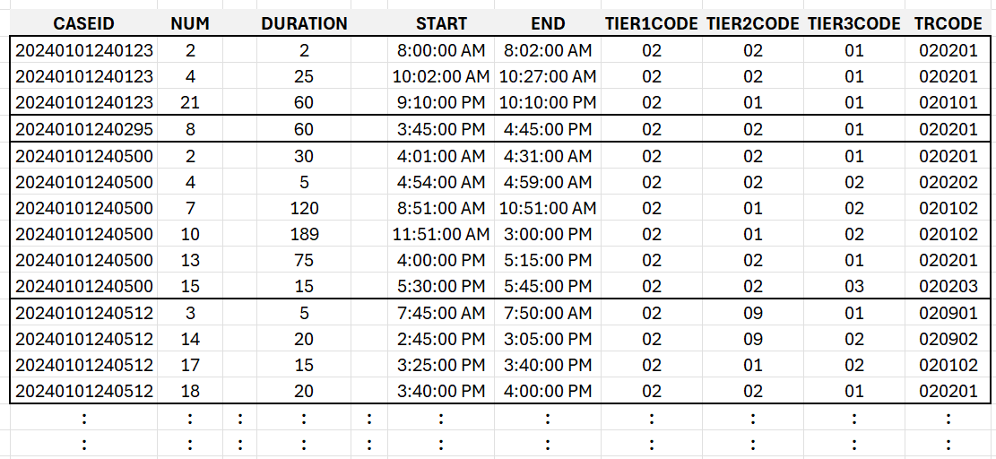
Time Use – Activity File

Slide 5
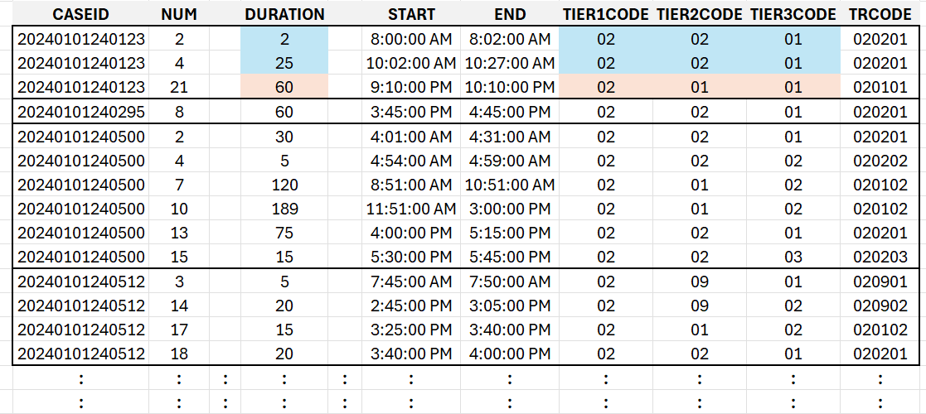
Time Use – Activity File

Slide 6
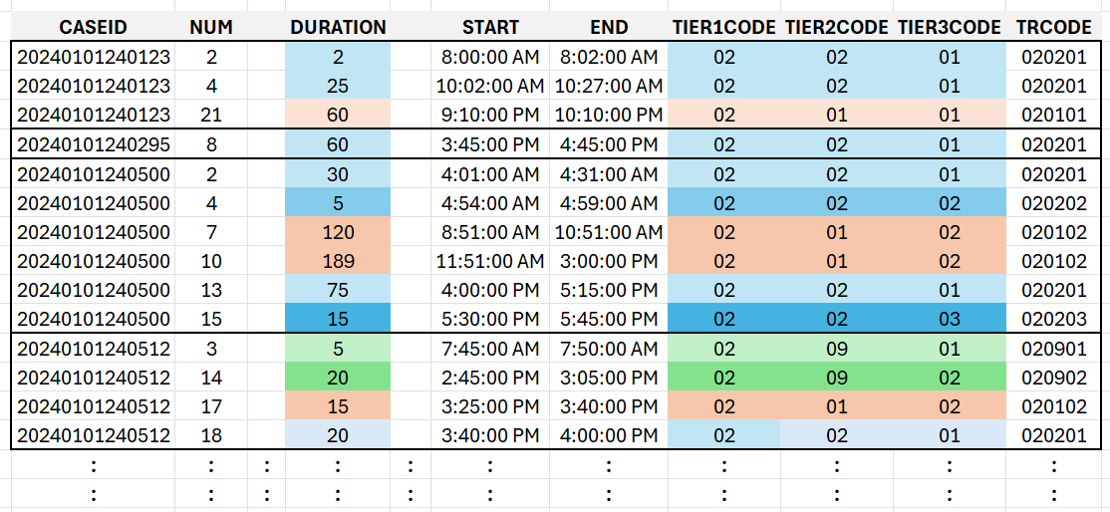
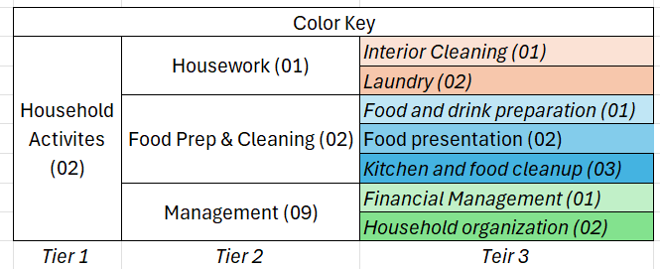
Time Use – Activity File

Slide 7
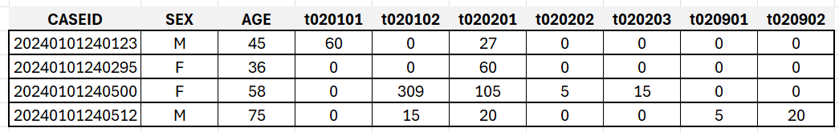
Time Use – Summary File

Slide 8
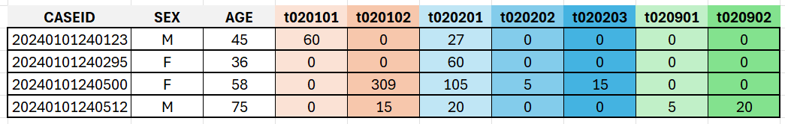
Time Use – Summary File

Slide 9
Time Use – Summary File

Slide 10
Men Time Spent
Over Time

Slide 11
Time Use – Summary Files Over Years
2003
2022
2023
2024

Slide 12
Pause

Slide 13
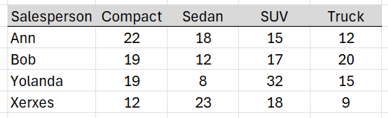
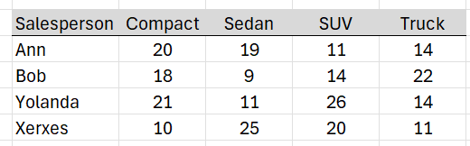
Example – Stacking Auto Sales
Course Notes
Q1 data
+
Q2 data

Slide 14
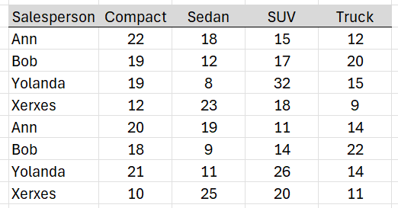
Example – Stacking Auto Sales
Course Notes
Q1 data
Q1
+
=
Q2
Q2 data

Slide 15
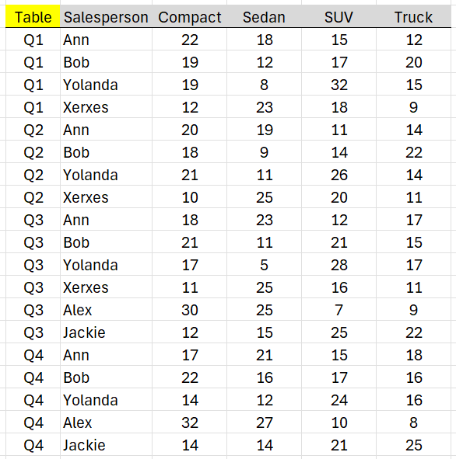
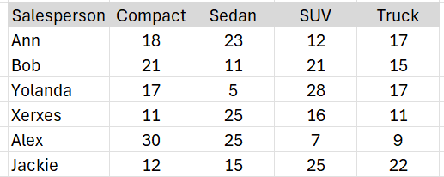
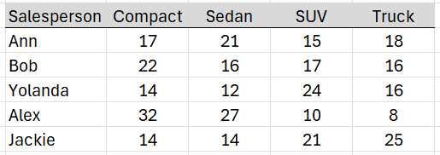
Example – Stacking Auto Sales
Course Notes
Q1
+
Q2
+
=
Q3
+
Q4

Slide 16
Men Time Spent

Slide 17
Time Use – Summary File

Slide 18
Time Use – Summary File
X
Food preparation and cleanup
Interior Cleaning
Laundry

Slide 19
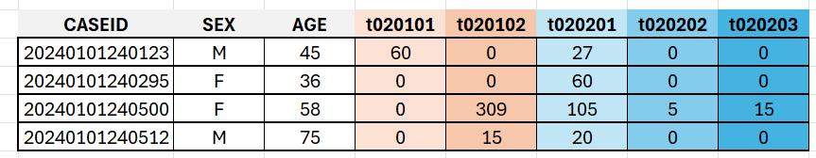
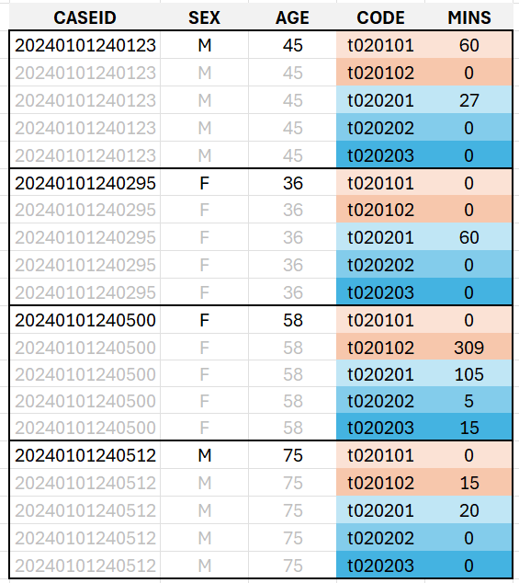
Time Use – Summary File Stacked
Unstacked
Stacked

Slide 20
Pause

Slide 21
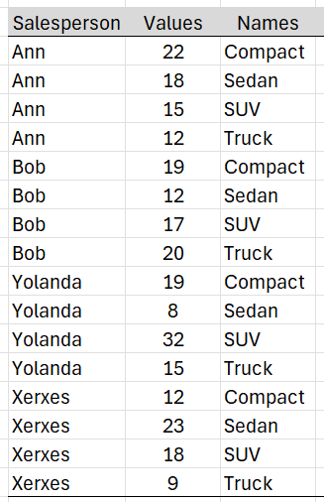
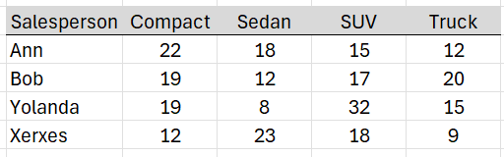
Stacking strategy
Course Notes
Same unit/context → Stack
Stacked Column Names → New Column
Row entries get replicated

Slide 22
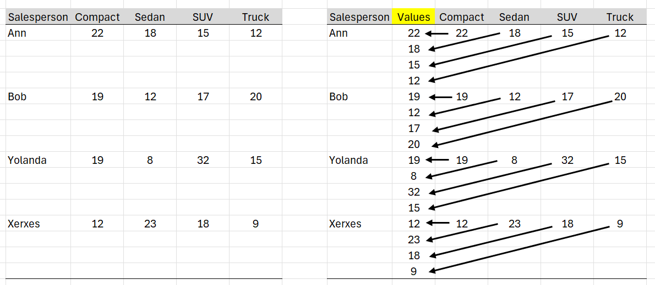
Stacking in action
Course Notes
Same unit/context → Stack

Slide 23
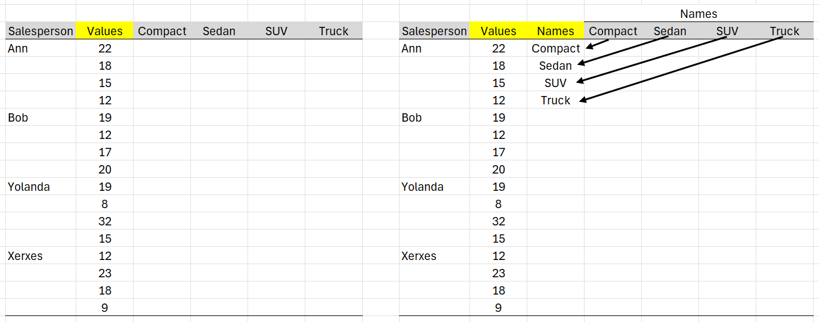
Stacking in action
Course Notes
Stacked Column Names → New Column

Slide 24
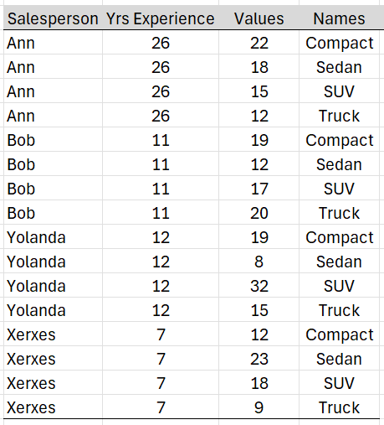
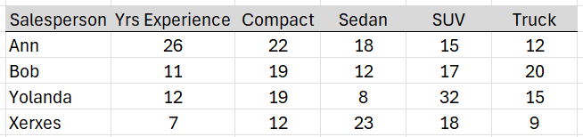
Stacking in action
Course Notes
Question: What happens to a non-stacked column?
Answer: A non-stacked column get replicated

Slide 25
Men Time Spent
3 codes into 1
single code
single code

Slide 26
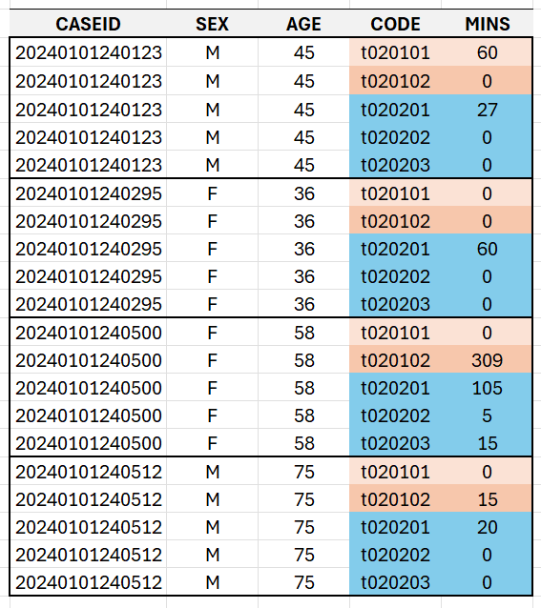
Time Use – Summary File Stacked

Slide 27
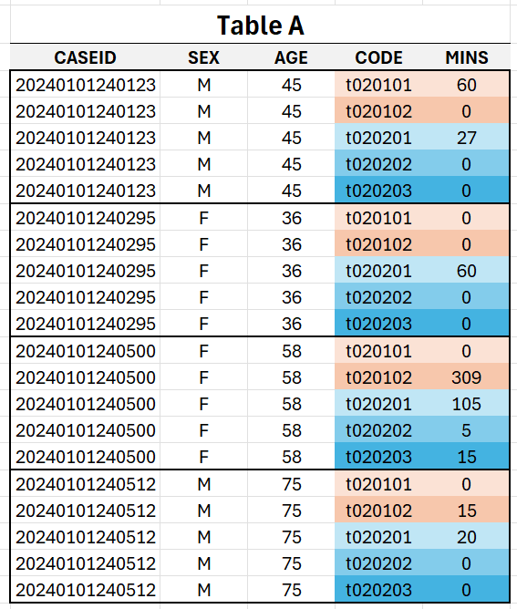
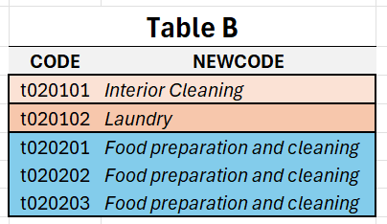

Slide 28
Pause

Slide 29
Example Left Join on DeptID
Course Notes
Employee Table
Department Table
Left Join
LastName | DeptID
Rafferty | 31
Jones | 33
Heisenberg | 33
Robinson | 34
Smith | 34
DeptID | DeptName
31 | Sales
33 | Engineering
34 | Clerical
Table 1
Table 2

Slide 30
Course Notes
Employee Table
Department Table
Left Join
LastName | DeptID
Rafferty | 31
Jones | 33
Heisenberg | 33
Robinson | 34
Smith | 34
DeptID | DeptName
31 | Sales
33 | Engineering
34 | Clerical
Table 1
Table 2
Employee.LastName | Employee.DeptID | Department.DeptID | Department.DeptName
Rafferty | 31 | 31 | Sales
Jones | 33 | 33 | Engineering
Heisenberg | 33 | 33 | Engineering
Robinson | 34 | 34 | Clerical
Smith | 34 | 34 | Clerical
Left Join: All rows from left; matching rows from right

Slide 31
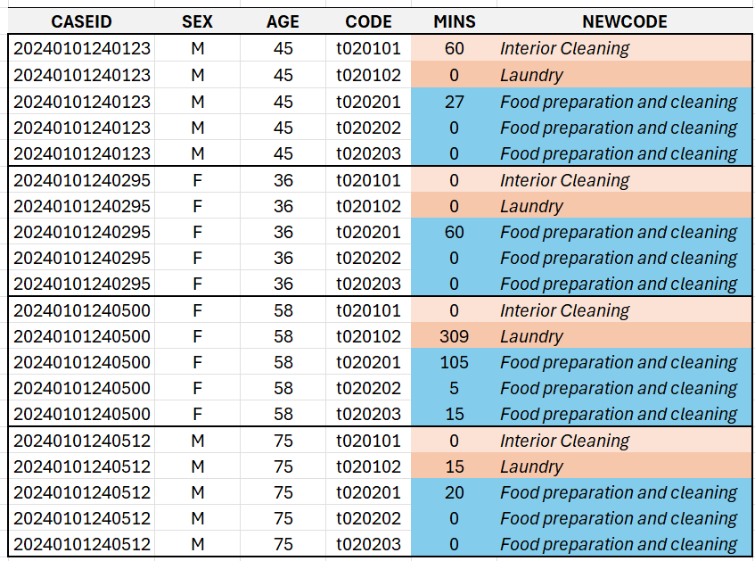
Time Use – Summary File Stacked | JOIN

Slide 32
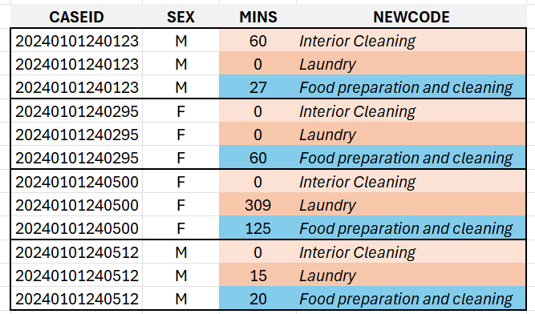
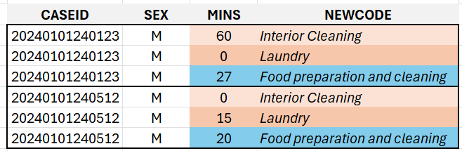
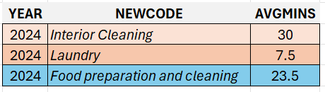
Time Use – Summary File Stacked | JOIN | FILTER | AGGREGATION

Slide 33
Men Time Spent

Slide 34
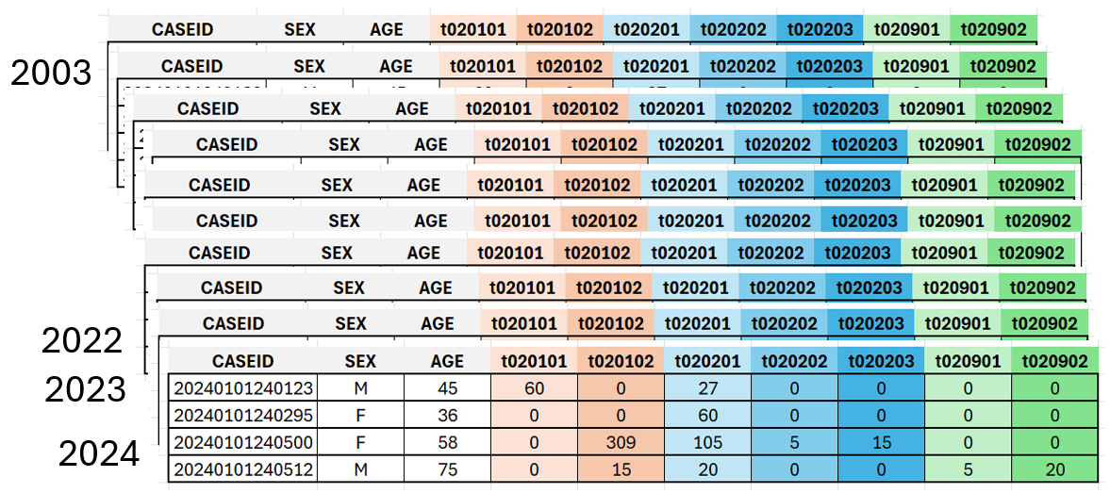
Implementation in Tableau Prep
Action Step #1: UNION

Slide 35
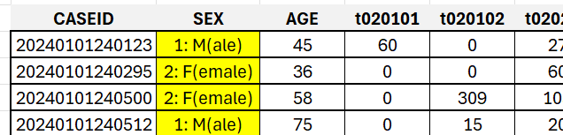
Implementation in Tableau Prep
Action Step #2: RECODE SEX

Slide 36
Implementation in Tableau Prep
Action Step #3: MUTATE - YEAR
Create YEAR via SPLIT

Slide 37
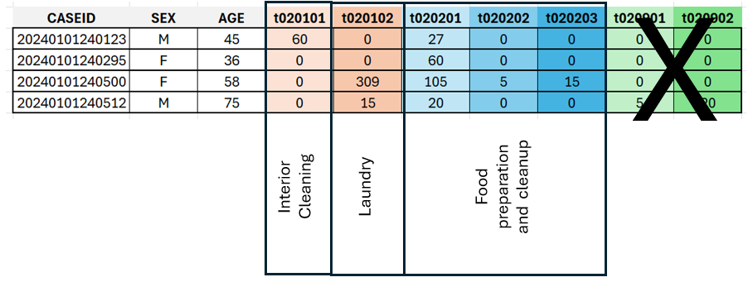
Implementation in Tableau Prep
Action Step #4: SELECT – Remove CODES
Remove unnecessary CODES

Slide 38
Implementation in Tableau Prep
Action Step #5: STACK (PIVOT)

Slide 39
Implementation in Tableau Prep
Action Step #6: JOIN

Slide 40
Implementation in Tableau Prep
Action Step #7: AGGREGATION – Total per person

Slide 41
Implementation in Tableau Prep
Action Step #8: FILTER – Males

Slide 42
Implementation in Tableau Prep
Action Step #9: AGGREGATION – AVG per activity * year

