Slide 1
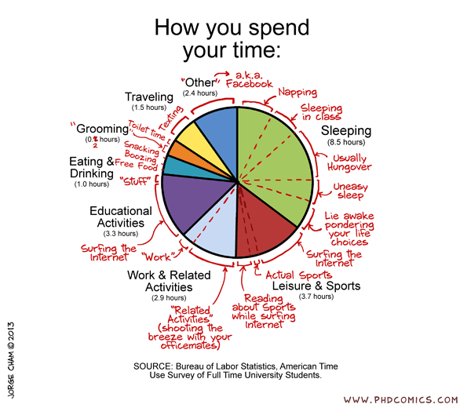
Example #2 Time Use
Article: https://www.nbcnews.com/data-graphics/men-do-housework-women-still-do-more-rcna216748
Data: https://www.bls.gov/tus/

Slide 2
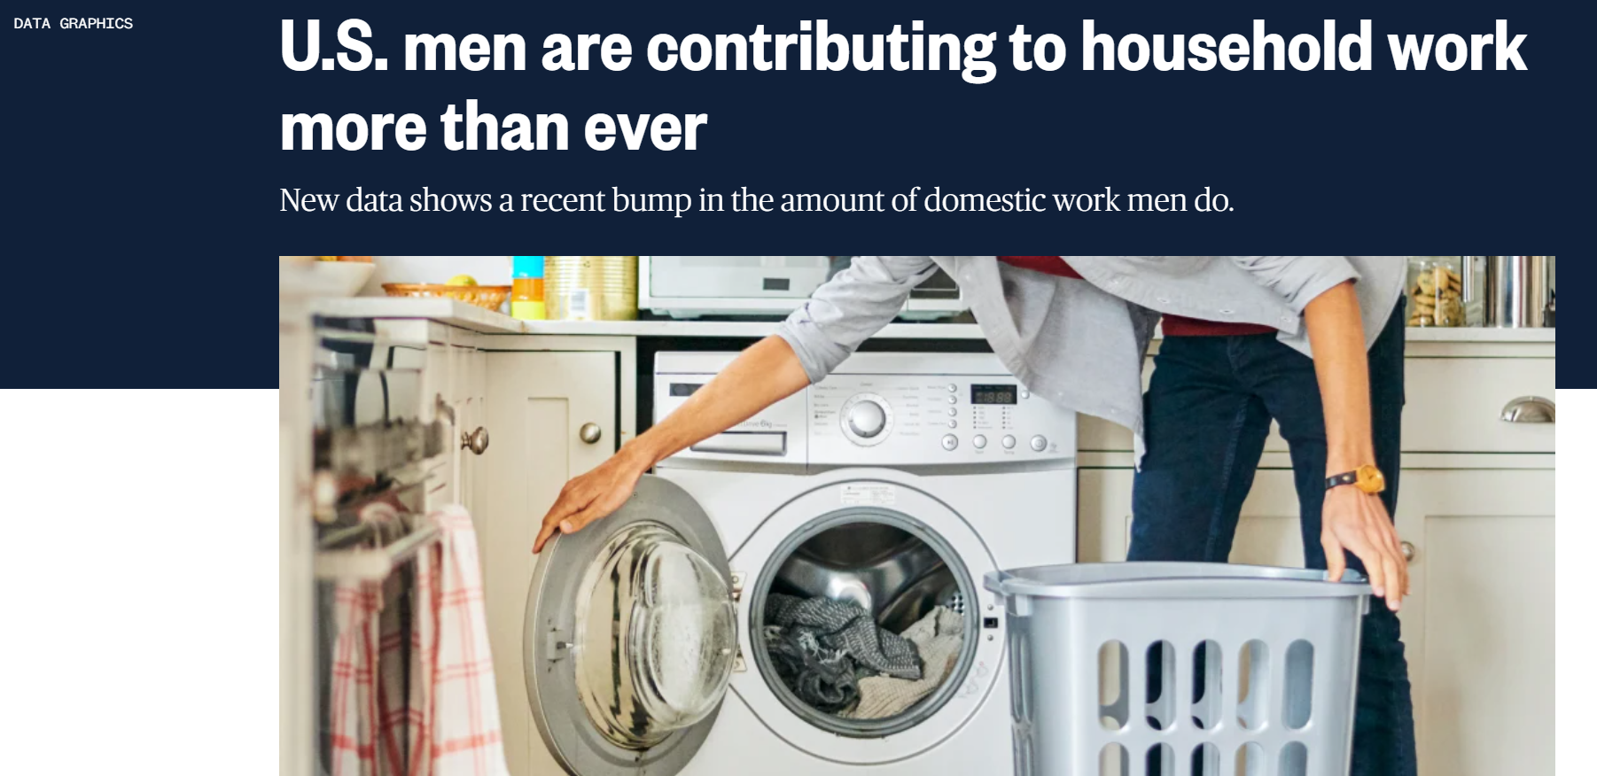


Slide 3
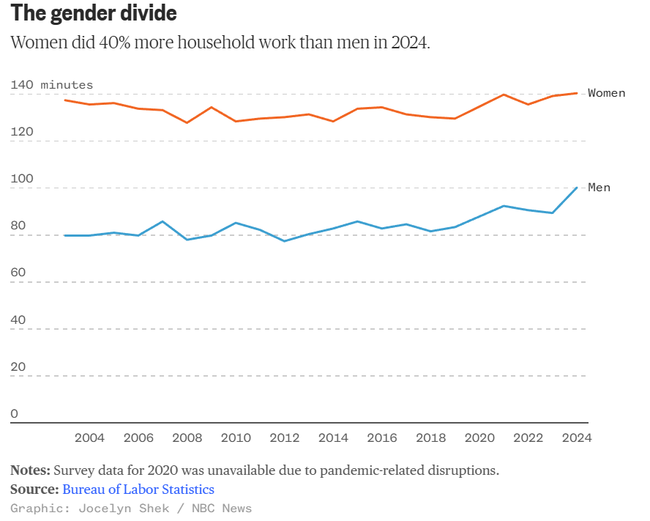
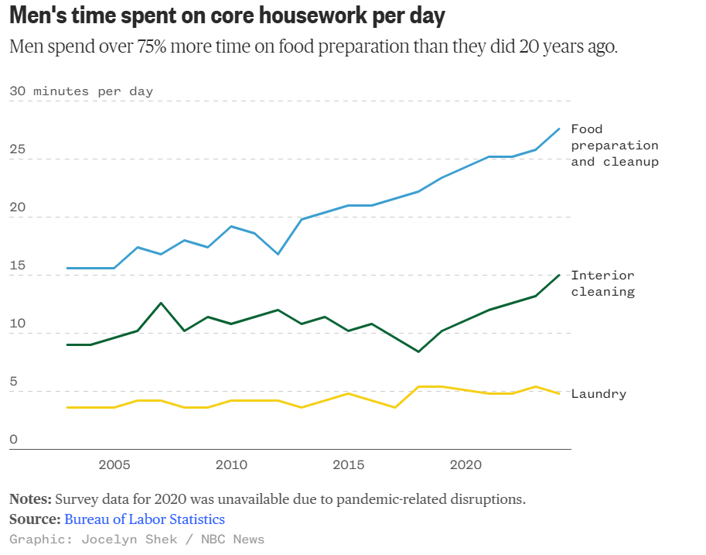
Gender Divide
Men Time Spent

Slide 4
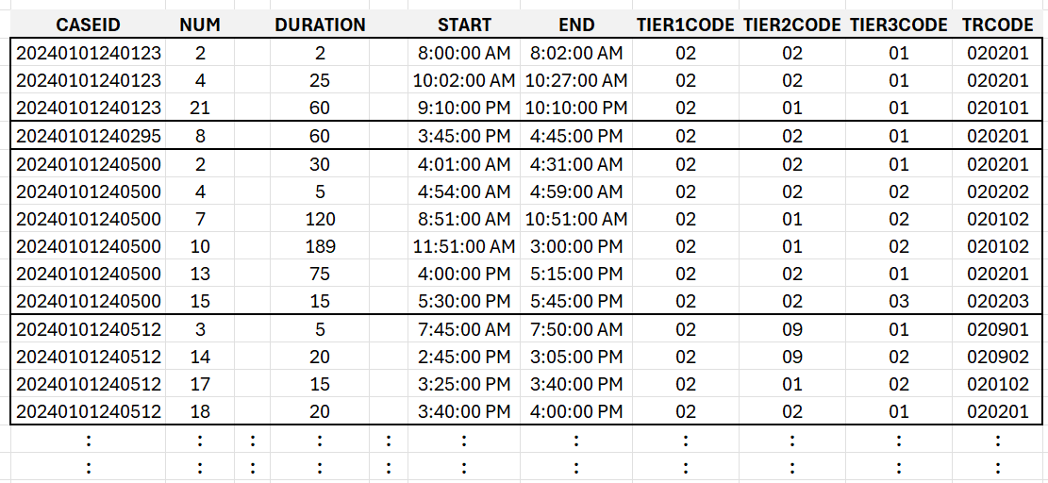
Time Use – Activity File

Slide 5
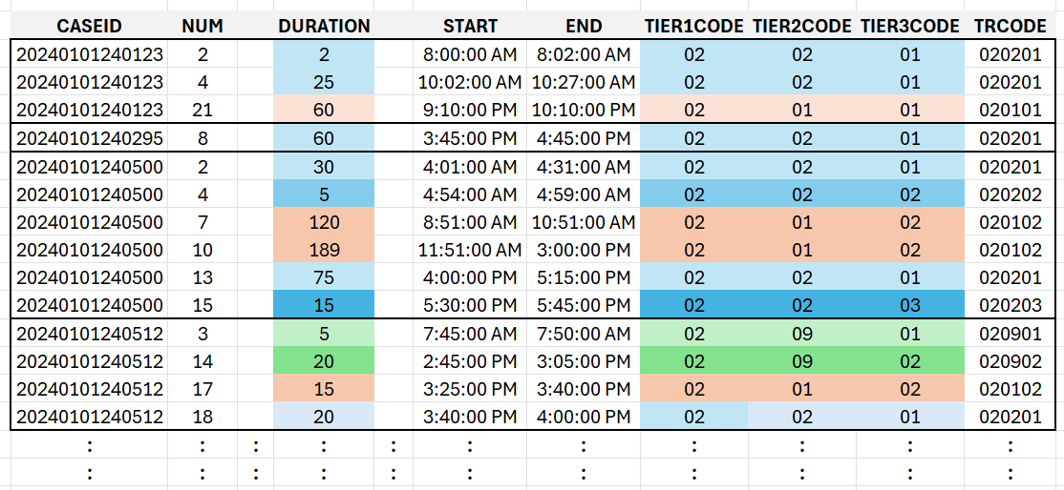
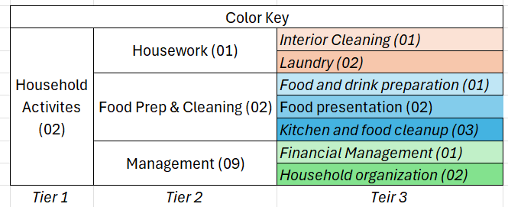
Time Use – Activity File

Slide 6
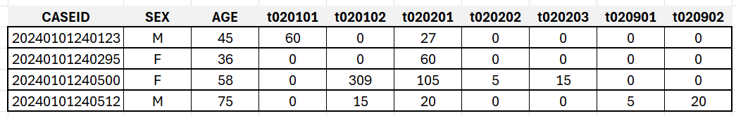
Time Use – Summary File

Slide 7
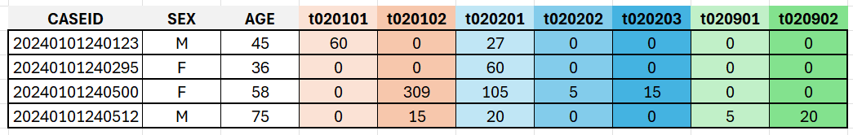
Time Use – Summary File

Slide 8
Time Use – Summary File

Slide 9
Men Time Spent
Over Time

Slide 10
Time Use – Summary Files Over Years
2003
2022
2023
2024

Slide 11
Pause

Slide 12
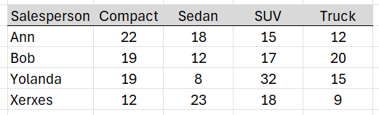
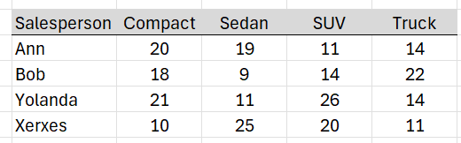
Example – Stacking Auto Sales
Course Notes
Q1 data
+
Q2 data

Slide 13
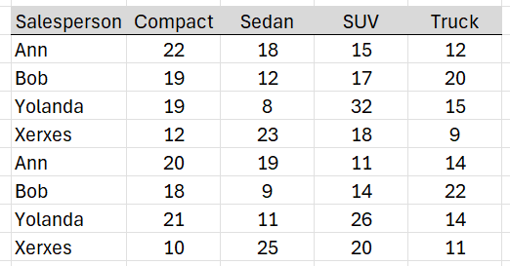
Example – Stacking Auto Sales
Course Notes
Q1 data
Q1
+
=
Q2
Q2 data

Slide 14
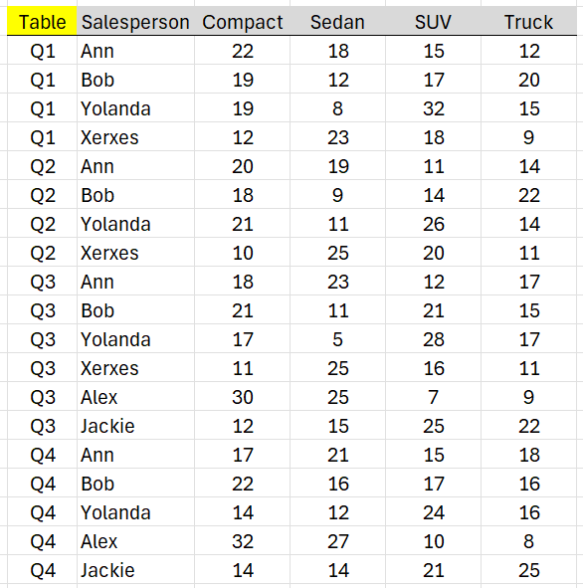
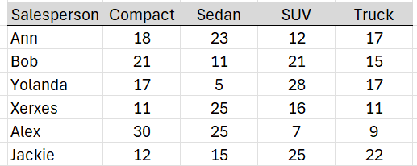
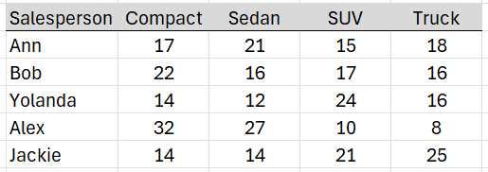
Example – Stacking Auto Sales
Course Notes
Q1
+
Q2
+
=
Q3
+
Q4

Slide 15
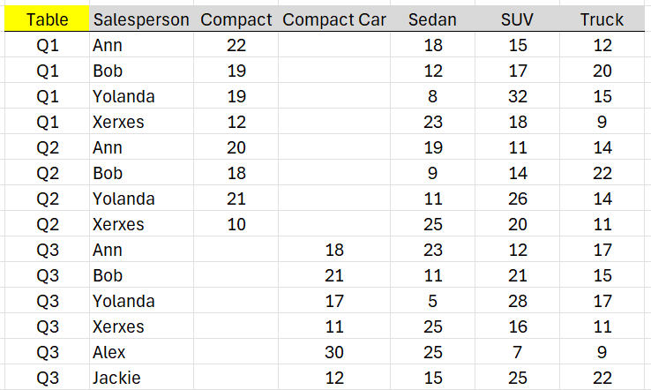
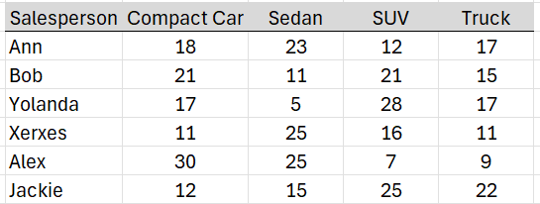
What happens with mismatched columns?
Course Notes
Q1
+
=
Q2
+
Q3
Question: Do mismatched rows matter?

Slide 16
Men Time Spent

Slide 17
Time Use – Summary File
X
Food preparation and cleanup
Interior Cleaning
Laundry

Slide 18
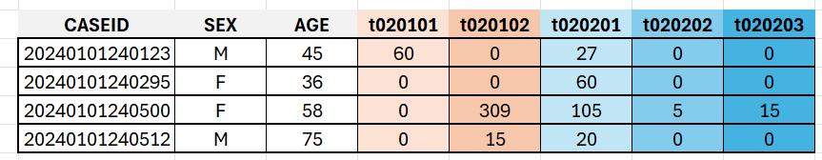
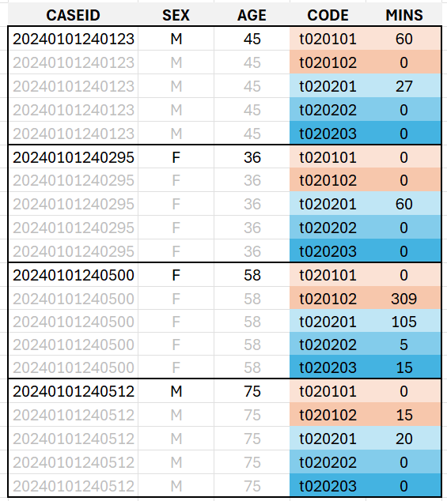
Time Use – Summary File Stacked
Unstacked
Stacked

Slide 19
Pause

Slide 20
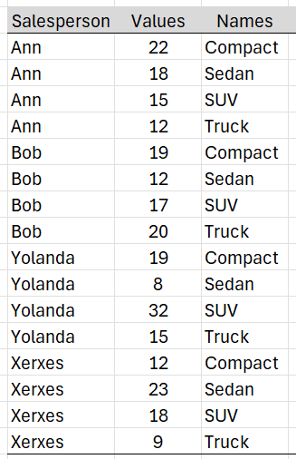
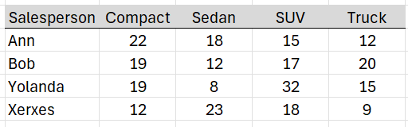
Stacking strategy
Course Notes
Same unit/context → Stack
Stacked Column Names → New Column
Row entries get replicated

Slide 21
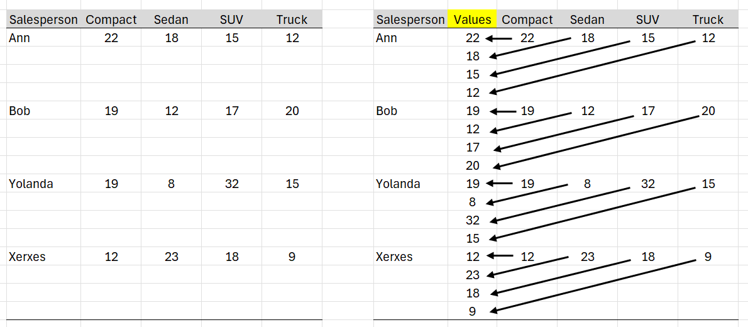
Stacking in action
Course Notes
Same unit/context → Stack

Slide 22
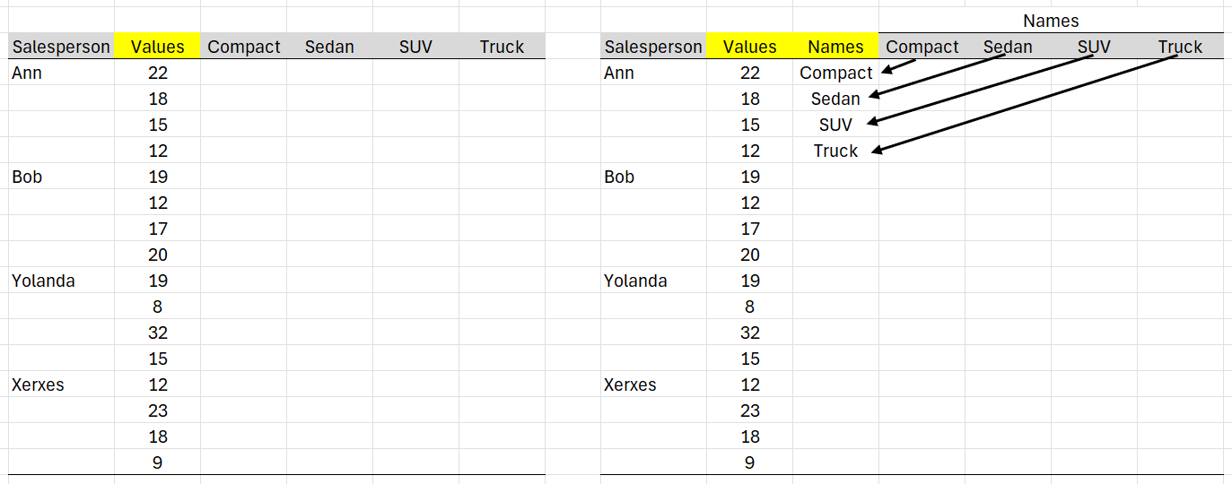
Stacking in action
Course Notes
Stacked Column Names → New Column

Slide 23
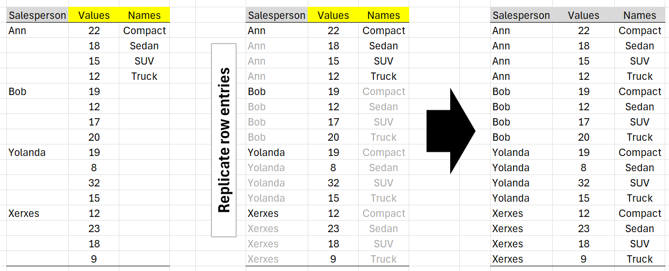
Stacking in action
Course Notes
Row entries get replicated

Slide 24
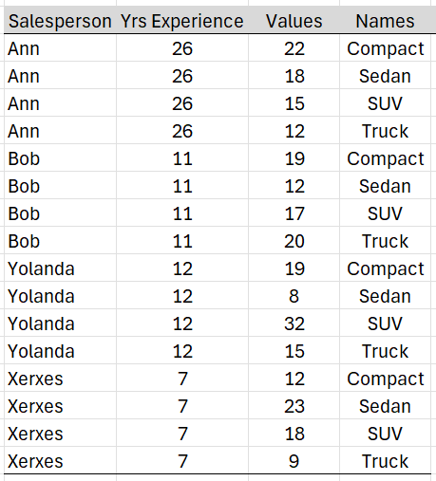
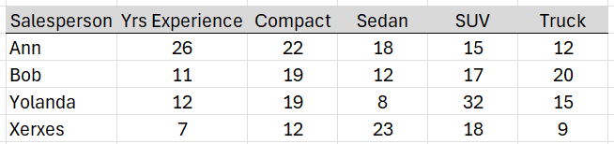
Stacking in action
Course Notes
Question: What happens to a non-stacked column?
Answer: A non-stacked column get replicated

Slide 25
Men Time Spent

Slide 26
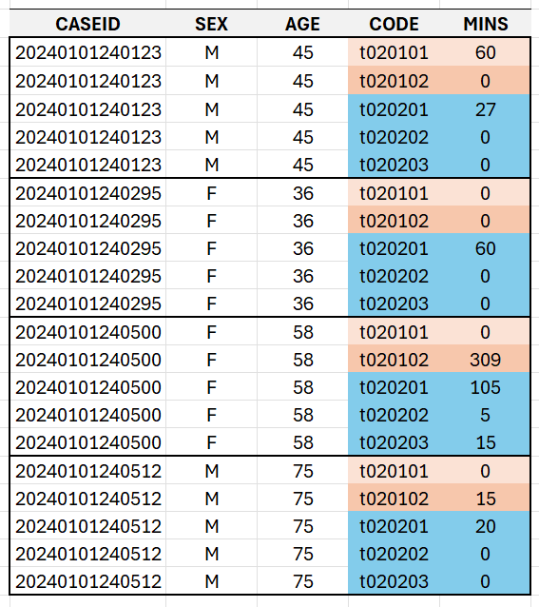
Time Use – Summary File Stacked

Slide 27
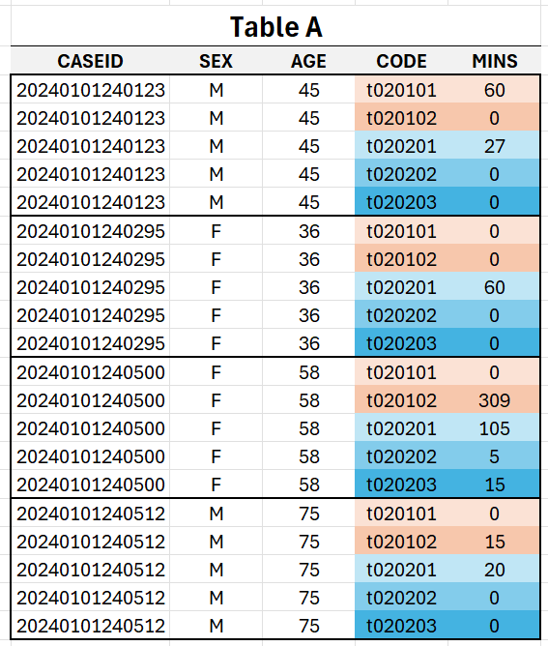
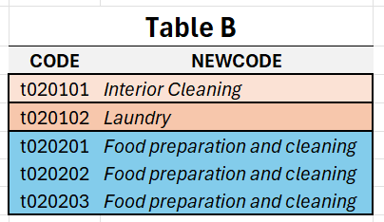

Slide 28
Pause

Slide 29
Example Left Join on DeptID
Course Notes
Employee Table
Department Table
Left Join
LastName | DeptID
Rafferty | 31
Jones | 33
Heisenberg | 33
Robinson | 34
Smith | 34
Williams | <NULL>
DeptID | DeptName
31 | Sales
33 | Engineering
34 | Clerical
35 | Marketing
Table 1
Table 2

Slide 30
Course Notes
Employee Table
Department Table
LastName | DeptID
Rafferty | 31
Jones | 33
Heisenberg | 33
Robinson | 34
Smith | 34
Williams | <NULL>
DeptID | DeptName
31 | Sales
33 | Engineering
34 | Clerical
35 | Marketing
Left Join
Table 1
Table 2
Employee.LastName | Employee.DeptID | Department.DeptID | Department.DeptName
Rafferty | 31 | 31 | Sales
Jones | 33 | 33 | Engineering
Heisenberg | 33 | 33 | Engineering
Robinson | 34 | 34 | Clerical
Smith | 34 | 34 | Clerical
Williams | <NULL>
 |  | 35 | Marketing
Left Join: All rows from left; matching rows from right

Slide 31
Course Notes
Employee Table
Department Table
LastName | DeptID
Rafferty | 31
Jones | 33
Heisenberg | 33
Robinson | 34
Smith | 34
Williams | <NULL>
DeptID | DeptName
31 | Sales
33 | Engineering
34 | Clerical
35 | Marketing
Left Join
Table 1
Table 2
Employee.LastName | DeptID | Department.DeptName
Rafferty | 31 | Sales
Jones | 33 | Engineering
Heisenberg | 33 | Engineering
Robinson | 34 | Clerical
Smith | 34 | Clerical
Williams | <NULL> | <NULL>
Filter and merge Join column

Slide 32
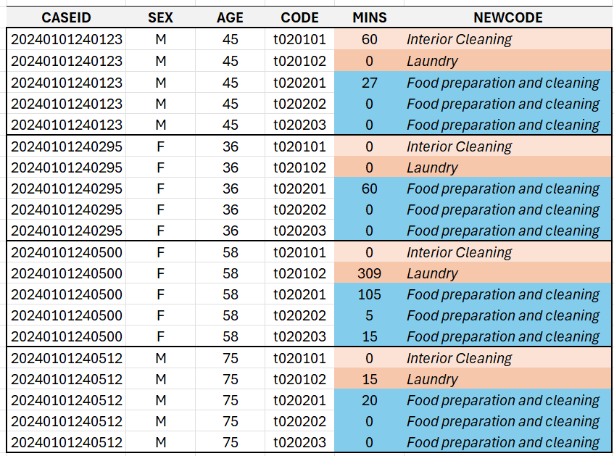
Time Use – Summary File Stacked | JOIN

Slide 33
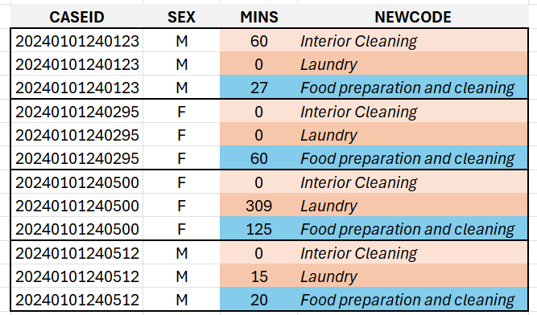
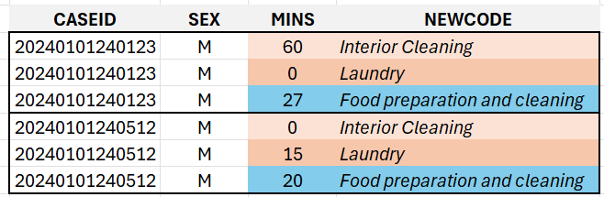
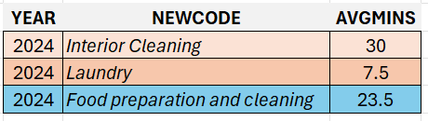
Time Use – Summary File Stacked | JOIN | FILTER | AGGREGATION

Slide 34
Men Time Spent

