Slide 1


Less is more: Writing code in an introductory data science course
Slides and more
Winona State University
Winona, MN. USA
GitHub repo: https://shorturl.at/5Nodo

Slide 2
Workshop Outline
Session 1
Session 2
Overview of DSCI 210
Technology agnostic exercises
Low code data management
Translate to code
Technology agnostic introduction to combining and reshaping tables
Low code implementation
Session 3
Guided activities

Slide 3
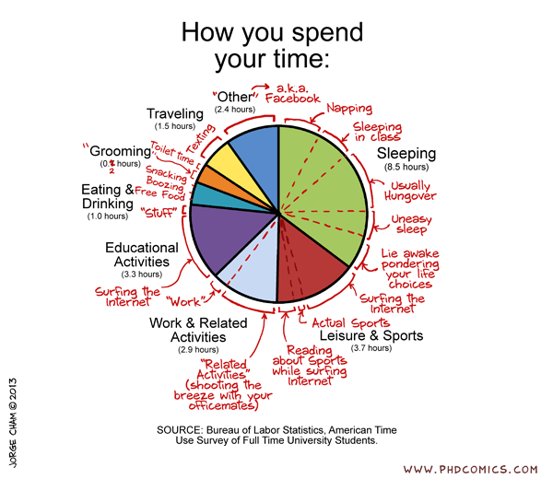
Session #2 Time Use Example
Article: https://www.nbcnews.com/data-graphics/men-do-housework-women-still-do-more-rcna216748
Data: https://www.bls.gov/tus/

Slide 4
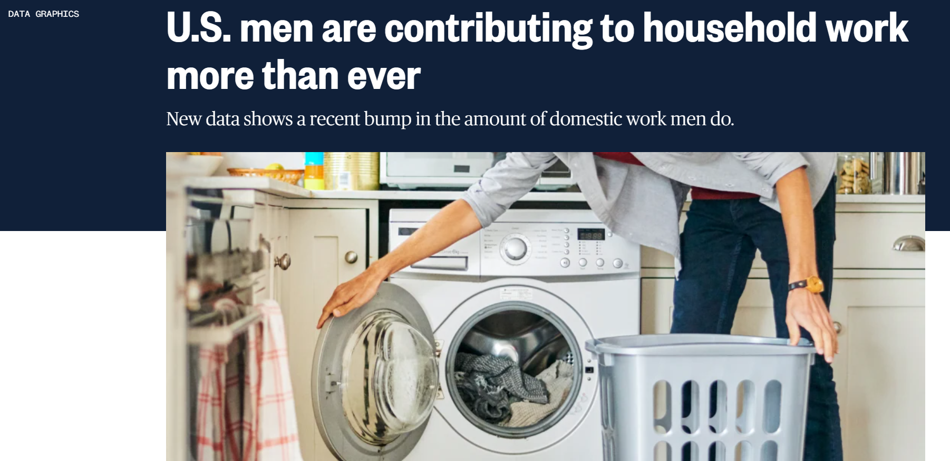


Slide 5
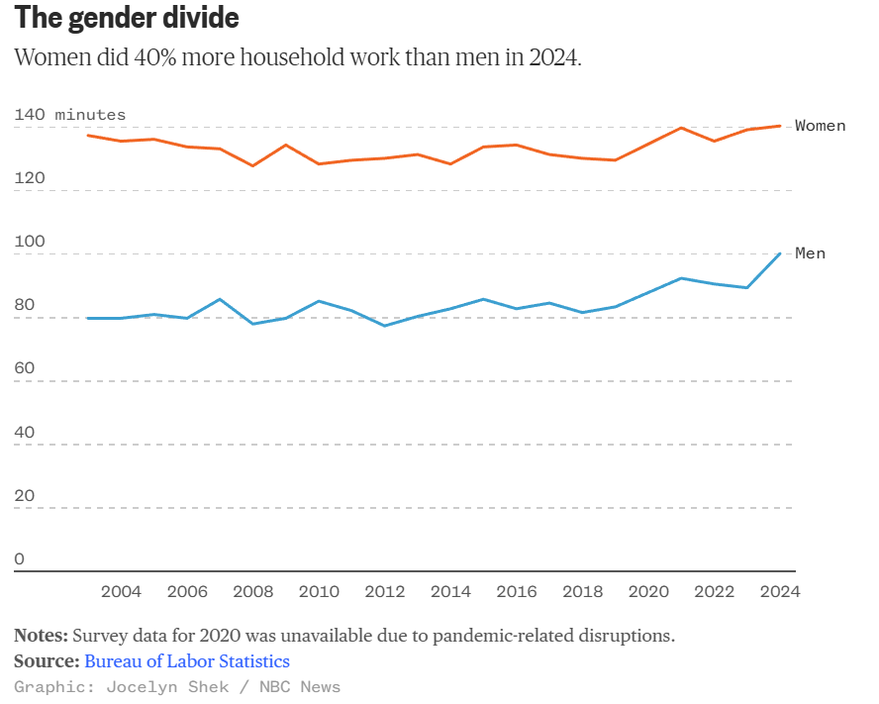
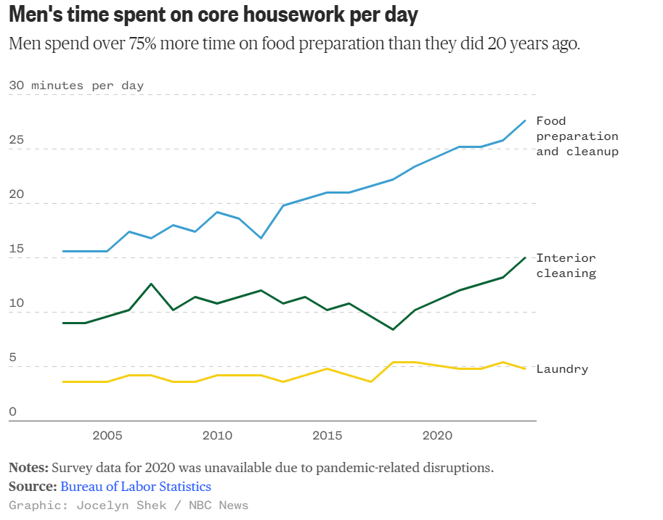
Gender Divide
Men Time Spent

Slide 6
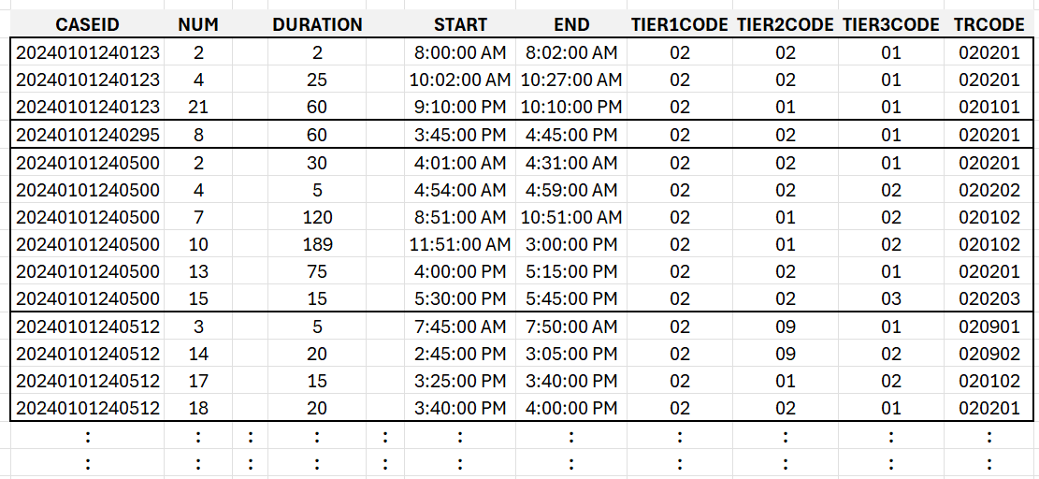
Time Use – Activity File

Slide 7
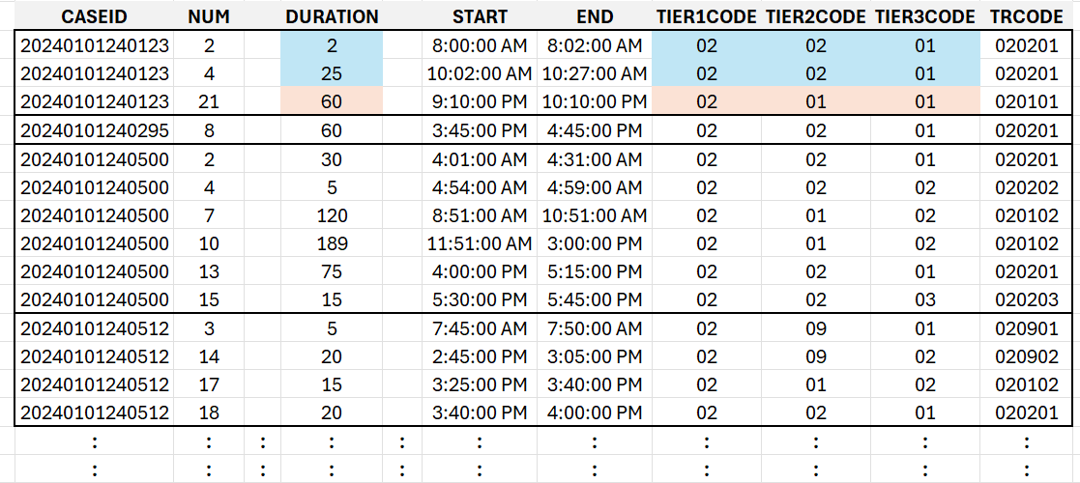
Time Use – Activity File

Slide 8
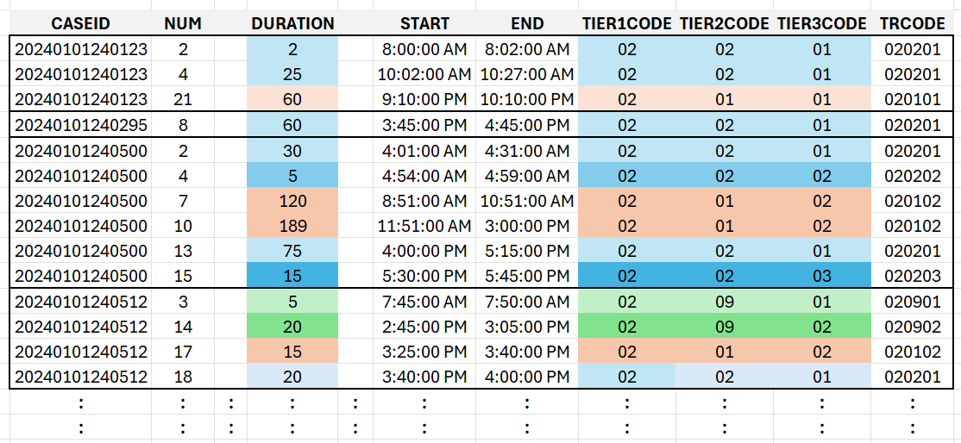
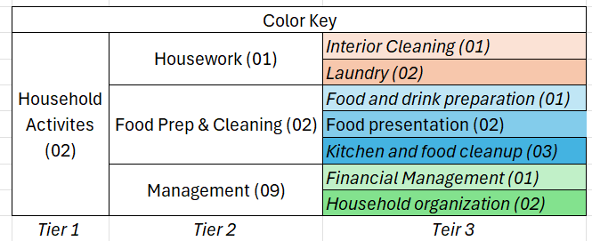
Time Use – Activity File

Slide 9
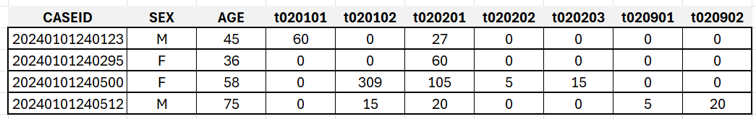
Time Use – Summary File

Slide 10
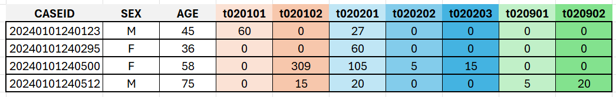
Time Use – Summary File

Slide 11
Time Use – Summary File

Slide 12
Men Time Spent
Over Time

Slide 13
Time Use – Summary Files Over Years
2003
2022
2023
2024

Slide 14
Pause

Slide 15
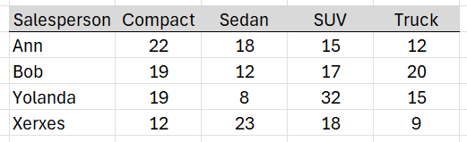
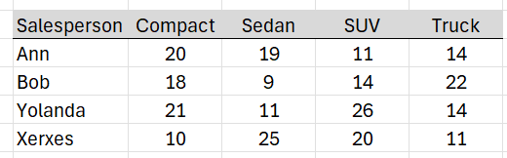
Example – Stacking Auto Sales
Course Notes
Q1 data
+
Q2 data

Slide 16
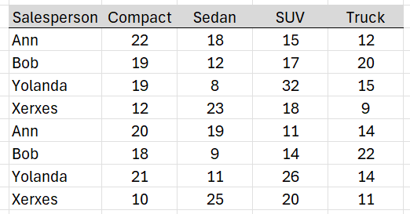
Example – Stacking Auto Sales
Course Notes
Q1 data
Q1
+
=
Q2
Q2 data

Slide 17
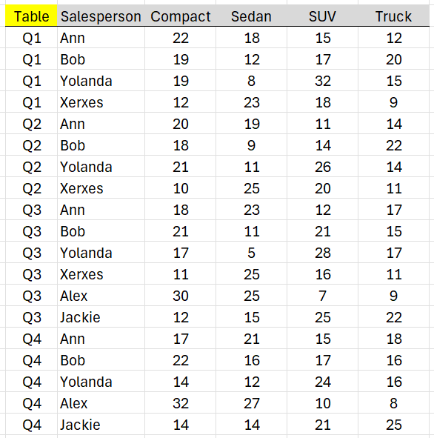
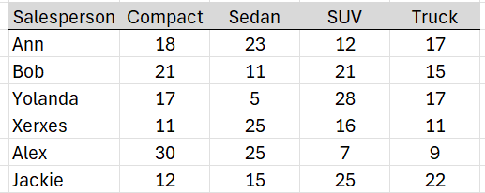
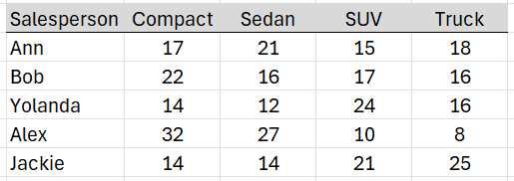
Example – Stacking Auto Sales
Course Notes
Q1
+
Q2
+
=
Q3
+
Q4

Slide 18
Men Time Spent

Slide 19
Time Use – Summary File

Slide 20
Time Use – Summary File
X
Food preparation and cleanup
Interior Cleaning
Laundry

Slide 21
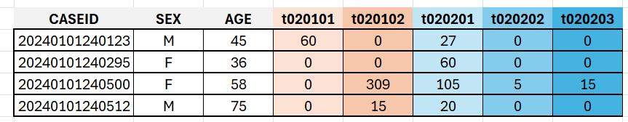
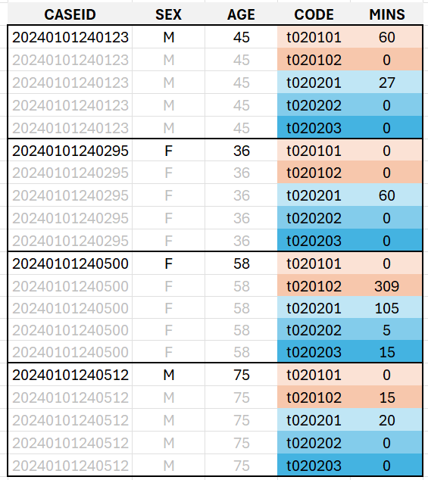
Time Use – Summary File Stacked
Unstacked
Stacked

Slide 22
Pause

Slide 23
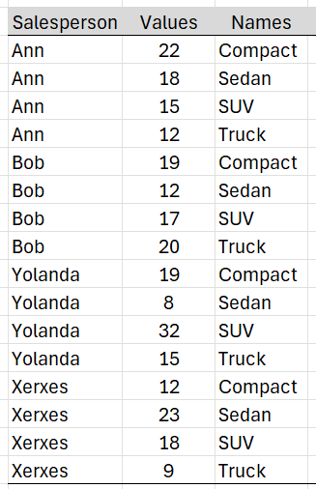
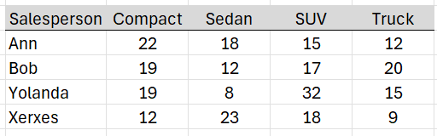
Stacking strategy
Course Notes
Same unit/context → Stack
Stacked Column Names → New Column
Row entries get replicated

Slide 24
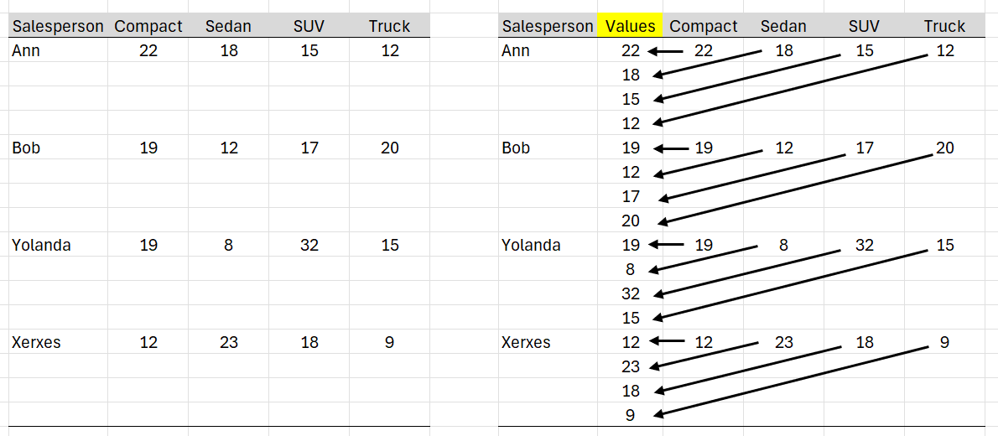
Stacking in action
Course Notes
Same unit/context → Stack

Slide 25
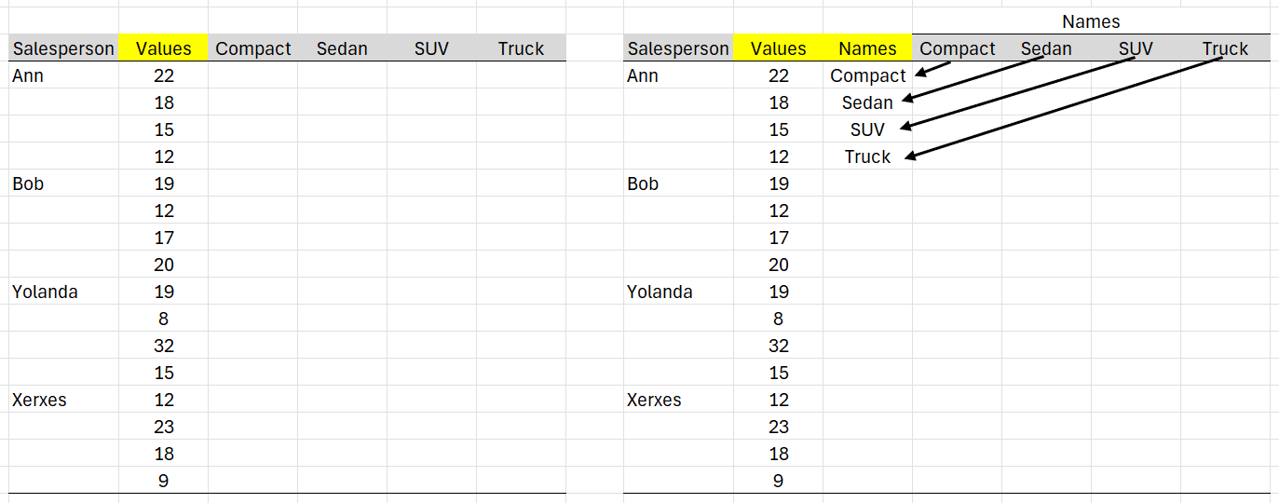
Stacking in action
Course Notes
Stacked Column Names → New Column

Slide 26
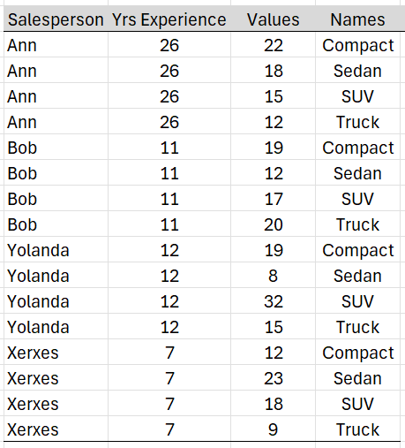
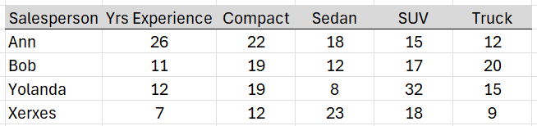
Stacking in action
Course Notes
Question: What happens to a non-stacked column?
Answer: A non-stacked column get replicated

Slide 27
Men Time Spent
3 codes into 1
single code
single code

Slide 28
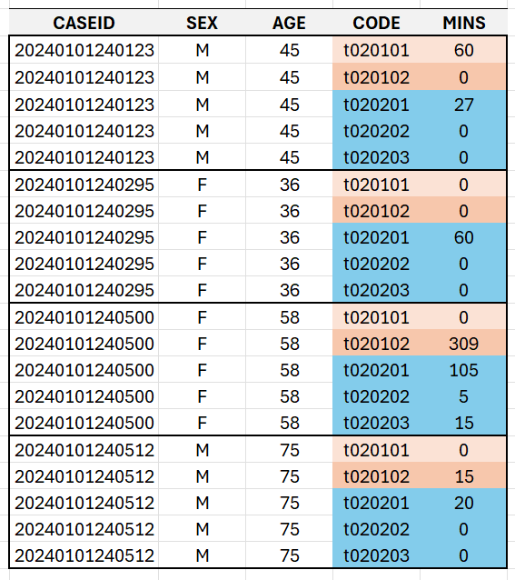
Time Use – Summary File Stacked

Slide 29
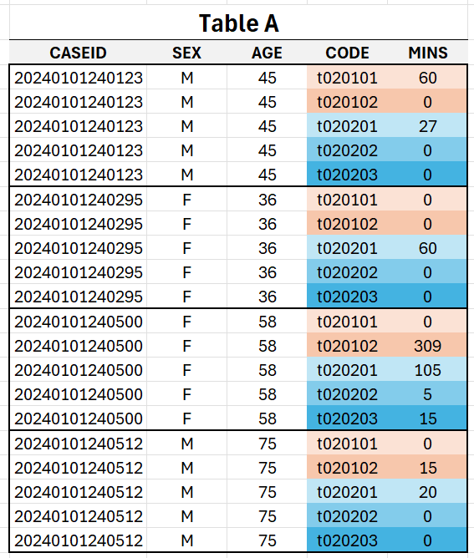
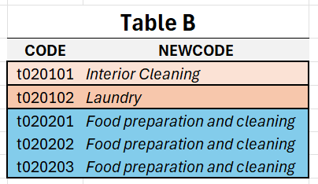

Slide 30
Pause

Slide 31
Example Left Join on DeptID
Course Notes
Employee Table
Department Table
Left Join
LastName | DeptID
Rafferty | 31
Jones | 33
Heisenberg | 33
Robinson | 34
Smith | 34
DeptID | DeptName
31 | Sales
33 | Engineering
34 | Clerical
Table 1
Table 2

Slide 32
Course Notes
Employee Table
Department Table
Left Join
LastName | DeptID
Rafferty | 31
Jones | 33
Heisenberg | 33
Robinson | 34
Smith | 34
DeptID | DeptName
31 | Sales
33 | Engineering
34 | Clerical
Table 1
Table 2
Employee.LastName | Employee.DeptID | Department.DeptID | Department.DeptName
Rafferty | 31 | 31 | Sales
Jones | 33 | 33 | Engineering
Heisenberg | 33 | 33 | Engineering
Robinson | 34 | 34 | Clerical
Smith | 34 | 34 | Clerical
Left Join: All rows from left; matching rows from right

Slide 33
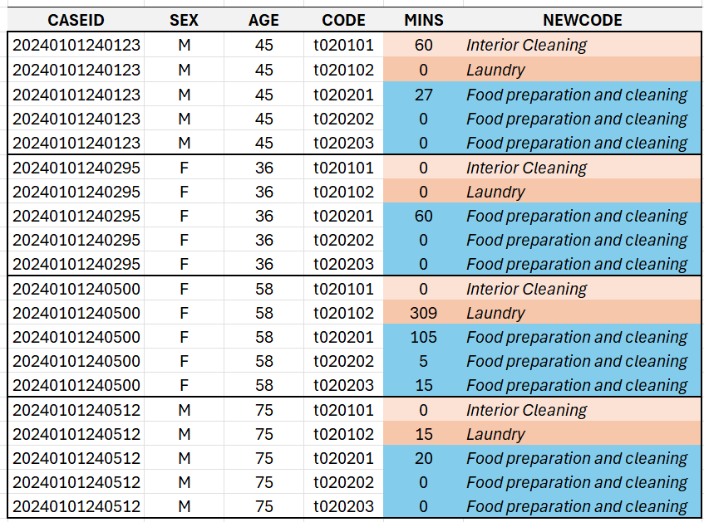
Time Use – Summary File Stacked | JOIN

Slide 34
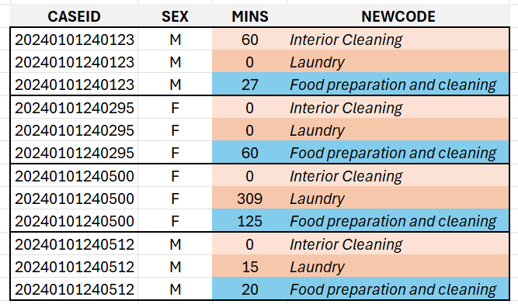
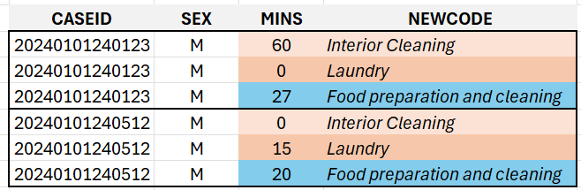
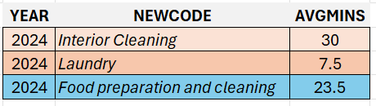
Time Use – Summary File Stacked | JOIN | FILTER | AGGREGATION

Slide 35
Men Time Spent

Slide 36
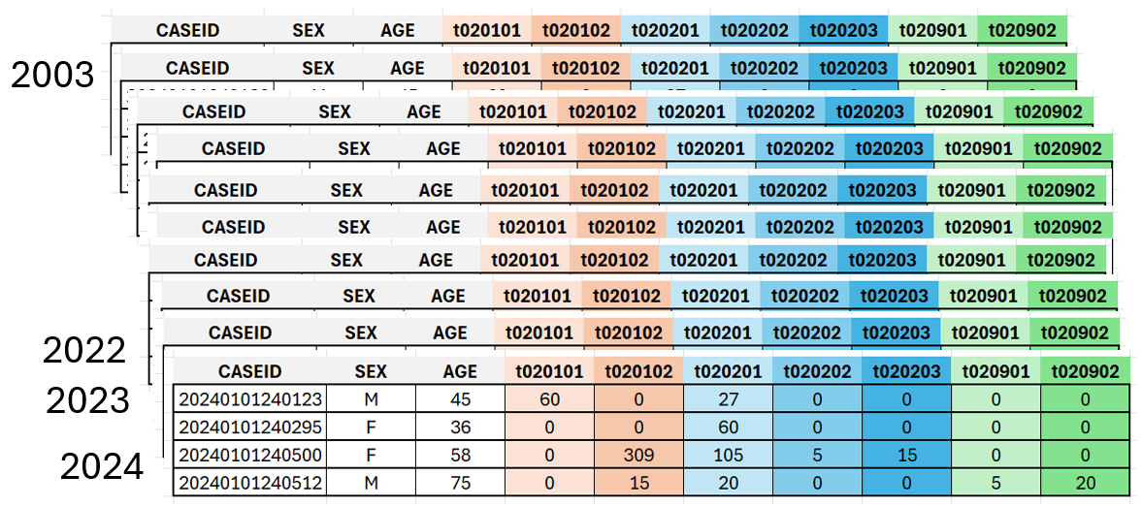
Implementation in Tableau Prep
Action Step #1: UNION

Slide 37
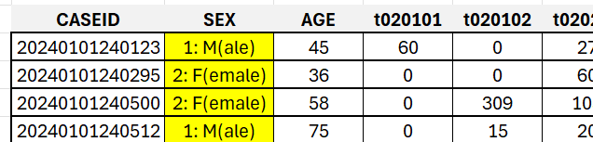
Implementation in Tableau Prep
Action Step #2: RECODE SEX

Slide 38
Implementation in Tableau Prep
Action Step #3: MUTATE - YEAR
Create YEAR via SPLIT

Slide 39
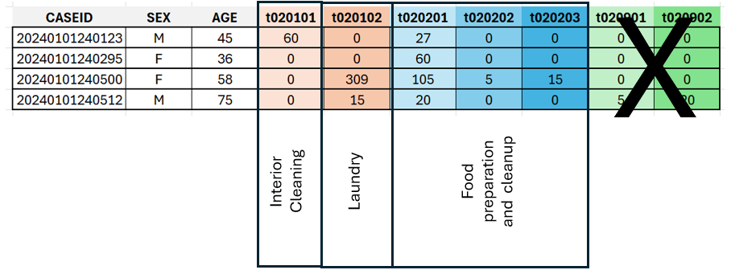
Implementation in Tableau Prep
Action Step #4: SELECT – Remove CODES
Remove unnecessary CODES

Slide 40
Implementation in Tableau Prep
Action Step #5: STACK (PIVOT)

Slide 41
Implementation in Tableau Prep
Action Step #6: JOIN

Slide 42
Implementation in Tableau Prep
Action Step #7: AGGREGATION – Total per person

Slide 43
Implementation in Tableau Prep
Action Step #8: FILTER – Males

Slide 44
Implementation in Tableau Prep
Action Step #9: AGGREGATION – AVG per activity * year

