Slide 1


Teaching Data Science to Undergraduates
Chris Malone
Todd Iverson
2020 Project Next
Zoomland, USA

Slide 2
The Three Pillars of Data Science
Fundamental Question
How do we extract insights and value from data
Data Management
Visualization
Statistical Learning

Slide 3
The Core Data Science Curriculum
Data Management
Visualization
Statistical Learning
DSCI 210
Survey
DSCI 210
Survey
DSCI 210
Survey
STAT 210/310
Statistics
DSCI 325
Structured
DSCI 330
Unstructured
DSCI 310
Intro to Viz
STAT 360
Regression
DSCI 430
DS @ Scale
DSCI 415
Unsupervised
DSCI 425
Supervised

Slide 4
The Introductory Course
Data Management
Visualization
Statistical Learning
DSCI 210
Survey
DSCI 210
Survey
DSCI 210
Survey
STAT 210/310
Statistics
DSCI 325
Structured
DSCI 330
Unstructured
DSCI 310
Intro to Viz
STAT 360
Regression
DSCI 430
DS @ Scale
DSCI 415
Unsupervised
DSCI 425
Supervised

Slide 5
Data Management
Data Management
Visualization
Statistical Learning
DSCI 210
Survey
DSCI 210
Survey
DSCI 210
Survey
STAT 210/310
Statistics
DSCI 325
Structured
DSCI 330
Unstructured
DSCI 310
Intro to Viz
STAT 360
Regression
DSCI 430
DS @ Scale
DSCI 415
Unsupervised
DSCI 425
Supervised

Slide 6

Example Project Explore the impact of property development on water quality
Examples
Average value; Percent garages
Property Data
$$⋯$$
Clean Text
Find closest lake
Aggregate
(year, lake)
2004
2005
2016
One row per parcel
200 MB per file
Millions of rows
Combined Data
1 row per year/lake
100+ MB
Water Quality Data
2004-2016
Aggregate
(year, lake)
One row per trip
A few MB
Thousands
Examples
Average suspended solids

Slide 7
Technology Agnostic
Teach concepts before specific technology

Slide 8
Data Verbs - Actions on a Single Table
D | G
5 | a
3 | a
4 | b
2 | b
3 | c
5 | c
4 | c
D
5
3
4
2
3
5
4
D | G
5 | a
3 | a
4 | b
2 | b
3 | c
5 | c
4 | c
Filter (G is not a)
Select (D)
D | G
4 | b
2 | b
3 | c
5 | c
4 | c
D | G
5 | a
3 | a
4 | b
2 | b
3 | c
5 | c
4 | c
D | G | N
5 | a | 10
3 | a | 6
4 | b | 8
2 | b | 4
3 | c | 6
5 | c | 10
4 | c | 8
D | G
5 | a
3 | a
4 | b
2 | b
3 | c
5 | c
4 | c
D | G
2 | b
3 | a
3 | c
4 | b
4 | c
5 | a
5 | c
Mutate (N = 2*D)
Sort (D, G)

Slide 9
“Solving” the Table – Task 1
D | G
5 | a
3 | a
4 | b
2 | b
3 | c
5 | c
4 | c
Task
????
G | X
A | 10
B | 8
C | 10
C | 8
D | G
5 | a
3 | a
4 | b
2 | b
3 | c
5 | c
4 | c
Filter
(D>3)
D | G
5 | a
4 | b
5 | c
4 | c
Mutate
(X = 2*D)
D | G | X
5 | a | 10
4 | b | 8
5 | c | 10
4 | c | 8
G | X
a | 10
b | 8
c | 10
c | 8
Mutate
(G = Upper(G))
G | X
A | 10
B | 8
C | 10
C | 8
Select
(G, X)

Slide 10
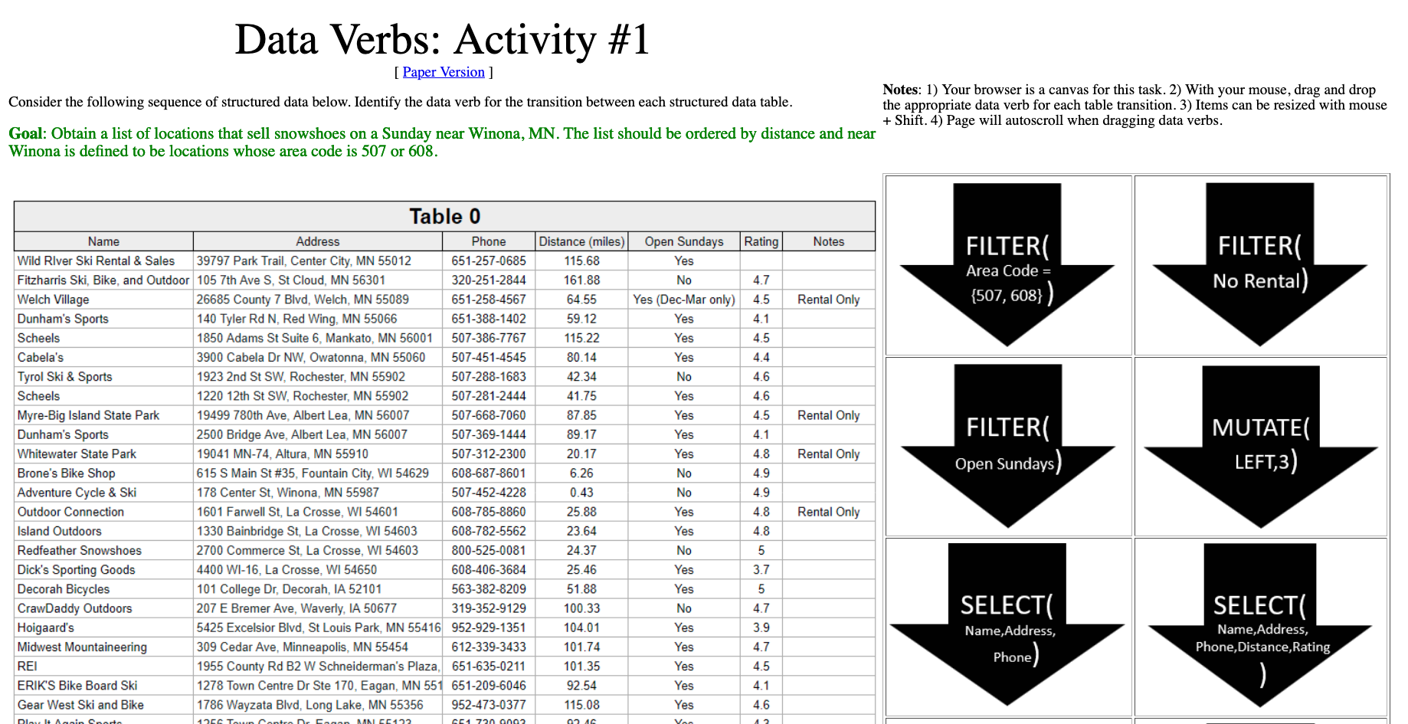
Exercise 1 Purchasing Snowshoes
http://statsclass.org/dsci210/Dataverbs/

Slide 11
Sequential Data Verb Activities
Activity 1
Tables in order
Activity 2
Unordered Tables
Activity 3
Join; Aggregate etc.

Slide 12
Data Visualization
Data Management
Visualization
Statistical Learning
DSCI 210
Survey
DSCI 210
Survey
DSCI 210
Survey
STAT 210/310
Statistics
DSCI 325
Structured
DSCI 330
Unstructured
DSCI 310
Intro to Viz
STAT 360
Regression
DSCI 430
DS @ Scale
DSCI 415
Unsupervised
DSCI 425
Supervised

Slide 13
Visualization Principles
Describing and evaluating data visualization

Slide 14
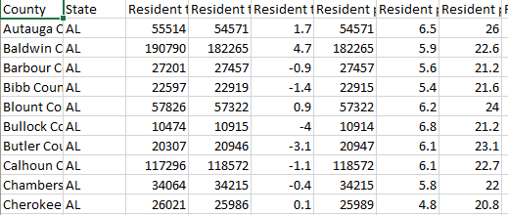
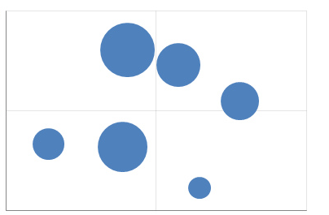
The grammar of graphics
What is a data visualization?
Examples
Aesthetic
Map
Tableau
Graph Builder (JMP)
ggplot (R)
Altair (Python)
Vega & Vega-lite (JavaScript)
Data
Geom/Mark
A map from data to the visual aesthetics of geometries/marks

Slide 15
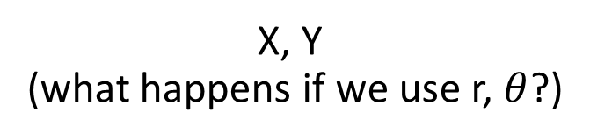
Aesthetic attributes of a bar geometry
What distinguishes one bar from another bar?
X, Y
(what happens if we use r, $θ$?)
Shape
Size
NA
(a bar is a bar!)
Hue
Saturation
Value

Slide 16
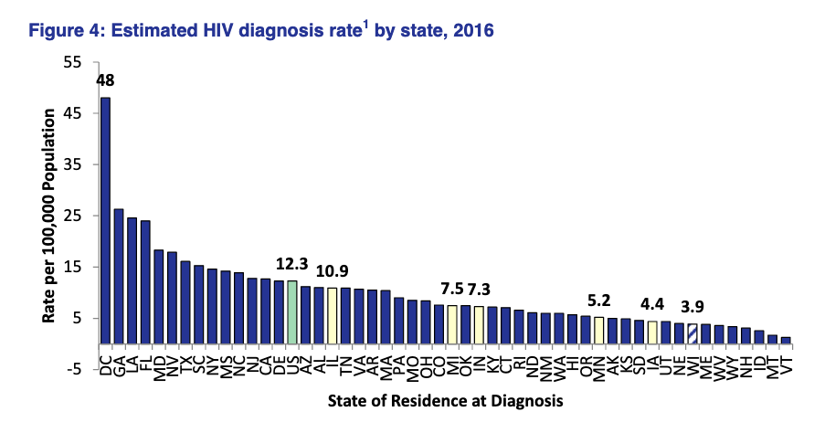
Data row:
WI HIV data
Geometry:
??
Variables/mapping:
??
??
??
https://www.dhs.wisconsin.gov/publications/p00484.pdf
Notes:
Quickly; add “key” slides

Slide 17
Data row:
WI HIV data
Geometry:
Bar
Variables/mapping:
Y is HIV diagnosis per 100,000
X is state
Color is region
https://www.dhs.wisconsin.gov/publications/p00484.pdf
Notes:
Quickly; add “key” slides

Slide 18
Visual perception
How we compare quantities

Slide 19
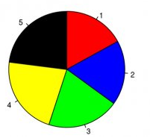
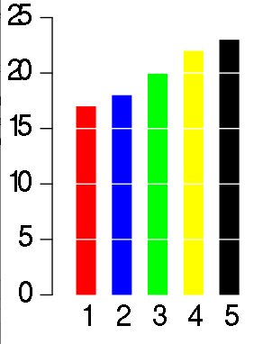
Rank the candidates’ vote shares.
Task: Complete the two polls.
Largest?
3rd place?

Slide 20
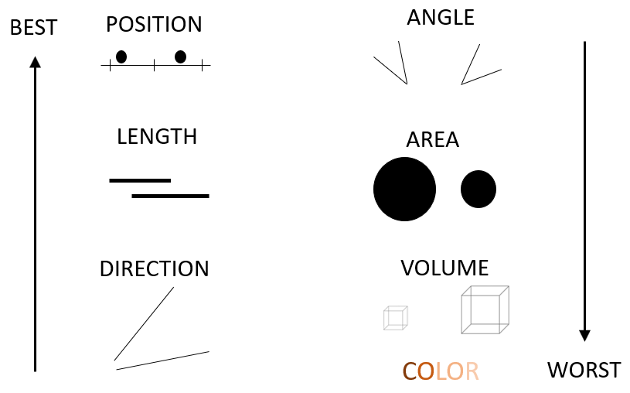
Cleveland’s and McGill’s
hierarchy of elementary perceptual tasks

Slide 21
Gestalt Principles
the whole is greater than the sum of the parts

Slide 22
Similarity
rows or columns?

Slide 23
Proximity
rows or columns?

Slide 24
Connection
rows or columns?

Slide 25
Enclosure
rows or columns?

Slide 26
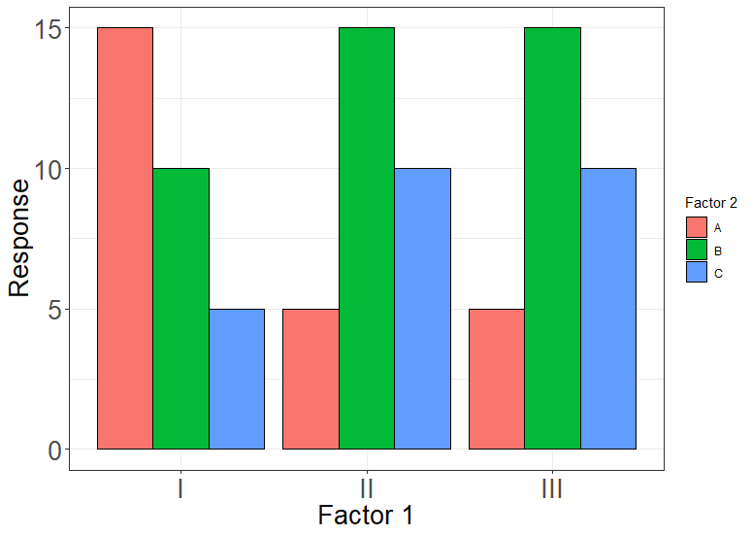
Notes:
775 x 550; proximity

Slide 27
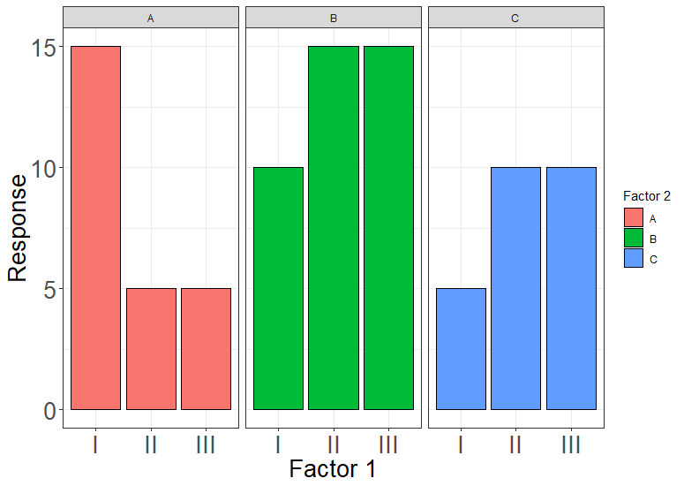
Notes:
775 x 550; proximity + enclosure

Slide 28
Exercise 2 Sketch a redesign
Collaborative Sketch Pad
Group 1 https://bit.ly/2P7LAxG
Group 2 https://bit.ly/336Ggms
Group 3 https://bit.ly/2P2oVD0

Slide 29
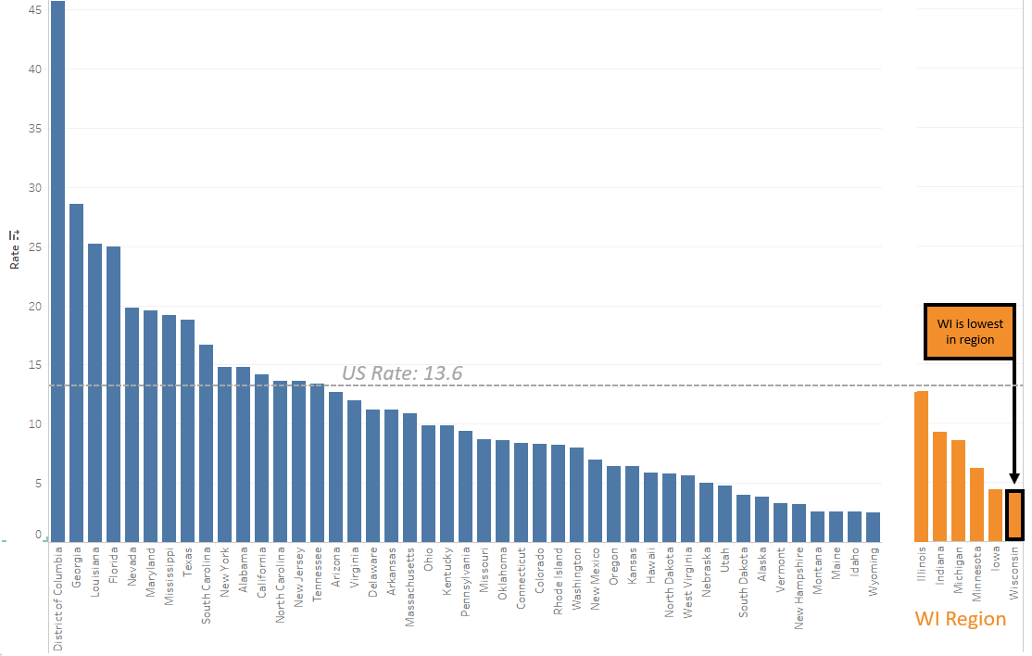
Malone’s redesign
Annotations
Another crucial technique
(see Alberto Cairo)

Slide 30
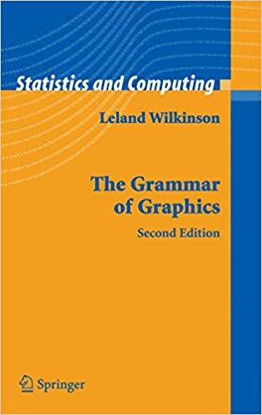
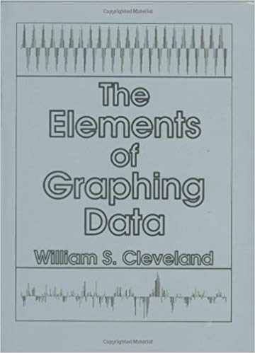

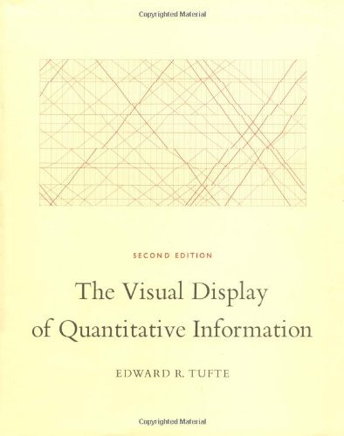
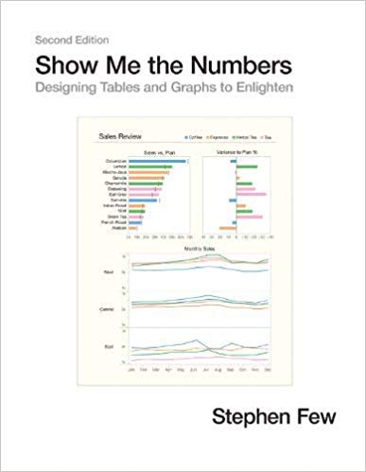



Slide 31
Statistical Learning Theory
Data Management
Visualization
Statistical Learning
DSCI 210
Survey
DSCI 210
Survey
DSCI 210
Survey
STAT 210/310
Statistics
DSCI 325
Structured
DSCI 330
Unstructured
DSCI 310
Intro to Viz
STAT 360
Regression
DSCI 430
DS @ Scale
DSCI 415
Unsupervised
DSCI 425
Supervised

Slide 32
CART
Classification and Regression Trees – An Introduction

Slide 33
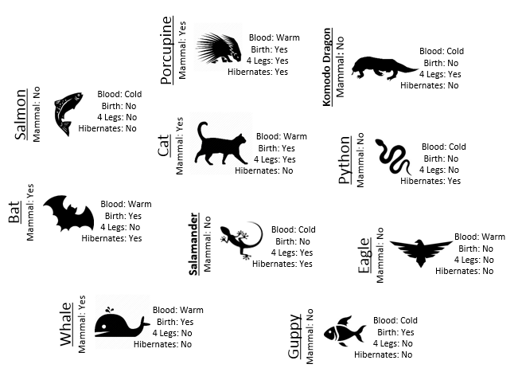
Mammal or not?

Slide 34
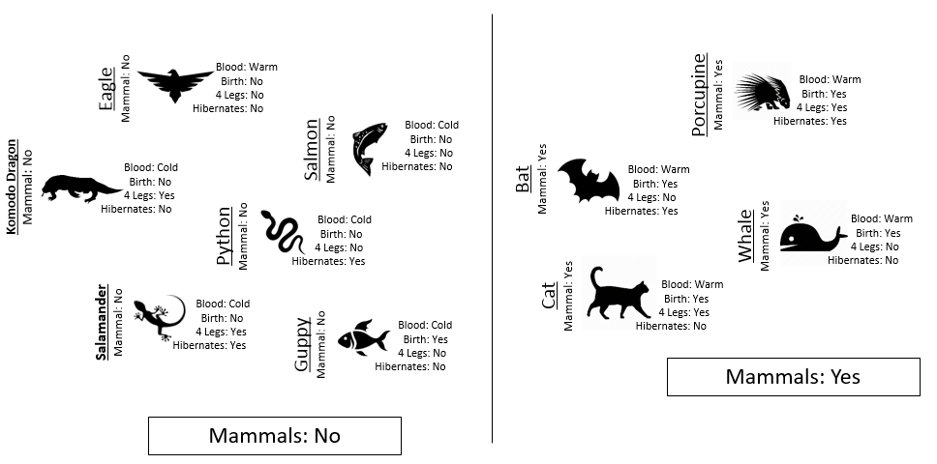
Build a Classification Rule

Slide 35
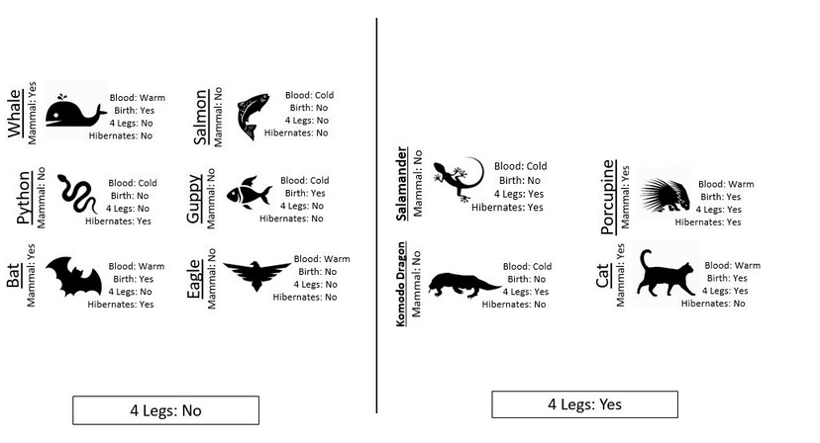
Building a classifier Step 1 – Split the examples by one feature.
All Cases
4 Legs: No
4 Legs: Yes
??
??
http://www.statsclass.org/dsci210/CART/train.html

Slide 36
Train the classifier
All Cases
4 Legs: No
4 Legs: Yes
Not Mammal
??
2 Mammal VS 4 Not Mammal
http://www.statsclass.org/dsci210/CART/train.html

Slide 37
Train the classifier
All Cases
4 Legs: No
4 Legs: Yes
Not Mammal
??
2 Mammal VS 2 Not Mammal
http://www.statsclass.org/dsci210/CART/train.html

Slide 38
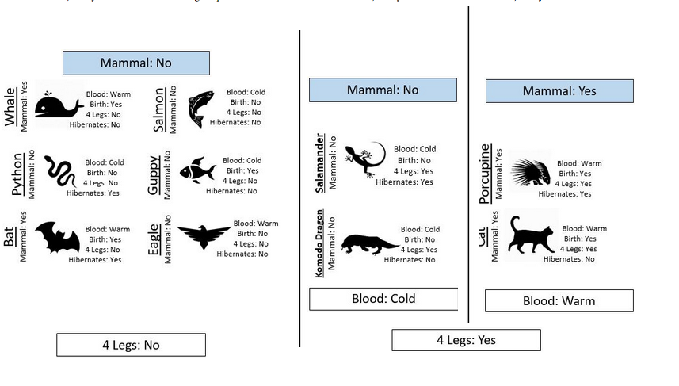
Building a classifier Step 3 – “Grow” the tree
All Cases
4 Legs: No
4 Legs: Yes
Not Mammal
Blood:
Cold
Blood:
Warm
Not Mammal
Mammal
http://www.statsclass.org/dsci210/CART/train.html

Slide 39
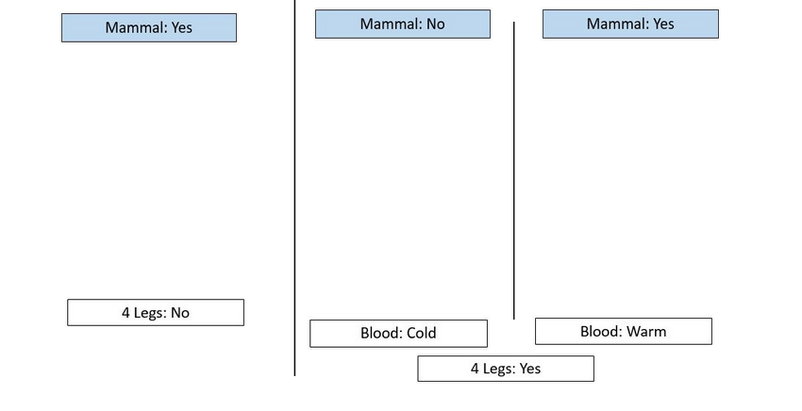
The final tree
All Cases
4 Legs: No
4 Legs: Yes
Not Mammal
Blood:
Cold
Blood:
Warm
Not Mammal
Mammal

Slide 40
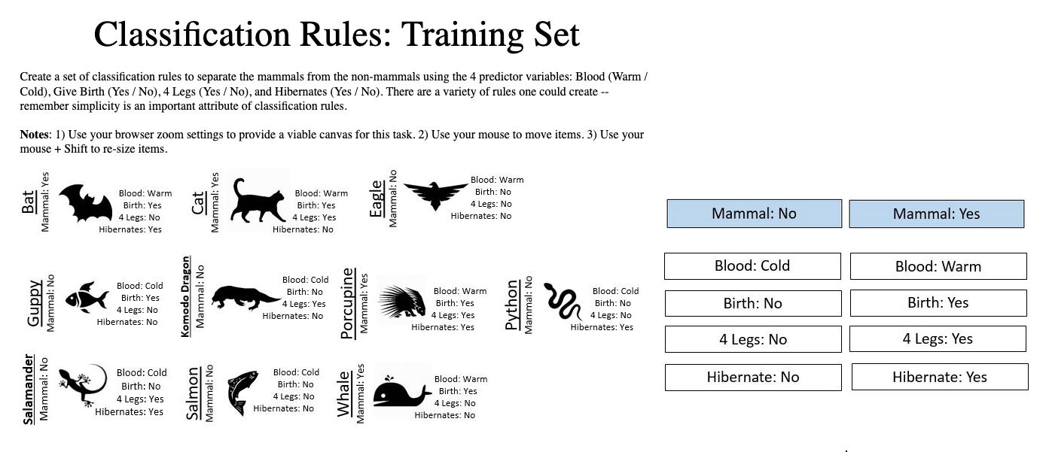
Exercise 2 Make your own rule (different than mine)
http://www.statsclass.org/dsci210/CART/train.html

Slide 41

Measure performance with test data Step 1 – Build the same tree
http://www.statsclass.org/dsci210/CART/test.html

Slide 42
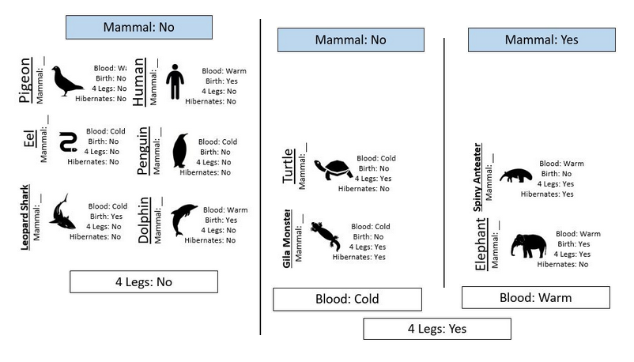
Measure performance with test data Step 2 – Apply the rule
✅
✅
✅
✅
✅
✅
✅
✅
http://www.statsclass.org/dsci210/CART/test.html

