Slide 2
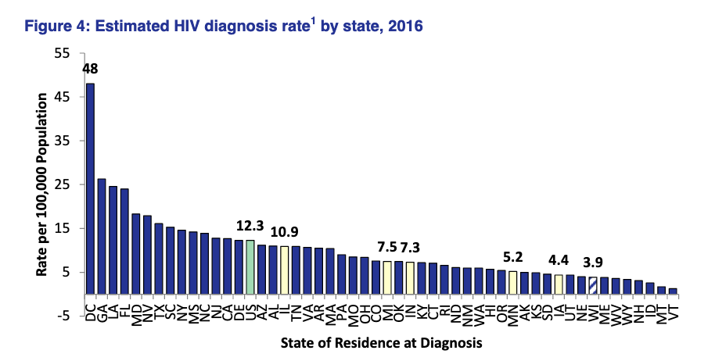
HIV Rate per 100,000 Population

Slide 3
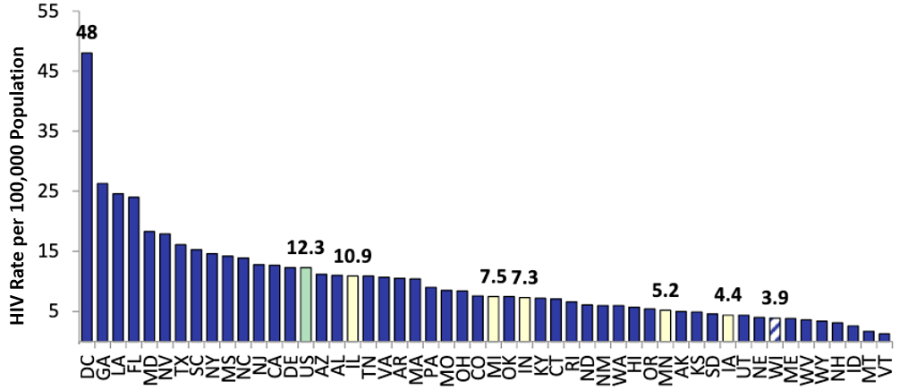




Task 1: Identify three intended comparisons
Task 2: Provide a rough sketch of a re-design to enhance the intended comparisons
Gestalt Principles
Enclosure
Strongest
Connection
Proximity
Similarity
Weakest

