Slide 1


Teaching Data Science to Undergraduates
Chris Malone
Todd Iverson
2021 Project Next
Zoomland, USA

Slide 2
The Three Pillars of Data Science
Fundamental Question
How do we extract insights and value from data
Data Management
Visualization
Statistical Learning

Slide 3
The Core Data Science Curriculum
Data Management
Visualization
Statistical Learning
DSCI 210
Survey
DSCI 210
Survey
DSCI 210
Survey
STAT 210/310
Statistics
DSCI 325
Structured
DSCI 330
Unstructured
DSCI 310
Intro to Viz
STAT 360
Regression
DSCI 430
DS @ Scale
DSCI 415
Unsupervised
DSCI 425
Supervised

Slide 4
The Introductory Course
Data Management
Visualization
Statistical Learning
DSCI 210
Survey
DSCI 210
Survey
DSCI 210
Survey
STAT 210/310
Statistics
DSCI 325
Structured
DSCI 330
Unstructured
DSCI 310
Intro to Viz
STAT 360
Regression
DSCI 430
DS @ Scale
DSCI 415
Unsupervised
DSCI 425
Supervised

Slide 5
Data Management
Data Management
Visualization
Statistical Learning
DSCI 210
Survey
DSCI 210
Survey
DSCI 210
Survey
STAT 210/310
Statistics
DSCI 325
Structured
DSCI 330
Unstructured
DSCI 310
Intro to Viz
STAT 360
Regression
DSCI 430
DS @ Scale
DSCI 415
Unsupervised
DSCI 425
Supervised

Slide 6
A data scientist spends 80% of their time managing data!

Slide 7

Example Project Explore the impact of property development on water quality
A big data science project includes …
Aggregating and joining multiple large files
80% time spent managing data
Examples
Average value; Percent garages
Property Data
$$⋯$$
Clean Text
Find closest lake
Aggregate
(year, lake)
2004
2005
2016
One row per parcel
200 MB per file
Millions of rows
Combined Data
1 row per year/lake
100+ MB
Water Quality Data
Examples
Average suspended solids
2004-2016
Aggregate
(year, lake)
One row per trip
A few MB
Thousands

Slide 8
Technology Agnostic
Teach concepts before specific technology

Slide 9
Data Verbs - Actions on a Single Table
D | G
5 | a
3 | a
4 | b
2 | b
3 | c
5 | c
4 | c
D
5
3
4
2
3
5
4
D | G
5 | a
3 | a
4 | b
2 | b
3 | c
5 | c
4 | c
Filter (G is not a)
Select (D)
D | G
4 | b
2 | b
3 | c
5 | c
4 | c
D | G
5 | a
3 | a
4 | b
2 | b
3 | c
5 | c
4 | c
D | G | N
5 | a | 10
3 | a | 6
4 | b | 8
2 | b | 4
3 | c | 6
5 | c | 10
4 | c | 8
D | G
5 | a
3 | a
4 | b
2 | b
3 | c
5 | c
4 | c
D | G
2 | b
3 | a
3 | c
4 | b
4 | c
5 | a
5 | c
Mutate (N = 2*D)
Sort (D, G)

Slide 10
“Solving” the Table – Task 1
D | G
5 | a
3 | a
4 | b
2 | b
3 | c
5 | c
4 | c
Task
????
G | X
A | 10
B | 8
C | 10
C | 8
D | G
5 | a
3 | a
4 | b
2 | b
3 | c
5 | c
4 | c
Filter
(D>3)
D | G
5 | a
4 | b
5 | c
4 | c
Mutate
(X = 2*D)
D | G | X
5 | a | 10
4 | b | 8
5 | c | 10
4 | c | 8
G | X
a | 10
b | 8
c | 10
c | 8
Mutate
(G = Upper(G))
G | X
A | 10
B | 8
C | 10
C | 8
Select
(G, X)

Slide 11
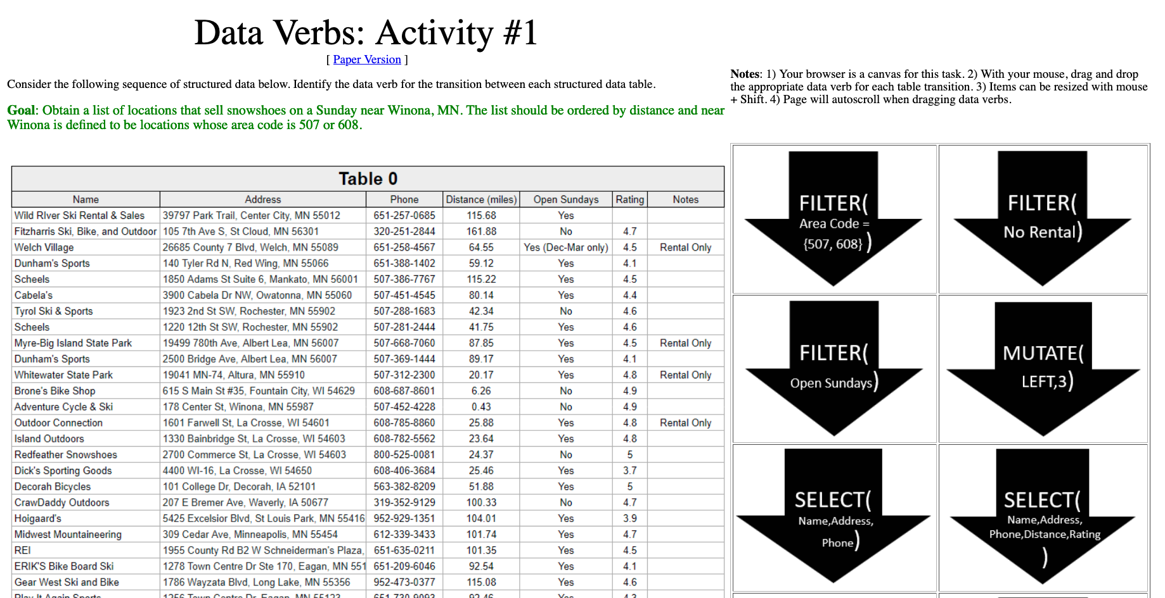
Exercise 1 Purchasing Snowshoes
http://statsclass.org/dsci210/Dataverbs/

Slide 12
Sequential Data Verb Activities
Activity 1
Tables in order
Activity 2
Unordered Tables
Activity 3
Join; Aggregate etc.

Slide 13
Data Visualization
Data Management
Visualization
Statistical Learning
DSCI 210
Survey
DSCI 210
Survey
DSCI 210
Survey
STAT 210/310
Statistics
DSCI 325
Structured
DSCI 330
Unstructured
DSCI 310
Intro to Viz
STAT 360
Regression
DSCI 430
DS @ Scale
DSCI 415
Unsupervised
DSCI 425
Supervised

Slide 14
Visualization Principles
Describing and evaluating data visualization

Slide 15
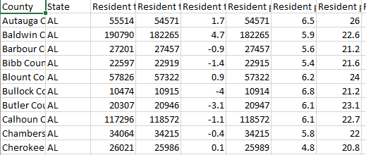
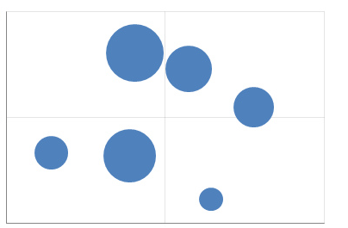
The grammar of graphics
What is a data visualization?
Examples
Aesthetic
Map
Tableau
Graph Builder (JMP)
ggplot (R)
Altair (Python)
Vega & Vega-lite (JavaScript)
Data
Geom/Mark
A map from data to the visual aesthetics of geometries/marks

Slide 16
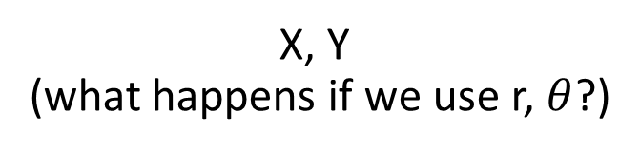
Aesthetic attributes of a bar geometry
What distinguishes one bar from another bar?
X, Y
(what happens if we use r, $θ$?)
Shape
Size
NA
(a bar is a bar!)
Hue
Saturation
Value

Slide 17
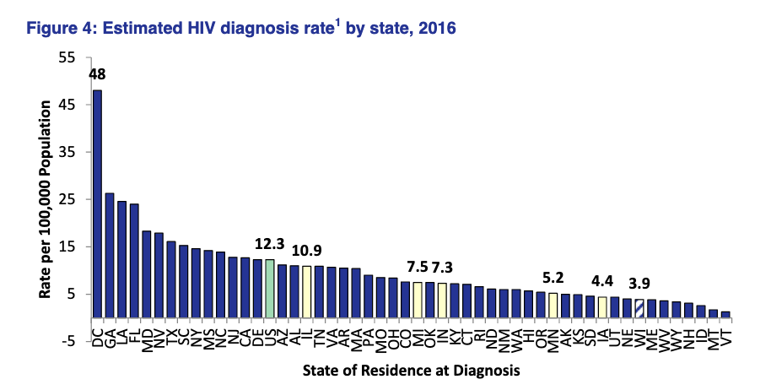
Data row:
WI HIV data
Geometry:
??
Variables/mapping:
??
??
??
https://www.dhs.wisconsin.gov/publications/p00484.pdf
Notes:
Quickly; add “key” slides

Slide 18
Solution
Data row:
WI HIV data
Geometry:
Bar
Variables/mapping:
Y is HIV diagnosis per 100,000
X is state
Color is region
https://www.dhs.wisconsin.gov/publications/p00484.pdf
Notes:
Quickly; add “key” slides

Slide 19
Visual perception
How we compare quantities

Slide 20
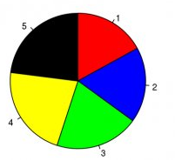
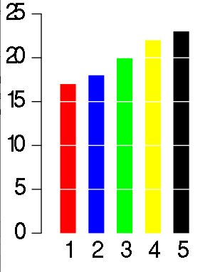
Rank the candidates’ vote shares.
Task: Complete the two polls.
Largest?
3rd place?

Slide 21
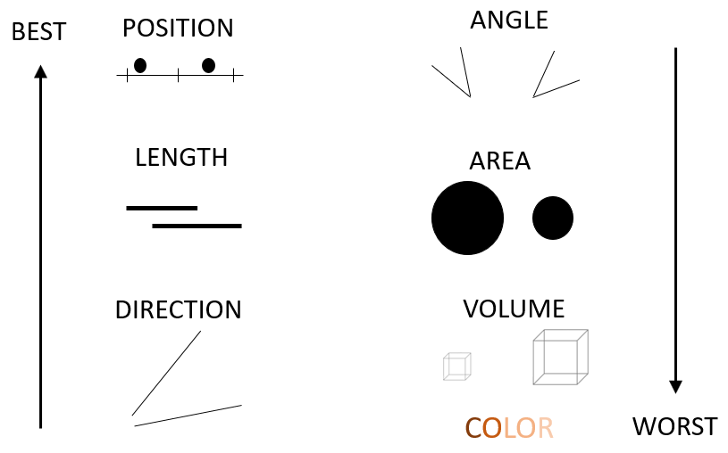
Cleveland’s and McGill’s
hierarchy of elementary perceptual tasks

Slide 22
Gestalt Principles
the whole is greater than the sum of the parts

Slide 23
Similarity
rows or columns?

Slide 24
Proximity
rows or columns?

Slide 25
Connection
rows or columns?

Slide 26
Enclosure
rows or columns?

Slide 27
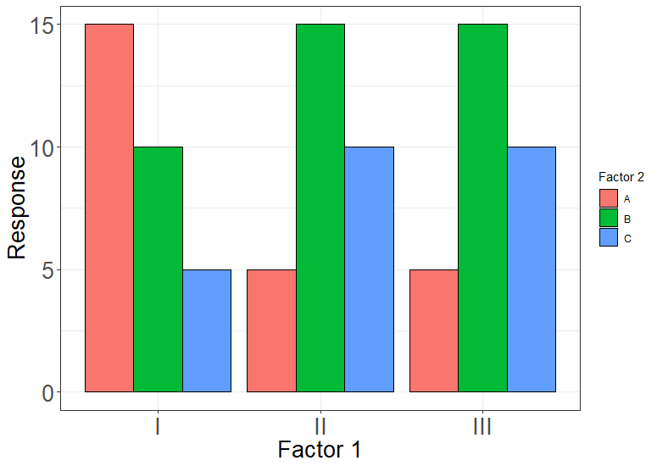
Notes:
775 x 550; proximity

Slide 28
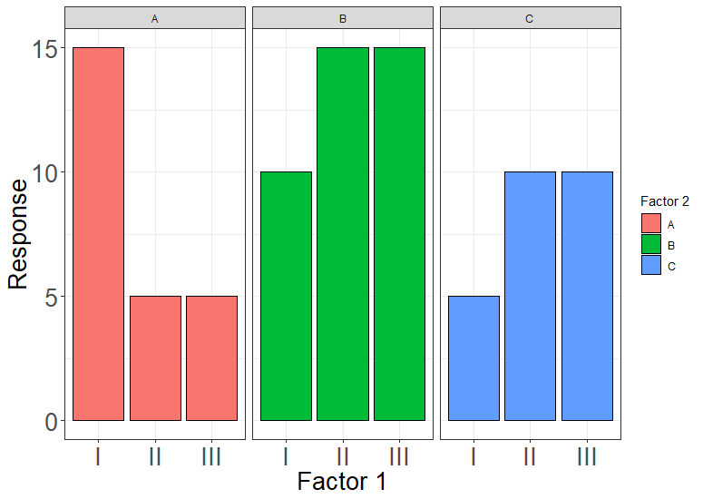
Notes:
775 x 550; proximity + enclosure

Slide 29
Keep the most important comparisons close!

Slide 30
Exercise 2 Sketch a redesign

Slide 31
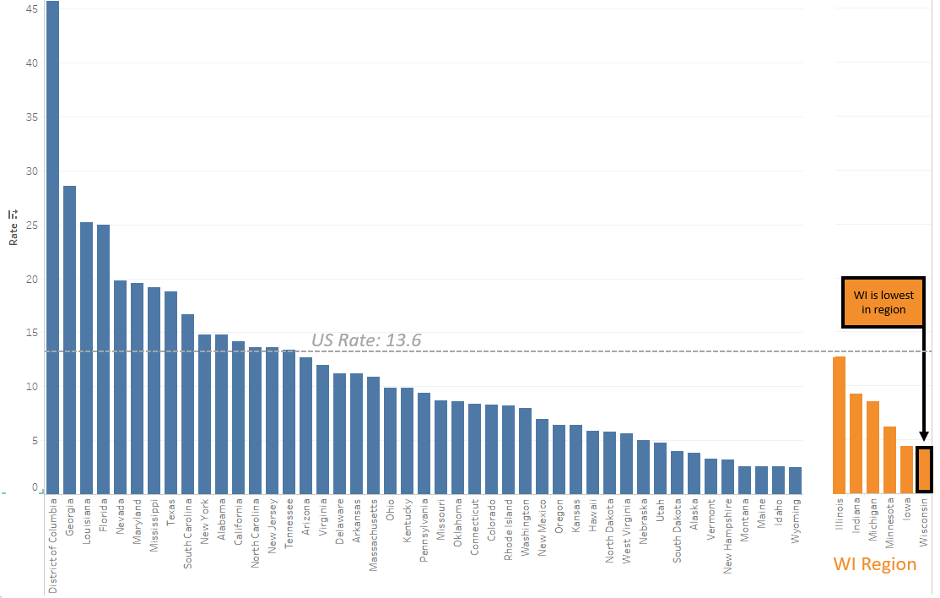
Solution
Annotations
Another crucial technique
(see Alberto Cairo)

Slide 32
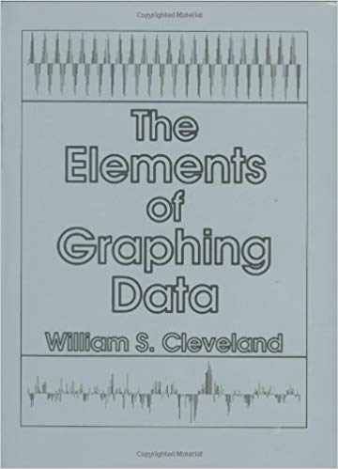
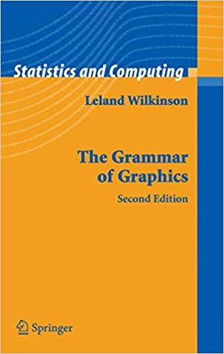

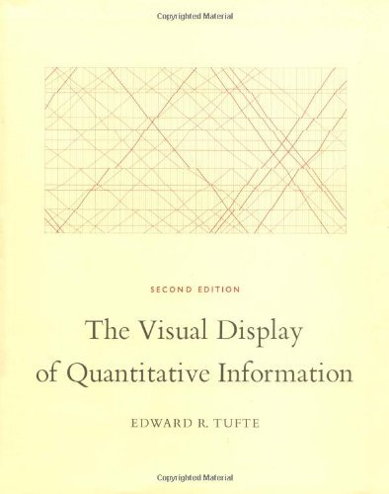
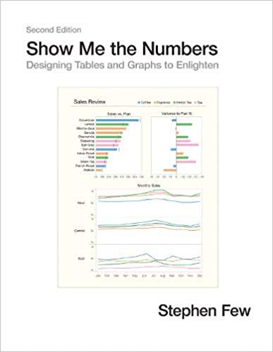


Bergen, Silas (2020). Using Gestalt principles to help students design effective tables and graphs; Link: https://github.com/WSU-DataScience/SDSS20_teaching_gestalt/raw/master/Bergen_Gestalt_presentation_SDSS2020.pptx.

Slide 33
Statistical Learning Theory
Data Management
Visualization
Statistical Learning
DSCI 210
Survey
DSCI 210
Survey
DSCI 210
Survey
STAT 210/310
Statistics
DSCI 325
Structured
DSCI 330
Unstructured
DSCI 310
Intro to Viz
STAT 360
Regression
DSCI 430
DS @ Scale
DSCI 415
Unsupervised
DSCI 425
Supervised

Slide 34
CART
Classification and Regression Trees – An Introduction

Slide 35
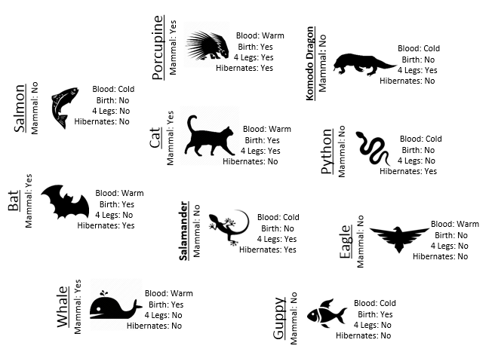
Mammal or not?

Slide 36
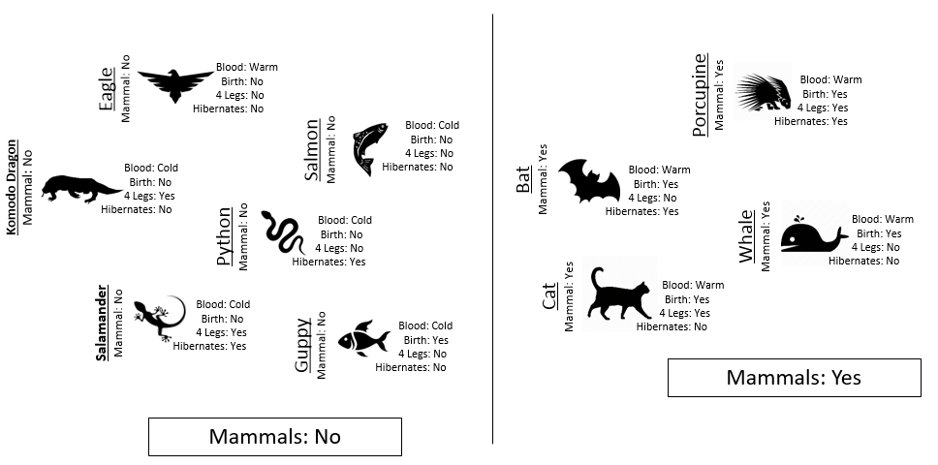
Build a Classification Rule

Slide 37
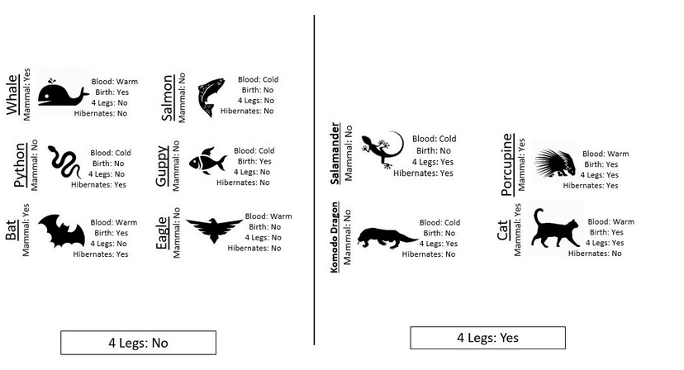
Building a classifier Step 1 – Split the examples by one feature.
All Cases
4 Legs: No
4 Legs: Yes
??
??
http://www.statsclass.org/dsci210/CART/train.html

Slide 38
Train the classifier
All Cases
4 Legs: No
4 Legs: Yes
Not Mammal
??
2 Mammal VS 4 Not Mammal
http://www.statsclass.org/dsci210/CART/train.html

Slide 39
Train the classifier
All Cases
4 Legs: No
4 Legs: Yes
Not Mammal
??
2 Mammal VS 2 Not Mammal
http://www.statsclass.org/dsci210/CART/train.html

Slide 40
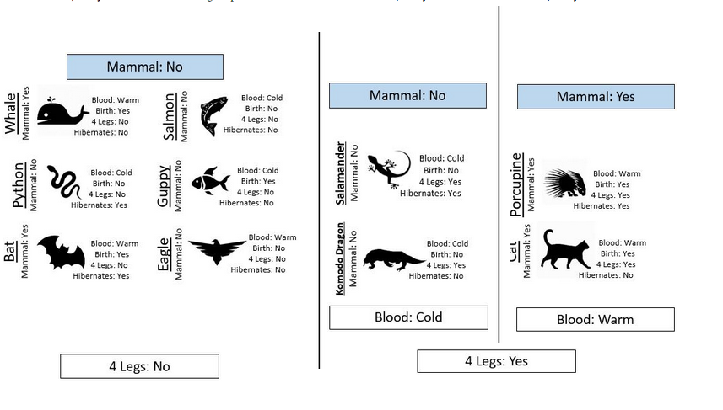
Building a classifier Step 3 – “Grow” the tree
All Cases
4 Legs: No
4 Legs: Yes
Not Mammal
Blood:
Cold
Blood:
Warm
Not Mammal
Mammal
http://www.statsclass.org/dsci210/CART/train.html

Slide 41
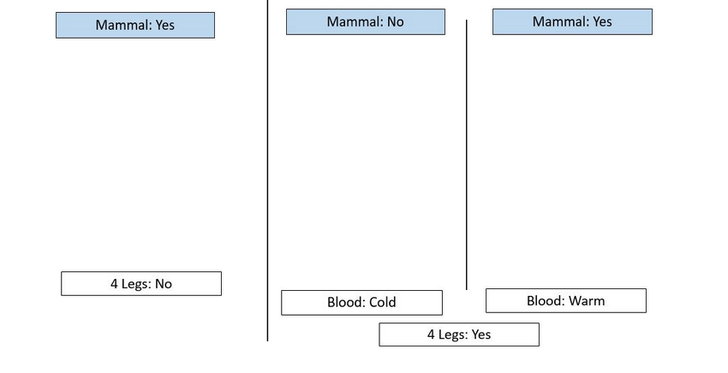
The final tree
All Cases
4 Legs: No
4 Legs: Yes
Not Mammal
Blood:
Cold
Blood:
Warm
Not Mammal
Mammal

Slide 42

Measure performance with test data Step 1 – Build the same tree
http://www.statsclass.org/dsci210/CART/test.html

Slide 43
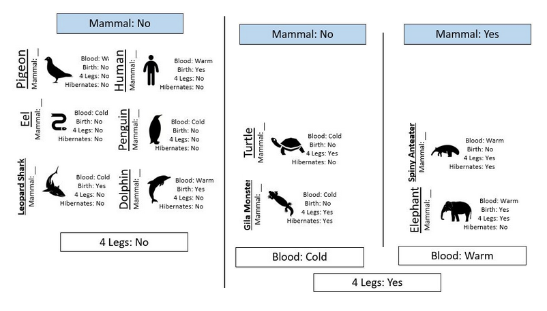
Measure performance with test data Step 2 – Apply the rule
✅
✅
✅
✅
✅
✅
✅
✅
http://www.statsclass.org/dsci210/CART/test.html

Slide 44
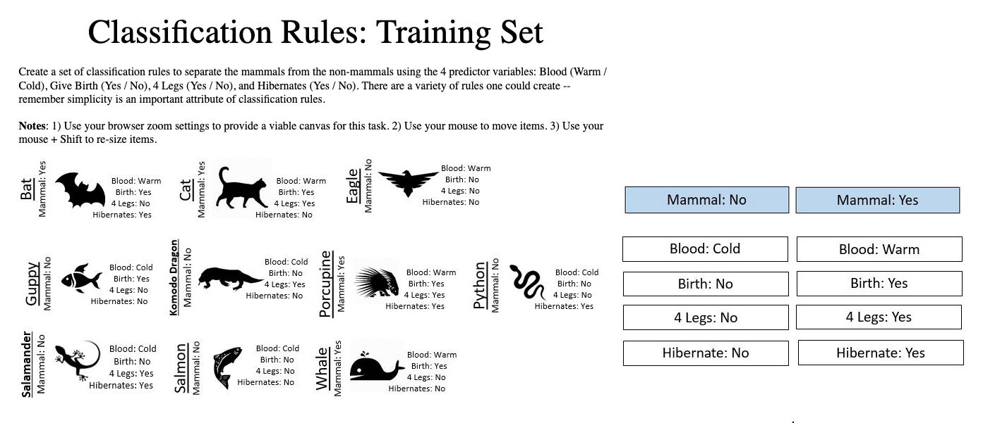
Exercise 3 Make your own rule (different than mine)
http://www.statsclass.org/dsci210/CART/train.html
http://www.statsclass.org/dsci210/CART/test.html

Slide 45
Thanks for attending! Feel free to reach out
Chris Malone
cmalone@winona.edu
Todd Iverson
tiverson@winona.edu

