Slide 1
Pokemon Game Playing Agent
Jodie Butterworth
CPT_S 440 Spring 2026

Slide 2
Introduction
Objective: Modify the PPO Pokemon Red Game Playing Agent originally created by Whidden. [1]
Introduction:
Peter Whidden created a game playing agent for Pokemon Red several years ago. It has undergone multiple revisions by many volunteers since he has shared his work. [1]
The program uses reinforcement learning to train the AI. [1] I have altered the rewards and punishments to encourage longer directional walks, less random movement, obtaining items, catching pokemon, getting HMs, obtaining badges, progressing to new areas quickly, avoiding fainting, avoiding prolonged time in the menu, avoiding prolonged time on any one map, rewarding effective combat moves, plus all the previous rewards like exploration and healing.

Slide 3
Problem Statement:
Pokemon is a very difficult game for AI to master. [2] Multiple large commercial Ais have attempted to play the game, and all of them struggled to make progress. “Some AI systems still struggle to make meaningful progress in classic Pokémon games, often wandering aimlessly or getting stuck early on. For example, Time first reported that earlier Claude models wandered without clear objectives and couldn’t get far beyond the first town of Pokémon Red, highlighting key weaknesses in long-term planning and execution.” [2]
Whidden’s early version of the game made it past Mt. Moon, but it took many revisions to get to the town for the second gym. Better optimized paths and faster reinforcement learning training methods have been created since then.
I have modified the original version with the goal of getting through Mt. Moon, a major obstacle for AI agents.

Slide 4
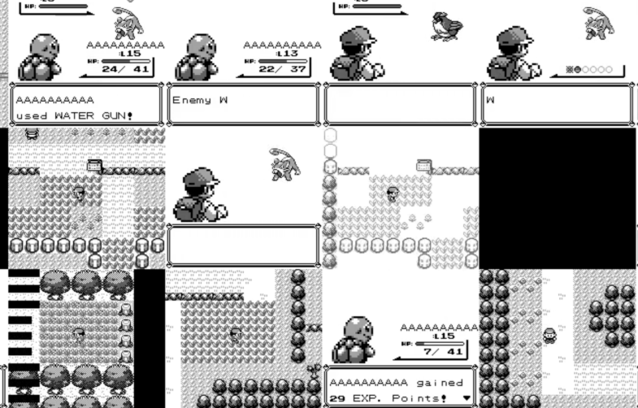

Project Implementation
PPO with Reinforcement Learning
I’m using the original python program and pipeline that Whidden created. [1]. I have modified the reward system in the .env, and I am using the original baseline to train the AI. Minimal changes were made to ensure compatibility with the old ex-register computer I am training on. Challenges & needs
Python, PyBoy and a computer copy of Pokemon Red are needed. The computer had to be adjusted to handle the file size and get the pipeline to run.
Image of Pokemon snapshots taken during ai training from the assets of Whidden’s GitHub. [1]

Slide 5
Changes Made to Reinforcements
Feature | Change | Purpose
Combat | KO, high damage rewarded, player fainting penalty | Encourage battling with damage dealing super-effective and high-damage moves
Movement | Jitter penalty, reward staying in one direction, penalty for staying in menu or one map too long, reward for getting to new areas quickly | To encourage player movement by penalizing walking in place, staying in menus and jittering in place. Walking in one direction and getting quickly to new maps rewarded
Game Assets | Extra rewards for picking up free items, getting badges, getting HMs, adding pokemon to party | Encourage acquiring assets needed to progress in the game and to make game progression easier
Original Code | Modifications made to original healing and exploration | Prevent healing from being repetitively farmed with no progress forward and reduce exploration because it was a very high reward

Slide 6
Demo
If all goes to plan, I will be on zoom on the computer with the AI training.
It used to be a retail cash register, and some of its settings were bizarre when I started setting it up.
Worse case scenario, I can send you a video of the program, and the code I altered (other than for set-up) is in a .zip on GitHub. https://github.com/WSU-JB5757/440_AI_Project

Slide 7
Results and Conclusions
Unfortunately, the reward for uniform direction was set to reward not changing direction rather than forward progress. So the AI began to farm this risk – free source of points and did not progress further in the game. This reward has been nerfed and exploration rewards have been increased.
In earlier versions, the combat system was over – powered and the AI lost all interest in progressing and staying in the first grass patch and farmed combat rewards. Combat rewards were nerfed to be less.
Originally, the AI would progress to Mt. Moon and get stuck there for hours scrolling through menus and running against walls. The menu and movement penalties have fixed this.
There is still some small alterations, and many hours of training to get my version of the AI to beat Mt. Moon, unfortunately.

Slide 8
References
[1] Peter Whidden. “PokemonRedExperiments.” https://github.com/PWhiddy/PokemonRedExperiments. (accessed 5 - 4 - 26).
[2] Elton Jones. “Pokémon reveals what AI still gets wrong — here’s what I found.” https://www.tomsguide.com/ai/pokemon-isnt-just-a-multimillion-dollar-franchise-its-one-of-the-best-testing-grounds-for-modern-ai-tools. (accessed 5 - 4 - 26).
Note: ChatGPT Generative AI was used on this project for both coding and instructions in set-up and troubleshooting.

