Slide 1
Crowd-funding platform
CPTS 451 Spring 2026 Project
Crowd-Funding Platform
Jodie Butterworth, Group 19

Slide 2
introduction
Crowd-funding platforms allow projects with public interest but limited financial support to organize campaigns to collect funding and advertise to their supporters.
This project creates a database and UI for a crowd-funding platform that collects:
user data for advertising and tracking campaign donations
campaign data containing campaign information including funding goals and start and end dates
transaction data of the donations made and details of each payment

Slide 3
Sprint one objectives
Organize database architecture
Create ER diagram
Create the tables, User, Transaction, Campaign in SQL
Organize project on Kanban board
Create functional and non-functional requirements
Create functional objectives and user stories

Slide 4
Functional requirements
FR-1: Users must be able to register
FR-2: Users must be able to donate
FR-3: Admins must be able to create and manage campaigns
FR-4: Campaigns must be able to collect donations
FR-5: Campaigns must have a start and an end date
FR-6: Admins must be able to contact users
FR-7: A UI interface must display site information and data appropriately to users and admins
FR-8: SQL databases created to hold crowd-funding platform data
FR-9: Databases must have checks for errors in data entry
FR-10: Database architecture to include additional tables to improve structure and operating costs

Slide 5
Non-Functional requirements
NR-1: Site must load reasonably quickly
NR-2: Site must encrypt passwords
NR-3: Donation data must be secure
NR-4: UI should be easy to use
NR-5: UI should be desktop and mobile compatible
NR-6: Database must be scalable and easy to edit
NR-7: Database hardware can be updated or exchanged without significantly changing programming

Slide 6
User Stories
U-1: As a new user, I want to add my information to the registration page so that I can create a user account.
U-2: As a user, I want to access my account so that I can make a donation.
U-3: As an admin, I want to access the Campaign table so that I can create a new campaign.
U-4: As an admin, I want to query the database so that I can view the donations collected for a specific campaign.
U-5: As an admin, I want to edit the campaign dates so that they display valid dates.
U-6: As an admin, I want post campaign information to social media, so that users can know the campaign progress.
U-7: As a registered user, I want to access my account so that I can view my past donations.
U-8: As an admin, I want to access the data in the User, Transaction and Campaign tables so that I can view the table contents.
U-9: As an admin, I want to secure the donation data so that negative and null donation amounts can not be entered.
U-10: As a registered user, I want to access my user email, so that I can edit it.

Slide 7
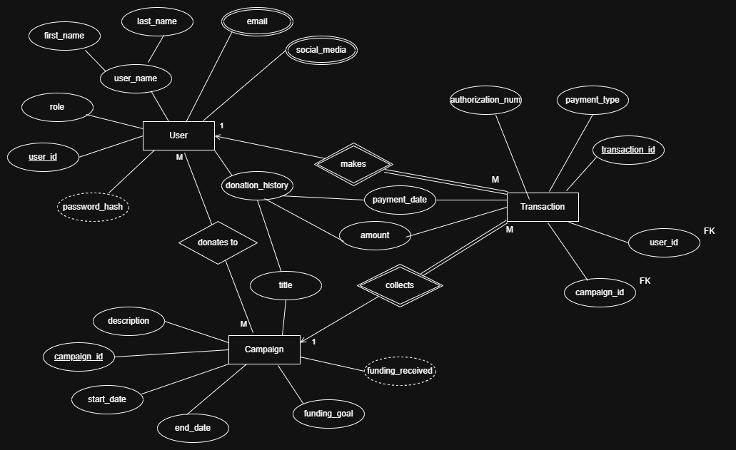
ER Diagram
3 Table Entities:
User
Transaction
Campaign
Relationships:
User to Transaction
1 : M
Campaign to Transaction
1 : M
User to Campaign
M : M
Email and SocialMedia tables for multiple type attributes
UserCampaign table to connect User and Campaign

Slide 8
Database Design
Database consists of 3 main tables, User, Transaction and Campaign
Database has 3 helper tables for easier data access and maintenance, UserCampaign, Email and SocialMedia.
The user_name attribute is stored in the User table as first_name and last_name.
User, Transaction and Campaign have their PK as ids unique to that record.
Transaction has FK for both user_id and campaign_id to connect its records to users and campaigns.
Password is shown as calculated because it is hashed. This may need to change.
Funding_received is calculated by summing transaction amounts for the campaign.
Donation_history is assembled for each user from the transaction records and the campaign details.
Records of transactions, campaigns and users so not delete if another table’s associated record is deleted.

Slide 9
Demo

Slide 10
Table Creation Oracle Free Entries
CREATE TABLE PROJECTTRANSACTION
(
transaction_id NUMBER,
campaign_id NUMBER,
user_id NUMBER,
authorization_num VARCHAR2(255) NOT NULL,
payment_type VARCHAR2(255) NOT NULL,
payment_date DATE NOT NULL,
amount DECIMAL(19,4) NOT NULL, CHECK(amount>0),
CONSTRAINT fk_campaign FOREIGN KEY (campaign_id) REFERENCES ProjectCampaign(campaign_id),
CONSTRAINT fk_user FOREIGN KEY (user_id) REFERENCES ProjectUser(user_id),
CONSTRAINT pk_transaction PRIMARY KEY (transaction_id)
);
CREATE TABLE PROJECTCAMPAIGN
(
campaign_id NUMBER,
title VARCHAR2(255),
start_date DATE NOT NULL,
end_date DATE NOT NULL,
funding_goal DECIMAL(19,4) NOT NULL,
funding_received DECIMAL(19,4) DEFAULT 0,
description VARCHAR2(255) NOT NULL,
CONSTRAINT campaign_pk PRIMARY KEY (campaign_id)
);
CREATE TABLE PROJECTUSER
(
user_id NUMBER,
first_name VARCHAR2(255) NOT NULL,
last_name VARCHAR2(255) NOT NULL,
password_hash VARCHAR2(255) NOT NULL,
role VARCAHR2(20) CHECK(role IN(('user','admin'))
);
I referenced https://www.oracletutorial.com/oracle-basics when making this code

Slide 11
Reflection and future plans
Test out different SQLs and possibly change to mySQL or Postgres
I had to redo both the Kanban board tasks and the database architecture, so I may want to spend more time on research to reduce revision time.
Encryption may be necessary for more database entries than password.
Donation_history may change its query if necessary.
I have a lot of projects that I’m doing solo, so I may need to start earlier to prevent work piling up.
Additional constraints on entries will probably be added, like greater than 0 on funding_goal.

Slide 12
Thank YOU for watching

