Slide 1
What is an API?
Quick introduction video.

Slide 2
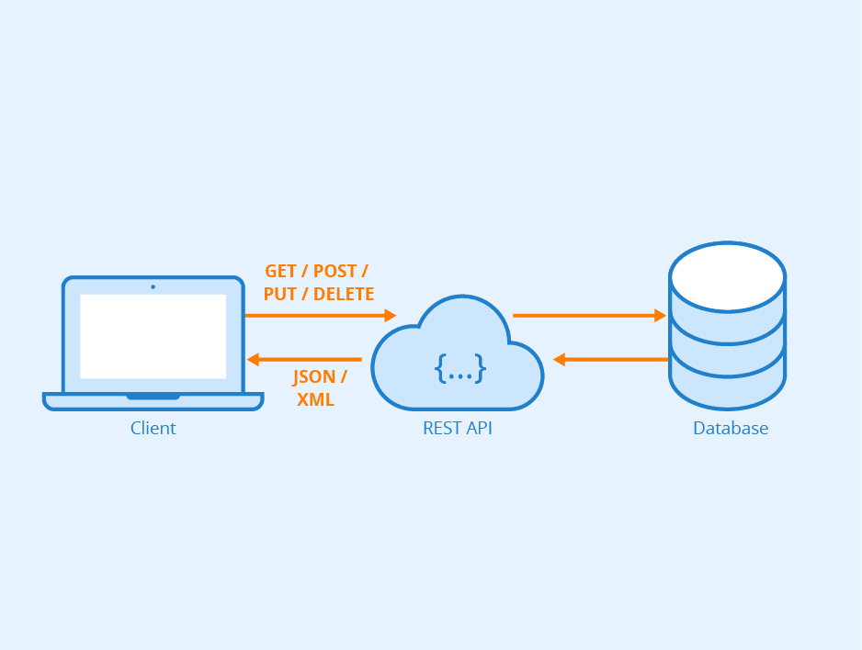
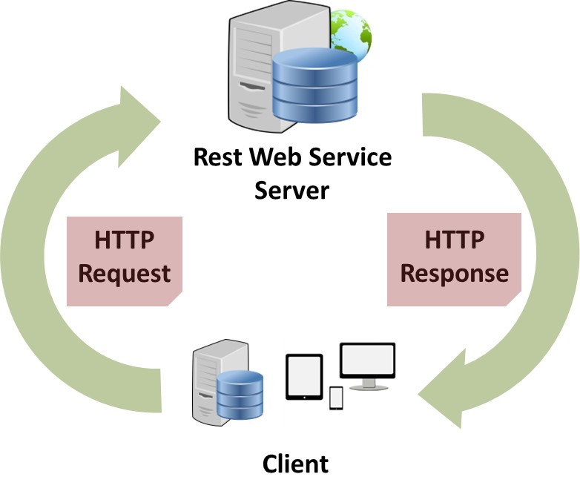
What is a REST API?
To simplify: a REST API is an API that links services together through the web (usually through HTTP)

Slide 3
Nomenclature:
Representational State Transfer (REST)
An architectural style for designing the linkage between frontend and backend web applications.
Application Programming Interface (API)
An API is a software medium that allows two different applications to talk to each other.

Slide 4
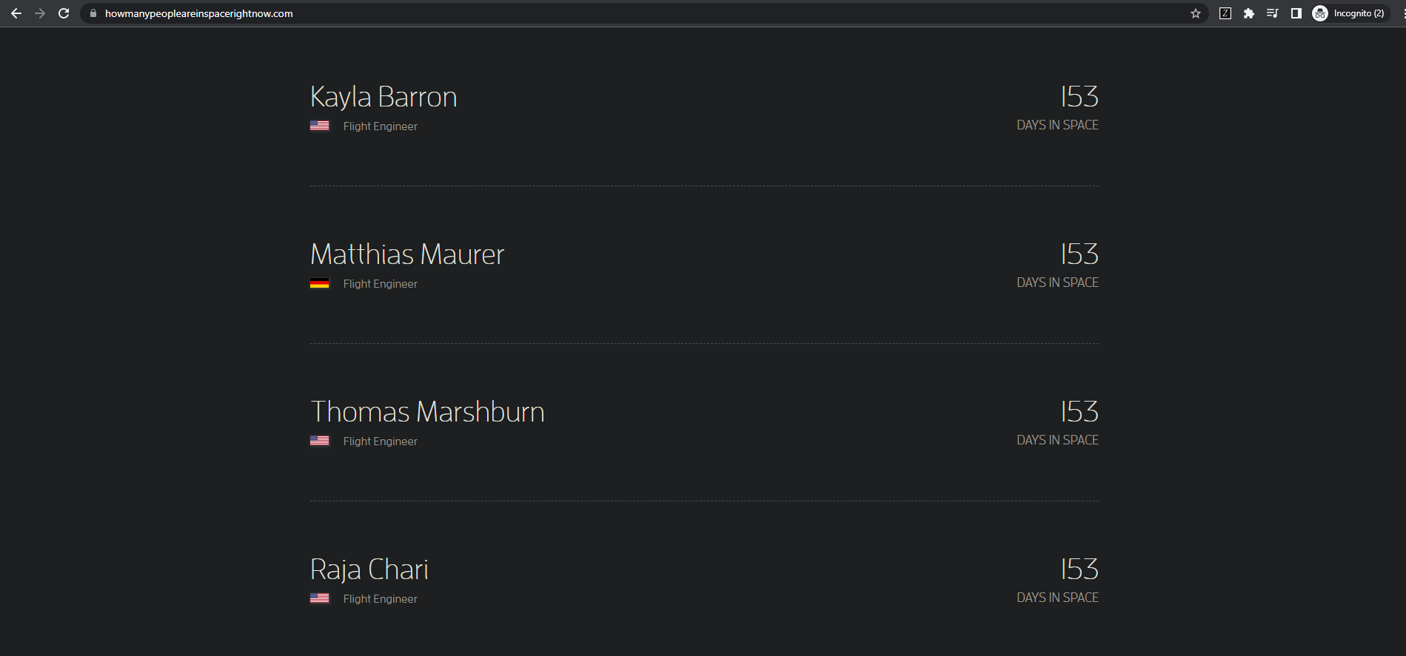
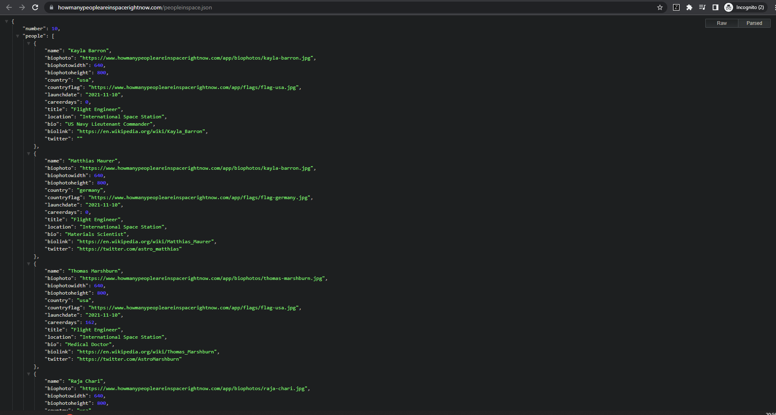
Example:
GET - https://www.howmanypeopleareinspacerightnow.com/
1) Client-side script calls (request) backend
2) Backend returns data (response) to client
GET - https://www.howmanypeopleareinspacerightnow.com/peopleinspace.json

Slide 5
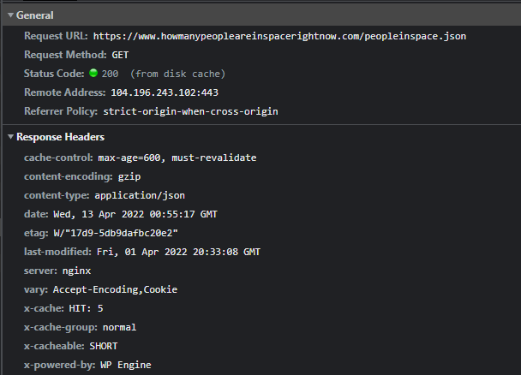
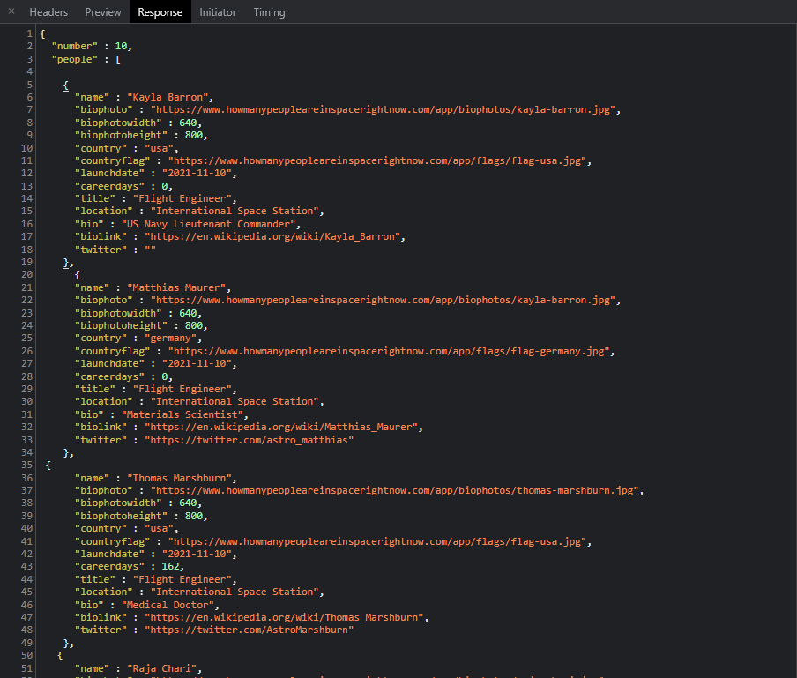
A dive deeper into the API request itself:
Request ^
Response (JSON) ^

Slide 6
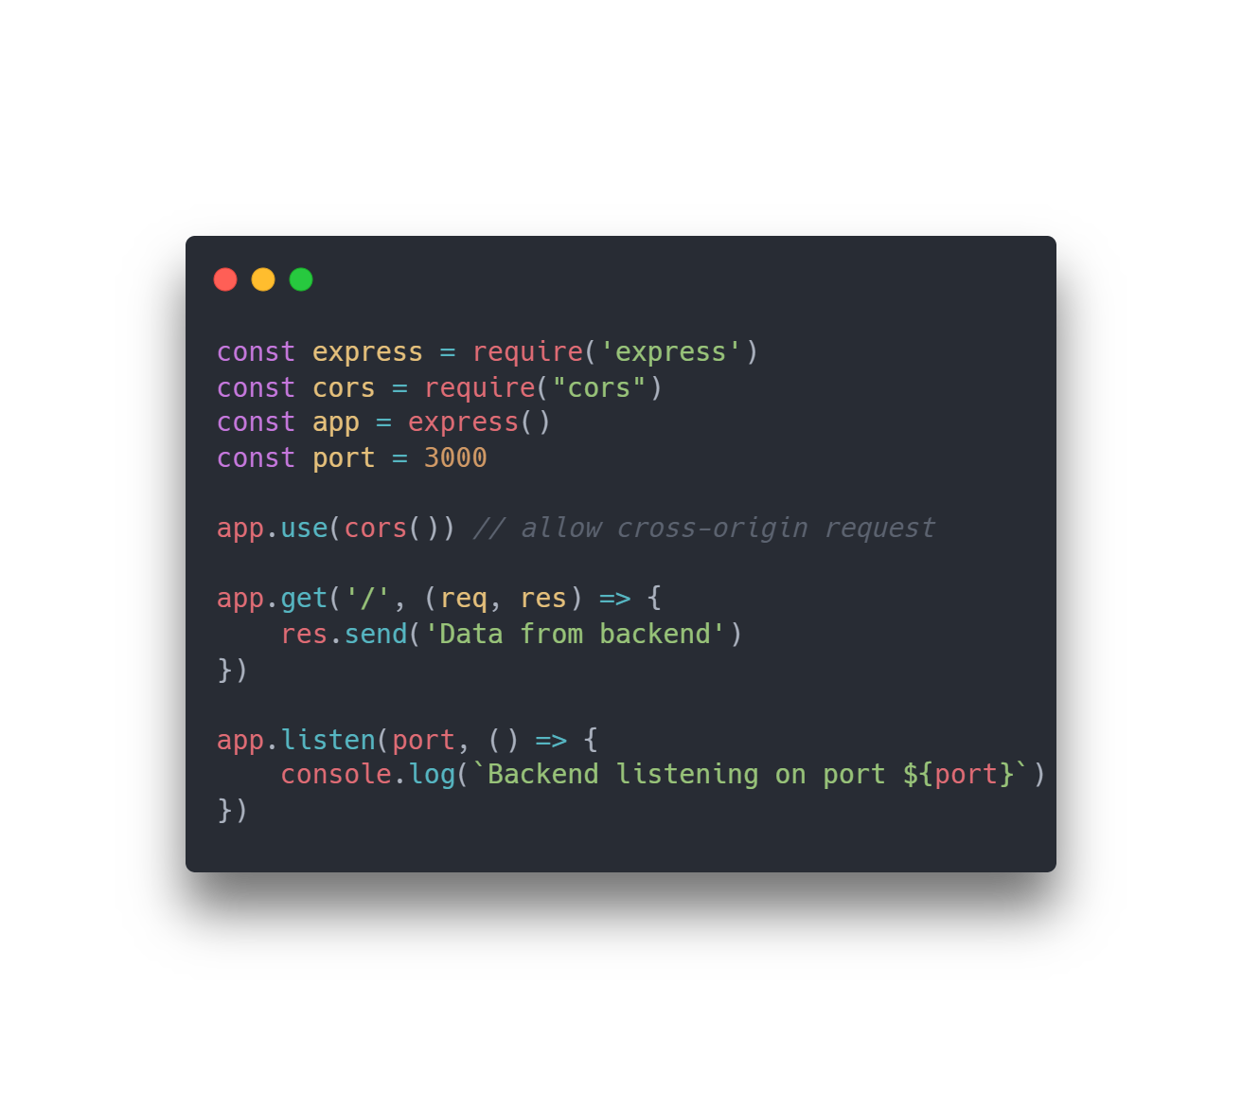

How would be build one? - Backend

Slide 7
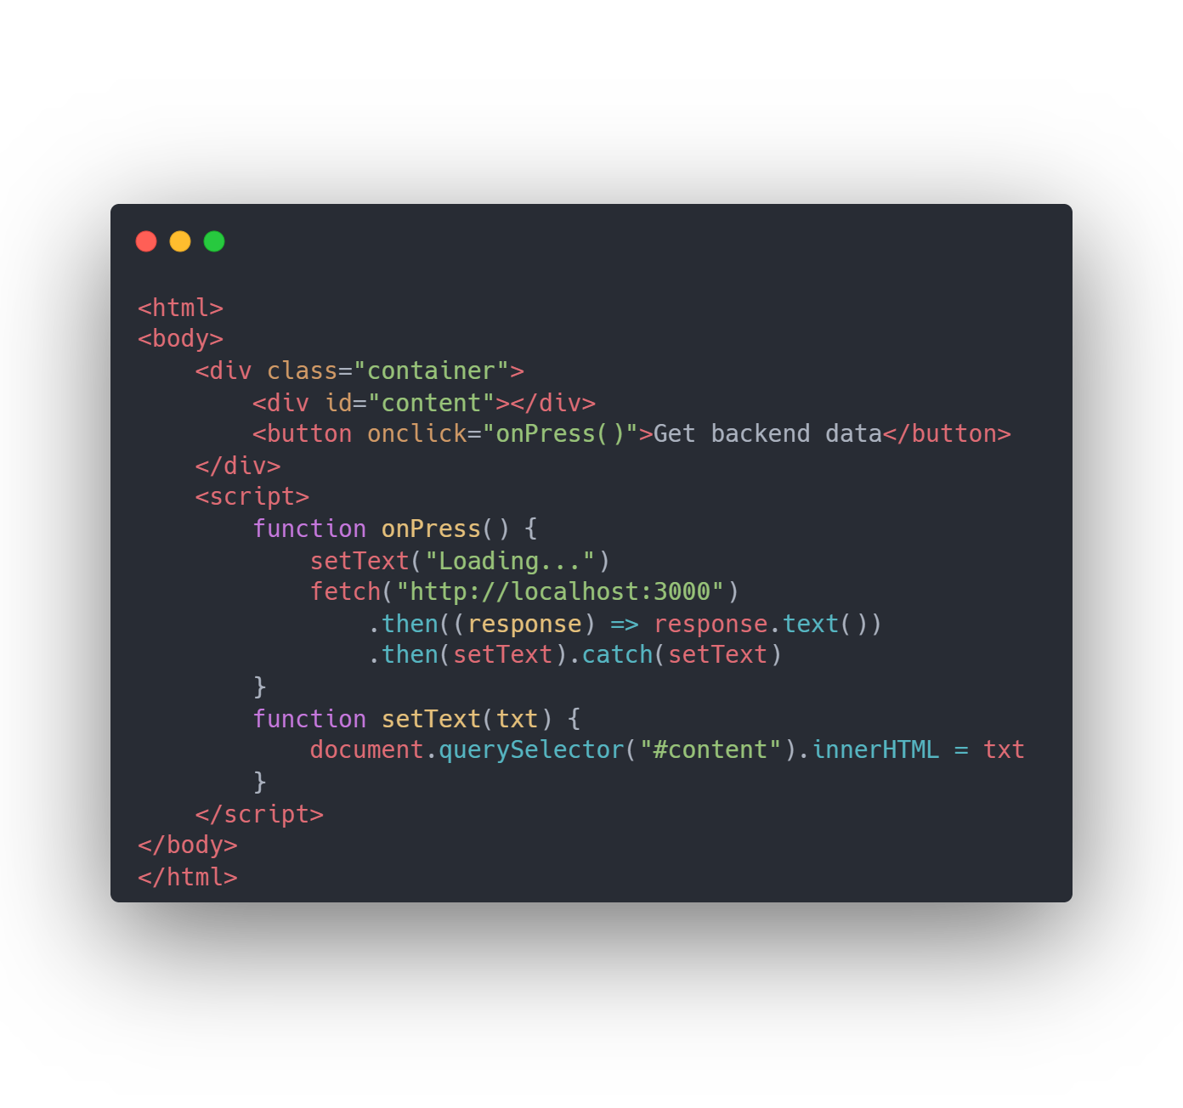

How would we build one? - Frontend

Slide 8
Demo:
Response when backend is offline
Response when backend is online

Slide 9
What we just did:
Server (Backend)
Client (Frontend)
Client Script
API Webserver
Response
Request

Slide 10
What’s next?
In these slides, we only scratched the surface for one of the most integral pieces of the internet. The REST API workshop (this Friday) will go more in-depth in terms of technicalities and conventions for backend REST practices. We will not only build scalable REST APIs, but also dissect prebuilt ones.
Thank you for listening

