Slide 1

Building scalable server-sided React apps.
By Zavaar Shah

Slide 2
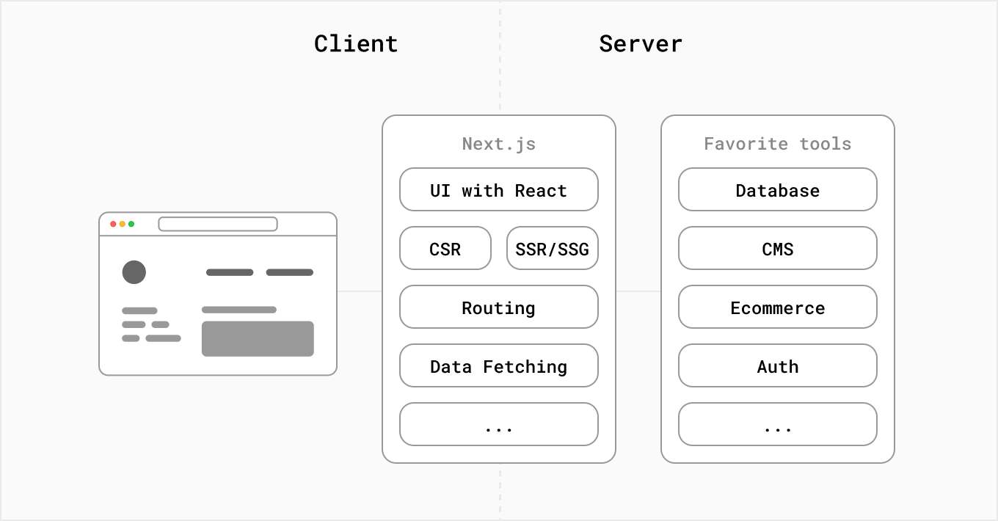
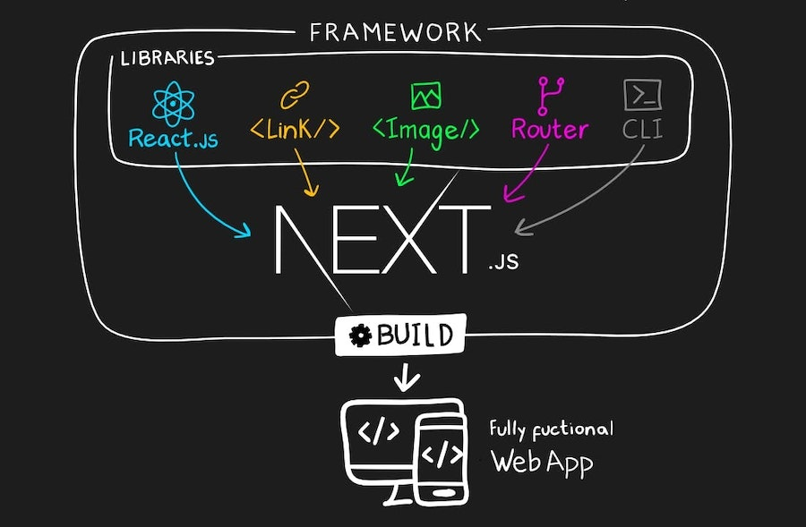
What is Next.js?
Next.js is a React framework that gives you building blocks to create web applications.
You can use React to build your UI, then incrementally adopt Next.js features to solve common application requirements such as routing, data fetching, integrations - all while improving the developer and end-user experience.
Whether you’re an individual developer or part of a larger team, you can leverage React and Next.js to build fully interactive, highly dynamic, and performant web applications.

Slide 3
Why Next.js?
PROS
Improved performance: Next.js optimizes page loading and enables server-side rendering, which can lead to faster page loads and improved SEO.
Automatic code splitting: Next.js automatically splits your code into small, optimized chunks, which can improve performance and reduce load times.
Improved developer experience: Next.js provides features like automatic reloads, error reporting, and hot module replacement, making it easier for developers to build and debug applications.
Static site generation: Next.js allows you to generate static sites, which can be deployed easily and have excellent performance.
Built-in routing: Next.js provides a built-in routing system that simplifies client-side navigation and enables easy creation of nested routes.
CONS
Learning curve: Next.js has a bit of a learning curve, particularly if you are not familiar with React, Node.js, or server-side rendering patterns.
Limited customization: While Next.js provides a lot of helpful tools and features out of the box, it may not be as customizable as some other frameworks (like Remix.js or Solid.js). This can limit your ability to tailor your application to your specific needs.
Server-side rendering
SSR sometimes can be slower as it can add overhead on an already busy server.
Requires a server to host (unlike CSR which can be hosted through GitHub Pages and others).
Integrating other libraries and modules that only operate in the browser, or if your component requires accessibility to client-exclusive properties like `window` or localStorage`.
Just another JavaScript framework to learn...

Slide 4
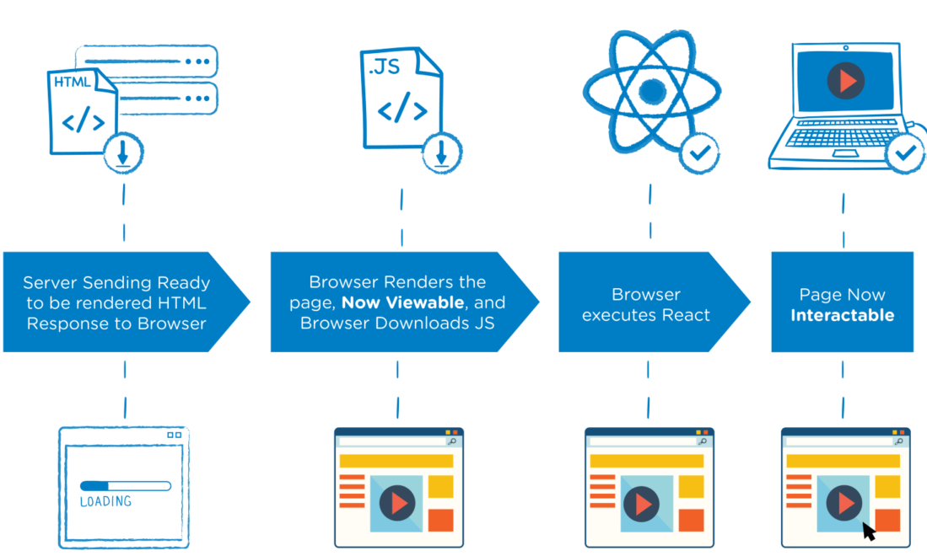
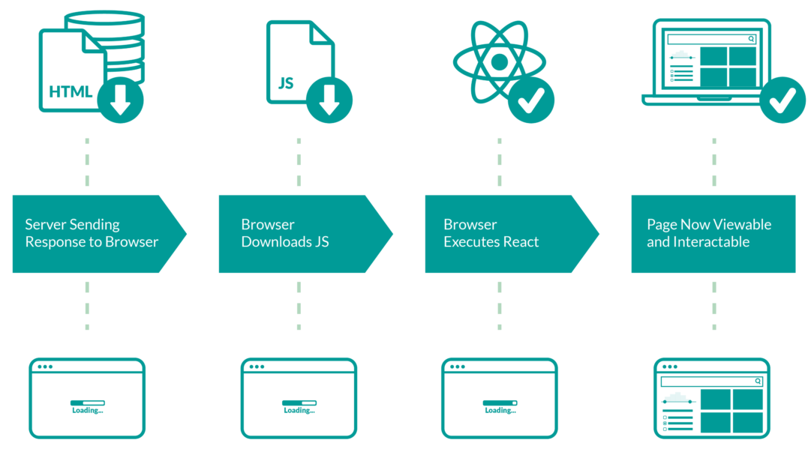
SSR vs. CSR
Server-side rendering
Client-side rendering
Server-side rendering (SSR) is a technique used to render web pages on the server and send the fully-rendered HTML to the client. In this approach, the server processes the initial request, fetches any data required for the page, and generates the HTML response, which is then sent to the client's browser. The client's browser does not have to wait for any further processing or data fetching, which can improve the initial load time and provide a better user experience.
Client-side rendering (CSR) is the process of generating the HTML and displaying content in the user's browser using JavaScript after the initial page load. In client-side rendering, the server sends a minimal amount of HTML and JavaScript to the client, and then the client uses that code to fetch and display as necessary. This approach allows for more interactive and dynamic user interfaces but can also result in slower initial page load times.

Slide 5
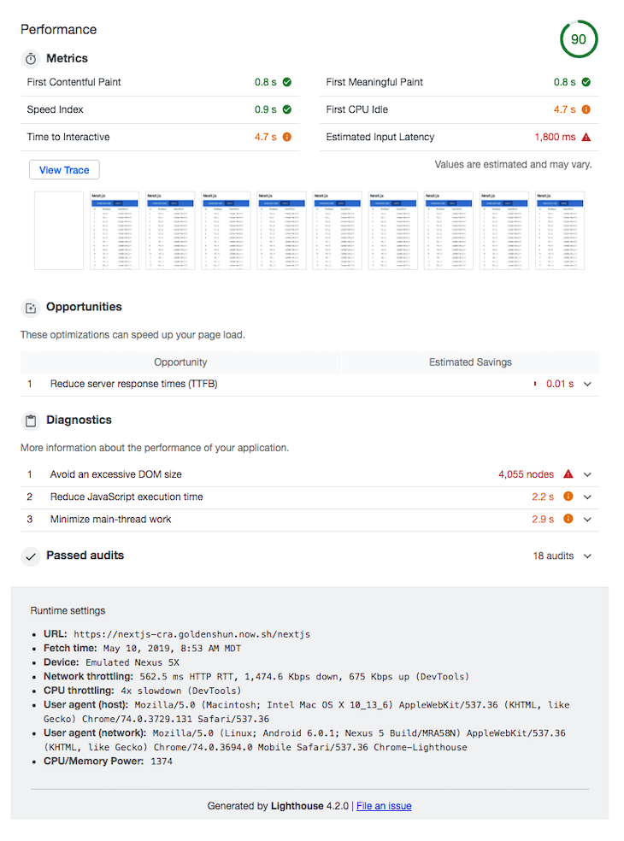
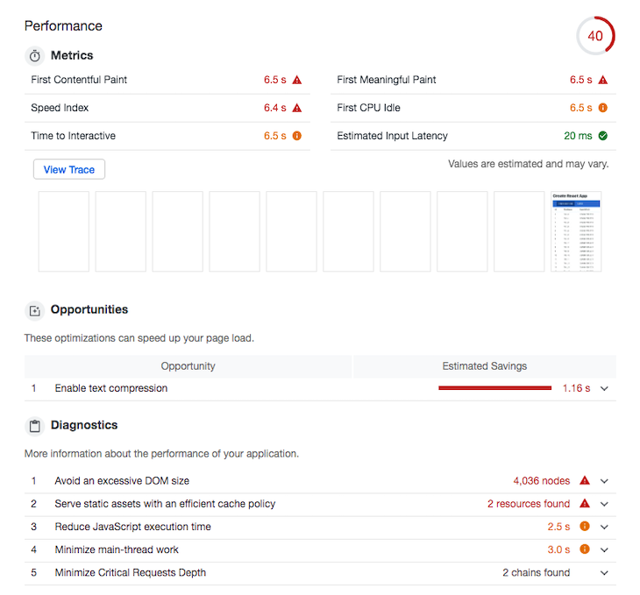
Next.js (SSR) vs. React.js (CSR)
https://blog.logrocket.com/create-react-app-vs-next-js-performance-differences/

Slide 6
Create Next App
npx create-next-app@latest
# automatic setup
cd my-app/
# go to ‘my-app’ directory
npm run dev
# start dev server @ http://localhost:3000

Slide 7
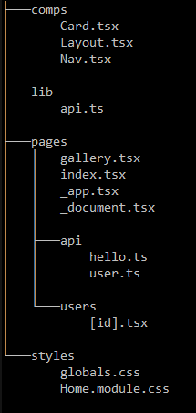
Routing - How is Next organized?
Directory of src/
In Next.js, a page is a React Component exported from a .js, .jsx, .ts, or .tsx file in the pages directory. Each page is associated with a route based on its file name.
/gallery
/
/api/hello
/api/user
/api/users/[any id here]

Slide 8
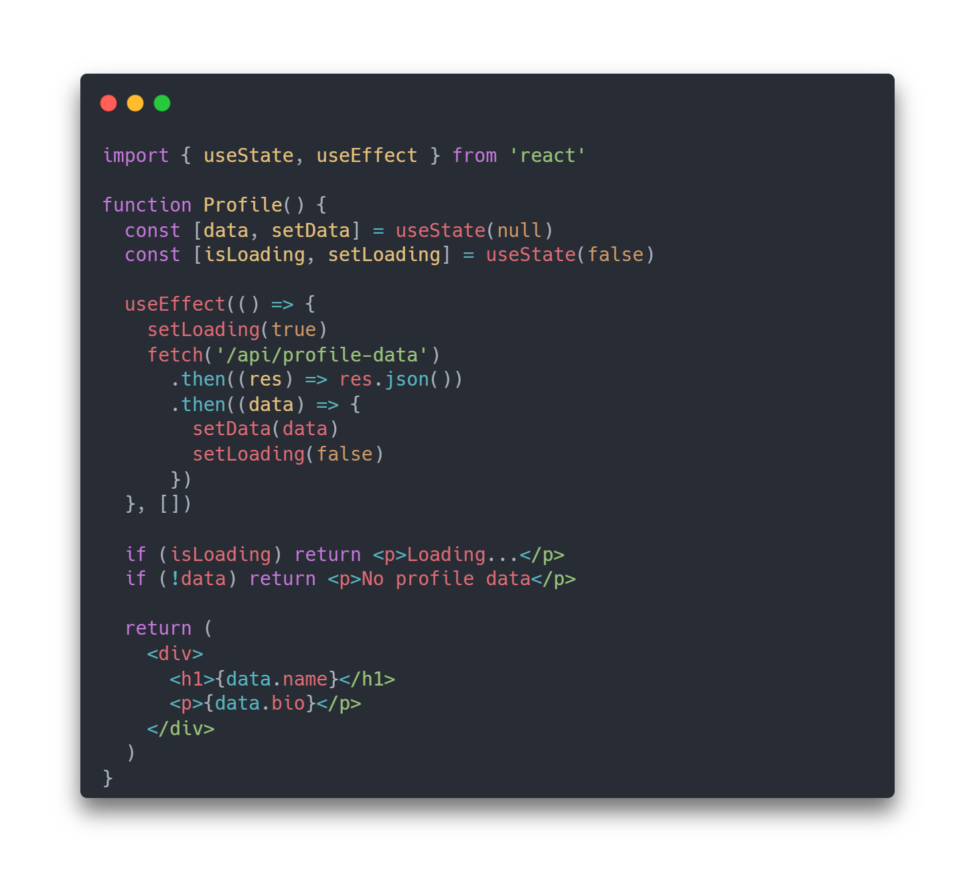
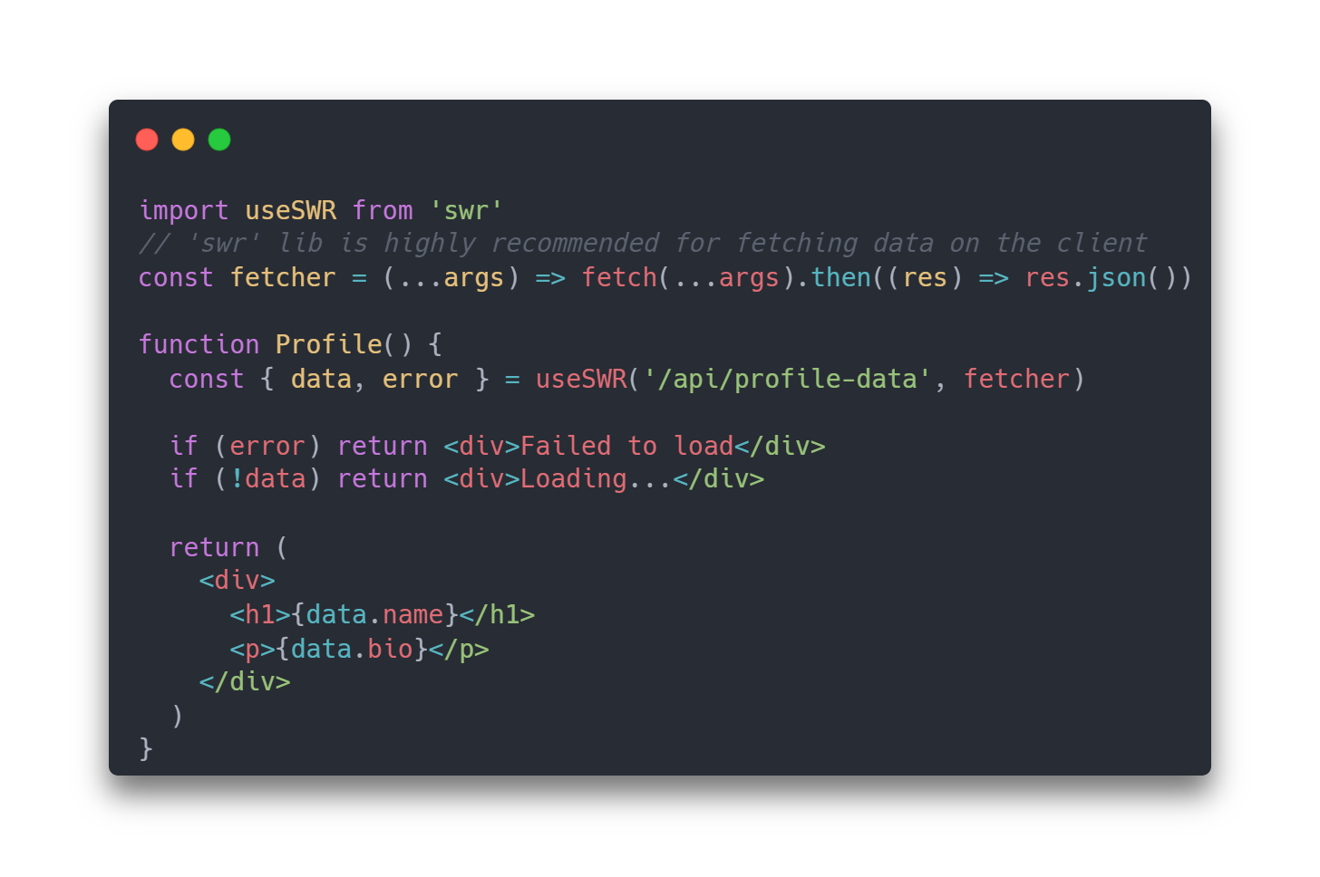
Client-side fetching
Using SWR
Traditional React implementation (works in Next as well)

Slide 9
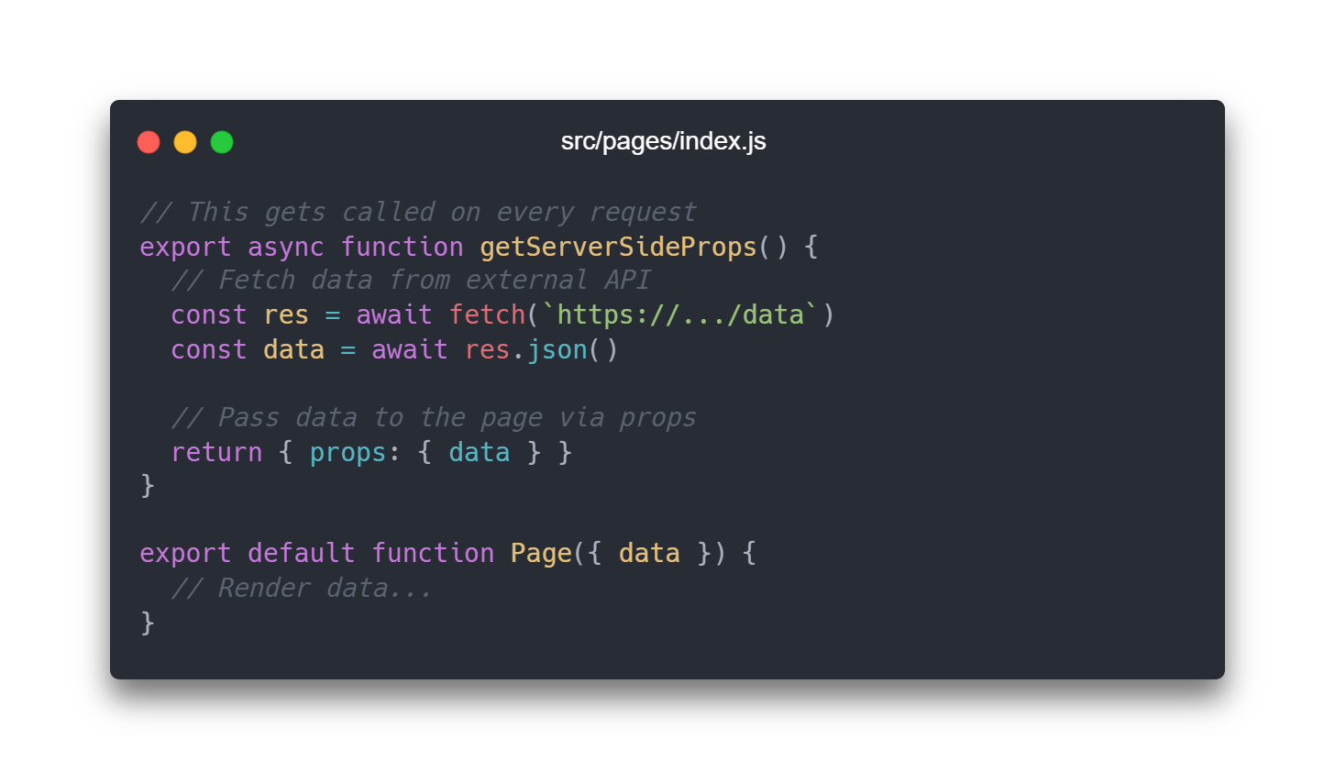
SSR - getServerSideProps
Next.js will pre-render this page on each request using the data returned by getServerSideProps.

Slide 10
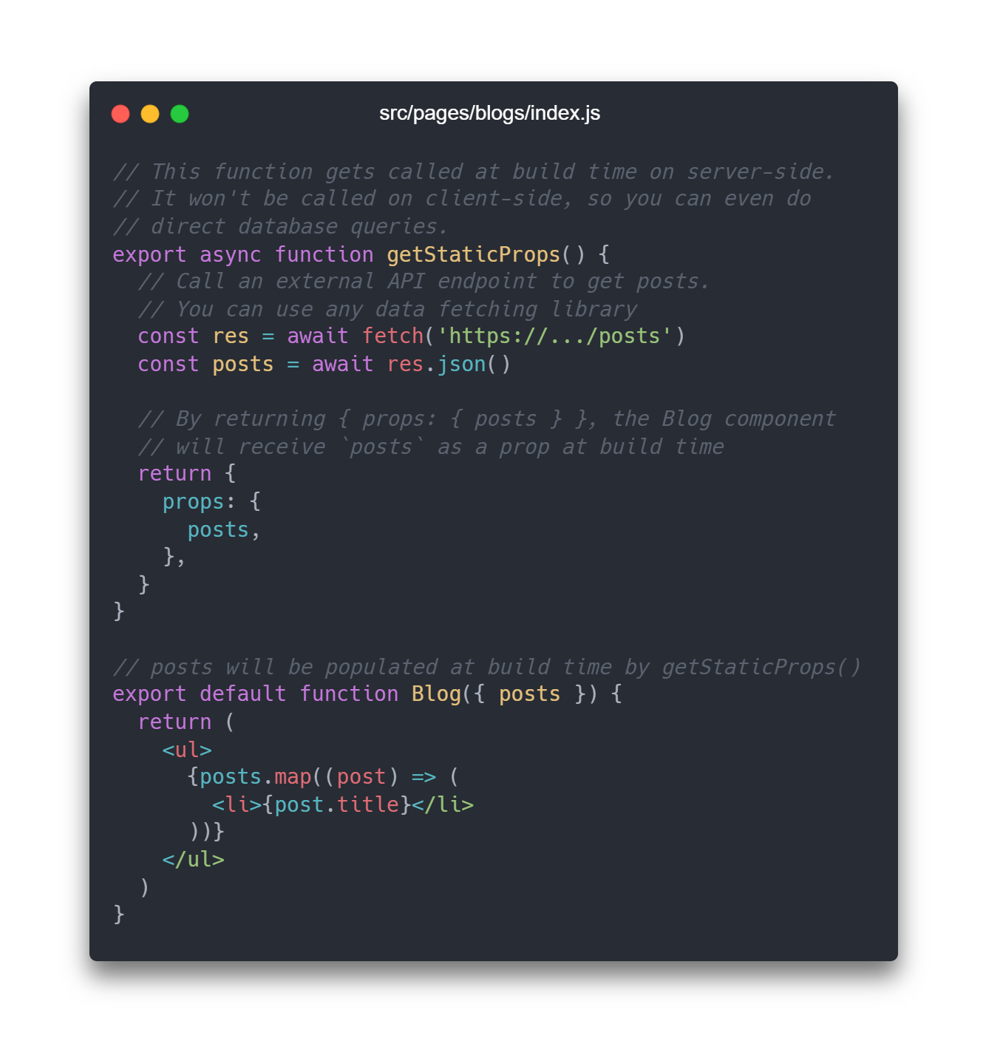
SSG - getStaticProps
SSG (Static Site Generation) will pre-render the page at build time using props returned by getStaticProps.
*NOTE: Runs every request in development mode.

Slide 11
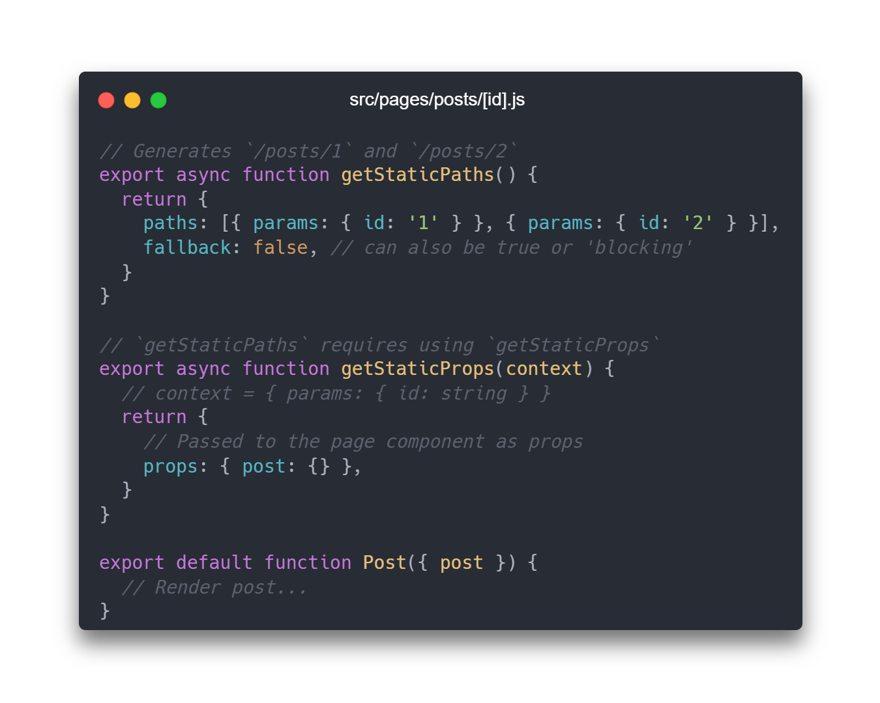
SSG - getStaticPaths
Static Site Generation with dynamic routes using getStaticPaths allows for the static pre-rendering of all paths programmatically.

Slide 12
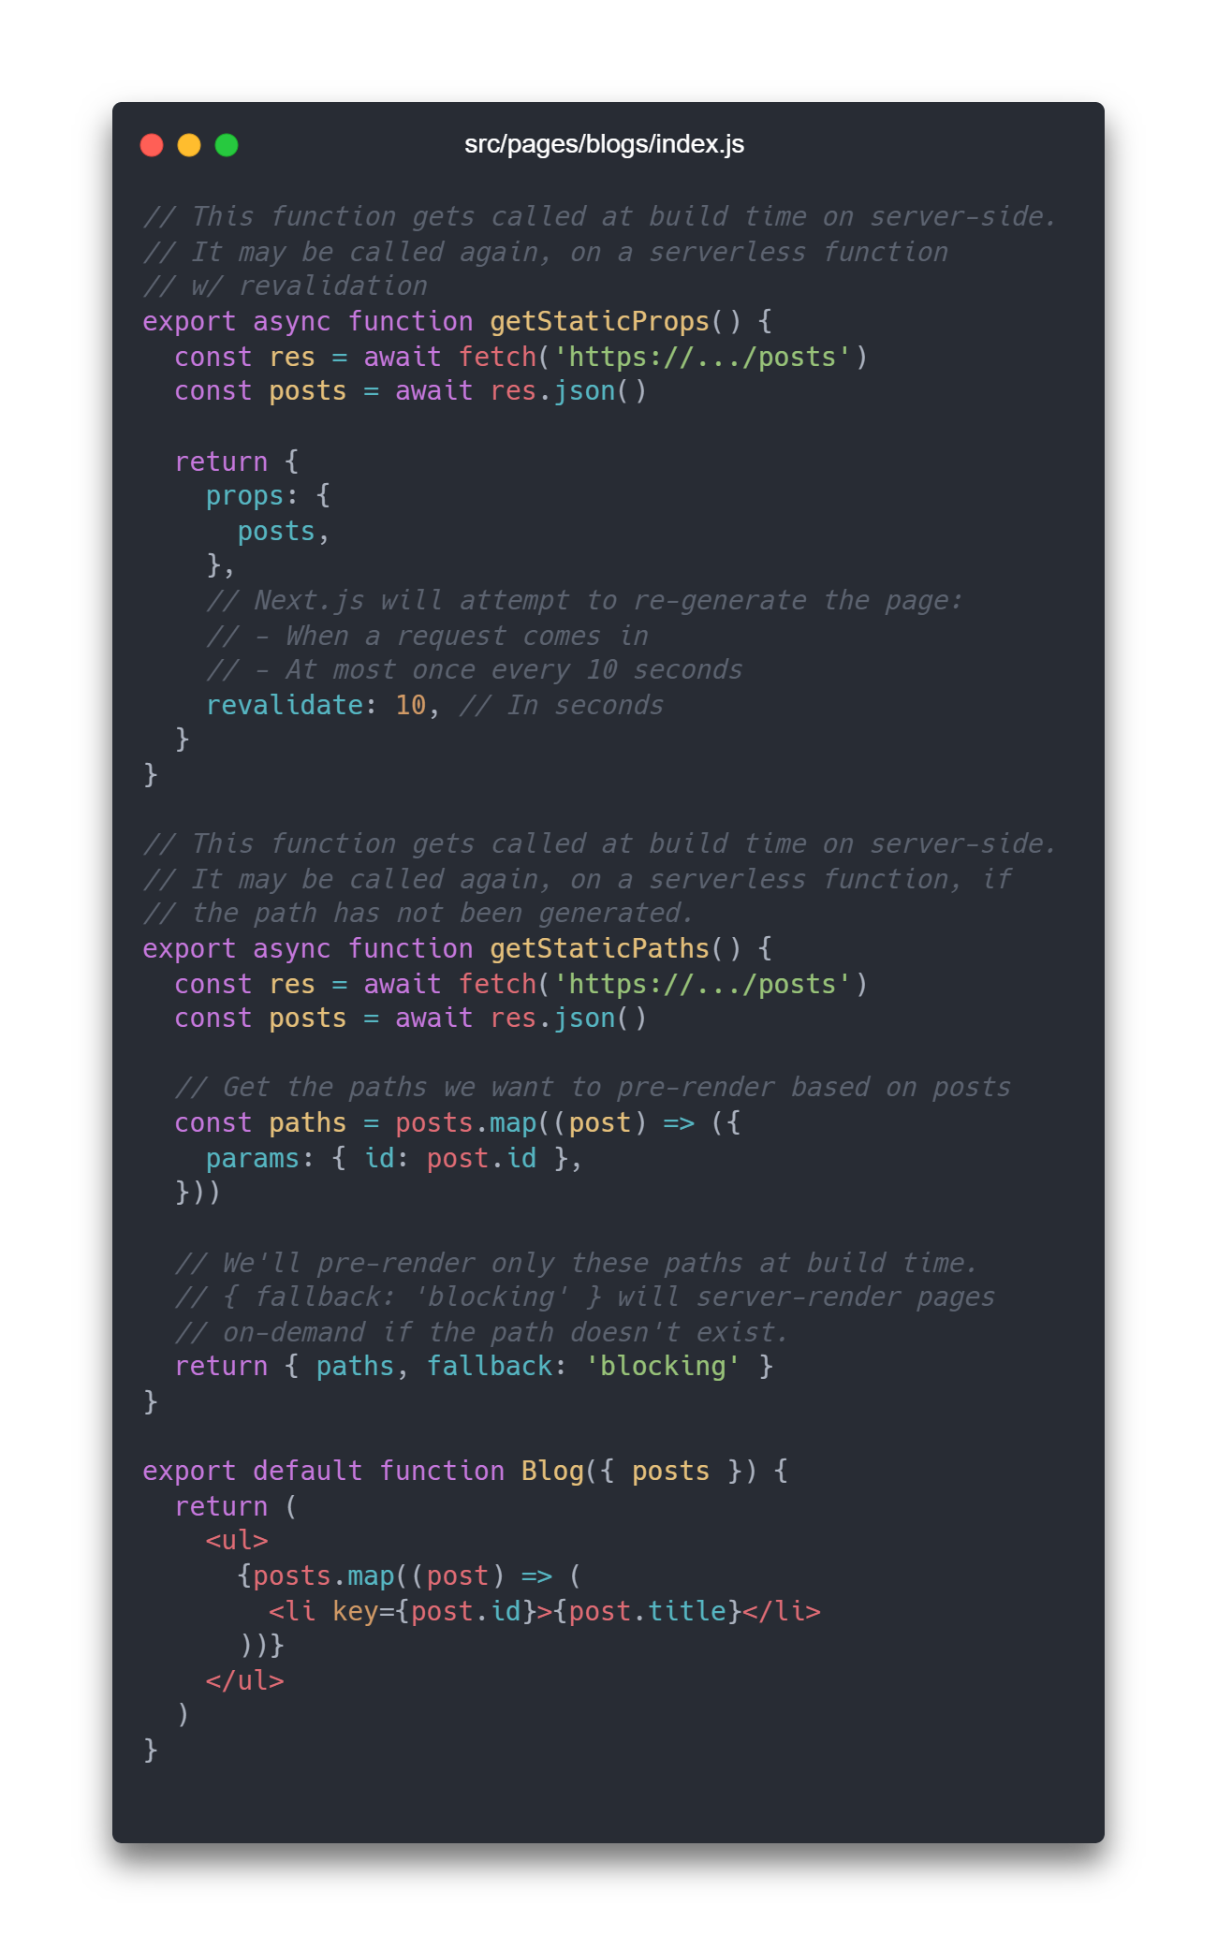
Incremental Static Regeneration (ISR) through revalidation
Incremental Static Regeneration (ISR) allows you to use static-generation on a per-page basis, without needing to rebuild the entire site. With ISR, you can retain the benefits of static while scaling to millions of pages.
Here's how it works:
When a user requests a page that was generated using getStaticProps, Next.js serves the static HTML file from the cache (if available).
At the same time, Next.js initiates a revalidation request in the background.
If the data has changed since the page was generated, Next.js generates a new HTML file and replaces the cache with the new version.
The next time a user requests the page, they will see the new version with updated data.

Slide 13

Quick summary
https://nextjs.org/docs/basic-features/data-fetching/overview

