Slide 1

React.js
A walkthrough of the library
Zavaar Shah

Slide 2
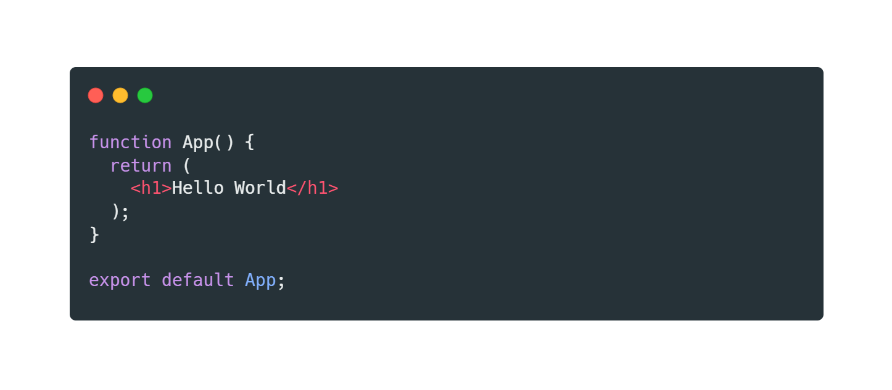
What is React?
React is a declarative, efficient, and flexible JavaScript library for building user interfaces. It lets you compose complex UIs from small and isolated pieces of code called “components”.
Hello world:
Directly use HTML syntax within JS environment (JSX)

Slide 3
Setup Environment
Download nodejs
https://nodejs.org/en/downloads
Install NPX globally (terminal)
npm install -g npx
Create React app project
npx create-react-app my-app
cd my-app
npm start

Slide 4
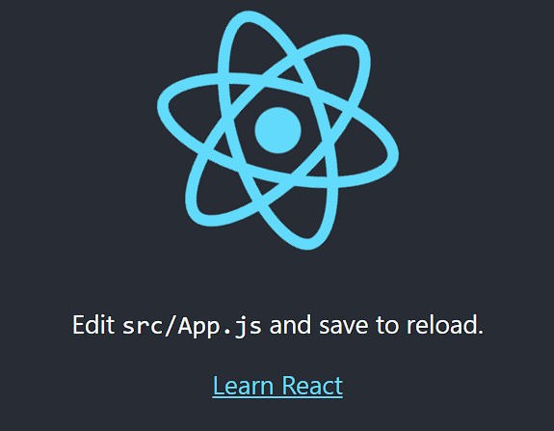
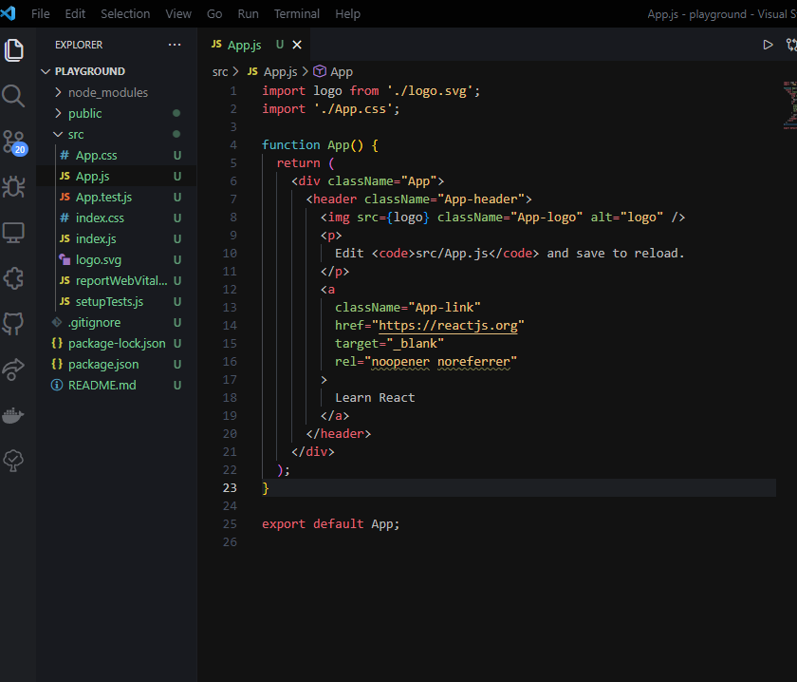
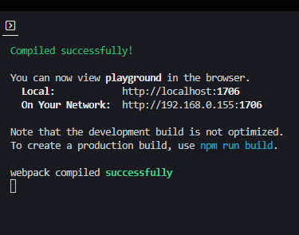
Development Environment
Website Preview
Default Code
Console Output
https://localhost:3000 by default
(after npm start)

Slide 5
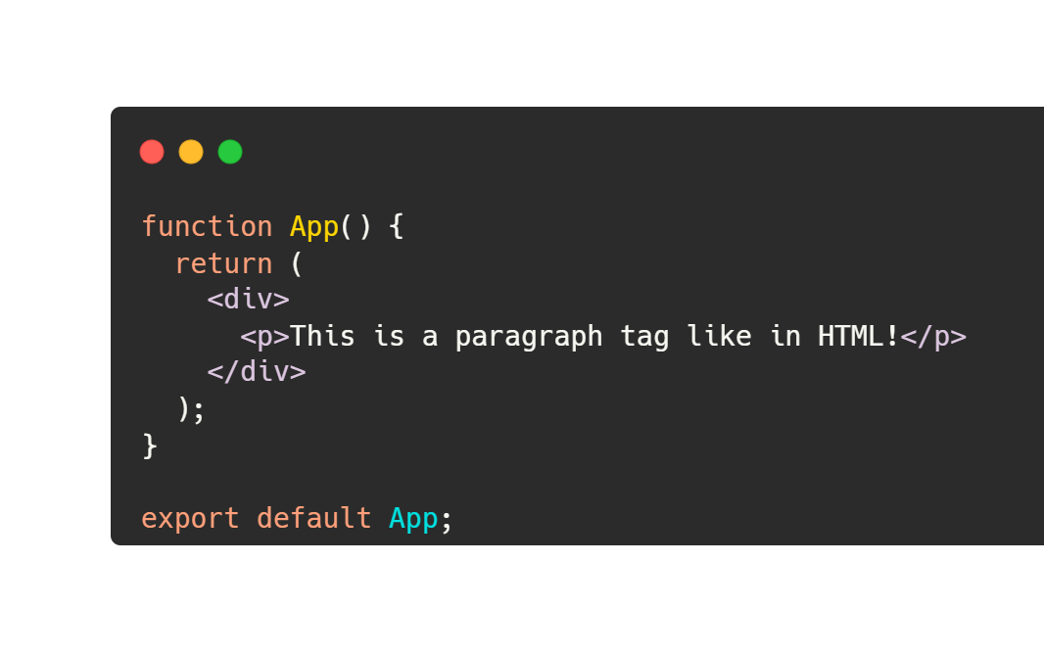
React Basics - JSX
Now that we have our project setup, let’s learn the basics of React. We can start by understanding the JSX structure of component-based rendering in React.
Traditional HTML syntax applies

Slide 6
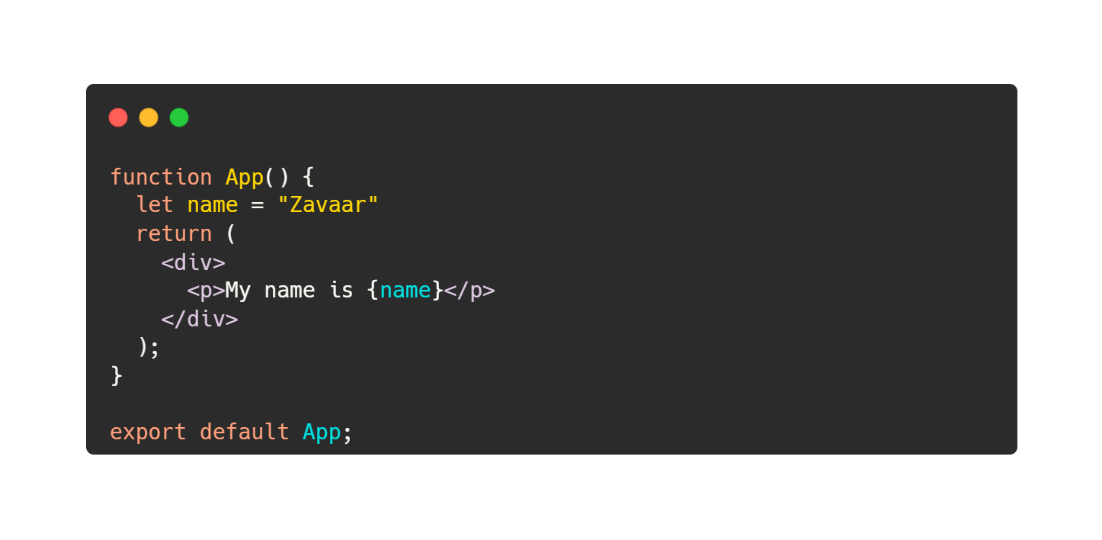

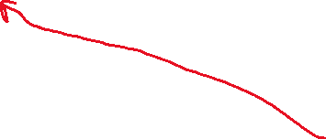
React Basics - JSX
Embedding Expressions
Output
By wrapping your expression around curly braces, the code will execute within.

Slide 7
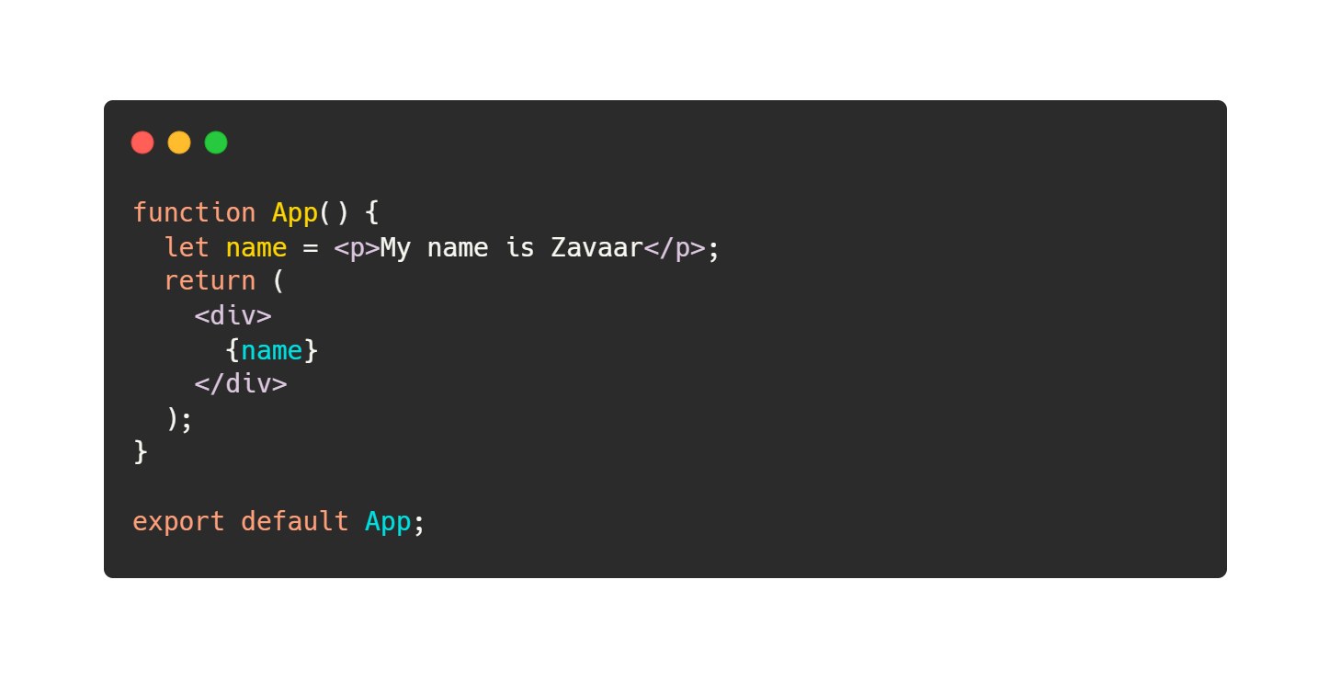
JSX is an expression too!

Slide 8
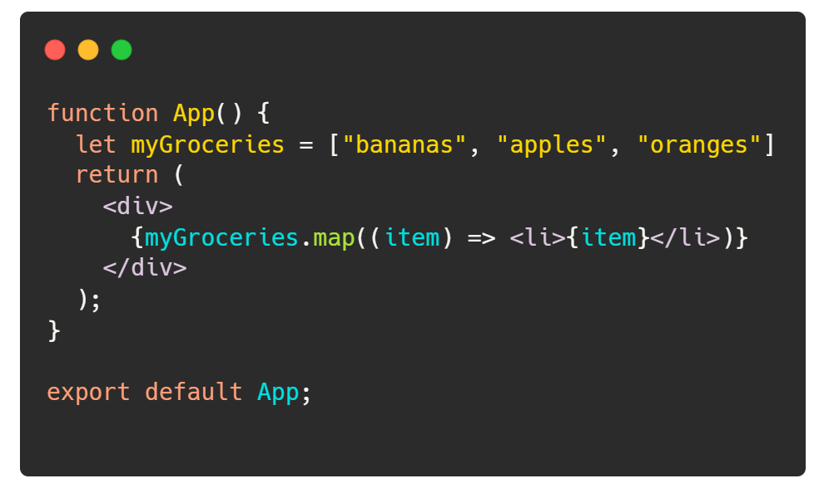
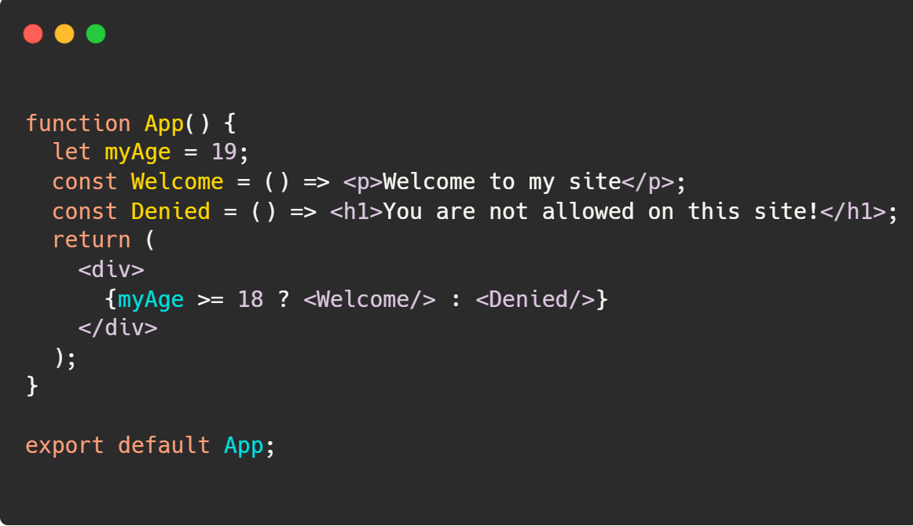

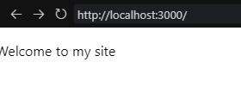


React Basics - JSX
Functions that return JSX are called components. They allow for code modularity.
Iterative rendering
Conditional rendering
You can “call” those functions with the JSX syntax to render them
https://developer.mozilla.org/en-US/docs/Web/JavaScript/Reference/Global_Objects/Array/map

Slide 9
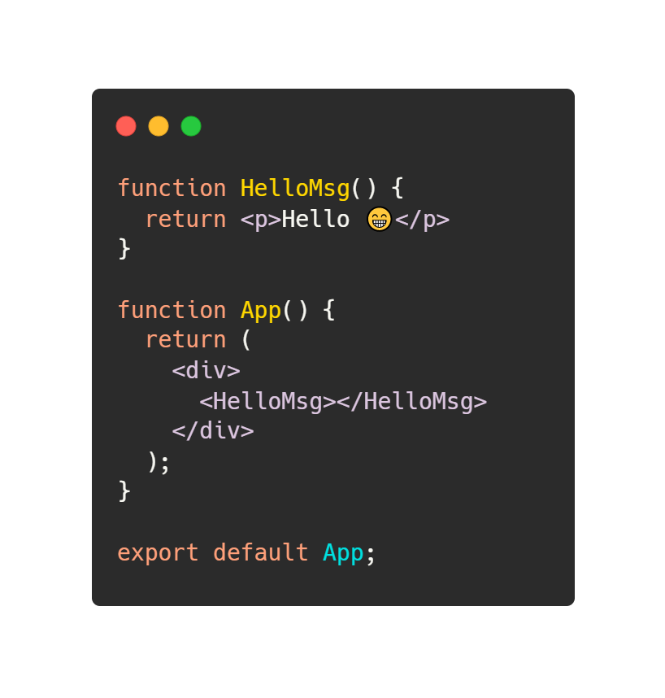

React Basics - Components
There’s a better way to bundle up JSX. We can use functions that return JSX – better known as components. Components let you split the UI into independent, reusable pieces, and think about each piece in isolation.

Slide 10
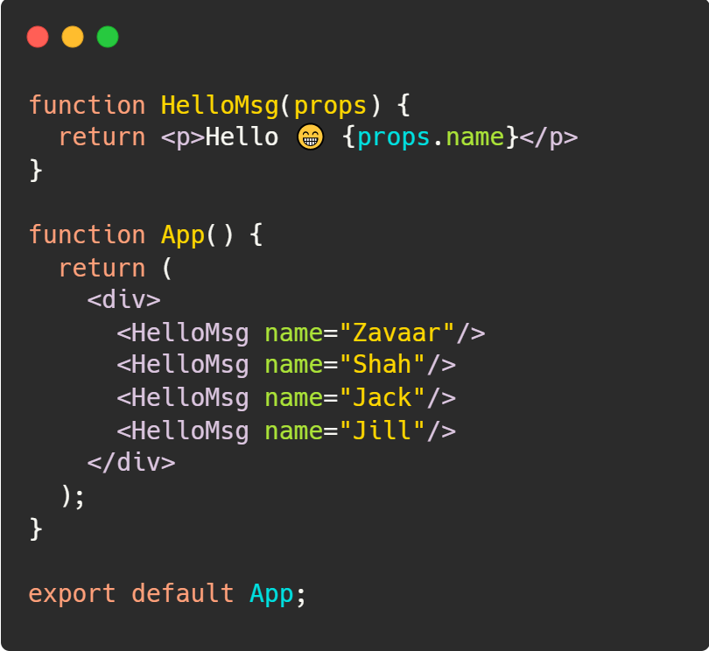
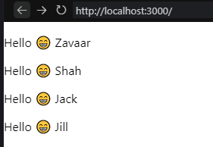
React Basics – Component Props
When React sees an element representing a user-defined component, it passes JSX attributes and children to this component as a single object. We call this object “props”.

Slide 11
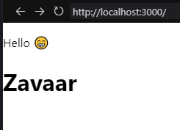
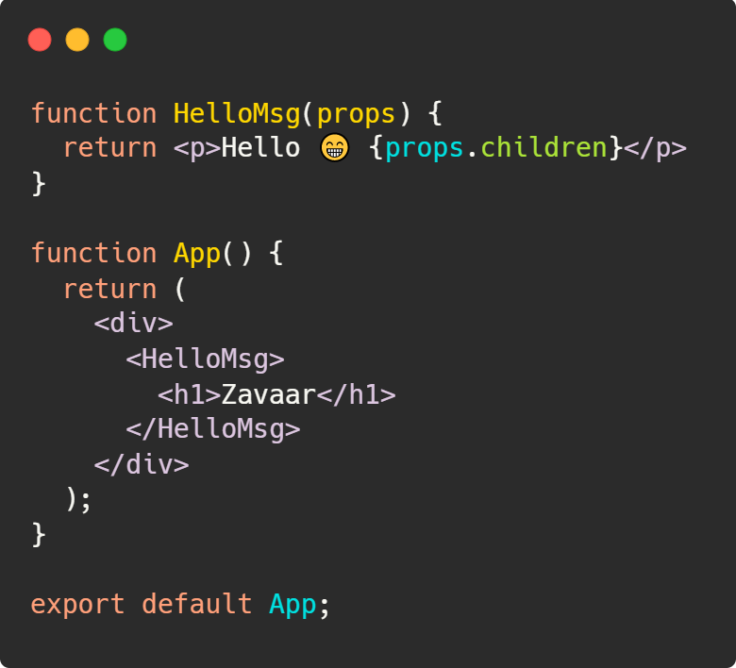
React Basics – Component Children

Slide 12
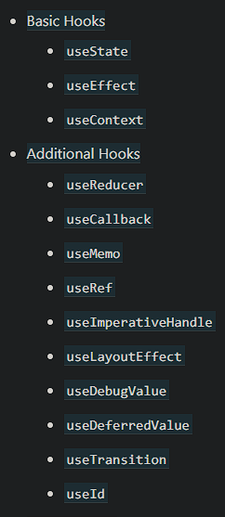
So far, all of this has been static.
Let’s introduce hooks. Hooks are the “primitives” of the React framework that give access to lower-level features of the frameworks within components.

Slide 13
How do we use reactive values?
For reactive values, we can use the useState hook. Why use a state instead of just declaring a temporary variable and redefining that? In order to show updated content, your component will unmount, remount and now that data is gone. Another problem with this is that our component wouldn’t know when to re-render when our temp variable changes. That is why we have states. States allow for the persistence of data within components throughout a component’s lifecycle. We will learn the stages of a component’s lifecycle later (useEffect).

Slide 14
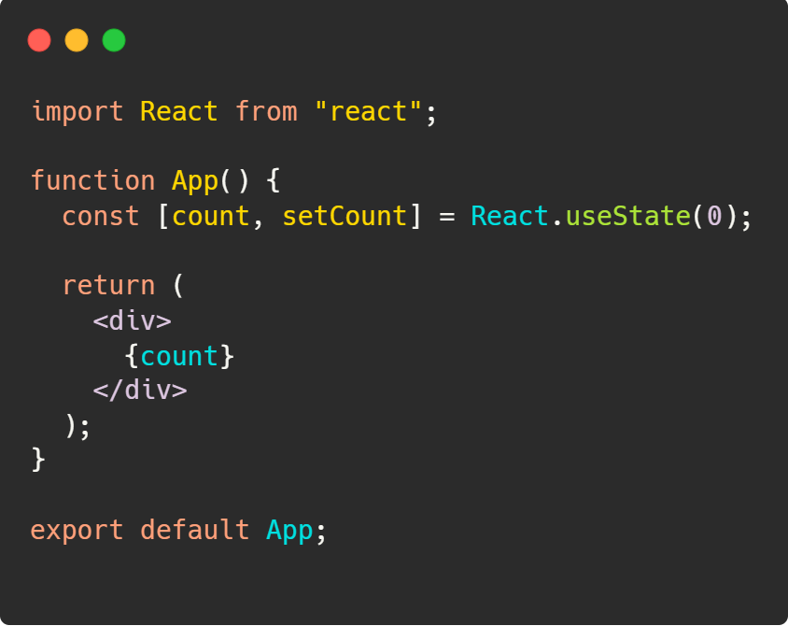

React Basics – Hooks: useState
A couple things worth mentioning:
“useState” returns an array with a “getter” and “setter” function. We can use take advantage of this by destructuring them.
The “count” constant itself is your “getter” value for that the count state
The “setCount” is a function that is your “setter” function for the count state. This is the only way to manipulate your count variable state.
Whenever the “count” variable is changed, those changes will get reflected in realtime.
Default state value

Slide 15
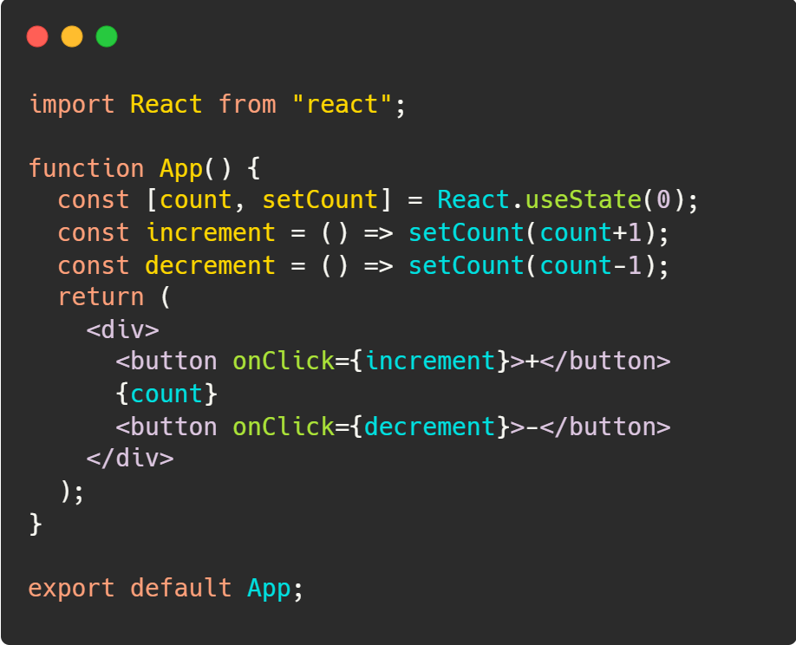
React Basics – Hooks: useState
Now how would we change the state of our counter? setCount

Slide 16
React Basics – Hooks: useEffect
Each component in React has a lifecycle which you can monitor and manipulate during its three main phases.
The three phases are: Mounting, Updating, and Unmounting.
https://www.w3schools.com/react/react_lifecycle.asp

Slide 17
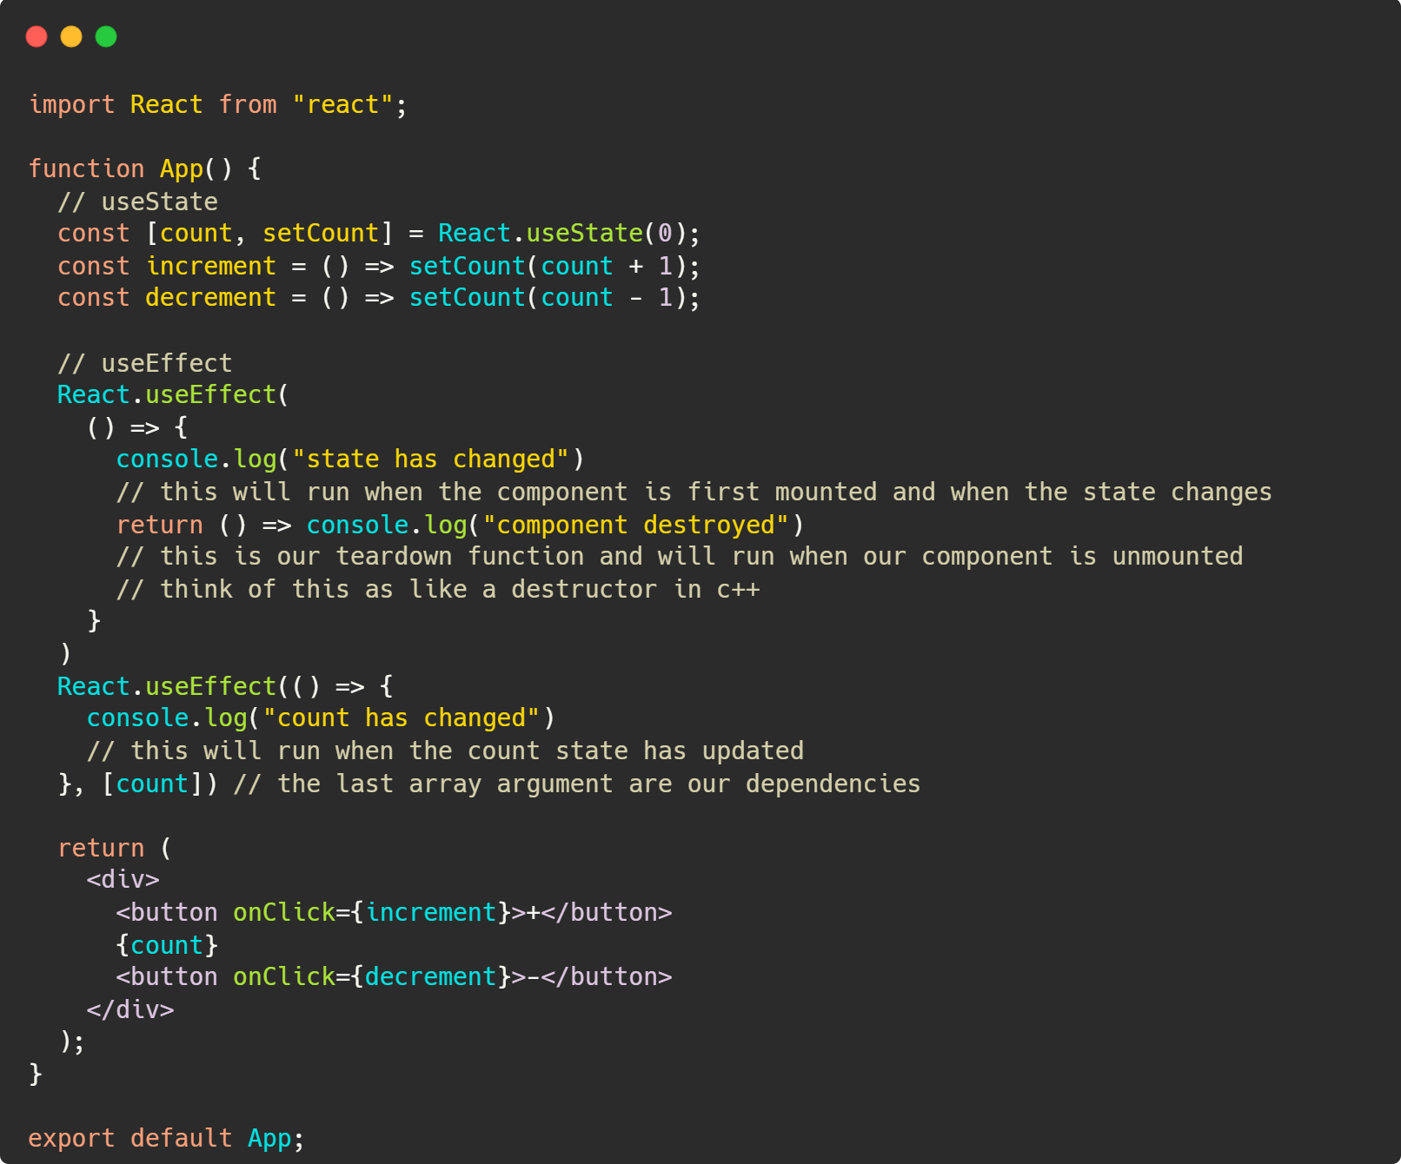



React Basics – Hooks: useEffect
Triggers when mounted & [any state] updates
Triggers when unmounted
Triggers when “count” state updates

Slide 18
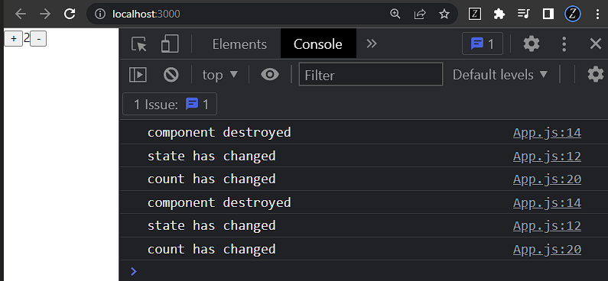

React Basics – Hooks: useEffect

Slide 19
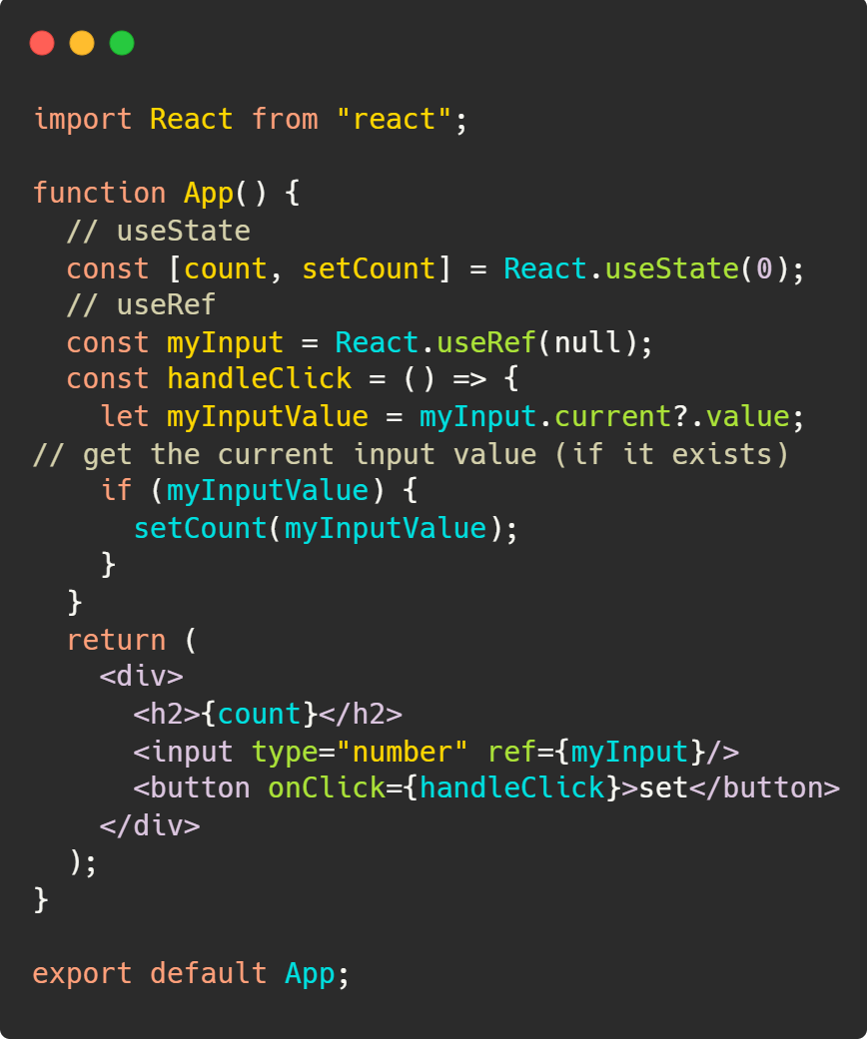
React Basics – Hooks: useRef
useRef allows us to interact with the JS DOM more easily. This let’s us take values other elements to parse user input.

Slide 20
React – Hooks: useContext
Contexts can be a bit tricky but very important when scaling your application up
Contexts allow sharing data between components without using props.
Context Providers allow for the use of useContext and must be the child of a provider to use its values

Slide 21
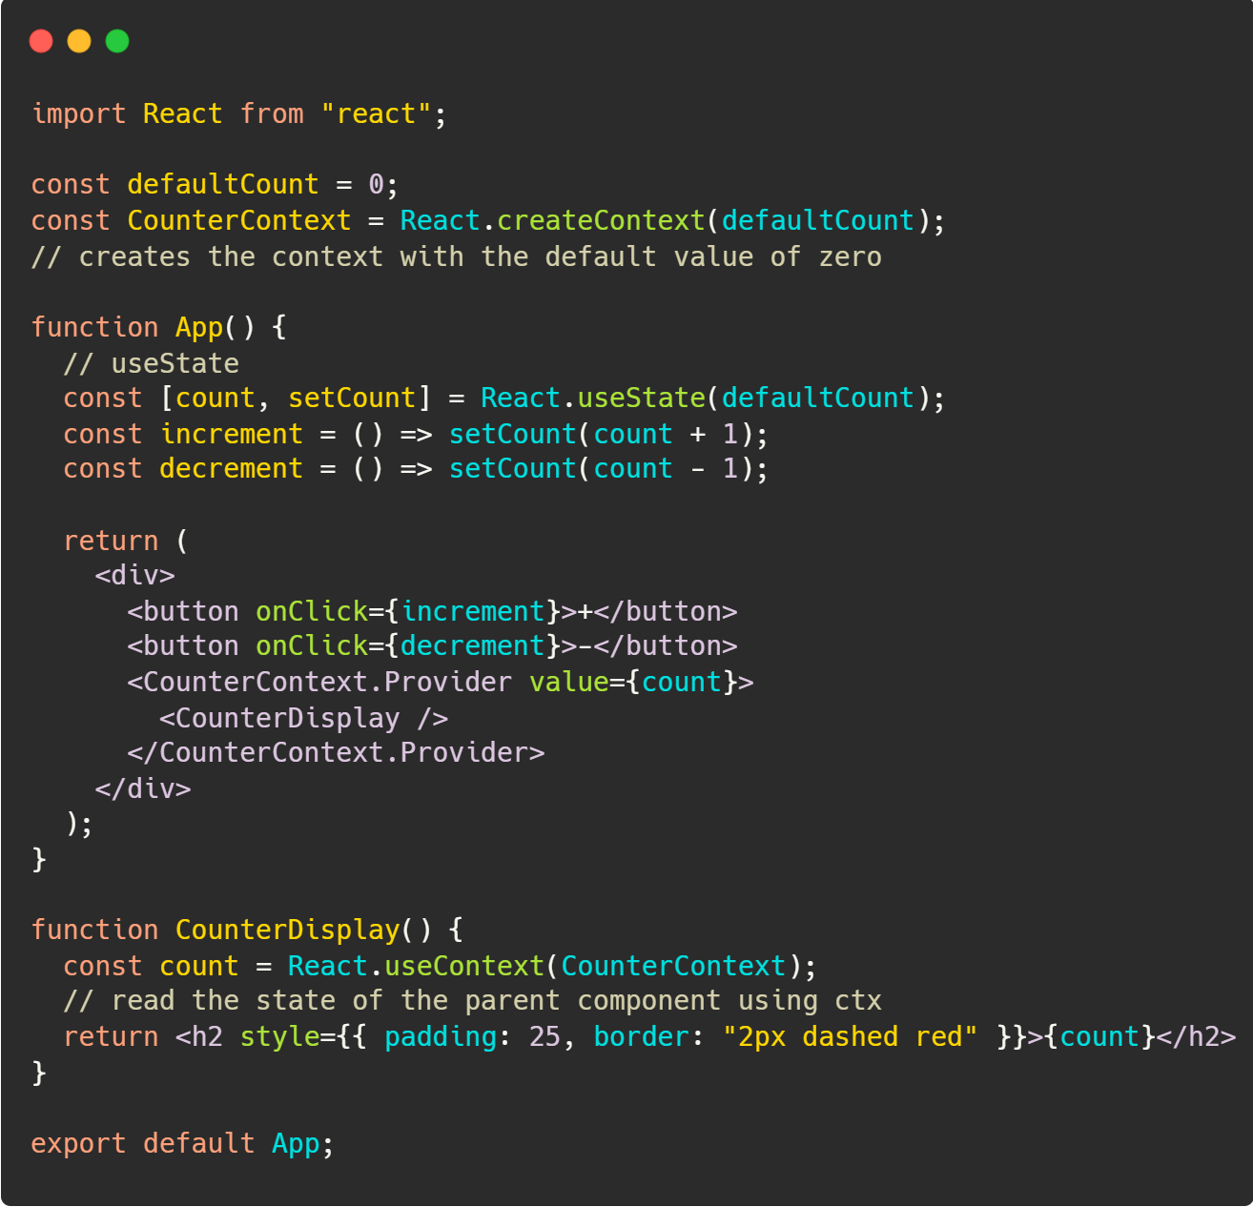
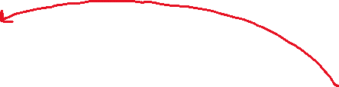
React – Hooks: useContext
Initialize the context
Pass the value of the context provider to be our counter state’s value
Take the context’s value from its parent (the provider).

Slide 22
React Advanced – Hooks: *Contexts & Reducers
You can also change their value from within nested components.
This can be done with Reducers.
Reducers allow for changes to specific sub-values within the state
To change the values of these “sub-values” we would use a dispatch (similar to React-redux).
This topic is beyond the scope of this session.
To learn more about reducers - https://reactjs.org/docs/hooks-reference.html#usereducer

Slide 23
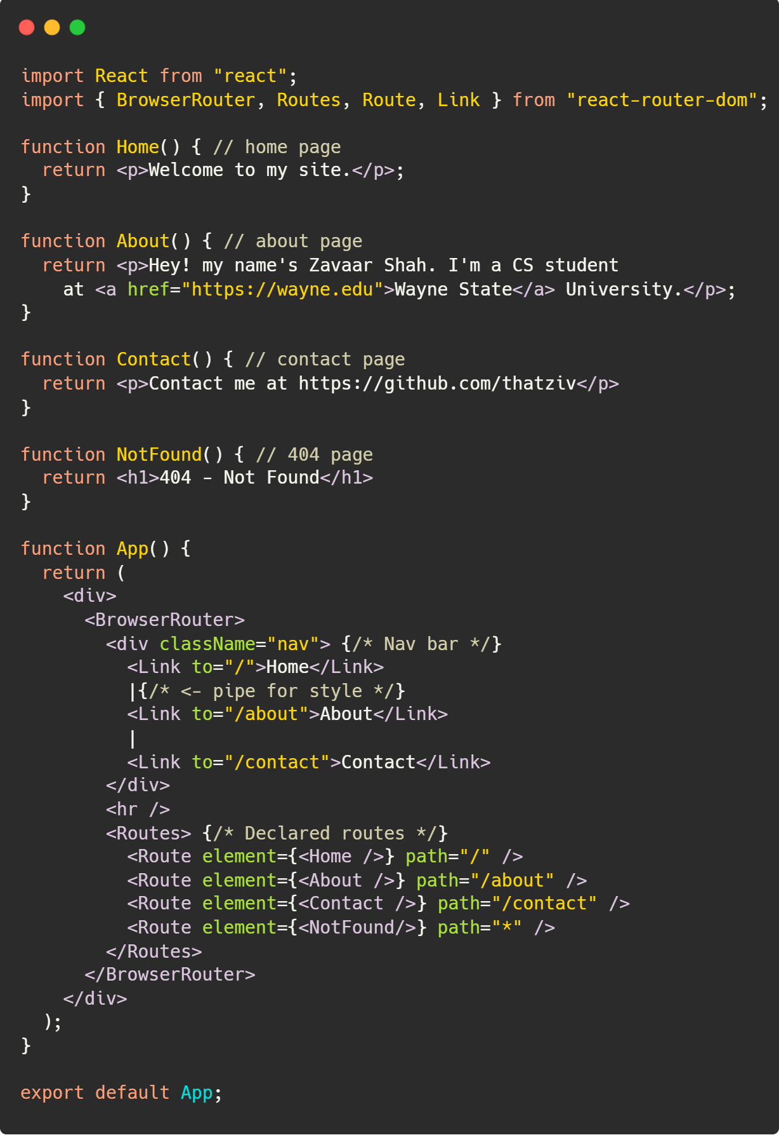

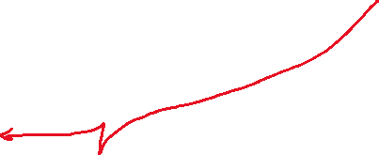



React Advanced – Routing
These 4 components represent pages
These “Links” in our navbar allow for the user to navigate our site. It’s purposefully outside of any of the pages so that it will render regardless of what route we are on.
Declare routing for each component to render whenever a user is at that location.

Slide 24


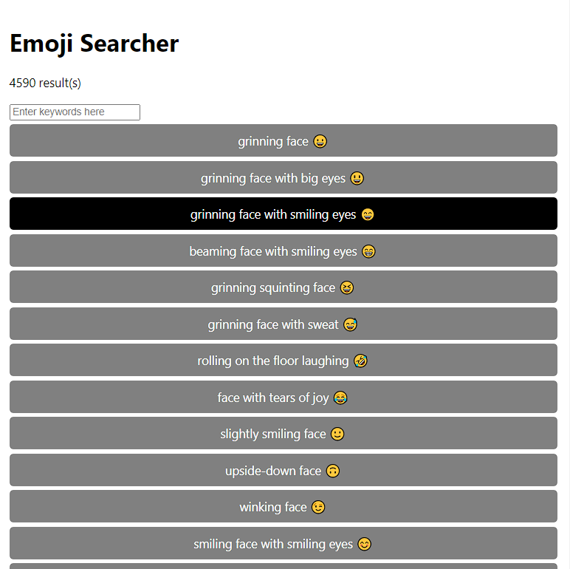
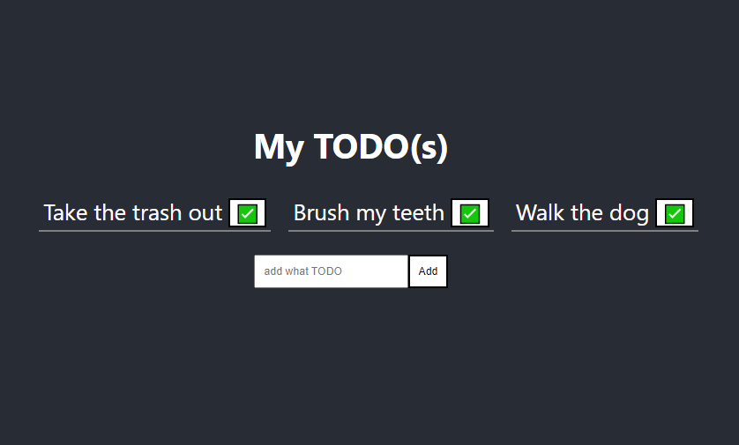
Now, let’s try to build a…
Emoji Searcher
TODO/Reminder app
BMI Calculator
https://github.com/WSU-Society-of-Computer-Developers/workshops/tree/main/react_nov28
OR https://s.zavaar.net/9uL9
Notes:
Additional Topics:
Deployment & Building

