Slide 1

Building scalable server-sided React apps.
By Zavaar Shah

Slide 2
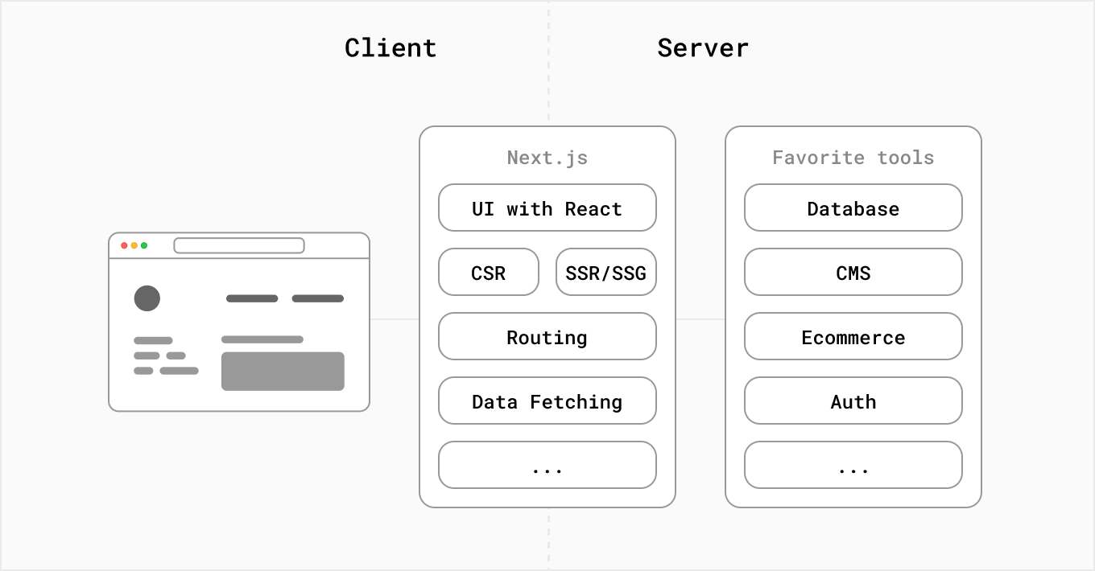

What is Next.js?
Next.js is a React framework that gives you building blocks to create web applications.
You can use React to build your UI, then incrementally adopt Next.js features to solve common application requirements such as routing, data fetching, integrations - all while improving the developer and end-user experience.
Whether you’re an individual developer or part of a larger team, you can leverage React and Next.js to build fully interactive, highly dynamic, and performant web applications.

Slide 3
Why Next.js?
PROS
Improved performance: Next.js optimizes page loading and enables server-side rendering, which can lead to faster page loads and improved SEO.
Automatic code splitting: Next.js automatically splits your code into small, optimized chunks, which can improve performance and reduce load times.
Improved developer experience: Next.js provides features like automatic reloads, error reporting, and hot module replacement, making it easier for developers to build and debug applications.
Static site generation: Next.js allows you to generate static sites, which can be deployed easily and have excellent performance.
Built-in routing: Next.js provides a built-in routing system that simplifies client-side navigation and enables easy creation of nested routes.
CONS
Learning curve: Next.js has a bit of a learning curve, particularly if you are not familiar with React, Node.js, or server-side rendering patterns.
Limited customization: While Next.js provides a lot of helpful tools and features out of the box, it may not be as customizable as some other frameworks (like Remix.js or Solid.js). This can limit your ability to tailor your application to your specific needs.
Server-side rendering
SSR sometimes can be slower as it can add overhead on an already busy server.
Requires a server to host (unlike CSR which can be hosted through GitHub Pages and others).
Integrating other libraries and modules that only operate in the browser, or if your component requires accessibility to client-exclusive properties like `window` or localStorage`.
Just another JavaScript framework to learn...

Slide 4
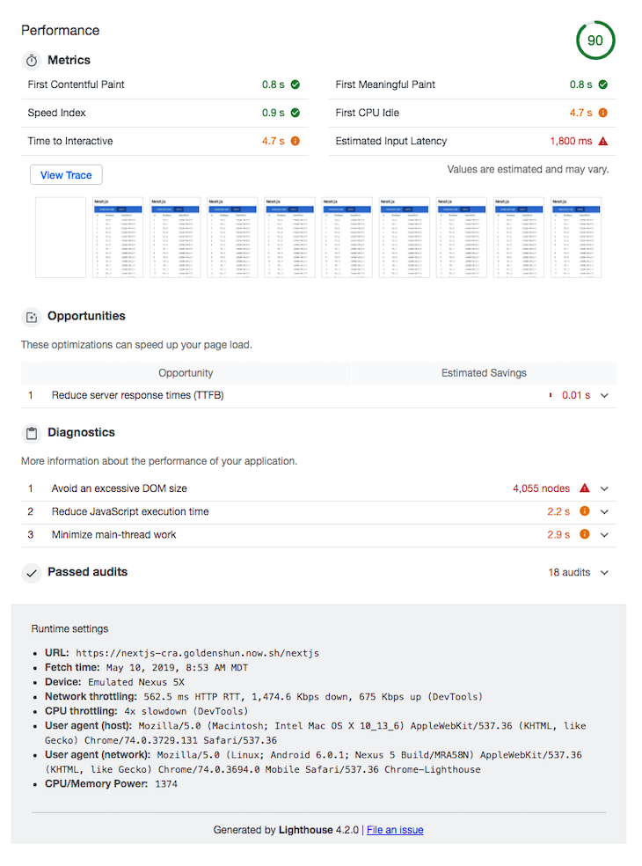
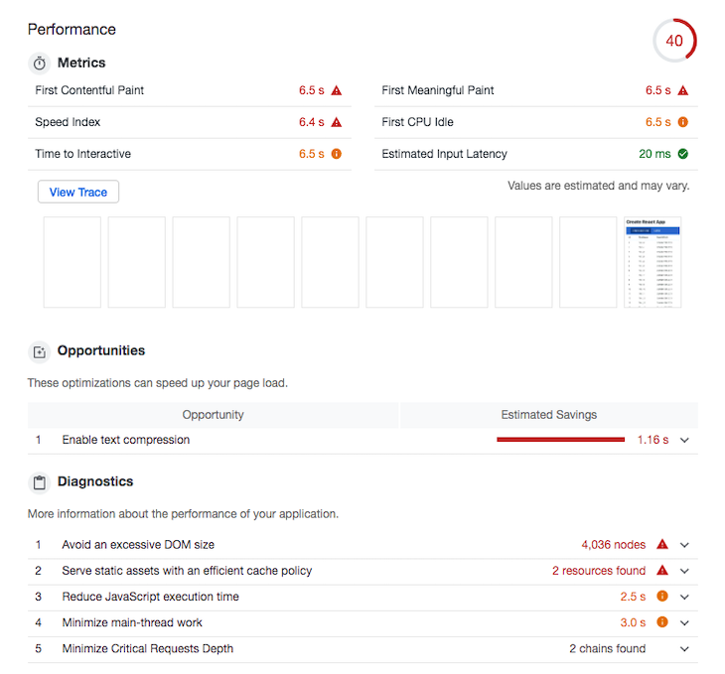
Next.js (SSR) vs. React.js (CSR)
https://blog.logrocket.com/create-react-app-vs-next-js-performance-differences/

