Slide 1
Quantum Computing
Encryption and Beyond
Notes:
Feel free to ask questions at any point, I will be stopping periodically as well

Slide 2
Overview
Complexity overview
Pre-quantum encryption
MI: Group theory I
Classical encryption algorithms
MI: Group theory II
Quantum algorithms
MI: Fourier transforms
Post-quantum encryption

Slide 3
Computational Complexity
What problems can computers solve?

Slide 4
What makes problems hard?
Computationally intensive
Resources: time, storage, hardware
Computability theory vs complexity theory
Computability: resource needs of an algorithm
Complexity: problem classification given a resource restriction
P vs NP – millennium prize problem

Slide 5
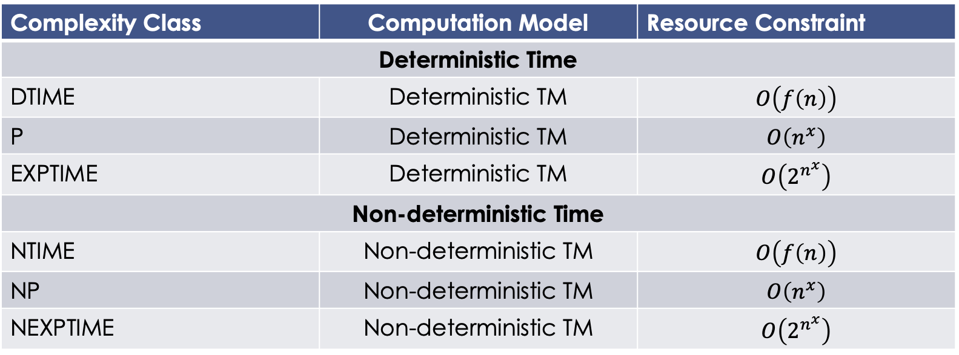
Time Complexity
Complexity Class | Computation Model | Resource Constraint
Deterministic Time
DTIME | Deterministic TM | $$O\left(f\left(n\right)\right)$$
P | Deterministic TM | $$O\left(n^{x}\right)$$
EXPTIME | Deterministic TM | $$O\left(2^{n^{x}}\right)$$
Non-deterministic Time
NTIME | Non-deterministic TM | $$O\left(f\left(n\right)\right)$$
NP | Non-deterministic TM | $$O\left(n^{x}\right)$$
NEXPTIME | Non-deterministic TM | $$O\left(2^{n^{x}}\right)$$

Slide 6
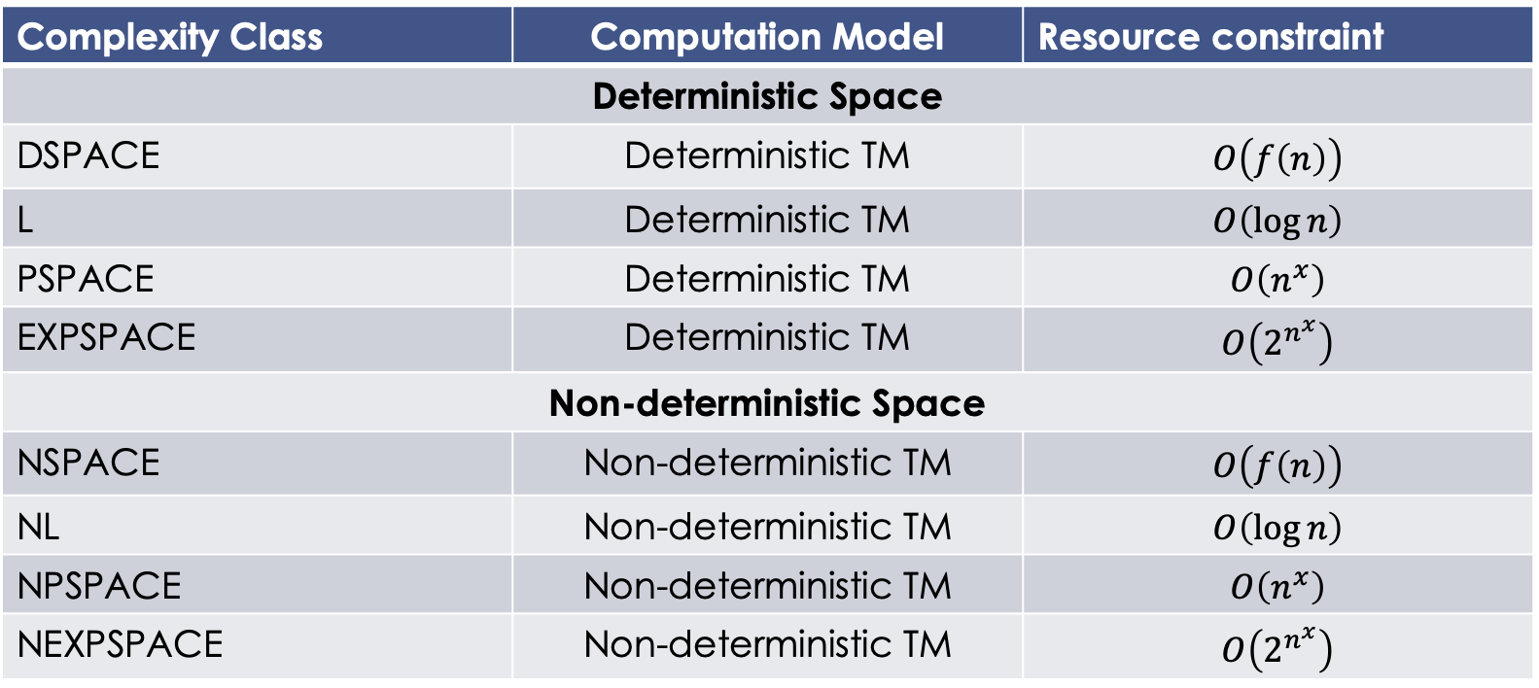
Space Complexity
Complexity Class | Computation Model | Resource constraint
Deterministic Space
DSPACE | Deterministic TM | $$O\left(f\left(n\right)\right)$$
L | Deterministic TM | $$O\left(\log{n}\right)$$
PSPACE | Deterministic TM | $$O\left(n^{x}\right)$$
EXPSPACE | Deterministic TM | $$O\left(2^{n^{x}}\right)$$
Non-deterministic Space
NSPACE | Non-deterministic TM | $$O\left(f\left(n\right)\right)$$
NL | Non-deterministic TM | $$O\left(\log{n}\right)$$
NPSPACE | Non-deterministic TM | $$O\left(n^{x}\right)$$
NEXPSPACE | Non-deterministic TM | $$O\left(2^{n^{x}}\right)$$

Slide 7
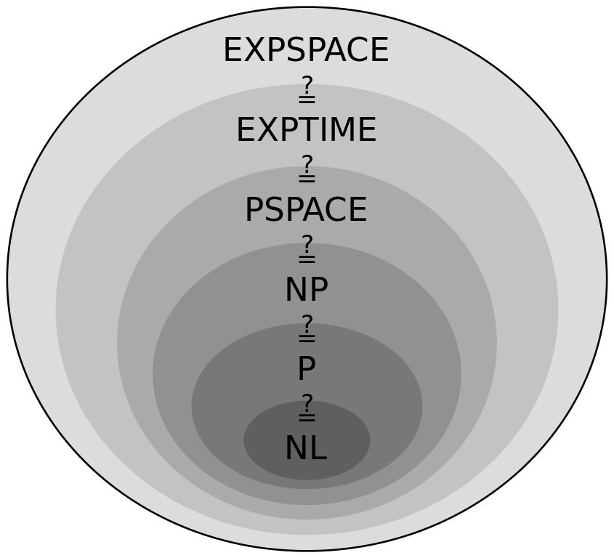
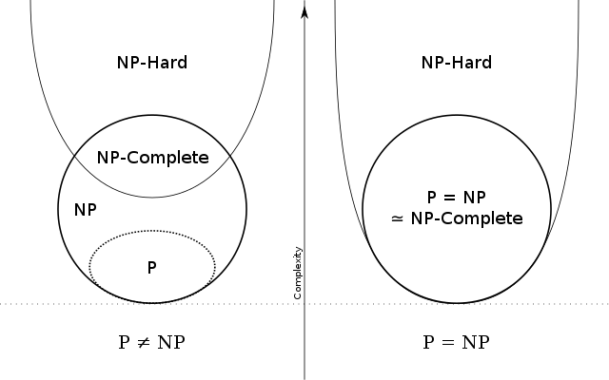
Complexity Visualized
Notes:
Question marks represent unknown boundary conditions
NP-complete: all NP-complete can be reduced to each other, solutions verified in polynomial time (ex: traveling salesman)
NP-hard: ”at least as hard as NP problems,” but not necessarily verifiable in polynomial time
“Intractability”
Examples:
Traveling salesman – np complete
Subset sum – np complete (given a set, does a non-empty subset add to 0)
Halting problem – np hard, not np complete (given a program and its input, will it run forever)

Slide 8
Encryption
Information Theory
Notes:
Any questions?

Slide 9
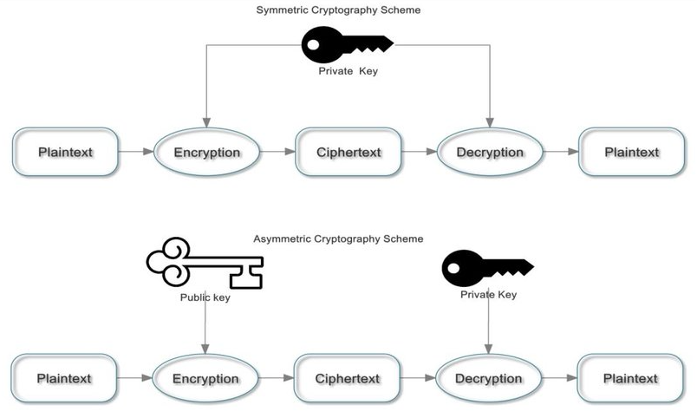
Standard Models of Encryption
Key-exchange
Symmetric
Asymmetric
Public/private
Notes:
Symmetric: same key for encryption/decryption
Asymmetric: separate keys for encryption/decryption (public/private)

Slide 10
One-Time Pad
Intuition
Pre-arranged identical sequences: key
Modular addition (Vigenère cipher)
“Information-theoretically secure”
Ciphertext gives no information about the original message
“Perfect secrecy” – Claude Shannon
Ciphertext can be translated into any plaintext of the same length, all of equal likelihood
Notes:
Alice wants to send Bob a message
Identical random sequences are issued to both (pre-arranged); usually each letter has a numerical value
Key and message are combined using modular addition (mod 26)
Vigenere cipher: interwoven caeser ciphers (simple substitution)
Is anything truly secure?

Slide 11
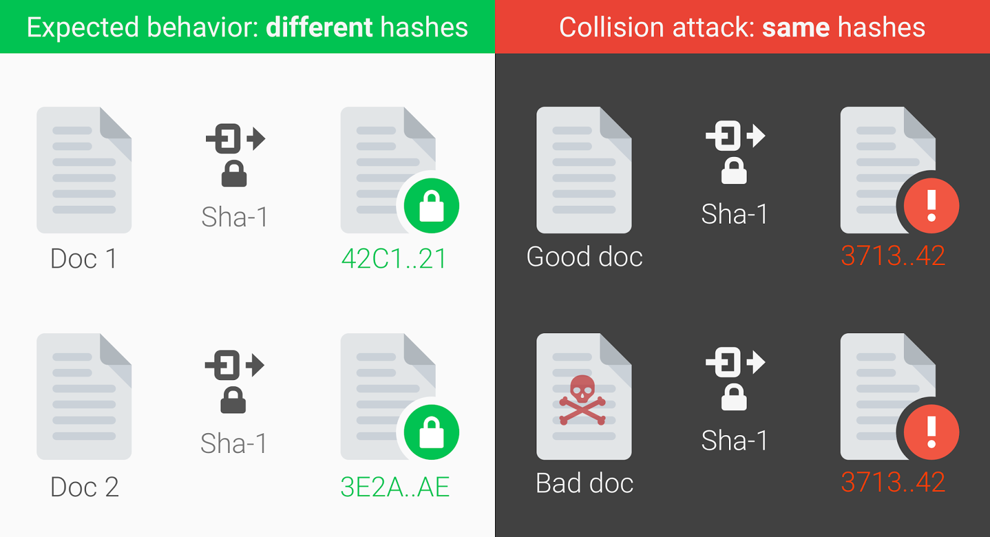
Symmetric Encryption
AES: Advanced Encryption Standard
Substitution-permutation
SHA: Secure Hash Algorithm family
SHA-1: first collision found by google in 2017
SHA-2
SHA-3
Notes:
SP: takes plaintext and key, applies layers of substitution boxes and permutation boxes
Ex: bitwise rotation, XOR
SHA: Sponge/squeeze
Sponge: message blocks XORed into state subset
Squeeze: output blocks are alternated with state transformation function
Cracked by google in 2017
Collision: two distinct pieces of data hash to the same digest
Collision attack: replace with a malicious file

Slide 12
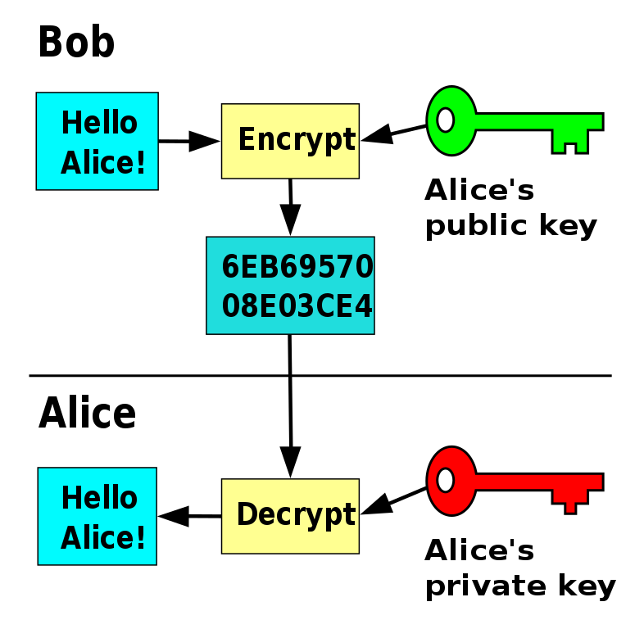
Public Key (Asymmetric) Cryptography
Public/private keys
Anybody can encrypt a message
Underpins internet standards
TLS
PGP
Notes:
Anybody can encrypt a message using a public key, only key holder cand ecrypt
Internet standards: TLS used for securing e-mail, VOIP, and HTTPS
TLS uses multiple different methods for key exchange (RSA, DH, etc)

Slide 13
Encryption
Algorithms
Notes:
Any questions?

Slide 14
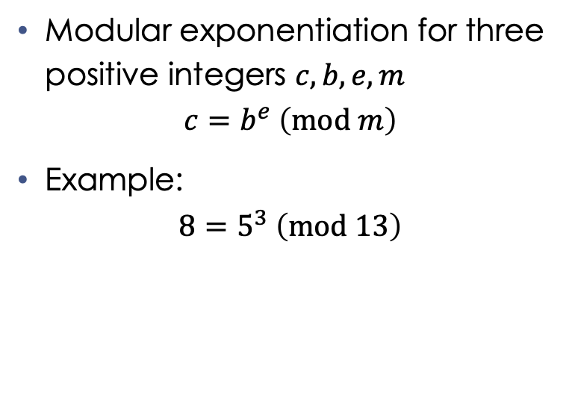
RSA: Rivest-Shamir-Adleman
Four steps
Key generation
Key distribution
Encryption
Decryption
Modular exponentiation for three positive integers $c,b,e,m$
$$c=b^{e} \left(mod m\right)$$
Example:
$$8=5^{3} \left(mod 13\right)$$
Notes:
Modular exponentiation: exponentiation performed over a modulus
Gives the remainder when an integer b is raised to some power e, and divided by a positive integer m

Slide 15
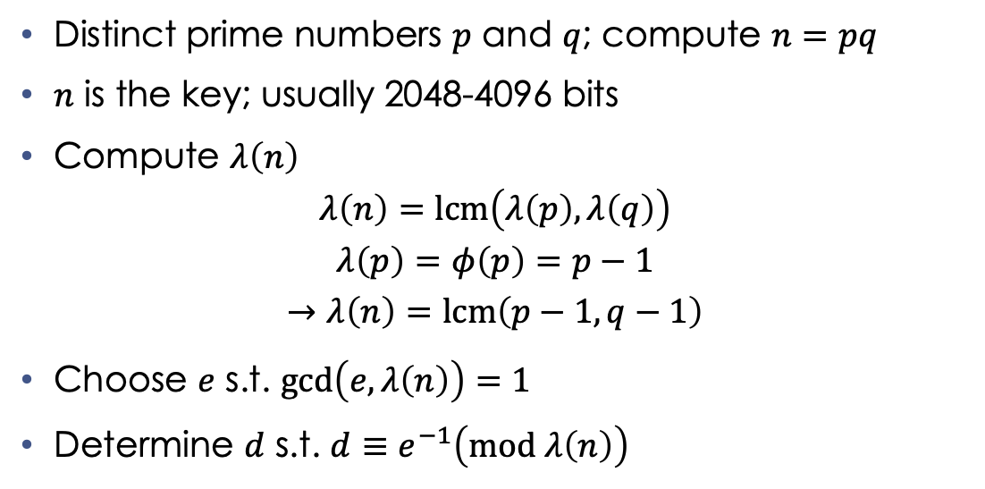
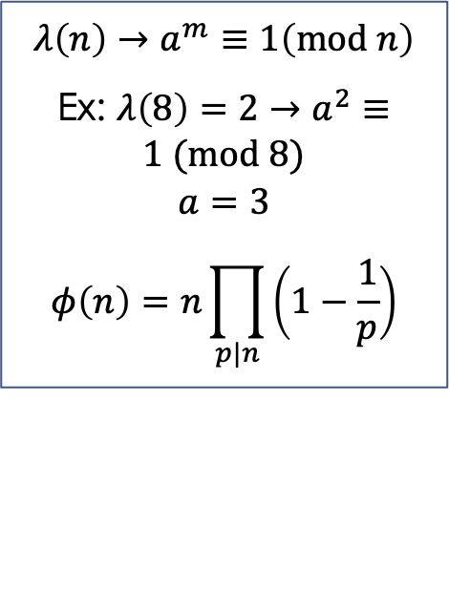
RSA: Key Generation
Distinct prime numbers $p$ and $q$; compute $n=pq$
$n$ is the key; usually 2048-4096 bits
Compute $λ\left(n\right)$
$$λ\left(n\right)=lcm\left(λ\left(p\right),λ\left(q\right)\right)$$
$$λ\left(p\right)=φ\left(p\right)=p−1$$
$$→λ\left(n\right)=lcm\left(p−1,q−1\right)$$
Choose $e$ s.t. $\gcd\left(e,λ\left(n\right)\right)=1$
Determine $d$ s.t. $d≡e^{−1}\left(mod λ\left(n\right)\right)$
$$λ\left(n\right)→a^{m}≡1\left(mod n\right)$$
Ex: $λ\left(8\right)=2→a^{2}≡1 (mod 8)$
$$a=3$$
$$φ\left(n\right)=n\prod_{p|n}{\left(1−\frac{1}{p}\right)}$$
Notes:
p/q are random, similar in magnitude, few different digits to make factoring harder
Compute n = pq; n is used as modulus for public and private keys; length of n is “key length”
Carmichael’s totient function: “least universal exponent function”
Smallest positive integer m such that a (coprime to n) mod n = 1
Euler’s totient function: counts the number of integers coprime to n
Find e s.t. coprime to lambda(n); release e as part of public key; most commonly used is e^216 + 1 = 65 537
D is the modular multiplicative inverse of e modulo lambda(n); d is kept secret in private key

Slide 16
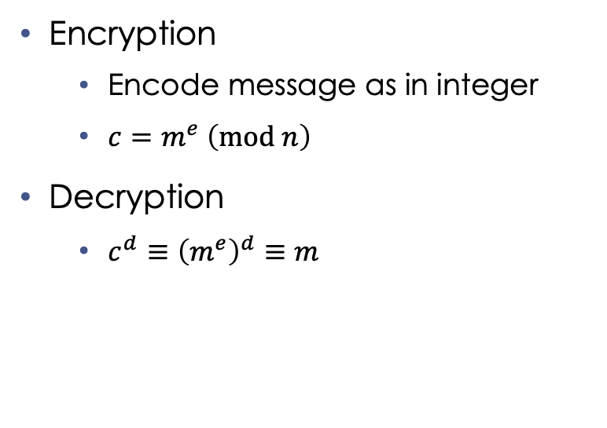
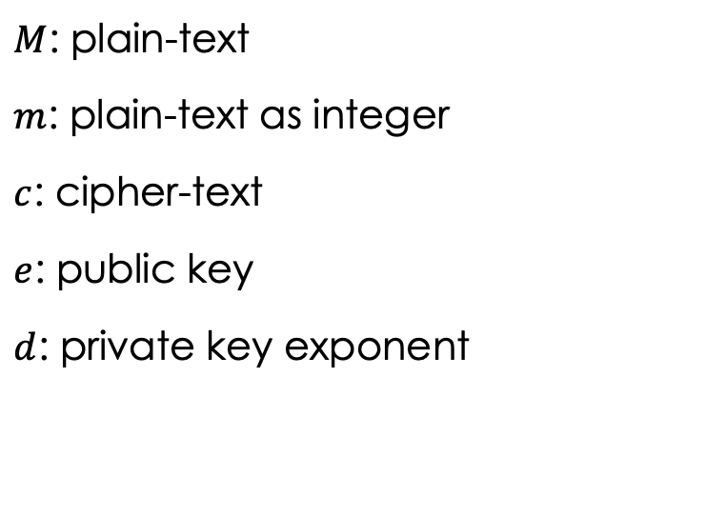
RSA (cont.)
Encryption
Encode message as in integer
$c=m^{e} \left(mod n\right)$
Decryption
$c^{d}≡{\left(m^{e}\right)}^{d}≡m$
$M$: plain-text
$m$: plain-text as integer
$c$: cipher-text
$e$: public key
$d$: private key exponent

Slide 17
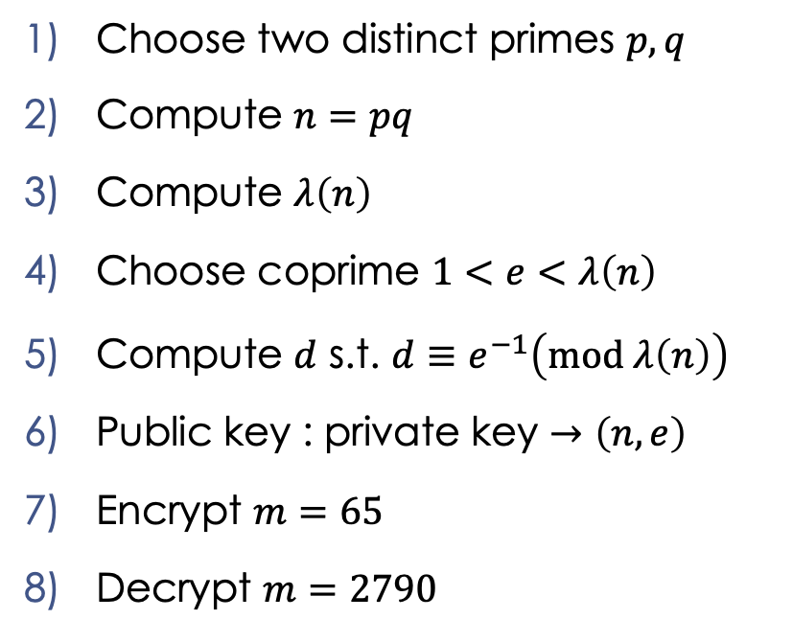
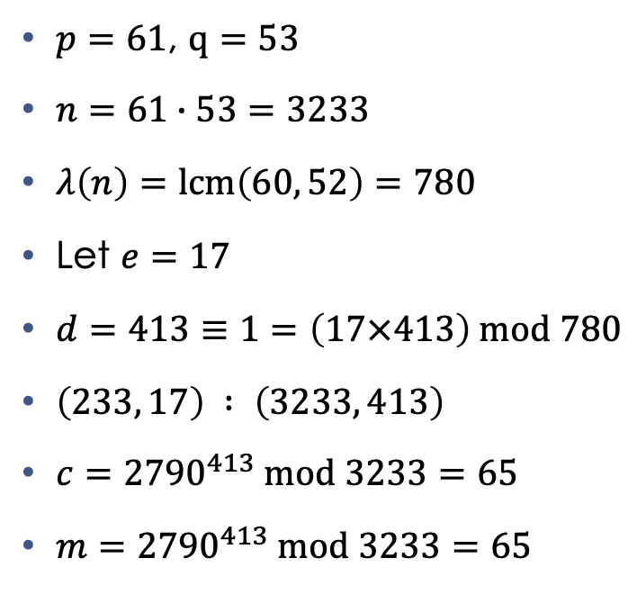
RSA: Example
Choose two distinct primes $p,q$
Compute $n=pq$
Compute $λ\left(n\right)$
Choose coprime $1<e<λ\left(n\right)$
Compute $d$ s.t. $d≡e^{−1}\left(mod λ\left(n\right)\right)$
Public key : private key $→\left(n,e\right)$
Encrypt $m=65$
Decrypt $m=2790$
$p=61$, $q=53$
$n=61∙53=3233$
$λ\left(n\right)=lcm\left(60, 52\right)=780$
Let $e=17$
$d=413≡1=\left(17×413\right) mod 780$
$\left(233, 17\right) : \left(3233, 413\right)$
$c={2790}^{413} mod 3233=65$
$m={2790}^{413} mod 3233=65$
Notes:
Any questions?

Slide 18
Math Interlude: Group Theory I
Def: A group is a set of elements equipped with an operation that combines any two elements to produce a third, s.t.
Associative
Identity
Inverse

Slide 19
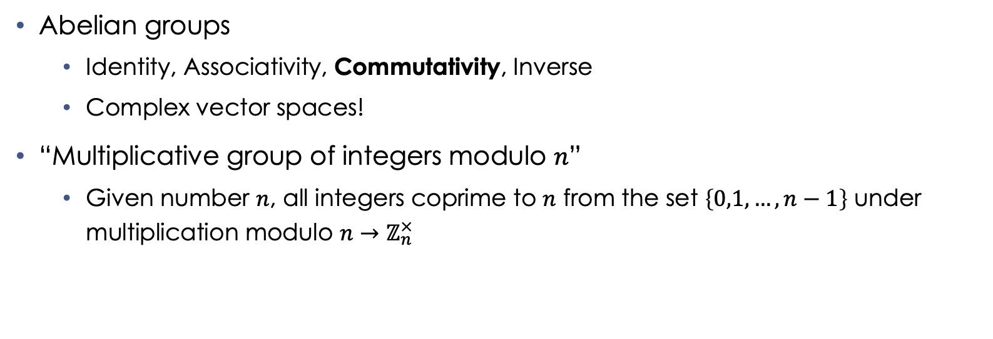
Math Interlude: Group Theory II
Abelian groups
Identity, Associativity, Commutativity, Inverse
Complex vector spaces!
“Multiplicative group of integers modulo $n$”
Given number $n$, all integers coprime to $n$ from the set $\left\{0,1,…,n−1\right\}$ under multiplication modulo $n→ℤ_{n}^{×}$
Notes:
Abelian groups are finite
Commutativity makes it Abelian (also called “commutative groups)
Other three operations define a group
Z_n is the congruence group

Slide 20
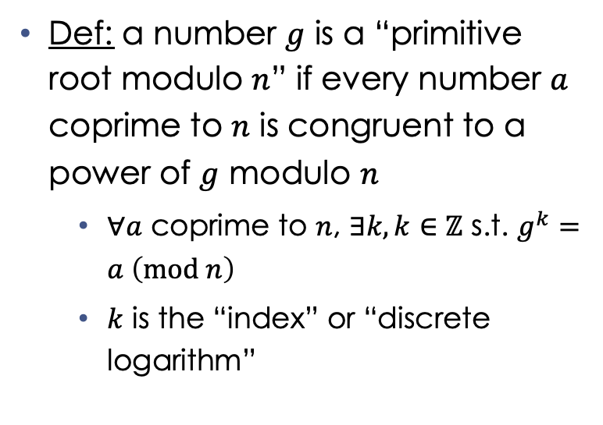
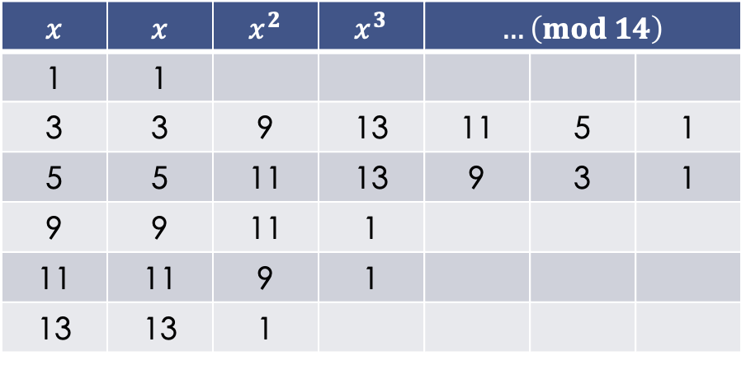
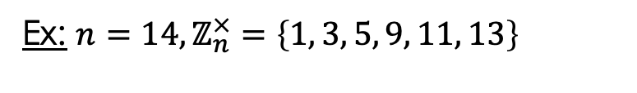
Math Interlude: Primitive Roots
Def: a number $g$ is a “primitive root modulo $n$” if every number $a$ coprime to $n$ is congruent to a power of $g$ modulo $n$
$∀a$ coprime to $n$, $∃k,k∈ℤ$ s.t. $g^{k}=a \left(mod n\right)$
$k$ is the “index” or “discrete logarithm”
Ex: $n=14, ℤ_{n}^{×}=\left\{1, 3, 5, 9, 11, 13\right\}$
$$x$$ | $$x$$ | $$x^{2}$$ | $$x^{3}$$ | $$…\left(mod 14\right)$$
1 | 1
3 | 3 | 9 | 13 | 11 | 5 | 1
5 | 5 | 11 | 13 | 9 | 3 | 1
9 | 9 | 11 | 1
11 | 11 | 9 | 1
13 | 13 | 1
Notes:
Ex: given 14, it’s “congruence group” is ___
For each number coprime to n, their order is given by the euler totient (number of ints coprime to it)
Remember the term “discrete logarithm”
Any questions?

Slide 21
Diffie-Hellman
Key distribution problem
RSA
Diffie-Hellman solves this problem
Secret key established
Encrypts subsequent communiques using symmetric-key
Notes:
KD problem: bob must know alice’s public key, and vice versa
Transmission of keys can be reliable but insecure

Slide 22
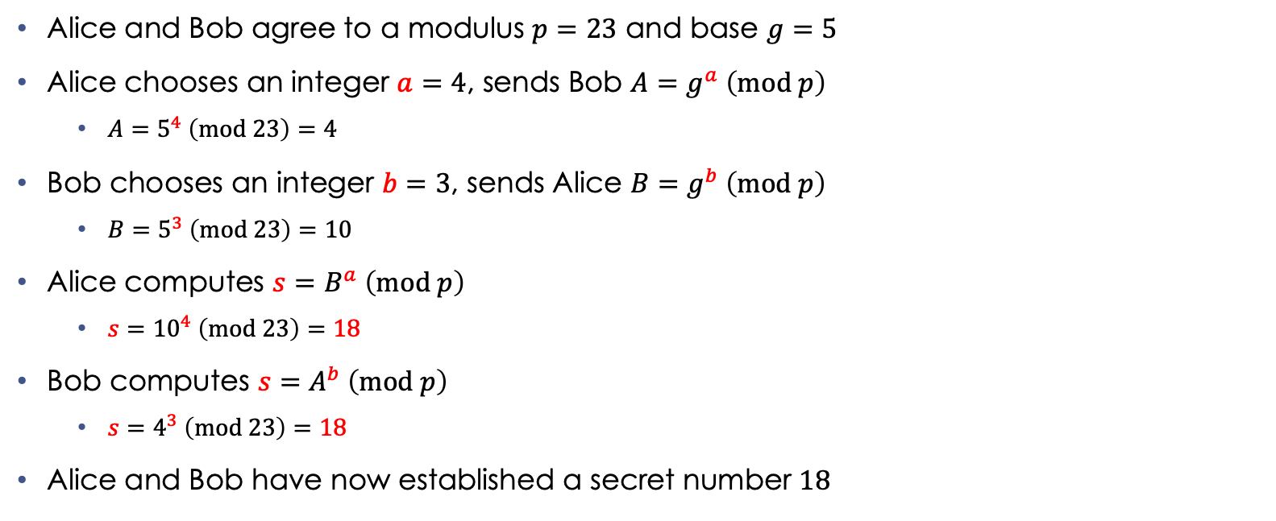
Diffie-Hellman: Original Implementation
Alice and Bob agree to a modulus $p=23$ and base $g=5$
Alice chooses an integer $a=4$, sends Bob $A=g^{a} \left(mod p\right)$
$A=5^{4} \left(mod 23\right)=4$
Bob chooses an integer $b=3$, sends Alice $B=g^{b} \left(mod p\right)$
$B=5^{3} \left(mod 23\right)=10$
Alice computes $s=B^{a} \left(mod p\right)$
$s={10}^{4} \left(mod 23\right)=18$
Bob computes $s=A^{b} \left(mod p\right)$
$s=4^{3} \left(mod 23\right)=18$
Alice and Bob have now established a secret number $18$
Notes:
Secret values are in red
Only a and b are kept secret, everything else can be transmitted publicly
Much longer numbers are used, ex: p is prime with 600+ digits
Important to remember: using modulus effectively limits your field over which you’re mapping these calculations
Literally restricting domain, instead of –infin←→infin, it is 0-modulus whatever

Slide 23
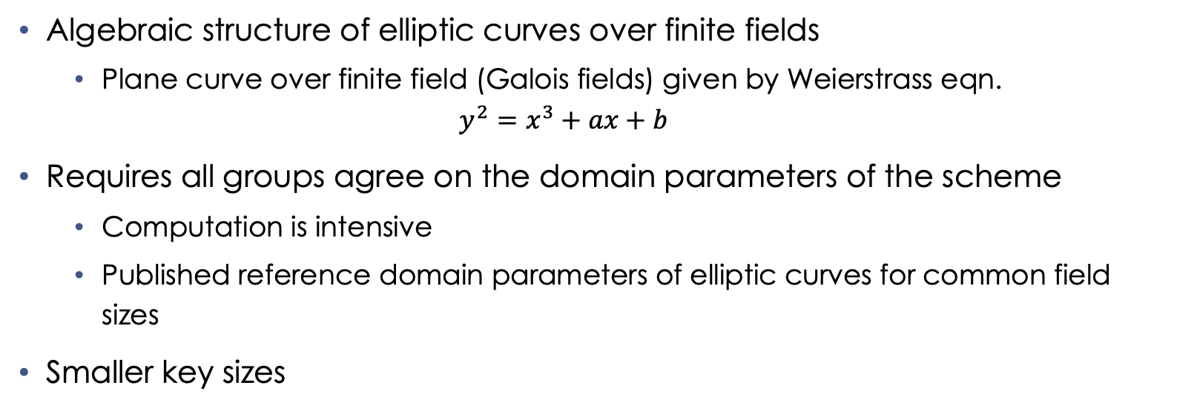
Elliptic-Curve Cryptography
Algebraic structure of elliptic curves over finite fields
Plane curve over finite field (Galois fields) given by Weierstrass eqn.
$$y^{2}=x^{3}+ax+b$$
Requires all groups agree on the domain parameters of the scheme
Computation is intensive
Published reference domain parameters of elliptic curves for common field sizes
Smaller key sizes
Notes:
Galois field is an extrapolation of a galois group; satisfies multiplication/division/addition/subtraction
Ex: finite field is integers mod p when p is prime
Computing parameters requires computing the number of points on a curve
Domain parameters of elliptic curves for standard field sizes “standard curves”/”named curves”

Slide 24
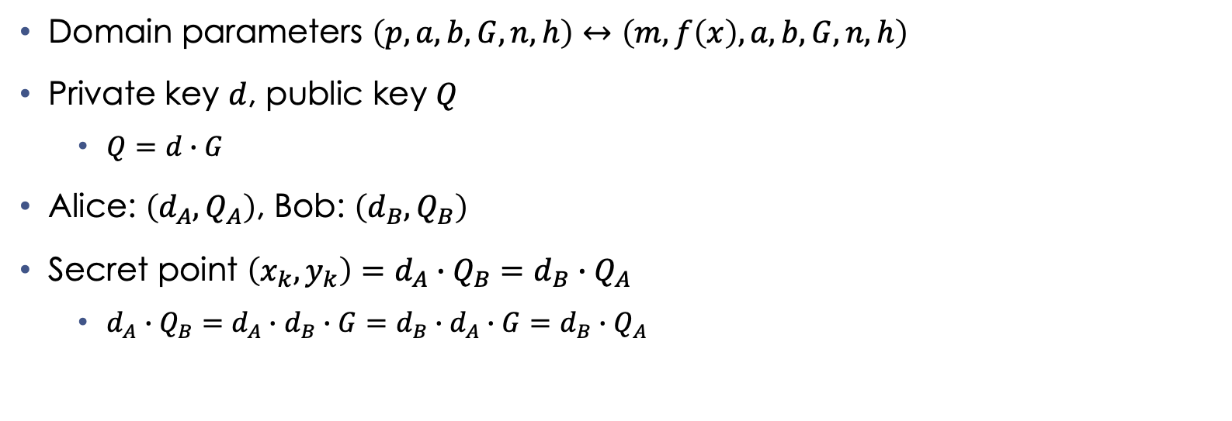
Elliptic-Curve Diffie-Hellman
Domain parameters $\left(p,a,b,G,n,h\right)↔\left(m,f\left(x\right),a,b,G,n,h\right)$
Private key $d$, public key $Q$
$Q=d∙G$
Alice: $\left(d_{A},Q_{A}\right)$, Bob: $\left(d_{B},Q_{B}\right)$
Secret point $\left(x_{k},y_{k}\right)=d_{A}∙Q_{B}=d_{B}∙Q_{A}$
$d_{A}∙Q_{B}=d_{A}∙d_{B}∙G=d_{B}∙d_{A}∙G=d_{B}∙Q_{A}$
Notes:
Domain parameters in prime or binary case
Public/private keys represented by (d, Q)
Any questions?

Slide 25
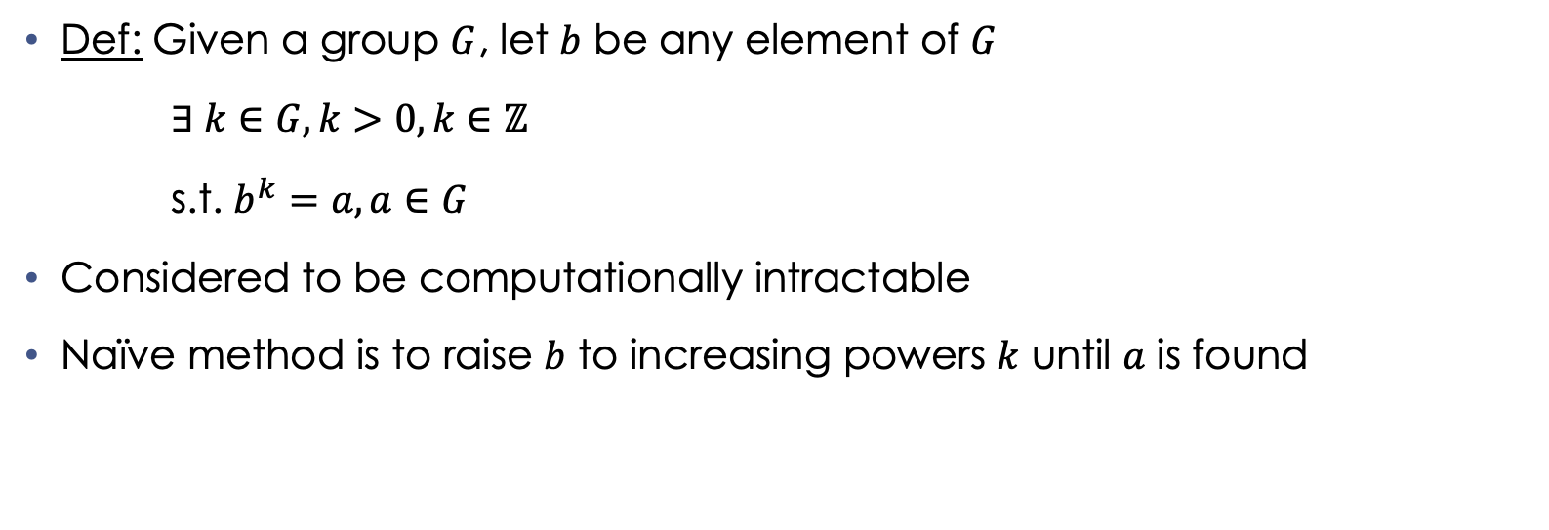
Math Interlude: Discrete Logarithm Problem
Def: Given a group $G$, let $b$ be any element of $G$
$∃ k∈G,k>0, k∈ℤ$
s.t. $b^{k}=a, a∈G$
Considered to be computationally intractable
Naïve method is to raise $b$ to increasing powers $k$ until $a$ is found
Notes:
Def: The positive integer k in group G such that the expression b^k = a holds, where a is some other number in G, but not necessarily positive
Naïve method = ”trial multiplication”
Running time is linear in group G, and therefore exponential in the # of digits
More sophisticated methods are exponential to the square root of the # of digits, but nothing in polynomial time

Slide 26
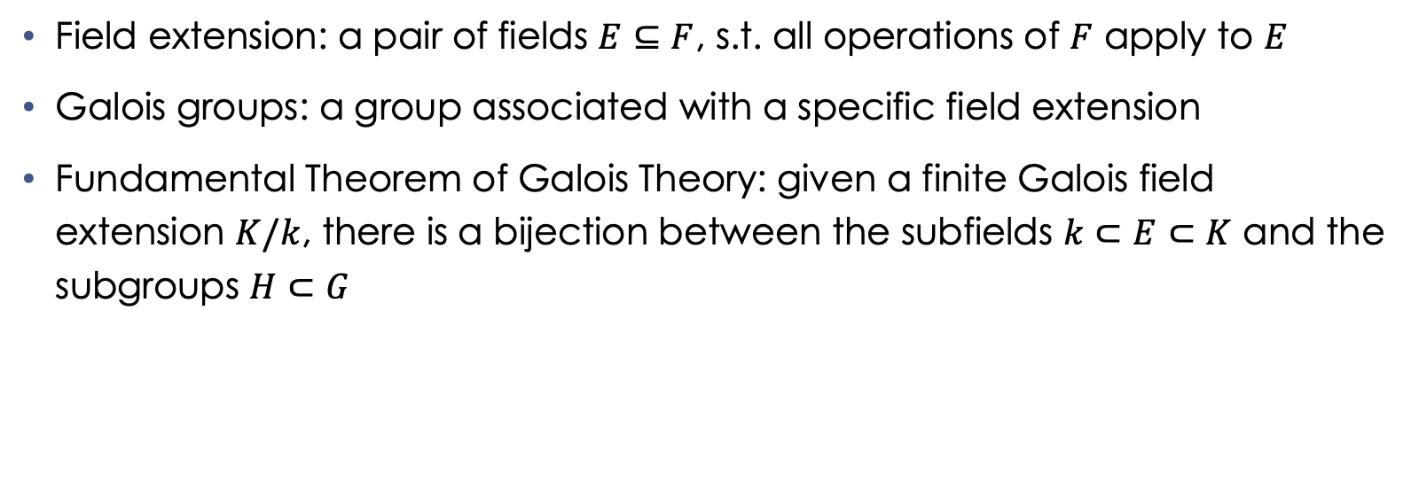
Math Interlude: Group Theory III
Field extension: a pair of fields $E⊆F$, s.t. all operations of $F$ apply to $E$
Galois groups: a group associated with a specific field extension
Fundamental Theorem of Galois Theory: given a finite Galois field extension $K/k$, there is a bijection between the subfields $k⊂E⊂K$ and the subgroups $H⊂G$
Notes:
Field extensions: using an extension field F, we can restrict all operations of F to its subfield E. Restriction of operations is equivalent to limiting domain
Galois groups were helped to solve polynomial equations by capturing their symmetry features

Slide 27
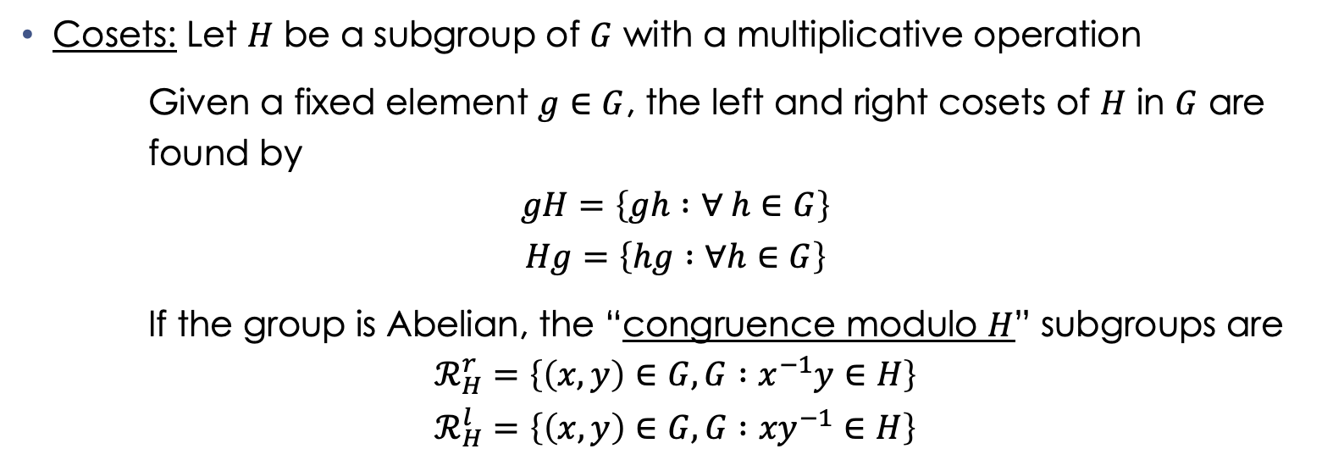
Math Interlude: Group Theory IV
Cosets: Let $H$ be a subgroup of $G$ with a multiplicative operation
Given a fixed element $g∈G$, the left and right cosets of $H$ in $G$ are found by
$$gH=\left\{gh :∀ h∈G\right\}$$
$$Hg=\left\{hg :∀h∈G\right\}$$
If the group is Abelian, the “congruence modulo $H$” subgroups are
$$ℛ_{H}^{r}=\left\{\left(x,y\right)∈G,G :x^{−1}y∈H\right\}$$
$$ℛ_{H}^{l}=\left\{\left(x,y\right)∈G,G :{xy}^{−1}∈H\right\}$$
Notes:
The operation that defines the group G is multiplicative, and written as such
Groups are not defined by their commutativity, meaning ab /= ba. This is especially important with operators for observables in Hilbert spaces, like the energy operator in quantum mechanics
Abelian groups have their operation written additively
Called “congruence modulo H,” where H is the subgroup
Operations are commutative, so we change which value is inversed

Slide 28
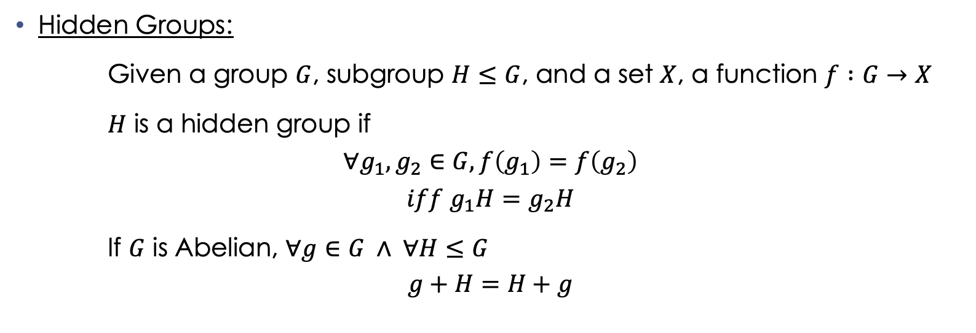
Math Interlude: Group Theory V
Hidden Groups:
Given a group $G$, subgroup $H≤G$, and a set $X$, a function $f :G→X$
$H$ is a hidden group if
$$∀g_{1},g_{2}∈G, f\left(g_{1}\right)=f\left(g_{2}\right)$$
$$iff g_{1}H=g_{2}H$$
If $G$ is Abelian, $∀g∈G ∧ ∀H≤G$
$$g+H=H+g$$
Notes:
Function f is said to be constant within a coset of H, and different between cosets
If this is an Abelian group, then the following equality holds for all g in G and all H of G

Slide 29
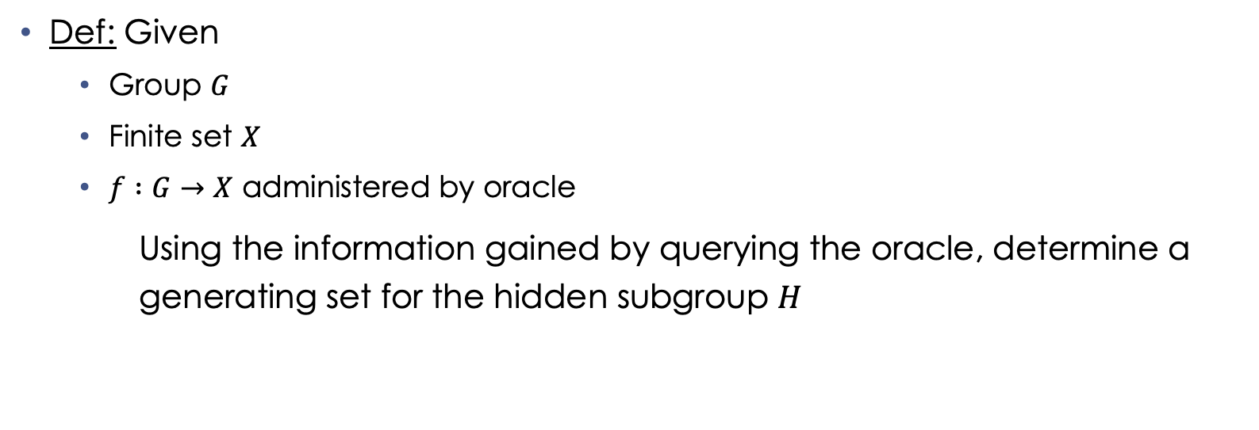
Math Interlude: Hidden Subgroup Problem
Def: Given
Group $G$
Finite set $X$
$f :G→X$ administered by oracle
Using the information gained by querying the oracle, determine a generating set for the hidden subgroup $H$
Notes:
Generating set: a subset of the group such that all other group elements can be derived using combinations of the subset elements, their inverses, and the group operation
No classical model can solve this in polynomial time

Slide 30
Quantum Algorithms
Notes:
Any questions?

Slide 31
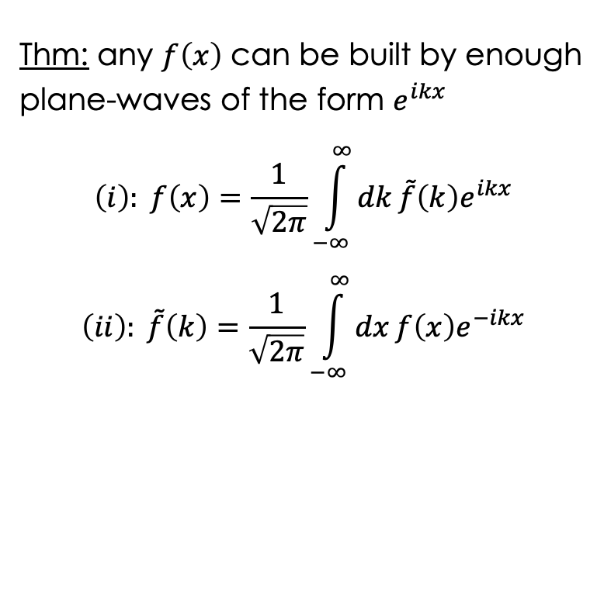
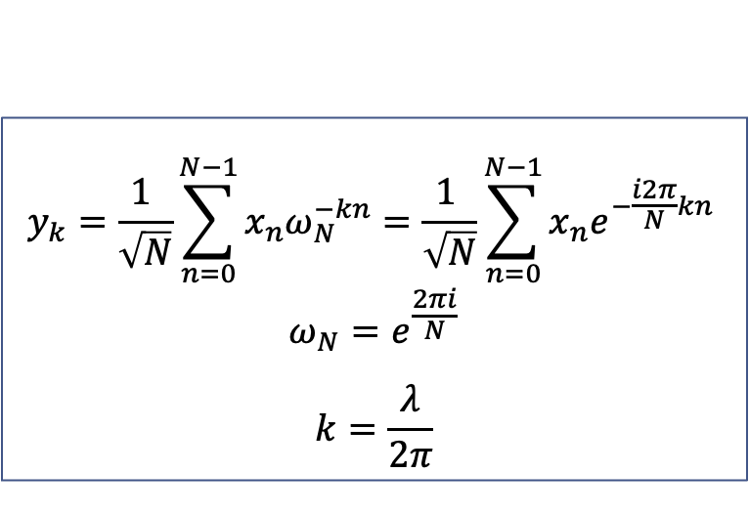
Math Interlude: Fourier Transforms
Thm: any $f\left(x\right)$ can be built by enough plane-waves of the form $e^{ikx}$
$$\left(i\right): f\left(x\right)=\frac{1}{\sqrt{2π}}\int_{−∞}^{∞}{dk}\tilde{f}\left(k\right)e^{ikx}$$
$$\left(ii\right): \tilde{f}\left(k\right)=\frac{1}{\sqrt{2π}}\int_{−∞}^{∞}{dx}f\left(x\right)e^{−ikx}$$
$$y_{k}=\frac{1 }{\sqrt{N}}\sum_{n=0}^{N−1}{x_{n}ω_{N}^{−kn}}=\frac{1 }{\sqrt{N}}\sum_{n=0}^{N−1}{x_{n}e^{−\frac{i2π}{N}kn }}$$
$$ω_{N}=e^{\frac{2πi}{N}}$$
$$k=\frac{λ}{2π}$$
Notes:
Converts a finite sequence of equally-spaced samples of a function into an equivalent length/spacing sequence of a complex-valued function of frequency
Functional definition of a DFT applied to physics
Plane wave: a physical quantity whose value, at any moment, is constant over any plane that is perpendicular to a fixed direction in space
Any continuously integrable and differentiable function f(x) …
Omega_N ^n is the N-th root of unity (# == -1 when raised to a power) -> “kn”-th root of unity
Cancels out with k to return left fxns

Slide 32
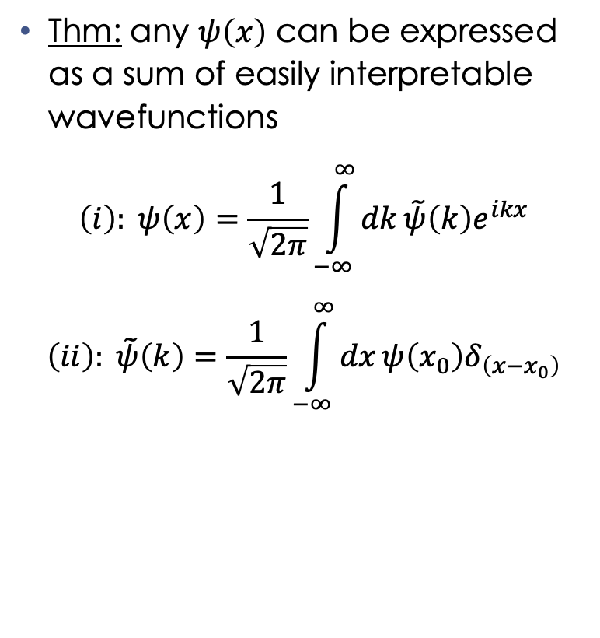
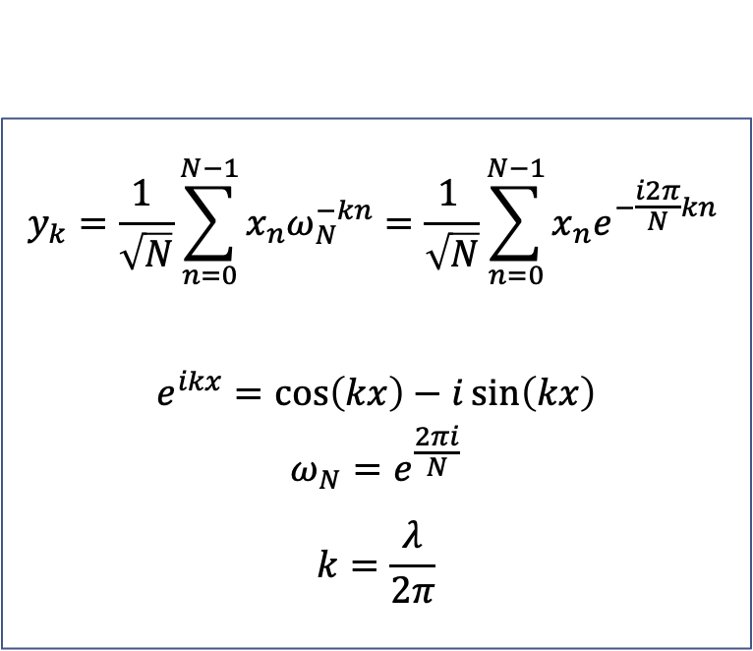
Math Interlude: Quantum Fourier Transforms
Thm: any $ψ\left(x\right)$ can be expressed as a sum of easily interpretable wavefunctions
$$\left(i\right): ψ\left(x\right)=\frac{1}{\sqrt{2π}}\int_{−∞}^{∞}{dk}\tilde{ψ}\left(k\right)e^{ikx}$$
$$\left(ii\right): \tilde{ψ}\left(k\right)=\frac{1}{\sqrt{2π}}\int_{−∞}^{∞}{dx}ψ\left(x_{0}\right)δ_{\left(x−x_{0}\right)}$$
$$y_{k}=\frac{1 }{\sqrt{N}}\sum_{n=0}^{N−1}{x_{n}ω_{N}^{−kn}}=\frac{1 }{\sqrt{N}}\sum_{n=0}^{N−1}{x_{n}e^{−\frac{i2π}{N}kn }}$$
$$e^{ikx}=\cos\left(kx\right)−i\sin\left(kx\right)$$
$$ω_{N}=e^{\frac{2πi}{N}}$$
$$k=\frac{λ}{2π}$$
Notes:
Superposition of states with definite momentum, as h_bar times k, where k is the wavenumber = lambda/2pi
Superposition of states with definite position, with the delta function with position x_0
Now we have the Q-th root of unity

Slide 33

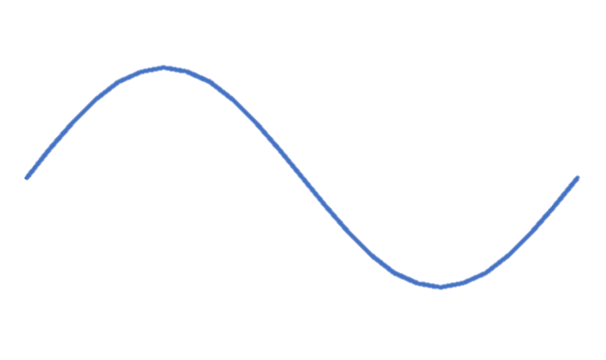











Math Interlude: QFT Intuition
$$ℝ\left(ψ\right)$$
$$ψ\left(x\right)=e^{ikx}$$
$$ℝ\left(ψ\right)$$
$$x_{1}$$
0
0
$$x_{2}$$
$$ℙ(x)$$
$$ℙ\left(x\right)=1$$
$$x_{1}$$
0
$$\tilde{ψ}(k)$$
$$\tilde{ψ}(k)$$
$$k$$
Notes:
Any questions?

Slide 34
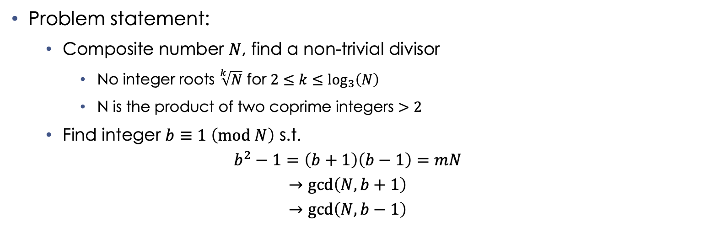
Shor’s Algorithm: Overview
Problem statement:
Composite number $N$, find a non-trivial divisor
No integer roots $\sqrt[k]{N}$ for $2≤k≤\log_{3}\left(N\right)$
N is the product of two coprime integers $>2$
Find integer $b≡1 \left(mod N\right)$ s.t.
$$b^{2}−1=\left(b+1\right)\left(b−1\right)=mN$$
$$→\gcd\left(N,b+1\right)$$
$$→\gcd\left(N,b−1\right)$$
Notes:
Given a composite number, find a non-trivial divisor. We can test for primality fairly quickly right at the get-go to confirm composite
N cannot be even, or a power of a prime
…
b cannot be 1 or -1, but will give us a non-zero m that returns the prime divisors of N

Slide 35
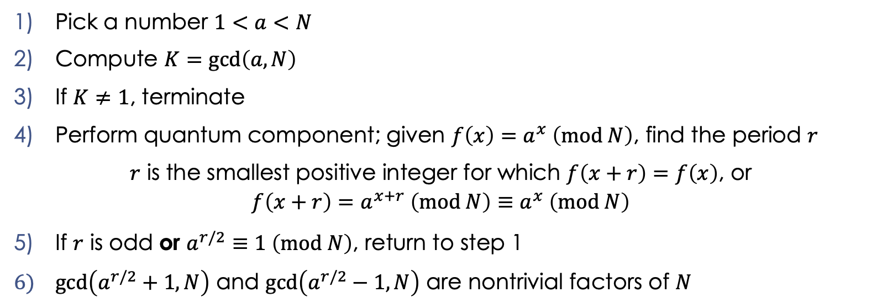
Shor’s Algorithm: Classical Component
Pick a number $1<a<N$
Compute $K=\gcd\left(a,N\right)$
If $K≠1$, terminate
Perform quantum component; given $f\left(x\right)=a^{x} \left(mod N\right)$, find the period $r$
$r$ is the smallest positive integer for which $f\left(x+r\right)=f\left(x\right)$, or
$$f\left(x+r\right)=a^{x+r} \left(mod N\right)≡a^{x} \left(mod N\right)$$
If $r$ is odd or $a^{r/2}≡1 \left(mod N\right)$, return to step 1
$\gcd\left(a^{r/2}+1,N\right)$ and $\gcd\left(a^{r/2}−1,N\right)$ are nontrivial factors of $N$
Notes:
Step 4: modular exponentiation!

Slide 36
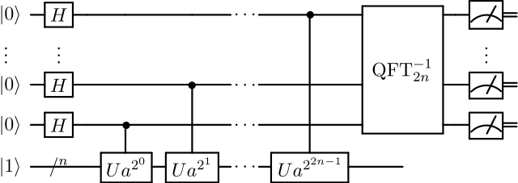
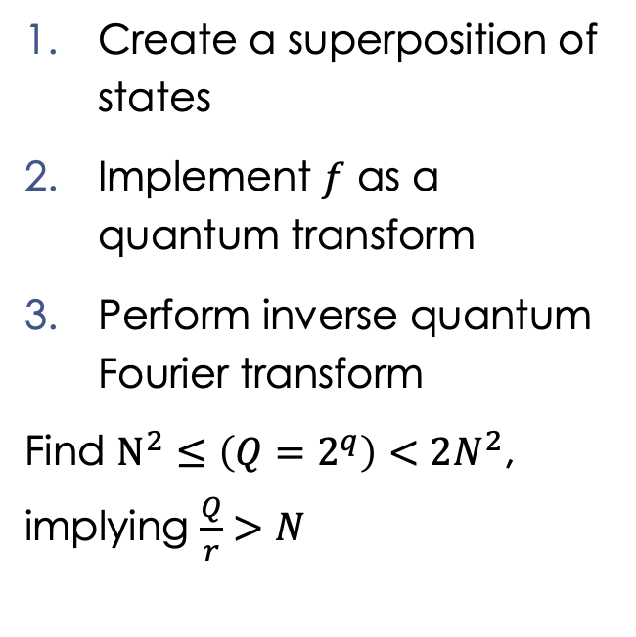
Shor’s Algorithm: Implementation Problems
Create a superposition of states
Implement $f$ as a quantum transform
Perform inverse quantum Fourier transform
Find $N^{2}≤\left(Q=2^{q}\right)<2N^{2}$, implying $\frac{Q}{r}>N$
Notes:
Why quantum? To compute the period, we evaluate f at all points
Measurement only yields one value, destroying all others
No-cloning, other wise we could measure f(x), make copies to get a super-pos. of all states w/ same f(x), then measure x and calculate
Shor had to solve three implementation problems
Shor’s algorithm circuits are tailor-made for N and r values
Qbit registers have to hold super-pos. Of values 0-(Q-1), so need q qubits each

Slide 37
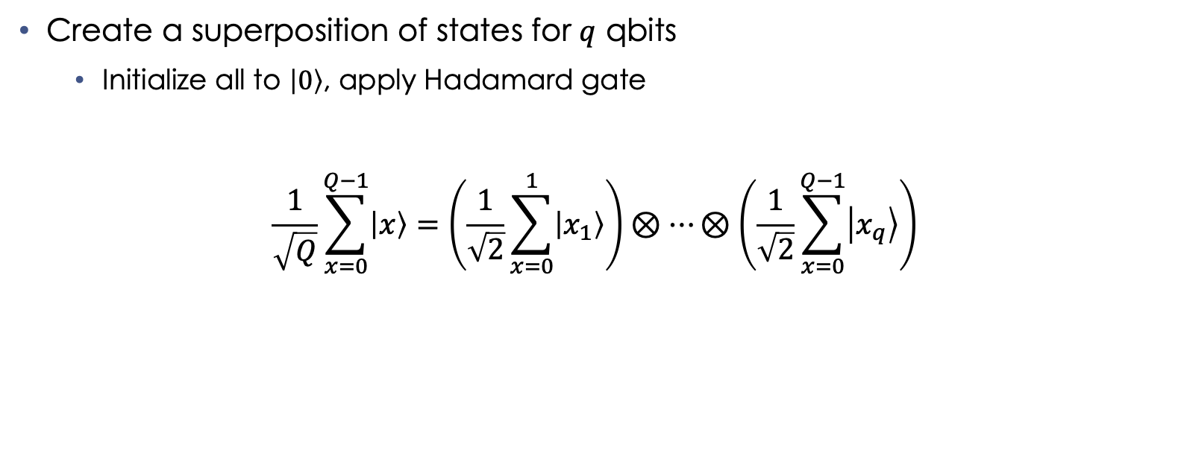
Shor’s Algorithm: Quantum Subroutine Task 1
Create a superposition of states for $q$ qbits
Initialize all to $\left|0\right\rangle$, apply Hadamard gate
$$\frac{1}{\sqrt{Q}}\sum_{x=0}^{Q−1}{\left|x\right\rangle =\left(\frac{1}{\sqrt{2}}\sum_{x=0}^{1}{\left|x_{1}\right\rangle }\right)}⊗…⊗\left(\frac{1}{\sqrt{2}}\sum_{x=0}^{Q−1}{\left|x_{q}\right\rangle }\right)$$
Notes:
In the summations, we can see all the qbits from 1 to q represented, totaling the entire superposition of states from 1 to Q-1

Slide 38
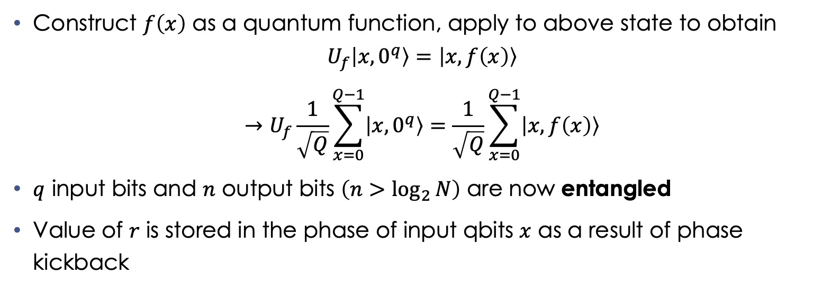
Shor’s Algorithm: Quantum Subroutine Task 2
Construct $f\left(x\right)$ as a quantum function, apply to above state to obtain
$$U_{f}\left|x,0^{q}\right\rangle =\left|x,f\left(x\right)\right\rangle$$
$$→U_{f}\frac{1}{\sqrt{Q}}\sum_{x=0}^{Q−1}{\left|x,0^{q}\right\rangle }=\frac{1}{\sqrt{Q}}\sum_{x=0}^{Q−1}{\left|x,f\left(x\right)\right\rangle }$$
$q$ input bits and $n$ output bits $\left(n>\log_{2}{N}\right)$ are now entangled
Value of $r$ is stored in the phase of input qbits $x$ as a result of phase kickback
Notes:
Quantum function applying to q qbits; we can see in the summation they’re in an equal superposition of amplitudes 1 upon root Q
Quantum function utilizes repeated squaring for modular exponentiation transformation
Phase kickback: using qbits as control inputs to unitary gates alters the relative phase of the control qbits

Slide 39
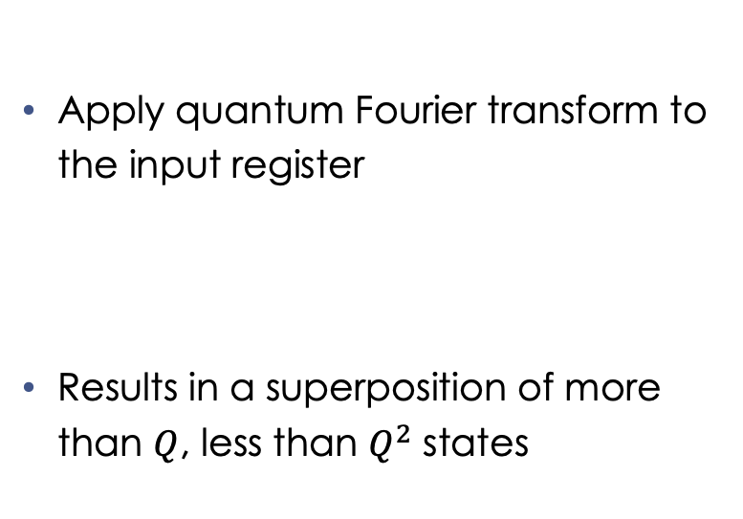
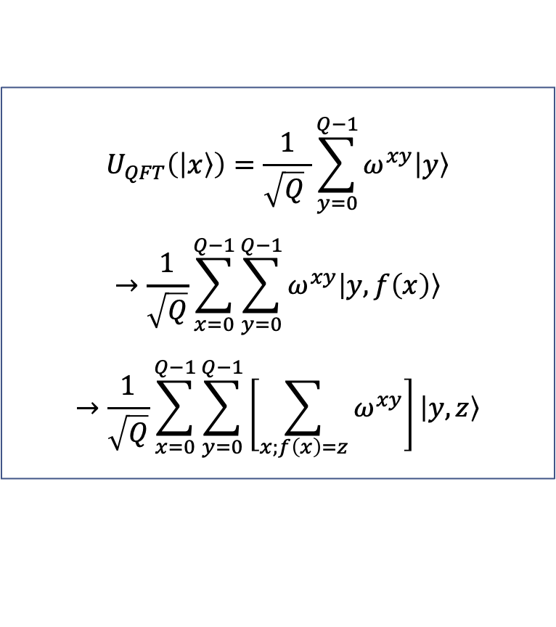
Shor’s Algorithm: Quantum Subroutine Task 3
Apply quantum Fourier transform to the input register
Results in a superposition of more than $Q$, less than $Q^{2}$ states
$$U_{QFT}\left(\left|x\right\rangle \right)=\frac{1}{\sqrt{Q} }\sum_{y=0}^{Q−1}{ω^{xy}\left|y\right\rangle }$$
$$→\frac{1}{\sqrt{Q}}\sum_{x=0}^{Q−1}{\sum_{y=0}^{Q−1}{ω^{xy}\left|y,f\left(x\right)\right\rangle }}$$
$$→\frac{1}{\sqrt{Q}}\sum_{x=0}^{Q−1}{\sum_{y=0}^{Q−1}{\left[\sum_{x;f\left(x\right)=z}{ω^{xy}}\right]}\left|y,z\right\rangle }$$
Notes:
Fundamentally, this transform distributes the amplitude of any given x state equally among all Q of the y states
Omega is the Q-th root of unity
X being the smallest of the values of Q for which f(x)=z
r is the period of F

Slide 40

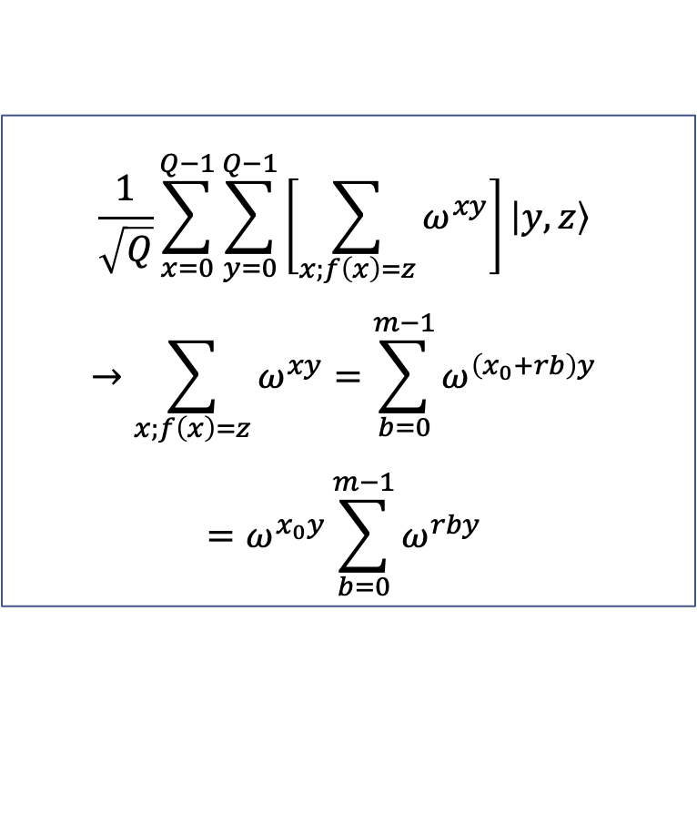
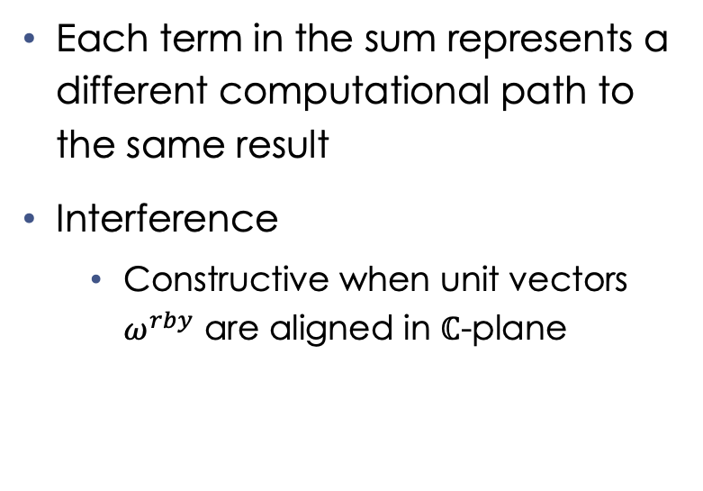
Shor’s Algorithm: Finding $r$
Each term in the sum represents a different computational path to the same result
Interference
Constructive when unit vectors $ω^{rby}$ are aligned in $ℂ$-plane
$$\frac{1}{\sqrt{Q}}\sum_{x=0}^{Q−1}{\sum_{y=0}^{Q−1}{\left[\sum_{x;f\left(x\right)=z}{ω^{xy}}\right]}\left|y,z\right\rangle }$$
$$→\sum_{x;f\left(x\right)=z}{ω^{xy}}=\sum_{b=0}^{m−1}{ω^{\left(x_{0}+rb\right)y}}$$
$$=ω^{x_{0}y}\sum_{b=0}^{m−1}{ω^{rby}}$$
Notes:
M is a term used by b to index x values

Slide 41
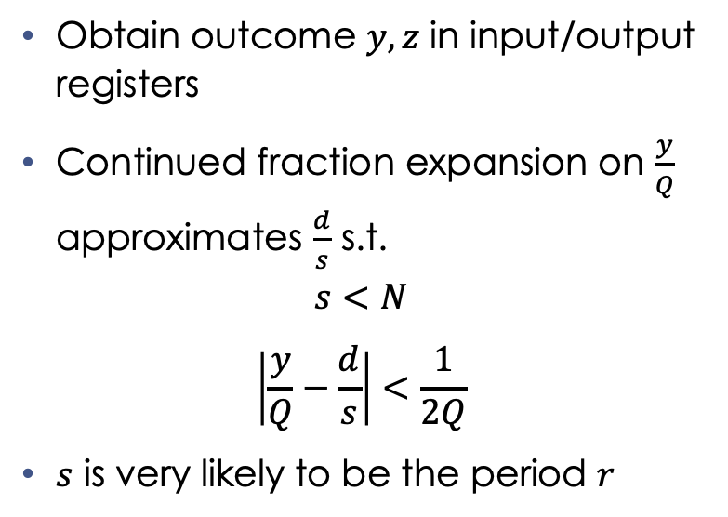
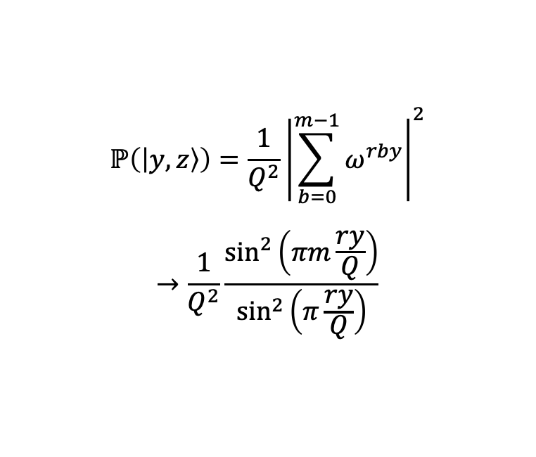
Shor’s Algorithm: Measurement
Obtain outcome $y,z$ in input/output registers
Continued fraction expansion on $\frac{y}{Q}$ approximates $\frac{d}{s}$ s.t.
$$s<N$$
$$\left|\frac{y}{Q}−\frac{d}{s}\right|<\frac{1}{2Q}$$
$s$ is very likely to be the period $r$
$$ℙ\left(\left|y,z\right\rangle \right)=\frac{1}{Q^{2}}{\left|\sum_{b=0}^{m−1}{ω^{rby}}\right|}^{2}$$
$$→\frac{1}{Q^{2}}\frac{\sin^{2}\left(πm\frac{ry}{Q}\right)}{\sin^{2}\left(π\frac{ry}{Q}\right)}$$
Notes:
S is likely to be the period r, or at least a factor of it
Now we do the final classical verification steps shown previously
If not, use multiples of s as candidates for r
Otherwise, start over (yay)

Slide 42
Shor’s Algorithm: Intuition
Solves the hidden subgroup problem for finite Abelian sets
Bottleneck is modular exponentiation performed by the quantum function in task 2
Can theoretically solve all three foundations for modern encryption
Integer factorization problem
Discrete logarithm problem
Elliptic-curve discrete logarithm problem

Slide 43
Post-Quantum Encryption
Notes:
Any questions?

Slide 44
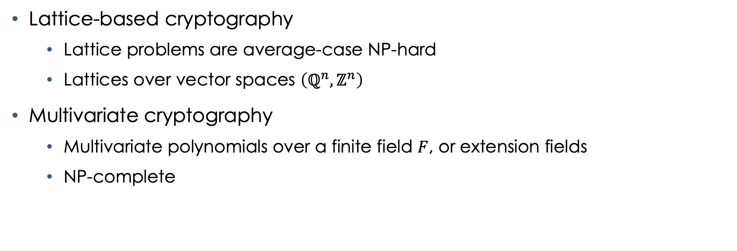
Increasing Complexity
Lattice-based cryptography
Lattice problems are average-case NP-hard
Lattices over vector spaces $\left(ℚ^{n}, ℤ^{n}\right)$
Multivariate cryptography
Multivariate polynomials over a finite field $F$, or extension fields
NP-complete
Notes:
One method to deal with post-quantum encryption is to increase complexity
Lie groups – groups that are also differentiable manifolds

Slide 45
Hash-Based Cryptography
Uses hash functions in a Merkle tree
Digital signature schemes
Merkle signature scheme
Range proofs
Zero knowledge, computational integrity proofs (zk-STARK)
Notes:
Merkle tree: hash tree where terminal nodes are hashed with their data, inner nodes are hashed with their child labels
Zk starks used in L2 protocols on blockchain
Zero-Knowledge Scalable Transparent ARguments of Knowledge
Proves a computation without exposing the computation itself

Slide 46
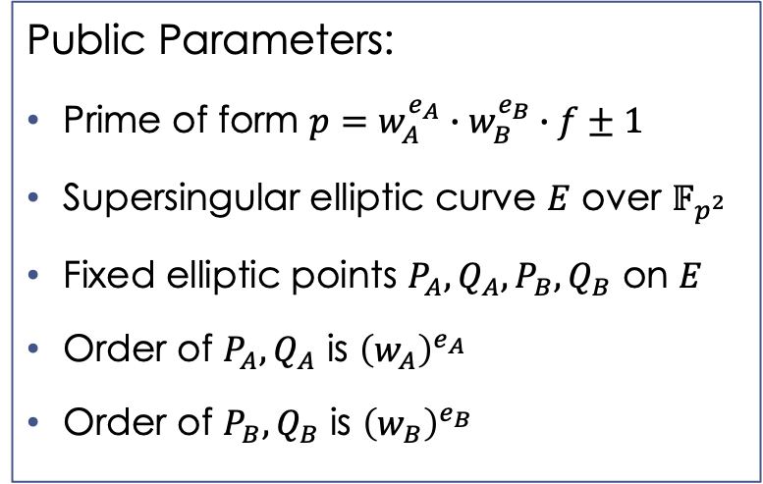
Supersingular Isogeny Diffie-Hellman
Supersingular isogeny graphs
Graph representations of supersingular elliptic curves
Nodes represent curves over finite fields
Edges represent isogenies between curves
Public Parameters:
Prime of form $p=w_{A}^{e_{A}}∙w_{B}^{e_{B}}∙f±1$
Supersingular elliptic curve $E$ over $𝔽_{p^{2}}$
Fixed elliptic points $P_{A}, Q_{A}, P_{B}, Q_{B}$ on $E$
Order of $P_{A},Q_{A}$ is ${\left(w_{A}\right)}^{e_{A}}$
Order of $P_{B},Q_{B}$ is ${\left(w_{B}\right)}^{e_{B}}$
Notes:
Isogeny: structure preserving map; surjective
Mapping from A to B; every element in B is the image of at least one element in A
W is the order of these fixed elliptic points

Slide 47
Code Demonstration
Shor’s Algorithm: Cirq

