Slide 1
Quantum Computing
Introduction

Slide 2

Complex Number Mathematics
Complex numbers
Real and imaginary component: $i^{2}=−1$
$$∀x∈ℂ,∃a,b∈ℝ$$
$$→x=a+bi$$
Complex conjugate
$$x=a+bi$$
$$\overline{x}=a−bi$$
Complex modulus
$${\left|x\right|}^{2}=\overline{x}x→\left|x\right|=\sqrt{x\overline{x}}$$
Notes:
Daniel

Slide 3
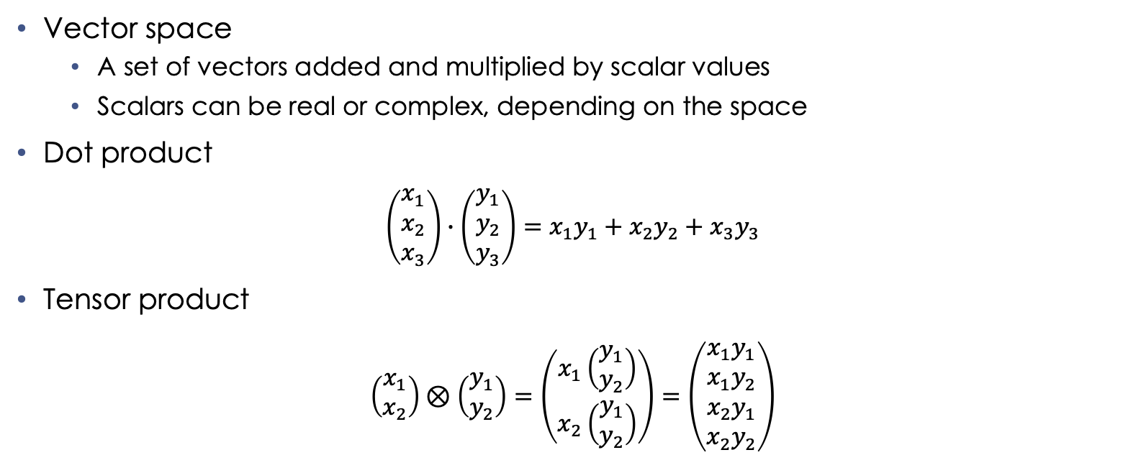
Terms/Operations
Vector space
A set of vectors added and multiplied by scalar values
Scalars can be real or complex, depending on the space
Dot product
$$\left(\begin{matrix}x_{1} \\ x_{2} \\ x_{3}\end{matrix}\right)∙\left(\begin{matrix}y_{1} \\ y_{2} \\ y_{3}\end{matrix}\right)=x_{1}y_{1}+x_{2}y_{2}+x_{3}y_{3}$$
Tensor product
$$\left(\begin{matrix}x_{1} \\ x_{2}\end{matrix}\right)⊗\left(\begin{matrix}y_{1} \\ y_{2}\end{matrix}\right)=\left(\begin{matrix}x_{1}\left(\begin{matrix}y_{1} \\ y_{2}\end{matrix}\right) \\ x_{2}\left(\begin{matrix}y_{1} \\ y_{2}\end{matrix}\right)\end{matrix}\right)=\left(\begin{matrix}x_{1}y_{1} \\ x_{1}y_{2} \\ x_{2}y_{1} \\ x_{2}y_{2}\end{matrix}\right)$$
Notes:
Daniel

Slide 4
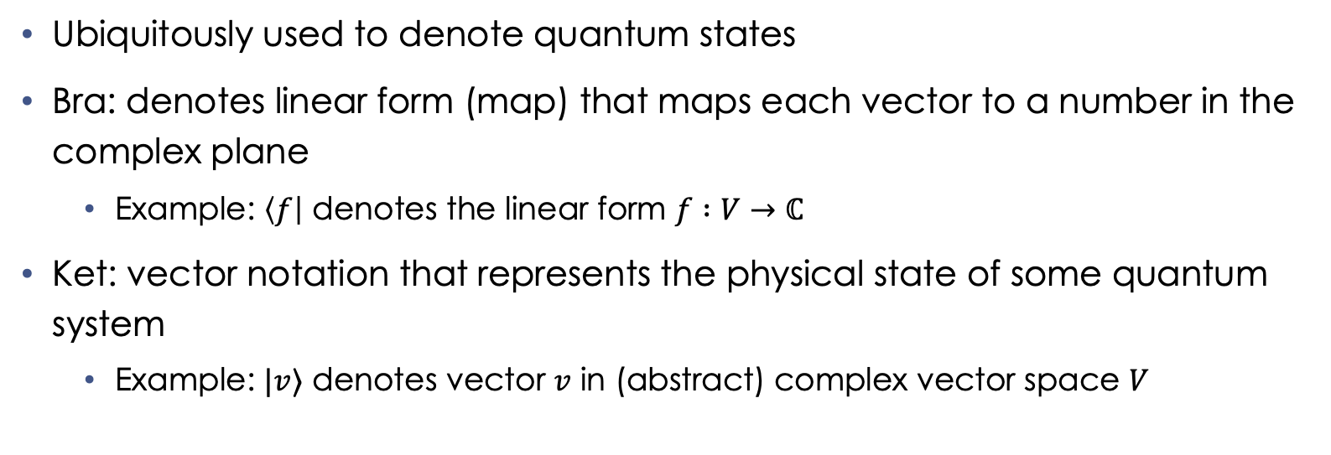
Bra-Ket Notation
Ubiquitously used to denote quantum states
Bra: denotes linear form (map) that maps each vector to a number in the complex plane
Example: $\left\langle f\right|$ denotes the linear form $f :V→ℂ$
Ket: vector notation that represents the physical state of some quantum system
Example: $|v⟩$ denotes vector $v$ in (abstract) complex vector space $V$
Notes:
Daniel

Slide 5
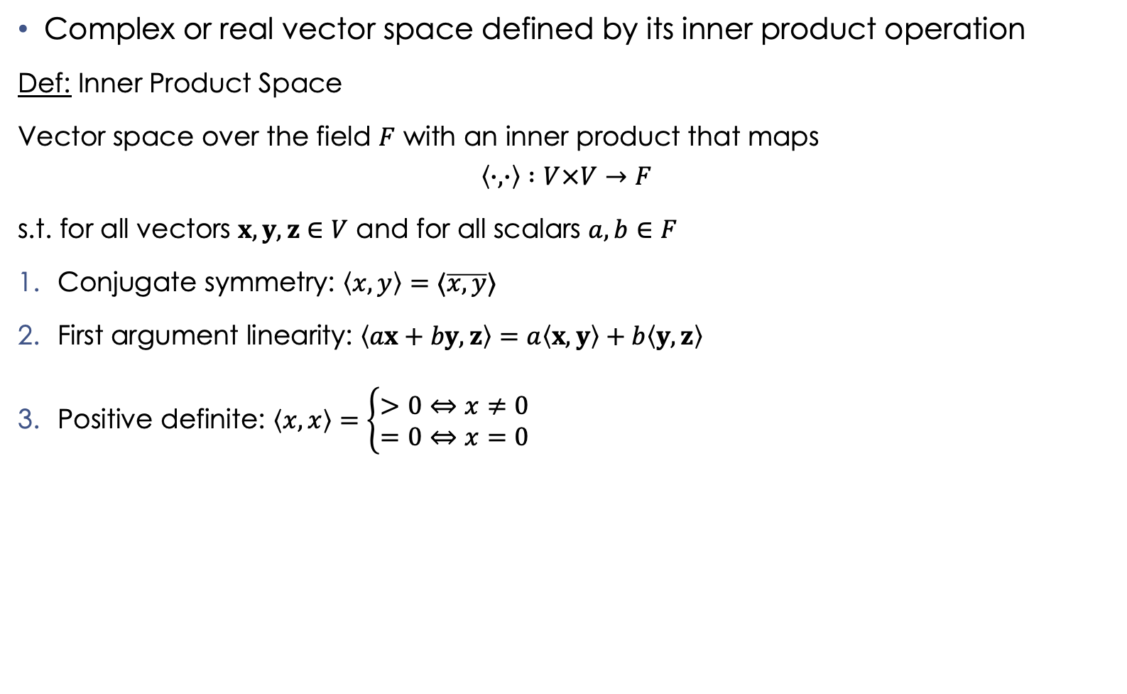
Hilbert Space
Complex or real vector space defined by its inner product operation
Def: Inner Product Space
Vector space over the field $F$ with an inner product that maps
$$\left\langle ∙,∙\right\rangle :V×V→F$$
s.t. for all vectors $x,y,z∈V$ and for all scalars $a,b∈F$
Conjugate symmetry: $\left\langle x,y\right\rangle =⟨\overline{x,y}⟩$
First argument linearity: $\left\langle ax+by, z\right\rangle =a\left\langle x,y\right\rangle +b\left\langle y,z\right\rangle$
Positive definite: $\left\langle x,x\right\rangle =\left\{\begin{matrix}>0⇔x≠0 \\ =0⇔x=0\end{matrix}\right.$
Notes:
Daniel
Field: a set on which addition, subtraction, multiplication, and division are defined and behave as the corresponding rational and real numbers do

Slide 6
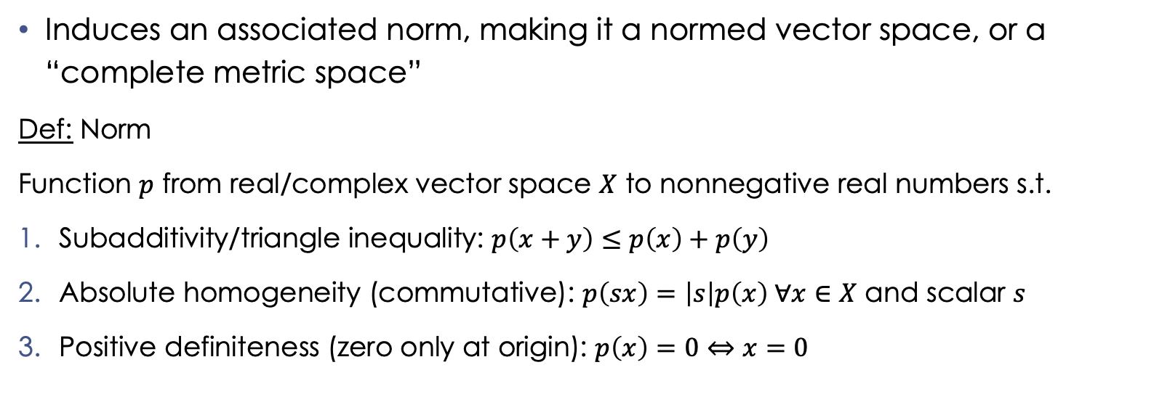
Hilbert Space (cont.)
Induces an associated norm, making it a normed vector space, or a “complete metric space”
Def: Norm
Function $p$ from real/complex vector space $X$ to nonnegative real numbers s.t.
Subadditivity/triangle inequality: $p\left(x+y\right)≤p\left(x\right)+p\left(y\right)$
Absolute homogeneity (commutative): $p\left(sx\right)=\left|s\right|p\left(x\right) ∀x∈X$ and scalar $s$
Positive definiteness (zero only at origin): $p\left(x\right)=0⇔x=0$
Notes:
Daniel
Inner product formalizes the definition of intuitive notions like lengths, angles, and orthogonality

Slide 7
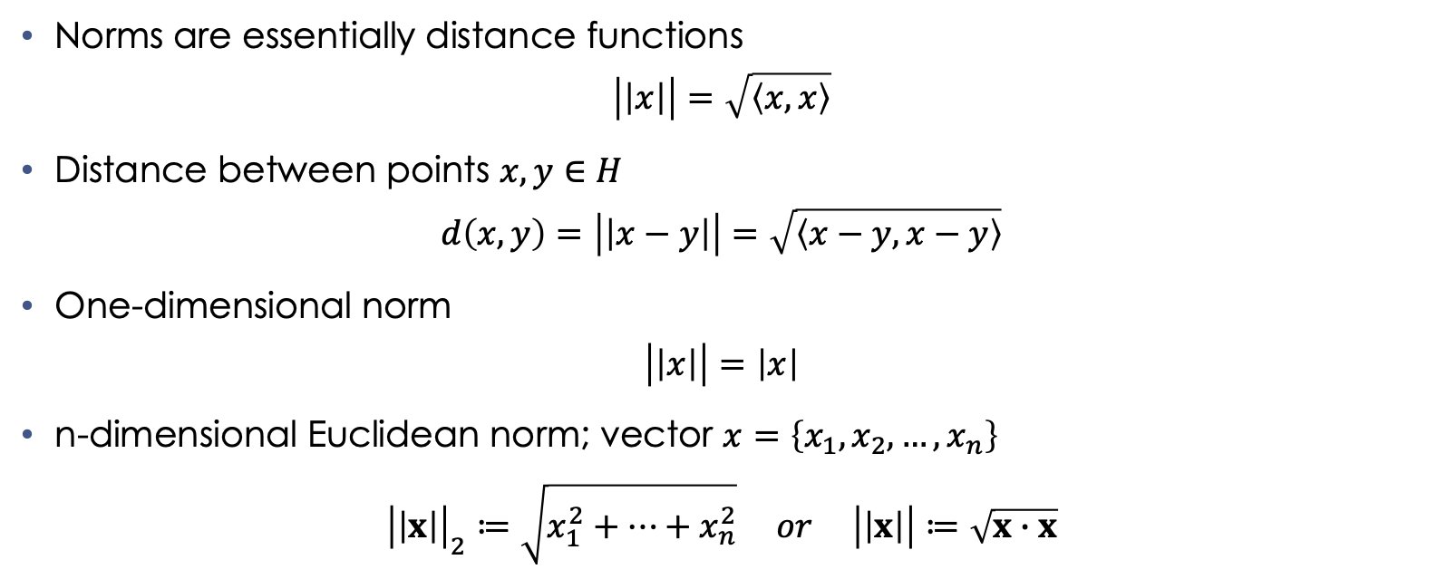
Hilbert Spaces (cont.)
Norms are essentially distance functions
$$\left|\left|x\right|\right|=\sqrt{\left\langle x,x\right\rangle }$$
Distance between points $x,y∈H$
$$d\left(x,y\right)=\left|\left|x−y\right|\right|=\sqrt{\left\langle x−y,x−y\right\rangle }$$
One-dimensional norm
$$\left|\left|x\right|\right|=\left|x\right|$$
n-dimensional Euclidean norm; vector $x=\left\{x_{1},x_{2},…, x_{n}\right\}$
$${\left|\left|x\right|\right|}_{2}≔\sqrt{x_{1}^{2}+…+x_{n}^{2}} or \left|\left|x\right|\right|≔\sqrt{x∙x}$$
Notes:
Daniel

Slide 8

Representing Classical Bits (cbits) as Vectors
One bit with value 1
$$\left(\begin{matrix}1 \\ 0\end{matrix}\right)=|0⟩$$
One bit with value 0
$$\left(\begin{matrix}0 \\ 1\end{matrix}\right)=\left|1\right\rangle$$
Notes:
Boris

Slide 9

Cbit Operations
Identity
$$\left(\begin{matrix}1 & 0 \\ 0 & 1\end{matrix}\right)\left(\begin{matrix}1 \\ 0\end{matrix}\right)=\left(\begin{matrix}1 \\ 0\end{matrix}\right)→f\left(x\right)=x$$
Negation
$$\left(\begin{matrix}0 & 1 \\ 1 & 0\end{matrix}\right)\left(\begin{matrix}1 \\ 0\end{matrix}\right)=\left(\begin{matrix}0 \\ 1\end{matrix}\right)→f\left(x\right)=¬x$$
Constant-0
$$\left(\begin{matrix}1 & 1 \\ 0 & 0\end{matrix}\right)\left(\begin{matrix}1 \\ 0\end{matrix}\right)=\left(\begin{matrix}1 \\ 0\end{matrix}\right)→f\left(x\right)=0$$
Constant-1
$$\left(\begin{matrix}0 & 0 \\ 1 & 1\end{matrix}\right)\left(\begin{matrix}1 \\ 0\end{matrix}\right)=\left(\begin{matrix}0 \\ 1\end{matrix}\right)→f\left(x\right)=1$$
Notes:
Boris

Slide 10

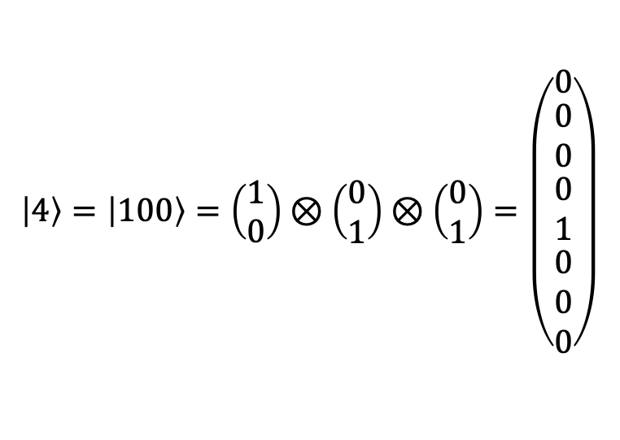
Multiple Cbits
$$\left|11\right\rangle =\left(\begin{matrix}0 \\ 1\end{matrix}\right)⊗\left(\begin{matrix}0 \\ 1\end{matrix}\right)=\left(\begin{matrix}0 \\ 0 \\ \begin{matrix}0 \\ 1\end{matrix}\end{matrix}\right)$$
$$\left|4\right\rangle =\left|100\right\rangle =\left(\begin{matrix}1 \\ 0\end{matrix}\right)⊗\left(\begin{matrix}0 \\ 1\end{matrix}\right)⊗\left(\begin{matrix}0 \\ 1\end{matrix}\right)=\left(\begin{matrix}0 \\ \begin{matrix}0 \\ 0 \\ \begin{matrix}0 \\ 1 \\ \begin{matrix}0 \\ 0 \\ 0\end{matrix}\end{matrix}\end{matrix}\end{matrix}\right)$$
Notes:
Boris
In Dirac notation, the values inside the brackets can be thought of as a tensor product of their individual discrete values

Slide 11
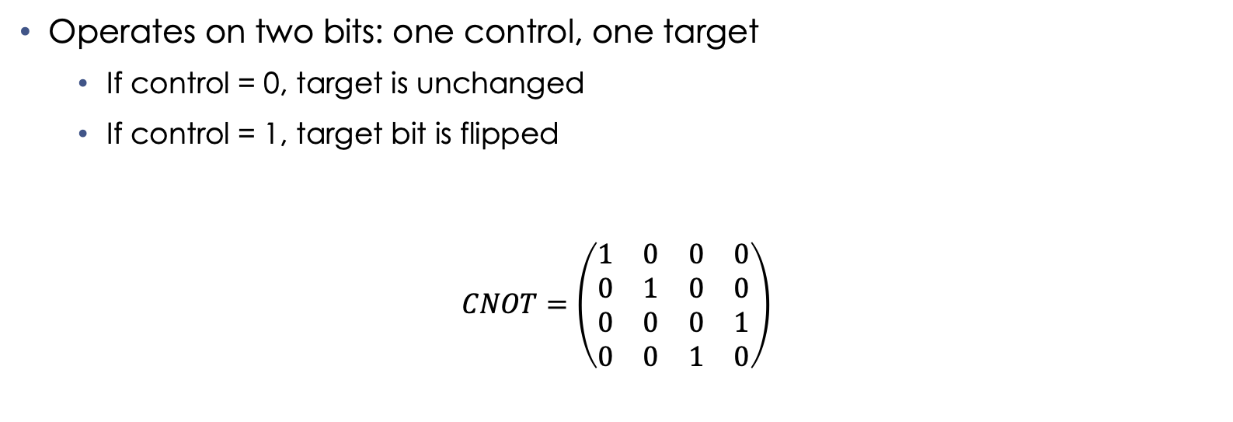
Conditional NOT (CNOT)
Operates on two bits: one control, one target
If control = 0, target is unchanged
If control = 1, target bit is flipped
$$CNOT=\left(\begin{matrix}1 & 0 & 0 & 0 \\ 0 & 1 & 0 & 0 \\ 0 & 0 & 0 & 1 \\ 0 & 0 & 1 & 0\end{matrix}\right)$$
Notes:
Boris

Slide 12
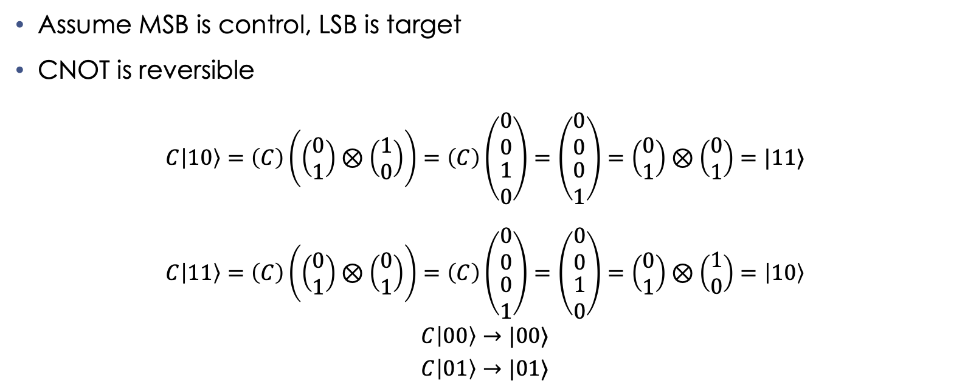
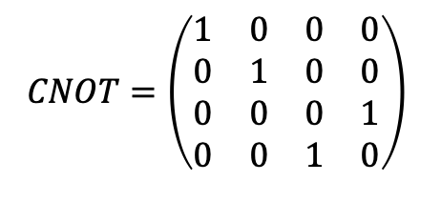
CNOT (cont.)
$$CNOT=\left(\begin{matrix}1 & 0 & 0 & 0 \\ 0 & 1 & 0 & 0 \\ 0 & 0 & 0 & 1 \\ 0 & 0 & 1 & 0\end{matrix}\right)$$
Assume MSB is control, LSB is target
CNOT is reversible
$C\left|10\right\rangle =\left(C\right)\left(\left(\begin{matrix}0 \\ 1\end{matrix}\right)⊗\left(\begin{matrix}1 \\ 0\end{matrix}\right)\right)=\left(C\right)\left(\begin{matrix}0 \\ 0 \\ \begin{matrix}1 \\ 0\end{matrix}\end{matrix}\right)=\left(\begin{matrix}0 \\ 0 \\ \begin{matrix}0 \\ 1\end{matrix}\end{matrix}\right)=\left(\begin{matrix}0 \\ 1\end{matrix}\right)⊗\left(\begin{matrix}0 \\ 1\end{matrix}\right)=|11⟩$
$$C\left|11\right\rangle =\left(C\right)\left(\left(\begin{matrix}0 \\ 1\end{matrix}\right)⊗\left(\begin{matrix}0 \\ 1\end{matrix}\right)\right)=\left(C\right)\left(\begin{matrix}0 \\ 0 \\ \begin{matrix}0 \\ 1\end{matrix}\end{matrix}\right)=\left(\begin{matrix}0 \\ 0 \\ \begin{matrix}1 \\ 0\end{matrix}\end{matrix}\right)=\left(\begin{matrix}0 \\ 1\end{matrix}\right)⊗\left(\begin{matrix}1 \\ 0\end{matrix}\right)=\left|10\right\rangle$$
$$C\left|00\right\rangle →|00⟩$$
$$C\left|01\right\rangle →|01⟩$$
Notes:
Boris
MSB: most significant bit
LSB: least significant bit

Slide 13

CNOT (cont.)
$$CNOT=\left(\begin{matrix}1 & 0 & 0 & 0 \\ 0 & 1 & 0 & 0 \\ 0 & 0 & 0 & 1 \\ 0 & 0 & 1 & 0\end{matrix}\right)$$
$$C\left(\left|00\right\rangle \right)→\left|00\right\rangle$$
$$C\left(\left|01\right\rangle \right)→\left|01\right\rangle$$
$$C\left(\left|10\right\rangle \right)→\left|11\right\rangle$$
$$C\left(\left|11\right\rangle \right)→\left|10\right\rangle$$
Truth Table:
CNOT | LSB
MSB |  | 0 | 1
 | 0 | 00 | 01
 | 1 | 11 | 10
Notes:
Boris

Slide 14
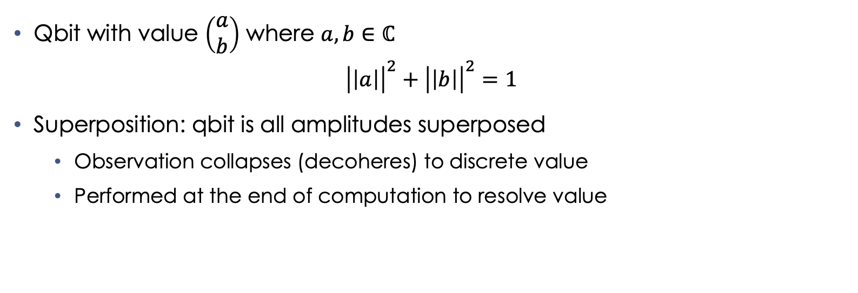
Qbits and Superposition
Qbit with value $\left(\begin{matrix}a \\ b\end{matrix}\right)$ where $a,b∈ℂ$
$${\left|\left|a\right|\right|}^{2}+{\left|\left|b\right|\right|}^{2}=1$$
Superposition: qbit is all amplitudes superposed
Observation collapses (decoheres) to discrete value
Performed at the end of computation to resolve value
Notes:
Daniel

Slide 15
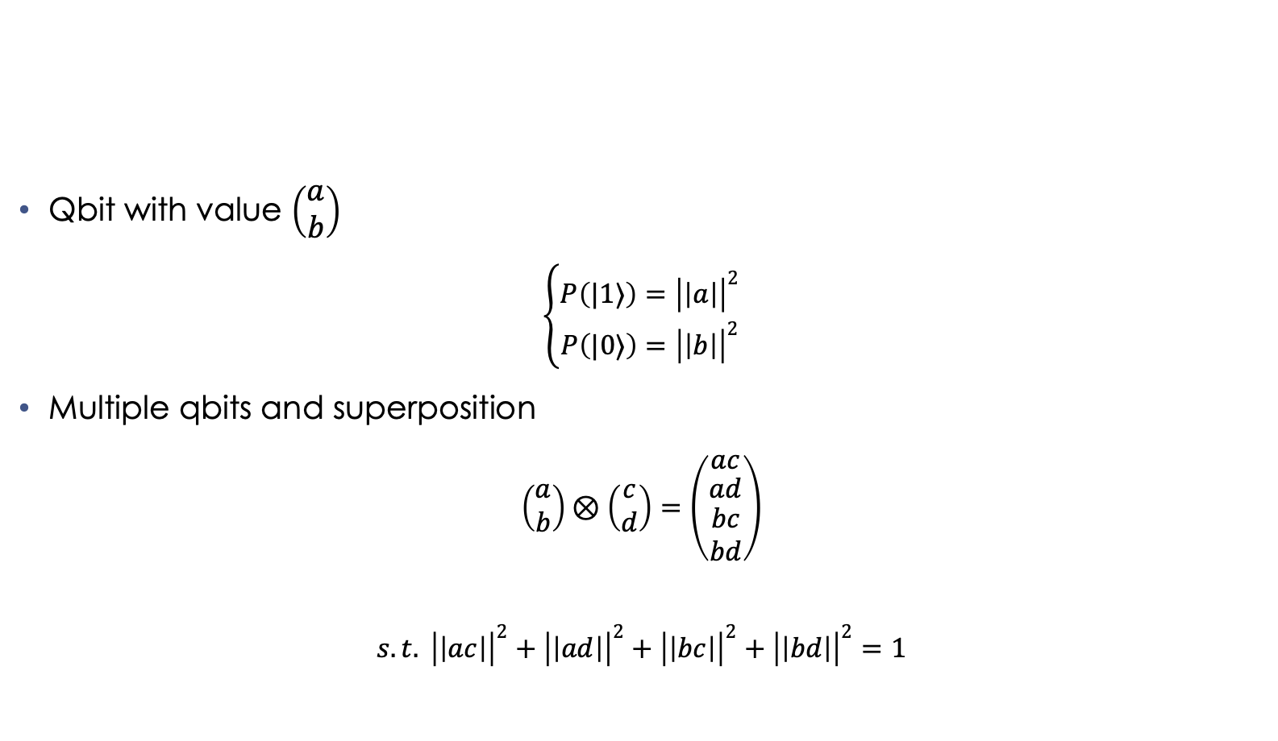
Qbits and Superposition (cont.)
Qbit with value $\left(\begin{matrix}a \\ b\end{matrix}\right)$
$$\left\{\begin{matrix}P\left(|1⟩\right)={\left|\left|a\right|\right|}^{2} \\ P\left(|0⟩\right)={\left|\left|b\right|\right|}^{2}\end{matrix}\right.$$
Multiple qbits and superposition
$$\left(\begin{matrix}a \\ b\end{matrix}\right)⊗\left(\begin{matrix}c \\ d\end{matrix}\right)=\left(\begin{matrix}ac \\ \begin{matrix}ad \\ \begin{matrix}bc \\ bd\end{matrix}\end{matrix}\end{matrix}\right)$$
$$s.t. {\left|\left|ac\right|\right|}^{2}+{\left|\left|ad\right|\right|}^{2}+{\left|\left|bc\right|\right|}^{2}+{\left|\left|bd\right|\right|}^{2}=1$$
Notes:
Daniel

Slide 16
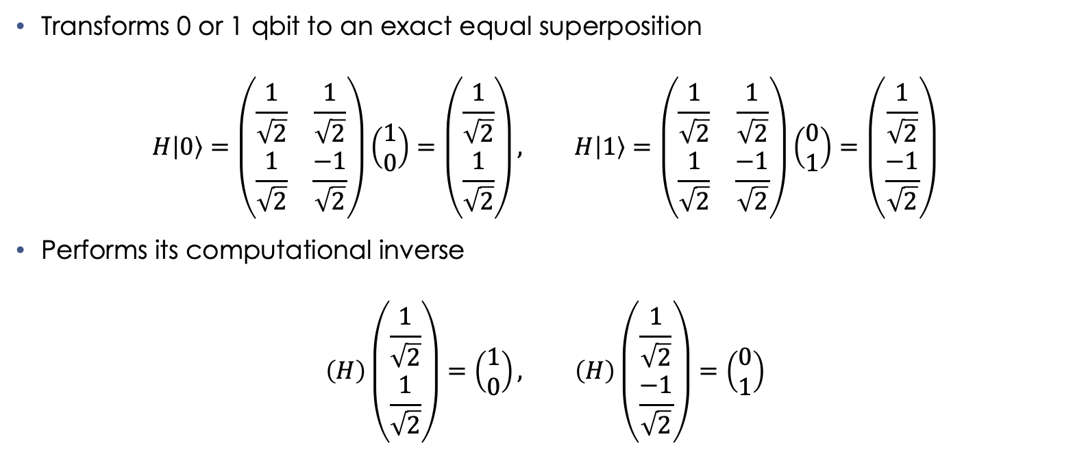
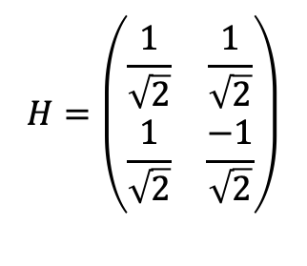
Hadamard Gate
$$H=\left(\begin{matrix}\frac{1}{\sqrt{2}} & \frac{1}{\sqrt{2}} \\ \frac{1}{\sqrt{2}} & \frac{−1}{\sqrt{2}}\end{matrix}\right)$$
Transforms 0 or 1 qbit to an exact equal superposition
$$H\left|0\right\rangle =\left(\begin{matrix}\frac{1}{\sqrt{2}} & \frac{1}{\sqrt{2}} \\ \frac{1}{\sqrt{2}} & \frac{−1}{\sqrt{2}}\end{matrix}\right)\left(\begin{matrix}1 \\ 0\end{matrix}\right)=\left(\begin{matrix}\frac{1}{\sqrt{2}} \\ \frac{1}{\sqrt{2}}\end{matrix}\right), H\left|1\right\rangle =\left(\begin{matrix}\frac{1}{\sqrt{2}} & \frac{1}{\sqrt{2}} \\ \frac{1}{\sqrt{2}} & \frac{−1}{\sqrt{2}}\end{matrix}\right)\left(\begin{matrix}0 \\ 1\end{matrix}\right)=\left(\begin{matrix}\frac{1}{\sqrt{2}} \\ \frac{−1}{\sqrt{2}}\end{matrix}\right)$$
Performs its computational inverse
$$\left(H\right)\left(\begin{matrix}\frac{1}{\sqrt{2}} \\ \frac{1}{\sqrt{2}}\end{matrix}\right)=\left(\begin{matrix}1 \\ 0\end{matrix}\right), \left(H\right)\left(\begin{matrix}\frac{1}{\sqrt{2}} \\ \frac{−1}{\sqrt{2}}\end{matrix}\right)=\left(\begin{matrix}0 \\ 1\end{matrix}\right)$$
Notes:
Daniel

Slide 17

Hadamard Operations
$$H=\left(\begin{matrix}\frac{1}{\sqrt{2}} & \frac{1}{\sqrt{2}} \\ \frac{1}{\sqrt{2}} & \frac{−1}{\sqrt{2}}\end{matrix}\right)$$
$$H\left(\left|0\right\rangle \right)=\frac{1}{\sqrt{2}}\left|0\right\rangle +\frac{1}{\sqrt{2}}\left|1\right\rangle =\frac{\left|0\right\rangle +|1⟩}{\sqrt{2}}≔\left|+\right\rangle$$
$$H\left(\left|1\right\rangle \right)=\frac{1}{\sqrt{2}}\left|0\right\rangle −\frac{1}{\sqrt{2}}\left|1\right\rangle =\frac{\left|0\right\rangle −|1⟩}{\sqrt{2}}≔\left|−\right\rangle$$
Notes:
Daniel

Slide 18
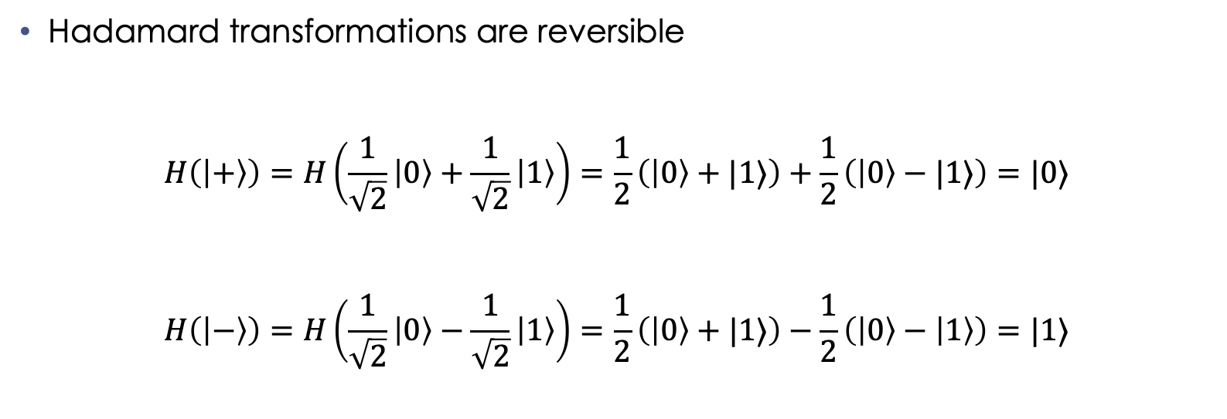
Hadamard Operations (cont.)
$$H=\left(\begin{matrix}\frac{1}{\sqrt{2}} & \frac{1}{\sqrt{2}} \\ \frac{1}{\sqrt{2}} & \frac{−1}{\sqrt{2}}\end{matrix}\right)$$
Hadamard transformations are reversible
$$H\left(\left|+\right\rangle \right)=H\left(\frac{1}{\sqrt{2}}\left|0\right\rangle +\frac{1}{\sqrt{2}}\left|1\right\rangle \right)=\frac{1}{2}\left(\left|0\right\rangle +|1⟩\right)+\frac{1}{2}\left(\left|0\right\rangle −|1⟩\right)=|0⟩$$
$$H\left(\left|−\right\rangle \right)=H\left(\frac{1}{\sqrt{2}}\left|0\right\rangle −\frac{1}{\sqrt{2}}\left|1\right\rangle \right)=\frac{1}{2}\left(\left|0\right\rangle +|1⟩\right)−\frac{1}{2}\left(\left|0\right\rangle −\left|1\right\rangle \right)=|1⟩$$
Notes:
Daniel

Slide 19
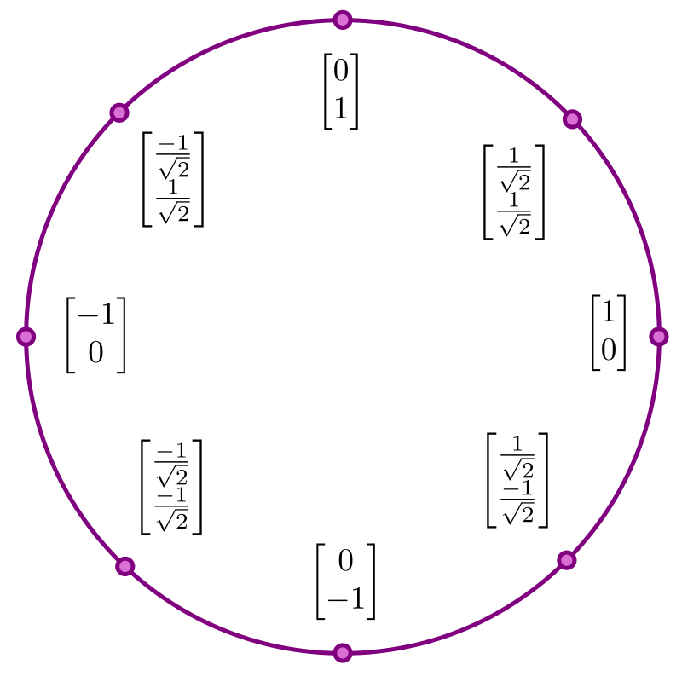
Unit Circle State Machine
Operations can be abstracted to transformations on a unit circle
Notes:
Boris
Operations can be abstracted to transformations on a unit circle
The values on the unit circle represent the possible amplitudes of the qbit

Slide 20
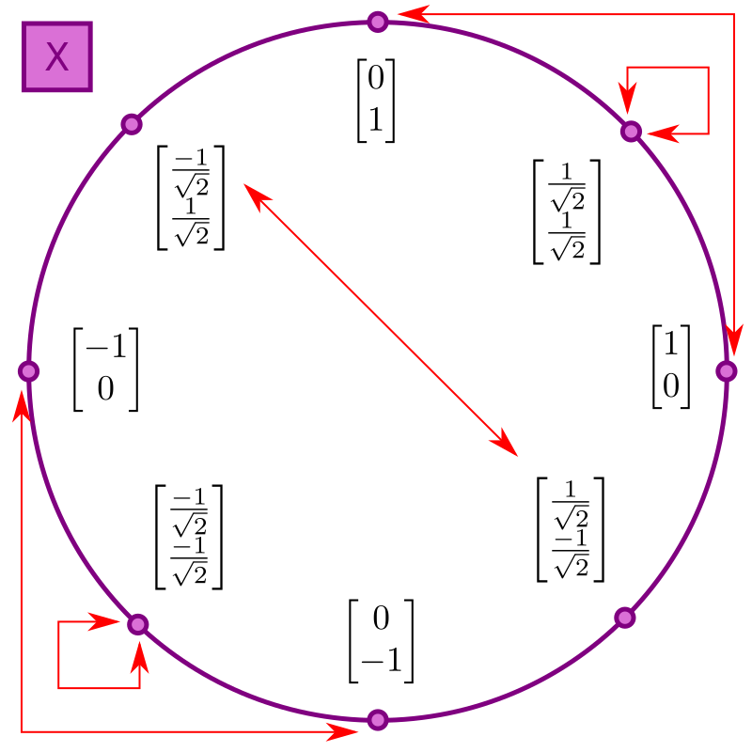
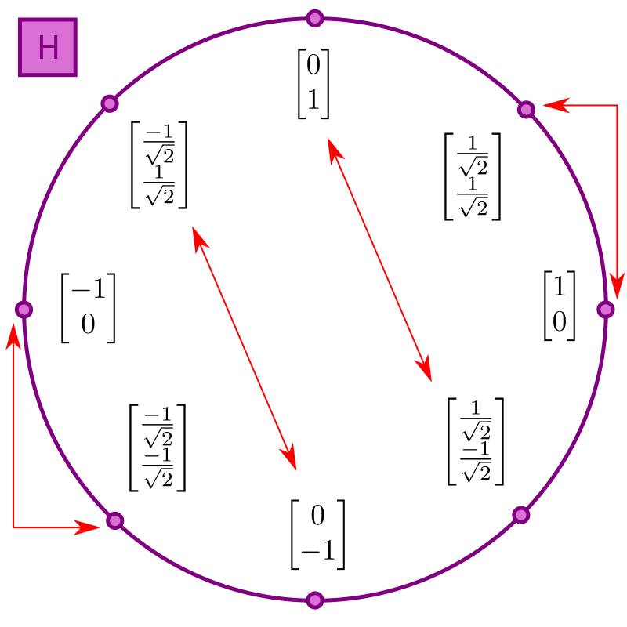
Unit Circle State Machine (cont.)
Notes:
Boris
On the left we can see the effect of the bit flip operator used in the negation operation
On the right we can see the effect of the Hadamard transformation
We can therefore think of operations as translations on this unit circle

Slide 21
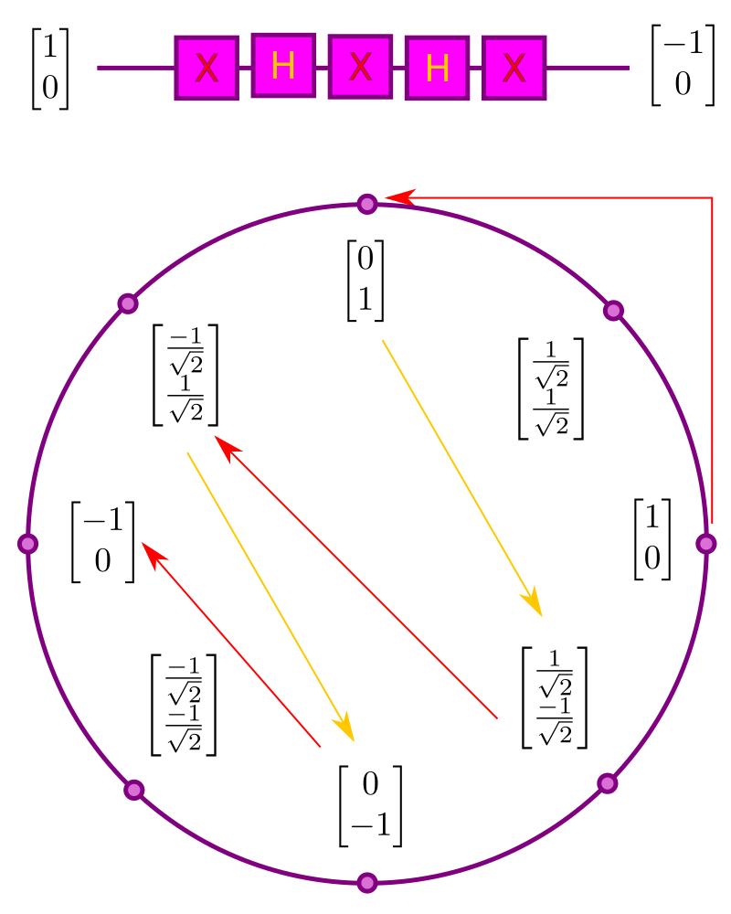

Unit Circle State Machine (cont.)
Applied to sample quantum circuit
Transforms qbit from $\left(\begin{matrix}1 \\ 0\end{matrix}\right)$ to $\left(\begin{matrix}−1 \\ 0\end{matrix}\right)$
Notes:
Boris
Example quantum circuit that transforms qbit from discrete state 0 to discrete state 1
Start – 0
Bit flip – 1
Hadamard – 50/50 superposition
Bit flip – flips relative phase (we will go over this shortly)
Hadamard – takes out of 50/50 into discrete state 1, but with negative amplitude
Bit flip – 1, but with negative phase

Slide 22






Deutsch Oracle
Black box with one fundamental function in it
Can only interact via I/O
Classical vs quantum
How many operations to determine state?
How many operations to determine constant or variable?
$$\left|0\right\rangle$$
$$f\left(\left|x\right\rangle \right)$$
$$\left|x\right\rangle$$
$$f\left(\left|x\right\rangle \right)$$
$$\left|x\right\rangle$$
$$|x⟩$$
Notes:
Boris
This is the classical example of a problem in which quantum computers have an exponential advantage over classical models
We have a black box with one fundamental function in it, Constant0, Constant1, Negation, and Identity
Can only interact with I/0
Classical model on the left, quantum model on the right

Slide 23




Qbit Operations: Constant-0
Target
register
$$\left|0\right\rangle$$
$$|0⟩$$
$$\left|x\right\rangle$$
$$|x⟩$$
Data
register
Notes:
Boris
Before we take a look at the solution and the unit circle translations, let’s see what’s happening within this black box for each potential function
Do nothing

Slide 24

Qbit Operations: Constant-1
Target
register
X
$$\left|0\right\rangle$$
$$|1⟩$$
$$\left|x\right\rangle$$
$$|x⟩$$
Data
register
Notes:
Boris
Bit flip

Slide 25



Qbit Operations: Identity
Target
register
$$\left|0\right\rangle$$
$$\left|x\right\rangle$$
$$\left|x\right\rangle$$
$$|x⟩$$
Data
register
Notes:
Boris
CNOT

Slide 26

Qbit Operations: Negation
Target
register
X
$$\left|0\right\rangle$$
$$\left|¬x\right\rangle$$
$$\left|x\right\rangle$$
$$|x⟩$$
Data
register
Notes:
Boris
CNOT followed by bit flip on the target register

Slide 27
Deutsch Oracle Solution
Target
register
X
H
H
M
Data
register
X
H
H
Notes:
Boris
Let’s just take a look at the solution before we dive into what’s happening here

Slide 28
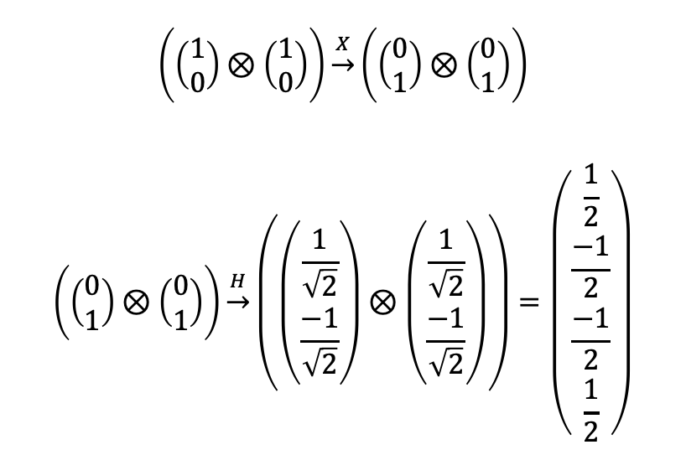

Pre-Processing
Target
register
X
H
H
M
Data
register
X
H
H
$$\left(\left(\begin{matrix}1 \\ 0\end{matrix}\right)⊗\left(\begin{matrix}1 \\ 0\end{matrix}\right)\right)\underset{→}{X}\left(\left(\begin{matrix}0 \\ 1\end{matrix}\right)⊗\left(\begin{matrix}0 \\ 1\end{matrix}\right)\right)$$
$$\left(\left(\begin{matrix}0 \\ 1\end{matrix}\right)⊗\left(\begin{matrix}0 \\ 1\end{matrix}\right)\right)\underset{→}{H}\left(\left(\begin{matrix}\frac{1}{\sqrt{2}} \\ \frac{−1}{\sqrt{2}}\end{matrix}\right)⊗\left(\begin{matrix}\frac{1}{\sqrt{2}} \\ \frac{−1}{\sqrt{2}}\end{matrix}\right)\right)=\left(\begin{matrix}\frac{1}{2} \\ \frac{−1}{2} \\ \frac{−1}{2} \\ \frac{1}{2}\end{matrix}\right)$$
$$H=\left(\begin{matrix}\frac{1}{\sqrt{2}} & \frac{1}{\sqrt{2}} \\ \frac{1}{\sqrt{2}} & \frac{−1}{\sqrt{2}}\end{matrix}\right)$$
Notes:
Boris
Begin with two qbits in discrete 0 state
Double bit flip gives us discrete 1 state
Double Hadamard gives us 50/50 superposition 0 -> this is the resulting matrix representation
BB function is applied
Double Hadamard takes us out of superposition
Target register is measured

Slide 29
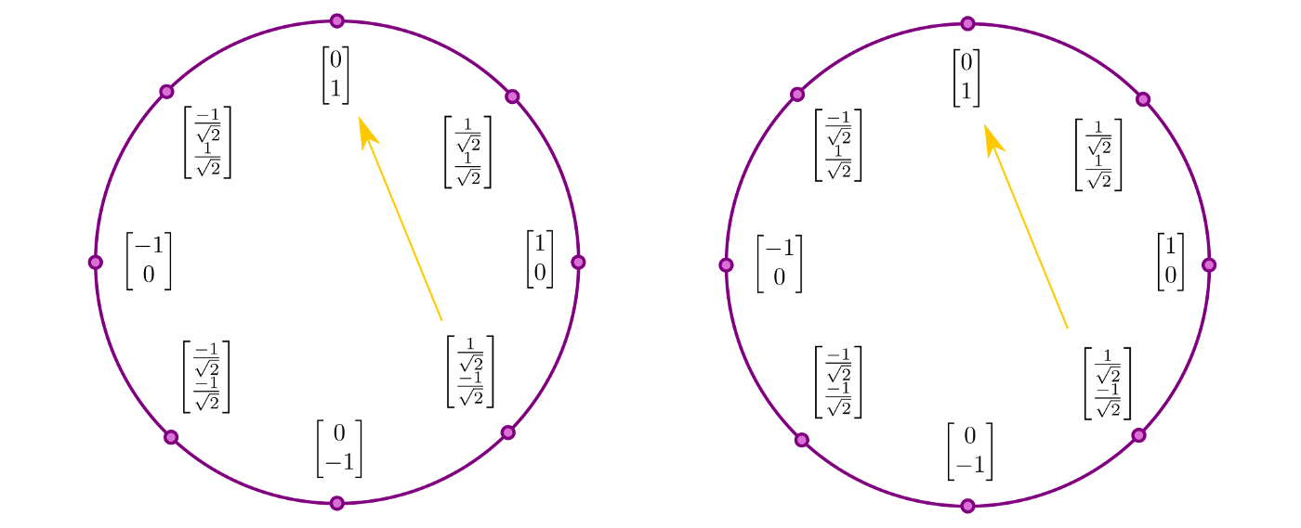
Constant-0
Data register
Target register
Notes:
Boris
Yellow arrow represents post-processing Hadamard
No operation in the black box, so we end with two qbits in discrete state 11

Slide 30
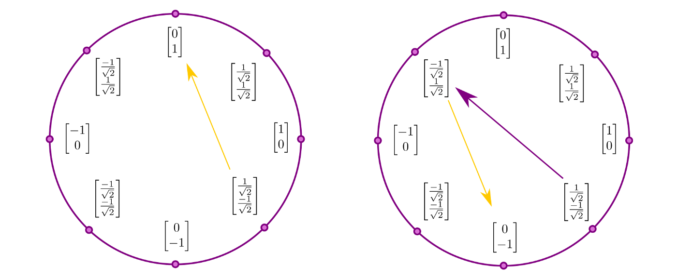
Constant-1
Data register
Target register
Notes:
Boris
Bit flip on the target register makes no effect on the outcome, both end up as discrete state 11, but with negative amplitude on the target register

Slide 31
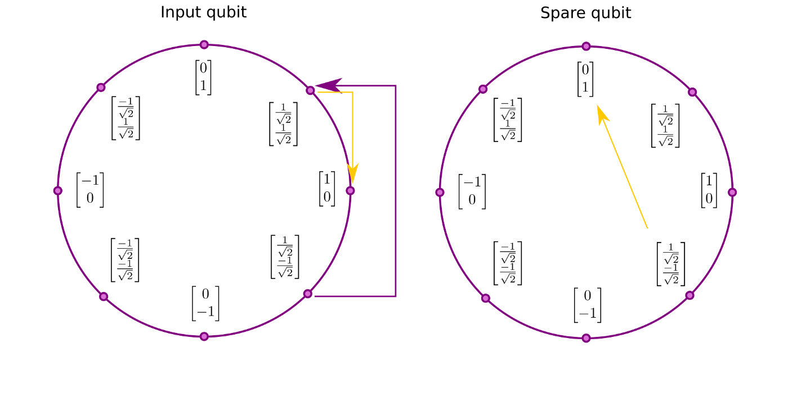
Identity
Target
register
Data
register
Data register
Target register
Notes:
Daniel
CNOT applied to the target register actually results in the data register changing relative phase – this isn’t what we just learned, but we will see soon why this happens.
We end up with two qbits in discrete states 01

Slide 32
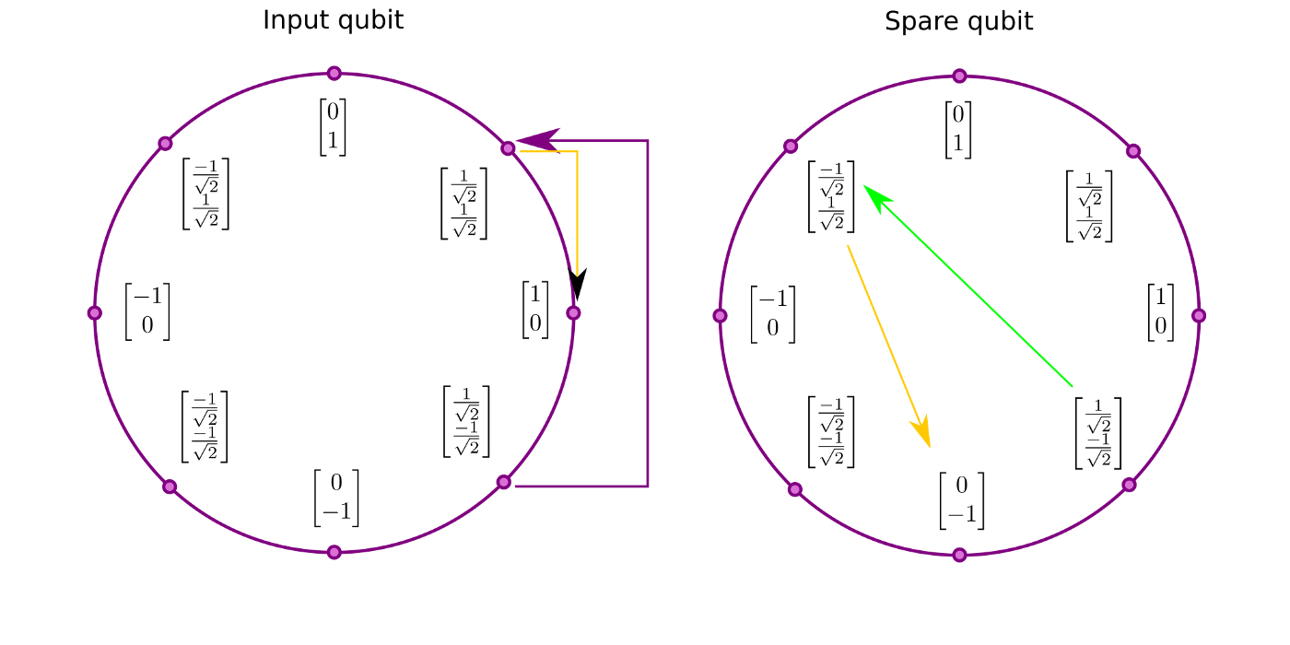
Negation
Target
register
X
Data
register
Data register
Target register
Notes:
Daniel
CNOT does the same as in the identity operation, but we apply a bit flip to target register
We still end up with two qbits in discrete states 01

Slide 33

Identity Math
Target
register
Data
register
$$\left(C\right)\left(\left(\begin{matrix}\frac{1}{\sqrt{2}} \\ \frac{−1}{\sqrt{2}}\end{matrix}\right)⊗\left(\begin{matrix}\frac{1}{\sqrt{2}} \\ \frac{−1}{\sqrt{2}}\end{matrix}\right)\right)=\frac{1}{2}\left(C\right)\left(\begin{matrix}1 \\ −1 \\ −1 \\ 1\end{matrix}\right)=\frac{1}{2}\left(\begin{matrix}1 \\ −1 \\ 1 \\ −1\end{matrix}\right)=\left(\left(\begin{matrix}\frac{1}{\sqrt{2}} \\ \frac{1}{\sqrt{2}}\end{matrix}\right)⊗\left(\begin{matrix}\frac{1}{\sqrt{2}} \\ \frac{−1}{\sqrt{2}}\end{matrix}\right)\right)=H|01⟩$$

Slide 34
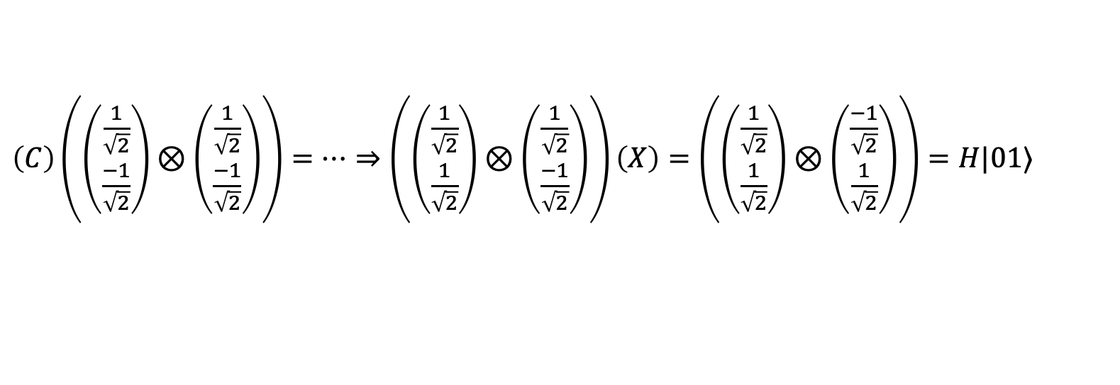
Negation Math
Target
register
X
Data
register
$\left(C\right)\left(\left(\begin{matrix}\frac{1}{\sqrt{2}} \\ \frac{−1}{\sqrt{2}}\end{matrix}\right)⊗\left(\begin{matrix}\frac{1}{\sqrt{2}} \\ \frac{−1}{\sqrt{2}}\end{matrix}\right)\right)=…⇒\left(\left(\begin{matrix}\frac{1}{\sqrt{2}} \\ \frac{1}{\sqrt{2}}\end{matrix}\right)⊗\left(\begin{matrix}\frac{1}{\sqrt{2}} \\ \frac{−1}{\sqrt{2}}\end{matrix}\right)\right)\left(X\right)=\left(\left(\begin{matrix}\frac{1}{\sqrt{2}} \\ \frac{1}{\sqrt{2}}\end{matrix}\right)⊗\left(\begin{matrix}\frac{−1}{\sqrt{2}} \\ \frac{1}{\sqrt{2}}\end{matrix}\right)\right)=H|01⟩$
Notes:
Bit flip is only applied to target register

Slide 35
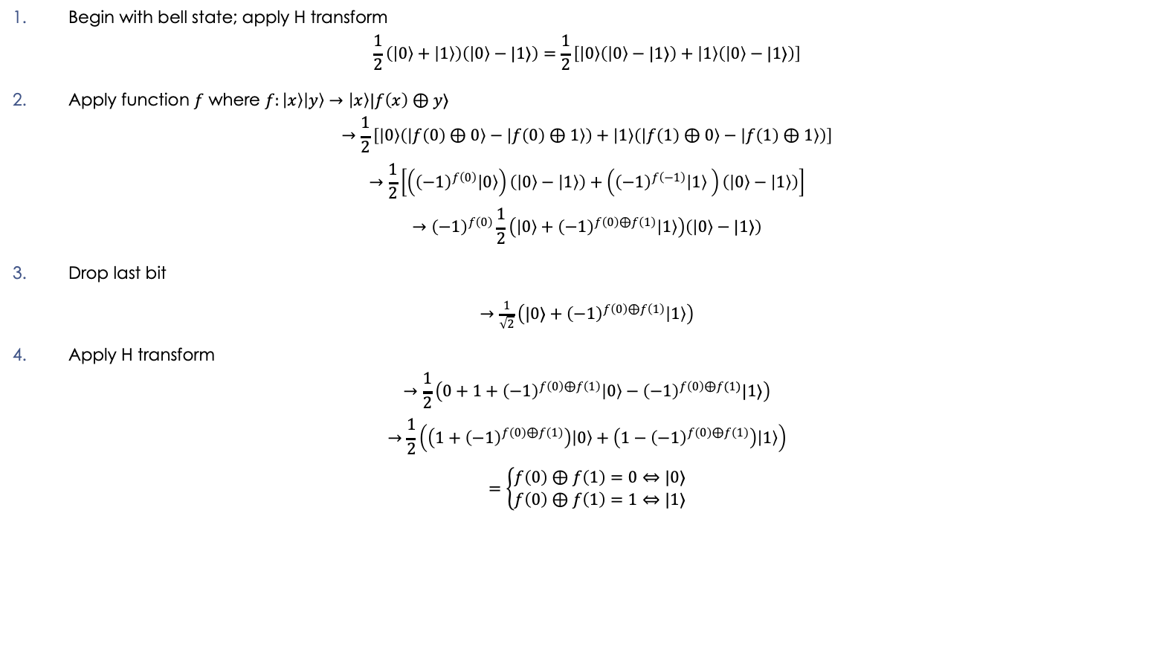
Deutsch Oracle Solution: Math
Begin with bell state; apply H transform
$$\frac{1}{2}\left(\left|0\right\rangle +\left|1\right\rangle \right)\left(\left|0\right\rangle −|1⟩\right)=\frac{1}{2}\left[\left|0\right\rangle \left(\left|0\right\rangle −|1⟩\right)+\left|1\right\rangle \left(\left|0\right\rangle −|1⟩\right)\right]$$
Apply function $f$ where $f:\left|x\right\rangle \left|y\right\rangle →\left|x\right\rangle |f\left(x\right)⊕y⟩$
$$→\frac{1}{2}\left[\left|0\right\rangle \left(\left|f\left(0\right)⊕0\right\rangle −\left|f\left(0\right)⊕1\right\rangle \right)+\left|1\right\rangle \left(\left|f\left(1\right)⊕0\right\rangle −\left|f\left(1\right)⊕1\right\rangle \right)\right]$$
$$→\frac{1}{2}\left[\left({\left(−1\right)}^{f\left(0\right)}\left|0\right\rangle \right)\left(\left|0\right\rangle −\left|1\right\rangle \right)+\left({\left(−1\right)}^{f\left(−1\right)}\left|1\right\rangle \right)\left(\left|0\right\rangle −\left|1\right\rangle \right)\right]$$
$$→{\left(−1\right)}^{f\left(0\right)}\frac{1}{2}\left(\left|0\right\rangle +{\left(−1\right)}^{f\left(0\right)⊕f\left(1\right)}\left|1\right\rangle \right)\left(\left|0\right\rangle −|1⟩\right)$$
Drop last bit
$→\frac{1}{\sqrt{2}}\left(|0⟩+{\left(−1\right)}^{f\left(0\right)⊕f\left(1\right)}\left|1\right\rangle \right)$
Apply H transform
$$→\frac{1}{2}\left(0+1+{\left(−1\right)}^{f\left(0\right)⊕f\left(1\right)}\left|0\right\rangle −{\left(−1\right)}^{f\left(0\right)⊕f(1)}|1⟩\right)$$
$$→\frac{1}{2}\left(\left(1+{\left(−1\right)}^{f\left(0\right)⊕f\left(1\right)}\right)\left|0\right\rangle +\left(1−{\left(−1\right)}^{f\left(0\right)⊕f\left(1\right)}\right)\left|1\right\rangle \right)$$
$$=\left\{\begin{matrix}f\left(0\right)⊕f\left(1\right)=0⇔|0⟩ \\ f\left(0\right)⊕f\left(1\right)=1⇔|1⟩\end{matrix}\right.$$

Slide 36
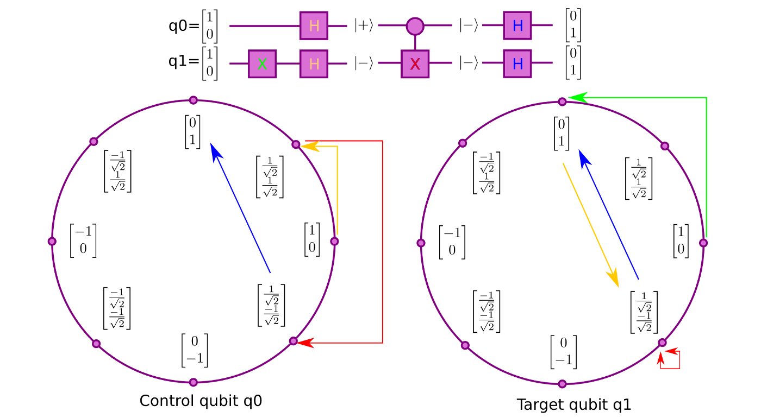
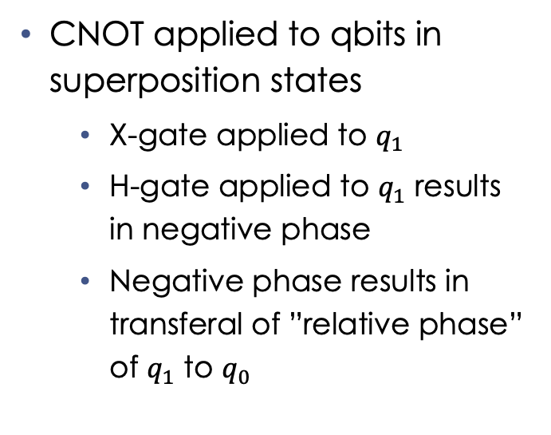
Quantum Phenomena: Phase Kickback
CNOT applied to qbits in superposition states
X-gate applied to $q_{1}$
H-gate applied to $q_{1}$ results in negative phase
Negative phase results in transferal of ”relative phase” of $q_{1}$ to $q_{0}$
Notes:
To understand why CNOT didn’t behave as anticipated, we need to talk about Phase Kickback
We applied CNOT to qbits in superposition states
Lets look at the quantum circuit
Reduced notation: |+> is H applied to 0, |-> is H applied to 1
Let’s call them x-gates now instead of bit flips
X-gate to q1 followed by h-gate gives us negative phase
Negative phase results in transferal of q1’s “relative phase” to q0
When taken out of superposition, results in two qbits of discrete state 1

Slide 37
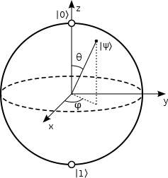
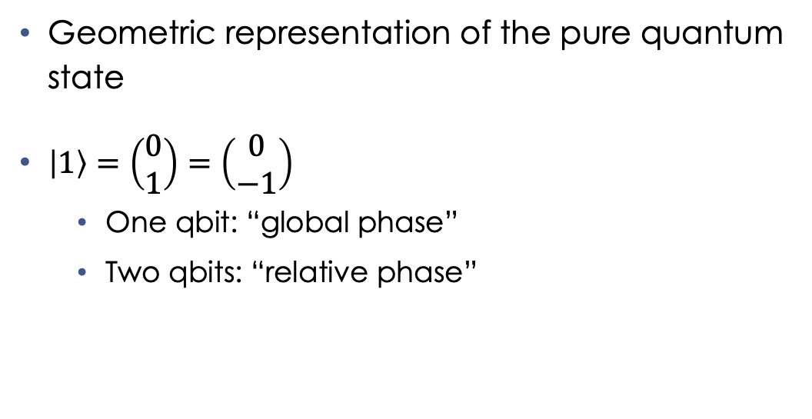
Quantum Phenomena: Bloch Sphere
Geometric representation of the pure quantum state
$\left|1\right\rangle =\left(\begin{matrix}0 \\ 1\end{matrix}\right)=\left(\begin{matrix}0 \\ −1\end{matrix}\right)$
One qbit: “global phase”
Two qbits: “relative phase”
Notes:
Let’s take our unit circle and make it a bit more technical
When we’re talking about a one qbit system

Slide 38
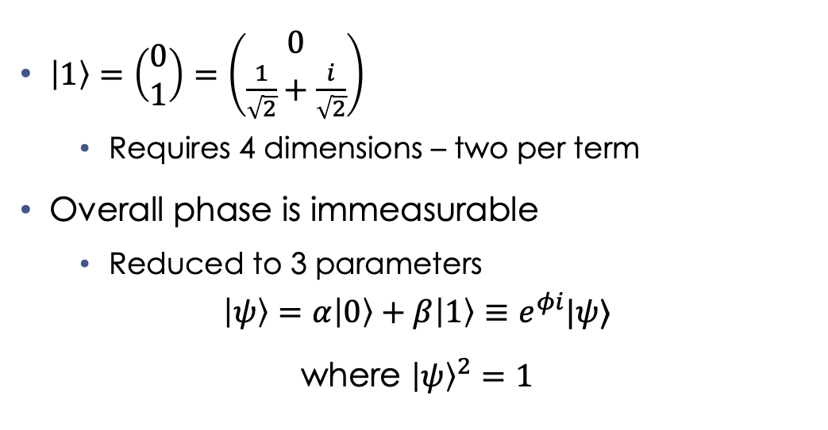
Quantum Phenomena: Representation
$\left|1\right\rangle =\left(\begin{matrix}0 \\ 1\end{matrix}\right)=\left(\begin{matrix}0 \\ \frac{1}{\sqrt{2}}+\frac{i}{\sqrt{2}}\end{matrix}\right)$
Requires 4 dimensions – two per term
Overall phase is immeasurable
Reduced to 3 parameters
$$\left|ψ\right\rangle =α\left|0\right\rangle +β\left|1\right\rangle ≡e^{φi}|ψ⟩$$
where ${\left|ψ\right\rangle }^{2}=1$

Slide 39


Quantum Phenomena: Uncertainty
$${\left|x\right|}^{2}=\overline{x}x→\left|x\right|=\sqrt{x\overline{x}}$$
$$\left|ψ\right\rangle =α\left|0\right\rangle +β\left|1\right\rangle ≡e^{φi}|ψ⟩$$
$$ℙ\left(x\right)={\left|\left|αψ_{1}+βψ_{2}\right|\right|}^{2}$$
$$={\left|\left|α\right|\right|}^{2}{\left|\left|ψ_{1}\right|\right|}^{2}+{\left|\left|β\right|\right|}^{2}{\left|\left|ψ_{2}\right|\right|}^{2}+\overline{α}\overline{ψ_{1}}βψ_{2}+αψ_{1}\overline{β}\overline{ψ_{2}}$$
$$→ℙ_{1}+ℙ_{2}+I$$
Notes:
Probability in our sup of psi1 and psi2 is equal to norm^2 of wavefunction
This is equivalent to (read equation), where bar is complex conjugation
First term alpha^2 psi1^2 is first term of alpha psi1 which gives us P1
Second term beta^2 psu2^2 is the second term of beta psi2, which gives us P1
We have no way to understand the interference terms in terms of probabilities of psi1 or psi2, so we represent them with I
The superposition principle corrects our classical notion of probability with the interference terms.
Since the norm^2 are real and nonnegative, the interference terms are real as they are complex conjugate, but not necessarily nonnegative
Bell’s inequality tells us that probabilities are additive, but in quantum mechanics, the probability is the norm^2 of the wavefunction. Meaning the wavefunctions add, not the probabilities

Slide 40
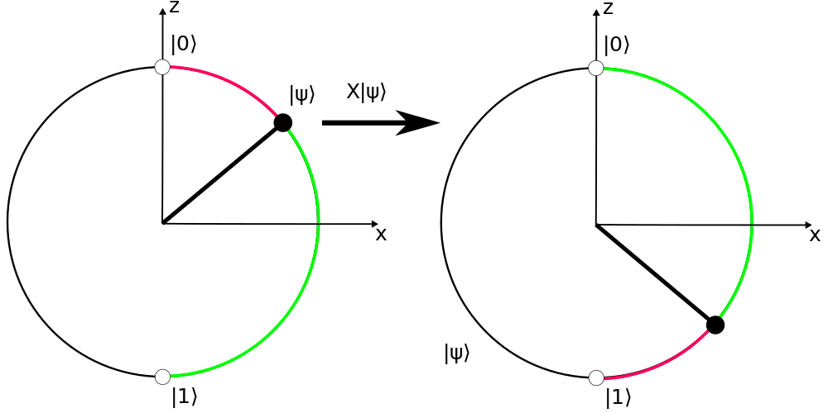
Quantum Phenomena: X-Gate
X-gate is negation around the x-axis
Probabilities are swapped
Notes:
Go back to our idea of the bloch sphere, and the unit circle as a necessary compression of it

Slide 41

Quantum Phenomena: Z-Gate
$$Z=\left(\begin{matrix}1 & 0 \\ 0 & −1\end{matrix}\right)$$
Z-gate is negation around the z-axis
Relative phase change

Slide 42

Quantum Phenomena: Linear Transformations
All gates are special linear combinations of rotations around a Bloch sphere
Hadamard: $\frac{π}{2}$ rotation around y-axis, $π$ rotation around x-axis
X-gate: $π$ rotation around z-axis

Slide 43
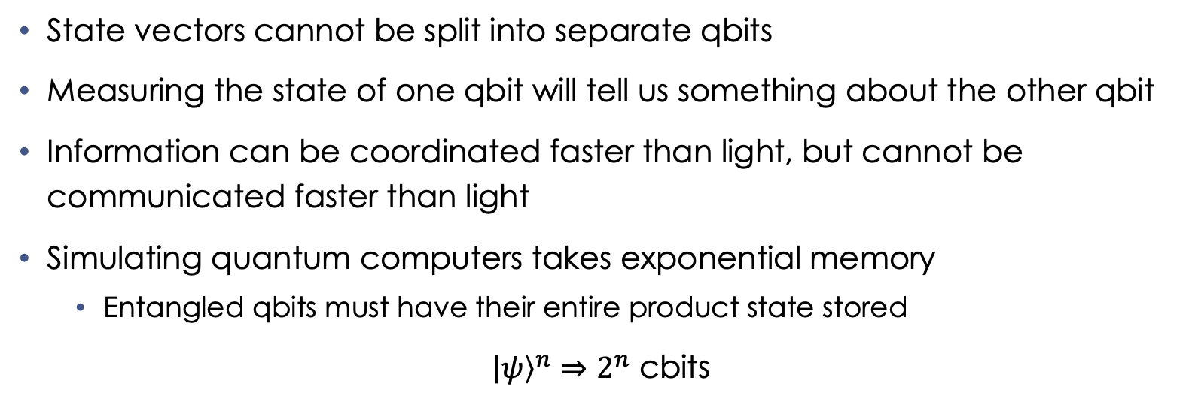
Quantum Phenomena: Entanglement (cont.)
State vectors cannot be split into separate qbits
Measuring the state of one qbit will tell us something about the other qbit
Information can be coordinated faster than light, but cannot be communicated faster than light
Simulating quantum computers takes exponential memory
Entangled qbits must have their entire product state stored
${\left|ψ\right\rangle }^{n}⇒2^{n}$ cbits

Slide 44
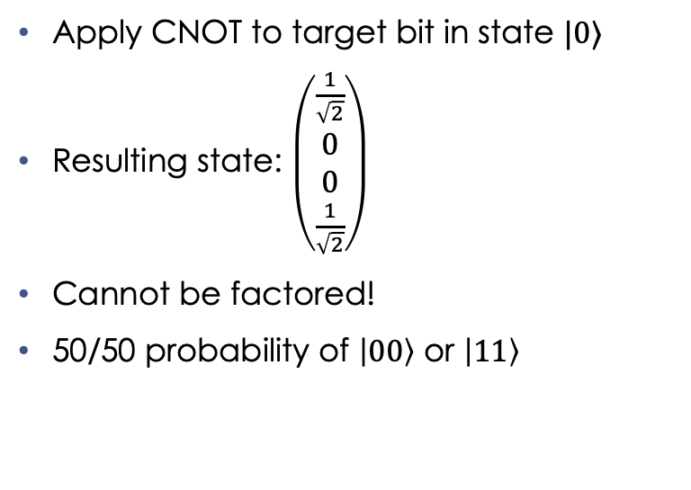
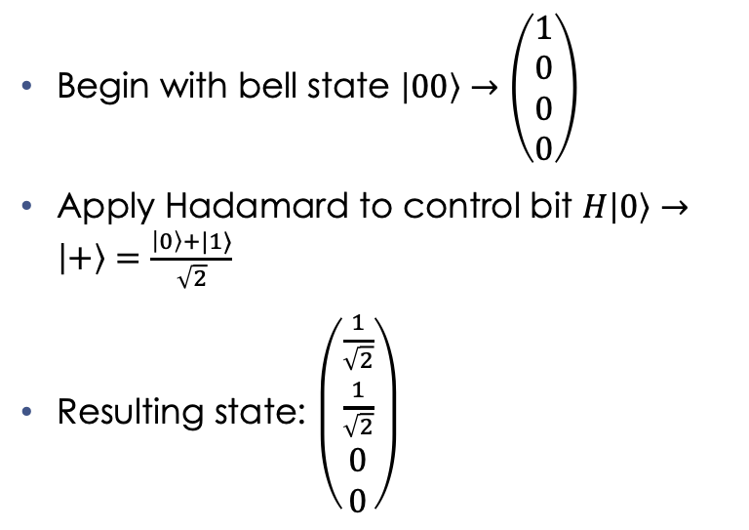
Quantum Phenomena: Entanglement
Begin with bell state $\left|00\right\rangle →\left(\begin{matrix}1 \\ 0 \\ 0 \\ 0\end{matrix}\right)$
Apply Hadamard to control bit $H\left|0\right\rangle →\left|+\right\rangle =\frac{\left|0\right\rangle +|1⟩}{\sqrt{2}}$
Resulting state: $\left(\begin{matrix}\frac{1}{\sqrt{2}} \\ \frac{1}{\sqrt{2}} \\ 0 \\ 0\end{matrix}\right)$
Apply CNOT to target bit in state $|0⟩$
Resulting state: $\left(\begin{matrix}\frac{1}{\sqrt{2}} \\ 0 \\ 0 \\ \frac{1}{\sqrt{2}}\end{matrix}\right)$
Cannot be factored!
50/50 probability of $\left|00\right\rangle$ or $\left|11\right\rangle$

Slide 45
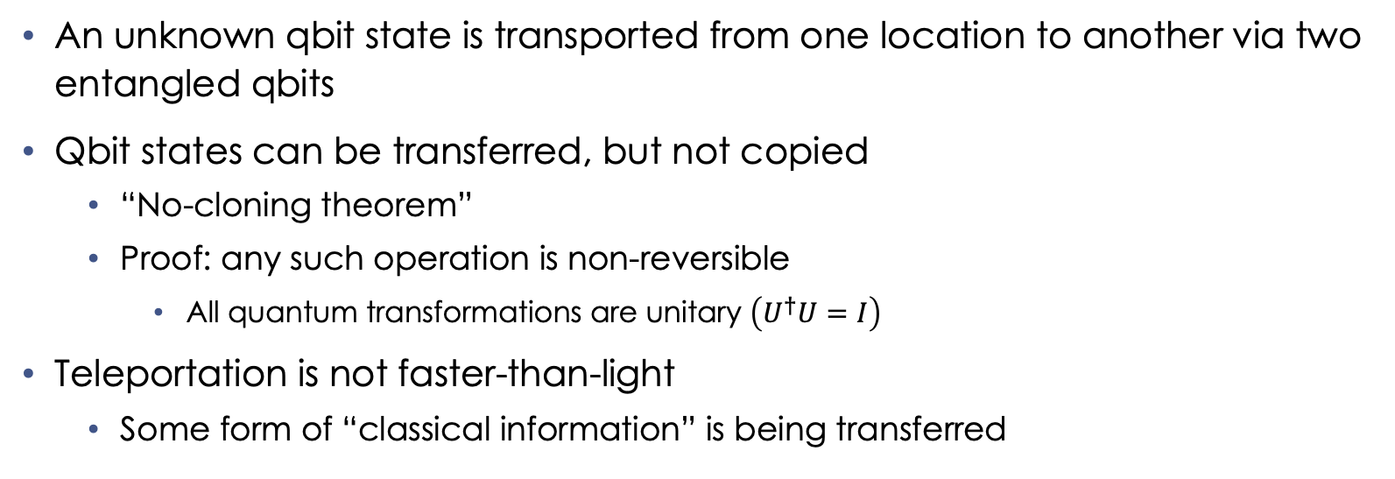
Quantum Phenomena: Transportation
An unknown qbit state is transported from one location to another via two entangled qbits
Qbit states can be transferred, but not copied
“No-cloning theorem”
Proof: any such operation is non-reversible
All quantum transformations are unitary $\left(U^{†}U=I\right)$
Teleportation is not faster-than-light
Some form of “classical information” is being transferred
Notes:
Unitary: conjugate transpose is also its inverse

Slide 46
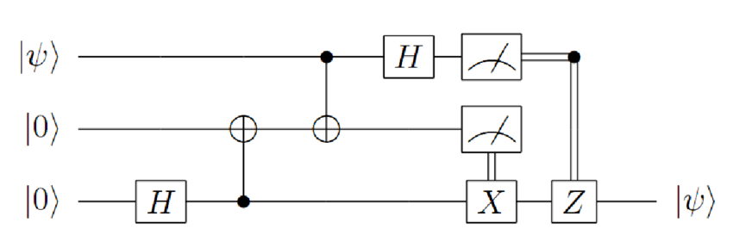


Quantum Phenomena: Transportation (cont.)
$$Z=\left(\begin{matrix}1 & 0 \\ 0 & −1\end{matrix}\right)$$
All qbits are entangled
${|q}_{1}⟩=\left|q_{2}\right\rangle =|0⟩$
${|q}_{0}⟩=\left|ψ\right\rangle$
Notes:
Bottom two cubits are entangled, then separated. Alice has top two, Bob has bottom one
Alice wants to send one qbit to bob. She then entangles her qbit with the one from Bob, resulting in 3 entangled qbits
Alice then puts her qbit through a Hadamard, and then measures both bits that she will send to Bob
Measurement of middle qbit determines whether Bob applies X-gate, while measurement of top qbit determines whether Bob applies phase transformation (z-gate, rotation around z-axis of Bloch sphere. Changes relative phase, but not probability)
Bob will result with the value of Alice’s qbit

Slide 47
Deutsch Oracle Code Demo: Cirq

