Slide 1
Numerical Integrators ∩ Molecular Dynamics
Michael Servis
Clark Group Meeting
4/26/2018

Slide 2
Outline of Talk
Newton’s equations of motion and molecular dynamics
Numerical integrators—naïve approach
Liouville’s theorem
Symplectic condition
Symplectic integrators—better approach

Slide 3
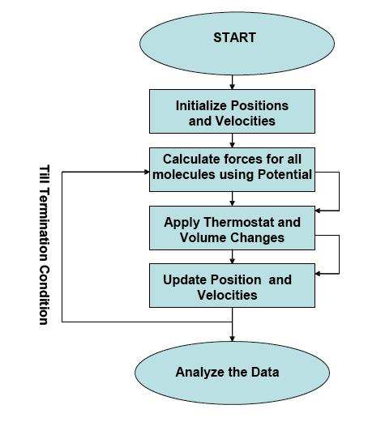
MD Flow Chart
Numerical integration used here

Slide 4
Newton’s Equations of Motion in MD
Forces obtained from potential energy description of interparticle interactions
Itself a summation over all (interacting) pairs of particles
Sum over N particles in system, calculate force, adjust q_{i} and p_{i}
Using i as index for particles on this slide only, not generalized coordinates of which there are 3N
Dot notation for time derivatives

Slide 5
Hamiltonian Formulation
For i generalized coordinates, q, and corresponding momenta, p
Results applicable to high dimensionality (3N), but derivation for low dimensionality in this talk for clarity

Slide 6
Trajectories in Phase Space
Can consider points in phase space, z, as trajectories
Defined by values for all p and q
Trajectory uniquely described by point in phase space!

Slide 7
Numerical Integration Schemes
How to propagate the trajectory* defined by the set of q_{i} and p_{i} in time?
Given that we know
for all i at time t₀.
*estimation of “true” trajectory, even if interparticle potentials are exact

Slide 8
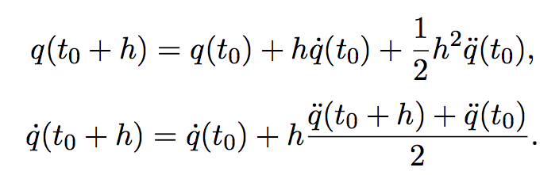
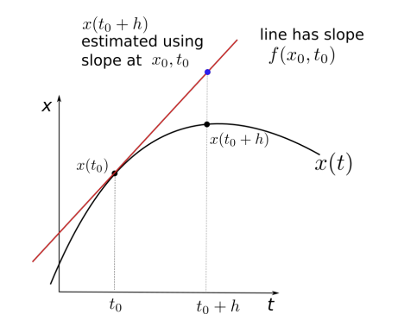
Euler’s Method
Obvious approach: use truncated Taylor expansion to get new q for t=t₀+h
This is second order Euler:

Slide 9
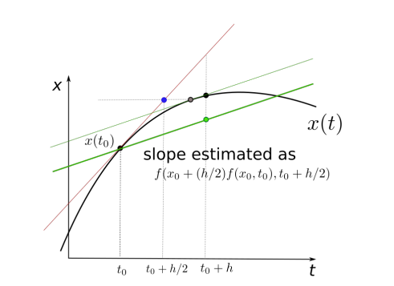
Runge-Kutta Methods
More accurate estimation than Euler’s method using midpoint(s) of interval h
Expandable to different orders (more midpoint estimates, which can be weighted differently)

Slide 10
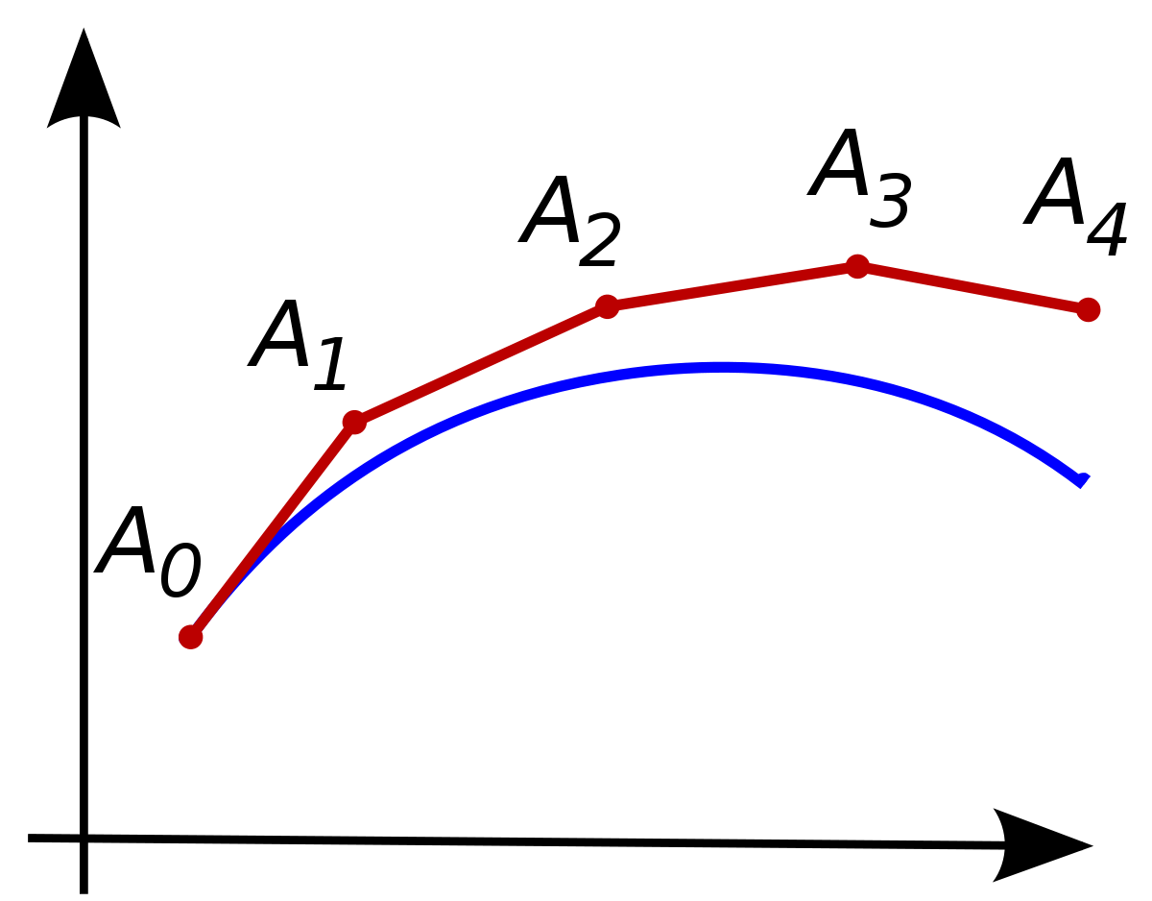
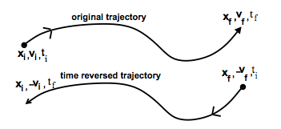
Time Reversibility
An integration algorithm is not necessary time reversible
Does not contain that symmetry inherent in Newton’s equations of motion

Slide 11
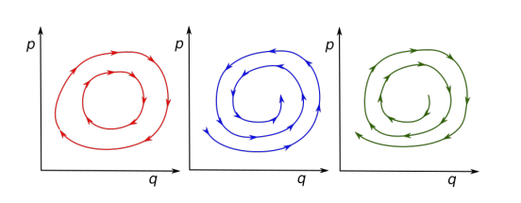
Integrators and Energy Conservation
The real problem with non-time reversible methods is that they don’t conserve the Hamiltonian
Short term and long term energy conservation (accuracy)… not the same
MD relies on long-term accuracy to estimate an ensemble with ergodicity

Slide 12
Importance for Molecular Dynamics
Changes to phase space volume of system results in long-term energy drift of that system… the Hamiltonian is not conserved
Problem for systems with long time evolution
For classical Hamiltonian mechanics, density of trajectories in phase space is constant (Liouville’s theorem)
For a time-independent Hamiltonian and conservative forces
This applies to description of energy in NVE ensemble molecular dynamics simulations

Slide 13
Liouville’s Theorem
Density of trajectories in phase space is constant for NVE molecular dynamics
Essential to ensure energy conservation
Derivation to follow!

Slide 14
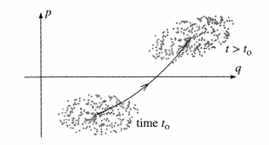
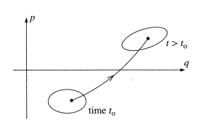
Time Evolution of Trajectories
Time evolution of trajectories near each other in phase space and the evolution of their enclosing hypervolume in time

Slide 15
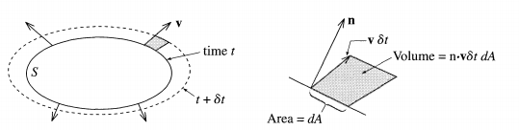
Time Evolution of Trajectory Volume
Change in phase space volume* during progression in time
*works for arbitrary coordinate dimensionality

Slide 16
Divergence Theorem
Divergence: sum of diagonal elements of the Jacobian of a vector
Surface integral transformed into volume integral

Slide 17
Small Volume Approximation
If V is small enough that the divergence of v is constant throughout V
Outward flow of trajectories per volume

Slide 18
Liouville’s Theorem
Change in volume* of trajectories (and therefore density) is zero!
“Incompressible flow”
*although not shape

Slide 19
Transformations and Symplecticity
Application to coordinate and momenta transformations… as in integrators
Is a condition which, among other properties, describes a canonical transformation in phase space which is area-preserving… which propagation of true NVE trajectories is!
Now providing mathematical description of the symplectic condition

Slide 20
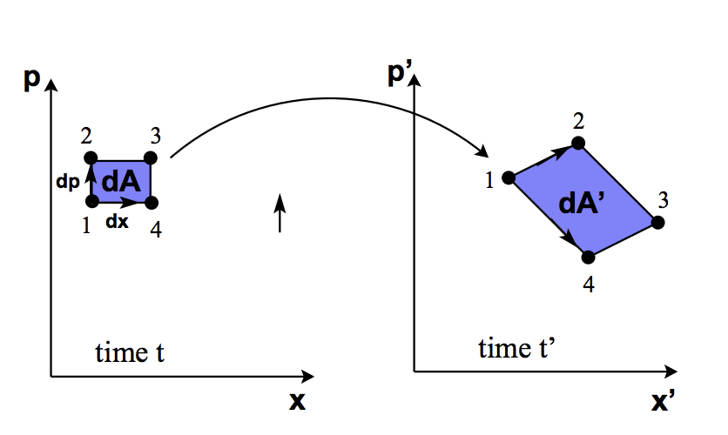
Canonical Transformations
Canonical transformation of p and q in phase space into P and Q preserves equations of motion and is therefore area preserving (from Liouville’s theorem)
A transformation is canonical if the Jacobian matrix of the transformation satisfies the symplectic condition

Slide 21
Symplectic Condition
Preservation of equations of motion

Slide 22
Symplectic Condition
Coordinate transformation and transformed equations of motion
Jacobian of transformation matrix, M

Slide 23
Symplectic Condition
If new coordinates ξ have canonical form, M will satisfy symplectic condition

Slide 24
Time Evolution is Symplectic
We showed this earlier, it can also be resolved with the symplectic criterion just defined
For sufficiently small 𝛿t

Slide 25
Symplectic Integrators
If actual time evolution of a trajectory is symplectic, a time-evolving numerical integrator should be symplectic as well to preserve this feature of the transformation
Area of phase space between coordinates differs by factor of det ω, which must be unity for symplectic integrator to preserve area
This is true for Verlet propagation

Slide 26
Verlet Algorithm
Order three derivatives cancel, error in order 4
Velocities not used! Calculated separately from change in position.

Slide 27
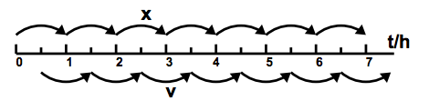
Leap-Frog Verlet Algorithm
Variant of Verlet which is more efficient to implement, velocities and positions not computed for the same time step at the same time

Slide 28
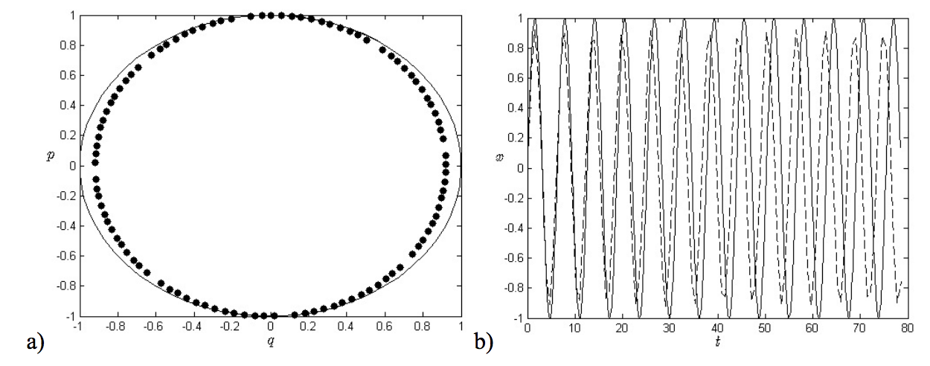
Well… Pseudo-Hamiltonian
Simulation trajectory follows actual trajectory closely
Conserved pseudo-Hamiltonian slightly different than actual Hamiltonian

Slide 29
Notes on Accuracy
Truncation error from using computer unavoidable
Possible to implement higher accuracy
Symplectic Runge-Kutta
Predictor-corrector schemes
Generally better served by decreasing h
Actually trying to statistically generate ensemble of configurations for given NVE macrostate
Propagating the “true” trajectory not necessary for MD
Is necessary for other applications!

Slide 30
Conclusions
Propagation of Newton’s equations of motion for molecular dynamics requires care: stepwise accuracy is not sufficient
The property that phase space density for time evolution canonical transformations is called symplecticity… and is required for good MD integrators
Accurate MD integrators should satisfy the symplectic condition

