Slide 1
ByteCode Velocity
Saurav Sitoula
Rohan rajbhandari
Aashik Bhattarai
Chiris young

Slide 2
Introduction
Our project is about creating a comprehensive web platform that integrates listings for events, jobs, and accommodations into a single, user-friendly online environment. This platform is designed to simplify how users access, interact with, and share information.

Slide 3
Problem Statement
Information Overload: Sifting through vast amounts of data to find relevant listings.
Fragmentation: The need to use multiple services for different needs complicates the search process.
Lack of Community: Many platforms focus on transactions over interactions, missing opportunities for users to connect and support each other.
This complexity leads to frustration, missed opportunities, and a sense of isolation in the digital space.

Slide 4
Solution
Unified Listings
All-in-one spot for events, jobs, and housing.
Switch seamlessly between categories.
Instant Postings
Post listings in a flash, hassle-free.
Easy edit and update on the go.

Slide 5
User Story and Majority components

Slide 6
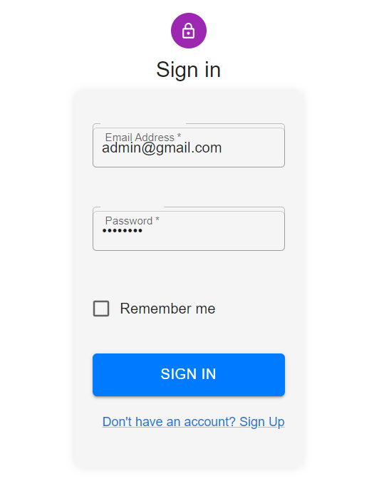
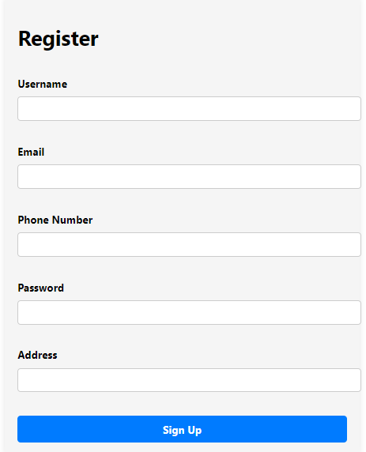
As a user i want to be able to create account and register to the system so that i can login and use the system as a registered user.

Slide 7
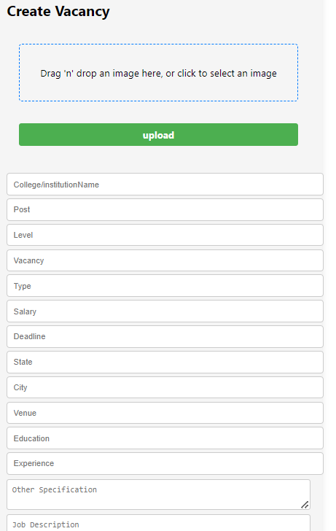
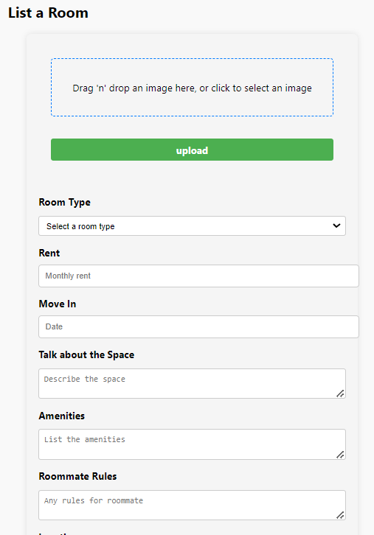
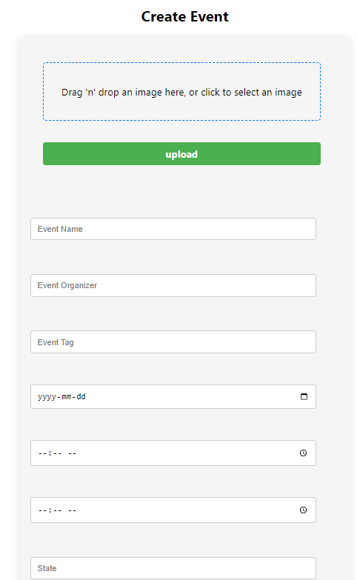
As a user i want to be able to create job, accommodation and event postings so that other users can view any postings that user create.

Slide 8
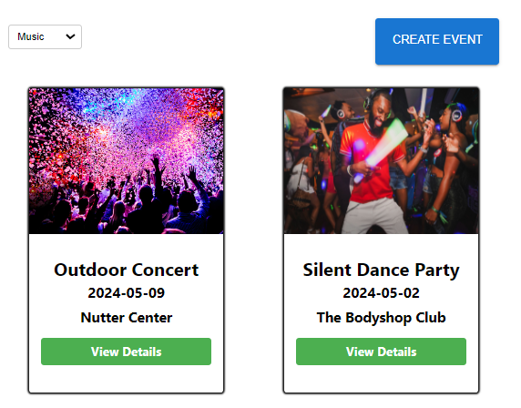
As a user i want to filter the event posting based on the tags provided so that I can search the post i want easily.

Slide 9
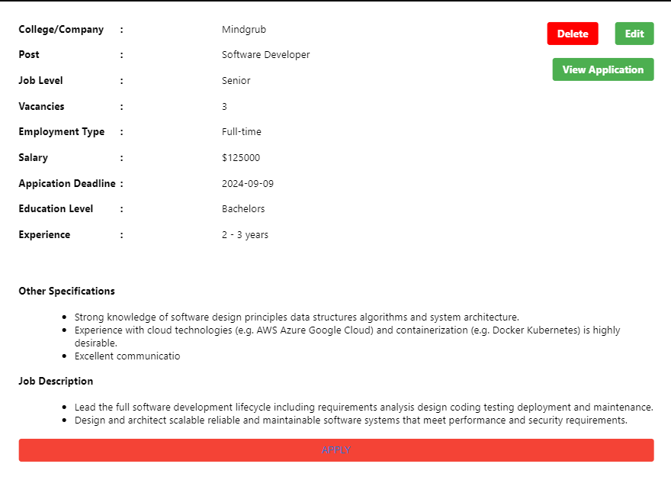
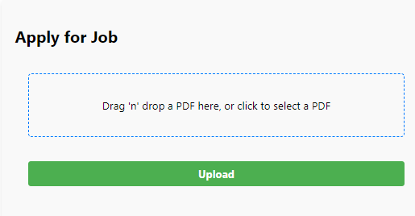
As a user I want to apply for the jobs i see in the posts so that i can get job opportunities.

Slide 10
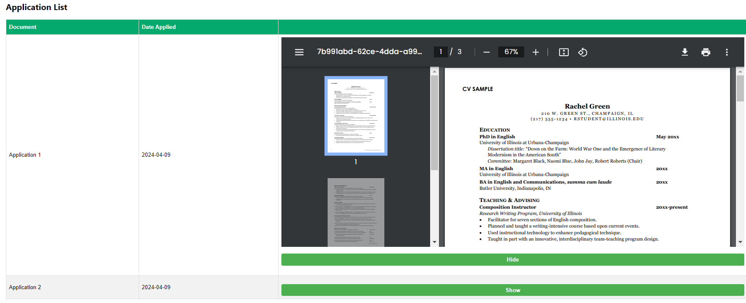
As a user I want to see the job applications that are made in the vacancy I created so that i can hire a candidate for my institution.

Slide 11
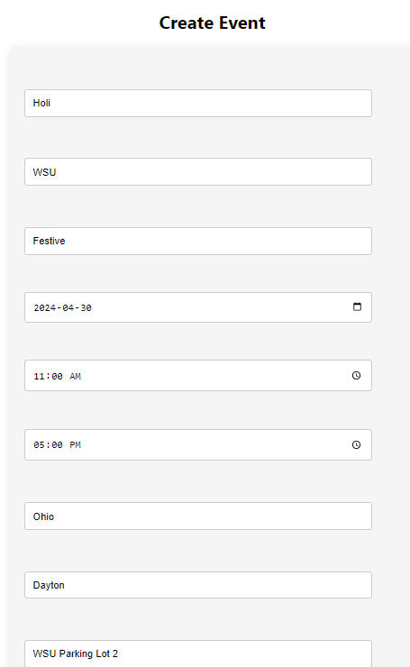
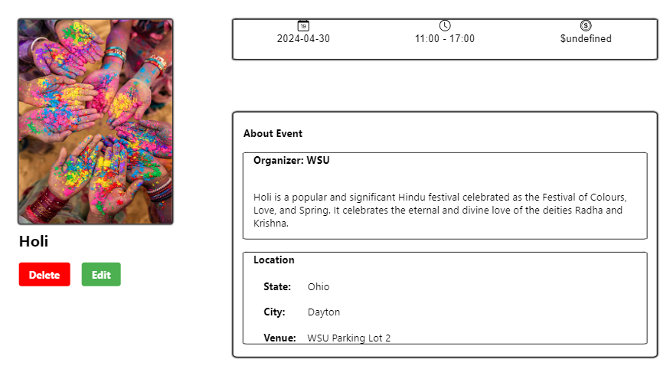
As a user i want to be able to edit the information that i provided while creating the postings so that i can fix any wrong information that i might have provided.

Slide 12
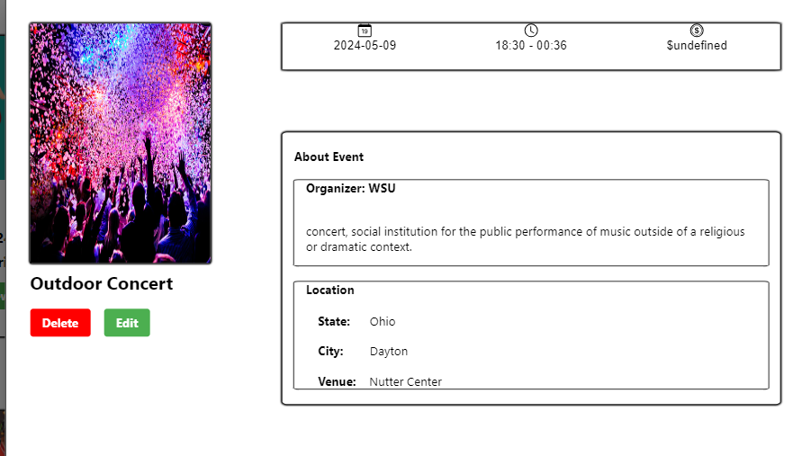
As a user i want to be able to delete the posting that i created which are don't think are needed anymore so that other users wont be able to see those irrelevant postings anymore.

Slide 13
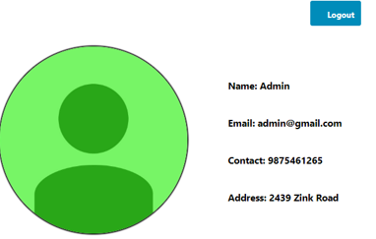
As a user i want to be able to logout of the application once i have completed my task so that i can safely stop using the application without risk of my identity being stolen.

Slide 14
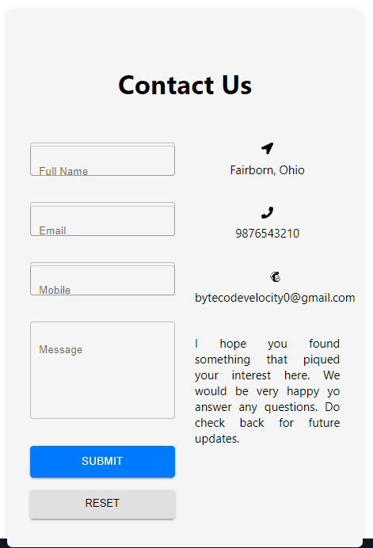
As a User i want to be able to send message to the development team so that i can aware them if there are any issues or if i have any inquiry.

Slide 15
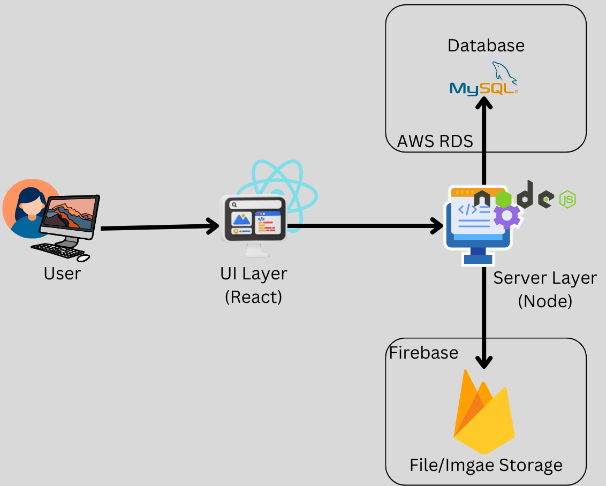
Architecture Overview

Slide 16
Frontend: Technology: React Role: Responsible for presenting the user interface and handling client-side logic. Communication: Makes API calls to the backend using HTTP protocols through REST API. Backend: Technology: Node.js Role: Processes API requests, handles server logic, authentication, and authorization. Communication: Performs database operations with the MySQL database. Database: Technology: MySQL hosted on AWS RDS Role: Stores, retrieves, and manages application data securely and efficiently. File Storage: Technology: Firebase Storage Role: Manages storage and retrieval of files and images for the application. Interaction: Allows direct uploads and downloads from the frontend for optimized performance and provides download URL of uploaded files.

Slide 17
Requirements and Design elements
Registration
The system shall provide a registration mechanism for new users.
Users shall be able to provide essential information to register (e.g., email, password).
Login
Registered users shall be able to log in to the system using their credentials.
The system shall authenticate users upon login.

Slide 18
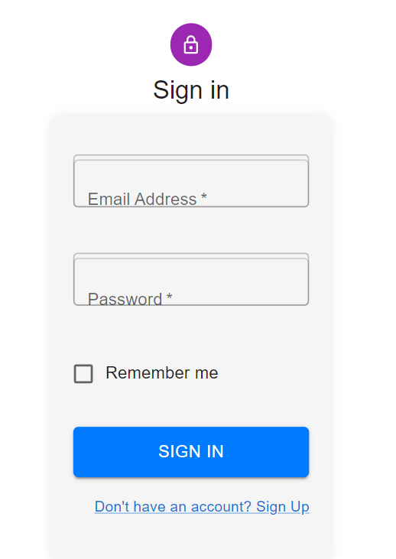
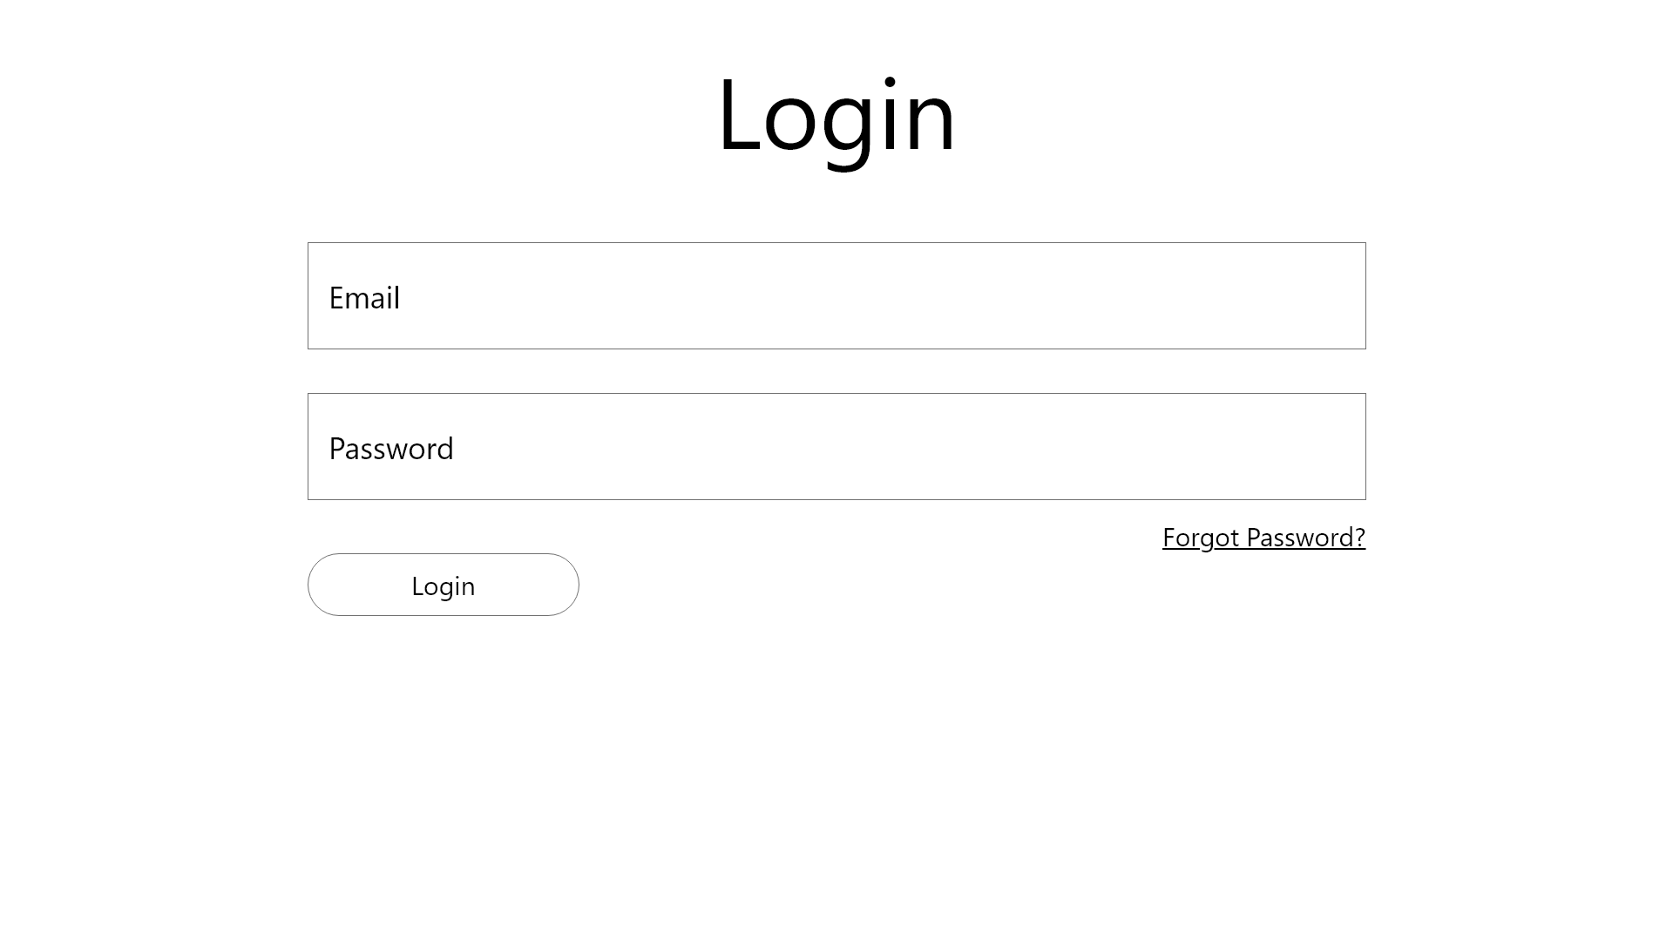

Slide 19
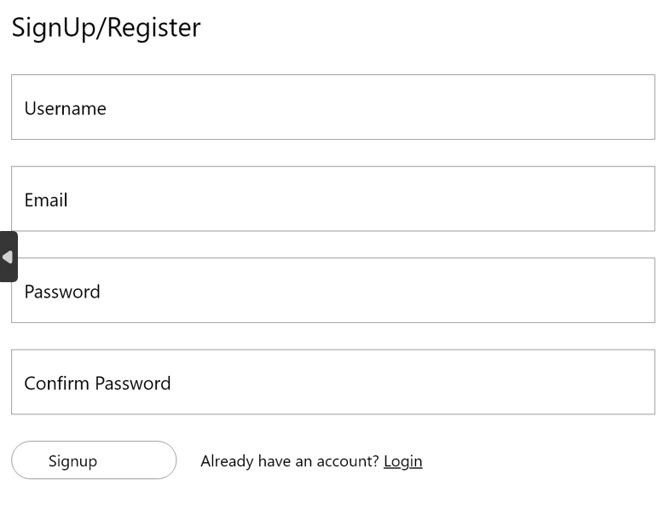
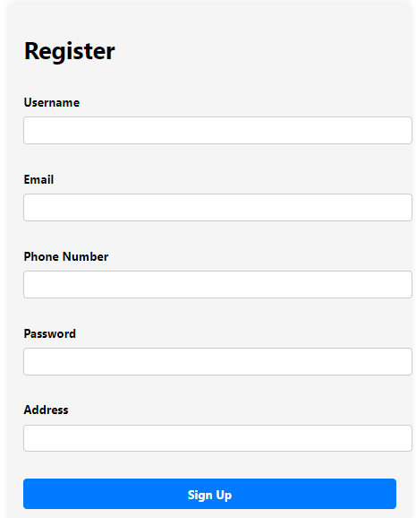
User Registration

Slide 20
Requirements and Design elements
Event Posting
Any registered user shall be able to create a post for an event.
The user shall be able to give information about the event such as name, location, date, time, organizer, venue of the event when creating the event posting.
Event posts shall include tags related to the event. The tags for the event can be event type, etc.
Job Posting
Any registered user shall be able to create a job posting.
The user shall be able to give information about the job such as name of hiring organization, level, salary, deadline, location, as well as education and experience requirements of the event when creating the job posting.
Job postings shall include tags related to the job. The tags may include part time, currently open, full time, negotiable/ non-negotiable salary.

Slide 21
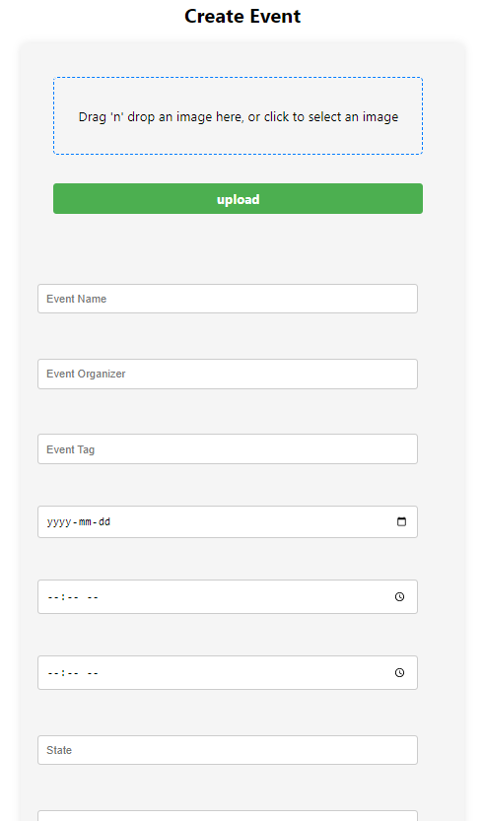
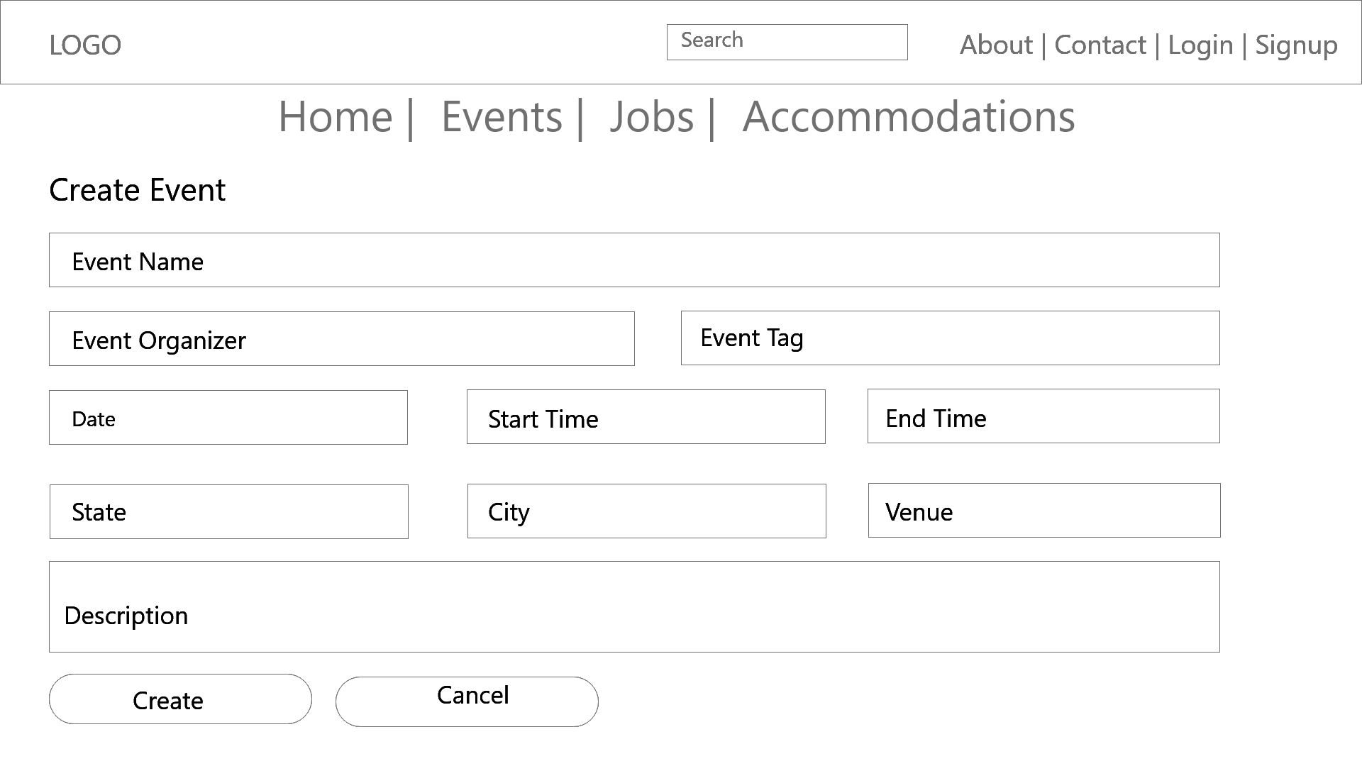
Create Event

Slide 22
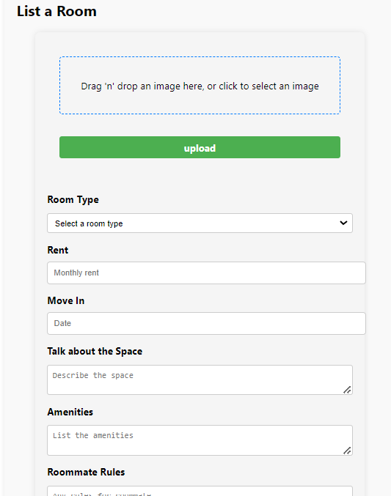
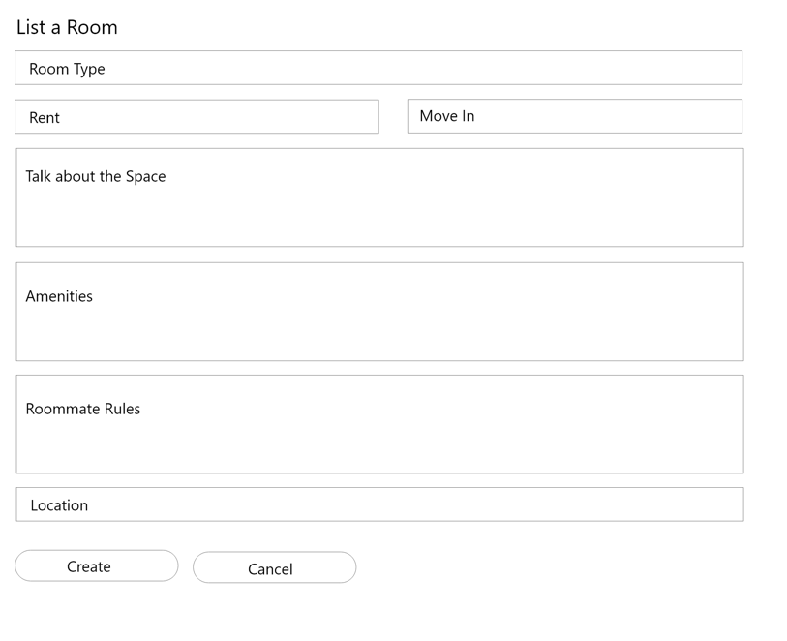
Create Accommodation

Slide 23
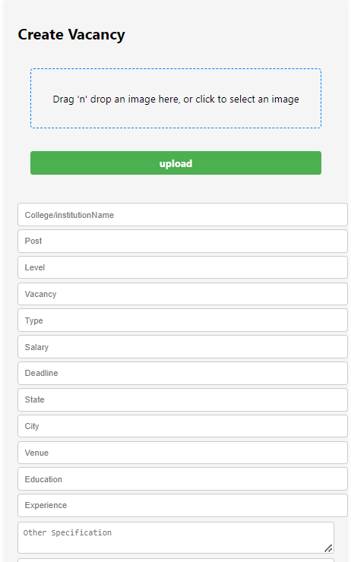
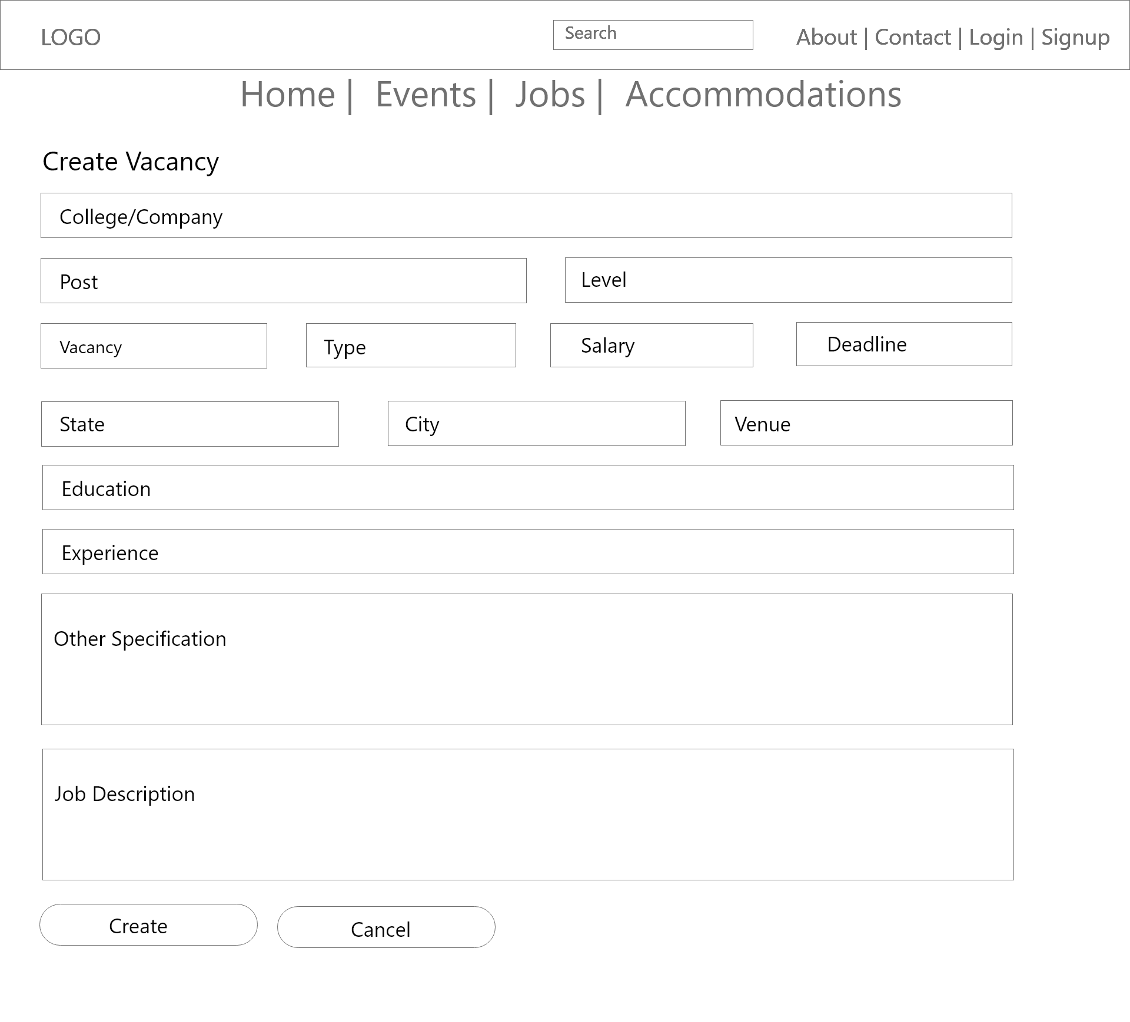
Create Job

Slide 24
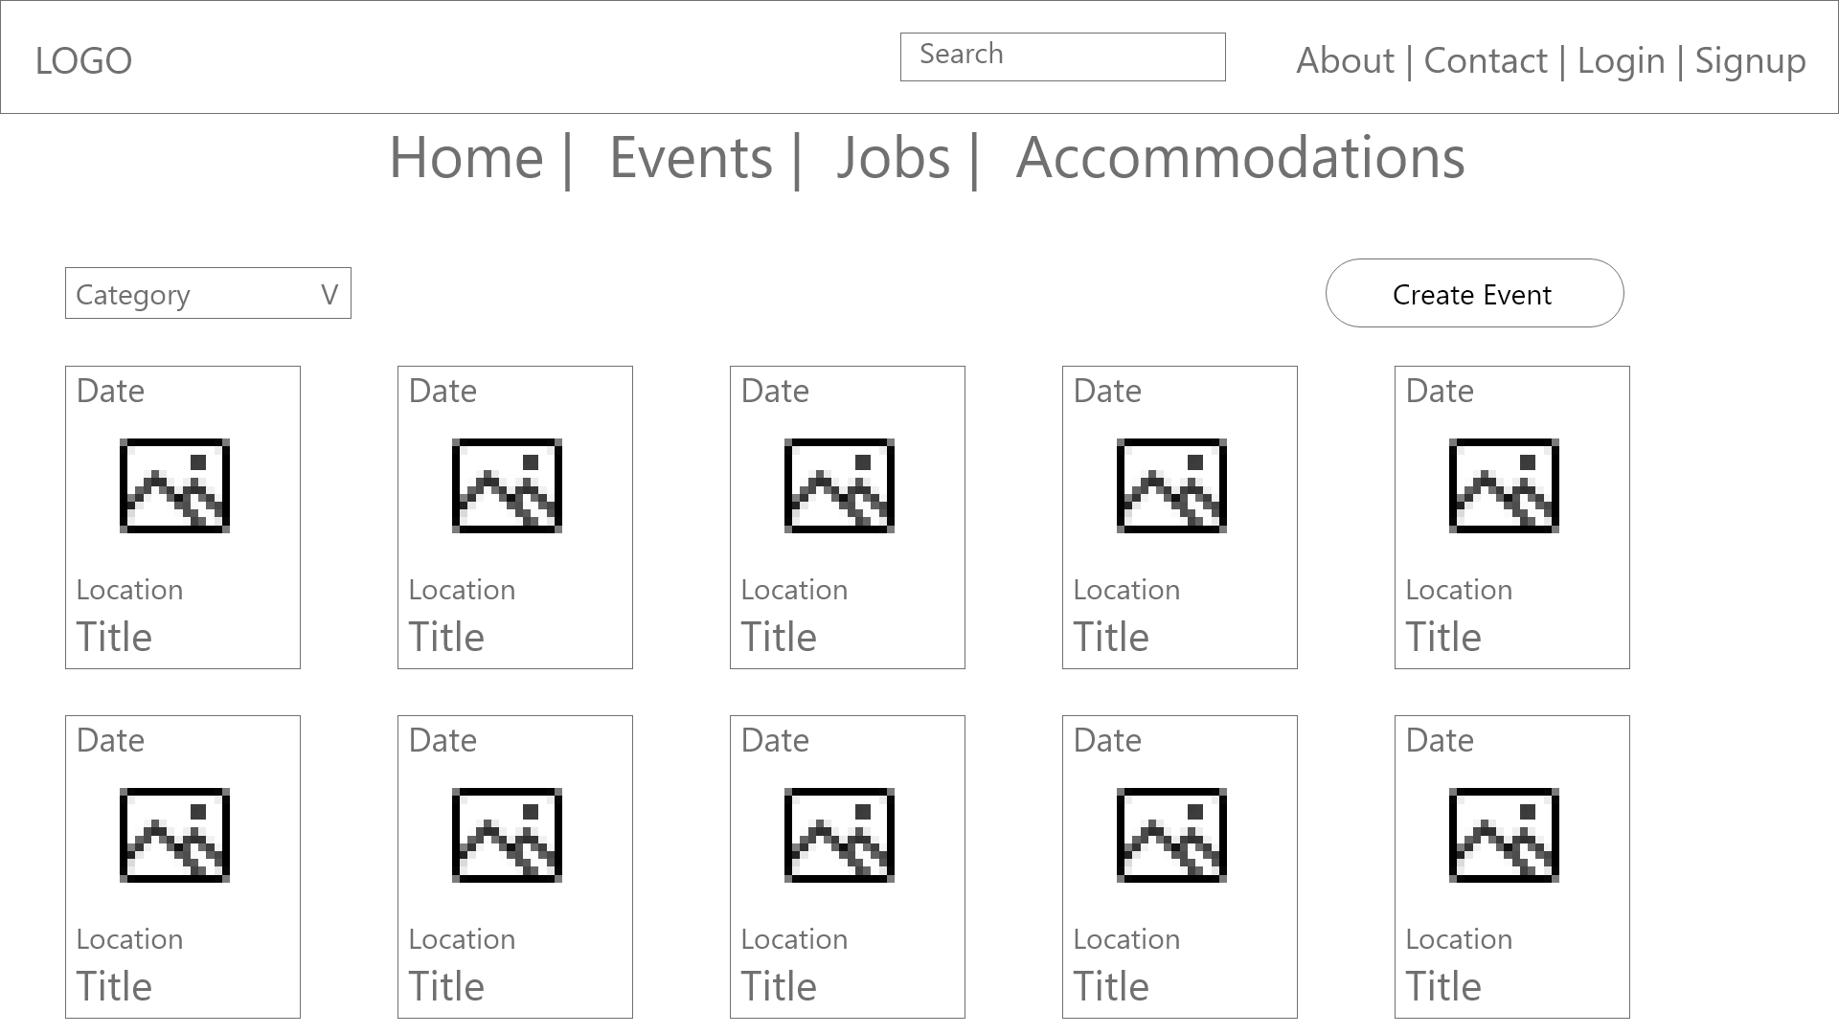
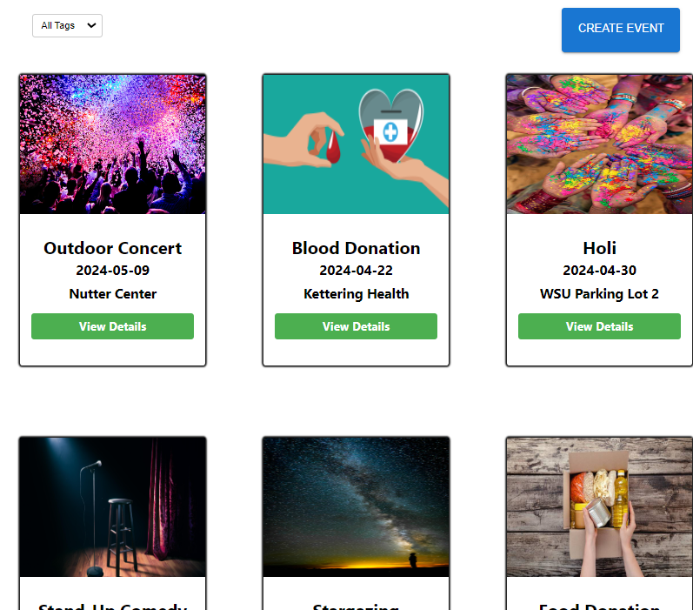
Event Post

Slide 25
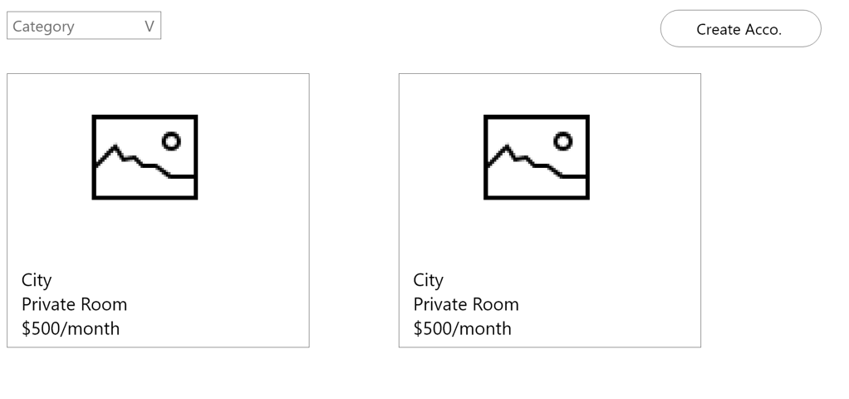
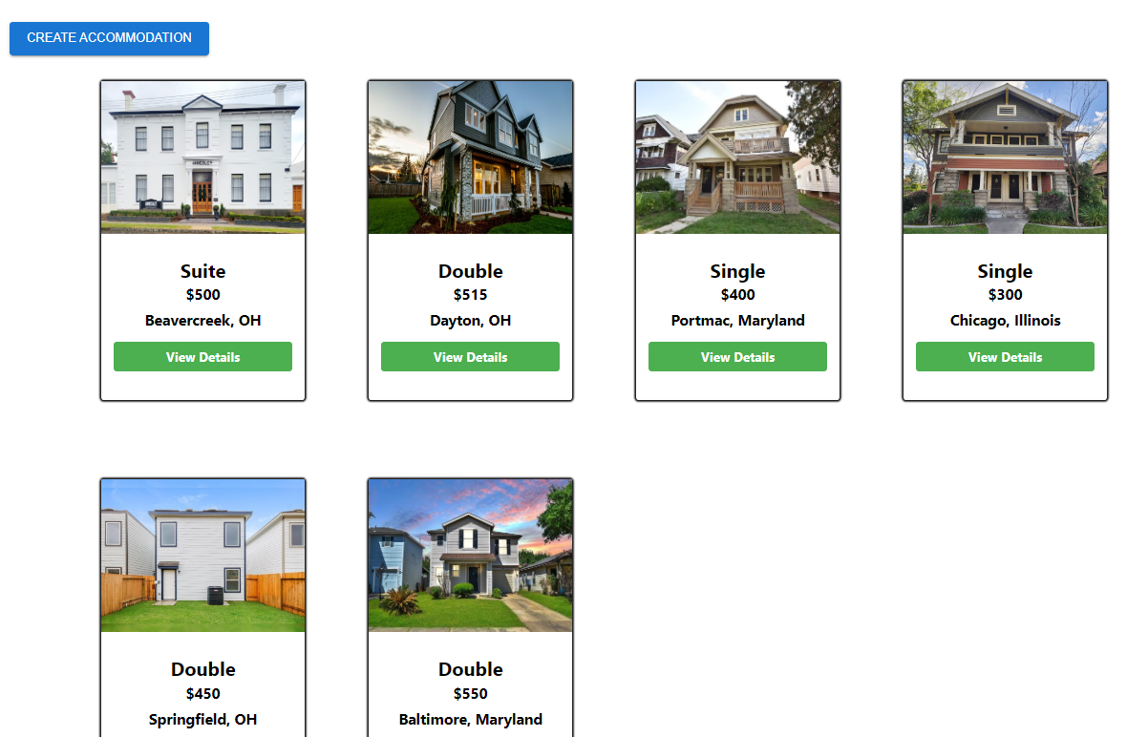
Accommodation Posts

Slide 26
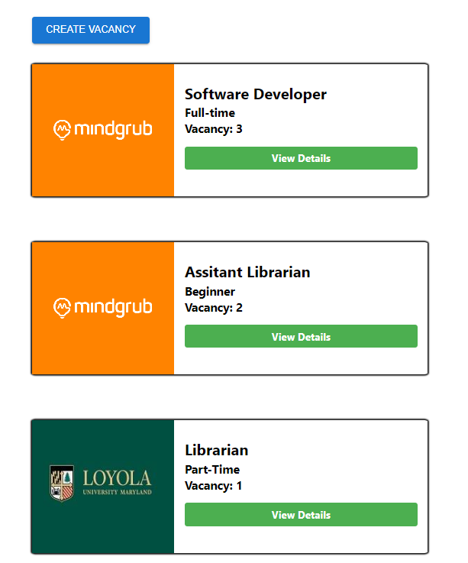
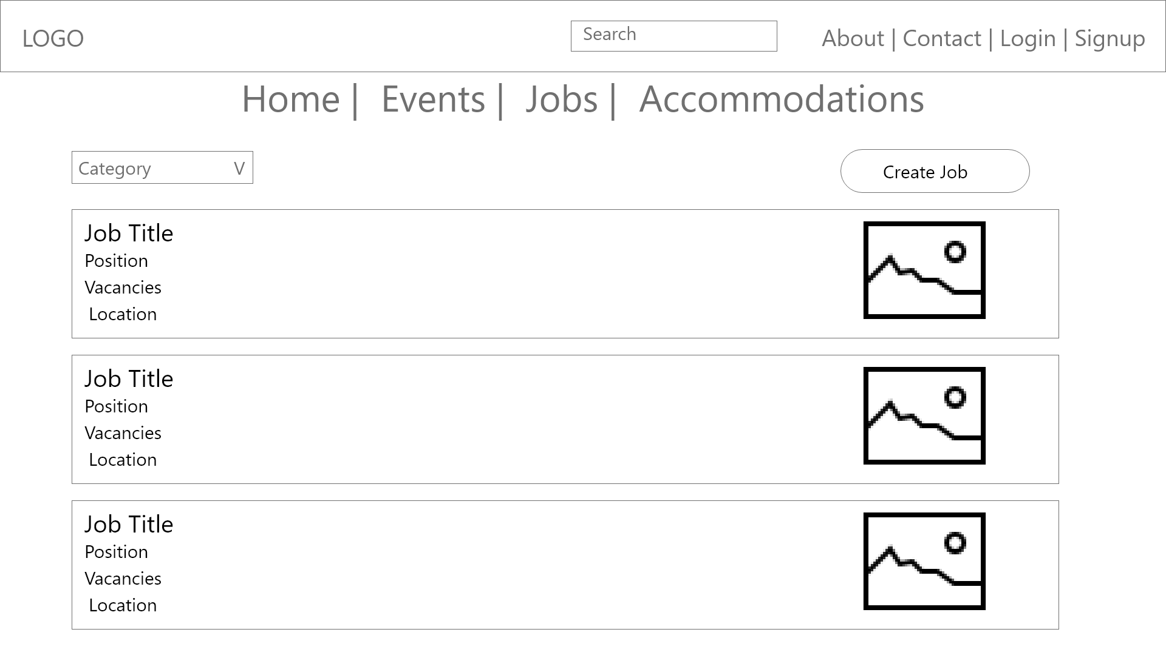
Job Posts

Slide 27
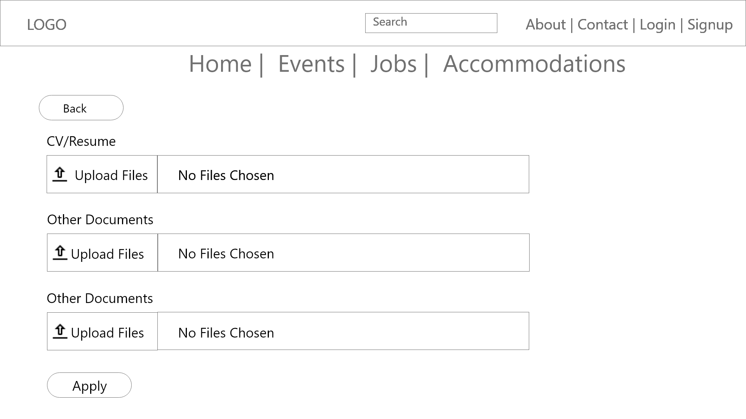
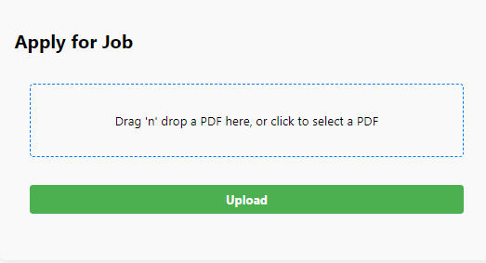
Apply Job
Members shall be able to upload document i.e. CV to a job posting portal. The uploaded documents may be used to hire people. Only the job posting owner and the user who uploaded the document shall be able to view or update it.

Slide 28
Apply Job

Slide 29
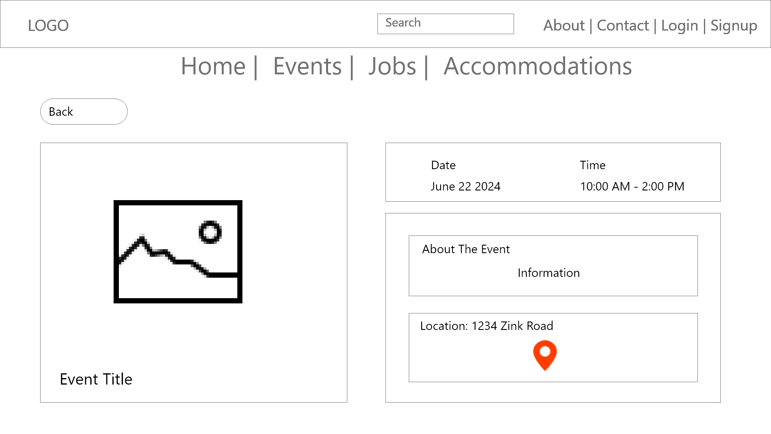
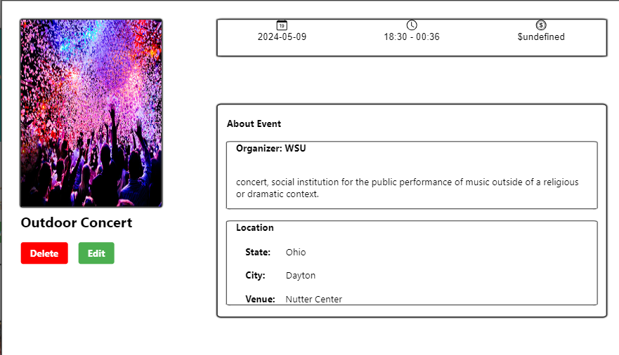
Event Description

Slide 30
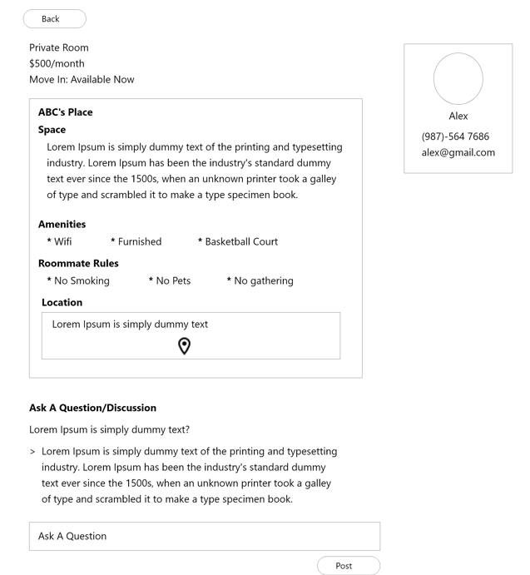
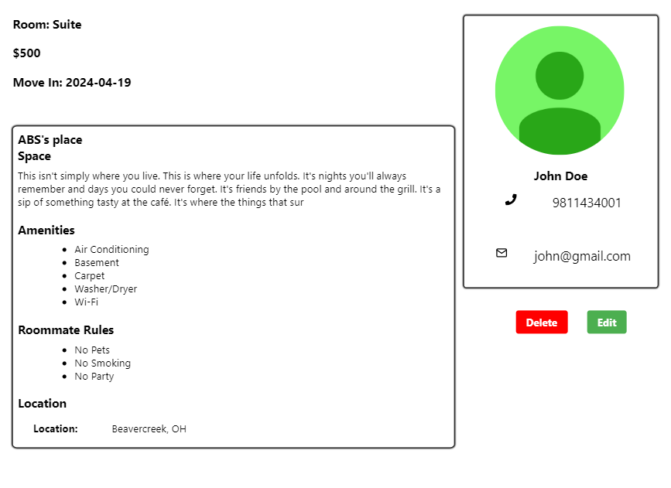
Accomodation Description
Accomodation Description

Slide 31
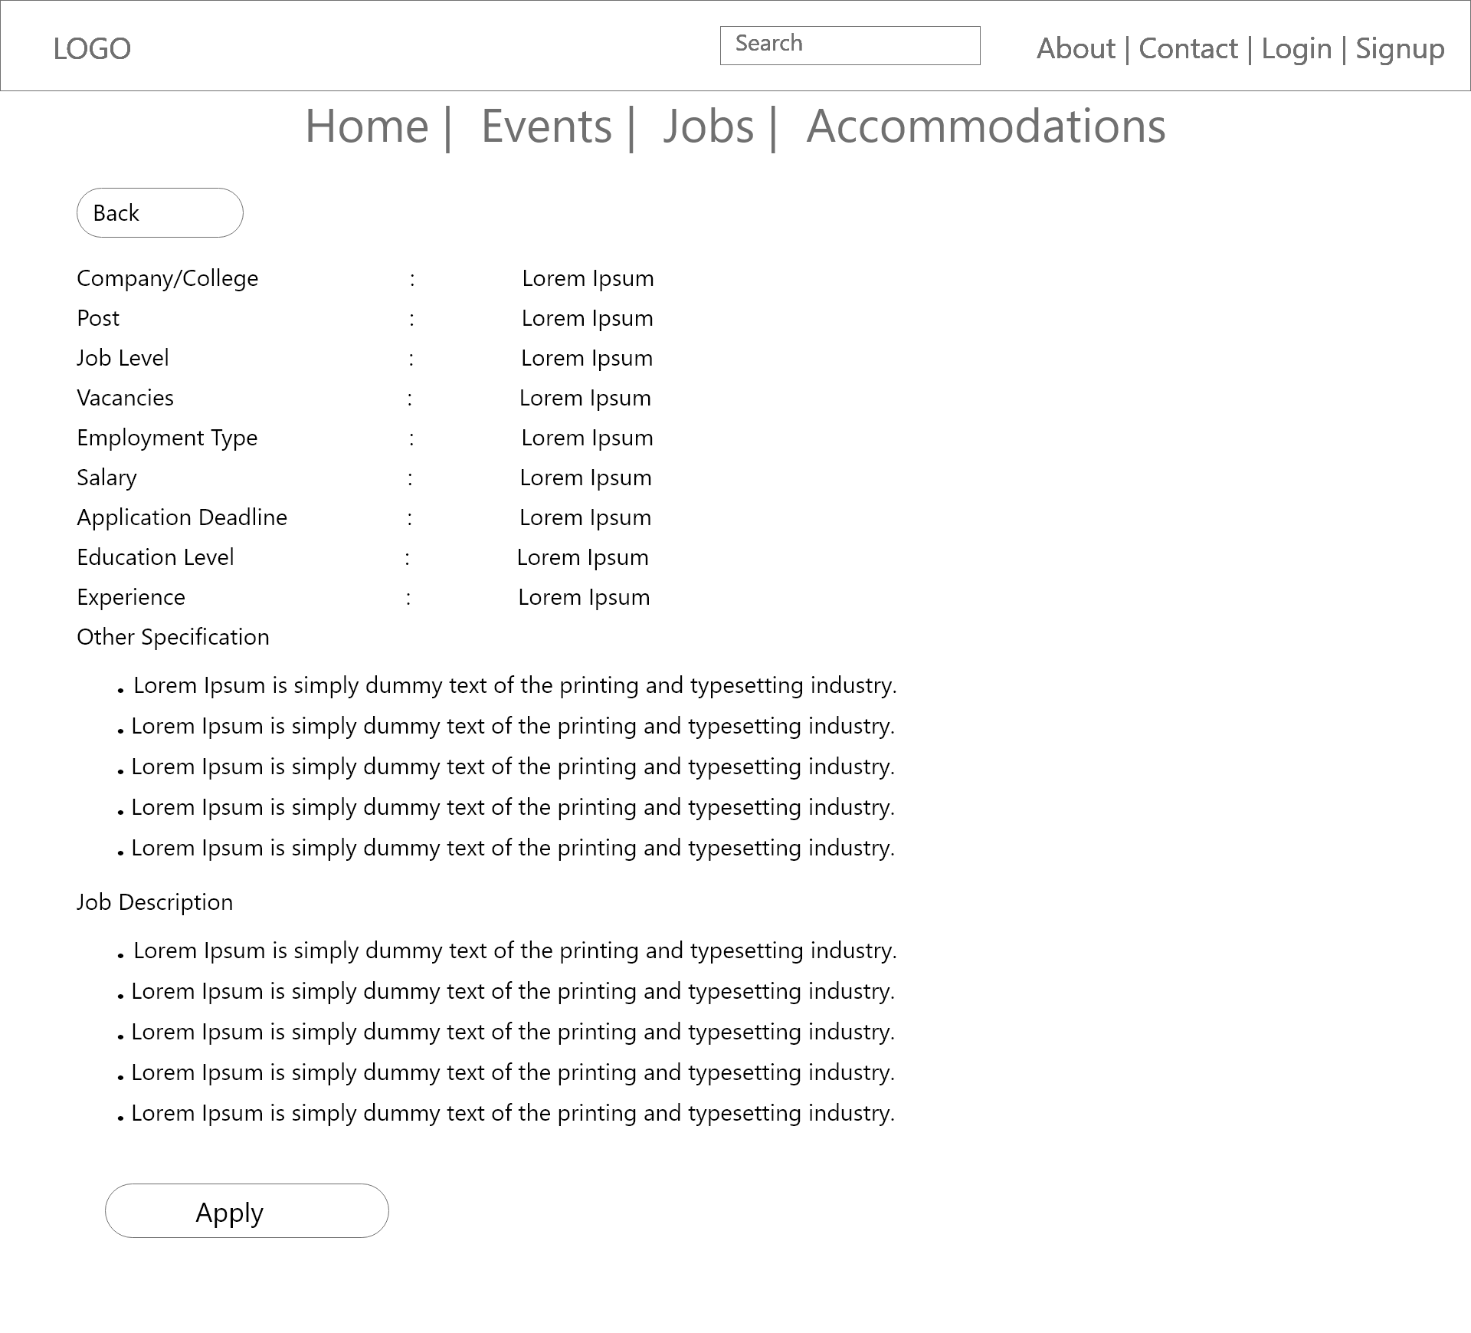
Jobs Description

Slide 32
Requirements and Design elements
Job Post Edit
The user who created the job post shall be able to edit the post. All the fields of the job posting along with the tags can be updated.
Job Post Delete
The user who created the job post must be able to delete the post. The deleted job posting shall not be shown to the users.
Event Update
The user who created the event post must be able to edit the post. All the attributes as well as the tags associated with the event can be updated.
Event Delete
The user who created the event post must be able to delete the post. The deleted event shall not be visible to the users.

Slide 33
Requirements and Design elements
Accommodation Edit
The user who created the accommodation post shall be able to edit and delete the post. All the fields of the accommodation postings shall be able to be updated.
Accommodation Delete
The user who created the accommodation post shall be able to delete the post. The deleted post shall not be visible to the users.

Slide 34
Requirements and Design elements
Filter Events
The users shall be able to filter out the events filtered based on the type of event.

Slide 35
Conclusion
Our application, represents a leap forward in how we connect online, bringing together jobs, events, and housing in one easy-to-use platform. It simplifies the digital chaos, making it easier for everyone to find what they need and share what they offer. In essence, Our system is about creating a more inclusive, efficient, and connected digital community for all.

