Slide 1
CAPSTONE PROJECT PRESENTATION
Presented By
Warren Siciliano
Cohort 20-A
October 14, 2021

Slide 2
Executive Summary
As Requested by QuickStart, Inc. we were asked to improve their network security by logging potential attacks against their Web Server and Production Server.
After analyzing the system, we found that the installation and configuration of a software-based IDS/IPS solution would meet their needs with the allowed budget.
The Snort Intrusion and Detection Software add-on to the PfSense Firewall were used to accomplish the network security goals.
Able to successfully show that these new security additions alerted a VSFTPD backdoor exploit access attempt, alerted when unauthorized port scans are initialized on the Web Server in the DMZ zone and an exploit on port 8180 known for an Apache Tomcat exploit which is the Operating system used by the Web Server.
Recommend monitoring the firewall logs on a regular basis, updating and patching the firewall and IDS software on at least a monthly basis and possibly more frequently as threat assessment dictates and adding additional parameters to the IPS/IDS to report other types of events targeted at the QuickStart, Inc. network.

Slide 3
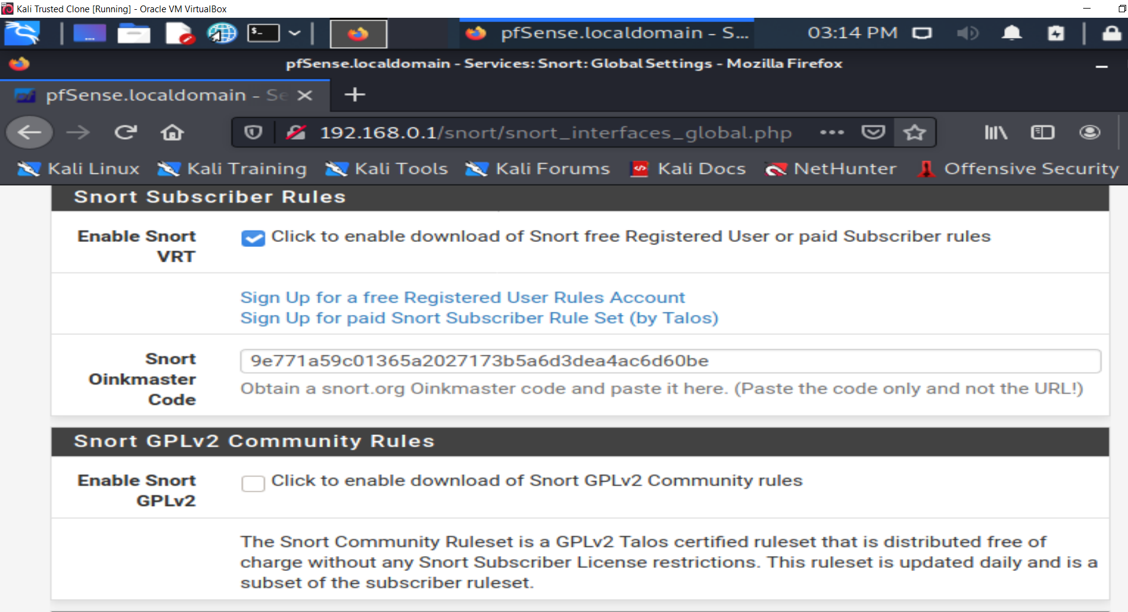
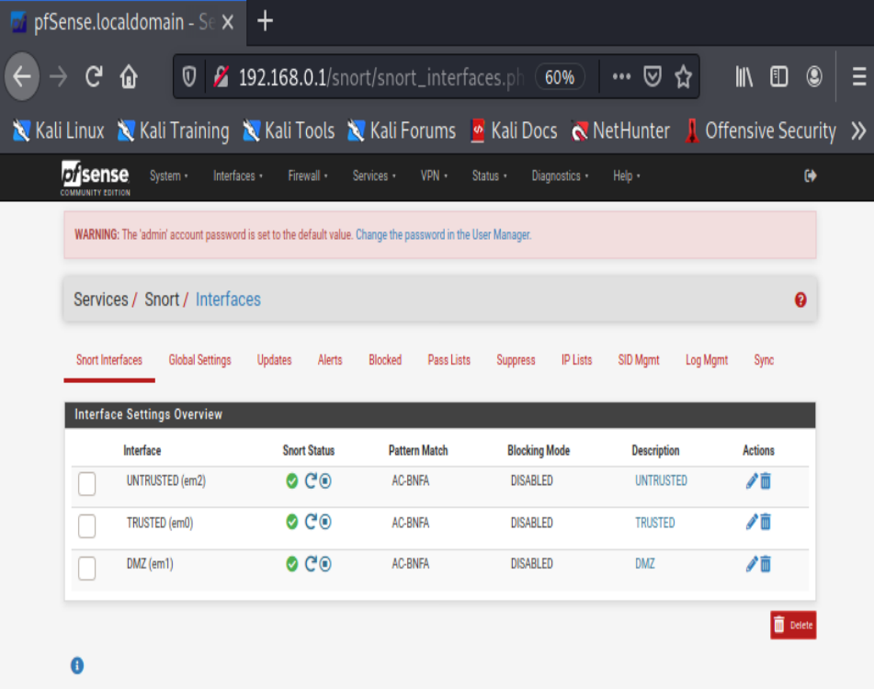
INSTALLATION OF THE SNORT IPS/IDS ON THE PfSENSE FIREWALL
Successfully installed the Snort Intrusion Detection System (IDS)/ Intrusion Prevention Systems (IPS) within the PfSense Firewall

Slide 4
Description of Vulnerabilities
The vulnerabilities found on the system were as follows:
An open FTP port which allowed remote access to the web and production servers.
An exploit that allows root user login from a remote system.
An exploit on the Apache Tomcat OS on port 8180 which is the OS used by the Web Server in the DMZ.
IRC Bot Exploit on port 6667 on the Web Server in the DMZ.
Web Server allows port scans without logging attempts on the Web Server in the DMZ zone. Possibly would allow enumeration of system.

Slide 5
HOW WE CONFIGURED THE SNORT IDS/IPS
Used a combination of pre-set rules, custom rules and pre-processors to alert for specific types of potential scanning and access attempts into the system.
Used a custom Snort rule to alert specifically for the VSFTPD backdoor access vulnerability on the Production Server and Web Server.
Used a custom Snort rule to alert specifically for the Apache Tomcat exploit on port 8180 on the Web Server located in the DMZ.
Used a custom Snort rule to alert specifically for the IRC Bot exploit on port 6667 on the Web Server located in the DMZ.
Used a Snort pre-processor to alert and log any port scanning attempts on the Web Server.
We used the built-in “Security” level in Snort to log other types of bad traffic and amount of traffic.
Set a PfSense firewall rule to block FTP traffic from anywhere in the Untrusted Network into the DMZ Network

Slide 6
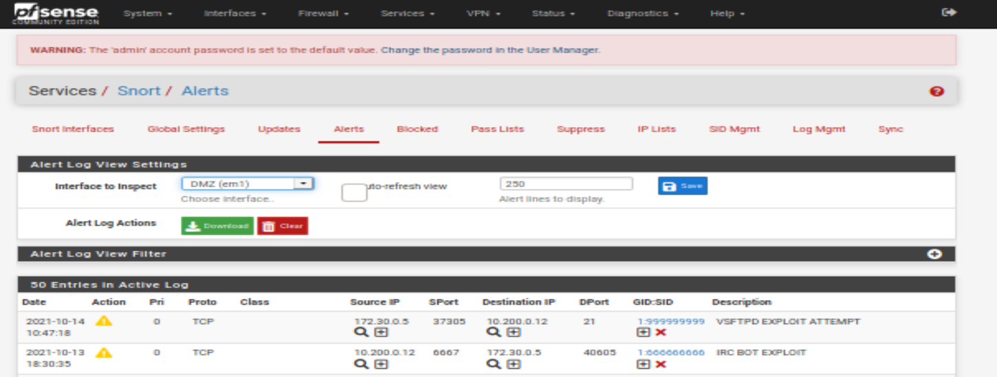
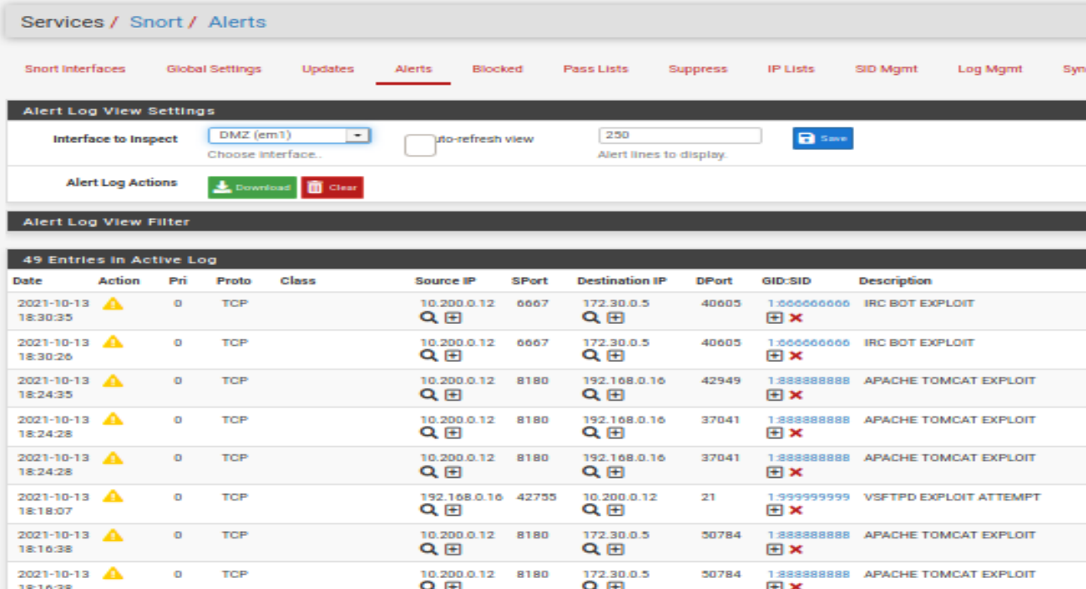
SUCCESSFUL ALERT EXAMPLES
Alert on VSFTPD FTP Backdoor exploit
From Untrusted to DMZ
Alert on APACHE TOMCAT Exploit port 8180
From Untrusted to DMZ

Slide 7
SUMMARY
In summary, we analyzed the current network system at Quickstart, Inc and determined the installation of a firewall with an added intrusion detection system (IDS) would be the most advantageous solution for the budget allowed.’
Installed and configured the PfSense firewall with the Snort IDS to meet this need. The are both open-source and therefore proven and frequently updated to provide the highest quality of security.
Successfully tested both programs to make sure they work on some of the common vulnerabilities that are exploited by bad actors.
Advised QuickStart how to maintain these new programs so that they will stay relevant and continue to protect their network optimally.

Slide 8
RECOMMENDATIONS
Monitor the logs from the PfSense firewall and Snort IDS alerts to look for unusual activity.
Keep all server software and firmware updated with the latest versions including the new PfSense firewall and Snort IDS to ensure any security flaws and other issues are patched.
Review and adjust the firewall/IDS settings as new threats are reported.
Hire professional Penetration testers occasionally to test system hardness against the latest potential threats.
Educate users on risky behaviors which can allow bad actors to gain access and exploit networks.

