Slide 1
Deep Learning-Based Phishing Detection
An approach by using CNN and CNN-LSTM
Wong Chun Ho, Simon

Slide 2
Introduction
Phishing attacks are a significant and growing cybersecurity threat. Attackers use deceptive techniques to trick individuals into divulging confidential information, such as passwords and credit card numbers. Traditional phishing detection methods, such as blacklists and heuristic-based approaches, are often inadequate due to their inability to adapt to new and sophisticated phishing techniques. This project aims to leverage deep learning, particularly Convolutional Neural Networks (CNN) and CNN-Long Short-Term Memory (CNN-LSTM) models, to enhance phishing detection capabilities.

Slide 3
Objectives
Improve Explore deep learning for phishing detection: Investigate the potential of deep learning algorithms, specifically convolutional neural networks (CNN) and CNN/LSTM models, for phishing website detection.
EnhaFeature extraction and analysis: Develop a comprehensive set of phishing detection capabilities, including URL-based and content-based capabilities.
Dual Model development: Design and implement CNN and CNN/LSTM models to effectively detect phishing websites using extracted features.
Performance: Define and use appropriate metrics to evaluate model performance, such as accuracy, precision, recall, and F1 score.

Slide 4
Phishing website Feature
URL Characteristics
URL Length: Longer URLs may indicate phishing attempts.
Top-Level Domain (TLD): Certain TLDs are more commonly associated with phishing.
Hostname Presence: Detecting the presence of suspicious hostnames.
Special Characters Count: Higher count can be indicative of obfuscation techniques.
HTTPS Usage: Phishing sites may or may not use HTTPS.
Digits and Letters Count: Analyzing the distribution of digits and letters.
URL Shortening Patterns: Identifying shortened URLs.
IP Address Usage: Phishing URLs may use direct IP addresses.

Slide 5
Phishing website Feature
Website Content
Link Types: Identifying different types of links (internal, external).
Anchor Tags: Analyzing anchor tags for suspicious links.
onMouseOver Events: Detecting URL changes in onMouseOver events.
Embedded Media: Analyzing images, videos, and sounds for legitimacy.
Disabled Right-Click: Detecting if right-click is disabled, which can be a sign of phishing.
Pop-Up Windows: Analyzing pop-ups with text fields.
iframe Elements: Identifying iframe usage for redirects and external content embedding.
Favicon Links: Analyzing favicon URLs for legitimacy.
Form Tags: Counting form tags and analyzing their methods (GET, POST).
Password Fields: Counting password input fields.

Slide 6
Deep learning Model
CNN Model: Trains on spatial features extracted from URLs and content.
CNN-LSTM Model: Combines CNN for spatial features and LSTM for temporal dependencies.

Slide 7
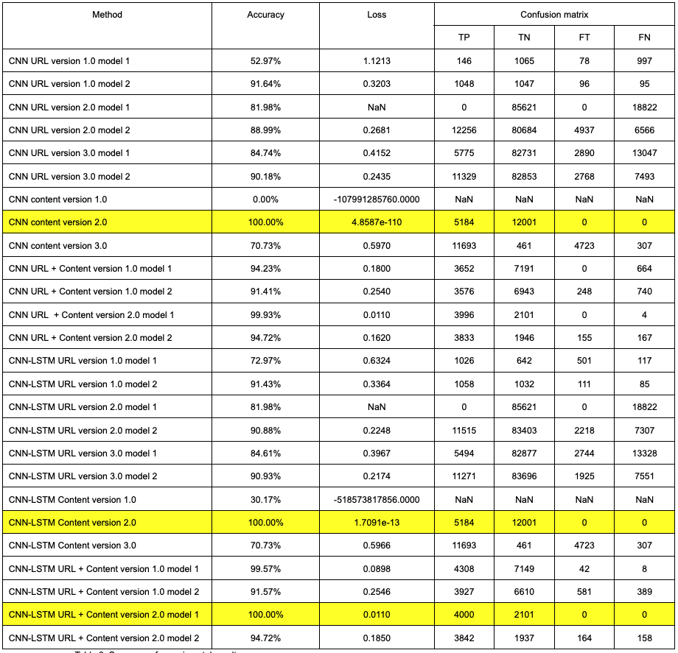
Result
The results demonstrate that the CNN-LSTM models outperformed the standalone CNN models, with the URL and content combined approach achieving the highest accuracy of up to 99%.

Slide 8
Future work
Feature Engineering: Explore additional features to further enhance model accuracy.
Interpretability: Improve the transparency and interpretability of the models.
Hybrid Models: Investigate other combinations of deep learning models to boost performance.
Adversarial Attacks: Enhance model robustness against adversarial attacks.
Dataset Augmentation: Utilize data augmentation techniques to improve model generalization.
Multimodal Learning: Integrate other types of data (e.g., user behavior, network traffic) for a comprehensive phishing detection system.

