Slide 1
Data Interpretation and Statistical Analysis Course Project
By: Warren Sky

Slide 2
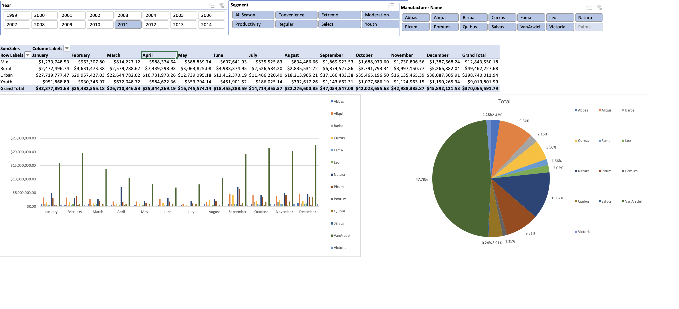
Excel Dashboards for VanArsdel dataset

Slide 3
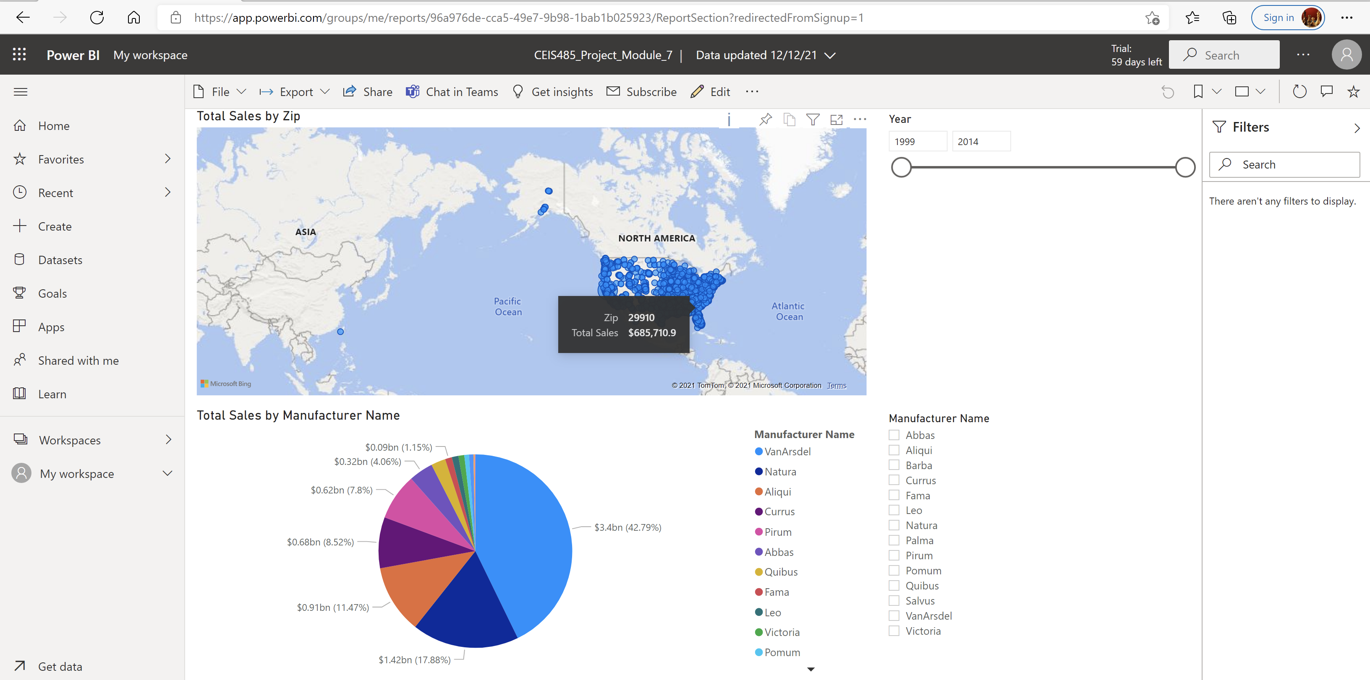
Dashboard Published to PowerBi

Slide 4
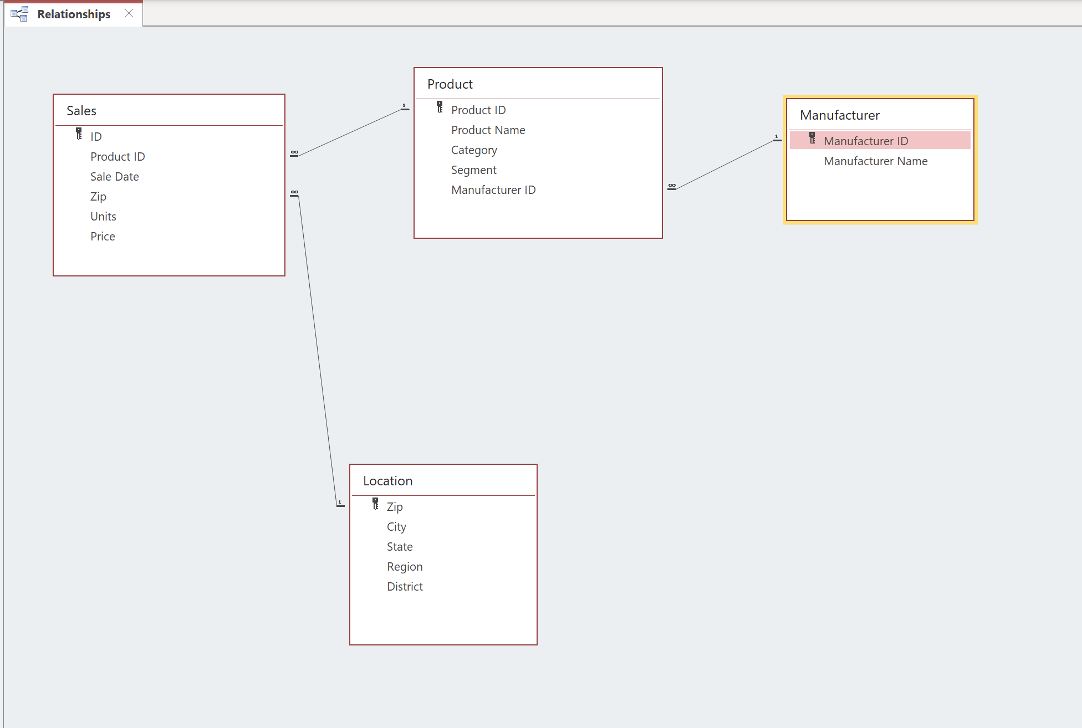
Data Model With Relationships

Slide 5
Skills Learned
How to prepare data for analysis with Excel
How to create Pivot tables and charts with Excel
How to create dashboards and connect to Pivot tables and charts
How to create data models and connected dashboards
How to connect Excel to external data sources

Slide 6
Challenges faced
Initially had difficulty creating data model in Excel.
When I copied the date from the spreadsheet, I copied the entire sheet including many empty rows which the data model read as duplicate data and would not allow me to create relationships using that table. I deleted the data from the table, copied only the rows with data from the spreadsheet and recreated the table. This resolved the issue.
The year slicer was not updating my dashboard in Excel.
I realized that although I had created the calendar table in the data model, I had not created the relationship between the Calendar table and my Sales table. After created the relationship, the problem was resolved.

