Slide 1

Public data archives for NGS data
Jacqui Keane
@drjkeane
drjkeane@gmail.com

Slide 2
Purpose of data archives
For archiving and distribution of data generated by NGS experiments
Submit your own data that you want to publish
Finding data sets that might be relevant to your own research
Retrieve data sets from publication
Many different data archives for different data types

Slide 3
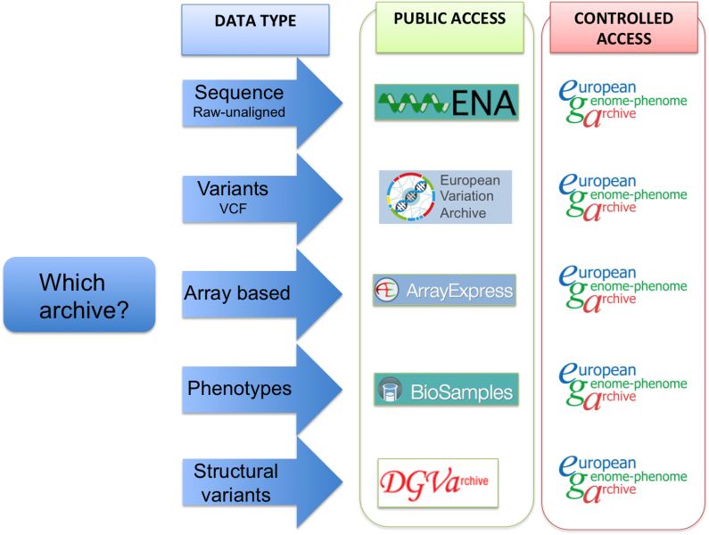
Which data archive?

Slide 4
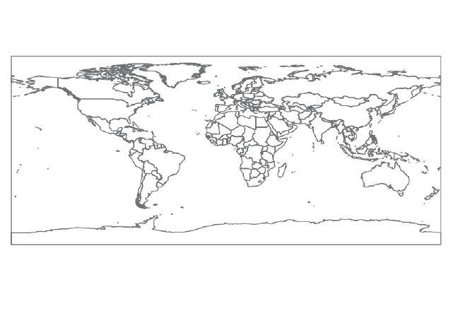



Data sharing across archives
EBI
NCBI
DDBJ
Notes:
Data deposited to each of the three databases are synchronized on a regular basis.
European Bioinformatics Institute (EMBL-EBI)
National Centre for Biotechnology Information (NCBI)
DNA Data Bank of Japan (DDBJ)

Slide 5
Global data archives
Data Type | DDBJ | EBI | NCBI
Primary Sequence Data | DDBJ Sequence Read Archive (DRA) | European Nucleotide Archive (ENA) | Sequence Read Archive (SRA)
Annotated Sequences | DDBJ |  | GenBank
Variation | - | European Variation Archive (EVA) | dbSNP
Structural Variation | - | Genomic Variants Archive (DGVa) | dbVar
Expression | DDBJ Omics Archive (DOR) | ArrayExpress | Gene Expression Omnibus (GEO)
Restricted | Japanese Genome-phenome Archive (JGA) | European Genome-phenome Archive (EGA) | dbGAP
Samples | BioSample | BioSample | BioSample
Studies | BioProject | BioProject | BioProject

Slide 6
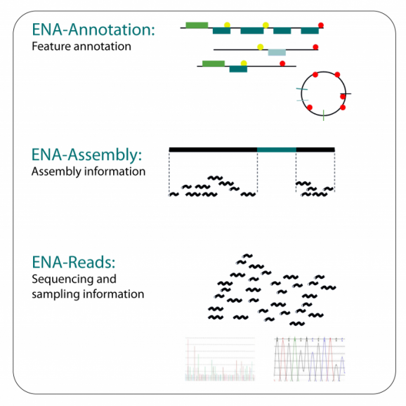
European Nucleotide Archive (ENA)
For data from experiments based on nucleotide sequencing

Slide 7
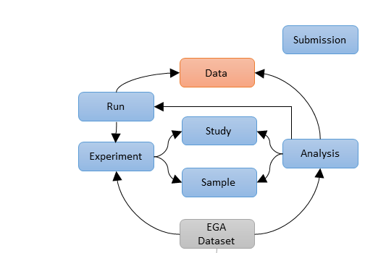
ENA data model

Slide 8
ENA accessions
Type | Accession | Description
Study | ERP/PRJE | Information about the sequencing study
Sample | ERS/SAME | Information about the samples sequenced
Experiment | ERX | Information about sequencing experiment including platform used and library information
Read | ERR | Raw data files containing sequence data (CRAM, BAM, Fastq)
Analysis | ERZ | Secondary analysis results computed from the primary sequencing reads (BAM, EMBL)
Annotated Sequence | LN CWSE | Assembled and annotated sequence, one number for each sequence e.g. CWSE01000001-CWSE01000051

Slide 9
ENA accessions
Type | Accession | Description
Study | ERP/PRJE | Information about the sequencing study
Sample | ERS/SAME | Information about the samples sequenced
Experiment | ERX | Information about sequencing experiment including platform used and library information
Read | ERR | Raw data files containing sequence data (CRAM, BAM, Fastq)
Analysis | ERZ | Secondary analysis results computed from the primary sequencing reads (BAM, EMBL)
Annotated Sequence | LN CWSE | Assembled and annotated sequence, one number for each sequence e.g. CWSE01000001-CWSE01000051

Slide 10
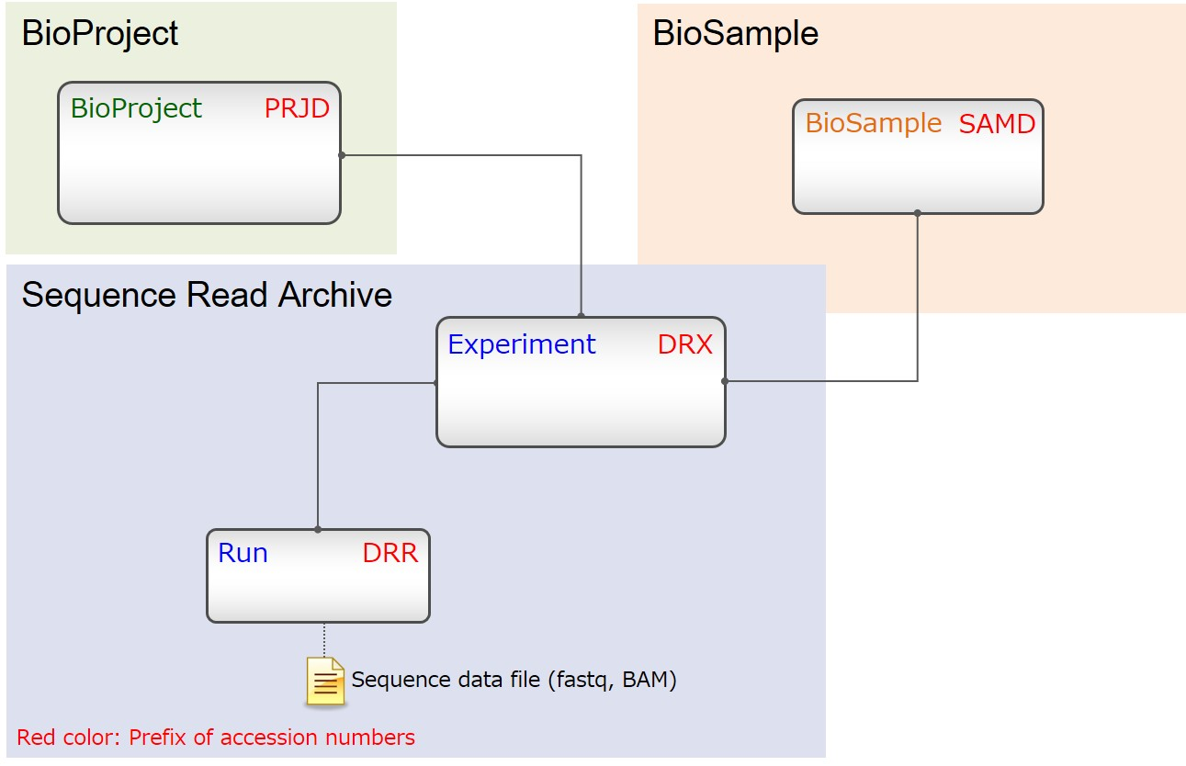
DDBJ data model

Slide 11
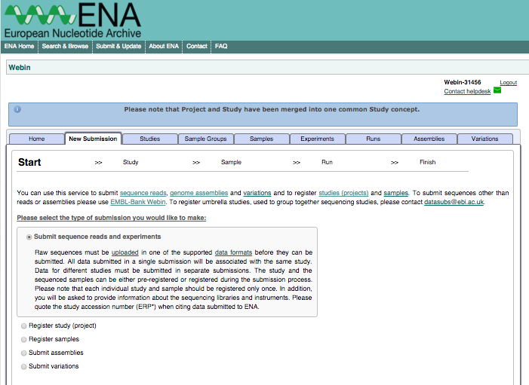
ENA data submission
Data submission to archives via
Web browser
API (programmatic access)

Slide 12
Browsing ENA
Let’s browse at
http://www.ebi.ac.uk/ena
PRJEB6352

Slide 13
European Variation Archive (EVA)
For genetic variation data from all species
Data submission
Same infrastructure as ENA
Consists of VCF file(s) and metadata that describes sample(s), experiment (s), and analysis that produced the variants
Accessions are ERZ
NCBI equivalent is dbSNP

Slide 14
Browsing EVA
Let’s browse at
http://www.ebi.ac.uk/eva/?Study%20Browser&browserType=sgv

Slide 15
Array Express
For functional genomics data from array and sequencing based experiments (RNA-Seq, CHiP-Seq)
raw e.g. Affymetrix CEL files, fastq files
processed e.g. aligned bam, txt files of read counts
Data submission is via ‘Annotare’ web interface
NCBI equivalent is GEO

Slide 16
Browsing ArrayExpress
Let’s browse at
https://www.ebi.ac.uk/arrayexpress/browse.html

Slide 17
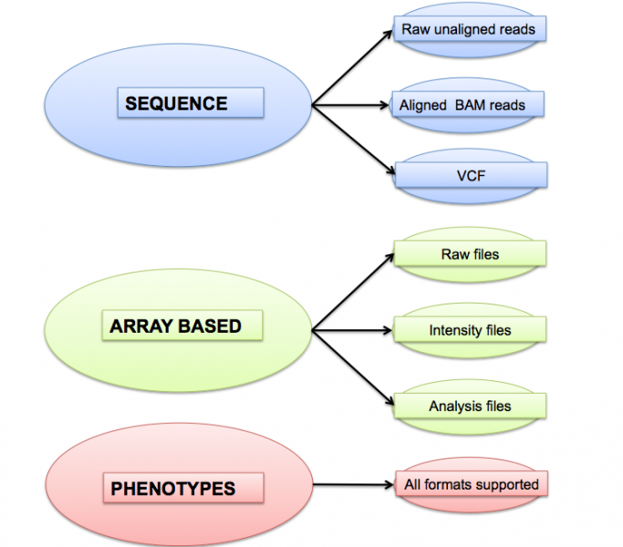
European Genome-phenome Archive (EGA)
For personally identifiable genetic and phenotypic data
Individuals whose consent agreements authorise that data is release for specific research use only

Slide 18
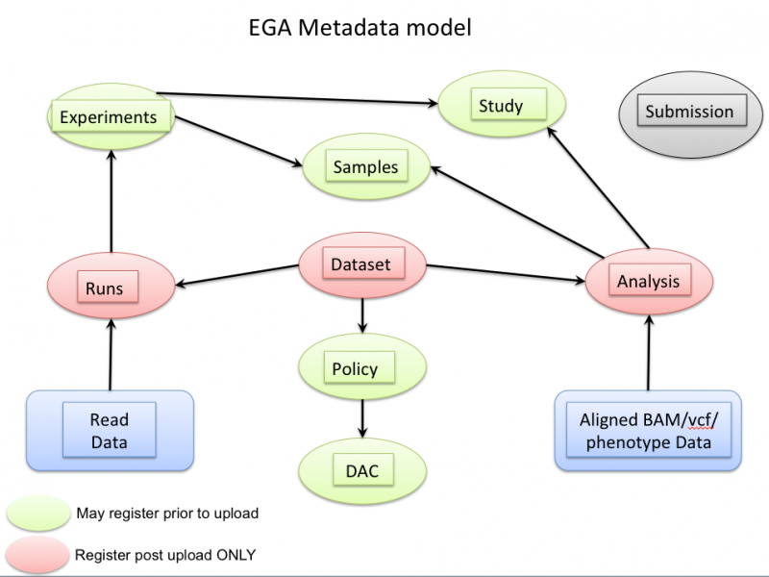
EGA data model

Slide 19
EGA accessions
Type | Accession | Description
Study | EGAS | Information about the sequencing study
Sample | EGAN | Information about the samples sequenced
Experiment | EGAX | Information about sequencing experiment including platform used and library information
Run | EGAR | Raw data files containing sequence data (CRAM, BAM, Fastq)
Analysis | EGAZ | Analysis data files associated with study and sample : BAM, VCF, array and phenotype data
Dataset | EGAD | Collection of runs/analysis data files to be subject to controlled access
Policy | EGAP | Contains the data access agreement (DAA)
DAC | EGAC | Information about the data access committee

Slide 20
EGA accessions
Type | Accession | Description
Study | EGAS | Information about the sequencing study
Sample | EGAN | Information about the samples sequenced
Experiment | EGAX | Information about sequencing experiment including platform used and library information
Run | EGAR | Raw data files containing sequence data (CRAM, BAM, Fastq)
Analysis | EGAZ | Analysis data files associated with study and sample : BAM, VCF, array and phenotype data
Dataset | EGAD | Collection of runs/analysis data files to be subject to controlled access
Policy | EGAP | Contains the data access agreement (DAA)
DAC | EGAC | Information about the data access committee

Slide 21
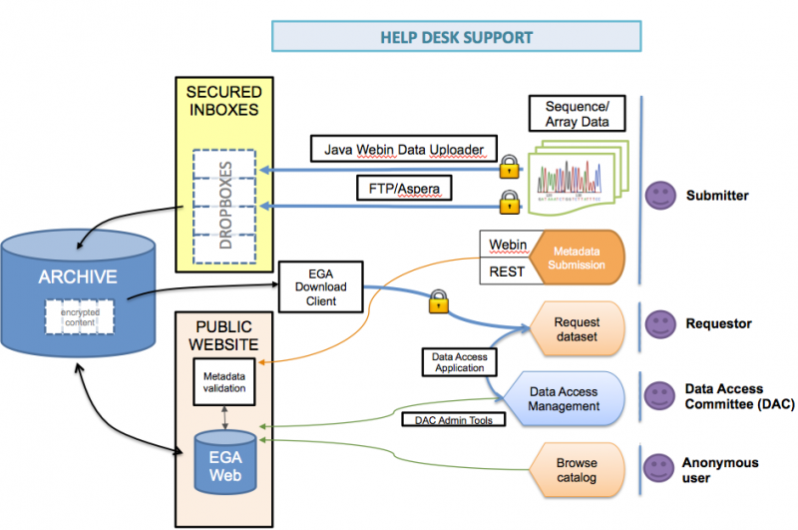
EGA overview
Strict protocols govern how information is managed, stored and distributed

Slide 22
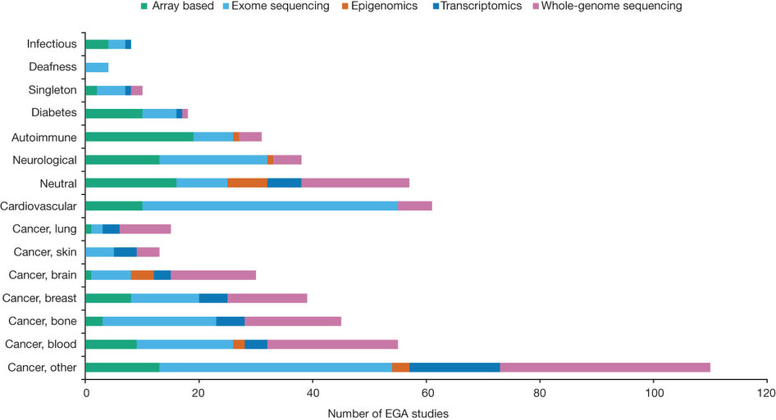
Breakdown of EGA studies (2014)
Notes:
The majority (57%) of EGA studies investigate cancer of various types. EGA experimental data describe the methodology employed for each study, which is represented by the different colors. Exome sequencing (38%) is the most common methodology, followed by whole-genome sequencing (29%), array-based technologies (20%), transcriptomics (9%) and epigenomics (3%). As one might expect, array-based experiments are typically from older studies, whereas both transcriptomic and epigenomic investigations are more recent.

Slide 23
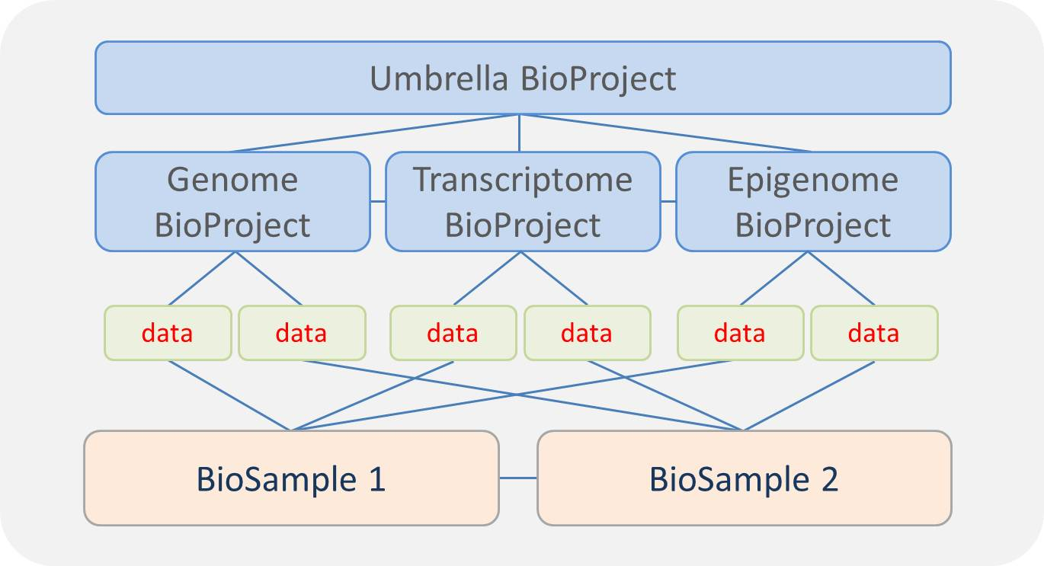
BioProjects and BioSamples

Slide 24
BioSample database
Stores descriptive information about biological samples used to generate experimental data
e.g. cell line, blood sample, environmental isolate
species, phenotypic information e.g. disease state, clinical info on individual
Can link up data from different archives for same sample
Accessions always begin with SAM
Next is E, N or D, for EBI, NCBI or DDBJ respectively
Next is A or a G, for a sample or a group of samples
Finally is a numeric component

Slide 25
BioProject database
Organises samples & data produced by projects
Deposited by several research groups
Deposited into several archival databases
Can be created for
Genome sequencing and assembly
Transcriptome sequencing and expression
Targeted locus sequencing
Variation detection
Accessions always begin with PRJ
Next is E, N or D for EBI, NCBI and DDBJ respectively
Finally is a numeric component

Slide 26
WSI data sharing policy
Aim to provide rapid and open access to data produced
Immediate release
Register sequencing studies in BioProject database
Register samples in BioSample database
Within 90 days
Primary sequence data (CRAM) in ENA/EGA
At publication
Secondary analysis in other archives
VCF, expression data, annotated sequences
Notes:
Within 2 months of generation

Slide 27
Useful resources
EBI Training
https://www.ebi.ac.uk/training/online/course-list
NCBI Handbook
http://www.ncbi.nlm.nih.gov/books/NBK143764/
DDBJ Training
http://trace.ddbj.nig.ac.jp/index_e.html
NAR Journal
http://nar.oxfordjournals.org/

